Slide 1
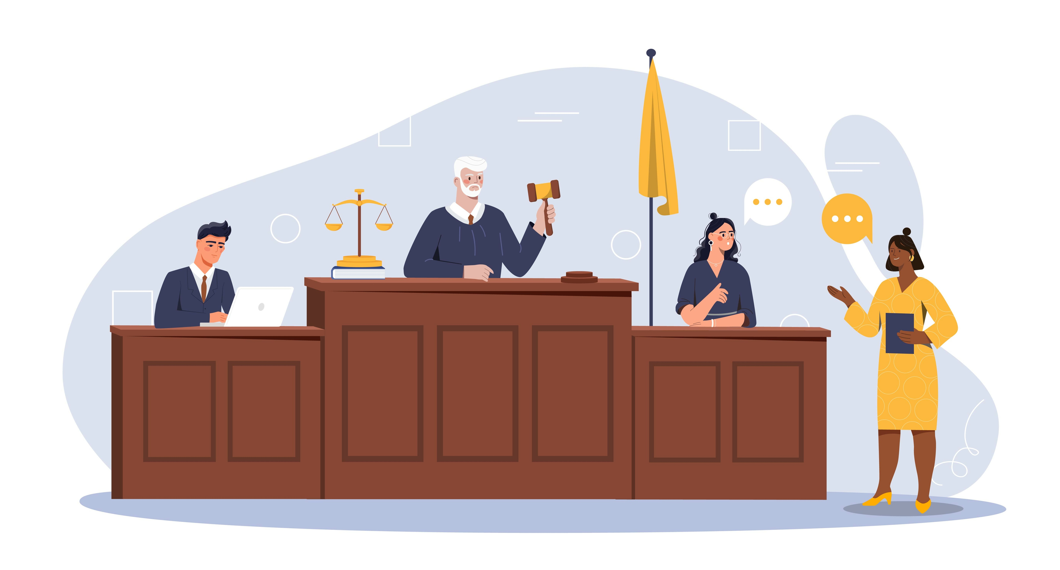
Inside the Courtroom: The Key Players and Steps of a Criminal Trial
Notes:
NOTES FOR THE TEACHER
These materials are the exclusive property of Éducaloi. Teachers in Quebec schools may use them for non-commercial purposes only.
None of the information contained in this presentation should be considered as legal advice.
Éducaloi attaches particular importance to the reliability of the legal information contained in its materials. This material must be used in its original, unaltered form.
The law changes. The information in this presentation is up to date to August 2024.

Slide 2

Introduction to the Law
  Civil Law
  Criminal Law
  Burden of Proof
Notes:
NOTES FOR THE TEACHER – Additional information
You can learn more by visiting Éducaloi’s website. To prepare for this teaching guide, we suggest consulting these articles and videos:
ARTICLES
The Quebec Judicial System: https://educaloi.qc.ca/en/capsules/the-quebec-judicial-system
Differences Between Civil and Criminal Cases: www.educaloi.qc.ca/en/capsules/differences-between-civil-and-criminal-cases
Rights of a Person Accused of a Crime: www.educaloi.qc.ca/en/capsules/rights-person-accused-crime
VIDEOS
Differences Between Civil Trials and Criminal or Penal Trials: www.educaloi.qc.ca/en/educaloi-tv/differences-between-civil-trials-and-criminal-or-penal-trials
The Legal Burden of Proof: www.educaloi.qc.ca/en/educaloi-tv/legal-burden-proof

Slide 3
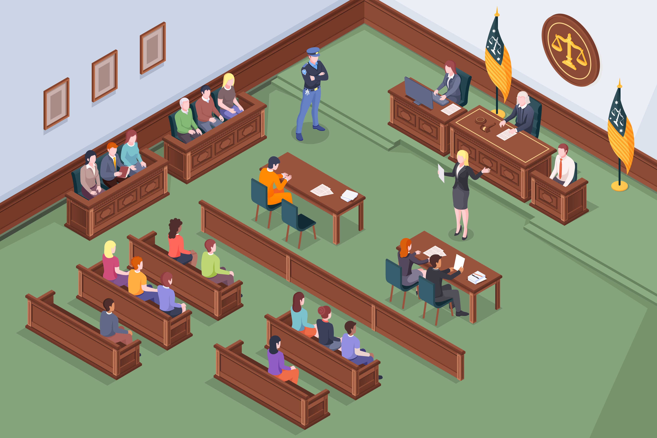

What is a trial?
The trial is one of the many steps in the legal process.
During a trial, the parties to a dispute come together before a court to present their arguments and evidence.
The goal of a trial is for a court to help settle a dispute.
Notes:
NOTES FOR THE TEACHER
This teaching guide deals with criminal trials. But it’s important to understand that there are different types of trials, depending on the area of law involved.
Ask students what they believe a trial is and write their answers on the board.
INFORMATION FOR STUDENTS
Taking the key notions from the students’ answers, connect the students’ definitions of a trial with one of the definitions below:
The trial is a step in the legal process where a court helps settle a dispute. During a trial, each side presents their arguments and evidence.
A public justice process where a court hears a case opposing at least 2 parties, examines the facts and makes a decision to resolve a dispute.
Simply put, a trial happens when two or more parties bring their conflict before a judge, who makes a decision to resolve it. To do this, the judge listens to the parties’ arguments, examines the evidence and relies on laws, regulations, jurisprudence (past court decisions, also sometimes called “case law”) and doctrine (interpretation of laws, regulations and jurisprudence by legal experts).
There are different types of trials, depending on the area of law and the court involved. The most well-known and common trials that people hear about are civil trials (civil law trials) and criminal trials (criminal law trials).
The next slide explains the differences between civil and criminal law.
FURTHER INFORMATION
Examples of other types of trials:
Constitutional law trials
Immigration hearings (before a specialized administrative tribunal called the Immigration and Refugee Board of Canada)
SOURCES
https://vitrinelinguistique.oqlf.gouv.qc.ca/fiche-gdt/fiche/26550694/proces

Slide 4
Criminal Law
In Canada, there are different categories of law.
Here are two important ones:
Civil Law
Responsibility of the federal government
Responsibility of provincial government​s
Notes:
NOTES FOR THE TEACHER
This teaching guide deals with criminal law. It is important to understand the differences between criminal law and civil law.
INFORMATION FOR STUDENTS
The federal government and all provincial governments have the power to make laws. But Canada's Constitution divides the subjects on which the federal government can legislate and the subjects on which the provincial governments can legislate (division of powers). This is the case for criminal law and civil law.
Criminal law is therefore the same in all Canadian provinces. Civil law, on the other hand, is different. Civil law is different in Quebec.
Although civil and criminal law are the two best-known areas of law, there are many more. For example: constitutional law, administrative law, business law, etc.
SOURCES
The Constitution Act, 1867 (UK) 30 & 31 Victoria, c 3, s 91(27)
The Constitution Act, 1867 (UK), s 92(13)

Slide 5
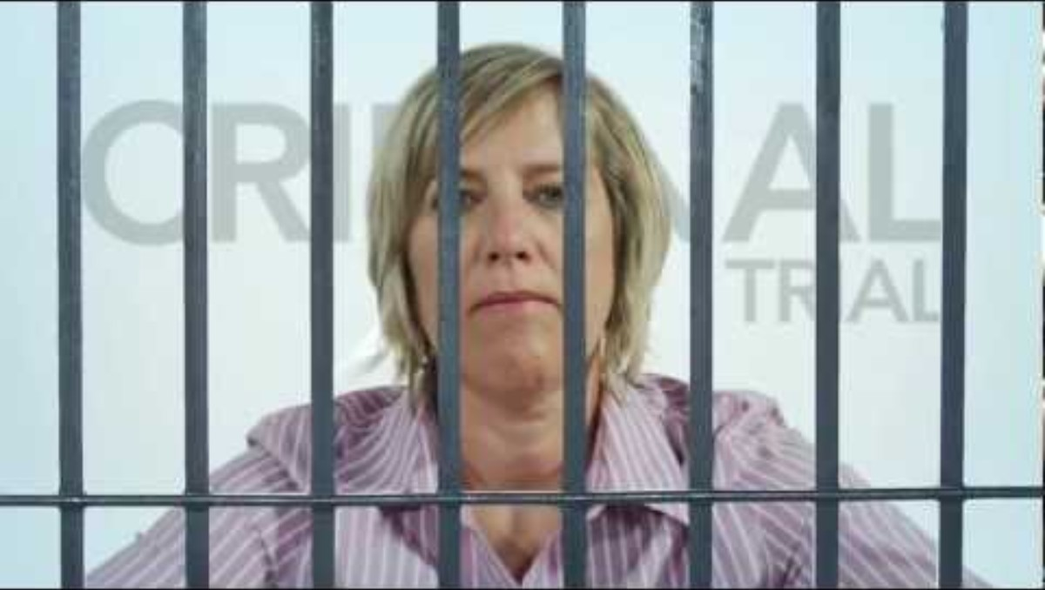
Differences Between Civil Trials and Criminal or Penal Trials
Notes:
NOTES FOR THE TEACHER
Watch this video with the students.
The key points are summarized on the following slides.

Slide 6
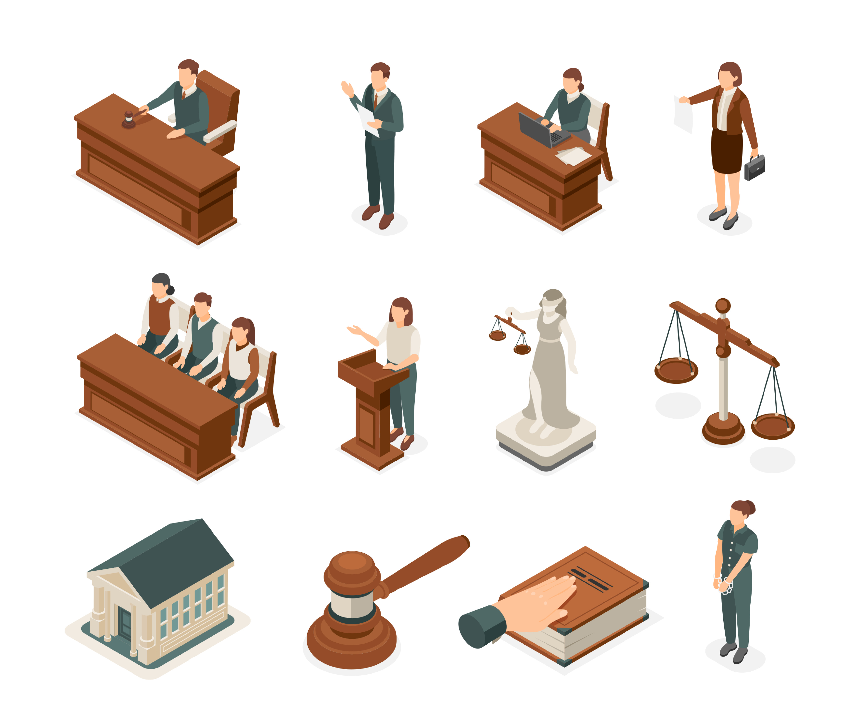
Civil Law
What?
  Rules that govern relationships between:
    Individuals or organizations,
    Individuals and property.
Where?
  Most of these rules can be found in the Civil Code of Québec.
Who brings the case to court?
  One individual or organization initiates legal action against another individual or organization.
Notes:
NOTES FOR THE TEACHER
Individually or in teams, students complete exercise 1 in the Student Workbook, pp. 4-5.
INFORMATION FOR STUDENTS
Civil law deals with many everyday situations. Here are just a few examples:
Family matters
Inheritance and succession
Contracts
Neighborhood problems
Etc.
As a general rule, in civil law, it is “private” persons who take each other to court. These “persons” may be individuals, companies or other organizations. In some cases, a person may even take legal action against a government body.
Civil law is inspired by French law. In Canada, it is specific to Quebec. It is not used in other Canadian provinces or territories, where common law, a law inspired by British law, applies.
Unlike criminal law, the main aim of civil law is not to punish harmful behaviour (crimes or criminal offences) or to denounce wrongful behaviour (offences), but rather to repair damage caused or compensate a victim for damage caused by another person.
SOURCES
Quebec Act, 1774, 14 George III, c. 83 (UK), art. 8
Constitution Act 1867 (UK), section 92(13)
Civil Code of Quebec, CQLR c CCQ-1991, preliminary provision
Hubert REID, Dictionnaire de droit québécois et canadien, 5th edn, Wilson & Lafleur, 2015, sub verbo “Droit civil”, accessed May 12, 2016 (CAIJ).
André ÉMOND, Introduction au droit canadien, Montréal, Wilson & Lafleur, 2012, p. 73 and 82.

Slide 7

Criminal Law
What? Rules governing harmful conduct
Why? To protect the public and uphold the shared values of a society.
Where? Most of these rules are found in the Criminal Code.
Who brings the case to court? The State initiates legal action against the person accused of a crime.
Criminal Trial
Notes:
NOTES FOR THE TEACHER
Individually or in teams, students complete exercise 1 in the Student Workbook, pp. 4-5.
INFORMATION FOR STUDENTS
Criminal law in Canada was inspired by British law. It is the same in all provinces and territories.
Criminal law serves to protect the public against harmful conduct and to preserve the shared values of a society. For example, theft, murder and drug trafficking are prohibited.
Most of the rules are found in the Criminal Code, but there are rules in other laws, such as the Controlled Drugs and Substances Act and the Firearms Act. The consequences, or possible sentences, associated with the various prohibited behaviours are also found in these laws.
There are two key players in a criminal case: the State and the person accused of committing a crime. In a criminal case, the State takes the accused to court. The State is represented by a government lawyer called a “criminal and penal prosecuting attorney,” often simply called “the prosecutor” or “the prosecution.”
THE ROLE OF THE STATE IN CRIMINAL TRIALS:
In a criminal trial, the victim can be asked to testify, but only as a witness.
The police officers who intervened at the crime scene or who questioned witnesses or the suspect can also be asked to testify as witnesses.
It is the State, represented by the criminal and penal prosecuting attorney that files charges against the accused in criminal cases.
Since King Charles III is officially Canada’s Head of State, criminal cases are designated as: K v. Whomever, with “K” meaning the King, and “v.” meaning versus.
Important! It is not the victim of the crime, or the victim’s family, who takes the accused to court, but the criminal and penal prosecuting attorney. For some crimes, there is no direct victim, for example, drug possession.
The law is no secret! Anyone can access and read the Criminal Code online for free: https://laws-lois.justice.gc.ca/eng/acts/c-46/
SOURCES
The Quebec Act, 1774, 14 George III, c. 83 (UK), s 11
Criminal Code, RSC 1985, c. C-46, s 8(2)
Criminal Code, ss 229 and 322
Controlled Drugs and Substances Act, c. 19, s 4(1)
Act Respecting the Director of Criminal and Penal Prosecutions, c D-9.1.1, ss 1 and 13(1)
Hubert REID, Dictionnaire de droit québécois et canadien, 5th ed., Wilson & Lafleur, 2015, sub verbo “Droit criminel”, consulted on May 12, 2016

Slide 8

Burden of Proof
This refers to the amount of proof needed to convince a judge or a jury.
Civil Law
The person who brings another to court must convince the judge that their version of the facts is more likely to be true.
50% +1
Criminal Law
The prosecutor must convince the judge or the jury that the accused is guilty beyond a reasonable doubt.​
The burden of proof is lighter in civil law than it is in criminal law.
Notes:
NOTES FOR THE TEACHER
Individually or in teams, students complete exercises 2 to 4 in the Student Workbook, p. 6.
INFORMATION FOR STUDENTS
In civil law, the burden of proof is well represented by a balance scale (scale of justice). It is based on a “balance of probabilities”: the heavier (or more convincing) side wins.
The same action can result in both a civil case and a criminal case.
Example: If an attendant abuses an older person in a nursing home, the attendant might be accused of the crime of assault and be taken to court by the State. In addition, the victim can bring the attendant to court in a civil case to make them compensate for the harm the victim suffered.
Important! Because the burden of proof has a higher standard in criminal law, a person might be held responsible in civil law but found not guilty in criminal law for the same act.
SOURCES
Code civil of Québec, art. 2803 and 2804
Criminal Code, RSC 1985, c C-46, s 6(1)

Slide 9


In Criminal Law
Beyond a Reasonable Doubt
If the judge or jury has a reasonable doubt as to the accused’s guilt, the accused must be acquitted (found not guilty).
This principle is called the "Presumption of Innocence.“
Since the accused is presumed innocent until proven guilty, the burden of proof gives the accused an advantage… it is up to the prosecutor to prove that the accused is guilty.
The accused is not even obliged to testify! This is known as the “right to remain silent."
Notes:
NOTES FOR THE TEACHER
Individually or in teams, students complete exercises 2 to 4 in the Student Workbook, p. 6.
INFORMATION FOR STUDENTS
The accused must be found not guilty if:
The prosecutor doesn’t present enough evidence that the accused is guilty, or
The defence can raise a reasonable doubt about the accused’s guilt in the mind of the judge (or jury).
The burden of proof “beyond a reasonable doubt” comes from the presumption of innocence. This means that everyone is presumed innocent until proven guilty. So, it is up to the state to prove the accused is guilty, not up to the accused to prove their innocence.
This right to be presumed innocent until proven guilty is protected by the Criminal Code, the Canadian Charter of Rights and Freedoms, and Quebec’s Charter of Human Rights and Freedoms.
The reason for the presumption of innocence is to ensure that innocent people are not found guilty by mistake. That’s why the presumption of innocence is such an important right in Canadian law.
The Right to Remain Silent
The Canadian Charter of Rights and Freedoms states that anyone charged with a crime has the right not to testify against themselves in any proceedings related to the crime of which they are accused. However, if the accused agrees to testify at their trial, they cannot then invoke their right to silence in the same proceedings and refuse to be cross-examined by the prosecutor!
SOURCES
The Constitution Act, 1982, being Schedule B to the Canada Act 1982 (UK), c 11 (UK), ss 2(b) and 11(d)
Charter of Human Rights and Freedoms, CQLR c C-12, s 33
Criminal Code, RSC 1985, c C-46, s 6(1)
R v Oakes, [1986] 1 SCR 103, paragraph 2.9
R v Lifchus, [1997] 3 SCR 320, paragraph 39

Slide 10

The Players in a Criminal Trial

Slide 11


The Prosecutor
The criminal and penal prosecuting attorney:
Is a government lawyer (represents the State).
Brings the accused to court in a criminal case.
Must prove the accused is guilty beyond a reasonable doubt.
The prosecutor’s job is to bring out the truth.
Notes:
NOTES FOR THE TEACHER
Individually or in teams, students complete exercise 5 in the Student Workbook, pp. 7-8.
INFORMATION FOR STUDENTS
A criminal and penal prosecuting attorney used to be called a "crown prosecutor." This lawyer is often referred to as "the prosecutor“ or “the Prosecution.”
Unlike defence lawyers, the prosecutor does not have regular clients. Prosecutors work only for the government and always represent the State.
The prosecutor’s main role is to ensure that “justice will be fully done.” But this doesn’t necessarily mean that their main goal is to win the case at all costs. For example, if the prosecutor discovers evidence during the trial that shows the accused is innocent, they must inform the judge and the defence, and then withdraw the accusations.
SOURCES
Act Respecting the Director of Criminal and Penal Prosecutions, ss 13 par 1(1) and 25 par 2
Dubois v La Reine, [1985] 2 SCR 350, par. 10
Boucher v The Queen, [1955] SCR 16, p. 21
R. v Kitaitchik, 2002 CanLII 45000 (ON C.A.), par. 47: «the truth-seeking goal of the criminal trial»
Erick VANCHESTEIN and Martin VAUCLAIR, « L'éthique et la déontologie en droit criminel », in Collection de droit 2015-2016, École du Barreau du Québec, vol. 1, Les règles déontologiques, Cowansville, Éditions Yvon Blais, p. 182
Website: Association des procureurs aux poursuites criminelles et pénales, consulted May 13, 2016: www.appcp.ca/index.php/association (in French only)

Slide 12


The Defence Lawyer
The lawyer representing the accused​.
Their role is to raise a reasonable doubt about their client’s guilt.
The defence lawyer prevents possible abuses of the justice system. ​
Notes:
NOTES FOR THE TEACHER
Individually or in teams, students complete exercise 5 in the Student Workbook, pp. 7-8.
INFORMATION FOR STUDENTS
The defence lawyer’s role is to raise a reasonable doubt about the accused’s guilt in the mind of the judge (or jurors, the members of the jury).
In addition, even if the accused pleads guilty, they still have the right to a fair and just trial. The defence lawyer acts as a kind of shield to protect their client against possible abuses of the judicial system, such as a violation of the accused’s rights, mistakes by police officers, or an unfair sentence.
People sometimes think that defence lawyers conspire with their clients to help them come up with a false story that will get them acquitted (found not guilty). This is not the case! If the accused admits to committing the crime, the defence lawyer can still represent them, but the lawyer cannot lie to the court or accept that the accused lies to the court. Otherwise, the defence lawyer can lose their right to practice law and be charged with the crime of being an “accessory” to perjury (lying to the court).
Accused individuals can choose to represent themselves, so they don’t have to hire a lawyer. However, the law is often complex, and a lawyer can greatly assist the accused in understanding the numerous laws and procedures involved in their trial.
Ask the following question to the students: True or False? The defence lawyer’s job is done when the accused pleads guilty or is found guilty.
Answer: FALSE. The defence lawyer must make sure their client receives an appropriate sentence, that is, a sentence that fits the crime, the circumstances, and the situation of the accused. The sentence must also be similar to sentences given to others in similar cases.
SOURCES
Canadian Charter of Rights and Freedoms, ss 7 and 10(b)
Charter of Human Rights and Freedoms, CQLR c C-12, s 29
Criminal Code, ss 131, 718 to 718.2
Code of ethics of advocates, QCLR c B-1, r 3, ss 14 and 116
Professional Code, QCLR c C-26, s 156
R. v Legato, 2002 CanLII 41296 (QC CA), par. 88
Erick VANCHESTEIN and Martin VAUCLAIR, « L'éthique et la déontologie en droit criminel », in Collection de droit 2015-2016, École du Barreau du Québec, vol. 1, Les règles déontologiques, Cowansville, Éditions Yvon Blais, p. 161

Slide 13
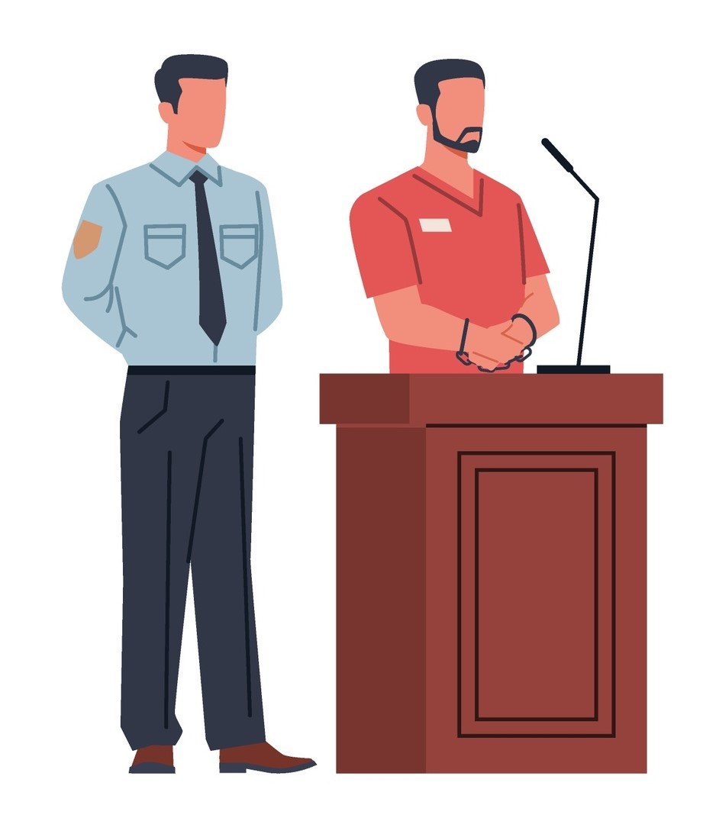
The Accused
The person suspected of committing a crime.
The accused is presumed innocent until proven guilty.
Notes:
NOTES FOR THE TEACHER
Individually or in teams, students complete exercise 5 in the Student Workbook, pp. 7-8.
INFORMATION FOR STUDENTS
Every accused has the right to a fair and equitable trial.
Due to the presumption of innocence, it is the Prosecution that must prove the guilt of the accused.
The accused may be called to the stand to testify and give their version of the facts.
The accused has several rights during their criminal trial. For example, they have the right to remain silent and the right to the assistance of an interpreter to understand everything that happens during the trial.
SOURCES
Canadian Charter of Rights and Freedoms, sections 7, 11, and 14
Criminal Code, section 530.
Dubois v. The Queen, [1985] 2 S.C.R. 350, paragraph 10.
Hubert REID, Dictionnaire de droit québécois et canadien, sub verbo “Accused”.
Canada Evidence Act, RSC (1985), c. C-5, section 4(1).

Slide 14
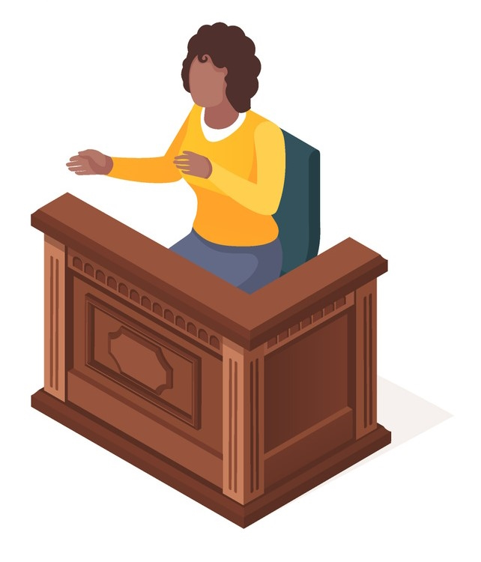
The "Ordinary" Witness
Knows certain facts about the crime.
Must swear to tell the truth!
These witnesses can only tell the court what they personally know, saw, or heard.
Usually, witnesses cannot give an opinion (but there are some exceptions).
Notes:
NOTES FOR THE TEACHER
Individually or in teams, students complete exercise 5 in the Student Workbook, pp. 7-8.
INFORMATION FOR STUDENTS
The prosecutor and the defence lawyer will ask people who have personal knowledge of facts relating to the case to testify in court. These people are called “witnesses.”
In most cases, the victim of the crime is a witness.
Witnesses have a choice of taking an oath on a religious book, such as the Bible or the Koran, or making a solemn affirmation that they will tell the truth, the whole truth, and nothing but the truth.
Important! Witnesses can only tell the court what they personally know, saw, or heard with their own senses (sight, hearing, etc.). If they don’t have direct, personal knowledge of a fact, what they say about it is hearsay and will not be accepted as evidence. Example of hearsay: “I know that X stole the car because Y told me so.”
In some situations, witnesses can give their opinions. For example, witnesses can give their opinions about things most people are able to judge, such as someone’s approximate age, whether a person was drunk, or whether a car was speeding.
SOURCES
Canada Evidence Act, RSC c C-5, ss 14 and 15
R. v N.S., 2012 SCC 72, paragraph 53
Nicolas BELLEMARE, « La preuve pénale », in Collection de droit 2015-2016, École du Barreau du Québec, vol. 11, Droit pénal: procédure et preuve, Cowansville, Éditions Yvon Blais, p. 128

Slide 15

The Expert Witness
A witness who has specialized knowledge in a specific field – referred to as an expert.
Expert witnesses can provide their opinions based on their expertise.
Notes:
NOTES FOR THE TEACHER
Individually or in teams, students complete exercise 5 in the Student Workbook, pp. 7-8.
INFORMATION FOR STUDENTS
Expert witnesses are called to court because they have specialized knowledge in a certain field, such as science, technology, or medicine.
Examples:
A fingerprint or dental specialist
A ballistics expert
A forensic medicine specialist
A psychiatrist who, for example, can explain the behaviour of a kidnapping victim with “Stockholm syndrome”
Unlike ordinary witnesses, expert witnesses can give their opinions on facts related to their expertise.
SOURCES
Canada Evidence Act, s. 7
Nicolas BELLEMARE, « La preuve pénale », in Collection de droit 2015-2016, École du Barreau du Québec, vol. 11, Droit pénal: procédure et preuve, Cowansville, Éditions Yvon Blais, p. 141
Delisle v R., 2013 QCCA 952, paragraphs 13-14, 26-30, and 31
In this case, several expert witnesses testified. In 2013, the appeal of former Supreme Court of Canada judge Jacques Delisle was refused. However, as of May 27, 2016, Mr. Delisle filed an appeal to the Canadian Minister of Justice, who can order a new trial or send the case back to the Quebec Court of Appeal if he believes that there was an error of law.

Slide 16
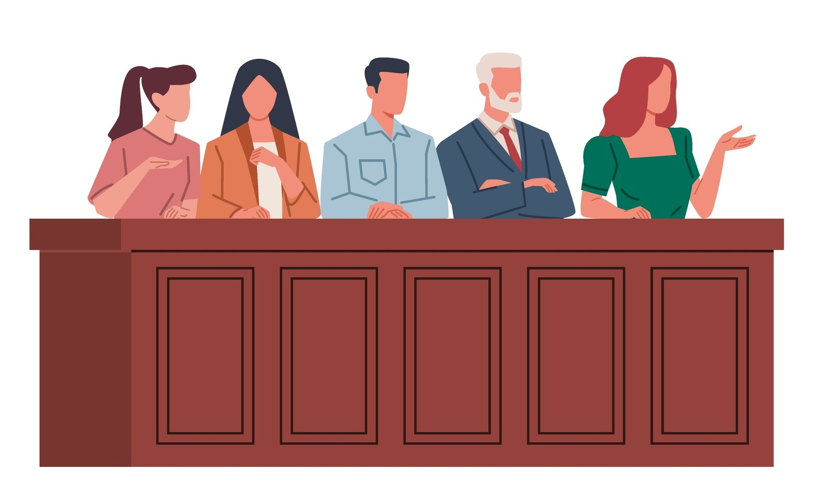
Important!
Not all trials take place in front of a jury!
The Jury
If there is a jury, it is made up of 12 citizens.
Each member of the jury is called a “juror.”
Their decision must be unanimous.
Notes:
NOTES FOR THE TEACHER
Individually or in teams, students complete exercise 5 in the Student Workbook, pp. 7-8.
INFORMATION FOR STUDENTS
For some lesser crimes (possessing a small amount of drugs, theft valued at less than $5,000, etc.), the trial is never before a jury. But for some serious crimes (like murder), there is always a trial by jury, except in some rare cases.
For all other crimes (theft valued at more than $5,000, sexual assault, etc.), the accused can choose to have a trial by jury or not.
When there is a jury, it is the jurors, and not the judge, who decide whether the accused is guilty or not guilty. We say that the jury “renders the verdict.” The decision must be unanimous, which means that all jurors must agree on the verdict. Since jurors are not legal specialists, they can only decide on the verdict after the judge has explained the law involved in the case. The judge can also answer any questions the jurors might have.
But the jurors do not decide the sentence. Only the judge can decide the sentence the accused will get. This happens at a later step called the sentencing.
SOURCES
The Constitution Act, 1982, being Schedule B to the Canada Act 1982 (UK), 1982, c 11, s 11f.
Criminal Code, ss 469, 471, 473, 469, 536(2), 553, 631(2.1) and (2.2), 643(1), 647, 653.
Criminal Code, art. 716 (“tribunal”) et 720(1).
R v Lifchus, [1997] 3 SCR 320, par. 22: an example of directions to the jury – explains the concept “beyond all reasonable doubt.”
Pierre BÉLIVEAU and Martin VAUCLAIR, Traité général de preuve et de procédure pénales, 22nd ed., Cowansville, Éditions Yvon Blais, 2015, par. 5334 et 1533.
Nicolas BELLEMARE, « La compétence des tribunaux – acte criminel », in Collection de droit 2015-2016, École du Barreau du Québec, vol. 11, Droit penal: procédure et preuve, Cowansville, Éditions Yvon Blais, p. 31.

Slide 17
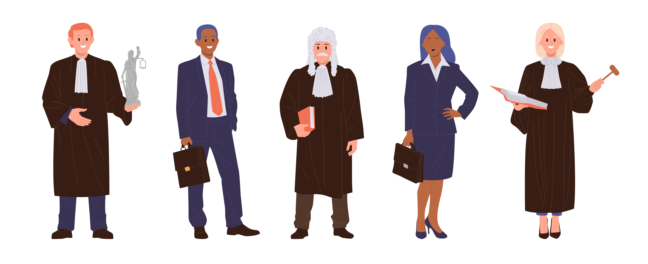
The Judge
Makes sure the rules of evidence and procedure are followed during the trial.
Renders the verdict, except in trials with a jury.
Decides on the appropriate sentence.
The judge must be impartial (not take sides)
Notes:
NOTES FOR THE TEACHER
Individually or in teams, students complete exercise 5 in the Student Workbook, pp. 7-8.
INFORMATION FOR STUDENTS
To become a judge, a person must have been a lawyer or a notary for at least 10 years.
If there is a jury, the judge must explain the relevant law and answer the jurors’ questions. If there is no jury, it is the judge who renders the verdict.
If the accused is found guilty, it is always the judge who decides on the sentence. If the trial takes place before a jury, the jury’s job is to decide the verdict—whether the accused is guilty or not guilty of the crime. The jury does not have the power to decide on the sentence.
SOURCES
Criminal Code, ss 718 and 718.2
Judicial Code of Ethics, CQLR, c T-16, r 1, s 1
Courts of Justice Act, CQLR, c T-16, s 87
Judges Act, RSC 1985, c J-1, s 3(a)
Supreme Court Act, RSC 1985, c S-26, s 5
R. v Lifchus, [1997] 3 SCR 320, par. 22: example of directions to the jury—explains the concept “beyond all reasonable doubt.”
Pierre BÉLIVEAU and Martin VAUCLAIR, Traité général de preuve et de procédure pénal, 22nd ed., Cowansville, Éditions Yvon Blais, 2015, par. 537 and 2455

Slide 18

The Court Usher
Makes sure everything runs smoothly during a trial.
Makes sure that decorum is maintained in the courtroom.
Notes:
NOTES FOR THE TEACHER
Individually or in teams, students complete exercise 5 in the Student Workbook, pp. 7-8.
INFORMATION FOR STUDENTS
The court usher makes sure the courtroom is ready before the trial starts and escorts the judge from their office to the courtroom.
The court usher maintains order in the courtroom. This is called decorum. There are strict rules that must be obeyed in a courtroom, for example:
Remain silent
Do not use electronic devices, such as cellphones or computers
Do not eat
When the judge arrives, the court usher makes this well-known statement: “Silence. All rise. The court, presided by the honourable justice ______, is in session.” and asks that everyone stands to welcome them.
SOURCE
Rules of practice of the Québec Superior Court in Penal Matters, c C-25.1, r 5, s 5

Slide 19


The Court Clerk
Takes detailed notes during the trial.
Swears in witnesses before they testify.
Notes:
NOTES FOR THE TEACHER
Individually or in teams, students complete exercise 5 in the Student Workbook, pp. 7-8.
INFORMATION FOR STUDENTS
The court clerk takes detailed notes on the different steps of the trial.
The court clerk asks witnesses to promise to tell the truth. The “promise” is either made by taking an oath or making a solemn affirmation:
“Do you swear (or solemnly affirm) to tell the truth, the whole truth, and nothing but the truth?”
This is called swearing in a witness.
SOURCE
Courts of Justice Act, s. 219(b)

Slide 20
The Special Constable
A real police officer who oversees what happens and maintains order in the courthouse.
Notes:
NOTES FOR THE TEACHER
Individually or in teams, students complete exercise 5 in the Student Workbook, pp. 7-8.
INFORMATION FOR STUDENTS
The special constable is the one who removes people from the courtroom if the rules of the court are not followed.
They also step in during conflicts or verbal or physical violence during a trial.
The special constable carries a firearm at their waist.
It’s relatively rare for the special constable to need to intervene, but they are present in almost all criminal trials. Their mere presence is usually enough to prevent discussions from escalating or becoming more personal or violent.
SOURCES
Police Act, c P-13.1, ss 105-111
Website: Sécurité publique Québec, consulted on May 16, 2016, www.securitepublique.gouv.qc.ca/police/police-quebec/constables-speciaux.html (in French only)

Slide 21
The Courtroom
Judge
Court usher
Jury
  Court clerk
Prosecutor
Defence lawyer
Accused
Witness
Public
Notes:
NOTES FOR THE TEACHER
Here is a suggestion for setting up the trial. Present it to the students.

Slide 22
Legal Terms Crossword
3
I
M
P
R
T
I
A
L
8
P
A
R
4
C
R
I
M
E
9
E
H
S
E
U
A
5
M
R
B
P
R
O
S
E
C
U
O
N
2
10
P
S
U
T
I
S
T
A
R
6
7
1
I
I
Y
D
U
D
R
E
A
13
E
S
O
N
A
B
L
C
L
O
11
E
V
N
E
S
O
E
N
N
A
C
12
O
L
E
M
N
L
Y
E
N
N
R
N
O
S
T
D
I
R
T
I
M
U
A
C
O
M
B
T
U
C
L
E
R
K
S
14
L
E
Notes:
NOTES FOR THE TEACHER
Present this slide to correct exercise 6 on p. 9 of the Student Workbook.

Slide 23
The Steps in the Criminal Judicial Process

Slide 24

Exercise
Using your prior knowledge, write the steps of the judicial process in logical order in your Student Workbook on p. 11.
When you're ready, explore each step on the next slide.
Correct your answers during the presentation of the information.
Notes:
NOTES FOR THE TEACHER
Students must complete Exercise 2.1 on page 11 of the Student Workbook.

Slide 25

Arrest and Court Summons
Step1
Who? Police officers
What?
  They have reasonable grounds to believe that a person has committed a crime.
  They have the power, not the obligation, to arrest the person.
Notes:
NOTES FOR THE TEACHER
Students must complete Exercise 2.1 on page 11 of the Student Workbook.
INFORMATION FOR STUDENTS
Police officers can arrest people, which means they have the right to restrict their freedom, at least temporarily. The law requires that a person be released as soon as possible after arrest, unless it is determined that they should remain imprisoned until trial. The person may remain imprisoned, for example, because they are dangerous, or because they are likely to flee before trial.
When police officers arrest someone, they may give them a summons to appear in court before releasing them. The summons requires the person to appear before a judge at a specific time and place. If the person fails to appear as scheduled, a judge may issue a warrant for their arrest.
An arrest warrant allows the police to arrest someone even if that person was not committing a criminal act at the time of interception. For example, if a person is stopped by the police because one of their vehicle's taillights is defective, and the police discover by checking the driver's license that a warrant has been issued for the driver's arrest, the police can and should proceed without delay to arrest them.
SOURCES
Canadian Charter, s. 10 c), 11e)
Béliveau and Vauclair, Traité général de la preuve et de la procédure pénale, para. 1851, 2920 Nicholas Bellemare, “Chapitre III - Les procédures précédant le procès en matière criminelle”, in Collection de droit 2016-2017, vol. 11, Droit pénal : procédure et preuve, p. 51-52

Slide 26
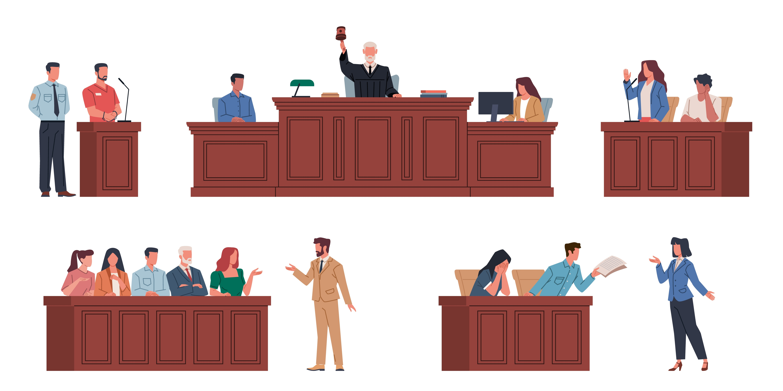
Appearance
Step 2
Who?​ The accused.​
What?​
  They appear before a judge for the first time.
  They plead guilty or not guilty to each of the crimes with which they are charged. They are said to enter a plea.
Notes:
NOTES FOR THE TEACHER
Students must complete Exercise 2.1 on page 11 of the Student Workbook.
INFORMATION FOR STUDENTS
In some cases, the accused has the option to choose for their trial to be before a judge or before a judge and a jury.
In some specific situations, the accused does not have to be present at the trial (their lawyer appears in their place).
Moreover, an accused who has pleaded not guilty may, later in the process, change their mind and plead guilty (this can be useful, for example, when negotiating a settlement, step #6).
FURTHER INFORMATION
At their first appearance, the accused may acknowledge that they have committed the acts of which they are accused. This is called “pleading guilty”. Once they have admitted their guilt, they no longer have to stand trial. The accused goes straight to the sentencing stage.
If, on the other hand, the accused denies the crime, they plead “not guilty”. A judge or jury will then rule on their guilt at trial.
SOURCES
C.Cr., art 536, consulted May 21, 2013
Michel Beauchemin, Les procédures précédant le procès en matière criminelle, Collection de droit 2012-2013, Volume 11, Droit pénal : procédure et preuve, 57 [XPS document].
C.Cr., art 552-572, consulted May 21, 2013
Art 574-670, consulted May 21, 2013.
Michel Beauchemin, Les procédures précédant le procès en matière criminelle, Collection de droit 2012-2013, Volume 11, Droit pénal : procédure et preuve, 77.

Slide 27
Interim Release Hearing
(Bail Hearing)
Step 3
Who? The judge
What?
  The judge determines whether the accused, while awaiting trial:
    is released with conditions, or
    must remain in custody.
Notes:
NOTES FOR THE TEACHER
Students must complete Exercise 2.1 on page 11 of the student booklet.
INFORMATION FOR STUDENTS
An accused must be released unless the evidence demonstrates the need to keep them behind bars. To reach this conclusion, a number of factors must be taken into account, such as the seriousness of the alleged offence, the need to prevent the continuation or repetition of the offence or the commission of any other offence, and the need to ensure the safety of the accused or any other person. It is therefore up to the Prosecution to convince the judge that the accused should be detained.
SOURCES
C.Cr., art 515, accessed May 21, 2013.
Canadian Charter of Rights and Freedoms, art 11e), (hereinafter “Canadian Charter”) consulted May 21, 2013.

Slide 28
Disclosure of Evidence
Step 4
Who? The Prosecution
What?
  The Prosecution sends to the accused all relevant evidence held against them.
Notes:
NOTES FOR THE TEACHER
Students must complete Exercise 2.1 on page 11 of the Student Workbook.
INFORMATION FOR STUDENTS
With rare exceptions, the Prosecution must transmit all relevant evidence in its possession, even if it does not intend to use this evidence during the trial, and even if the evidence may help the accused prove their innocence.
The obligation to disclose evidence is constant and continues to exist throughout the trial if new evidence comes to light.
SOURCES
Exceptions: Babcock v. Canada (Attorney General), 2002 SCC 57 (CanLII), [2002] 3 SCR 3, para. 17: Sections 37, 38 and 39 of the Canada Evidence Act govern objections to the disclosure of privileged information held by the federal government. Section 37 covers all cases where the Crown asserts immunity, except for Cabinet confidences or confidences of the Queen's Privy Council for Canada; section 38 deals with objections relating to international relations or national defence; and section 39 applies to Cabinet confidences. Under sections 37 and 38, a judge determines whether the public interest requires disclosure or, on the contrary, protection of the information.
R. v. McNeil, [2009] 1 SCR 66, 62 C.R. (6th) 1, 238 C.C.C. (3d) 353 - The obligation to disclose evidence established in Stinchcombe is not absolute, but it allows few exceptions. Evidence that is irrelevant or privileged, or if its disclosure is otherwise governed by law, need not be disclosed.
R. v. Stinchcombe, [1991] 3 S.C.R. 326, page 336.

Slide 29
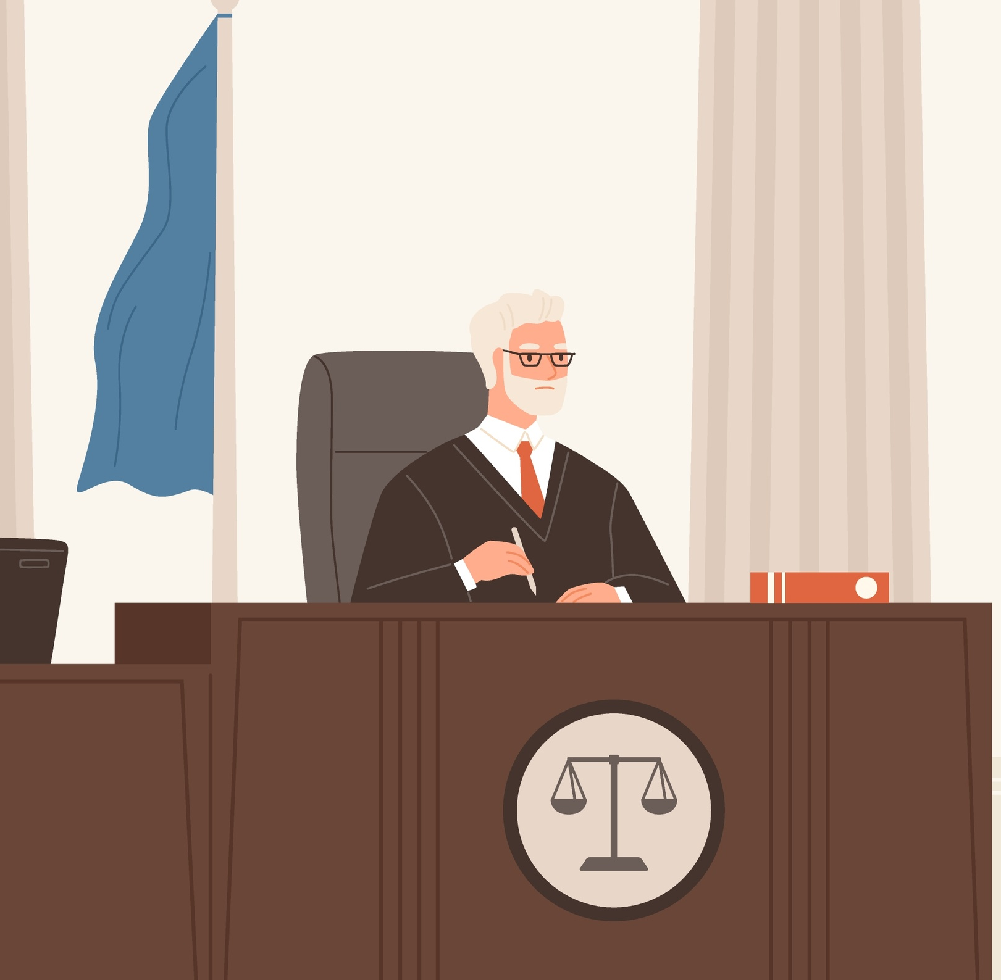
Preliminary Hearing
Step 5
Who?​ The judge
What?
  The purpose is to ascertain or evaluate the evidence to determine whether or not a trial should take place.
  An optional step that takes place only at the request of the Prosecution or the accused.
Notes:
NOTES FOR THE TEACHER
Students must complete Exercise 2.1 on page 11 of the Student Workbook.
INFORMATION FOR STUDENTS
At this stage, the Prosecution presents the judge with witnesses, documents or other evidence to prove each of the crimes with which the accused is charged. The accused may also present evidence.
The preliminary hearing can only be held for serious crimes, for which the accused could receive a prison sentence of 14 years or more.
SOURCES
Criminal Code, LRC 1985, c C-46, art 535 et seq.
Nicolas Bellemare, “Les procédures précédant le procès en matière criminelle” in École du Barreau du Québec, Droit pénal - Procédure et preuve, Collection de droit 2023-2024, vol. 12, Montreal (Qc), CAIJ, 2023 at p 72.

Slide 30

Negotiation
Step 6
Who?​ The Prosecution and Defence
What?​
  In light of the strengths and weaknesses of the evidence, the parties may meet privately and attempt to reach an agreement.
  The accused may agree to plead guilty in order to
    receive a lesser sentence,
    avoid the costs and delays of a trial.
Notes:
NOTES FOR THE TEACHER
Students must complete Exercise 2.1 on page 11 of the Student Workbook.
INFORMATION FOR STUDENTS
The parties must then propose their agreement to a judge, who may accept or reject it. The parties are free to negotiate or not. They can do so at any stage of the proceedings, although it is often preferable to wait for disclosure (of evidence). The full name of this step is “settlement negotiations”.
SOURCES
Jean-Paul Perron, La négociation en droit pénal, Collection de droit 2012-2013, Volume 12, Droit pénal : infractions, moyens de défense et peine, 317-328 [XPS document]

Slide 31

The Trial
Step 7
This step will be detailed later in the presentation.
Notes:
NOTES FOR THE TEACHER
Students must complete Exercise 2.1 on page 11 of the Student Workbook.

Slide 32
Sentencing
Step 8
Who?​ The judge
What?
  They determine a sentence appropriate to the circumstances by examining the seriousness of the crime, the degree of responsibility of the accused and more.
  Examples of possible sentences: imprisonment, community service, fine, probation, etc.
Notes:
NOTES FOR THE TEACHER
Students must complete Exercise 2.1 on page 11 of the Student Workbook.
INFORMATION FOR STUDENTS
Purpose of a sentence:
denounce the behaviour of the accused.
send a message to other members of society.
isolate the accused, if necessary.
promote the accused's social reintegration.
repair the harm done to victims.
make the accused realize that their behaviour is unacceptable.
SOURCES
Criminal Code, LRC 1985, c C-46, art. 718, 718.1, 718.2.

Slide 33
Appeal
Step 9
Who?​ The Prosecution or the Defence
What?
  A party may contest the judge's decision when they consider that the judge erred in their judgment regarding:
    the guilt of the accused, or
    the sentence.
Notes:
NOTES FOR THE TEACHER
Students must complete Exercise 2.1 on page of the Student Workbook.
INFORMATION FOR STUDENTS
The accused can ask a higher court to review the decision. This is called appealing a decision. However, in some cases, permission must be obtained from the court before filing an application for review.
The Court of Appeal of Québec is the court responsible to hear criminal appeals, but other courts can also review decisions in other types of cases.
The deadline for appealing a decision in criminal matters is 30 days, whether to review the verdict or the sentence. If an accused wishes to appeal a decision after this time, they must first ask permission from the Court of Appeal before being able to challenge the decision handed down by the first judge.
SOURCES
Criminal Code, LRC 1985, c C-46, art. 675, 676.
R. v. Lampart, (1969) 3 CCC 249 (SCC).

Slide 34
The Steps in a Criminal Trial

Slide 35
The steps, en brief
1
Opening proceedings and courtroom decorum​
Opening statement of the Prosecution
​
The Prosecution’s evidence​
​
Cross-examination by the Defence​
​Opening statement of the Defence
The Defence’s evidence​
​
Cross-examination by the Prosecution
​
Oral arguments​
​
Deliberation, verdict and sentencing
2
3
Witnesses for the Prosecution
4
5
6
Witnesses for the Defence
7
8
9
Notes:
NOTES FOR THE TEACHER
Once all the steps are presented, students must complete Exercise 3.1 on pages 12 to 14 of the Student Workbook.

Slide 36

Opening Proceedings and Courtroom Decorum
Step 1
Who?
  The court usher and the judge.
What?
  Review of the rules of decorum
  Entrance of the judge
Notes:
NOTES FOR THE TEACHER
Once all the steps are presented, students must complete Exercise 3.1 on pages 12 to 14 of the Student Workbook.
INFORMATION FOR STUDENTS
In general, the rules of decorum during a trial are similar to those found in a classroom. It is forbidden to:
Eat or drink anything other than water
Speak out of turn or talk with other members of the public
Use a cellphone
Dress inappropriately (proper business attire is required)
It is also required to address everyone in the courtroom politely. The judge should be addressed as “Your Honour”.
If any of these rules are not followed, the court usher will intervene. If someone continues to break the rules, the special constable will expel them from the courtroom.
SOURCES
Rules of procedure of the Québec Superior Court, Criminal Division (2002), TR/2002-46, articles 3-9.

Slide 37
Opening Statement of the Prosecution
Step 2
Who? The Prosecution
What? They present their “theory of the case,” a summary of their version of the facts and of the exhibits and witnesses that support their case.
Notes:
NOTES FOR THE TEACHER
Once all the steps are presented, students must complete Exercise 3.1 on pages 12 to 14 of the Student Workbook. This step is included in “Opening statements”, without distinction between the opening statement of the Prosecution and that of the Defence.
INFORMATION FOR STUDENTS
The opening statement of the Prosecution is like an introduction to the trial.
Just like an introduction to a text, a lawyer’s “theory of the case” shows how they will lay out the facts to reach their conclusions and justify the verdict they are seeking.
The Prosecution addresses the court and gives a brief summary of the anticipated course of the trial. The lawyer goes over the facts of the case, as well as the circumstances surrounding the crime and the arrest. They then provide a brief overview of the evidence they will present and state which witnesses they will call.
SOURCE
Pierre BÉLIVEAU and Martin VAUCLAIR, Traité général de preuve et de procédure pénales, 22nd ed., Cowansville, Éditions Yvon Blais, 2015, par. 2361

Slide 38
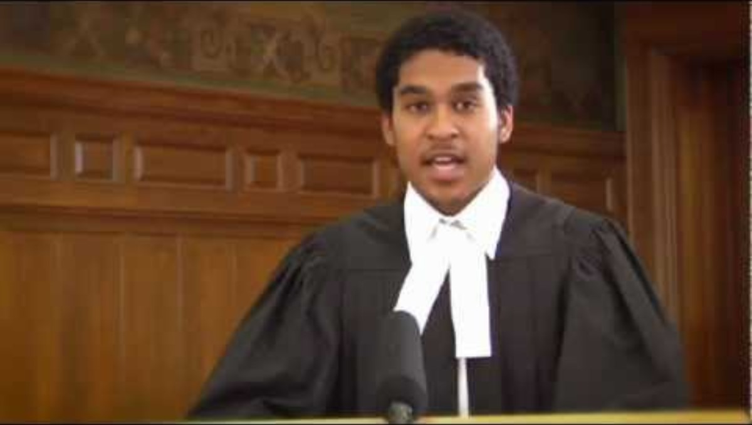
Opening Statements
Notes:
NOTES FOR THE TEACHER
Watch this video with the students. The key points were summarized in the previous slide.

Slide 39
The Prosecution’s Evidence
Step 3
What?
  Presents exhibits
  Questions witnesses called by the Prosecution after they’ve been sworn in by the court clerk.
    Open questions
Burden of Proof:
Must prove beyond a reasonable doubt that the accused is guilty.
Notes:
NOTES FOR THE TEACHER
Once all the steps are presented, students must complete Exercise 3.1 on pages 12 to 14 of the Student Workbook.
INFORMATION FOR STUDENTS
It is the Prosecution’s job to prove that the accused is guilty. It is not up to the accused to prove their innocence.
Evidence can be material exhibits or witness testimony. Examples of exhibits:
The gun used to commit the crime
Photographs
Videos
Audio recordings
When lawyers question the witnesses they have called (during “direct” examination), their questions must be open questions and can’t be leading questions.
Closed question: A question that can only be answered with “yes” or “no.” For example: “Did you see the accused covered in blood when leaving their home?”
Leading question: A question in which the answer has already been implied, leading the witness to say something specific. For example: “Is it not true that Mr. Smith has a reputation for angry outbursts?”
SOURCES
Canadian Charter of Rights and Freedoms, s. 11(d)
Dubois v The Queen, [1985] 2 SCR 350, par. 10
Nicolas BELLEMARE, « Le procès en matière criminelle : les procédures pendant le procès », in Collection de droit 2015-2016, École du Barreau du Québec, vol. 11, Droit pénal : procédure et preuve, Cowansville, Éditions Yvon Blais, p. 100-101
L’interrogatoire et le contre-interrogatoire des témoins, Capsule d’information juridique, Directeur des poursuites criminelles et pénales du Québec, Ministère de la Justice du Québec, 2016.

Slide 40
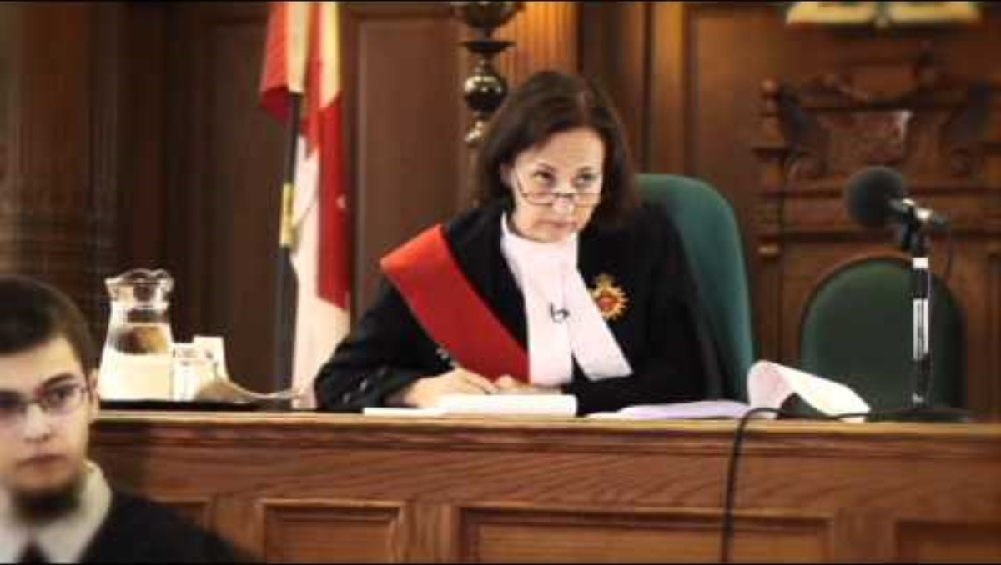
Direct Examination
Notes:
NOTES FOR THE TEACHER
Watch the beginning of this video with the students (45 seconds). The key points were summarized in the previous slide.

Slide 41
Cross-Examination by the Defence
Step 4
What? The Defence cross-examines (questions) the Prosecution’s witnesses.
Why? To highlight statements by the witness that are favorable to the accused.
Notes:
NOTES FOR THE TEACHER
Once all the steps are presented, students must complete Exercise 3.1 on pages 12 to 14 of the Student Workbook.
INFORMATION FOR STUDENTS
The defence lawyer can challenge the credibility of a witness, highlight contradictions or lies in the witness’s testimony, etc.
It is important to note that during cross-examinations, unlike the previous stage (direct examination), it is permitted to ask closed and leading questions.
SOURCES
Canadian Charter of Rights and Freedoms, ss. 7 and 11(d)
Nicolas BELLEMARE, « La preuve pénale », in Collection de droit 2015-2016, École du Barreau du Québec, vol. 11, Droit pénal : procédure et preuve, Cowansville, Éditions Yvon Blais, p. 153-154

Slide 42
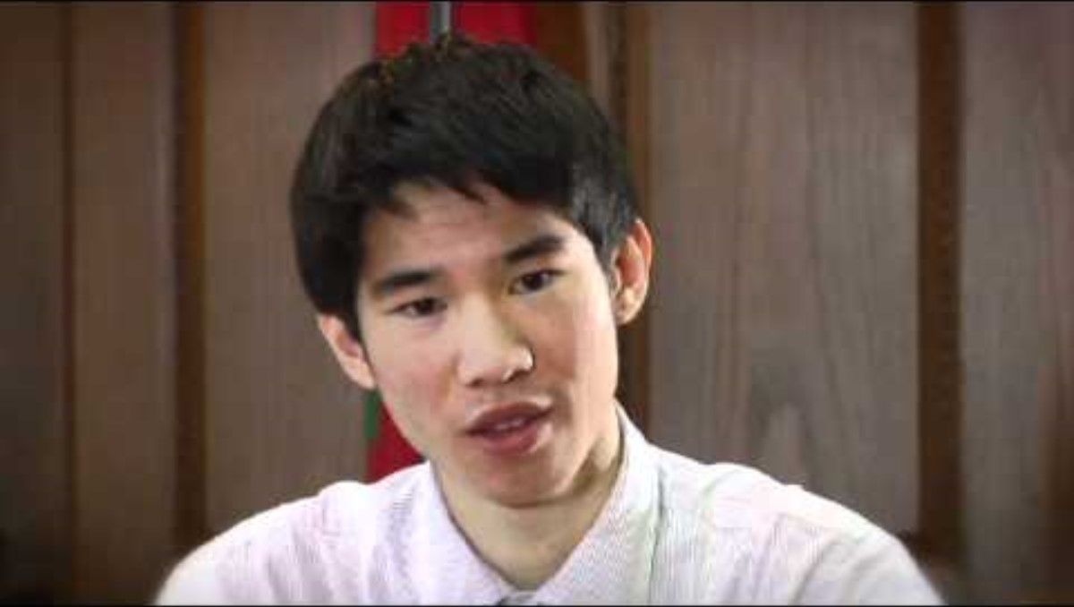
Cross-Examination
Notes:
NOTES FOR THE TEACHER
Watch the beginning of this video with the students (until 1:10). The key points were summarized in the previous slide.

Slide 43
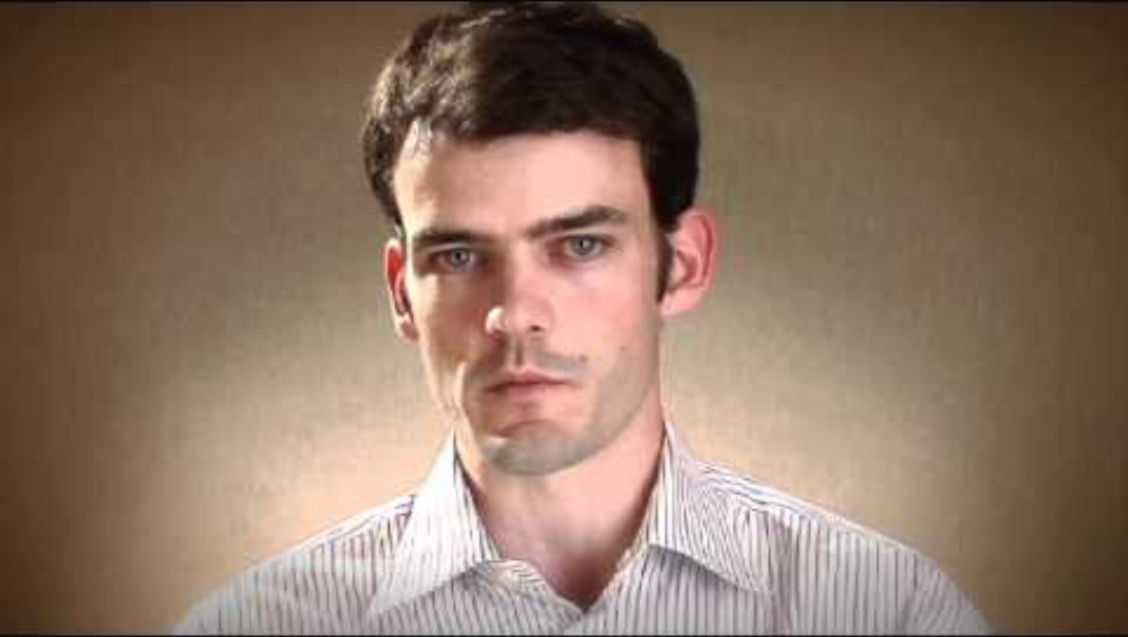
Witness Testimony
Notes:
NOTES FOR THE TEACHER
Watch this video with the students. The information presented applies to the direct examination and the cross-examination of witnesses.

Slide 44
Opening Statement of the Defence
Step 5
Who? The defence lawyer.
What? They present their “theory of the case,” a summary of their version of the facts and of the exhibits and witnesses that support their case.
Notes:
NOTES FOR THE TEACHER
Once all the steps are presented, students must complete Exercise 3.1 on pages 12 to 14 of the Student Workbook. This step is included in “Opening statements”, without distinction between the opening statement of the Prosecution and that of the Defence.
INFORMATION FOR STUDENTS
Just like an introduction to a text, a lawyer’s “theory of the case” shows how they will lay out the facts to reach their conclusions and justify the verdict they are seeking.
The Defence addresses the court and gives a brief summary of the anticipated course of the trial. The lawyer goes over the facts of the case, as well as the circumstances surrounding the crime and the arrest. They then provide a brief overview of the evidence they will present and state which witnesses they will call.
FURTHER INFORMATION
In general, in trials with a jury, the Defense’s opening statement is presented later, at the beginning of the presentation of its evidence. However, judges have the authority to allow the defense’s opening statement to be presented immediately after the Prosecution's. This power should only be exercised in specific circumstances, such as in the case of a lengthy trial.
SOURCE
Pierre BÉLIVEAU and Martin VAUCLAIR, Traité général de preuve et de procédure pénales, 22nd ed., Cowansville, Éditions Yvon Blais, 2015, par. 2361

Slide 45
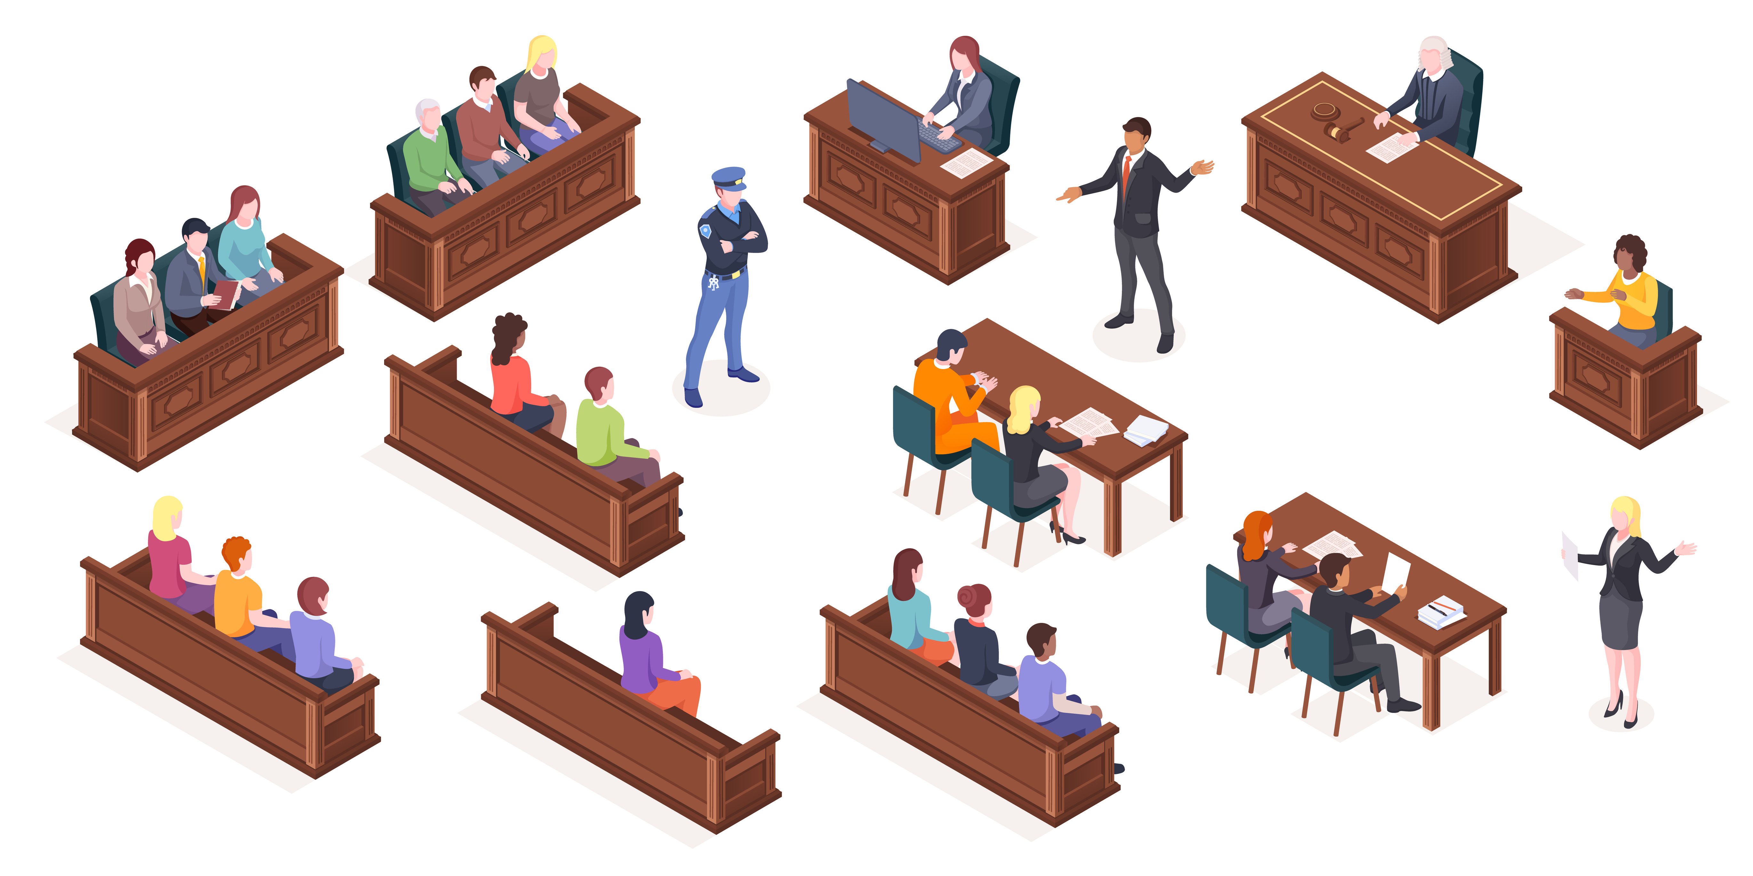
The Defence’s Evidence (if any)
Step 6
What?
  Presents exhibits
  Questions witnesses called by the Defence after they’ve been sworn in by the court clerk.
    Open questions
Notes:
NOTES FOR THE TEACHER
Once all the steps are presented, students must complete Exercise 3.1 on pages 12 to 14 of the Student Workbook.
INFORMATION FOR STUDENTS
If the defence lawyer presents evidence, they will try to raise a reasonable doubt about the guilt of the accused.
Evidence can be material exhibits or witness testimony.
If the accused wants to, they can testify as a witness in their own trial. However, an accused is never obliged to do so because they have a right called “the right to remain silent.”
Sometimes, a defense lawyer may advise an accused not to testify. This is the case if the Prosecution's evidence is weak and if the accused’s testimony could potentially be self-incriminating.
SOURCES
Canadian Charter of Rights and Freedoms, ss 11(c) and (d)
Criminal Code, ss 650(3) and 651(2)
Dubois v The Queen, [1985] 2 SCR 350, par. 10
Nicolas BELLEMARE, « Le procès en matière criminelle : les procédures pendant le procès », in Collection de droit 2015-2016, École du Barreau du Québec, vol. 11, Droit pénal : procédure et preuve, Cowansville, Éditions Yvon Blais, p. 101

Slide 46
Cross-Examination by the Prosecution
Step 7
What?
  The Prosecution can question the witnesses called by the Defence.
    Leading questions permitted.
Why?
  To highlight statements that go against the accused.
  To point out weaknesses in the Defence’s case.
Notes:
NOTES FOR THE TEACHER
Once all the steps are presented, students must complete Exercise 3.1 on pages 12 to 14 of the Student Workbook.
INFORMATION FOR STUDENTS
This step is the same as Step 4, but in reverse. This time, it is the Prosecution who is cross-examining the witnesses for the defence.
The prosecutor can attack the witness’s credibility, highlight contradictions or lies in the witness’s testimony, etc. Leading questions are allowed during cross-examination.
SOURCES
Canadian Charter of Rights and Freedoms, ss 7 and 11(d)
Nicolas BELLEMARE, « La preuve pénale », in Collection de droit 2015-2016, École du Barreau du Québec, vol. 11, Droit pénal: procédure et preuve, Cowansville, Éditions Yvon Blais, p. 153-15
Pierre BÉLIVEAU and Martin VAUCLAIR, Traité général de preuve et de procédure pénales, 22nd ed., Cowansville, Éditions Yvon Blais, 2015, par. 1541-1557

Slide 47
Oral Arguments
Step 8
Who?
  The Prosecution and the Defence.
What?
  Summarize elements of the case favorable to their sides.
Why?
  To convince the judge or jury.
Notes:
NOTES FOR THE TEACHER
Once all the steps are presented, students must complete Exercise 3.1 on pages 12 to 14 of the Student Workbook.
INFORMATION FOR STUDENTS
The aim of the oral arguments (also called closing statements), is to ensure that all the evidence is clear and remains fresh in the minds of the judge (or jury). This step is especially important when the trial lasts several days.
It's the lawyers' last chance to convince the judge or jury. Once the oral arguments are finished, the trial itself is over.
SOURCE
Nicolas BELLEMARE, « Le procès en matière criminelle : les procédures pendant le procès », in Collection de droit 2015-2016, École du Barreau du Québec, vol. 11, Droit pénal : procédure et preuve, Cowansville, Éditions Yvon Blais, p. 101

Slide 48
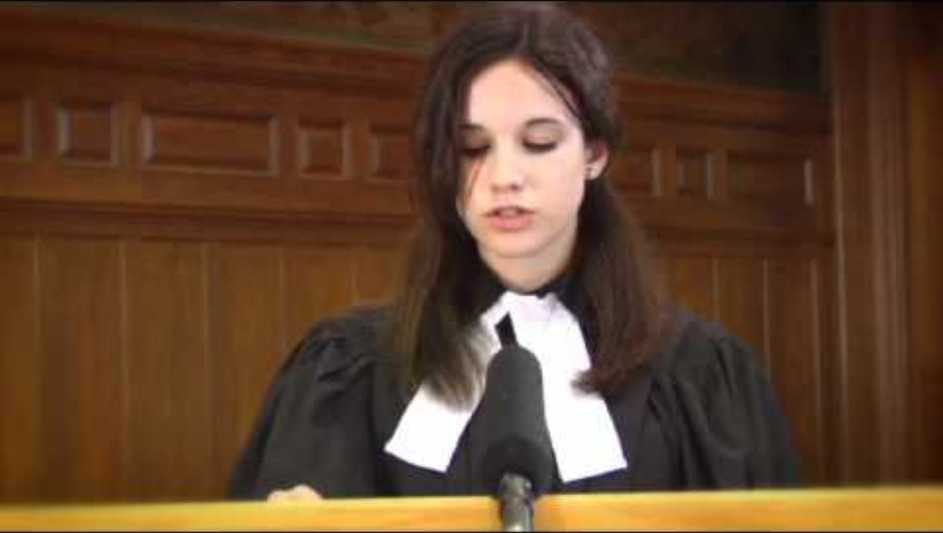
Oral Arguments
Notes:
NOTES FOR THE TEACHER
Watch the beginning of this video with the students (until 1:05). The key points were summarized in the previous slide.

Slide 49

Directives to the jury
Optional step
Who?
  The judge
What?
  Explain the rules regarding the jury’s verdict.
Why?
  To ensure that the jury’s verdict complies with the law.
Reminder
Not all trials are jury trials.
Notes:
NOTES FOR THE TEACHER
Once all the steps are presented, students must complete Exercise 3.1 on pages 12 to 14 of the Student Workbook.
INFORMATION FOR STUDENTS
Since jurors are citizens without legal training, before the deliberation phase begins, the judge reminds them of certain instructions to guide them.
In the judge's directions to the jury, they take the time to explain the jurors' role, how they should reach a decision, and how the deliberations will proceed.
Here is a summary of what the judge would normally remind the jurors:
The decision must be unanimous.
The decision must be based solely on the evidence presented during the trial. Therefore, the jurors must strive to be as impartial as possible and not take into account any biases they may have, even unconsciously.
In order to return a guilty verdict, all jurors must be convinced, beyond a reasonable doubt, of the accused’s guilt.
SOURCES
Pierre Béliveau et Martin Vauclair, Traité général de preuve et de procédure pénales, 25e éd, Yvon Blais, 2018, p 1201-1224.​
Model jury instructions by the National Judicial Institute: https://www.nji-inm.ca/index.cfm/publications/model-jury-instructions/?langSwitch=en​
R. c. Lifchus, [1997] 3 R.C.S. 320, at para 36-39.​

Slide 50
Deliberation, verdict and sentencing
Step 9
Who?​ The judge (and the jury). ​
What? ​The judge (or jury) announces if the accused is guilty or innocent after an additional period of reflection (deliberations).
If the accused is found guilty - Determining the sentence
Who? The judge.
What? The judge must announce a sentence that is appropriate in the circumstances (prison, fine, community service…).
Notes:
NOTES FOR THE TEACHER
Once all the steps are presented, students must complete Exercise 3.1 on pages 12 to 14 of the Student Workbook.
INFORMATION FOR STUDENTS
The information provided during the testimonies of different witnesses is part of the evidence. These testimonies help determine whether the accused did indeed commit a crime. The judge or jury must examine all the evidence, including testimonies, to determine if the accused is guilty or not guilty.
In the case of a trial before a judge and jury, the 12 jurors meet to discuss and decide whether the accused is guilty. The head juror (appointed by their co-jurors and called the foreperson) then announces the decision to the court. The decision must be unanimous, meaning all the jurors must agree.
Generally, jurors have as much time as they need to reach a unanimous decision.
If there is no jury, the judge renders the verdict.
Sentencing:
Only a judge can issue a sentence to an accused found guilty of a crime.
When deliberating, the judge must keep in mind the main principles and purposes of sentencing. The judge must also take into account the facts about the accused and the crime, such as aggravating or mitigating circumstances that could justify a more severe or lenient sentence. The judge must always listen to the Prosecution and the Defence’s arguments about the sentence.
Apart from a prison sentence, there are other types of sentences:
A fine
Community service
Serving the sentence in the community under certain conditions
Etc.
Important! The judge is not completely free to choose the sentence. For some crimes, the Criminal Code specifies the maximum and minimum sentences that can be given. The sentence must also be similar to those given in similar previous cases, unless there is a reason to justify a deviation from past sentences.
SOURCES
Code criminel, art. 647
R. c. M. (C.A.), [1996] 1 R.C.S. 500
Pierre BÉLIVEAU and Martin VAUCLAIR, Traité général de preuve et de procédure pénales, 22nd ed., Cowansville, Éditions Yvon Blais, 2015, par. 2457
Nicolas BELLEMARE, « Le procès en matière criminelle : les procédures pendant le procès », in Collection de droit 2015-2016, École du Barreau du Québec, vol. 11, Droit pénal : procédure et preuve, Cowansville, Éditions Yvon Blais, p. 99-100
Encyclopédie Larousse, Thémis, online
David GILLES, Introduction aux fondements philosophiques du droit : Thémis et Dikè, Cowansville, Éditions Yvon Blais, 2012, p. 4 and 9

Slide 51


Slide 52
Additional Resources
  Let’s talk law!​
  Commission des services juridiques (Legal Aid)​
  Tel-jeunes
Notes:
COMPLEMENTARY INFORMATION TO SHARE
There are a lot of resources for students who want to learn more about their rights and responsibilities or ask a legal professional specific questions. We’ve listed some of these resources on the slide, but there are many more. If you have ideas for resources that should be added, please share them with the students and contact us so we can update our list.
The Young Bar of Montreal (Association du Jeune Barreau de Montréal - AJBM) offers a free telephone consultation service for 12 to 21-year-olds called “Let's Talk Law!”. If students have legal questions about a personal situation, they can fill out a form on the AJBM’s website, and a volunteer lawyer will call them back within a week. Priority is given to young people in the Montreal area, but depending on the availability of volunteer lawyers, the service is also offered in other regions.
https://ajbm.qc.ca/fr/for-the-public/services-available/let-s-talk-law-1074
The Commission des services juridiques is the organization responsible for legal aid. For more information on legal aid, please visit their website:
https://www.csj.qc.ca/commission-des-services-juridiques/lang/en
Tel-jeunes is a free and confidential bilingual helpline with counselors available at all times of the day and night. Tel-jeunes counselors can suggest resources and provide information on many subjects, including bullying and violence, sexuality, work, school, etc. Visit the website:
https://www.teljeunes.com/en or call 1-800-263-2266.

Slide 53


