Slide 1

The Right to Privacy
Notes:
NOTES FOR THE TEACHER
The material in this Teaching Kit is the exclusive property of Éducaloi.
Teachers in Quebec may use it for non-commercial purposes only. None on the information in this kit can be considered a legal opinion.
Éducaloi places great importance on the reliability of legal information. For the legal information in this kit to remain reliable, the documents must be used in their original format, without modification.
The law is in constant evolution. This document was updated in August 2025.

Slide 2

Introduction to the Right to Privacy

Slide 3

What is the right to privacy?
It’s the right to keep some information or aspects of your life to yourself.
For example, in Quebec, this right protects:
your personal information,
what you do in your personal life,
your home and belongings.
Notes:
NOTES FOR THE TEACHER
With the students, read what the right to privacy is.
The Teacher’s Guide contains complete explanations.

Slide 4
Can you think of examples of situations involving the right to privacy?
Notes:
NOTES FOR THE TEACHER
Identify as a class a few examples of situations involving the right to privacy.
The students write a few examples on page X in their workbook.

Slide 5

Scenario:
Searches at School

Slide 6
Definition
Search
The act of inspecting a person or their personal belongings to look for evidence related to an offence or violation of rules.
Notes:
NOTES FOR THE TEACHER
Read the definition of “search,” also presented in the Student Workbook, p. X.

Slide 7
Scenario
Read the scenario in the workbook.
Debate question: Should the school administration have the right to search the contents of all lockers and bags at all times?
Complete the reflection questions to prepare for the debate.
Notes:
NOTES FOR THE TEACHER
As a class, read the scenario in the Student Workbook, p. X.
Read the debate question.
Review the reflection questions with the students and give them time to answer.

Slide 8

Debate time!
Debate question:
Should the school administration have the right to search the contents of all of all lockers and bags at all times?
Notes:
NOTES FOR THE TEACHER
Explain the steps in the debate and divide the students into 2 teams.
Suggested format:
The students are divided into 2 teams, each with a position to defend. The teams are seated facing each other.
The teacher gives one team the floor to present their argument. A stopwatch could be displayed.
The teacher then gives the floor to the other team. They can respond to the first team’s argument or present a new argument.
Continue the debate, alternating between the teams. Encourage the students to make connections with the ideas already mentioned. Ideally, a different student speaks each time a team takes the floor.
Give the students about 5 minutes to share their ideas with their team.
Start the debate!
About 5 minutes before the end of the debate, ask one student per team to summarize the main arguments supporting their team’s position.
Ask the students to write their final personal opinion following the debate in the Student Workbook, p. X. Their position does not have to be the same as the one taken during the debate. You could ask the students to vote by a show of hands to determine the majority position of the class.

Slide 9

What the law says
The school administration has the right to search students or their belongings.
There must “reasonable grounds” to believe that:
a law or a rule was broken, and
a search will prove it.
The search must be conducted in a reasonable manner.
Notes:
NOTES FOR THE TEACHER
Explain to the students what the law says (see complete explanation in the Teacher’s Guide).
Ask the students to write down the key legal information in the Student Workbook, p. X.
As a class, share final impressions of the debate and/or the legal information.

Slide 10

Scenario:
Camera Surveillance of Employees

Slide 11
Definition
Time theft
A term sometimes used in the workplace to refer to a situation where an employee is paid for time not actually worked.
For example:
time spent on personal activities during work hours,
longer breaks than provided for,
falsification of timesheets.
Notes:
NOTES FOR THE TEACHER
Read the definition of “time theft,” also presented in the Student Workbook, p. X.

Slide 12

Camera Surveillance of Employees
Read the scenario in the workbook.
Debate question: Can an employer use security cameras to regularly monitor their employees’ work?
Complete the reflection questions to prepare for the debate.
Notes:
NOTES FOR THE TEACHER
As a class, read the scenario in the Student Workbook, p. X.
Read the debate question.
Review the reflection questions with the students and give them time to answer.

Slide 13
Debate time!
Debate question:
Can an employer use security cameras to regularly monitor their employees’ work?
Notes:
NOTES FOR THE TEACHER
Explain the steps in the debate and divide the students into 2 teams.
Suggested format:
The students are divided into 2 teams, each with a position to defend. The teams are seated facing each other.
The teacher gives one team the floor to present their argument. A stopwatch could be displayed.
The teacher then gives the floor to the other team. They can respond to the first team’s argument or present a new argument.
Continue the debate, alternating between the teams. Encourage the students to make connections with the ideas already mentioned. Ideally, a different student speaks each time a team takes the floor.
Give the students about 5 minutes to share their ideas with their team.
Start the debate!
About 5 minutes before the end of the debate, ask one student per team to summarize the main arguments supporting their team’s position.
Ask the students to write their final personal opinion following the debate in the Student Workbook, p. X. Their position does not have to be the same as the one taken during the debate. You could ask the students to vote by a show of hands to determine the majority position of the class.

Slide 14
What the law says
The employer has a right of management to ensure that their business is profitable and runs smoothly.
Camera surveillance is only permitted if:
there’s a real, serious, and ongoing problem
installing cameras will likely resolve the problem,
the cameras are installed where the problem is occurring,
insofar as possible, the employer’s monitoring limits the violation of the employees’ rights, such as the right to privacy
Notes:
NOTES FOR THE TEACHER
Explain to the students what the law says (see complete explanation in the Teacher’s Guide).
Ask the students to write down the key legal information in the Student Workbook, p. X.
As a class, share final impressions of the debate and/or the legal information.

Slide 15
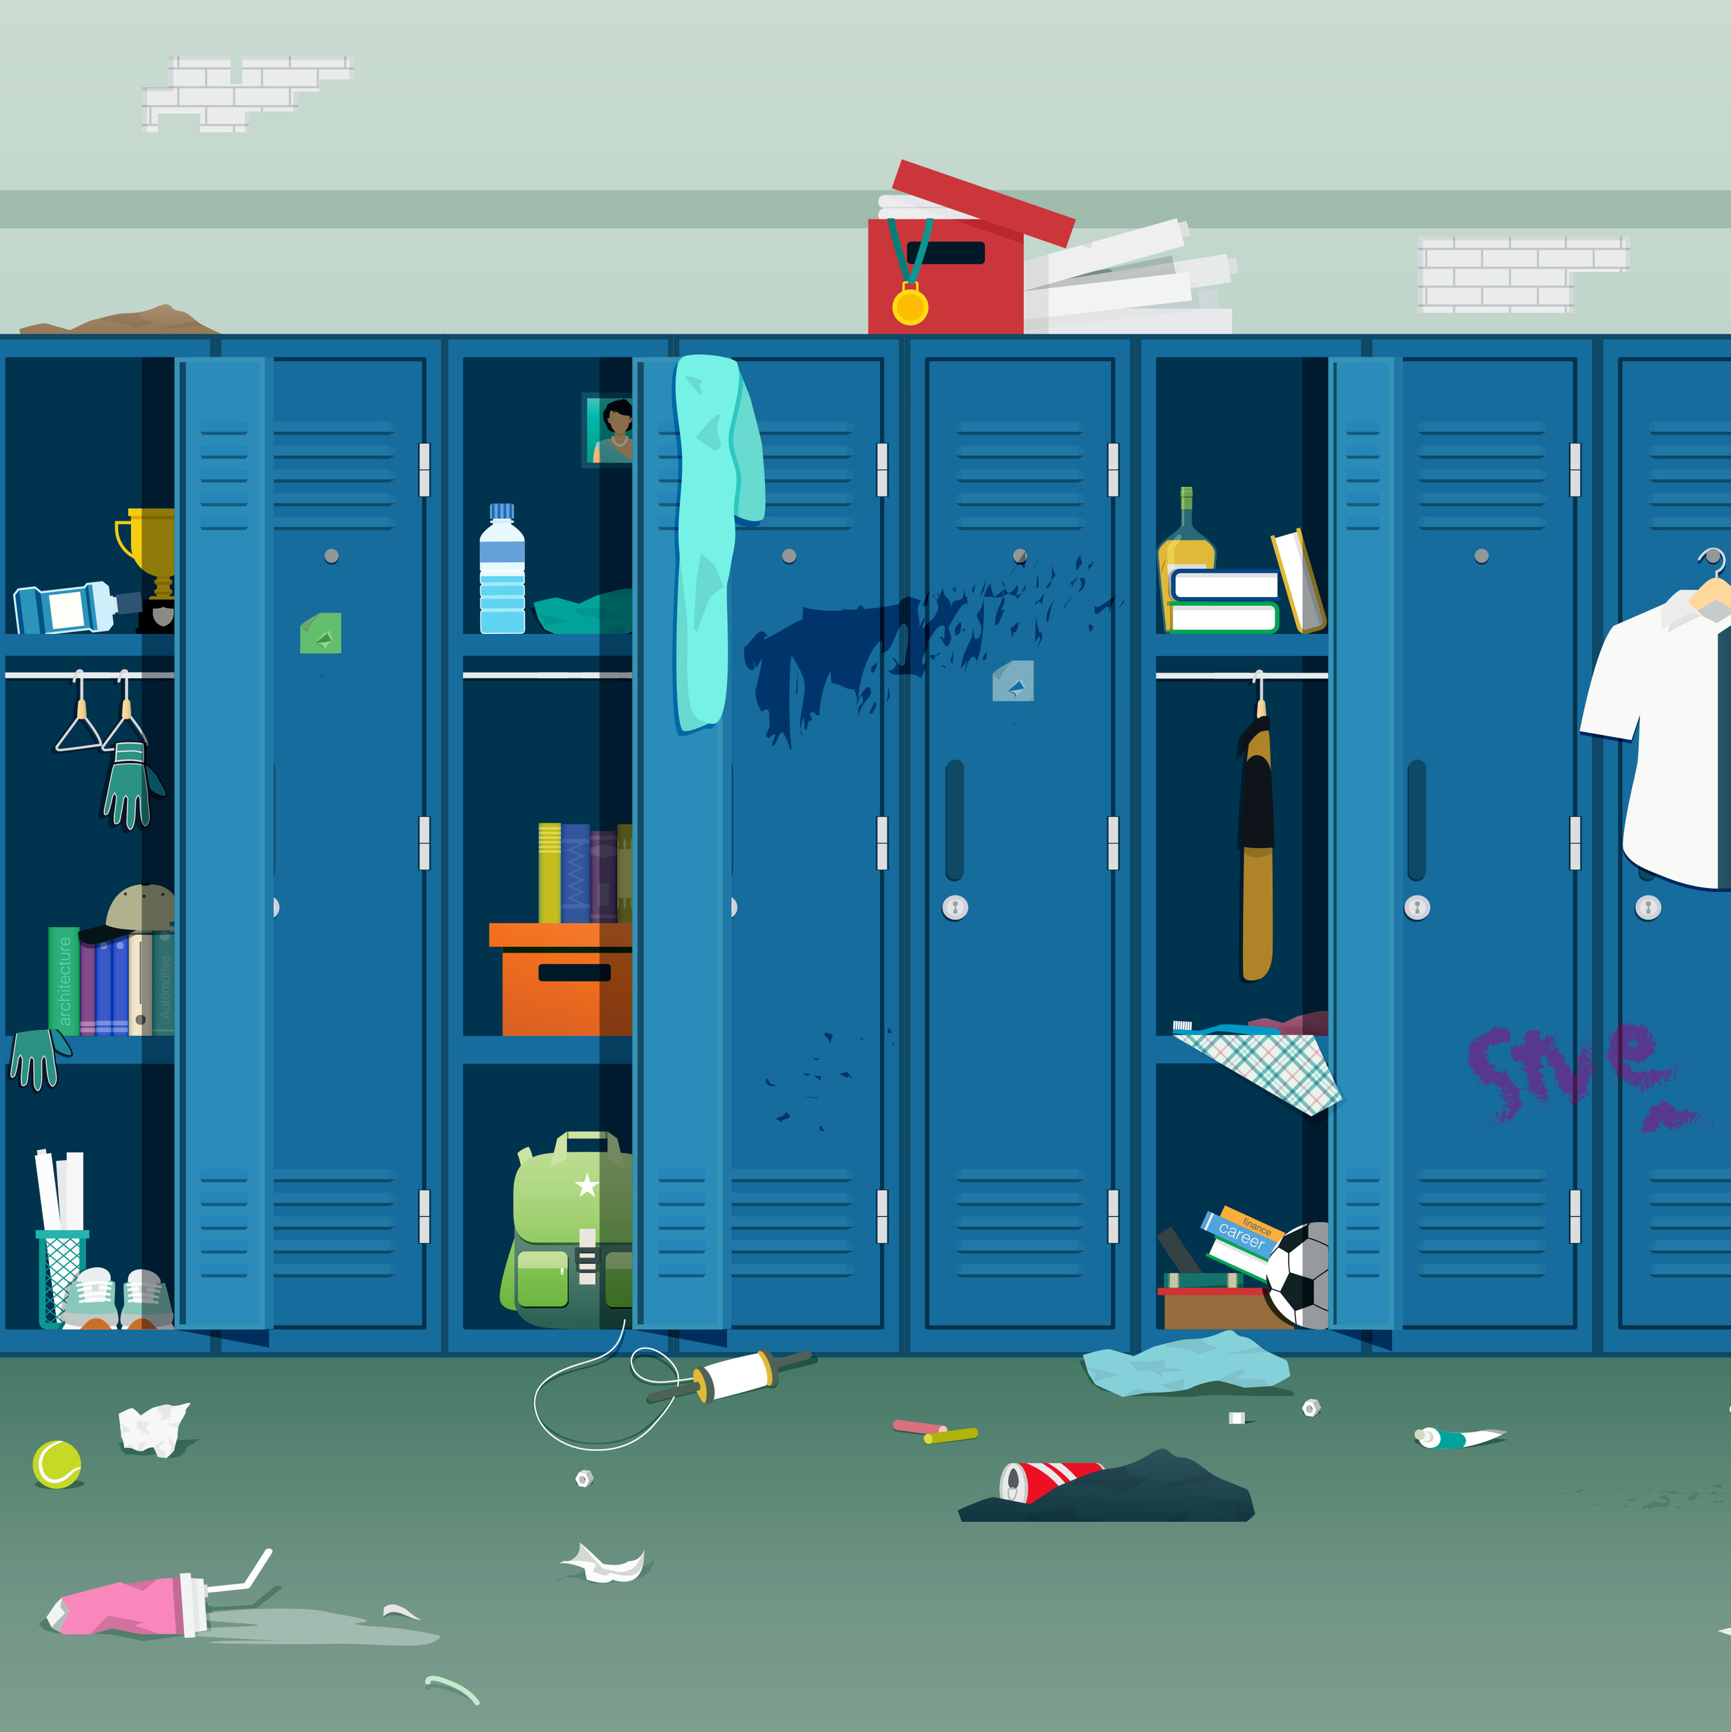
Scenario:
Video of an Act of Vandalism

Slide 16
Definition
Vandalism
Destruction or defacement of objects, generally works of art or objects in public spaces.
For example, damaging a bus shelter or writing graffiti on a wall is considered vandalism. Sometimes, vandalism is deemed a crime.
Notes:
NOTES FOR THE TEACHER
Read the definition of “vandalism,” also presented in the Student Workbook, p. X.

Slide 17
Definition
Hate crime or incident
A crime or a non-criminal incident motivated in part or in whole by hate or prejudice regarding:
race
national or ethnic origin
religion
sex
sexual orientation
gender identity or expression
etc.
Notes:
NOTES FOR THE TEACHER
Read the definition of "hate crime or incident,” also presented in the Student Workbook, p. X.

Slide 18
Definition
Search
The act of inspecting a person or their personal belongings to look for evidence related to an offence or violation of rules.
Notes:
NOTES FOR THE TEACHER
Read the definition of “search,” also presented in the Student Workbook, p. X.

Slide 19
Video of an Act of Vandalism
Read the scenario in the workbook.
Debate question: Should the school administration have the right to search students’ cell phones?
Complete the reflection questions to prepare for the debate.
Notes:
NOTES FOR THE TEACHER
As a class, read the scenario in the Student Workbook, p. X.
Read the debate question.
Review the reflection questions with the students and give them time to answer.

Slide 20
Debate time!
Debate question:
Should the school administration have the right to search students’ cell phones?
Notes:
NOTES FOR THE TEACHER
Explain the steps in the debate and divide the students into 2 teams.
Suggested format:
The students are divided into 2 teams, each with a position to defend. The teams are seated facing each other.
The teacher gives one team the floor to present their argument. A stopwatch could be displayed.
The teacher then gives the floor to the other team. They can respond to the first team’s argument or present a new argument.
Continue the debate, alternating between the teams. Encourage the students to make connections with the ideas already mentioned. Ideally, a different student speaks each time a team takes the floor.
Give the students about 5 minutes to share their ideas with their team.
Start the debate!
About 5 minutes before the end of the debate, ask one student per team to summarize the main arguments supporting their team’s position.
Ask the students to write their final personal opinion following the debate in the Student Workbook, p. X. Their position does not have to be the same as the one taken during the debate. You could ask the students to vote by a show of hands to determine the majority position in the class.

Slide 21
What the law says
The school administration has the right to search students or their belongings.
There must be reasonable grounds to believe that:
a law or rule was broken, and
a search will prove it.
The search must be conducted in a reasonable manner.
Notes:
NOTES FOR THE TEACHER
Explain to the students what the law says (see complete explanation in the Teacher’s Guide).
Ask the students to write the key legal information in the Student Workbook, p. X.
As a class, share final impressions of the debate and/or the legal information.

Slide 22
What the law says: And cell phones?
Searching a phone is a serious invasion of a student’s privacy.
The school administration’s search of a cell phone must respect the same rules as other searches.
The search must be conducted with even greater prudence and restraint to be considered reasonable.
Notes:
NOTES FOR THE TEACHER
Explain to the students what the law says (complete explanation in the Teacher’s Guide).
Ask the students to write down the key legal information in the Student Workbook, p. X.
As a class, share final impressions of the debate and/or the legal aspects.

Slide 23


Slide 24
Other resources
Parlons droit​ (Let’s Talk Law)
La Commission des services juridiques​ (legal aid)
Tel-jeunes
Notes:
ADDITIONAL INTERESTING INFORMATION TO SHARE
There are many resources for students who want to learn more about their rights and obligations, or ask a lawyer a specific question. Here are just a few of them. This list is by no means exhaustive. If you have any ideas for new resources, please let your students know, and contact us so we can add them when we do our annual update.
- Parlons Droit (Let's Talk Law) is a service offered by the Young Bar Association of Montreal for 12 to 21-year-olds, allowing them to speak to a lawyer free of charge. This telephone service is available to all young Quebecers, regardless of geographic location. If students have legal questions about a personal situation, they can fill out a form on the Young Bar Association of Montreal website, and a volunteer lawyer will call them back within a week. https://ajbm.qc.ca/en/pour-la-population/services-offerts/parlons-droit-102
- The Commission des services juridiques is the organization responsible for Quebec legal aid. Legal aid enables people on low incomes to receive the services of a lawyer free of charge (or for a small fee) in certain situations. For more information: https://www.csj.qc.ca/commission-des-services-juridiques/lang/en
- Tel-jeunes is a free, confidential listening and referral service. Counsellors can be reached free of charge at any time, day or night. Tel-jeunes counsellors can provide resources and information to young people in many areas: bullying and violence, sexuality, family, work and school, etc. https://www.teljeunes.com/en 1-800-263-2266.

