Slide 1

Discrimination at School?
Reflection on Discrimination and Reasonable Accommodations
Notes:
NOTES FOR THE TEACHER
This PowerPoint presentation is intended to be used in conjunction with the “Discrimination at School?” activity.
The notes section of several slides include “NOTES FOR THE TEACHER," which provide specific information for the activity.
You can print the notes to help with the facilitation of the activity.
© Éducaloi, 2024

Slide 2

Scenario
The law firm you work for opened two years ago. The firm has always been very interested in questions of discrimination and reasonable accommodations in Quebec schools. You have been mandated on several occasions to take part in mediation sessions to help parents and school administrators find solutions to different conflicts. Mediation is a process that tries to help two sides to a disagreement find a solution without going to court.
Today, you got a request to accompany parents in a mediation session. They believe their children have been victims of discrimination. You have to do some preparation to represent your clients’ interests. For the moment, you only have part of the information about the file. The rest of the information will be given to you soon.
Notes:
NOTES FOR THE TEACHER
Read the scenario in the Student Workbook with the students.
This scenario will serve as a guiding framework for the learning activities throughout the LES.

Slide 3

Here is the information you have for now:
Scenario
  Your clients are parents who believe that their children have been victims of discrimination at school. They want to ask the school to accommodate their children to ensure that their children’s rights are respected.
  The school refuses to grant this accommodation request.
Will you be able to successfully present your clients’ point of view and defend their rights?

Slide 4

A few things to think about…
Notes:
NOTES FOR THE TEACHER
Individually or in teams, the students will answer the following questions on pages 5 and 6 of their Student Workbook BEFORE continuing the PowerPoint presentation.
What is discrimination?
What is a reasonable accommodation?
Is it true that accommodation measures are always related to religious issues? Are there other reasons for accommodation measures?
What are the main features of the mediation process?
The students will then share their answers during a class discussion. This discussion will encourage the students to reflect on their personal answers before seeing the answers on the upcoming slides.

Slide 5
What is discrimination?
Depriving a person of their rights or access to the same services as others
Based on personal characteristics
(recognized by the Charters as prohibited grounds of discrimination)
Direct discrimination
Indirect discrimination
VS
Notes:
NOTES FOR THE TEACHER
Following the class discussion, click to display the different elements of the answer.
What is discrimination?
Discrimination refers to not respecting someone’s right to equality. Discrimination happens when someone is prevented from
enjoying the same rights and services as other people
because of a personal characteristic mentioned in the Charters. These characteristics are prohibited grounds of discrimination. They include characteristics such as religion, ethnic origins or a disability.
Discrimination can be direct when someone is deprived of their rights based on a prohibited ground of discrimination. Discrimination can also be indirect. Indirect discrimination happens when a rule that seems fair (applies to everyone in the same way) has the effect of discriminating against some people.

Slide 6
What is a reasonable accommodation?
Adapting a situation so that a person can have the same rights as others despite their differences.
Reasonable =
Notes:
NOTES FOR THE TEACHER
Following the class discussion, click to display the different elements of the answer.
What is a reasonable accommodation?
It means accommodating someone by adapting a situation, making changes to help someone enjoy the same rights as others, even if they have a personal characteristic that is different from others.
“Reasonable” means that the adaptation or change shouldn’t impose undue hardship (excessive burdens) on the organization being asked to adapt. In particular, the accommodation cannot:
be too expensive for the organization,
interfere with the proper operation of the organization, or,
violate the rights or jeopardize the safety of other people.
If a request for accommodation is related to religion, additional rules apply. For example, the accommodation must not impose more than minimal hardship on the organization and must respect gender equality.
It’s also interesting to note that, if a person decides they don’t need any particular accommodation measure, there is no issue to work out. Everything depends on how the person feels about the situation!

Slide 7



Is it true that accommodation measures are always related to religious issues? Are there other reasons for accommodation measures ?
NO
Notes:
NOTES FOR THE TEACHER
Following the class discussion, click to display the different elements of the answer and images showing reasons for accommodation measures.
Is it true that accommodation measures are always related to religious issues?
Reasonable accommodations are not always related to religious issues. They can be requested in many situations.
Are there other reasons for accommodation measures?
Other than religion, other reasons for accommodation measures include:
Pregnancy
A disability
A medical condition

Slide 8

What are the main features of the mediation process?
The parties work together instead of against each other.
The mediator helps the parties negotiate.
Notes:
NOTES FOR THE TEACHER
Following the class discussion, click to display the different elements of the answer.
What are the main features of the mediation process?
The people involved in the conflict try to work together to find a solution that suits everyone.
The mediator, who can be a lawyer or not, helps the people negotiate (unlike a judge who has to impose a decision on the people involved in the conflict).
Not all conflicts end up before the courts: if the people involved can reach a solution on their own or with the help of a mediator, the issue is solved!

Slide 9




Presentation of the assignment
The mediation session will take place in a few days. Time to get to work!
Notes:
NOTES FOR THE TEACHER
Present the different stages of the upcoming assignment to the students. There is one image per stage.
Review the various protections under the Canadian and Quebec Charters.
Make sure you have a good understanding of how the Charters define discrimination, and of the principles of reasonable accommodations. As a lawyer, you must clearly explain why your clients have the right to an accommodation measure and why the proposed measure is reasonable.
Next, you will be asked to study similar cases that have been presented in court and review the decisions that were made in these cases.
Your group must bring the following documents to the mediation session:
The Legal Analysis Framework table that will help you dertemine whether your clients have a right to an accommodation measure. As a lawyer, you must ensure your clients’ request is legitimate before prensenting it.
A case study based on the perspectives of the various people involved and the values at stake. You will be asked to evaluate the possible impacts of accepting or refusing the accommodation measure request, both on the people directly involved and on society as a whole.

Slide 10

Discrimination at school?
  The Charters
    The Canadian Charter
    The Quebec Charter
  Discrimination
    Direct discrimination
    Indirect discrimination
Notes:
NOTES FOR THE TEACHER
Click to display the different elements of the answer.

Slide 11

The Charters:
Instruments for protecting fundamental rights and freedoms

Slide 12
What is a charter?
It’s a text that guarantees certain human rights and freedoms.
In Quebec, there are two charters that protect our rights:
  Canadian Charter of Rights and Freedoms (Canadian Charter)​
  Charter of Human Rights and Freedoms (Quebec Charter)
Notes:
NOTES FOR THE TEACHER
Present the theory on the Charters to the students.
Click to display the different elements of the answer.
SOURCES
Canadian Charter of Rights and Freedoms, art 1, part I of Constitution Act of 1982, constituting Schedule B of the Canada Act 1982 (UK), 1982, c 11 [hereinafter Canadian Charter]
Charter of Human Rights and Freedoms, RLRQ c C-12, preamble [hereinafter Quebec Charter].

Slide 13


Some differences between the Charters...
  Passed into law in 1982.
  Protects the rights of indigenous people.
  Protects rights regarding the use of French and English
  Passed into law in 1975.
  Provides a more explicit protection of privacy rights than the Canadian Charter.
  Protects economic and social rights (e.g., free public education and fair working conditions).
Notes:
NOTES FOR THE TEACHER
Click to display the different elements of the answer.
SOURCES
Canadian Charter, art 16-23, 25, 35.
Quebec Charter, art 4-9, 39-48.

Slide 14

Similarities between the Charters...
Some rights protected by both Charters:
  Right to life, liberty and security
  Freedom of expression
  Freedom of religion
  Right to counsel (right to a lawyer)
  Right to be tried within a reasonable time
  Right to be secure against unreasonable search or seizure
  Right to equality and freedom from discrimination
Notes:
NOTES FOR THE TEACHER
Click to display the different elements of the answer.
SOURCES
Canadian Charter, art 2, 6, 7, 8, 10b), 11b), 15
Quebec Charter, 1, 3, 10, 24.1, 29, 32.1

Slide 15

Who must respect the Charters?
Canadian and Quebec laws
But not only our laws...
The government.
Notes:
NOTES FOR THE TEACHER
Click to display the different elements of the answer.
Our laws must respect the Charters.
All the laws adopted in Canada (including those adopted in Quebec) must respect the Canadian Charter.
On the other hand, only Quebec laws must respect the Quebec Charter.
But not only our laws...
The federal and provincial governments must uphold the fundamental rights and freedoms protected by the Canadian Charter. The governements can be sued for violations of this Charter.
In contrast, the government of Quebec is not the only one that must respect the Quebec Charter. Individuals, businesses, private schools, and many others must also respect the Quebec Charter.
SOURCES
Canadian Charter, art 24(1), 32(1), 52(1).
Quebec Charter, art 49, 52, 54, 55.
Godbout c. Longueuil (Ville), [1997] 3 RCS 844, para 93.
SDGMR c. Dolphin Delivery Ltd, [1986] 2 RCS 573, paras 33-34.
Christian Brunelle, Les domaines d’application des Chartes des droits, Collection de droit 2016-2017, vol 7, tit I, ch III at pp 35-39.

Slide 16
Activity 1
The Charters
Notes:
NOTES FOR THE TEACHER
Now that the theory on the Charters has been presented to the students, ask them to answer the questions on page 8 (Activity 1) of their student workbooks.
The following slides present the answers to each of the questions.

Slide 17
What is a charter?
It’s a text that guarantees certain human rights and freedoms.
Charters set standards for other laws. This means that other laws must respect charters.
Notes:
NOTES FOR THE TEACHER
Ask the students what they answered in their workbooks before presenting the answer.
Click to display the different elements of the answer.

Slide 18
Who must respect the Canadian and Quebec Charters of rights and freedoms?
Canadian Charter: the federal and provincial governments.
Quebec Charter: individuals in Quebec, the Quebec government and non-governmental organizations (businesses, private schools, etc.).
Notes:
NOTES FOR THE TEACHER
Ask the students what they answered in their workbooks before presenting the answer.
Click to display the different elements of the answer.

Slide 19
Name two grounds of discrimination prohibited by the Quebec Charter.
  Age (except as provided by law)
  Ethnic or national origins
  Disability or an aid to cope with a disability
  Civil status (e.g. married, single, divorced)
  Pregnancy
  Political beliefs
  Social status (rich, poor, etc.)
  Language
  Religion
  Race
  Colour
  Sex
  Sexual orientation
  Gender identity or expression
Notes:
NOTES FOR THE TEACHER
Ask the students what they answered in their workbooks before presenting the answer.
Click to display the different elements of the answer.

Slide 20
Identify one difference between the Canadian and the Quebec Charters.
The Canadian Charter protects
  The rights of indigenous people,
  Rights regarding the use of French and English.
The Quebec Charter has
  More explicit protection for privacy rights,
  Protection for economic and social rights (e.g., free public education and fair working conditions).
Notes:
NOTES FOR THE TEACHER
Ask the students what they answered in their workbooks before presenting the answer.
Click to display the different elements of the answer.

Slide 21

Are there any additional grounds of discrimination that the Charters should address?
Dialogue
SCENARIO
At your summer camp, there is only one meal choice today: meat loaf! As a vegetarian, you’re not happy. You think eating meat is bad for the environment and bad for your health.
Unfortunately for you, vegetarianism is not one of the grounds of discrimination mentioned in the Quebec Charter. This means it is not a type of discrimination that is against the law.
Notes:
NOTES FOR THE TEACHER
Ask the students if they believe that the Charters are incomplete. Are there any additional grounds of discrimination that they should address?
Click to display a scenario on summer camps.
Read the scenario with the students. One student can read the scenario aloud.
Ask the students the following questions about the scenario:
Despite what the law and the Charters provide, do you think this situation is unjust? Why or why not?
Yes: just because it’s legal doesn’t mean it’s fair.
Yes: when we guarantee rights, we should do it in a very complete way, so we can avoid situations like this.
No: the camper should have checked the menu before signing up for this camp.
No: the government knew what it was doing when it limited the kinds of rights protected by the Charters.
Could vegetarianism fall under another ground of discrimination prohibited by the Quebec Charter? If so, which one (or which ones)?
Some Hindus don’t eat meat for religious reasons (religion).
Some people can’t eat meat due to illness (disability).
A vegetarian who advocates for the protection of animals (political beliefs).
(These examples don’t necessarily reflect what the law currently says.)
In your opinion, should vegetarianism be considered a prohibited ground of discrimination under the Quebec Charter?
Yes: there is a lot of prejudice against vegetarianism and we need to fight this prejudice.
Yes: we should respect everyone’s choices and differences, even if this makes the Charter more complex.
No: for the most part, vegetarians are not victims of prejudices or stereotyping.
No: this would open the door to more and more grounds of possible discrimination. The Charter would become so complicated that it would be ineffective.
Can you think of other grounds of discrimination that should be prohibited?
Clothing choices, hair colour, etc.
A person’s physique (height, weight)
Tastes in music
Food preferences

Slide 22
Discrimination…
Refers to not respecting someone’s right to equality,
  preventing this person from benefiting from the same rights or access to the same services as others
  because of a personal characteristic mentioned in the Charters. These characteristics are prohibited grounds of discrimination.
Notes:
NOTES FOR THE TEACHER
Present the theory on discrimination to the students.
Click to display the different elements of the answer.
Discrimination is: not respecting another person's right to equality.
Preventing this person from benefiting from the same rights or access to the same services as others.
Because of a personal characteristic mentioned in the Charters. These characteristics are prohibited grounds of discrimination.
religion
disability
ethnic or national origin
etc.
Can you name other grounds of discrimination prohibited by the Charters?
SOURCES
Canadian Charter, art 15(1).
Quebec Charter, art 10.
Andrews c. Law Society of British Columbia, [1989] 1 RCS 143 at pp 174-175.
Christian Brunelle, Les domaines d’application des Chartes des droits, Collection de droit 2016-2017, vol 7, tit I, ch III at pp 64-67.

Slide 23

Some prohibited grounds for discrimination:
  Social status
  Sexual orientation
  Political beliefs
  Skin colour
  Pregnancy
  Sex
  Civil status
  Disability
  Religion
  Language
Notes:
NOTES FOR THE TEACHER
Click to display the different elements.
SOURCES
Canadian Charter, art 15(1).
Quebec Charter, art 10.

Slide 24
Direct discrimination
It’s when a rule or a decision deliberately deprives specific individuals of a right.
​Example: A school board decides to not admit people of colour​
​
​
The rule is invalid and prohibited by the Charters.
​This type of rule constitute direct discrimination, as it prevents some people from attending the school like everyone else.
​
Notes:
NOTES FOR THE TEACHER
Click to display the different elements.
SOURCES
Ont. Human Rights Comm. v. Simpsons-Sears, 1985 CanLII 18 (SCC), [1985] 2 SCR 536 at 55 and following.
Christian Brunelle, Les domaines d’application des Chartes des droits, Collection de droit 2016-2017, vol 7, tit I, ch III at pp 64-67..

Slide 25
Indirect discrimination
It’s when a rule or a decision directed at everyone prevents some people from exercising their rights like everyone else.
​Example: A school board decides that no animals can be in its schools. ​
​
​
The rule is valid, but an exception (accommodation) must be considered.
This type of rule indirectly prevents people with guide dogs or other services animals from attending school like everyone else. ​
​
Notes:
NOTES FOR THE TEACHER
Click to display the different elements.
SOURCES
Ont. Human Rights Comm. v. Simpsons-Sears, 1985 CanLII 18 (SCC), [1985] 2 SCR 536 at 551 and following.
Christian Brunelle, Les domaines d’application des Chartes des droits, Collection de droit 2016-2017, vol 7, tit I, ch III at pp 64-67.

Slide 26
Activity 2
The right to equality and freedom from discrimination
Notes:
NOTES FOR THE TEACHER
Now that the theory on discrimination has been presented to the students, ask them to answer the questions on page 14 (Activity 2) of their student workbooks.

Slide 27
In your own words, what is discrimination?
Do you think that discrimination is the same thing as intolerance? Explain.
Notes:
NOTES FOR THE TEACHER
Ask the students what they answered in their workbooks before presenting the answer.
Click to display the different elements of the answer.
In your own words, what is discrimination?
Possible answer: It means treating someone differently and removing some of that person’s rights or preventing that person from enjoying the same rights as other people.
Do you think that discrimination is the same thing as intolerance? Explain.
Yes: It means treating someone differently and removing some of that person’s rights or preventing that person from enjoying the same rights as other people.
Yes: Being intolerant means treating others with a lack of respect because you don’t agree with their values. Intolerance is therefore a kind of discrimination.
No: Sometimes people discriminate without realizing it. The best example of this is indirect discrimination.
No: It is possible to be intolerant without discriminating. For example, you might not like another religion, but still respect the people who practice it.
These examples are for reflection purposes and do not necessarily reflect the state of the law.

Slide 28

Activity 3
What is a reasonable accommodation?
Notes:
NOTES FOR THE TEACHER
Present the theory on reasonable accommodations to the students. The students can follow along in their workbooks on page 15.

Slide 29
Reasonable accommodation:
Who? Why? When?
The idea is to create an exception in favour of one person, so that the person can enjoy the same rights and access the same services as everyone else.
  For a person who is a victim of indirect discrimination.
  For a person who requests it.
  A request that does not impose excessive burdens on the organization.
Notes:
NOTES FOR THE TEACHER
Present the theory of reasonable accommodations to students.
Click to display the different elements of the answer.
Ask the students to invent a situation or a request for accomodation that would not seem reasonable. (Student workbook page 15)
Reasonable accommodation: Who? Why? When?
The notion of reasonable accommodation comes from the right to be treated equally and without discrimination. Accommodation involves making an exception for some people so they can enjoy the same rights and services as others.
An accommodation measure should be granted if
someone makes a request,
that person is a victim of indirect discrimination,
and the accommodation does not impose excessive burdens on the organization being asked to accommodate. This is the “reasonable” aspect of the accommodation. It means that an accommodation measure must be granted unless
the cost is too high for the organization involved,
the measure would interfere with the proper operation of the organization, or,
the measure would significantly affect the safety or infringe the rights of other people.
If a request for accommodation is related to religion, additional rules apply. For example, the accommodation must not impose more than minimal hardship on the organization and must respect gender equality. The law doesn't define what "more than minimal” means. As a result, it's up to the courts to interpret this standard and apply it to each specific situation.
Also, you cannot request an accommodation to choose a person based on their gender. For example, you cannot insist on being served only by a man or only by a woman, except in certain specific situations, such as healthcare services or services that involve physical contact.

Slide 30

Activity 4
Exploring Real Court Cases
Notes:
NOTES FOR THE TEACHER
Choose the court cases you want to present to the students. It’s possible to analyze just one, or to do all of them.
Present the chosen court cases to the students and answer the questions as a group.

Slide 31
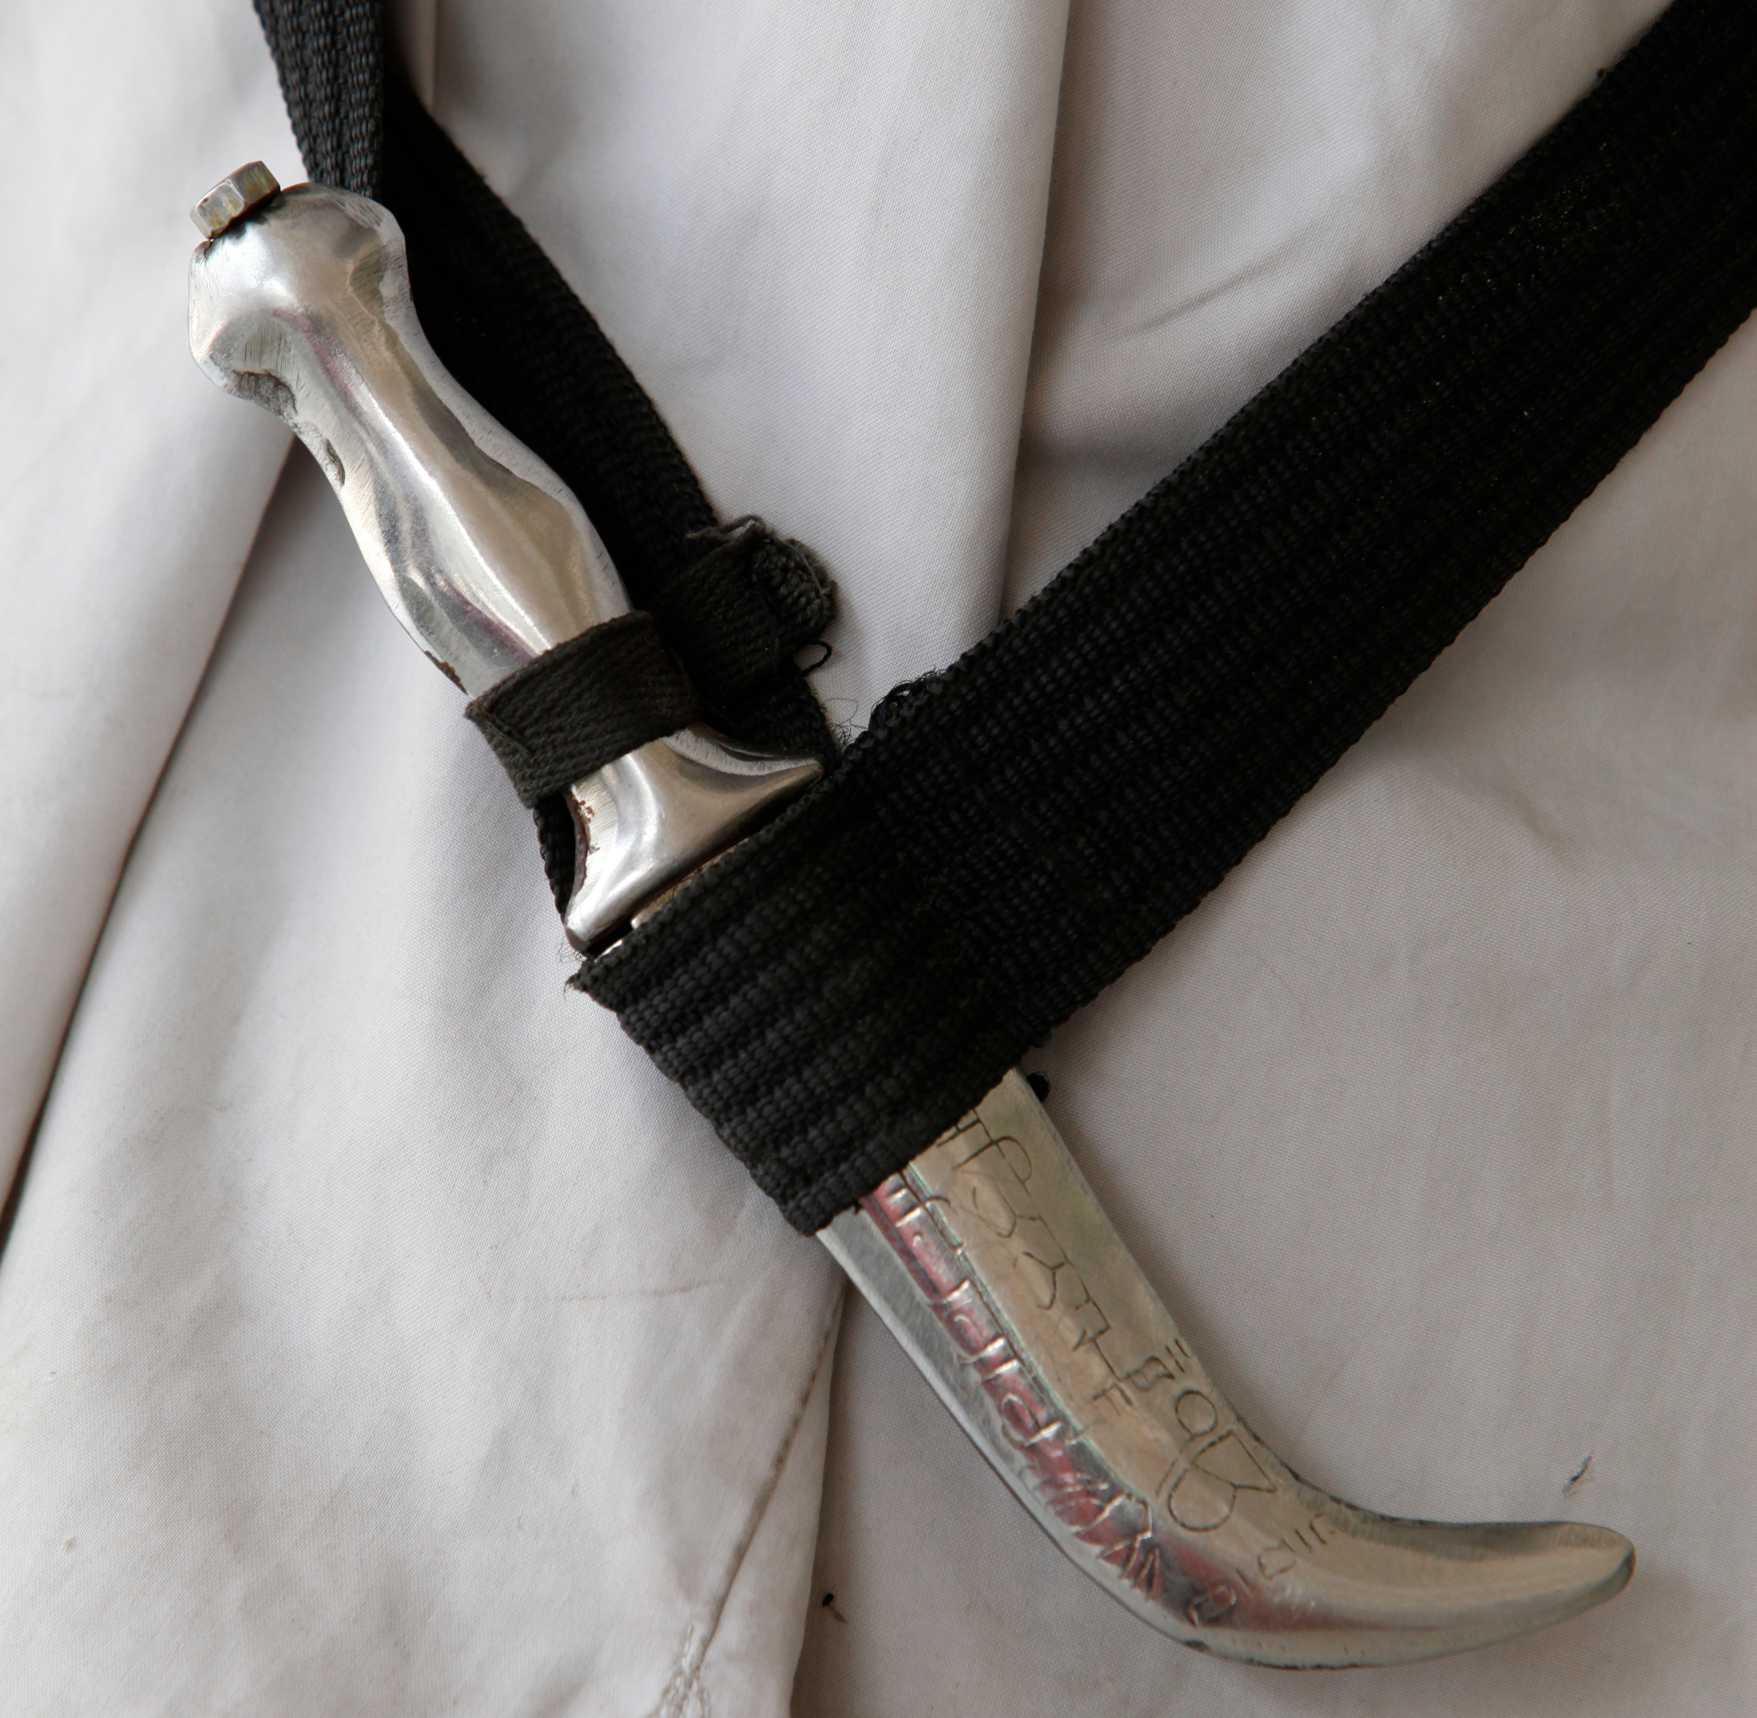
The Multani case
Summary of Multani v. Commission scolaire Marguerite-Bourgeoys, 2006 SCC 6.
The facts
Gurbaj was a high school student who was an orthodox Sikh. Gurbaj sincerely believed that his religion required him to wear a kirpan at all times, including at school. This object couldn’t be seen because it was hidden under his clothing. But one day, the kirpan accidentally fell out of his clothing in the school yard.
After this incident, the principal told Gurbaj he could not wear his kirpan at school. This reason was that the school’s Code of Conduct prohibited the carrying of weapons or dangerous objects at school. The school board, like the principal, refused to let Gurbaj bring his real kirpan to school. However, the board said that he could bring a symbolic kirpan that was not dangerous, for example, a plastic kirpan.
Gurbaj’s father did not agree with the school board’s proposal. He felt the decision infringed his son’s freedom of religion. Gurbaj’s father asked a court for a reasonable accommodation measure to allow his son to wear a real metal kirpan at school, one that would be sealed and sewn inside his clothing.
Notes:
NOTES FOR THE TEACHER
Present the court case to the students and answer the questions as a group.
The students can follow along in their workbooks on pages 16-17.

Slide 32
Identification of issues and questions for reflection
  Does this case involve direct or indirect discrimination? What is the prohibited ground of discrimination at issue?
  Should we ban all religious symbols in schools?
  In your opinion, what is a desirable level of safety at your school? Absolute safety (no scissors, compasses or hockey sticks), or a reasonable level of safety?
  Would the decision in the Multani case be the same in a place where there is a low tolerance for risk, for example, in airports?
Notes:
NOTES FOR THE TEACHER
Answer the question as a group. The students can follow along in their workbooks, pages 17-18.
Click to display the different questions.
Present the court’s decision in the chosen court case.
The answers to the questions can be found on pages 23-24 of the teaching guide.
The decision
The Supreme Court said that the rule in the Code of Conduct prohibiting the carrying of weapons was valid. It was meant to ensure the safety of students and applied in the same way to everyone. But the rule nevertheless had the effect of preventing Gurbaj from having access to the same services as other students. Why? Because Gurbaj sincerely believed that he couldn’t go to school without the metal kirpan required by his religion.
The court said that the school rules resulted in indirect discrimination that could be remedied by an accommodation measure.
After analysing the facts, the court notably concluded that the religious practice in question didn’t infringe the rights of other students or compromise their safety:
no cases of violence involving a kirpan in schools had been reported.
the goal of the school rule was to ensure a reasonable level of safety at school, not absolute safety.
allowing Gurbaj to wear his real metal kirpan under certain conditions allowed for a reasonable level of safety in the school.
The court decided in favor of Gurbaj. It overturned the decision of the school board and allowed Gurbaj, by way of an accommodation measure, to wear his real kirpan to school under certain conditions: the kirpan had to be in a wooden case and kept securely sealed under his clothes.

Slide 33
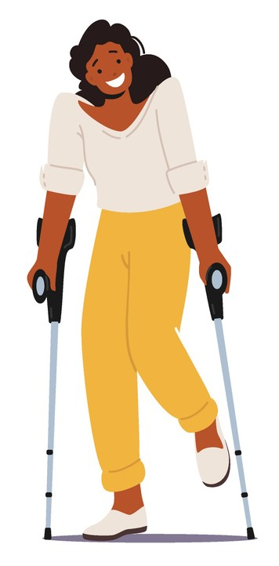
The Collège Notre-Dame case*​​
Summary of Commission des droits de la personne c. Collège Notre-Dame, 2001 CanLII 11763 (QC CA).
The facts
Maud was 11 years old. She suffered from a disability that reduced the mobility of her legs. Despite this, she could walk independently and even did some sports, such as swimming and skiing.
As she prepared for high school, Maud, like many of her friends, dreamed of attending Collège Notre-Dame. The school placed a strong emphasis on physical education. For example, the program included one hour of mandatory physical activity every day.
Maud attended the school’s open house and successfully completed the entry exams. However, despite passing the exams, her application was denied. The College said that her disability would prevent her from efficiently moving around the school and participating in the mandatory physical education classes.
Maud felt discriminated against due to her disability. The College didn’t even consider adapting its education program or school facilities to respond to her particular needs. Maud went to court to challenge Collège Notre-Dame’s decision.
Notes:
NOTES FOR THE TEACHER
Present the court case to the students and answer the questions as a group.
The students can follow along in their workbooks on pages 19-20.

Slide 34
Identification of issues and questions for reflection
  Does this case involve direct or indirect discrimination? What is the prohibited ground of discrimination at issue?
  The College didn’t offer to adapt its education program or facilities for Maud in response to her special needs. What happens when students are temporarily injured or sick? Should a school have to take special measures in those situations?
  In your opinion, if the College had a sports-study program aimed mainly at training high-level athletes, could it exclude students with physical disabilities? Explain your answer.
  According to the court, it was reasonable to require the College to adopt accommodation measures to help Maud move around the school and go about her regular activities. Can you think of some examples of accommodation measures that could be put into place?
  In your opinion, could this decision also apply in the case of a student who suffers from an intellectual disability? Explain your answer
Notes:
NOTES FOR THE TEACHER
Answer the question as a group. The students can follow along in their workbooks, pages 20-21.
Click to display the different questions.
Present the court’s decision in the chosen court case.
The answers to the questions can be found on pages 26-27 of the teaching guide.
The decision
The court recognized the importance that the College placed on physical education (e.g., mandatory physical education courses for all students). While acknowledging that this was a good policy, the court determined that it did not justify excluding all students with physical disabilities. The court found that the physical education program in question was not a specialized sports-study program. It also found that the College’s main objective was to offer a general high school education and not to train athletes.
The court concluded that Maud had been a victim of discrimination: the College’s refusal to admit her due to her disability prevented Maud from attending the school like other students.
According to the court, the physical abilities of each student should be assessed individually. If it did not impose an excessive burden on the school, the College had an obligation to offer accommodation measures tailored to the physical disabilities of a student.
The court found that Maud’s physical abilities let her meet the College’s educational goals. Integrating Maud into the school would not impose an excessive burden on the College. In particular, the court found that it would not be too expensive to adapt the school’s facilities to accommodate Maud. The College therefore had to admit Maud and to implement some accommodations measures (e.g., let her use the elevator) so she could move around the school and participate in the physical education classes.

Slide 35

The Marc Hall case*​​​
Summary of Hall (Litigation guardian of) v. Powers, 59 OR (3d) 423.
The facts
Marc Hall is a secondary V student at a Catholic school. The people close to him (parents, friends and classmates) know he’s gay.
When buying prom tickets, students must provide the name of the person who will be accompanying them for approval. The school needs this information so they’ll know who will be in attendance, have their contact information and prevent known troublemakers from attending. Marc gave his boyfriend’s name as his prom date.
The school principal refused Marc’s request to bring his boyfriend to prom. He believes that the interaction between romantic partners at prom is a form of sexual activity and that if Marc is allowed to attend prom with his boyfriend as a same-sex couple, this will be seen as approval and tolerance of behaviour that goes against the teachings of the Catholic church. The school’s policy is for teachers to apply its Catholic teachings and therefore refuse to allow students to bring a same-sex date to prom.
After the school board refused to overrule the principal’s decision, Marc and his father went to court and asked for the decision to be modified, arguing that the decision was discriminatory and based on Marc’s sexual orientation.
Notes:
NOTES FOR THE TEACHER
Present the court case to the students and answer the questions as a group.
The students can follow along in their workbooks on page 22.

Slide 36
Identification of issues and questions for reflection
  Does this case involve direct or indirect discrimination? What is the prohibited ground of discrimination at issue in this situation?
  In your opinion, what other measures could the school have taken to avoid inappropriate behaviour among students without discriminating against Marc?
  In your opinion, are there situations where schools could rely on a distinction, exclusion or preference based on a personal characteristic without it being a case of prohibited discrimination? Can you give an example.
Notes:
NOTES FOR THE TEACHER
Answer the question as a group. The students can follow along in their workbooks, page 23.
Click to display the different questions.
Present the court’s decision in the chosen court case.
The answers to the questions can be found on pages 29-30 of the teaching guide.
The decision
A public school board and its schools must respect the Canadian Charter, even if the policy of the Catholic school prohibits all students (and not just Marc) from bringing a same-sex date to prom. One of the objectives of the Charter is to ensure that human dignity is valued in a free society where differences among individuals are respected and equality is valued.
If people in Canada were simply allowed to argue that their religious beliefs required them to discriminate against gay people, without any objective examination, there would be no protection against discrimination for the LGBTQ+ community. Anyone wishing to discriminate against this community could use their religious beliefs to defend their actions.
The court therefore ruled that the principal’s decision discriminated against Marc. The principal’s decision was overruled and Marc was allowed to bring his boyfriend to prom.
The school could instead apply a rule about inappropriate behaviour that would apply fairly to all students without distinction based on their sexual orientation.

Slide 37

The L’Escale High School case*​​​
Summary of Guay v. École secondaire de l'Escale d'Asbestos, 2012 QCCS 4530.
The facts
In 2012-2013, the governing board of L’Escale High School implemented a “half-uniform” policy, requiring students to wear a polo shirt in school colours with an embroidered logo.
Some parents contacted the governing board and the school to request that the new rule be withdrawn. They argued that the policy infringed on students’ “right to education, the right to free school services, the right to equality and the right to attend the school of their choice.” They believed that imposing a half-uniform was discriminatory based on social condition and that the governing board’s decision to require students to wear a polo shirt was illegal. The school board refused to get involved, and the school wouldn’t reverse its decision. The rule was therefore included in the school’s new code of conduct and distributed to parents at the beginning of the school year. In a communication to parents, the school stated that measures would be taken to help low-income families.
During the first two weeks of the school year, approximately 30 students didn’t wear the required polo shirt “for multiple reasons.” The school lent polo shirts to about 20 students who agreed to wear them, but the students who refused to wear them weren’t allowed to attend class. Certain parents and students then brought the case to court.
Notes:
NOTES FOR THE TEACHER
Present the court case to the students and answer the questions as a group.
The students can follow along in their workbooks on page 24.

Slide 38
Identification of issues and questions for reflection
  Does this case involve direct or indirect discrimination? What is the prohibited ground of discrimination at issue?
  In your opinion, would wearing a half-uniform at school eliminate bullying and the rejection of certain students?
  ​
  Are you generally for or against school uniforms? Explain your answer.
Notes:
NOTES FOR THE TEACHER
Answer the question as a group. The students can follow along in their workbooks, page 25.
Click to display the different questions.
Present the court’s decision in the chosen court case.
The answers to the questions can be found on pages 32-33 of the teaching guide.
The decision
The parents argued that their region is in a socio-economically disadvantaged area, and this point wasn’t contested. In order to fully respect to the right to free public education for all students, the school board and the school have the duty to provide reasonable accommodations. The court determined that the lending of polo shirts could be considered discriminatory and harmful to students in two situations: if the polo shirt doesn’t fit a student properly or if a student’s specific situation hasn’t been carefully considered.
The court accepted the school’s argument that having students wear polo shirts would help with discipline, foster inclusion regardless of the clothes students wear as well as limit bullying and the rejection of students who can’t afford the latest fashion trends. However, this objective wasn’t reached in the two situations described above. As a result, there was discrimination, the right to equality was violated and irreparable harm was caused to students who weren’t allowed to attend class unless they agreed to wear a polo shirt that did not fit them properly or wasn’t adapted to their specific situation. The court therefore ordered the school to adapt its accommodation measures for the half-uniform policy to account for each student’s size and individual circumstances.
Example of a specific situation that would lead to discrimination if the proposed accommodation measure was applied: A child born with a malformation of the forearm, with one arm that is shorter than the other.

Slide 39

Activity 5
Case Study
Notes:
NOTES FOR THE TEACHER
Present the different steps of the activity to the students.
Step 1: Divide students into teams and assign each team a case. Ask the teams to summarize the case using their own words and to identify at least two issues.
Step 2: Ask students to complete the “Legal Analysis Framework” to help them determine whether the case involves indirect discrimination that could be resolved through reasonable accommodations.
Note: It’s possible that students will say they would refuse an accommodation measure out of concern for potential future requests of the same nature. This type of reasoning should not be accepted.
Step 3 (optional integration activity): Ask students to complete the “Presentation and Summary of [character name]’s Case: Issues and Effects on Coexistence”. Students will use this document and the Legal Analysis Framework to prepare a short presentation of the case study assigned to them and the requested accommodation measure. They must also clearly explain the different points of view and moral issues and norms involved in the case.
Following the presentations, ask the students to answer the final reflection questions on reasonable accommodations.

Slide 40
The Cases
Joël
Sarah
Jessie
Sasha
Samia
Martin
Lily
Charles

Slide 41
Step 1 – The context
  Briefly present the facts of the case in your own words.
  Identify at least two ethical issues at stake.
Notes:
NOTES FOR THE TEACHER
Student workbook, page 30.
Step 1: Place the students in groups of your choice. Ask them to briefly describe the situation in their own words by identifying at least two ethical issues.

Slide 42
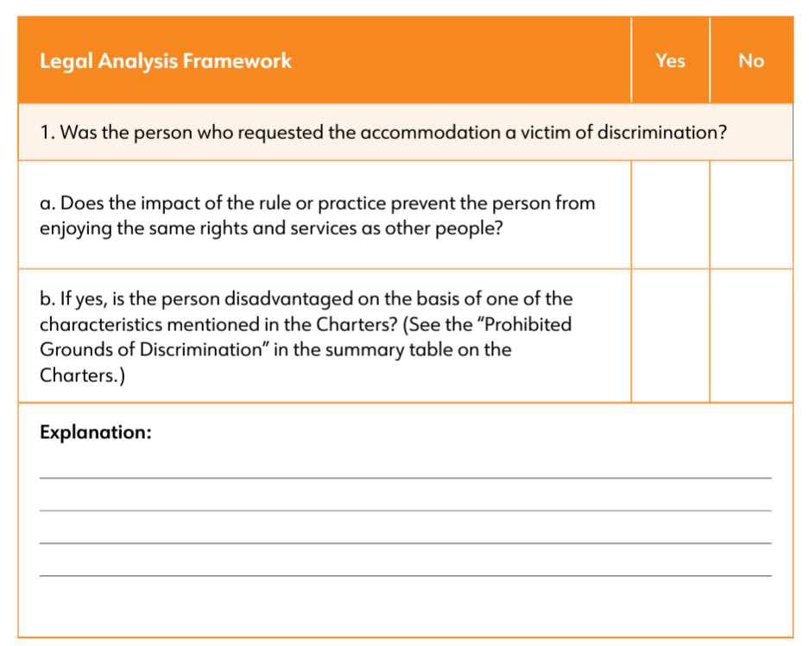
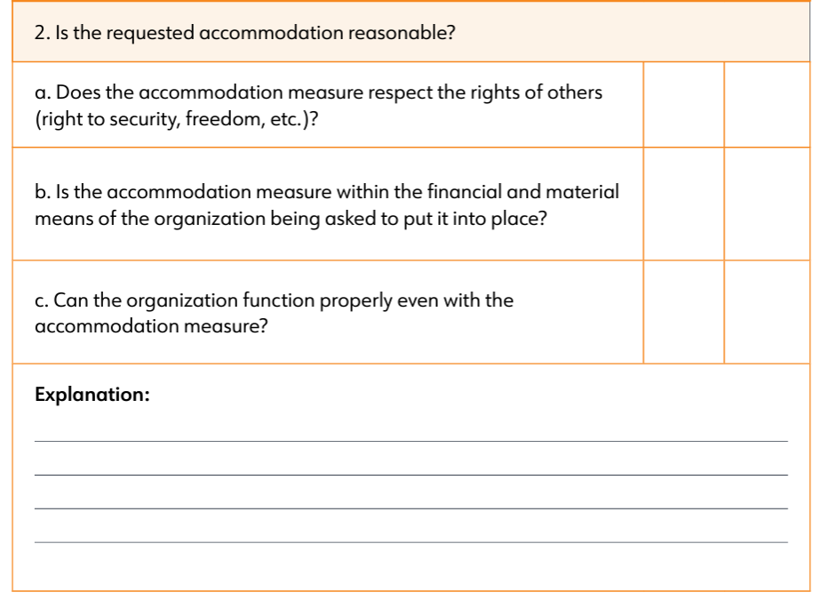
Step 2 – Is the requested accommodation reasonable?
Notes:
NOTES FOR THE TEACHER
Student workbook, pages 30-31.
Step 2 : Ask students to complete the “Legal Analysis Framework” to help them determine whether the case involves indirect discrimination that could be resolved through reasonable accommodations.

Slide 43
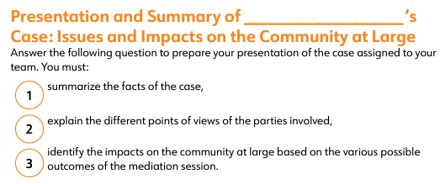
Step 3 – Integration activity
Notes:
NOTES FOR THE TEACHER
Student workbook, page 33.
Step 3: Ask students to complete the “Presentation and Summary of [character name]’s Case: Issues and Effects on Coexistence”.
Allocate time for each team to present its case study to the rest of the class. The groups must clearly explain the different points of view and moral issues and norms involved. To prepare for this activity, students can use the worksheets they completed during the case study. This activity can take place as a round table, with each team acting as an expert on its case of discrimination.
Following the presentations, ask the students to answer the final reflection questions on reasonable accommodations.

Slide 44


Slide 45


