Slide 1
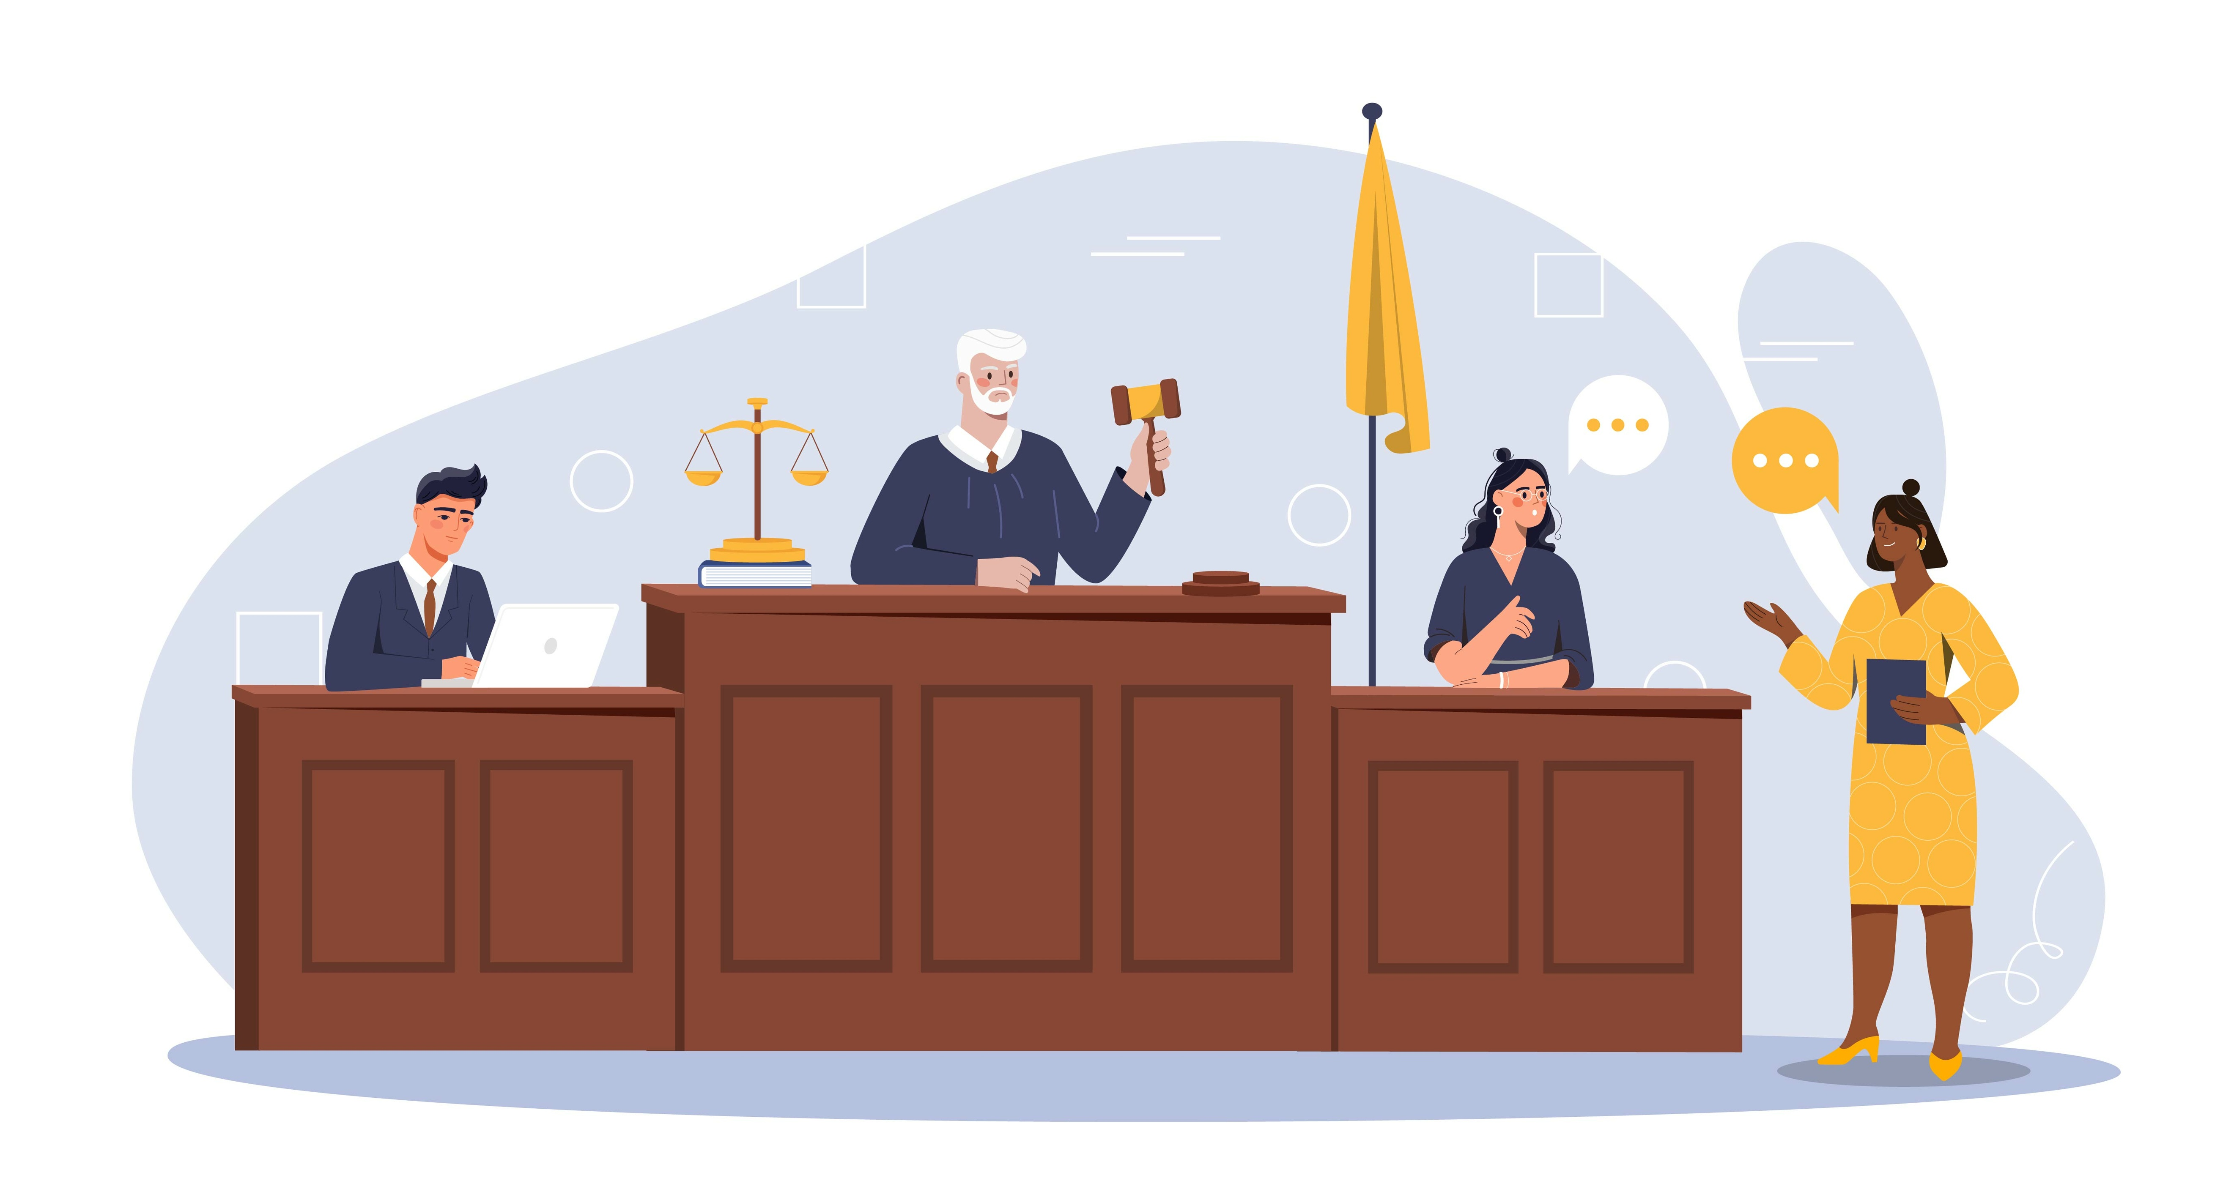
Under the Spotlight:
Witness Examination and
Cross-Examination
Notes:
NOTES FOR THE TEACHER
This PowerPoint presentation is part of the support material for the Under the Spotlight: Witness Examination and Cross-Examination activity.
The suggested exercises are ready-to-use suggestions to stimulate your students' participation.
In the notes on each slide, you'll find a section “NOTES FOR THE TEACHER”. This section addresses any special information required for the exercise.
​
The law changes. The information in this presentation is up to date to August 2024.

Slide 2
Introduction
During this activity, you will:
Learn about basic principles of criminal law.
Explore a hypothetical scenario.
Draft relevant questions for a trial.
Play different roles in a mock trial.
Analyze evidence to reach a verdict.
Notes:
NOTES FOR THE TEACHER
Explain the outline of the upcoming activity.

Slide 3
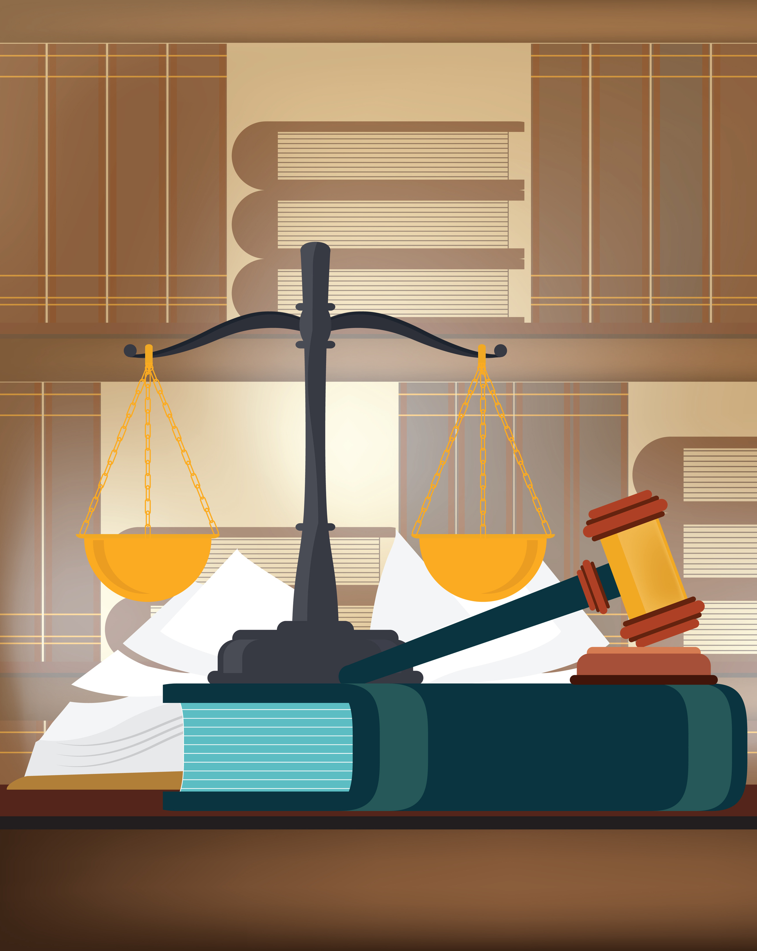
Criminal Law
What is it?
Rules that serve to protect the public against harmful conduct and to preserve the shared values of society.
Where can we find the rules?
Most of the rules are found in the Criminal Code, but there are rules in other laws.
Who brings the case to court?
The State initiates legal action against the person accused of a crime.
Notes:
NOTES FOR THE TEACHER
Read the slide. It summarizes the contents of the Student Workbook, p.6.
INFORMATION FOR STUDENTS
“The State initiates legal action”: A few clarifications…
The criminal and penal prosecuting attorney, sometimes called the “Crown prosecutor”, the “Crown”, the “prosecutor” or the “Prosecution”, is the lawyer who represents the government and brings the case to court against the accused in a criminal trial. In this activity, we’ll be calling them the “Prosecution”.
So it's not the victim who sues the accused. Nor is there always a “victim” in a criminal trial. For example, there is generally no direct victim for drug-related offences (production, possession, trafficking, etc.).
SOURCES
Code criminel, L.R.C. (1985), ch. C-46, art. 2.
Loi sur le Directeur des poursuites criminelles et pénales, L.R.Q., c. D-9.1.1, art. 1.
Reid, Hubert, Dictionnaire de droit québécois et canadien, 4e éd, Wilson & Lafleur, 2010, p. 218.

Slide 4
A Few Basic Principles of Criminal Law in Canada

Slide 5
The Presumption of Innocence
The accused is presumed innocent until proven guilty.
It’s up to the Prosecution to prove that the accused is guilty.
The accused doesn’t have to prove that they’re innocent. They have the right to defend themselves in court, but have no obligation to do so.
Notes:
NOTES FOR THE TEACHER
Read the slide. It summarizes the contents of the Student Workbook, p. 6.
INFORMATION FOR STUDENTS
This presumption of innocence means that the accused is officially innocent as long as proof of their guilt has not been shown in court.
Why? Because the consequences of a conviction, of being found guilty, are very serious.
For example, someone who is accused of a crime and found guilty could face heavy fines or imprisonment. They will also have to face the consequences of having a criminal record and being perceived as a criminal. We must therefore be certain of their guilt before declaring them guilty in court.
* To learn more on this subject, see Éducaloi’s article: Rights of a Person Accused of a Crime (https://educaloi.qc.ca/en/capsules/rights-of-a-person-accused-of-a-crime/)
SOURCES
Loi constitutionnelle de 1982, Annexe B de la Loi de 1982 sur le Canada (R-U), 1982, c 11, (Charte canadienne des droits et libertés) <http://canlii.ca/t/q3x8> art. 11 d).
R c. Oakes (1986) 1 RCS 103 aux para 27-32, EYB 1986-67556
Collection de Droit 2015-2016, Volume 11, Preuve et procédure pénale, Chapitre VII, p. 116-117

Slide 6
Beyond a Reasonable Doubt
The Prosecution must prove that the accused is guilty beyond a reasonable doubt.
If the judge or jury have a reasonable doubt that the accused did not commit the crime, the accused must be acquitted (found not guilty).
Why? To avoid finding an innocent person guilty by mistake.
Notes:
NOTES FOR THE TEACHER
Read the slide. It summarizes the contents of the Student Workbook, p. 7.
INFORMATION FOR STUDENTS
What is a reasonable doubt?
A reasonable doubt is not imaginary. It can’t be based on feelings of sympathy, a bias or prejudice. A reasonable doubt is one based on logic, common sense and evidence.
Before finding someone guilty, the judge or jury can’t simply think that the accused is probably guilty:
If, after analyzing all the evidence, the judge or jury has a doubt the accused committed the crime, they must find the accused not guilty.
If, after analyzing all the evidence, the judge or jury is certain that the accused committed the crime, they must find the accused guilty.
* To learn more about the legal burden of proof (guilty beyond a reasonable doubt), see Éducaloi’s video: The Legal Burden of Proof (https://educaloi.qc.ca/en/publications/legal-burden-of-proof/)
SOURCES
Loi constitutionnelle de 1982, Annexe B de la Loi de 1982 sur le Canada (R-U), 1982, c 11, (Charte canadienne des droits et libertés), art. 11 d).
R c Oakes, [1986] 1 RCS 103, EYB 1986-67556
R c Lifchus, [1997] 3 R.C.S. 320, par. 36
Collection de Droit 2015-2016, Volume 11, Preuve et procédure pénale, Chapitre VII, p. 116-118

Slide 7
The Steps Before the Trial

Slide 8
The Steps Before the Trial:
The police intervention
The police investigation
The charges
The first appearance
“Guilty.”
“Not guilty.”
Notes:
NOTES FOR THE TEACHER
Have students read the Student Workbook, p. 8-9.
Read the slide. It summarizes the contents of the Student Workbook, p. 8-9.
INFORMATION FOR STUDENTS
The first appearance is an administrative step that happens before trial, where the court hears how the accused wants to answer the charges against them. No evidence is given. The accused is asked how they plead (guilty or not guilty).
This is called the “arraignment” and “plea”. The purpose of the arraignment is to make a public declaration of the charges against the accused and to inform the accused of the exact allegations before they decide on a plea.
An arraignment often takes place at the beginning of the trial as well.

Slide 9
Arraignment and Plea
Notes:
NOTES FOR THE TEACHER
Watch this video with the students. This is an example of an arraignment and plea at the beginning of a trial.

Slide 10
The Players in a Criminal Trial

Slide 11
The Prosecutor
My role is to bring the accused to court on behalf of the State (government).
Official name: The criminal and penal prosecuting attorney
The prosecutor must:
bring out the truth.
prove that the accused is guilty beyond a reasonable doubt.
They’re often referred to as “the Prosecution”.
Notes:
NOTES FOR THE TEACHER
Read the slide. It summarizes the contents of the Student Workbook, p. 9.
You can continue the activity using the term “the Prosecution”.
FURTHER INFORMATION
“Bring out the truth”: the Prosecution is also said to ensure that the “fullest possible justice” is done, in a fair and equitable trial.
The Prosecution is not out to win the case at any cost. Unlike a defence lawyer, who acts on behalf of their client, a criminal and penal prosecuting attorney is a person employed by the government who must act in the interest of society and in the administration of justice.
This means that the Prosecution must help the court get to the bottom of a case, to get to the truth. The Prosecution must disclose (share) all evidence in their possession to the Defence, even if some of the evidence is to the advantage of the accused.
SOURCES
Loi sur le directeur des poursuites criminelles et pénales, L.R.Q. c. D-9.1.1, art 1,13(1),25
Dubois c. La Reine, [1985] 2 R.C.S. 350, para 10.
Boucher c. La Reine [1955] RCS 16, p.25.
R. c. Stinchcombe, [1991] 3 RCS 326, p. 340.

Slide 12
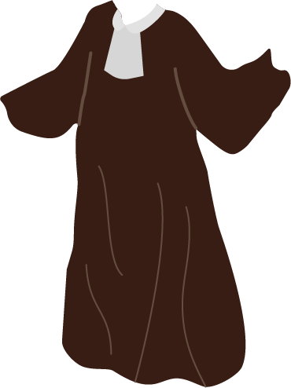
The Defence Lawyer
My role is to represent the accused.
The defence lawyer must:
point out weaknesses in the Prosecution’s case.
Make sure that the accused is given the opportunity to present their side of the story.
ensure that the rights of the accused are respected throughout the trial.
They’re often referred to as “the Defence”.
Notes:
NOTES FOR THE TEACHER
Read the slide. It summarizes the contents of the Student Workbook, p. 9.
You can continue the activity using the term “the Defence”.
FURTHER INFORMATION
Can the Defence defend their client even if they know that the accused has committed the crime they’re accused of?
Yes, but...
First of all, all accused persons have the right to be represented by a lawyer. They also have the right to a fair trial in front of an independent, neutral judge (or jury).
When a lawyer knows that their client has committed the crime, it’s their duty to ensure that the rights of the accused are respected. If the accused is found guilty (or pleads guilty), their lawyer will make sure that the sentence imposed by the judge is appropriate in the circumstances.
However, the Defence is not allowed to mislead the court. In other words, they cannot lie to the court (judge or jury). For example, the Defence cannot:
Invoke means of defence (such as, for example, the alibi) that they know to be false.
Attempt to convict another person instead of their client.
Have their client testify in court to claim innocence, if they know the client is guilty.
SOURCES
Loi constitutionnelle de 1982, Annexe B de la Loi de 1982 sur le Canada (R-U), 1982, c 11, <http://canlii.ca/t/q3x8> (Charte canadienne des droits et libertés), « Garanties juridiques », art. 9, 10, 11
Code criminel, art. 723.
Code de déontologie des avocats, RLRQ c B-1, r 3.1, <http://canlii.ca/t/69gc9> , art. 8 et 116.
Collection de Droit, 2015-2016, Vol. 1 Éthique et Déontologie, p. 167 et p. 176 et ss.

Slide 13
The Judge
My role is to make sure the rules of evidence and procedure are followed during the trial
The judge must be impartial, which is to say neutral. They can’t take sides.
They render (give) the verdict if there is no jury.
They always decide the sentence.
Notes:
NOTES FOR THE TEACHER
Read the slide. It summarizes the contents of the Student Workbook, p. 10.
INFORMATION FOR STUDENTS
The judge is kind of like a « referee » of the trial: They manage the process, the proceedings, and above all, are a good listener.
The judge does not interrogate the witnesses (though they can sometimes intervene, in particular to ensure that the trial remains fair to the accused). They must stop themselves from participating too actively in the examination and cross-examination of witnesses.
The verdict is the decision to declare someone guilty or not guilty of a crime, after having analyzed all the evidence submitted during the trial.
When there is a jury, it’s the jury that renders the verdict, but only after the judge has given the jurors instructions and directives on the legal rules to follow.
SOURCES
Code de déontologie de la magistrature, R.Q. c. T-16, r.4.1, art 1.
Code civil du Québec, LRQ, c C-1991, art 2858.
Code criminel, art 553(a)(i) et (c)(x), 469(a)(vi) et (viii), 473, 536 et 631.
R c Lifchus, [1997] 3 R.C.S. 320, para 22 : exemple de directives au jury – explication de la notion de « hors de tout doute raisonnable ».
Pierre Béliveau et Martin Vauclair, Traité général de preuve et de procédures pénales, 22e éd, Cowansville (Qc), Yvon Blais, 2015 aux para 534 et 1533.
Collection de Droit 2015-2016, Volume 11, Preuve et procédure pénale, Chapitre VII, p 31.

Slide 14
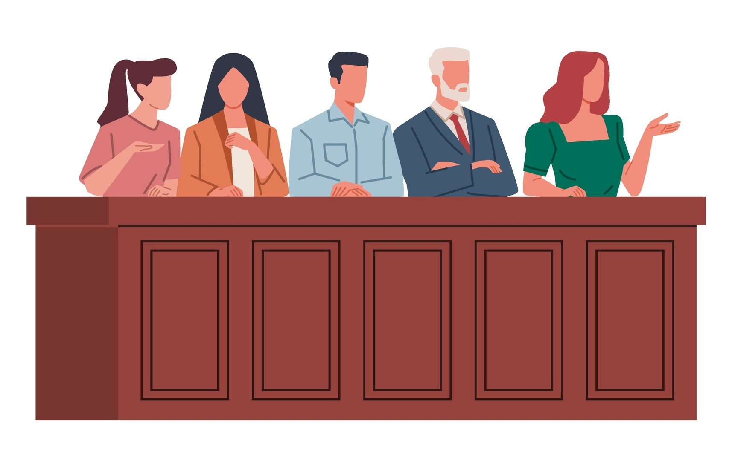
The Jury
We must reach a unanimous verdict.
Not all trials take place in front of a jury
A jury trial is required for some serious crimes, like murder.
A jury is made up of 12 citizens, the jurors.
Notes:
NOTES FOR THE TEACHER
Read the slide. It summarizes the contents of the Student Workbook, p. 10.
INFORMATION FOR STUDENTS
Note: not all trials take place before a jury!
For some less serious crimes (drug possession, theft under $5,000, etc.), the trial never takes place before a jury.
For some serious crimes (like murder), jury trials are always held (with rare exceptions).
In all other cases that don't fall into these two categories, it's up to the accused to choose whether or not they want a jury. This decision is usually made during the first appearance.
When there is one, the jury is made up of 12 citizens (the members of a jury are called “jurors”).
When there is a jury, it’s the jurors who decide whether the accused person should be found guilty or not guilty (i.e. who render the verdict) instead of the judge. The jury must reach this decision unanimously, which means all 12 juror must agree with the decision. Their decision must be based on the law and the evidence heard during the trial, not on their personal opinion. They must discuss until the decision is unanimous, which can take one or several days.
Since jurors are not legal experts, the judge must explain the necessary legal notions to them before they make their decision. The judge can also answer any questions they may have.
Once the verdict is rendered, it’s the judge who will decide on the sentence, at a later step (see notes under slide 35).
* To learn more about the jury, see Éducaloi’s video: The Jury’s Role in a Court Trial (https://educaloi.qc.ca/en/publications/the-jurys-role-in-a-court-trial/)
SOURCES
Code de déontologie de la magistrature, R.Q. c. T-16, r.4.1, art 1.
Code civil du Québec, LRQ, c C-1991, art 2858.
Code criminel, art 553(a)(i) et (c)(x), 469(a)(vi) et (viii), 473, 536 et 631.
R c Lifchus, [1997] 3 R.C.S. 320, para 22 : exemple de directives au jury – explication de la notion de « hors de tout doute raisonnable ».
Pierre Béliveau et Martin Vauclair, Traité général de preuve et de procédures pénales, 22e éd, Cowansville (Qc), Yvon Blais, 2015 aux para 534 et 1533.
Collection de Droit 2015-2016, Volume 11, Preuve et procédure pénale, Chapitre VII, p 31.

Slide 15
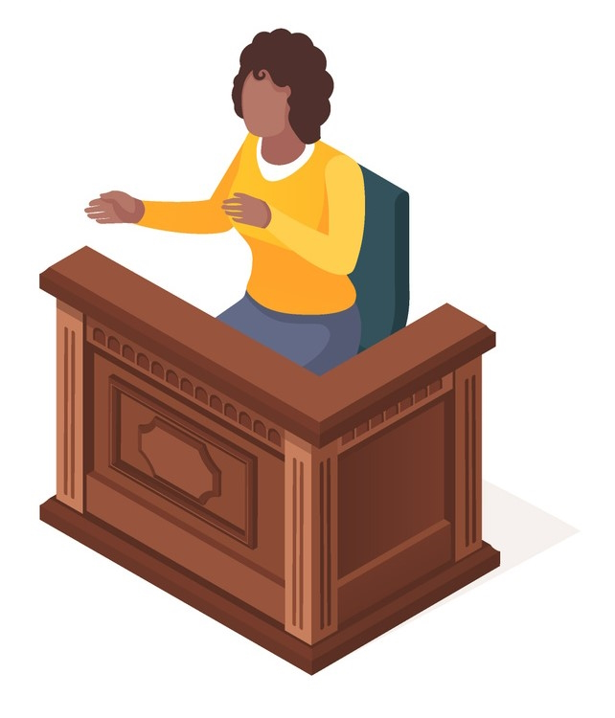
The Witnesses​
A witness must promise to tell “the truth, the whole truth, and nothing but the truth.”
I can only tell the court what I personally know, saw, or heard.
Notes:
NOTES FOR THE TEACHER
Read the slide. It summarizes the contents of the Student Workbook, p. 10.
The witness’s role will be further explained later (slides 22 onwards).
SOURCES
Collection de Droit 2015-2016, Volume 11, Preuve et procédure pénale, Chapitre VII, p. 135 et suivantes.
Loi sur la prevue au Canada, L.R.C. (1985), ch. C-5, art. 14 (1)

Slide 16
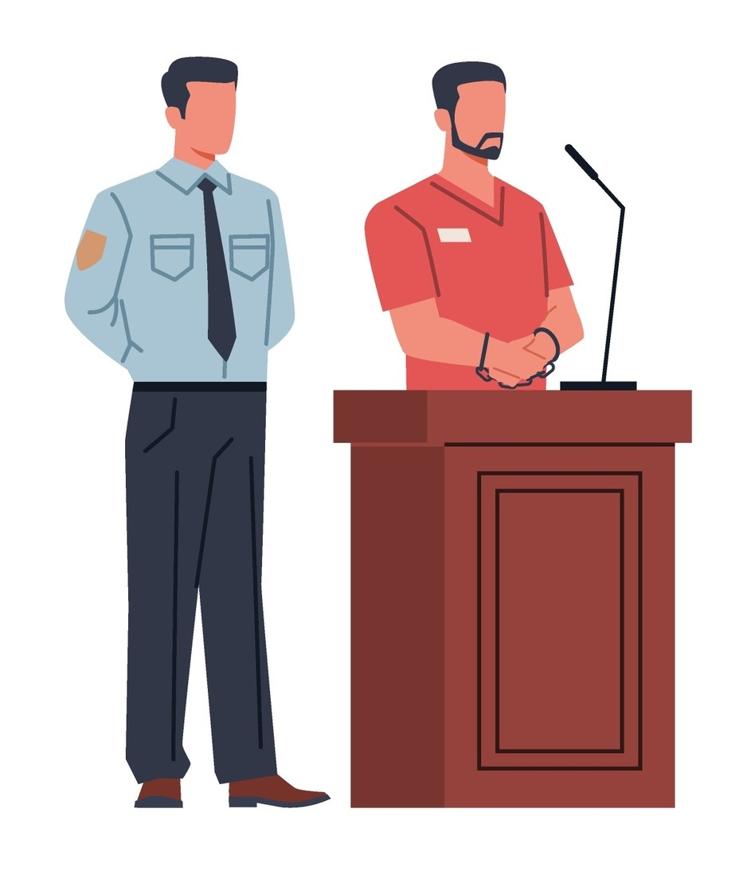
The Accused
Remember, I’m presumed innocent!
The accused is suspected of committing a crime.
The accused can be a witness and testify at their trial, but they have no obligation to do so.
Notes:
NOTES FOR THE TEACHER
Read the slide.
INFORMATION FOR STUDENTS
The accused can be one of the witnesses for the defence.
However, the accused has the right to remain silent at all times, which means they can choose to not testify during their trial. No one can force them to testify, even if it’s to defend themselves.
Choosing whether to testify or not is the accused’s right alone, but they can get advice from their lawyer. Generally, the judge or jury must not interpret the accused’s refusal to testify as proof of their guilt.
SOURCES
Hubert Reid, Dictionnaire de droit québécois et canadien 4e éd., 2010, Wilson & Lafleur, 11, sub verbo « Accusé »
Pierre Béliveau et Martin Vauclair, Traité général de preuve et de procédures pénales, 22e éd, Cowansville (Qc), Yvon Blais, 2015, aux para 1615-1628.
Loi sur la preuve au Canada, LRC 1985, c C-5, art 4(1) et (6).
Loi constitutionnelle de 1982, Annexe B de la Loi de 1982 sur le Canada (R-U), 1982, art 7, 9, 10 et 11.
Dubois c. La Reine, [1985] 2 R.C.S. 350, para 10.
R. c. Noble, [1997] 1 RCS 874, 1997 CanLII 388 (CSC).

Slide 17
The Court Clerk
Do you swear (or solemly affirm) to tell the truth, the whole truth, and nothing but the truth?
The court clerk prepares the court file for the trial.
The court clerk takes detailed notes during the trial.
They swear in witnesses before they testify.
Notes:
NOTES FOR THE TEACHER
Read the slide. It summarizes the contents of the Student Workbook, p. 12.
Swearing in a witness can be done by having the witness take an oath or make a solemn affirmation. For more information on this subject, see the notes under slide 23.
SOURCES
Loi sur la preuve, L.R.C. 1985, c. C-5, art. 13 à 15.
Règlement de la Cour du Québec, RLRQ, c. 25.01, r.9, art. 30, 34(1) et 37.

Slide 18
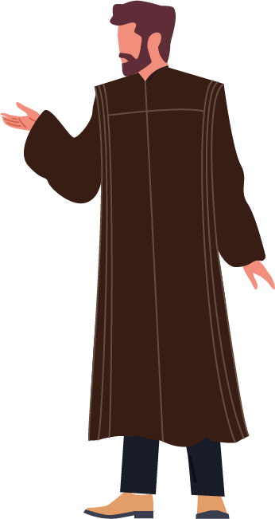
The Court Bailiff (or Court Usher)
Silence. All rise. The court, presided by the honourable justice So-and-so, is in session.
The court bailiff prepares the courtroom before the trial.
When the judge arrives, the court bailiff reminds the public to be quiet and makes the well-known statement: “The court is in session.”
Notes:
NOTES FOR THE TEACHER
Read the slide. It summarizes the contents of the Student Workbook, p. 12.
SOURCES
Règlement de la Cour du Québec, RLRQ, c. 25.01, r.9, art. 21, al.2 et 29, al.2 à 4.

Slide 19
The Steps in a Criminal Trial

Slide 20
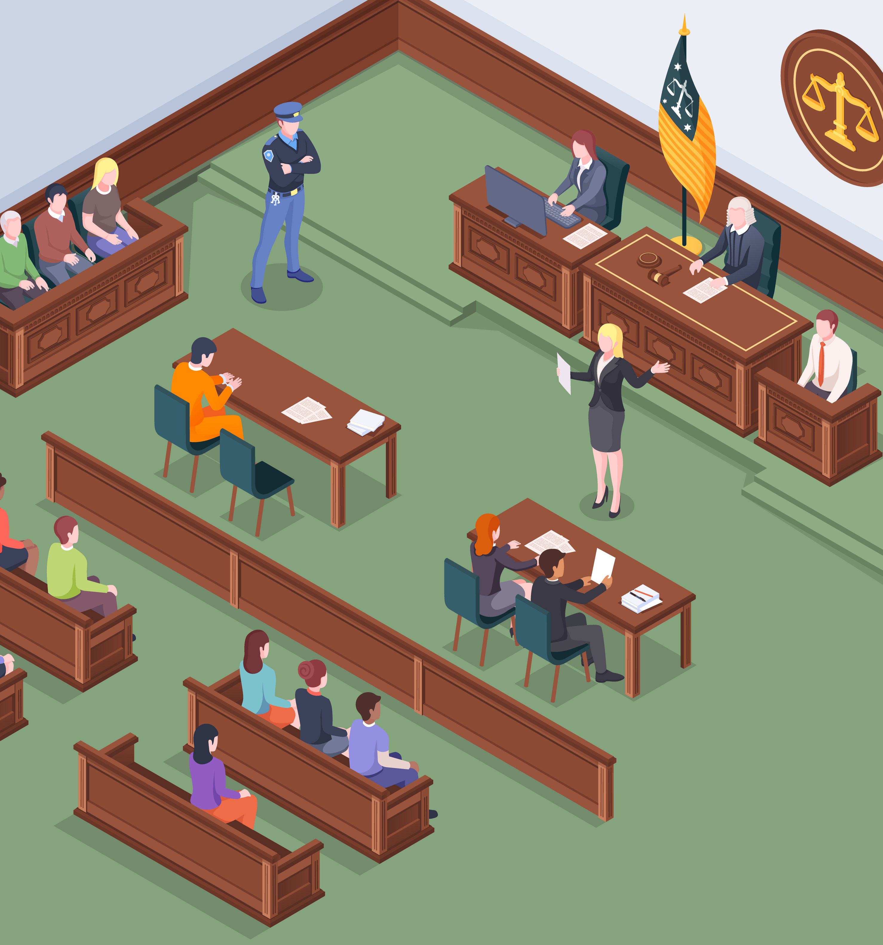
The Steps in a Criminal Trial:
Presenting the evidence
The Prosecution’s evidence
The Defence’s evidence
Oral arguments
Verdict
Notes:
NOTES FOR THE TEACHER
This slide presents an overview of the steps explained in the following slides.
The Ontario Justice Education Network’s YouTube channel contains several short videos on the steps in a criminal trial. The information applies to criminal trials in Quebec as well. The most relevant videos are included in this PowerPoint presentation. You can find the full playlist here: https://www.youtube.com/playlist?list=PLExy1V9S_1DxTGUh6HLpMIouVCC1HjQGS
INFORMATION FOR STUDENTS
There are many rules surrounding evidence and they can be quite complex. These rules notably cover how the police must gather evidence. If the law wasn’t followed during the collection of evidence, the evidence will not be admissible in court, which means that the judge or jury cannot consider it when making their decision.
SOURCES
Règlement de la Cour du Québec, RLRQ, c. 25.01, r.9, art. 21, al.2 et 29, al.2 à 4.

Slide 21
Presenting the Evidence
Proving that an allegation is true
Lawyers can use “real” (physical) evidence. For example:
video recordings,
a weapon,
a DNA sample.
Lawyers can also call on witnesses to testify during the trial. This is oral evidence. For example:
a witness of the crime,
a witness who saw the accused somewhere else during the crime,
etc.
Notes:
NOTES FOR THE TEACHER
Read the slide. It summarizes the contents of the Student Workbook, p. 13.
You can emphasize oral evidence (witness testimonials), since this is what will be presented at the mock trial.
SOURCES
Collection de Droit 2015-2016, Volume 11, Preuve et procédure pénale, p. 132-144.

Slide 22
Swearing in a Witness
Notes:
NOTES FOR THE TEACHER
Watch this video with the students. The key points are summarized in the next slide.

Slide 23
The Testimonial
Witnesses who come to testify must first:
identify themselves,
promise to tell the truth.
This is known as « swearing in » witnesses.
Notes:
NOTES FOR THE TEACHER
Read the slide. It summarizes the contents of the Student Workbook, p. 13.
INFORMATION FOR STUDENTS
Swearing in witnesses
Swearing in witnesses is essential for a testimonial to be admissible in court. There is one exception: If the witness is under 14, the judge can simply ask the witness to promise to tell the truth. The witness is not sworn in.
When sworn in, the witness swears to tell the truth by taking an “oath” or making a “solemn affirmation”.
The more traditional oath is taken with the hand on the Bible, or in some other way depending on the witness's religious beliefs.
The solemn affirmation has no religious dimension and is made with the right hand raised; it has the same effect as the oath.
The witness chooses whether to take an oath or make a solemn affirmation. The solemn affirmation was chosen for the mock trial.
* To learn more about witness testimonials, see Éducaloi’s article: The Role of Witnesses (https://educaloi.qc.ca/en/capsules/the-role-of-witnesses/)
SOURCES
Loi sur la preuve au Canada, L.R.C. (1985), c. C-5, art. 14 à 16.1.
R c B (KG), [1993] 1 RCS 740.
Pierre Béliveau et Martin Vauclair, Traité général de preuve et de procédures pénales, 22e éd, Cowansville (Qc), Yvon Blais, 2015, au para 1494.

Slide 24
The Testimonial
Witnesses can testify about facts of which they have personal knowledge, meaning:
what they saw,
what they heard,
what they experienced,
what they smelled,
etc.
Important! A witness cannot give their opinion, except if…
They’re an expert, or
The opinion is about something very obvious.
Notes:
NOTES FOR THE TEACHER
Read the slide. It summarizes the contents of the Student Workbook, p. 13.
INFORMATION FOR STUDENTS
The witness must state what they personally did, saw, heard or felt.
If, instead, they recount something someone else told them, the opposing lawyer could object. This is called hearsay.
The witness cannot give their opinion.
Except on very obvious elements. For example, they can give their opinion on the age or state of inebriation of a driver, or the speed of the car they were driving, or the identity of a person.
When a witness testifies, they must be respectful and cooperative. The witness must look at the judge. They must answer to the best of their knowledge, without exaggerating or downplaying the facts.
SOURCES
Loi sur la preuve au Canada, L.R.C. (1985), c. C-5, art. 14 et 15.
Graat c La Reine, [1982] 2 R.C.S. 819 aux pp 835, 838.
Charles-Maxime PANACCIO, L’administration de la preuve, 4e éd., Montréal, Wilson & Lafleur, 2010, Par. 585-586.
Nicolas BELLEMARE, Droit pénal : preuve et procédure, Titre I, ch. VII, École du Barreau du Québec, dans Collection de droit 2015-2016, p. 135 à 138 et 140.

Slide 25
Witness Examination: The Rules
During the examination of a witness, the lawyer must ask open questions.
An open question is a question that can’t be answered by just a “yes” or a “no”.
Open question often start with: Who? When? Why? How? Where? Which…? Explain…
For example:
The questions must also be relevant.
When did you last see this person?
Where were you last night at 10 pm?
Notes:
NOTES FOR THE TEACHER
Read the slide. It summarizes the contents of the Student Workbook, p. 14.
INFORMATION FOR STUDENTS
A question is relevant if it is useful in the context of the trial..
Witnesses can't be asked just anything: questions must relate to the crime with which the accused is charged.
SOURCES
Nicolas BELLEMARE, Droit pénal : preuve et procédure, Titre I, ch. VII, École du Barreau du Québec, dans Collection de droit 2015-2016, p. 126 à 128,

Slide 26
Leading Questions
A leading question is a question in which the answer (or part of the answer) has already been implied.
Example: Were you angry at Albert?
Generally, a leading question can be answered with a “yes” or a “no”.
If a lawyer asks a leading question during the examination of a witness, the opposing lawyer could object.
Leading questions are allowed during the cross-examination of a witness.
Notes:
NOTES FOR THE TEACHER
Read the slide. It summarizes the contents of the Student Workbook, p. 14

Slide 27
The Cross-Examination
Notes:
NOTES FOR THE TEACHER
Watch the beginning of this video with the students (until 1:10). The key points are summarized in the next slide.

Slide 28
The Cross-Examination
When a lawyer finishes the examination of their witness, the opposing side’s lawyer can choose to cross-examine that same witness.
Lawyers can challenge the credibility of witnesses during cross-examination.
Important!
During cross-examination, lawyers must still only ask relevant questions.
However, they can ask leading questions..
Notes:
NOTES FOR THE TEACHER
Read the slide. It summarizes the contents of the Student Workbook, p. 14.
INFORMATION FOR STUDENTS
A witness is called to be examined by the lawyer who requested their presence at the trial (the Prosecution or the Defence).
Once the lawyer who called the witness has finished examining them, the witness can be cross-examined by the other lawyer.
The right to cross-examine is very important. It can bring out new information or context to what was said during the examination.
Cross-examination is also often used to attack the credibility of the opposing party's witness: this is why it’s allowed for the lawyer to try to “trap” the witness by asking leading questions, i.e. questions that direct the witness towards one answer rather than another.
Even an honest, good-faith witness can give an unreliable testimonial. It’s possible, for example, that the witness had vision or memory problems, or that their state of shock prevented them from observing the scene properly.
Each of the Prosecution’s witnesses will be examined and cross-examined one after the other until all the Prosecution’s witnesses have testified. The Defence’s witnesses will then also be examined and cross-examined one after the other.
SOURCES
R c Lyttle, 2004 CSC 5 aux para 43-44, [2004] 1 RCS 193.
Nicolas BELLEMARE, Droit pénal : preuve et procédure, Titre I, ch. VII, École du Barreau du Québec, dans Collection de droit 2015-2016, p. 123-124 et 155-156.

Slide 29
Objections
Notes:
NOTES FOR THE TEACHER
Watch this video with the students. The key points are summarized in the next slide.

Slide 30
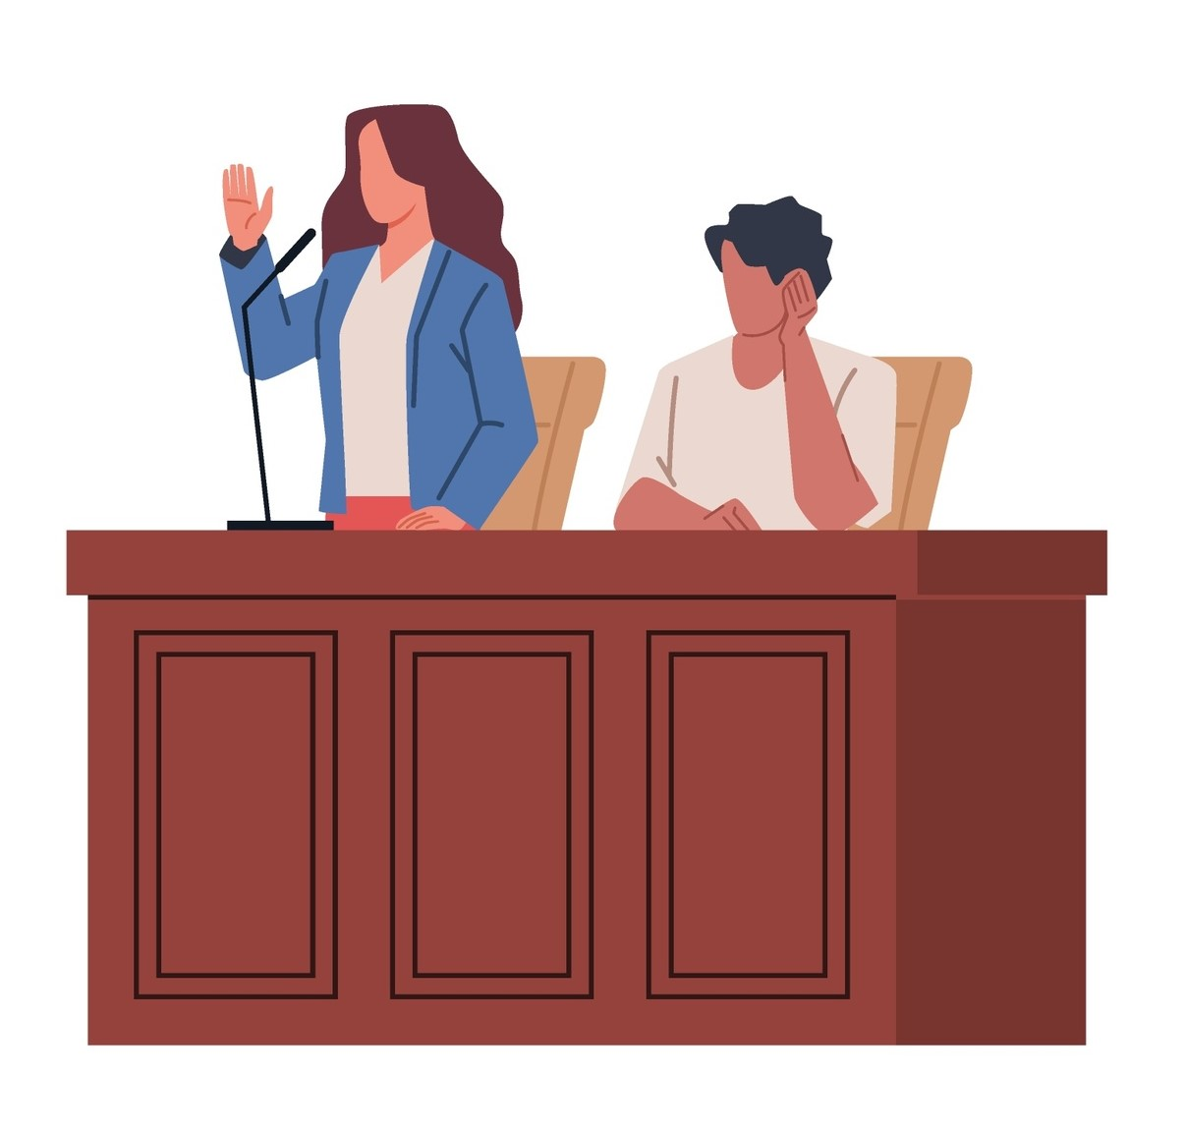
Objections
Objection your Honour! The question isn’t relevant.
When a rule is not respected, the opposing side’s lawyer can object:
The lawyer stands up.
The lawyer says “Objection”.
The lawyer explains their objection.
Notes:
NOTES FOR THE TEACHER
Read the slide. It summarizes the contents of the Student Workbook, p. 15.
INFORMATION FOR STUDENTS
During examination or cross-examination, the lawyers may object if they consider the questions asked to be problematic for one of the following reasons:
The question is not relevant.
The question is leading (during the examination only).
The witness gives their opinion.
The witness reports the statements of another person (hearsay).
The lawyer who has reasons to object must do so as soon as possible. They object by standing up and saying “Objection!”, and they must explain the reason for their objection.
The judge then decides if they accept or reject the objection. If the objection is accepted, the evidence will be ignored, as if it were never presented!
SOURCES
CENTRE D’ACCÈS À L’INFORMATION JURIDIQUE, « eDictionnaire », http://dictionnairereid.caij.qc.ca/recherche#q=objection&t=edictionnaire&sort=relevancy&m=search (consulté le 1er mars 2016).
Trucs et astuces de la magistrature, L’honorable Dominique B. Joly, Cour municipale de la Ville de Montréal, p. 10
Règlement de la Cour supérieure du Québec, chambre criminelle (2002), art. 7 al. 2

Slide 31
The Means of Defence
I was walking my dog, Shadow!
Alibi
Legitimate defence
Duress
Ignorance of the law is no excuse!
Notes:
NOTES FOR THE TEACHER
Read the slide. It summarizes the contents of the Student Workbook, p. 15.

Slide 32
Oral Arguments
Notes:
NOTES FOR THE TEACHER
Watch the beginning of this video with the students (until 1:05). The key points are summarized in the next slide.

Slide 33
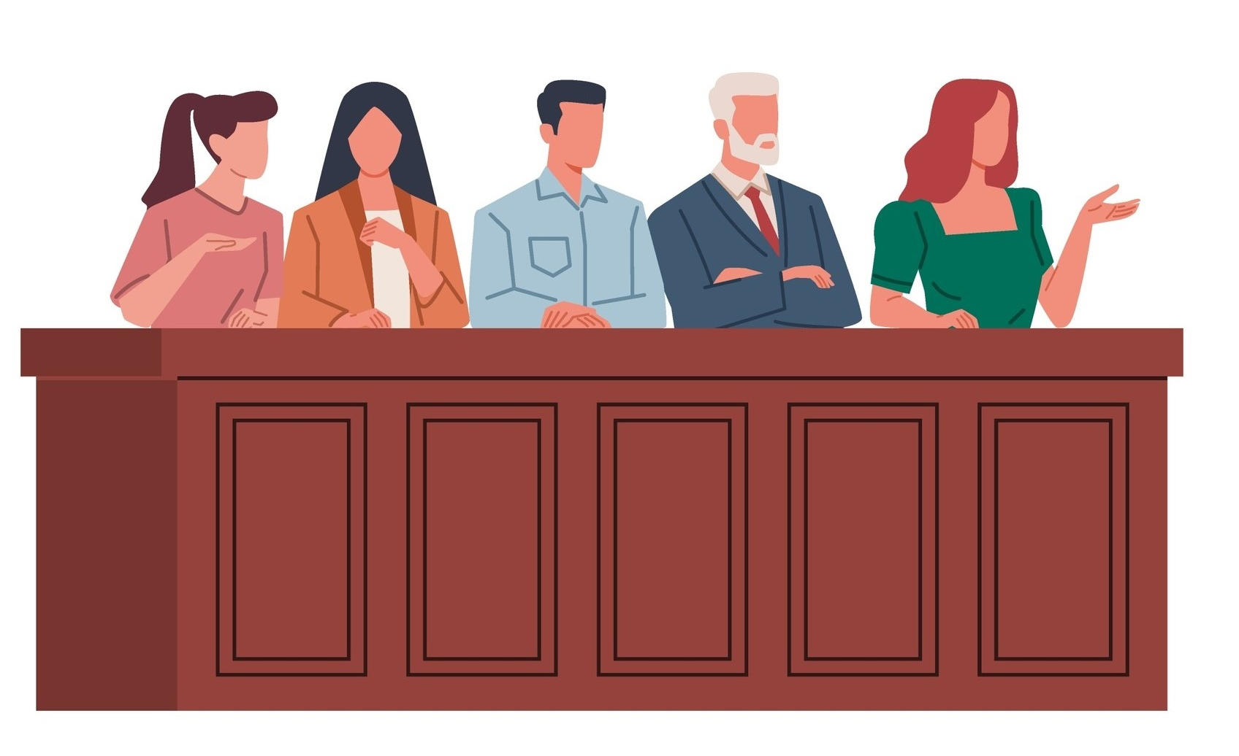
Oral Arguments (sometimes called “closing statements”)
The Prosecution and the Defence present their oral arguments once both sides have presented their evidence.
The oral arguments summarize elements of the case favorable to each side in order to convince the judge or the jury.
Notes:
NOTES FOR THE TEACHER
Read the slide. It summarizes the contents of the Student Workbook, p. 17.
Mention to students that the mock trial focuses on witness examination and cross-examination, so there will be no oral arguments, unless you decide to do otherwise.
FURTHER INFORMATION FOR THE TEACHER
If you'd like to give your students the opportunity to try oral arguments, but on the theme of the charters of rights and freedoms, we suggest the excellent Citizenship and Charters Program, created by the Canadian Bar Association (Quebec section). Find out more on their website: https://www.abcqc.qc.ca/Our-Work/Initiatives-de-l%E2%80%99ABC-Quebec/Programme-citoyennete-et-chartes/Citizenship-and-Charters-Program
SOURCES
Code criminel, art 651.
Michel BEAUCHEMIN, Collection de droit 2015-2016, Volume 11 – droit pénal : procédure et preuve, Titre I – la procédure et la preuve, chapitre IV, à la p 101, en ligne : http://edoctrine.caij.qc.ca/collection-de-droit/2015/11/831832433/

Slide 34
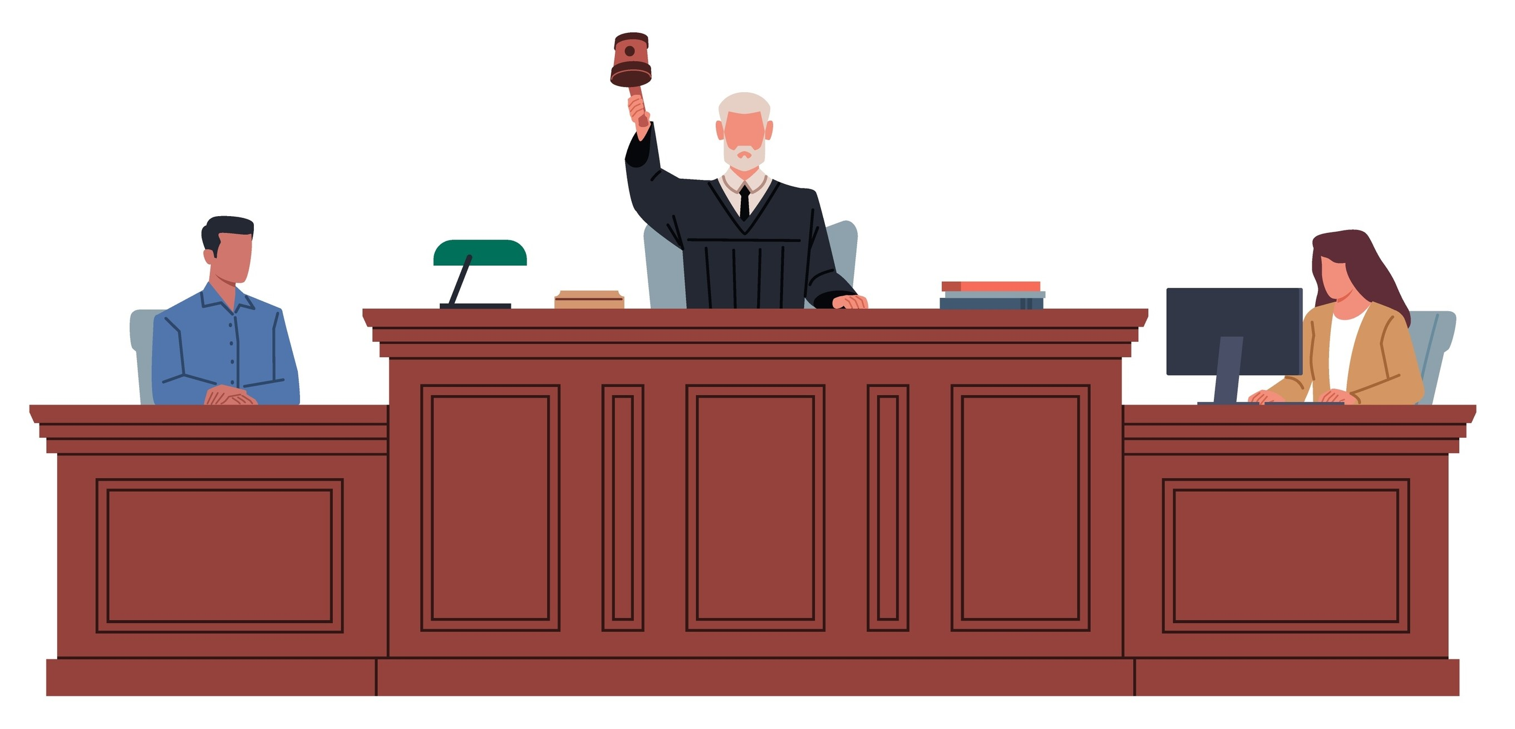
The Verdict
After hearing the oral arguments, the judge can make a decision right away or the judge (or the jury) can leave the courtroom to deliberate (take time to think carefully about the decision).
It’s during this step that the judge or jury decides whether the accused is guilty beyond a reasonable doubt or not.
If there is still a reasonable doubt, the accused must be acquitted (declared not guilty).
Notes:
NOTES FOR THE TEACHER
Read the slide. It summarizes the contents of the Student Workbook, p. 17.
INFORMATION FOR STUDENTS
If there’s no jury, the judge can either make a decision right away or “take the case under advisement.” This means they need more time to think and analyze the evidence before making a final decision.
If there is a jury, all 12 jurors must meet in a private room to talk about the case and decide on a verdict. Their decision must be unanimous.
To help the jury during this process, the judge will remind them of the rules:
The jury must only base their decision on the evidence presented during the trial—nothing else.
To find the accused guilty, they must be sure the person is guilty beyond a reasonable doubt.
If they have any doubts, they must find the person not guilty.
The jury keeps discussing until they all agree. In Quebec, there have even been jury deliberations that lasted more than 20 days!
Once the jury reaches a decision, they return to the courtroom to announce the verdict. The judge will ask what their decision is, and the jury’s spokesperson will say either “guilty” or “not guilty.”
If the verdict is not guilty, the trial ends.
If the verdict is guilty, the judge will decide on the sentence.
SOURCES
Loi constitutionnelle de 1982, Annexe B de la Loi de 1982 sur le Canada (R-U), 1982, c 11, <http://canlii.ca/t/q3x8> (Charte canadienne des droits et libertés), « Garanties juridiques », art. 9, 10, 11
Code criminel, L.R.C. 1985, c. C-46, art. 652.1(1).
R c. Oakes (1986) 1 RCS 103, EYB 1986-67556
Pierre Béliveau et Martin Vauclair, Traité général de preuve et de procédures pénales, 22e éd, Cowansville (Qc), Yvon Blais, 2015, p. 1101 et suivantes.
Hubert Reid, Dictionnaire de droit québécois et canadien, 4e ed, Montréal, Wilson et Lafleur, 2010, sub verbo « délibéré »

Slide 35
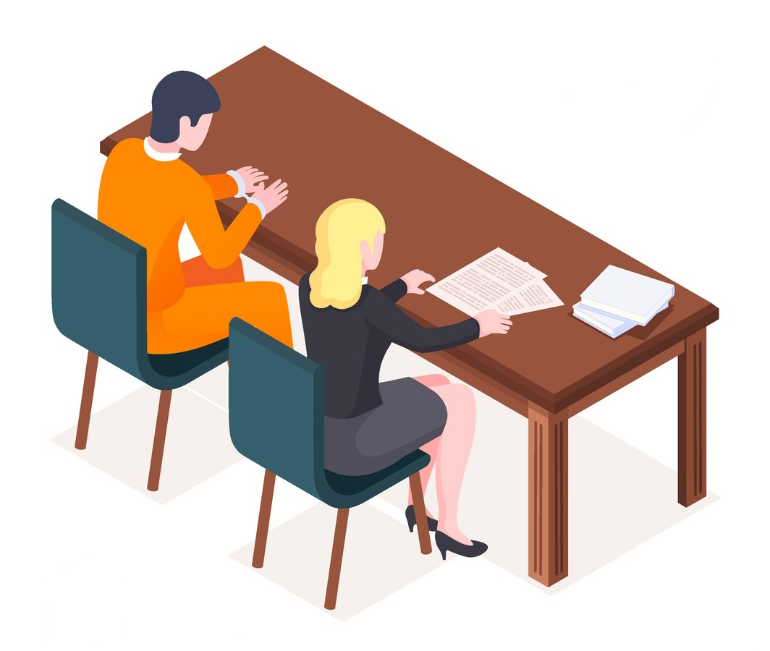
What Happens Next?
If the accused person is found guilty, the judge (never the jury) will then decide on the sentence.
The judge can choose to give their decision right away in the courtroom (this is called giving the decision “from the bench”), or they can write a judgment explaining their decision in more detail.
If the Defence or the Prosecution believes that there is a mistake in the decision rendered, they can “appeal” the decision.
Notes:
NOTES FOR THE TEACHER
Read the slide. It summarizes the contents of the Student Workbook, p. 18.
INFORMATION FOR STUDENTS
Determining a sentence
This step happens after the verdict is given.
When deciding on the sentence, the judge must keep in mind the main goals and principles behind criminal sentencing. The judge also considers facts about the accused or about the crime itself — called aggravating or mitigating circumstances — which might justify a harsher or more lenient sentence. The judge must always listen to the arguments from both the Prosecution and the Defence on the subject.
In addition to imprisonment, other types of sentences are possible, such as:
fines,
a sentence served in the community,
and more.
Sometimes, the judge may decide that the person should not be punished at all, even if they were found guilty. This is called a discharge, and it only happens in very specific situations.
Important: The judge isn’t completely free to choose any sentence. The Criminal Code sometimes sets a maximum or minimum sentence for a specific crime. According to the principle of fairness in sentencing, the sentence must also be just. This means that the sentence must be similar to other sentences ordered for similar crimes in similar circumstances, unless there’s a good reason to do otherwise.
* For more information on the steps in a criminal trial, see Éducaloi’s article: How Criminal Trials Work (https://educaloi.qc.ca/en/capsules/how-criminal-trials-work/)
SOURCES
Code criminel, L.R.C. 1985, c. C-46, art. 716 et ss.
Code criminel, L.R.C. 1985, c. C-46, art. 675 et 676.
Code criminel, L.R.C. 1985, c. C-46, art. 718, 718.2, 718.3, 723, 730.
Nicolas BELLEMARE, Collection de droit 2015-2016, Vol. 11 – Droit pénal : procédure et preuve, Titre I, p. 104 à 108 et p.273-274.
R. c. Nasogaluak, [2010] 1 RCS 206 aux para 43-44, 2010 CSC 6 (CanLII).

Slide 36
Decorum
“Decorum” is what we call court etiquette, which is all of the rules that must be respected in the courtroom.
The people present in the courtroom must:
remain silent,
turn off their cell phone,
rise when the judge enters or exists the courtroom.
The lawyers must:
rise to address the judge,
say “Madam Justice”, “Mr. Justice” or “Your Honour”,
Be respectful.
Notes:
NOTES FOR THE TEACHER
Read the slide. It summarizes the contents of the Student Workbook, p. 18.
INFORMATION FOR STUDENTS
The people present in the courtroom must:
remain silent,
dress appropriately,
turn off their cell phones, cameras and other devices,
refrain from eating, drinking or chewing gum,
always be respectful and follow the instructions,
rise when the judge enters or exits the courtroom.
The lawyers must:
rise to address the judge,
address themselves to the judge, not the opposing party,
always show respect,
address themselves to the judge by saying: “Madam Justice” or “Mr. Justice” or “Your Honour”,
Avoid interrupting the judge or the opposing party (except to object).
* To learn more about decorum, see JuridiQC’s webpage: 10 questions and answers on court etiquette
(https://juridiqc.gouv.qc.ca/en/separation-and-divorce/court/the-court-process/10-questions-and-answers-on-court-etiquette)
SOURCES
Règlement de la Cour du Québec, RLRQ, c. C+25.01, r.9, art.22(1), 25(1), (2) et (3), 29(1).
Règles de procédure de la Cour supérieure du Québec, chambre criminelle, TR/2002-46, art. 4, 7(2), 8(1), (2) et (3), 8A.
Cour du Québec, Lignes directrices concernant l’utilisation des technologies en salle d’audience, en ligne: <http://www.tribunaux.qc.ca/c-quebec/CommuniquesDocumentation/LignesDirectricesTech_28mars2013.pdf>
Fondation du Barreau, Guide « Seul devant la Cour en matières criminelles et pénale », www.fondationdubarreau.qc.ca/pdf/publication/seul-devant-la-cour-criminelle-penale-fr.pdf, p. 17 (consulté le 1er mars 2016).

Slide 37
Preparing the Mock Trial
Reading the scenario,
Split into two large teams (prosecution and defence),
Draft, in sub-groups, questions for the examination and cross-examination of your witness,
Practice asking the questions to a member of another sub-group,
Decide who will play each role,
Choose the best questions for the lawyer(s) on your team.
Notes:
NOTES FOR THE TEACHER
Explain and lead the next steps in the activity. These are described in the Student Workbook, p. 21.

Slide 38
Distribution of Roles
Witnesses for the prosecution,
Witnesses for the defence,
Lawyer for the prosecution (one or many),
Lawyer for the defence (one or many),
Judge,
Court clerk,
Court bailiff,
Public (everyone else).
Notes:
NOTES FOR THE TEACHER
Show this slide while distributing the roles. This information is also on p. 21 of the Student Workbook.

Slide 39
During the Mock Trial
Respect courtroom decorum.
Everyone plays their role, sticking as close as possible to the script.
The lawyers ask the witnesses the most relevant questions.
The witnesses play their role as best as possible and answer the questions with the facts set out on their Witness Reference Sheet.
The lawyers raise relevant and justified objections.
The public watches the trial without disrupting it.
Everyone takes notes on the most noteworthy evidence brought up during the trial.
Notes:
NOTES FOR THE TEACHER
Show this slide at the beginning of the class during which the mock trial is held. This information is also on p. 23 of the Student Workbook.

Slide 40
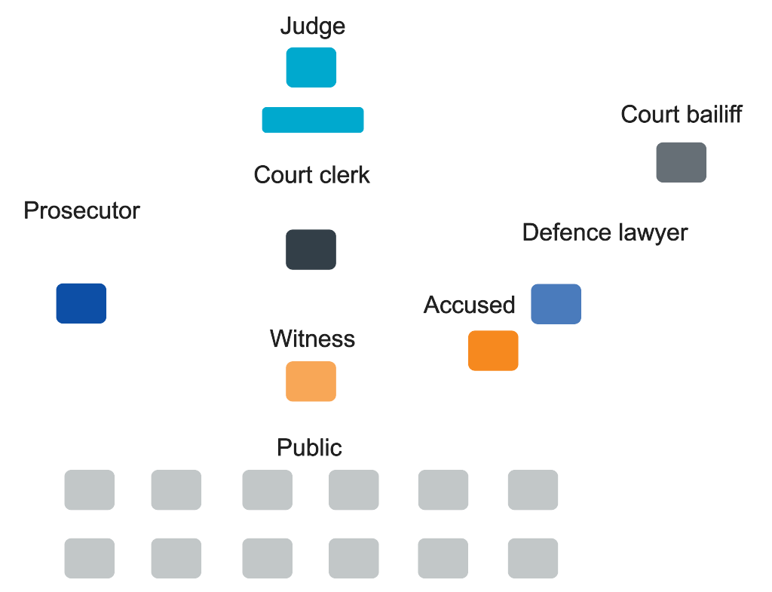
Layout of the Courtroom
Notes:
NOTES FOR THE TEACHER
Show this slide during the mock trial. This information is also on p. 23 of the Student Workbook.

