Slide 1

A Look Through History: The Evolution of Abortion Rights
Notes:
NOTES FOR THE TEACHER
This PowerPoint presentation is a tool to support the activity A Look Through History: The Evolution of Abortion Rights.
The proposed exercises are ready-to-use suggestions to lead the activity and encourage student participation.
The comments accompanying the slides include NOTES FOR THE TEACHER, providing specific information for the activity.
July 2025 version
© Éducaloi. 2013–2016. This material is the exclusive property of Éducaloi.
Note that the law is in constant evolution. This document is up to date on April 30, 2025.

Slide 2


What Happens During the Activity
Learn about the right to abortion
Learn how the right to abortion has evolved throughout the years
Learn about the role of the Supreme Court of Canada
Complete the activity
Review what was learned

Slide 3
Learn About the Right to Abortion :

Slide 4
Definition of the Concepts

Slide 5

What is abortion?
It is when someone chooses to end a pregnancy.
The termination can be voluntary or not.
Notes:
NOTES FOR THE TEACHER
As a class, define abortion by asking the students about their previous knowledge.
Ask students the following questions to generate a debate. Write the students’ ideas on the board.
What is abortion?
Can an abortion be performed at any time during pregnancy?
You can ask students to answer these questions in the Student Workbook.
Click once to display a simple abortion definition on the slide.
Now ask the students the following question:
What do you think is the difference between abortion and the right to abortion?
Proceed to the next slide. It presents a simple definition of the right to abortion.
ADDITIONAL INFORMATION
Abortion can be spontaneous, in other words, it can happen without wanting one. This is often referred to as a miscarriage. Abortion can also be planned: in this case we say the abortion was voluntary. It can be done by taking medication (often referred to as the abortion pill) or through other medical procedures.
Sometimes, the acronyms TP (termination of pregnancy) or VTP (voluntary termination of pregnancy) are used to refer to abortion.
There are many reasons why someone may want to have an abortion. What do you think those reasons could be?
Generally, a doctor performs the abortion. However, in some circumstances, especially in circumstances where abortion is illegal, they can be performed in non-medical conditions, with serious health risks.
SOURCES
« avortement ». Le dictionnaire Usito. Repéré le 4 septembre 2024 à https://usito.usherbrooke.ca/d%C3%A9finitions/avortement.
« avortement » dans Hubert Reid et Simon Reid. (2023). Dictionnaire de droit québécois et canadien (adaptation numérique de la 6e édition par le CAIJ). Repéré le 4 septembre 2024 à https://dictionnaires.caij.qc.ca/recherche#t=edictionnaire&sort=relevancy&m=dico&dico=dictionnaire-reid-6.
Gouvernement du Québec. À propos des services d’avortement. Repéré le 4 septembre 2024 à https://www.quebec.ca/sante/systeme-et-services-de-sante/organisation-des-services/avortement-services/description.
Organisation mondiale de la santé. (25 novembre 2021). Avortement. Repéré le 4 septembre 2024 à https://www.who.int/fr/news-room/fact-sheets/detail/abortion.
Catherine Solano. (14 décembre 2021 (mise à jour). Avortement : qu’est-ce que c’est?. Repéré le 4 septembre 2024 à https://www.passeportsante.net/fr/Maux/Problemes/Fiche.aspx?doc=avortement.

Slide 6

What is the right to abortion?
It’s a right that allows women to make their own decisions about their bodies and pregnancies.
In Quebec, abortion is a free and legal procedure.
Notes:
NOTES FOR THE TEACHER
Read the information on the slide with students.
INFORMATION FOR THE STUDENTS
What is the right to abortion? It’s a right that allows women to make decisions about their bodies and pregnancies without being harassed, punished or condemned. This procedure is legal today.
This right varies from country to country: in some countries, there is no abortion law, in others, the laws make it easy to access, and for others, the laws limit or prohibit access.
You could ask the students if they know of countries that allow or prohibit abortion. If so, what are the reasons? Ask this question to facilitate an understanding of the close connection between law and society’s values.
Abortion is also considered an ethical issue.
Some social groups are against this right while others defend it.
You could ask the students questions about this statement: Do you know of arguments for or against abortion? Ask this question to facilitate an understanding of the connections between law, society’s values and what the society considers ethical.
Some groups refer specifically to the protection of the fetus and its ‘’right to life’’.
Their opinion is that human life begins at conception, and the fetus rights must prevail.
SECONDARY INFORMATION
The law and rights
The law is a set of rules that govern relations between people living in a society. In Quebec, the law includes legislations, regulations, and their interpretation by courts.
Rights refer to the result of the law’s application. The application of legislations, regulations and judgments ensures that a person in Quebec can have the right to vote, the right to go to school, and the right to abortion.
The consequences of the criminalization of abortion
An abortion performed by someone who doesn’t have the required skills or that’s performed in an environment that doesn’t meet medical standards is dangerous to women’s health. Abortion being criminalized doesn’t prevent people from getting abortions. It makes having an abortion in good conditions less accessible and more dangerous. When abortion was illegal in Canada, dangerous abortions were common.
SOURCES
Henri Brun. 23 avril 2025 (mise à jour). Le droit au Québec. Repéré le 29 avril 2025 à : https://usito.usherbrooke.ca/articles/th%C3%A9matiques/brun_1
Aministie Internationale. 26 septembre 2019. Éléments clés sur l’avortement. Répéré le 9 décembre 2024 à : https://amnistie.ca/sinformer/communiques/international/2019/international/elements-cles-lavortement
Radio Canada. 16 mai 2019. Le 15-18 avec Annie Desrochers. https://ici.radio-canada.ca/ohdio/premiere/emissions/le-15-18/segments/entrevue/118291/antiavortement-alabama-senateur-loi-criminalisation-grossesse-femme : “Quelques chiffres sur l’avortement en 1962. De 10 000 à 25 000 avortements clandestins sont réalisés chaque année au Québec. De 100 000 à 300 000 sont réalisés chaque année au Canada”. “En 1962, la première cause d’hospitalisation des femmes étaient l’avortement”
Florence Meny. 21 janvier 2013. 25 ans de droit à l’avortement. Repéré le 15 mai 2025 à : https://ici.radio-canada.ca/nouvelle/596708/001-avortement-droit-anniversaire#:~:text=Le%2026%20juillet%201989%2C%20la,Canada%20le%208%20ao%C3%BBt%201989.

Slide 7
Abortion is governed by specific laws
It’s free
It can be done at any time during the pregnancy
No justification is required
The decision can be made without the need for a partner to agree
Before 14 years of age, parents’ authorization is needed
Notes:
NOTES FOR THE TEACHER
Read the information on the slide with the students.
INFORMATION FOR THE STUDENTS
Today in Canada, abortion is a legal medical act. There’s no longer a law that prohibits it.
Abortion is free, covered by Quebec’s health insurance (RAMQ).
Note: People who don’t have access to health insurance still have the right to an abortion, but, they’ll probably have to pay for it themselves or go through private insurance.
There’s no time limit to when you can have an abortion. It can be done at any time during the pregnancy since no specific law or judgment specifies a time limit.
But keep in mind that access to abortion can become more difficult as the pregnancy progresses. For example, if you have one at a later stage of pregnancy, it’s possible that the required medical equipment isn’t available or a doctor refuses to perform the procedure. In this case, the doctor must find another person that can assist the pregnant person. See Éducaloi. Abortion: Free and Legal Throughout Pregnancy at https://educaloi.qc.ca/en/capsules/abortion/.
Women have the right to abort without having to give a reason why and they also don’t need their partner to agree. This was confirmed by the Supreme Court of Canada in 1989 decision.
Keep in mind that most centres conduct a psychological interview to make sure that the decision was informed, made freely, and to determine if the person needs support.
Youth of 14 years old and over do not need their parents’ authorization. According to the law, youth aged 14 years old and over can give their own consent for health care that’s necessary.
SOURCES
Éducaloi. Avortement: gratuit et légal tout au long de la grossesse. Repéré le 4 septembre 2024 à https://educaloi.qc.ca/capsules/avortement/.
Éducaloi. L’avortement quand tu as moins de 18 ans. Repéré le 4 septembre 2024 à https://educaloi.qc.ca/capsules/lavortement-quand-tu-as-moins-de-18-ans/.
Éducaloi. Santé: petit guide à l’intention des femmes. Repéré le 10 septembre 2024 à https://educaloi.qc.ca/dossier/sante-femmes/#sujet-5.

Slide 8

How did the right to abortion evolve throughout the years?
When?
Who?
How?
Notes:
NOTES FOR THE TEACHER
Ask students the following questions to spark their reflection:
When did abortion become legal?
What made it possible to change this right?
How has this right evolved? How are laws changed? Who changes them? How?
Who do you think was punished before if an abortion was performed?
What do you think were the possible sentences or consequences?
Is the right to abortion governed by a federal law? Or by a provincial law?
Note down the students’ answers or write them up on the board.
Leave the students hanging or give them a few clues and tell them that all these questions will be answered during the upcoming sessions.
We’ll see through the evolution of abortion rights that laws can be changed and how an act that was once prohibited, punished and condemned (criminal) can become a legal and permissible act.

Slide 9

Quiz
Abortion Rights Today

Slide 10

Let’s say...
William just turned 18. He tells you that his girlfriend is pregnant. They discussed the situation and she’s unsure about if she wants to have an abortion. William wants her to go through with the procedure.
What can you tell him about his rights?
Notes:
NOTES FOR THE TEACHER
Read the scenario and ask students the question.
Answer:
The other partner does not have the power to oppose the woman’s decision, whether she choses to continue or end her pregnancy.
In 1989, Supreme Court of Canada confirmed that a partner doesn’t have the right to veto a woman’s decision regarding the fetus she’s carrying. For more information, see https://educaloi.qc.ca/en/understanding-the-law/chantale-daigles-race-against-the-clock/.
SOURCES
Code civil du Québec, RLRQ c CCQ-1991, art 10 et 14(2).
Tremblay c. Daigle, 1989 CanLII 33 (CSC), [1989] 2 RCS 530, p. 48, <https://canlii.ca/t/1ft3s>.
Voir aussi : Le droit à l’avortement en 4 dates clés | Décryptage | Éducaloi

Slide 11

And...
Joannie, William’s girlfriend, is 16 years old. She wants to have an abortion, but she’s scared. She wants to ask her doctor to do it, but he knows her parents well. She’s worried he’ll talk to them about it and refuse to do the procedure.
How can you reassure her?
Notes:
NOTES FOR THE TEACHER
Read the scenario and ask the students the question.
Answer:
As of 14 years of age, the law states that a teenager can consent alone to health care that’s necessary for them. An abortion is generally considered a care that’s necessary for one’s health. Therefore, Joannie can decide on her own. She doesn’t need her parents’ permission.
In addition to being able to decide on her own, Joannie also has the right to privacy. The doctor isn’t allowed to tell her parents … except if she has to stay at the hospital for more than 12 hours, which is not usually not the case for an abortion.
The doctor is allowed to refuse to perform the abortion but, in this case, the doctor must find another person who can perform it and provide the pregnant woman with support. See Éducaloi. Abortion: Free and Legal Throughout Pregnancy at https://educaloi.qc.ca/en/capsules/abortion/.
SOURCES
Voir L'avortement quand tu as moins de 18 ans | Éducaloi
Code civil du Québec, RLRQ c CCQ-1991, art 10, 14(2) et 14 al. 2; R c Morgentaler, (1988) 1 RCS 30; Tremblay c Daigle, (1989) 2 RCS 530 à la p 48.

Slide 12
And...
William wonders if he needs to help cover the medical expenses. Since Joannie is hesitating, he’s also worried she’ll take too long to decide.
Explain the right to abortion to him, while considering his worries.
Notes:
NOTES FOR THE TEACHER
Read the scenario and ask students the question.
Answer:
Abortion is free and can be performed at any time during the pregnancy. There’s no time limit to go through one, since there’s no law or judgment that addresses this question.
Keep in mind that access to abortion can become more difficult as the pregnancy progresses. For example, it’s possible that the necessary medical equipment is not available or that a doctor refuses to perform the procedure. In these cases, the doctor must find another person who can perform the abortion and provide the pregnant woman with support. See Éducaloi. Abortion: Free and Legal Throughout Pregnancy at https://educaloi.qc.ca/en/capsules/abortion/.
Note: This slide marks the end of the Teaching Guide’s short version. You can complete the evaluation activity 1 with your students to finalize this LES.
SOURCES
Code civil du Québec, RLRQ c CCQ-1991, art 10 et 14(2).
Tremblay c. Daigle, 1989 CanLII 33 (CSC), [1989] 2 RCS 530, p. 48, <https://canlii.ca/t/1ft3s>.
Voir aussi : Le droit à l’avortement en 4 dates clés | Décryptage | Éducaloi

Slide 13

How Abortion Rights have Evolved : Then vs. Now

Slide 14

From crime to legal medical act
History of the right to abortion in Canada
Abortion is no longer a crime
From 1869 to 1969
Since 1988
Abortion is a crime
Abortion is legal, but with certain conditions
From 1969 to 1988
Notes:
NOTES FOR THE TEACHER
Present the information on the slide. The next few slides present a more detailed explanation of each stage.
What is a crime?
ADDITIONAL INFORMATION
The difference between legalizing and decriminalizing
Decriminalizing removes the prohibition and the sanctions; legalizing authorizes and regulates.
More specifically:
Decriminalizing an action means that it’s no longer considered a crime. Therefore, the decriminalized act can no longer be criminally sanctioned.
Decriminalization can happen in two ways:
A court decision invalidates a section of the law.
The government changes the law, often the Criminal Code, and withdraws the offence.
The decriminalized act can remain non-regulated, in other words, the act is neither prohibited nor regulated by another law. This is referred to as a “legal vacuum.”
On the other hand, legalizing means that the law now recognizes the action as being allowed and regulates it according to specific rules. The legalized act is not only not criminal, but it becomes regulated, often by laws or regulations that create conditions under which it may be practised (such as minimum age, authorized sites, etc.).
The numbering of the Criminal Code section on abortion has changed several times over the years.
SOURCES
Éducaloi. Le droit à l’avortement en 4 dates clés. Récupéré en ligne le 11 décembre 2024 à https://educaloi.qc.ca/decryptage/le-droit-a-lavortement-en-4-dates-cles/.

Slide 15

What is a crime?
Definition of the concept
Crimes are listed in criminal law.
Criminal law prohibits actions that contradict our society’s fundamental values. For example: murder and theft.
The Criminal Code is a federal law.
Notes:
NOTES FOR THE TEACHER
Present the information on the slide.
Ask students the following questions:
Do you know how old the Criminal Code of Canada is?
Answer: The Confederation of Canada in 1867
INFORMATION FOR THE STUDENTS
Crimes are generally behaviours that go against society’s values. Crimes can target people (murder, physical violence, sexual assault), objects (theft, vandalism, fraud, breaking and entering), or society (drug and weapons trafficking).
A person who commits a crime can be charged and found guilty of this crime. There’s a consequence (or sanction) that’s decided by a judge. Most crimes are listed in the Criminal Code, a federal law that applies everywhere in Canada.
ADDITIONAL INFORMATION
In Canada, most criminal offences (“crimes”) and their consequences (“sentences”) are set out in the Criminal Code.
The Criminal Code of Canada is a federal law, that means, it applies everywhere in Canada. It contains most of the rules that establish what behaviours are crimes. It also specifies what sentences can be given to a person who’s found guilty and how a criminal trial is led in front of courts.
The Criminal Code was created by the Parliament of Canada, under powers that were given to it by the Constitution Act, 1867. Only the federal government can create criminal laws in Canada.
Other federal laws can also contain criminal offences, but most criminal offences are listed in the Criminal Code.
SOURCE
L'encyclopédie canadienne. Code criminel du Canada, en ligne: https://www.thecanadianencyclopedia.ca/fr/article/code-criminel

Slide 16
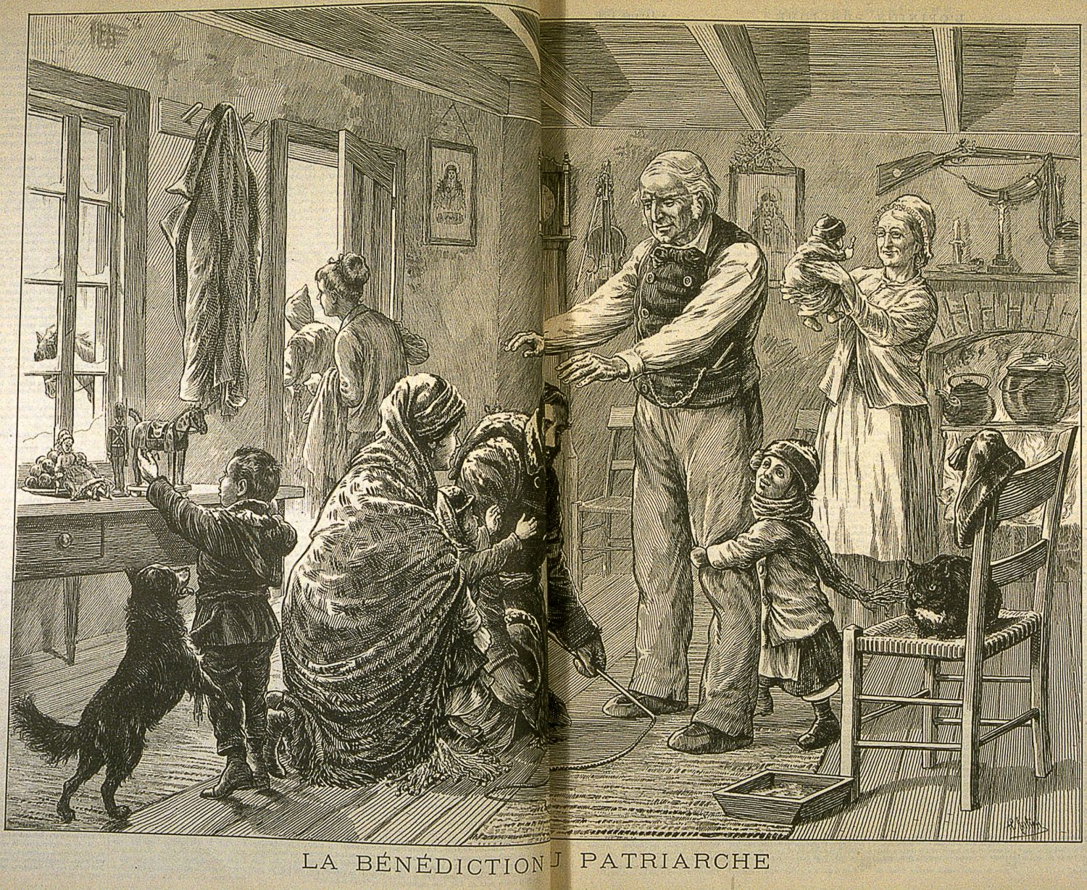
When abortion was a crime in Canada
History of the right to abortion in Canada
1869: Canada adopts its first abortion law.
1892: The abortion laws are set out in the first Canadian Criminal Code.
Julien, Henri. La bénédiction du patriarche. L'Opinion publique, Vol. 11, no 2 (January 8, 1880), p. 18-19. Source: https://collections.banq.qc.ca/ark:/52327/2070079
Notes:
INFORMATION FOR THE STUDENTS
Did you know that in 1869, Canada introduced its first abortion law? Before, a person found guilty of performing an abortion could be sentenced to life imprisonment while a woman who caused her own abortion could be sentenced to 7 years in prison.
SUGGESTIONS FOR FURTHER REFLECTION
You could analyze the illustration with the students:
This illustration was drawn in 1880, for Henri Julien, for the Montreal newspaper called L’Opinion publique.
What does it represent?
What do you see at the centre of the image?
What are the details?
What does this illustration tell us about the morals and customs of the time?
ADDITIONAL INFORMATION
The Criminal Code
When it was made public (enacted) in 1892 by the Parliament, the Criminal Code listed several offences that are no longer considered crimes today.
It was modified several times over the years to take into account changes in society.
You could ask the students the following questions: What can you tell me about society at the end of the 19th century? Were people allowed to divorce? Did women have the right to vote? What institution had a lot of power in society at the time?
Ask these questions to facilitate an understanding of the connections between their general knowledge of history and the law.
SOURCES
Éducaloi. Le droit à l’avortement en 4 dates clés. Récupéré en ligne le (date) à (adresse).
Code criminel, 1892, S. C. 1892, ch. 29, art. 272 à 274 et art. 179.
Acte concernant les offenses contre la Personne, S.C.1869, ch. 20, art. 59 et 60.
Mollie Dunsmuis. (1998). « Avortement : Développements constitutionnels et juridiques ». Récupéré le 15 août 2024 à https://publications.gc.ca/Pilot/LoPBdP/CIR/8910-f.htm.
Elspeth Tulloch, « Nous, les soussignées : Un aperçu historique du statut politique et légal des femmes du Nouveau-Brunswick 1784-1984 », dans La justice sera mienne’ : les femmes et les droits légaux, 1985, Moncton, p, x, consulté en ligne : Chapitre II (gnb.ca) (consulté le 15 août 2024).
Voir : Elspeth Tulloch, « Nous, les soussignées : Un aperçu historique du statut politique et légal des femmes du Nouveau-Brunswick 1784-1984 », dans La justice sera mienne’ : les femmes et les droits légaux, 1985, Moncton, p, 82, consulté en ligne : Chapitre II (gnb.ca) (consulté le 15 août 2024). Pour une chronologie des projets de loi visant à modifier le Code criminel en matière d’avortement ou de régulation des naissances, voir : https://www.thecanadianencyclopedia.ca/fr/article/histoire-de-la-regulation-des-naissances-au-canada.

Slide 17

Feminism
Social evolution, social impacts
Source: Alloprof, “What Is… Feminism? | Social Studies | Alloprof”
Notes:
NOTES FOR THE TEACHER
First, play the video.
Second, present the information in the section below called INFORMATION FOR THE STUDENTS.
Third, ask students the following discussion questions:
Why do you think the right to abortion is a feminist demand?
Suggestions for further reflection:
So that women can have control over their bodies and have children only if they choose to.
So that women can have safe abortions if they decide to end an unwanted pregnancy.
Both previous answers have an impact on women’s social equality.
INFORMATION FOR THE STUDENTS
Society and the law change over time.
Social movements are created to ask for social change.
Social movements can influence laws (protests, political actions, etc.).
A clear example of social movements’ influence on the evolution of laws is the feminist movement. Over the last few centuries, many concepts supported by the feminists were legalized, ex: the right to vote and the decriminalization of abortion. Do you know how laws are changed?
There are two ways the law can change:
The government (of Quebec or Canada) can create new laws or regulations or change existing ones. It can also remove a law or regulation, in other words, cancel it.
The courts (judges) interpret the law to clarify, expand or restrict the application of certain laws or regulations. The courts can also decide that a law, regulation or certain provisions of a law or regulation cannot be applied, for example when they go against the basic rights and freedoms protected by the Québec Charter of Human Rights and Freedoms or the Canadian Charter of Rights and Freedoms. No law in Quebec can contradict these two charters.
The video on this slide presents the history of the feminist movement. Today, the feminist movement works to protect the progress made by earlier generations. While recent feminist efforts are influenced by different ideas and are therefore not all the same, the movement generally fights for changes that would stop violence and discrimination against women. This work is not easy because there is growing opposition from anti-feminist and masculinist groups.
SOURCES
https://histoire.recitus.qc.ca/periode/explorer/1945-1980/page/feminisme
https://paricilademocratie.com/approfondir/femmes-societe-et-politique/755-qu-est-ce-que-le-feminisme-

Slide 18
1969: Abortion is legal … under certain conditions.
History of the right to abortion in Canada
If the woman’s life or health is at risk
Notes:
INFORMATION FOR THE STUDENTS
In 1969, the Canadian Parliament introduced a law that modified the Criminal Code: abortion was now legal, but only if the woman’s life or health was at risk.
To get an abortion, legally, a woman had to obtain a certificate given by a committee of doctors from an accredited hospital.
Abortions under other circumstances were considered crimes: if the procedure in law was not respected, the abortion was still a crime with a possible of life sentence imprisonment for the person that performed the abortion, such as a doctor, and two years of imprisonment for a woman who had an abortion.
SOURCES
Projet de loi C-150 : Loi modifiant le droit pénal, L. C.1968-1969, ch. 38, art. 18.
Ce projet de loi, aussi connu sous le nom de Loi omnibus, est adopté le 14 mai 1969.
Pour le consulter en ligne voir : https://parl.canadiana.ca/view/oop.bills_HOC_2801_2/361.
Code criminel, S.R.C.. ch. C-34, art. 251.

Slide 19
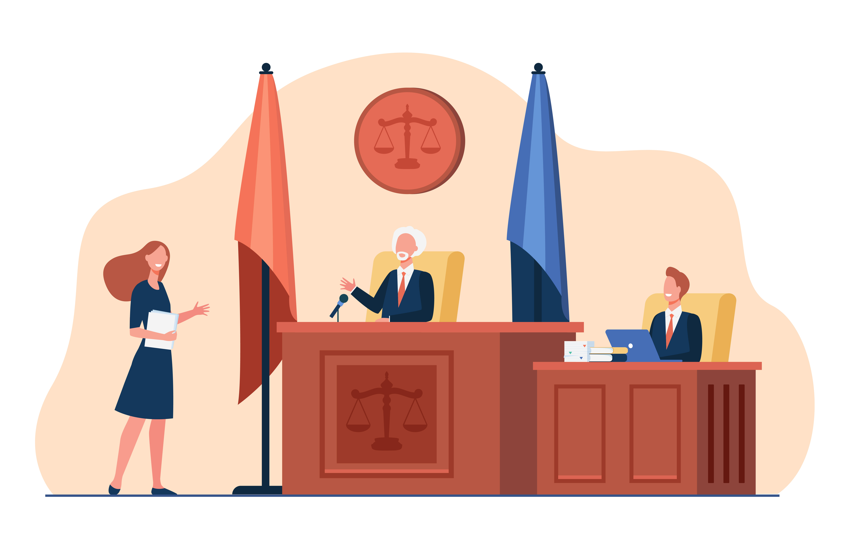
Abortion is no longer a crime in Canada
History of the right to abortion in Canada
1988: The Supreme Court of Canada decriminalizes abortion.
1989: The Supreme Court of Canada confirms that abortion only concerns the woman herself.
Notes:
INFORMATION FOR THE STUDENTS
Around the end of the 1980s, the right to abortion was greatly transformed, this time by the Supreme Court of Canada.
ADDITIONAL INFORMATION
Decriminalizing an act removes the prohibition and the sanctions; while legalizing authorizes and regulates the act.
More specifically:
Decriminalizing an action means that it’s no longer considered a crime. The decriminalized act can no longer be sanctioned criminally.
Decriminalization can happen in 2 ways:
A court decision invalidates a section of a law
The government changes the law — often in the Criminal Code — and removes the offence.
The decriminalized act can remain unregulated, meaning the act is neither prohibited nor governed by another law. This is referred to as a “legal vacuum.”
Legalizing the act means that the law recognizes that the action is allowed and regulates it by setting up specific rules. The legalized act is not criminal anymore, and it becomes regulated, often through laws or regulations that define the conditions under which it is practised (such as minimum age, authorized sites, etc.).

Slide 20

Find Out About the Role of the Supreme Court

Slide 21

What is the Supreme Court?
The highest court in the country and the court of last resort.
Its decisions are final and often change the law.
Notes:
INFORMATION FOR THE STUDENTS
We saw in the last slide that the Supreme Court played a key role in the history of abortion rights in Canada. But what is the Supreme Court of Canada?
The Supreme Court is the highest court in the country. It’s the court of last resort. The Supreme Court is made up of of nine judges, three of who must come from Quebec. The court is located in Ottawa.
One of the roles of the Supreme Court of Canada is to examine cases that come from all provinces or territories to determine if there’s an ‘error of law’. This is referred to as applying for a leave to appeal a judgment.
The judges examine judgments that are important for Canada as a whole, in areas of the law that are unclear. For this reason, it’s necessary to ask the permission of the Supreme Court judges to have the right to submit a case. Supreme Court decisions are final and often change the applicable law. This was the case for abortion.
ADDITIONAL INFORMATION
The difference between applicable law and laws and regulations
Laws and regulations are the written rules adopted by the government (provincial or federal). For example, the Youth Protection Act, the Criminal Code and the Canadian Charter of Rights and Freedoms are laws.
The applicable law is broader. It includes the laws, regulations and decisions made by courts to clarify a rule or overturn it. The text of the laws and regulations is not modified by these decisions, but the way they’re applied is.
ADDITIONAL RESOURCES
The Supreme Court of Canada, as explained by the Chief Justice of Canada: https://www.youtube.com/watch?v=4GUpVIrqcDU&t=18s
Video game and docu-course on the Supreme Court of Canada developped by the University of Ottawa and Jurivision : https://supremecourtexperience.ca
SOURCES
Éducaloi. La Cour suprême du Canada. Repéré le 10 septembre 2024 à https://educaloi.qc.ca/capsules/la-cour-supreme-du-canada/.
Loi sur la Cour suprême, LRC 1985, c S-26, art. 2(1), 4 (1), 6, 32(1), 35, 40(1), 42 (2), 58(1)a).

Slide 22

How can the Supreme Court change the law?
The Supreme Court:
reviews judgments made by other courts.
Makes sure the laws respect protected rights.
clarifies how the law applies.
For the right to abortion, the Court clarified several aspects of the law.
Notes:
NOTES FOR THE TEACHER
After presenting the content, ask the students the following comprehension questions and have them answer them in their Student Workbook:
What is the Supreme Court?
The Supreme Court is the highest court in the country. It is the court of last resort.
Why is the highest court in the country the court of last resort?
The Supreme Court is responsible for upholding the Constitution, the Canadian Charter of Rights and Freedoms, and the resulting laws, such as the Criminal Code. In other words, making sure these laws are respected.
INFORMATION FOR THE STUDENTS
The Supreme Court is responsible for making sure the Constitution, the Canadian Charter of Rights and Freedoms, and the resulting laws, such as the Criminal Code are respected. It makes sure that judgments made by other courts respect Canadian laws, and that laws respect the rights protected by the Constitution and the Canadian Charter of Rights and Freedoms.
When it reviews a judgment or analyzes a law or regulation, the Supreme Court can interpret the law or regulation to clarify its scope or expand or limit its application. It can also decide that a provision of the law or regulation is illegal since it goes against fundamental rights. The provision will then be overturned by the judgment (in other words, it will stop its application).
ADDITIONAL RESOURCES
The Supreme Court of Canada, as explained by the Chief Justice of Canada: https://www.youtube.com/watch?v=4GUpVIrqcDU&t=18
SOURCES
Éducaloi. La Cour suprême du Canada. Repéré le 10 septembre 2024 à https://educaloi.qc.ca/capsules/la-cour-supreme-du-canada/.
Loi sur la Cour suprême, LRC 1985, c S-26, art. 2(1), 4 (1), 6, 32(1), 35, 40(1), 42 (2), 58(1)a).

Slide 23

Review of the two cases that changed the status of abortion in Canada
History of the right to abortion in Canada
1988 – The Morgentaler case: When a section in the Criminal Code … wasn’t legal!
1989 – The Chantale Daigle case confirmed a woman’s right to choose.
Notes:
INFORMATION FOR THE STUDENTS
As indicated in the timeline, toward the end of the 1980s, the right to abortion was greatly transformed by the Supreme Court of Canada.
The Morgentaler case (1988)
Dr. Morgentaler and two other doctors were charged with performing illegal abortions, in other words, ending women’s pregnancies without the permission of a committee of doctors as it was required under the Criminal Code at the time. Several trials took place, and it was a complex case. The doctors were initially acquitted (cleared of charges), but the decision was appealed. Over the course of the judicial proceedings, various judges questioned whether the section of the Criminal Code on abortion was legal, until the Supreme Court judges finally settled the subject.
Dr. Morgentaler and his peers argued that they could not be found guilty of performeing illegal abortion because the section of the Criminal Code that regulates abortion rights violated the Canadian Charter of Rights and Freedoms. They asked the court to invalidate that section of the law and that the trial be stopped. The Supreme Court ruled in their favour (decided Morgentaler arguments were right)… but that’s all we’ll say for the moment because you’re going to be playing the role of the Supreme Court judges in this case in an upcoming activity.
The Chantale Daigle case (1989)
In 1989, the Supreme Court made another decision on abortion.
In this case, Chantale Daigle was pregnant and wanted to get an abortion. Her spouse, Jean-Guy Tremblay, was becoming controlling and violent. As a potential future father, he didn’t want her to get an abortion. He asked the courts to prevent Chantale Daigle from ending her pregnancy.
In the judgment Tremblay v. Daigle, the Supreme Court decided that neither the fetus nor the potential father have the right to prevent a woman from having an abortion. The fetus isn’t considered a human being or a person under the law and doesn’t have a legal status. Therefore, the fetus doesn’t have the “right to life”, that’s usually guaranteed by the Canadian Charter of Rights and Freedoms. The potential father of the fetus didn’t have the power to oppose a woman’s decision to go through a pregnancy or end it. Nothing in the law gave him that power.
SOURCES
Éducaloi. (25 mai 2023). La course contre la montre de Chantal Daigle. Repéré le 10 septembre 2024 à https://educaloi.qc.ca/decryptage/la-course-contre-la-montre-de-chantale-daigle/.
R. c. Morgentaler, 1988 CanLII 90 (CSC), [1988] 1 RCS 30
Tremblay c. Daigle, 1989 CanLII 33 (CSC), [1989] 2 RCS 530.
Mary F. Bishop. (2021). Histoire de la régulation des naissances au Canada. Repéré le 9 septembre 2024 à https://www.thecanadianencyclopedia.ca/fr/article/histoire-de-la-regulation-des-naissances-au-Canada.

Slide 24

Activity
Judge for a Day:
You Get to Decide!
Notes:
NOTES FOR THE TEACHER
You can do take the quiz as a class or divide the students into two teams and have them compete to answer the questions.
You could also do this activity at the end of the first session or the beginning of the next session.
SOURCES
Éducaloi. Avortement: gratuit et légal tout au long de la grossesse. Repéré le 4 septembre 2024 à https://educaloi.qc.ca/capsules/avortement/.
Éducaloi. L’avortement quand tu as moins de 18 ans. Repéré le 4 septembre 2024 à https://educaloi.qc.ca/capsules/lavortement-quand-tu-as-moins-de-18-ans/.
Éducaloi. Santé: petit guide à l’intention des femmes. Repéré le 10 septembre 2024 à https://educaloi.qc.ca/dossier/sante-femmes/#sujet-5.

Slide 25
Judge for a Day: You Get to Decide!
You have to play the role of a Supreme Court judge!
The chief justice of the Supreme Court assigned you an important case and you must make a decision.
Notes:
NOTES FOR THE TEACHER
​
Read the information on the slide with students.

Slide 26
The activity
Like a real judge, before coming to a decision and writing your judgment, you must:
Read the case.
Familiarize yourself with the Canadian Charter of Rights and Freedoms.
Familiarize yourself with the role of a Supreme Court judge.
Carefully read the documents in the case, then answer the questions in the Student Workbook, p. 6.
Next, write your judgment and give it to the chief justice (your teacher).
Notes:
NOTES FOR THE TEACHER
​
Give out the instructions for the activity.
Explain to students that they must follow legal reasoning and express their conclusions in their judgment. They’re not being asked to recreate the conclusions of the Supreme Court judges.
The next few slides present the content of the case. You can present it to the students or have them read the texts in the Student Workbook (pages 9 to 15).

Slide 27


Case Content

Slide 28
Document 1 :
Introduction to the Canadian Charter

Slide 29

Why do the judges have to take the charters into account?
The charters outline the main rights and freedoms that a society guarantees to its citizens.
The Canadian Charter of Rights and Freedoms
1982
The most important law in Canada – part of the Constitution
Respected by all governments and public institutions in Canada
Notes:
NOTES FOR THE TEACHER
​
Read the information on the slide. You can determine the students’ prior knowledge by asking them questions about the slide before presenting the content.
After presenting the content, ask the students the following comprehension questions and have them answer them in their Student Workbook:
Question: What is a charter?
Answer: It’s a legal text that defines the main rights and freedoms guaranteed to society’s citizens.
Question: Who must respect the Canadian Charter of Rights and Freedoms?
Answer: All governments in Canada, like the Canadian and Quebec governments, must respect the Canadian Charter.
INFORMATION FOR THE STUDENTS
The charters guarantee the human rights and freedoms of citizens, sometimes referred to as fundamental rights and freedoms. Here are a few examples of rights and freedoms protected by the Canadian Charter of Rights and Freedoms:
The right to freedom of expression
The right to privacy
The right to be treated with equality and not be discriminated
The right to life and to the security of a person
The Canadian Charter of Rights and Freedoms
It was introduced in 1982.
It contains the basic rights recognized in Canada.
It’s a part of the Constitution. The Constitution is the most important law in Canada. It applies to every province. The Canadian Charter and the Constitution govern all other federal and provincial laws.
Usually, all laws passed by the federal and provincial governments must respect the Charter and they cannot oppose or contract it, although there are some exceptions.
The governments must also respect the Canadian Charter and the Constitution when they act or make decisions.
The government includes federal and provincial departments, the Royal Canadian Mounted Police, the Sureté du Québec and the other provincial police forces, municipalities, public schools, municipal police, etc.
Interpretation of the charters
In the decisions judges make, they’re asked to interpret the charters to specify their meaning. That’s what happened when the Supreme Court of Canada overturned the section on abortion rights. How charters and other laws are interpreted is based on the judgments made over the years.
ADDITIONAL INFORMATION
NOTE: You could watch the following video in class: Éducaloi. Video as part of Quebec Legal Education Week: Qu’est-ce qu’une charte des droits et libertés? (1m.58s.) Retrieved September 10, 2024 at https://www.facebook.com/watch/?v=1776404835865853.
You could ask students the following question:
Do you know any other charter? (e.g., the Quebec Charter of Human Rights and Freedoms, the Charter of the French Language)
The Charter of Human Rights and Freedoms
It’s sometimes called the Quebec Charter.
It was introduced in 1975.
It contains the fundamental rights guaranteed in Quebec. It only applies in Quebec. It has be respected by the Quebec government, but also by non-governmental organizations such as private business and schools. It also has to be respected by the citizens of Quebec, for example: employers and employees, landlords and tenants, merchants and their customers.
The Quebe Charter is not part of the Constitution. However, other Quebec laws must almost always respect the fundamental laws it sets out.
​
SOURCES
« Charte », « Charte des droits et libertés de la personne » et « Charte canadienne des droits et libertés » et dans Hubert Reid et Simon Reid. (2023). Dictionnaire de droit québécois et canadien (adaptation numérique de la 6e édition par le CAIJ). Repéré le 10 septembre 2024 à https://dictionnaires.caij.qc.ca/recherche#t=edictionnaire&sort=relevancy&m=dico&dico=dictionnaire-reid-6.
Éducaloi. Les lois au Québec et au Canada. Repéré le 10 septembre 2024 au https://educaloi.qc.ca/capsules/les-lois-au-canada-et-au-quebec/.

Slide 30
Document 2:
The Role of a Supreme Court of Canada Judge

Slide 31
What do the judges do?
Step 1: Approve the appeal
Step 2: Read the case
Step 3: Lead the hearing
Step 4: Make a decision
Step 5: Write a judgment
Notes:
INFORMATION FOR THE STUDENTS
​Step 1: Approve the appeal
The Supreme Court doesn’t agree to hear all the cases submitted to it. Generally, judges agree to only hear cases that are important to the country as a whole or that relate to areas of the law that are unclear.
Step 2: Read the case
The judges first read the case submitted to them by the chief justice. The case contains the testimonies, evidence and all previous court decisions.
At this stage, lawyers generally don’t have new information or witnesses to present to the judges.
The case also includes something called briefs. Briefs are prepared by both parties in the case and are a written presentation of their arguments.
Step 3: Lead the hearing
A Supreme Court hearing is a public session during which both sides of the case make an oral presentation of their arguments. The judges can ask questions and request clarifications during this presentation that usually takes about 2 hours.
Cases are usually presented in front of at least a five judges, but sometimes there can be more. It must always be an odd number of judges so that a majority can make a decision. A Supreme Court decision doesn’t have to be unanimous, unlike, for example, the decision made by a jury in a criminal trial.
The hearing is held in a special room decorated in red. In this room, the judges sit on a bench in front of the public and the representatives for each side.
Step 4: Make a decision
After the hearing, the judges return to their office to begin the tricky task of settling the debate and making a fair decision that respects the law. Most of the time, decisions are written, but sometimes the judges present their decision orally.
This involves long hours of reading, reflection and writing! It’s a huge responsibility because Supreme Court decisions have an impact across Canada. Before making their decision, the judges meet to compare their opinions.
The judges may render a unanimous opinion, but sometimes one or more judges do not share the majority position of the judges. This is referred to as a dissenting opinion.
For step 5, move on to the next slide.
SOURCES
Loi sur la Cour suprême, LRC 1985, c S-26, <https://canlii.ca/t/6c5q5> consulté le 2024-08-21 (à jour au 2024-06-2024), 40(1), art. 42 (2) et 58(1)a).
Loi sur la Cour suprême, LRC 1985, c S-26, <https://canlii.ca/t/6c5q5> consulté le 2024-08-21 (à jour au 2024-06-2024), art. 62(2)
Voir Loi sur la Cour suprême, LRC 1985, c S-26, <https://canlii.ca/t/6c5q5> consulté le 2024-08-21 (à jour au 2024-06-2024), art. 62(3).
Les avocates ou les avocats plaident une heure chacun : Cour suprême du Canada, Règles de la, DORS/2002-156, art. 71 (1) et 71 (5).
Loi sur la Cour suprême, LRC 1985, c S-26, <https://canlii.ca/t/6c5q5> consulté le 2024-08-21 (à jour au 2024-06-2024), art. 25. Le quorum peut parfois être de quatre juges (art. 28(2) et 29).
Loi ? Règlement ? Voir Cour suprême du Canada - Rétrospective annuelle 2019 (scc-csc.ca) (consulté le 21-08-2024).
R c. Brydon (1995) 4 R.C.S. 253 et Pierre Béliveau et Martin Vauclair, Traité général de preuve et de procédures pénales, 20e éd, Cowansville (Qc), Yvon Blais, 2013, aux par 2398, 2434 (trouver l’équivalent dans le Traité général de preuve et de procédure pénales 2024, 31e édition).
Éducaloi. Juge. Repéré le 10 septembre 2024 à https://educaloi.qc.ca/capsules/juge/.
Cour suprême du Canada | l'Encyclopédie Canadienne (thecanadianencyclopedia.ca), consulté en ligne (21-08-2024).

Slide 32

Write a judgment
Before making their decision, the judges meet to compare their opinions.
Once each judge has made their decision, the chief justice chooses the judge who will write the majority’s decision.
In the judgment, the judges use legal arguments to explain why the majority has arrived to their conclusion. This is referred to as the reasons of the judgment.
Notes:
NOTES TO THE TEACHER
Present the information on the slide and the additional information.
After presenting the content, ask students the following comprehension questions and have them answer them in their Student Workbook:
What are the reasons of the judgment?
Answer: They are legal arguments that explain why the judges took a certain decision.
What happens if the decision of the judges is not unanimous?
Answer: The minority judges also write their “reasons.“
ADDITIONAL INFORMATION
The judges can make a unanimous decision. However, it often happens that one or more judges don’t share the same opinion as the majority. This is called a dissenting decision. In this case, the minority judges also write their own “reasons.” All the judges’ opinions are kept in the same judgment.
SOURCES
Tiré de la LLVD Le juge, consultée en ligne Juge | Éducaloi (educaloi.qc.ca) (21-08-2024).
Cour suprême du Canada | l'Encyclopédie Canadienne (thecanadianencyclopedia.ca), consulté en ligne (21-08-2024).
Cour suprême du Canada | l'Encyclopédie Canadienne (thecanadianencyclopedia.ca), consulté en ligne (21-08-2024).

Slide 33
Document 3:
The Morgentaler Case

Slide 34

Who was Dr. Morgentaler?
A symbol of the movement to decriminalize abortion.
A doctor who offered abortion services.
Since 1967, he fought for women’s right to abortion.
Back then, iIllegal abortions threatened the health and lives of women.
Notes:
INFORMATION FOR THE STUDENTS
In 1955, Dr. Henry Morgentaler started working as a family doctor in Montreal. Among other things, he provided women and men with contraception, a practice that was not common at the time.
In 1967, he participated to public hearings on changes that had to be made to the Criminal Code. He argued that all women should have the right to abortion.
In his opinion, abortions that were performed illegally at the time, women’s health and lives seriously at risk.
Over the years, Dr. Morgentaler opened up abortion clinics in several places in Canada. He was taken to court several times, was found guilty, then acquitted (released from accusations) several times by various juries. He spent 10 months in prison.
Abortion was decriminalized in 1988 during one of these court cases. Dr. Morgentaler became a symbol of the fight and movement to decriminalize abortion. He fought for this right his whole life and risked his freedom and security.
He died in 2013 at the age of 90.
SOURCES
Radio-Canada. (26 janvier 2018). Il y a 30 ans: la victoire juridique du docteur Morgentaler. Repéré le 19 août 2024 à https://ici.radio-canada.ca, archives.
Hélène Bussetti, Le docteur Henry Morgentaler est décédé. Repéré le 24 août 2024 à www.ledevoir.com.

Slide 35

The Morgentaler judgment:
An overview of the case
In 1982, Dr. Morgentaler and two other doctors were charged with performing illegal abortions. The case went all the way to the Supreme Court.
Notes:
INFORMATION FOR THE STUDENTS
In 1982, Dr. Morgentaler and two other doctors were accused of performing illegal abortions, in other words, ending the pregnancies of women who didn’t receive an authorization from a committee of doctors as it was required at the time under the Criminal Code. The case went all the way to the Supreme Court.
The Criminal Code
There was a section in the Criminal Code in 1982 that banned abortion except when the life or health of the pregnant women were at risk. To have a legal abortion, a pregnant woman had to receive a certificate given by a committee of doctors. The doctors were the ones to decide if the pregnancy put the the women’s health or life at risk.
The committees of doctors
Not every hospital in Canada had a committee of doctors. A woman who wanted to have an abortion sometimes had to travel to get access to one. Also, the delays in obtaining an abortion could be long.
Abortion methods
The further along the pregnancy, the greater the higher the risk of the abortion for the woman’s health. Several medical techniques are used to perform an abortion at each stage of the pregnancy. An abortion performed as early as possible lowers the risk of complications or death for the woman.
SOURCE
R. c. Morgentaler, 1988 CanLII 90 (CSC), [1988] 1 RCS 30.

Slide 36
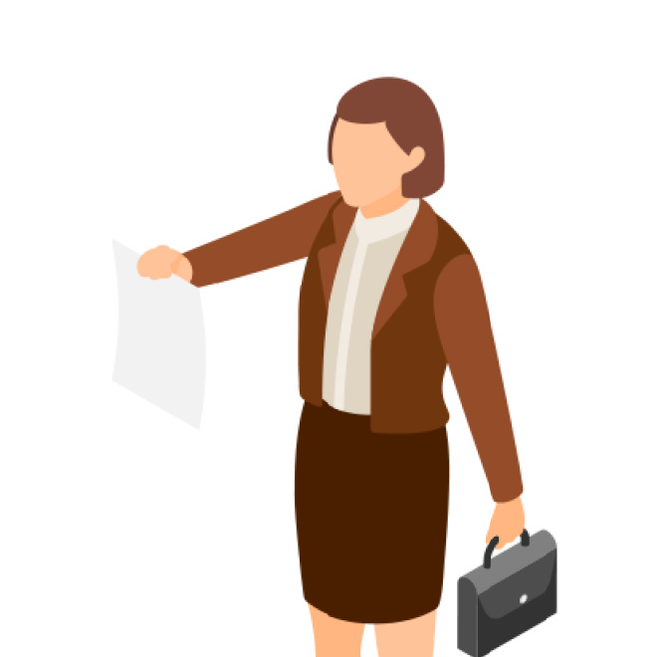
The Canadian Charter
One of Morgentaler’s arguments: the section of the Criminal Code that governed the right to abortion did not not respect the Canadian Charter.
Morgentaler asked
the section be revoked;
the court process to be stopped.
Notes:
NOTES FOR THE TEACHER
After presenting the content, ask students the following comprehension questions and have them answer them in their Student Workbook:
What was the main argument presented by Dr. Morgentaler and his colleagues in support of their position?
The argument: The section of the Criminal Code on the abortion rights didn’t respect the Canadian Charter of Rights and Freedoms.
INFORMATION FOR THE STUDENTS
Among the arguments presented to defend their position, the doctors stated that they couldn’t be found guilty of performing illegal abortions because the section of the Criminal Code on abortion rights didn’t respect the Canadian Charter of Rights and Freedoms.
SOURCE
R. c. Morgentaler, 1988 CanLII 90 (CSC), [1988] 1 RCS 30.

Slide 37
The Criminal Code on abortion in 1982 (passages)
(1) Every one who, with intent to procure the miscarriage of a female person, whether or not she is pregnant, uses any means for the purposes of carrying out his intention is guilty of an indictable offence and liable to imprisonment for life.
(2) Every female person who, being pregnant, with intent to procure her own miscarriage, uses any means or permits any means to be used for the purposes of carrying out her intention is guilty of an indictable offence and liable to imprisonment for a term not exceeding two years.
Notes:
NOTES FOR THE TEACHER
​
Read the information on the slide.
SOURCES
Code criminel, S.R.C.. ch. C-34, art. 251(4) c).
Pour lire le libellé de l’article au complet voir R. c. Morgentaler, 1988 CanLII 90 (SCC), [1988] 1 SCR 30, <https://canlii.ca/t/1ftjt>, au par. 4.

Slide 38
The Canadian Charter of Rights and Freedoms (passages)
1. The Canadian Charter of Rights and Freedoms guarantees the rights and freedoms set out in it subject only to such reasonable limits prescribed by law as can be demonstrably justified in a free and democratic society.
Life, liberty and security
7. Everyone has the right to life, liberty and security of the person and the right not to be deprived thereof except in accordance with the principles of fundamental justice.
Notes:
NOTES FOR THE TEACHER
​
Read the information on the slide.
SOURCE
Loi constitutionnelle de 1982, Annexe B de la Loi de 1982 sur le Canada (R-U), 1982, c 11, art. 1 et 7.

Slide 39
The question asked to the judges
Does the section of the Criminal Code on the right to abortion respect the Canadian Charter, specifically section 7?
Notes:
NOTES FOR THE TEACHER
Ask students the following questions to spark their reflection:
When did abortion become legal?
What made it possible to change this right?
How has this right evolved? How are laws changed? Who changes them? How?
Who do you think was punished before if an abortion was performed?
What do you think were the possible sentences or consequences?
Is the right to abortion governed by a federal law? Or by a provincial law?
Note down the students’ answers or write them up on the board.
Leave the students hanging or give them a few clues and tell them that all these questions will be answered during the upcoming sessions.
We’ll see through the evolution of abortion rights that laws can be changed and how an act that was once prohibited, punished and condemned (criminal) can become a legal and permissible act.

Slide 40
Work Session!

Slide 41
The Decision and What We Learned

Slide 42
The decision of the Supreme Court judges
Based on different reasonings, the majority of the judges concluded the same thing: The section on abortion in the Criminal Code had an impact on women’s health that wasn’t justified. It also violated their right to security.
The section of the law on abortion had to be overturned.
Two judges didn’t agree with the majority.
Notes:
NOTES FOR THE TEACHER
After presenting the content, ask students the following discussion question:
Was the class's decision similar to the Supreme Court judges’ decision?
Then, share the decision of the majority of students and a few dissenting opinions. ​
Ask the following questions to trigger the students’ reflection: ​
Did your judgment agree with the majority’s decision? ​
What arguments support your decision?
INFORMATION FOR THE STUDENTS
Judges sometimes come to different decisions. In fact, in this decision, even though the majority of judges agreed that the section on abortion didn’t respect the rights protected by the Canadian Charter, they didn’t come to this conclusion for the same reasons. For example, the majority judges’ decision didn’t agree on the objectives of the Criminal Code section on abortion: was the priority to protect the pregnant woman whose pregnancy put her health at risk or to protect the fetus?
Based on different reasoning, they came to the same conclusion: the section of the Criminal Code on abortion had an unjustified impact on women’s health and violated their right to security. Also, it created an injustice for women because the criteria for obtaining a legal abortion were too difficult to meet. The section of the law on abortion had to be overturned. This judgment led to the acquittal of Dr. Morgentaler and the other two doctors, which means they were found not guilty.
Two ‘dissenting’ judges came to a different conclusion. They thought that the section on abortion didn’t violate the Canadian Charter.
The dissenting judges acknowledged that some women could encounter obstacles or delays in accessing abortion. However, they found that these difficulties are caused by problems in the system, not by law itself. In result, for them, the Criminal Code section didn’t violate the right to women’s security.
In their opinion, the Canadian Charter didn’t protect the right to abortion.
The role of the Supreme Court is to interpret and apply the law, as it is written. The dissenting judges thought it was up to Parliament—not the courts—to decide if it’s necessary to create, modify or ban rules of law to correct problems in the application and organization of the system.
SOURCE
R. c. Morgentaler, 1988 CanLII 90 (CSC), [1988] 1 RCS 30, <https://canlii.ca/t/1ftjs>

Slide 43


Since Morgentaler
The section on abortion in the Criminal Code was overturned in 1988.
Therefore, abortion is no longer a crime.
Women have the right to freely proceed to abortion.​
Notes:
NOTES FOR THE TEACHER
​
Read the information on the slide.
SOURCE
R. c. Morgentaler (1988) 1 R.C.S. 30

Slide 44
From a crime to a right
Abortion is no longer a crime
Today
However, there have been several attempts to limit the right to abortion.
Why do you think so?
Notes:
NOTES FOR THE TEACHER
Ask the students the question on the slide.
You can present the following information to complement the discussion:
Even though it was decriminalized, there have been various attempts to remove or limit the right to abortion.
Judges are not the only ones to play a role in society’ rights and freedoms. It’s also an ethical question of general interest.
In the Morgentaler decision, the Supreme Court overturned the section of the Criminal Code on abortion, but also left a possibility for the government to regulate the right to abortion or even restrict it, in order to protect the fetus.
In 1989, the Conservative government of Brian Mulroney tried to introduce a law to regulate this right. The first bill proposed criminalizing abortions that were performed when a woman’s health wasn’t at risk. The bill was passed by the House of Commons but the Senate rejected it.
Political and social players can try to influence society on these issues. Over the years in Canada, members of political parties have proposed other bills to regulate and restrict the right to abortion. They were all defeated. Activists also use picketing and intimidation outside abortion clinics to influence the opinion of women and society on the right to abortion.
In 2016, the Quebec government passed a law to prevent protests around or close to abortion clinics.
If you want to to take their reflections further, you can ask the following questions:
Do you know of countries that have modified or tried to modify their right to abortion in the last few years?
The United States: https://ici.radio-canada.ca/nouvelle/1990890/avortement-biden-parti-republicain-programme-
France: https://ici.radio-canada.ca/nouvelle/2053736/france-premier-pays-avortement-constitution#:~:text=L'%20IVG%20a%20%C3%A9t%C3%A9%20l%C3%A9galis%C3%A9e,r%C3%A9v%C3%A9l%C3%A9%20s'%C3%AAtre%20fait%20avorter.
Brazil: https://www.ledevoir.com/monde/ameriques/814885/manifestations-bresil-contre-criminalisation-avortement-issu-viol , https://www.lapresse.ca/international/amerique-latine/2024-06-15/bresil/manifestation-contre-la-criminalisation-de-l-avortement-tardif.php
SOURCES
Lemonde, Lucie. « Les menaces au droit à l’avortement et à l’autonomie des femmes enceintes. » Les Cahiers de droit, volume 50, numéro 3-4, septembre–décembre 2009, p. 611–635. https://doi.org/10.7202/039335ar (consulté le 9 décembre 2024).
Mollie Dunsmuir. (18 août 1998, mise à jour)). Avortement : développements constitutionnels et juridiques. Récupéré le 4 septembre 2024 à https://publications.gc.ca/Pilot/LoPBdP/CIR/8910-f.htm#D%C3%89FINITION.

Slide 45


Resources
Dr. Morgentaler | The Doctor Who Risked His Life For Abortion Rights - part 1
Dr. Morgentaler | The Doctor Who Risked His Life For Abortion Rights - part 2
Abortion: Free and Legal Throughout Pregnancy | Éducaloi (educaloi.qc.ca)
Abortion for People Under 18 (educaloi.qc.ca)

Slide 46


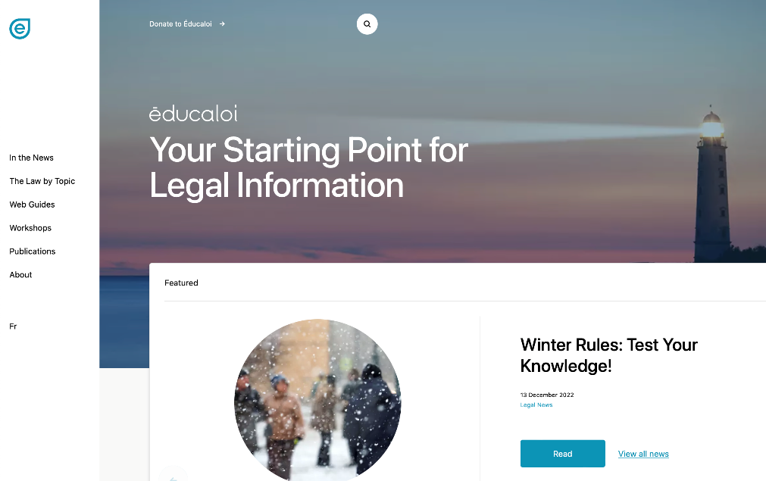



Instagram/educaloi_en
YouTube/educaloi
Facebook/educaloi
educaloi.qc.ca/en

