Slide 1
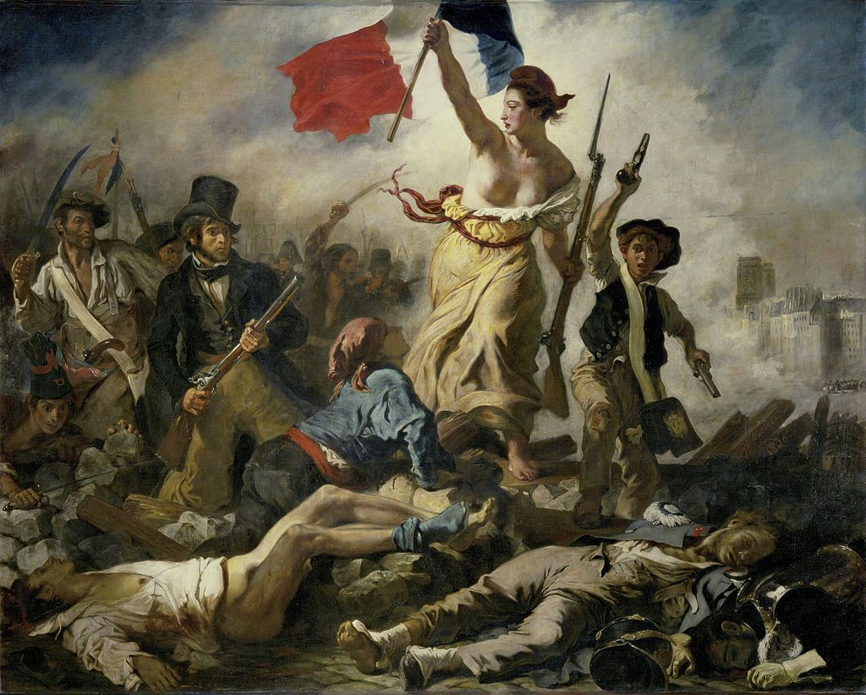
The French Revolution
Overview
The Revolution brought about important changes
The Canadian state: influenced by the Revolution
Notes:
INFORMATION FOR STUDENTS
The symbols on this slide are used throughout this presentation to help students remember the various themes.
Sources:
La liberté guidant le peuple, by Eugène Delacroix — Erich Lessing Culture and Fine Arts Archives via artsy.net, pubic domain, https://commons.wikimedia.org/w/index.php?curid=27539198 (page consulted January 7, 2021).

Slide 2
Age of Enlightenment
The French Revolution
The big changes brought about by the revolution:
The modern state
The constitution
Theoretical equality
The Canadian state heir to these principles!

Slide 3
The French Revolution: Overview

Slide 4
The French Revolution: Overview
Triggers
Absolute, divine right monarchy Agricultural crisis Financial crisis Social structures
Events:
February – March 1789
Drafting of the cahiers de doléances (lists of grievances)
May 5, 1789
Start of the Estates General
July 14, 1789
Storming of the Bastille
August 4, 1789
Abolition of feudal privileges
August 26, 1789
Universal Declaration of the Rights of Man and of the Citizen
October 1, 1791
First French constitution
1793-1794
The Reign of Terror
Notes:
INFORMATION FOR STUDENTS
Ask students how each of the elements in the table “Triggers“ were causes of the Revolution. Possible elements of answers:
The monarchy : The king lived in the Château de Versailles, built specifically to keep people away from royalty. Increasingly, the people were seen as a threat to the king’s security. Members of the Third Estate had no real power and faced a ruling class less and less interested in their welfare.
Agricultural crisis: The winter of 1788-1789 was especially cold and harvests were very bad. People were increasingly suffering from famine.
Financial crisis: Largely due to the bad harvest of 1789, prices increased dramatically. The price of bread in Paris doubled!
Social structures: The Third Estate, which represented 85% of the population, was impoverished. Wealth was concentrated in the hands of other social classes: the nobility and the clergy. There was little social mobility and it was impossible for peasants to build wealth since the Third Estate was the only one to pay taxes. They were too heavily taxed to accumulate wealth.
Cahiers de doléances (lists of grievances): These were books in which regional assemblies with elected representatives recorded their complaints or wishes. In 1789, the Third Estate was growing restless and its anger getting harder to ignore. A difficult winter, on top of the other factors mentioned above, meant that those in the Third Estate were suffering from famine even more than usual.
Estates General: The Estates General were gatherings of representatives of the three orders (or estates) of the kingdom: the clergy , the nobility and the Third Estate. At these gatherings, participants spoke about problems of the three orders. Serious financial issues led King Louis XVI to convoke the Estates General on May 1, 1789. The participants asked for fundamental changes: a constitution garanteeing individual freedoms and equality of rights and responsibilities of all citizens. On June 20, 1789, representatives of the Third Estate (and certain representatives of the other two orders) took the Serment du Jeu de paumes (tennis court oath), vowing to not disperse until a constitution was adopted. These representatives became the ‘’Assemblée nationale constituante’’, giving rise to the French representative system.
Storming of the Bastille: This event became a symbol of the French Revolution. The people of Paris stormed the Bastille and freed its prisoners. This event ignited the whole country and led many members of the ruling class to leave into exile.
Abolition of feudal privileges: See slide 9 for more details.
Universal Declaration of the Rights of Man and of the Citizen: See slide 10 for more details.
First French constitution: See slide 11 for more details.
The Reign of Terror: On March 10, 1793 the Tribunal révolutionnaire (revolutionary tribunal) was created. It was responsible for trying all so-called counter-revolutionary crimes. With time, the definition of a counter-revolutionary crime became more and more extreme: an enemy of the people included anyone who was trying to quash public freedom. People accused of crimes had no right to question witnesses, or to appeal decisions of the tribunal. It is estimated that 500,000 people were imprisoned and tens of thousand executed.
Sources:
Encyclopédie Larousse en ligne, Cahiers de doléances, https://www.larousse.fr/encyclopedie/divers/cahiers_de_dol%C3%A9ances/182555 (Consulted December 9, 2020)
Encyclopédie Larousse en ligne, États généraux, https://www.larousse.fr/encyclopedie/divers/%C3%A9tats_g%C3%A9n%C3%A9raux/49635 (Consulted December 9, 2020)
Site web de l’Assemblée nationale française, Histoire de l’assemblée nationale, http://www2.assemblee-nationale.fr/decouvrir-l-assemblee/histoire/histoire-de-l-assemblee-nationale [Consulted December 9, 2020]
Encyclopédie Universalis en ligne, Quatorze juillet 1789, https://www.universalis.fr/encyclopedie/quatorze-juillet-1789/ (Consulted December 10, 2020)
Encyclopédie Universalis en ligne, la Terreur, https://www.universalis.fr/encyclopedie/la-terreur/ (Consulted December 10, 2020)

Slide 5
The Enlightenment
Englightenment Philosophers
Locke: "The necessity of pursuing happiness is the foundation of liberty." Rousseau: "Money we have gives us freedom; money we pursue enslaves us.“ Voltaire: "The more enlightened men are, the more free they are."
Natural Rights
The right to life: Human life is valuable, regardless of a person’s social status or wealth. The right to property: to have your own belongings, furniture, property (house, money, etc.) The right to liberty: a fundamental right to freedom of thought, movement and expression
Underpin the existence of …
Notes:
INFORMATION FOR STUDENTS
Enlightenment philosophers promoted ideals of freedom that became a driving force of the French Revolution. Their publications were very popular with the bourgeoisie and helped change the conception of the individual. This new vision and its ideas about individual freedoms and free will was very different from the pre-Revolution society of the learned bourgeoisie. Most of the leaders of the Revolution did their best to build a more just society in which most people enjoyed individual rights (right to life, property and liberty). (Some people, such as prisoners or people in a state of servitude, did not benefit from these rights.)
Sources :
All historical quotes are taken from: dicocitations.lemonde.fr/. Any translations are Éducaloi’s.
Encyclopédie Larousse, « siècle des Lumières », on line: ˂ https://www.larousse.fr/encyclopedie/divers/si%C3%A8cle_des_Lumi%C3%A8res/130660 ˃ (consulted December 14, 2020)
The various rights are also discussed in slide 10.
The equivalent rights in Quebec: Civil Code of Quebec, CQLR, c C-1991, ss 900, 905 and 947:
947. ”Ownership is the right to use, enjoy and dispose of property fully and freely, subject to the limits and conditions for doing so determined by law.
Ownership may be in various modalities and dismemberments.”
900. “Land, and any constructions and works of a permanent nature located thereon and anything forming an integral part thereof, are immovables. [….]”
905. ”Things which can be moved are movables.”
See also Quebec’s Charter of Human Rights and Freedoms, CQLR c-12, art. 1 : ”Every human being has a right to life, and to personal security, inviolability and freedom.
He also possesses juridical personality.”

Slide 6
The French Revolution:
Drives Major Changes!

Slide 7
The French Revolution: Drives Major Changes!
1. Creation of the modern state: the separation of powers
2. Equality before the law:
abolition of the aristocracy
Universal Declaration of the Rights of Man and of the Citizen
3. A constitution

Slide 8
1. Creation of a Modern State: The Separation of Powers
The legislative power
The executive power
The judicial power
Notes:
INFORMATION FOR STUDENTS
States are made up of three branches for creating, applying and interpreting laws. We’ll look at each separately.
This concept was introduced for the first time by the philosopher Montesquieu, who saw the separation of powers as a way to counter absolutism.
To understand the three branches, or powers, we can think of a team sport like hockey. The slides that follow use pictograms to help make a comparaison between the creation of laws and a hockey match.
SOURCES
Henri BRUN, Guy TREMBLAY et Eugène BROUILLET, Droit constitutionnel, 6e éd, Éditions Yvon Blais, Cowansville, 2014, par. II.131, II.76, VI-2.22 and VI-2.23
Nicole DUPLÉ, Droit constitutionnel : principes fondamentaux, 3e éd., Wilson et Lafleur, Montréal, 2014, p.53
Nicole DUPLÉ, Droit constitutionnel : principes fondamentaux, 3e éd., Wilson et Lafleur, Montréal, 2014, p.55 last paragraph
Encyclopédie Larousse, Charles de secondat, baron de La Brède et de Montesquieu, on line: www.larousse.fr/encyclopedie/personnage/Charles_de_Secondat_baron_de_La_Br%C3%A8de_et_de_Montesquieu/133812 (consulted December 2, 2020)

Slide 9
1. Legislative Power
Drafts laws
Decides the rules of the game
Notes:
INFORMATION FOR STUDENTS
When you want to play a game, the first thing to do is to invent the rules. Hockey is no different. If you play in a league, you know that the rules are created by the league. For example, some kinds of physical contact might not be allowed. For players in the National Hockey League, that league decides the rules.
When it comes to government, the power to decide the rules is called the legislative power. This is the power to create laws. Sometimes it is called the power to legislate. We call people who make the laws legislators. These words come from the Latin word lex, which means law.
The legislative branch is the first branch of the state.
SOURCES
Perspective Monde, Pouvoir législatif, École de politique appliquée, Université de Sherbrooke, on line: https://perspective.usherbrooke.ca/bilan/servlet/BMDictionnaire?iddictionnaire=1629#:~:text=Le%20pouvoir%20l%C3%A9gislatif%20(synonyme%20%3A%20branche,pouvoir%20judiciaire%20(les%20tribunaux).&text=G%C3%A9n%C3%A9ralement%2C%20les%20projets%20doivent%20%C3%AAtre,%C3%89tat)%20pour%20devenir%20des%20lois
(consulted January 7, 2021).
Henri BRUN, Guy TREMBLAY et Eugène BROUILLET, Droit constitutionnel, 6e éd, Éditions Yvon Blais, Cowansville, 2014, par. II.84-II.88.

Slide 10
2. Executive Power
Implements laws
Plays hockey and tries to win
Notes:
INFORMATION FOR STUDENTS
Once the rules are in place, we can play. We put on our hockey equipment, grab a puck and we’re off! The purpose of the game – the mission of the players – is to score points and win.
To win you need a strategy. The coach decides which players to play and the captain and players decide on techniques to score goals.
In a political system, the power to implement rules is called the executive power. It’s the power to use laws to reach a goal. For example:
A law can give the government the mission to create three hospitals in the province, but without saying where. The government decides where to put them.
A law can give the government the mission to ensure security in the province. The government can set up police forces to ensure security.
We call this power the executive power because it involves executing missions described in laws.
SOURCES
Perspective Monde, Pouvoir exécutif, École de politique appliquée, Université de Sherbrooke, on line: http://perspective.usherbrooke.ca/bilan/servlet/BMDictionnaire?iddictionnaire=1494 (consulted December 2, 2020)
Henri BRUN, Guy TREMBLAY et Eugène BROUILLET, Droit constitutionnel, 6e éd, Éditions Yvon Blais, Cowansville, 2014, par. II.95-II.99
Creating a hospital: Act respecting health and social services, CQLR c S-4.2, ss 431 and 437
Ensuring public security: Civil Protection Act, CQLR c S-2.3, s 88 (power to declare a state of emergency), s 123 (power to make rules to protect the public), s 67 (powers of the minister of public security). Police Act, CQLR P-13.1, ss. 48, 49 and 112 to 114 (organization of police forces )

Slide 11
3. Judicial Power
Il interprète la loi pour déterminer si une personne la enfreinte (les juges exercent ce pouvoir)
Il est l’arbitre, qui tente d’appliquer les règles du mieux possible
Notes:
INFORMATIONS À TRANSMETTRE AUX ÉLÈVES
Même si les joueurs connaissent les règles du jeu, il arrive qu’ils commettent des fautes dans le feu de l’action. L’arbitre a le pouvoir de décider si le comportement d’un joueur enfreint une règle du jeu et de sanctionner les fautes.
Le pouvoir de sanctionner les personnes qui ne respectent pas les règles du jeu, dans le système politique, s’appelle le pouvoir judiciaire. C’est le pouvoir d’interpréter les lois pour décider si une personne a ou non violé ces lois. Ce pouvoir est exercé par les juges.
SOURCES
Perspective Monde, Pouvoir judiciaire, École de politique appliquée, Université de Sherbrooke, en ligne : https://perspective.usherbrooke.ca/bilan/servlet/BMDictionnaire?iddictionnaire=1637 (consulté le 7 janvier 2021).
Henri BRUN, Guy TREMBLAY et Eugène BROUILLET, Droit constitutionnel, 6e éd, Éditions Yvon Blais, Cowansville, 2014, par. II.89-II.94.

Slide 12
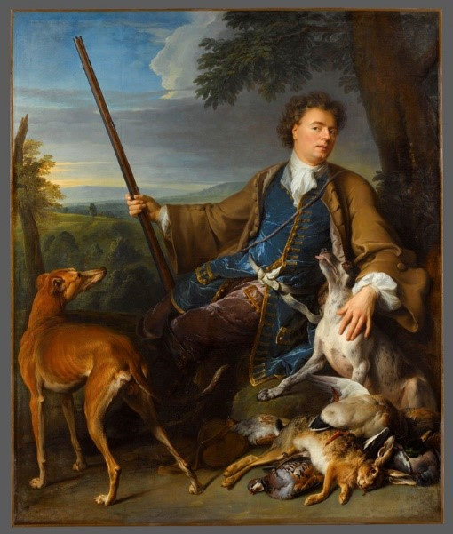
Equality Before the Law (abolition of privileges of the nobility)
On August 4, 1789, members of the assembly voted to abolish feudal privileges:
right to hunt no longer reserved for nobility
abolition of the right of mortmain
abolition of tithes
abolition of justice administered by lords
abolition of restrictions on access to certain professions
Notes:
INFORMATION FOR STUDENTS
This decree, adopted on the evening of August 4, 1789, responded to a lot of the demands of the Third Estate. Before this decree, the nobility had a lot of rights that peasants did not. This led to a widening wealth gap and prevented non-nobles from getting out of poverty. For example, peasants in a state of servitude could not
hunt,
leave land to their children (the right of mortmain gave the land to the lord when serfs died), or
enter certain professions, for example, the ministry or certain ranks of the army.
Also, peasants were subject to justice administered by lords, which was often arbitrary.
Sources:
Encyclopédie Larousse, « nuit du 4 août 1789 » on line: https://www.larousse.fr/encyclopedie/divers/nuit_du_ao%c3%bbt_1789/105784 (consulted December 14, 2020)
Decrees of August 4, 6, 7, 8 and 11, 1789, on line: https://books.google.fr/books?id=Np7A5Q3PqwYC&pg=PA13&dq=D%C3%A9crets+des+4,+6,+7,+8+et+11+ao%C3%BBt+1789&hl=fr&sa=X&ved=0ahUKEwjYqLaL26bQAhXM0xoKHShsCnIQ6AEIHTAA#v=onepage&q&f=false (consulted December 14, 2020)
Louis Firmin Julien Laferrière, Histoire du droit français, Joubert, 1837, p. 510 sq.
Source of photo:
Portrait de l'artiste en chasseur, on line: ˂ https://www.louvre.fr/oeuvre-notices/portrait-de-l-artiste-en-chasseur˃, © 2009 RMN / Stéphane Maréchalle

Slide 13
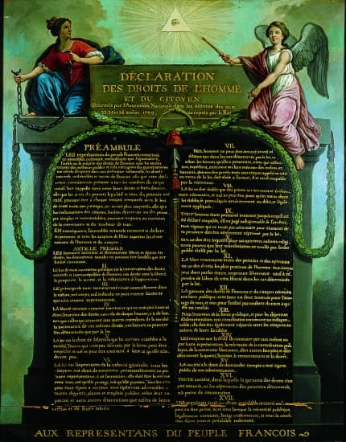
Declaration of the Rights of Man and of the Citizen
Inspired by the American Declaration of Independence (1776) and by Enlightenment principles, the Declaration of the Rights of Man and of the Citizen was adopted on August 26, 1789.
The Declaration
right to liberty (arts. 1, 10 and 11) right to property (art. 17) right to equality before the law (arts. 1 and 6) principle of the separation of powers (art. 16) presumption of innocence (art. 9)
Notes:
INFORMATION FOR STUDENTS
Representatives of the Estates General wanted the new French constitution to be accompanied by a declaration of principles.
The Declaration of the Rights of Man and of the Citizen was inspired by Enlightenment ideas and by the American Declaration of Independence. The French Declaration contained the following:
a preamble
definitions of “natural and inalienable rights“: liberty, property, security and freedom from oppression
recognition of certain principles:
equality before the law
the separation of powers
Sources:
Encyclopédie Larousse on line, Droits de l’homme, https://www.larousse.fr/encyclopedie/divers/droits_de_lhomme/44843 (consulted December 9, 2020)
Élysée, « La déclaration des droits de l'homme et du citoyen », on line: ˂ https://www.elysee.fr/la-presidence/la-declaration-des-droits-de-l-homme-et-du-citoyen ˃ (consulted December 14, 2020)
Image:
Ph. Jeanbor © Archives Larbor

Slide 14
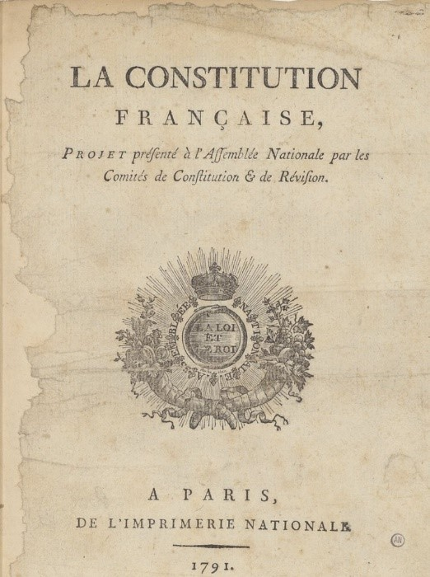
A First Constitution (1791)
What is a constitution? It’s the supreme law of a country.
It sets out :
how government works, and
basic rights of citizens.
All laws must respect the constitution.
Notes:
INFORMATION FOR STUDENTS
The Universal Declaration of the Rights of Man and of the Citizen of 1789 was incorporated into the constitution of 1791.
France has modified its constitution on many occasions. Today, the 5th Republic in France is governed by the constitution of 1958.
The constitution of 1791 also provided for the following:
modalities of the right to vote
national sovereignty
the separation of powers
Sources:
Encyclopédie universalis on line, Constitution de 1791, https://www.universalis.fr/encyclopedie/constitution-francaise-de-1791/, consulted January 19, 2021

Slide 15
The Modern Canadian State: Inspired by the Same Principles

Slide 16
Separation of the Three Powers
Federal
Quebec
Provinces
Legislative
Executive
Judicial
Legislative
Executive
Judicial
Notes:
INFORMATION FOR STUDENTS
The federal government and the provincial governments in each province have the same three powers (legislative, executive and judicial). The three powers are sometimes called the three branches.
But the federal and provincial governments don’t have the same areas of responsibility.
For example, the federal government is responsible for these things, among others:
the army (there is only one army for all of Canada)
banks (the same money is used all across Canada)
For example, provinces are responsible for these things, among others:
hospitals
schools
SOURCES :
Constitution Act, 1867, 30 & 31 Vict c 3, (U.K.) reproduced in RSC 1985, Appendix II, n°5, arts 91 (7) (15), 92 (7) and 93

Slide 17
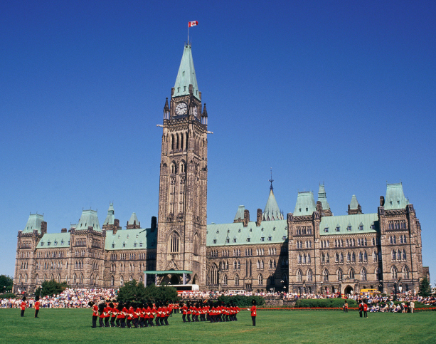
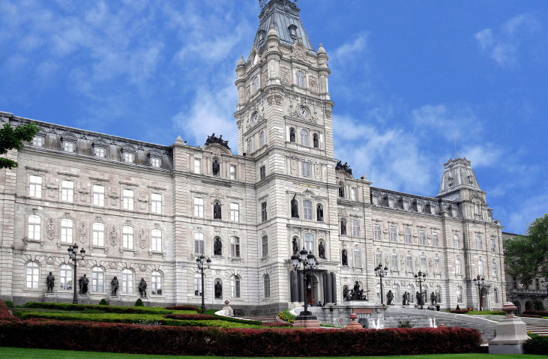
Federal
Quebec
Legislative Power
Legislative Power
Chambre des communes
Assemblée nationale du Québec
+
Sénat
Notes:
INFORMATION FOR STUDENTS
Legislative branch
Creates laws.
The power to legislate is exercised by elected representatives of all the parties. First, laws are drafted. Then the representatives debate and vote on the laws. A draft law becomes an actual law if the majority representatives vote in favour of it.
Canada (federal) Laws are voted on in the House of Commons and in the Senate, which are in Ottawa.
Quebec (province) Laws are voted on in the national assembly in Quebec City.
OPTIONAL INFORMATION
Senate
The Senate is a decision-making body that only exists at the federal level.
Senators are recommended for their positions by the Prime Minister but are formally named by the Governor General.
The main role of the Senate is to study and debate laws proposed by the House of Commons. A proposed law is called a bill. To become a law, a bill must be adopted by both the House of Commons and the Senate and sanctioned (approved) by the Governor General.
In practice, it is very rare for the Senate to refuse to adopt a bill.
One example of this occurred in 1991 when the Senate refused to adopt a bill dealing with abortion, Bill C-43, which arose out of the court case Daigle c. Tremblay.
NOTE TO STUDENTS
For more on the adoption of laws, you can read the article The Process of Passing a Bill on the website of the Canadian Parliament: https://lop.parl.ca/about/parliament/education/ourcountryourparliament/html_booklet/process-passing-bill-e.html (January 7, 2021)
SOURCES
Constitution Act,1867, arts. 17 and 21 and following; 37 and following; 49
Act respecting the National Assembly, CQLR, A-23.1, ss 29-30
Règlement de l’Assemblée nationale, s 219 al.1, p. 256-257 : http://www.assnat.qc.ca/fr/abc-assemblee/fondements-procedure-parlementaire/reglement-assemblee.html
Henri BRUN, Guy TREMBLAY et Eugène BROUILLET, Droit constitutionnel, 6e éd, Éditions Yvon Blais, Cowansville, 2014, par. II.84-II.88 and V-1.273 and following
Perspective Monde, Pouvoir législatif, École de politique appliquée, Université de Sherbrooke, on line : https://perspective.usherbrooke.ca/bilan/servlet/BMDictionnaire?iddictionnaire=1629#:~:text=Le%20pouvoir%20l%C3%A9gislatif%20(synonyme%20%3A%20branche,pouvoir%20judiciaire%20(les%20tribunaux).&text=G%C3%A9n%C3%A9ralement%2C%20les%20projets%20doivent%20%C3%AAtre,%C3%89tat)%20pour%20devenir%20des%20lois. (consulted January 7, 2021).
National Assembly, Bills, The ABC of the National Assembly, on line : www.assnat.qc.ca/en/abc-assemblee/projets-loi.html (consulted January 7, 2021)
Assemblée nationale du Québec, Vote, on line : http://www.assnat.qc.ca/fr/patrimoine/lexique/vote.html (consulted January 7, 2021)
Parliament of Canada, The Process of Passing a Bill, Our Country, Our Parliament, on line: http://lop.parl.gc.ca/About/Parliament/Education/OurCountryOurParliament/html_booklet/process-passing-bill-e.html (consulted January 7, 2021)
Parliamment of Canada, The Senate, Our Country, Our Parliament, on line: http://lop.parl.gc.ca/About/Parliament/Education/OurCountryOurParliament/html_booklet/senate-e.html (consulted January 7, 2021)

Slide 18
Federal
Quebec
Executive
Power
Executive
Power
Governor General
Lieutenant Governor
+
+
Prime Minister
Premier
+
+
Ministers
Ministers
Notes:
INFORMATION FOR STUDENTS
The executive power implements laws.
The executive power is exercised by the government, that is, the political party that won the election by electing the most representatives. The government, either federal or provincial, is made up of the following:
the prime minister (federal) or a premier (provincial). This person is the head of the government.
a cabinet (federal ) or a council of ministers (provincial). The members of cabinet or the council are selected by the prime minister (federal) or premier (provincial) from among the elected representatives.
The government’s mission is to run public services (departments), police forces, the army, etc.
OPTIONAL INFORMATION
Present the political parties in power and the prime minister of Canada and premier of Quebec. This is a chance to introduce some current affairs!
To take it further, you can talk with students about the Governor General and the lieutenant governor.
Gouvernor General and lieutenant governor
The head of state of Canada is the King of England. At the federal level he is represented by the Governor General, and in each province by a lieutenant governor.
Given their symbolic and historic roles, the Governor General and lieutenant governors are rarely involved in significant political or judicial affairs. Their role is mostly to approve certain decisions made by the State. For example, they must approve bills (proposed laws) so they can become law.
SOURCES
Constitution Act,1867, arts. 15, 55, 58, 63 and 91(7)
National Defence Act, RSC 1985, c. N-5, ss 3 and following
Executive Power Act, CQLR, c. E-18, ss 4 and 9
Government Departments Act, QCLR, c. M-34, s 1
Salaries Act, RSC 1985, c. S-3, s 4.1.
Henri BRUN, Guy TREMBLAY et Eugène BROUILLET, Droit constitutionnel, 6e éd, Éditions Yvon Blais, Cowansville, 2014, par. II.95-II.99 / V.2.8-V.2.12 / V.2.31-V.2.35 / V-2.40, V-2.47 to V-2.51 / V-2.43, V.247 / IX.178, IX.183 and following.
Perspective Monde, Pouvoir exécutif, École de politique appliquée, Université de Sherbrooke, on line: http://perspective.usherbrooke.ca/bilan/servlet/BMDictionnaire?iddictionnaire=1494 (consulted January 7, 2021)
Eugene A. FORSEY, How Canadians Govern Themselves, 6.4 Political Parties, Website of the Parliament of Canada, on line: www.bdp.parl.gc.ca/About/Parliament/SenatorEugeneForsey/book/chapter_6-e.html (consulted January 7, 2021)
Parliament of Canada, Canadian Parliamentary Institutions, The Executive, on line: https://www.ourcommons.ca/About/ProcedureAndPractice3rdEdition/ch_01_2-e.htm (consulted January 7, 2021)
Parliament of Canada, Overview of the Canadian Parliamentary System, Our Country, Our Parliament , on line: http://lop.parl.gc.ca/About/Parliament/Education/OurCountryOurParliament/html_booklet/overview-canadian-parliamentary-system-e.html (consulted January 7, 2021)

Slide 19
Federal
Quebec
Judicial Power
Judicial Power
Courts
Courts
Notes:
INFORMATION FOR STUDENTS
The judicial branch makes decisions about conflicts. This power is exercised by the courts and therefore by judges. The courts must be neutral and separate from the legislative and executive branches.
Judges make decisions on conflicts between citizens, for example, two neighbours disagreeing about the placement of a fence. To ensure fair decisions, judges must decide based only on the law. So, for example, the judge cannot be related to one of the neighbours and decide in favour of that person. We say that judges must be impartial.
Judges also make decisions on conflicts between citizens and the State. The conflict could be, for example, a citizen who thinks the police entered his or her home by force without having the right to. Judges must be free to decide that the State acted improperly without fearing the consequences of this kind of decision. So, judges can’t lose their salaries or be fired because of a decision the State did not like. We therefore say that judges must be independent.
Judges are therefore both impartial and independent.
Of course, judges don’t decide on conflicts any which way they like: they must decide based on the law. We sometimes say that they interpret laws, which are not always easy to understand, and that they make legal rulings. They usually have to write down their decisions in a “judgment” that explains their reasoning.
The highest court in Canada is the Supreme Court.
SOURCES
Supreme Court Act, RSC 1985, c S-26, ss 3 and 52
Henri BRUN, Guy TREMBLAY et Eugène BROUILLET, Droit constitutionnel, 6e éd, Éditions Yvon Blais, Cowansville, 2014, par. II.89-II.94, X.125 and following and X.147 and following
Perspective Monde, Pouvoir judiciaire, École de politique appliquée, Université de Sherbrooke, on line: http://perspective.usherbrooke.ca/bilan/servlet/BMDictionnaire?iddictionnaire=1637 (consulted January 7, 2021)

Slide 20
In Canada: Democracy
The government represents the people.
No one is above the law.
The government serves the people.
The government can be held accountable.
Law
Notes:
INFORMATION FOR STUDENTS
The well-being of the people is central in a democracy. Tĥe population makes decisions (because the government is made up of citizens) and must respect government decisions (because no one is above the law).
People can participate freely in decisions that affect them. Here are examples:
vote freely in elections
create newspapers, TV stations or You Tube channels and criticize the government
demonstrate in the street
create political parties or associations to express their views
In democracies, government power is circumscribed by laws. Citizens must also respect laws. When the law is more powerful than the government, we say that the country is governed by the “rule of law.”
For example, in Canada, the law requires that representatives be elected in elections held every four years by universal suffrage and by secret vote. This means that all citizens 18 and over can vote and that their vote is secret.
In Canada, citizens vote for the people who will represent them and take decisions on their behalf.
NOTE: Representative democracy and direct democracy
In our example, we are talking about so-called representative decmocracy, which is the Canadian system.
But there are other forms of democracy. In direct democracy, citizens participate directly in making laws.
SOURCES
Canada Elections Act, LC 2000, c 9, ss 3, 56.1, 163 and 385
Canadian Charter of Rights and Freedoms, arts 2 b), c), d) and 3, Part I of the Constitution Act, 1982, Schedule B of the Canada Act 1982 (U.K.), 1982, c 11
Perspective Monde, Suffrage universel, École de politique appliquée, Université de Sherbrooke: http://perspective.usherbrooke.ca/bilan/servlet/BMDictionnaire?iddictionnaire=1526 (consulted January 7, 2021)
Perspective Monde, Démocratie, École de politique appliquée, Université de Sherbrooke : http://perspective.usherbrooke.ca/bilan/servlet/BMDictionnaire?iddictionnaire=1487 (consulted January 7, 2021)
Perspective Monde, État de droit, École de politique appliquée, Université de Sherbrooke : http://perspective.usherbrooke.ca/bilan/servlet/BMDictionnaire?iddictionnaire=1493 (consulted January 7, 2021)
Philippe Parini, Régimes politiques contemporains, Masson, Paris, 1991, pp.105 to 108
Raymond Aron, Démocratie et totalitarisme, Gallimard, Paris, 1965, p.76
Dominique Chagnollaud, Science politique, 2e éd., Dalloz, Paris, 1999, pp. 50, 67 to 69

Slide 21
In Canada: Indirect Democracy
Law
Representative
Citizens
Notes:
INFORMATION FOR STUDENTS
In a direct democracy, citizens vote for or against proposed laws.
In an indirect democracy, like Canada’s, citizens don’t vote directly for or against proposed laws. They vote for a representative, also called a member of the House of Commons (federal) or member of the national assembly (Quebec). The member represents citizens in a certain region. (The region is called a riding.) It is the member who votes for or against proposed laws.
SOURCES
Rémi Bouguet, « Pour une démocratie directe », Éthique publique [on line ], vol. 13, n° 2 | 2011: http://journals.openedition.org/ethiquepublique/753 (Consulted April 29, 2020)
Internation IDEA, Démocratie indirecte - Un aperçu du Manuel d’Internation IDEA, 2008 : https://www.idea.int/sites/default/files/publications/democratie-directe-un-apercu-du-manuel-d-international-idea_1.pdf (Consulted April 29, 2020)
R., POLIN (1997). 4 - Le problème de la représentativité . Dans R. Polin, La République entre démocratie sociale et démocratie aristocratique (pp. 144-152). Paris cedex 14, France: Presses Universitaires de France : https://www.cairn.info/la-republique-entre-democratie-sociale--9782130486985-page-144.htm?contenu=resume (Consulted April 29, 2020)

Slide 22
Majority Government
13 elected representatives of the ORANGE party
Winning Party
Losing Parties
13 > 12 13 > 8
13 > 4
8 elected representatives of the BLUE party
4 elected representatives of the
GREY party
Total: 25 elected representatives
Notes:
INFORMATION FOR STUDENTS
The separation between the legislative and executive power is not always obvious. In the Canadian political system, it is easier to see the separation when the government is a minority government.
This slide gives an example of a party in power with a majority.
The representatives (legislative power) are elected by citizens. The government (executive power) is formed by the party that wins the elections.
In this slide, the orange party won the elections with 13 of 25 elected representatives. This party is therefore in the majority.
The orange party forms the government. The head of this party becomes prime minister (federal) or premier (provincial) and choses representatives to be in the cabinet (federal) or council of ministers (provincial).
The legislative and executive powers are therefore exercised by the same party.
The separation of powers is therefore harder to see: the majority party controls both the executive and the legislative branches. See the next slide for an example of a minority government.
SOURCES
Henri BRUN, Guy TREMBLAY et Eugène BROUILLET, Droit constitutionnel, 6e éd, Éditions Yvon Blais, Cowansville, 2014, par. VII.11
Perspective Monde, Gouvernement minoritaire, École de politique appliquée, Université de Sherbrooke, on line: http://perspective.usherbrooke.ca/bilan/servlet/BMDictionnaire?iddictionnaire=1506 (consulted January 7, 2021)

Slide 23
Minority Government
13 elected representatives of the ORANGE party
Winning Party
Losing Parties
10 < 15 10 > 8
10 > 7
4 elected representatives of the
GREY party
8 elected representatives of the BLUE party
Total: 25 elected representatives
Notes:
INFORMATION FOR STUDENTS
This slide shows an example of a minority government.
The elected representatives (legislative power) are elected by citizens. The government (executive power) is made up of the party that wins the elections.
In the example, the orange party won the elections with a very small lead. It got 10 representatives. The blue party got 8 and the grey party 7.
The blue and grey parties together have more than the orange party. In this situation, we say there is a minority government, because no one has an absolute majority.
In other words, the winning party (orange party) exercises the executive power by forming the government, but the losing parties, if they get together, can block laws they don’t agree with. They therefore have a certain degree of control over the legislative power.
The separation of powers between the executive power (orange party) and the legislative power (coalition of the blue and grey parties) is clearer. To pass laws, the orange party must collaborate with the oher parties.
SOURCES
Henri BRUN, Guy TREMBLAY et Eugène BROUILLET, Droit constitutionnel, 6e éd, Éditions Yvon Blais, Cowansville, 2014, par. VII.11
Perspective Monde, Gouvernement minoritaire, École de politique appliquée, Université de Sherbrooke, on line: http://perspective.usherbrooke.ca/bilan/servlet/BMDictionnaire?iddictionnaire=1506 (consulted January 7, 2021)

Slide 24
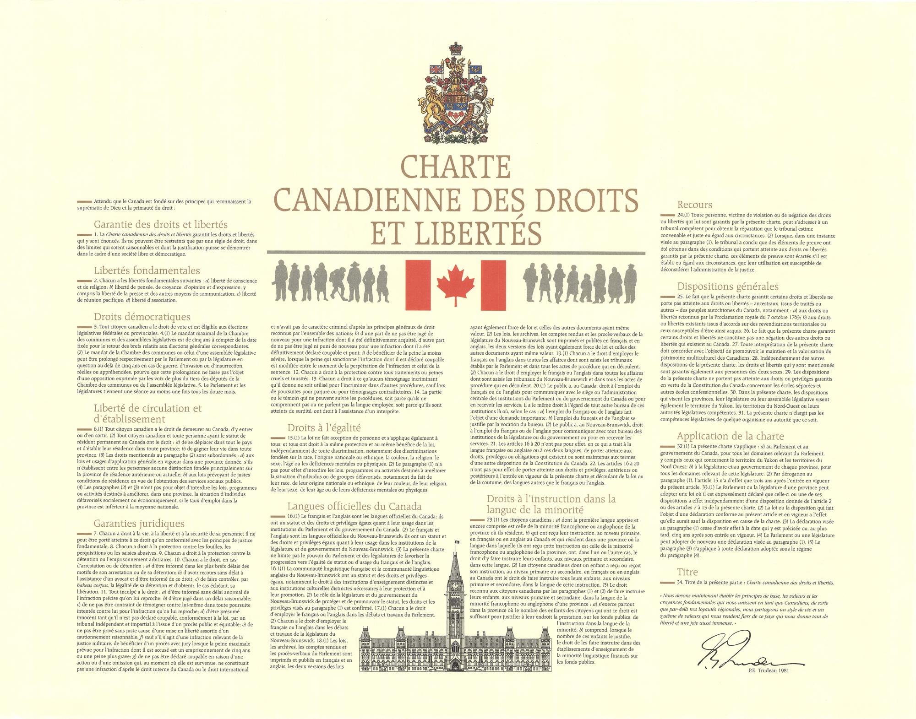
In Canada: Equality Before the Law
The Canadian Charter of Rights and Freedoms garantees equality before the law.
​
"Every individual is equal before and under the law and has the right to the equal protection and equal benefit of the law without discrimination …. " Art 15 (1)​
Notes:
INFORMATION FOR STUDENTS​
​
What is a charter?
The Canadian Charter is a law, but a special law that is above all other laws. This means that no other laws – federal, provincial or territorial – can contradict the Charter. For example, since the right to equality is guaranteed by the Canadian Charter, legislators could not make a law saying only men can join the army.
An example of a real law that turned out to violate the Charter had to do with marriage: the law said marriage could only take place between a man and a woman. The courts decided that law violated the right of people to be treated equally because it discriminated against same-sex couples. The law was changed so they could marry.
The Canadian Charter of Rights and Freedoms
The Charter was adopted in 1982, as the first part of the Canadian Constitution. As its name suggests, it protects certain rights and freedoms of Canadians.
Here are examples of freedoms protected by the Charter:
freedom of conscience and religion
freedom of thought, belief and expression
freedom of association
freedom of movement and freedom to take up residence in any province
Here are examples of rights guaraneed by the Charter:
right to life, liberty and security of the person
right to protection against arbitrary imprisonment
right to vote
Canadian Charter of Rights and Freedoms: https://laws-lois.justice.gc.ca/eng/const/page-15.html
Sources:
Canadian Charter of Rights and Freedoms, Schedule B, Part I, Constitution Act, 1982, art 15 (1)

Slide 25
For or against?
Judges should be elected by citizens instead of named by the government.
Notes:
INFORMATION FOR STUDENTS
Advantage: Elected judges would better represent the interests of the population. They would also be more independent of government.
Problem: Elected judges would be tempted to make decisions that pleased voters so they could get elected or re-elected, even if those decisions went against the law. Also, being elected would not ensure their independence: their independence is guaranteed by the fact that the government can’t take away their salaries or fire them.

Slide 26
For or against?
The law should consider people to be adults before age 18.
Notes:
INFORMATION FOR STUDENTS
The “age of majority” –18 – is the age when somene becomes an adult in the eyes of the law. Before 18, people are considered to be “minors.” Minors don’t have the same rights and responsibilities as adults.
However, the law gives some minors certain rights and certain responsibilities:
12 years old: You can be accused of a crime, for example, theft. We say that people become “criminally responsible for their actions” as of this age.
14 years od: You can do things like consult a doctor without permission from parents, work without parental permission and keep money earned from a job.
16 years old: You get more rights. For example, you can marry (if a court agrees), get a driver’s licence or belong to a union.
However, certain things are reserved for adults: the right to vote, to be a candidate in an election, to buy cigarettes and alcohol, to make a will or to go to a casino or buy lottery tickets.
18 might seem like a long ways away. But not so long ago – before 1971 – teenagers had to wait until 21 to legally be an adult in Quebec. And before 1782, the age of majority was 25!
Sources :
Civil Code of Quebec, arts 14 al. 2, 153, 157 and 167 al. 1
Youth Criminal Justice Act, S.C. 2002, c 1, s 2 “young person”
Highway Safety Code, CQLR c C-24.2, s 67
Profesional Syndicates Act, CQLR c S-40 s 7
Election Act, CQLR c E-3.3, s 1
Canada Elections Act, S.C. 2000, c 9, s 3
Tobacco Control Act, CQLR c L-6.2, s 13
Tobacco and Vaping Products Act, S.C. 1997, c 13, ss 2 “young person” and 8(1)
Act rspecting offences relating to alcholic beverages, CQLR c I-8.1, s 103.2
Act respecting the Société des loteries du Québec, CQLR c S-13.1, s 25.1
Convention on the Rights of the Child, art 1
Justice Canada, Important dates in the history of the civil law in Quebec: www.justice.gc.ca/eng/pr-rp/sjc-csj/pji-ilp/hist/

Slide 27
Instagram/educaloi_en
YouTube/educaloi
Facebook/educaloi
educaloi.qc.ca/en

