Slide 1
Civil Rights and Freedoms
Notes:
NOTES FOR THE TEACHER
This teaching kit was developed to be used with the History and Citizenship Education course (Secondary 2). This PowerPoint document covers the legal aspects of the “Winning of civil rights and freedoms” chapter.
The “Notes” section accompanying each slide provides additional information you can pass along to students, as well as questions if you wish to expand upon certain topics.
The “Sources” section provides legal and other sources supporting the information in the slides and notes.

Slide 2
Civil Rights and Freedoms
1. History of the civil rights movement in the United States
2. History of the women’s rights movement in Quebec
3. What is discrimination?
4. Reporting discrimination
5. Movements today? How are laws changed?
Notes:
NOTES FOR THE TEACHER
This teaching kit was developed to be used with the History and Citizenship Education course (Secondary 2). This PowerPoint document covers the legal aspects of the “Winning of civil rights and freedoms” chapter.
The “Notes” section accompanying each slide provides additional information you can pass along to students, as well as questions if you wish to expand upon certain topics.
The “Sources” section provides legal and other sources supporting the information in the slides and notes.

Slide 3
History of the civil rights movement in the United States

Slide 4
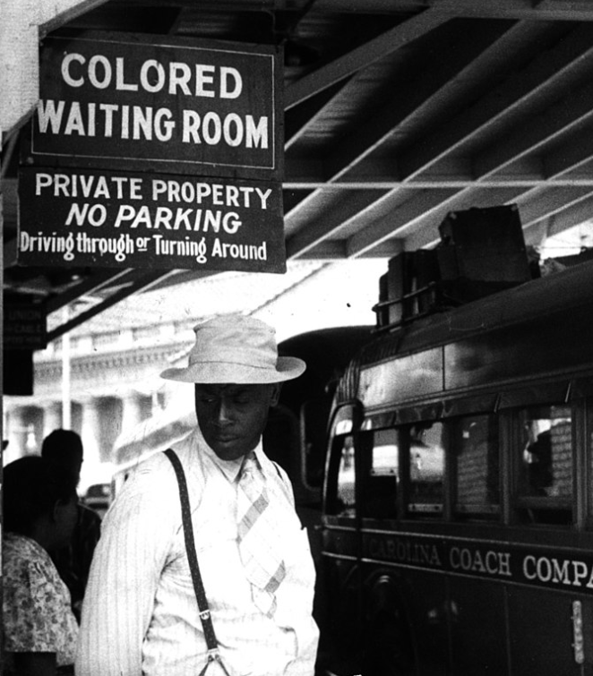
History of the civil rights movement in the United States
Causes
Though the 14th Amendment (passed in 1868) guarantees equal protection under the law to everyone, black people still were not treated fairly. Laws enacted between 1877 and 1964 (Jim Crow Laws) even legalized discrimination in some of the southern states: Segregation (separation of black people from white people) In public services and gathering places In schools In certain neighbourhoods Black people and white people couldn’t marry each other.
Notes:
INFORMATION FOR STUDENTS
Segregation of services and public places systematically resulted in lower quality services for black people. In Florida, for example, white men and women had separate washrooms, but black men and women had to use the same ones.
In certain states like Georgia, it was illegal for a white person to marry anyone who wasn’t white. The state did not recognize marriages that did not follow this rule.
The definition of a black person varied among states. In Maryland, for example, a person was considered black up to three generations later. (Therefore, if a person had one black great-grandparent out of eight, they were considered black even if it didn’t really show in their physical appearance.)
Sources :
University of central Florida, A History of central Florida, The Podcast Project, Episode 42 : Jim Crow signs, [consulté le 24 mars 2021]
Ferris State University, « The Origins of Jim Crow », https://www.ferris.edu/HTMLS/news/jimcrow/origins.htm, [consulté le 24 mars 2021]
Ferris State University, Jim Crow Laws, https://www.ferris.edu/HTMLS/news/jimcrow/pdfs-docs/origins/jimcrowlaws.pdf, [consulté le 24 mars 2021]
Encyclopédie Universalis, en ligne : <http://www.universalis-edu.com/encyclopedie/noirs-americains/> [consulté le 25 mai 2021]
Source iconographique :
"At the bus station in Durham, North Carolina." May 1940, Jack Delano. Cette image fait partie du domaine public.

Slide 5
History of the civil rights movement in the United States
Events:
1868: 14th Amendment
2008: First black president
1964 : Civil Rights Act
1963: Speech of Martin Luther King Jr. at the Lincoln Memorial
1965: Voting Rights Act
Notes:
INFORMATION FOR STUDENTS
1868, 14th Amendment to the United States Constitution: The 14th Amendment granted US citizenship to all recently freed slaves. It also required each state to offer the same legal protections to all male citizens. Unfortunately, some southern state did not apply the amendment.
1963, speech of Martin Luther King Jr.: Over 250,000 people gathered at the Lincoln Memorial to hear one of history’s most famous speeches. Dr, King described his dream of black people and white people living in harmony, and where individuals will “not be judged by the colour of their skin but by the content of their character.” The speech was the culmination of the March on Washington, which increased pressure on the Kennedy administration to pass the Civil Rights Act, which was finally enacted after Dr. King’s death in 1964.
Video of the speech (with French subtitles): https://www.youtube.com/watch?v=8ryy7eP0kks
1964, Civil Rights Act: When this law was enacted, its objective was to stop discrimination based on race, ethnic background and religion. Its broad scope prohibited discrimination concerning voting rights, in public places, in certain job sectors, in business and in schools.
1965, Voting Rights Act: Despite the enactment of the Civil Rights Act barely a year earlier, certain southern states (where slavery used to be legal) continued to place indirect obstacles in the way of black people’s voting rights. Though these states could no longer directly stop black people from voting, some had put literacy tests in place. Since black Americans were generally less educated than white Americans, more of them failed the tests and therefore fewer of them were able to vote. The Voting Rights Act put an end to these practices.
Sources :
Library of congress online, 14th Amendment to the U.S. Constitution, https://guides.loc.gov/14th-amendment, [consulté le 24 mars 2021]
Encyclopédie Universalis, en ligne : <http://www.universalis-edu.com/encyclopedie/noirs-americains/> [consulté le 25 mai 2021]
Encyclopédie Britannica, en ligne : <https://www.britannica.com/event/Civil-Rights-Act-United-States-1964>
Encyclopédie Britannica, en ligne : <https://www.britannica.com/event/Voting-Rights-Act>
Université de Sherbrooke, Perspective Monde, en ligne : <https://perspective.usherbrooke.ca/bilan/servlet/BMEve/1025>.

Slide 6
Lutte pour les droits des femmes au Québec

Slide 7
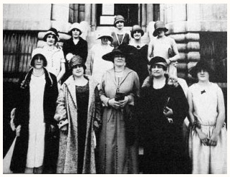
History of the women’s rights movement in Quebec
Causes
Before progress was made in the area of women’s rights, women did not have the same rights and opportunities as men. Until about 100 years ago, women could not hold most types of jobs, study in most programs, manage their own money, or vote or run for office. Women also had the duty to obey their husband in all situations.
Idola Saint-Jean accompanied by Suffragettes at the founding of the Provincial Committee for Women’s Suffrage (1922)
Notes:
INFORMATION FOR STUDENTS
1866: The Civil Code of Quebec confirmed women’s legal incapacity . In the eyes of the law, their status was very similar to that of minors.
Note to revisor: Please confirm my adaptation (“déchéance légale” in source text).
Source iconographique :
Répertoire du patrimoine culturel du Québec, en ligne : https://www.patrimoine-culturel.gouv.qc.ca/rpcq/detail.do?methode=consulter&id=26964&type=pge#.WPk07v9vqhB (domaine public)

Slide 8
History of the women’s rights movement in Quebec
Events:
1941: Women allowed to practise law in Quebec.
1927: Creation of the Canadian Alliance for Women’s Vote in Quebec.
1964: Act respecting the legal capacity of married women
1975: Prohibition against discrimination based on sex
1917: Women granted the right to vote in Canada (federal elections)
1940: Women granted the right to vote in Quebec
1961: First female Member of the National Assembly in Quebec
1993: First female Prime Minister of Canada
Notes:
INFORMATION FOR STUDENTS
1917: Women related to military personnel could vote in federal elections. Ontario and British Columbia granted women the right to vote in provincial elections. The right to vote in federal elections was extended to all women soon afterward (in 1918). They were allowed to vote for the first time in the 1921 federal election.
1927: Idola Saint-Jean founded the Canadian Alliance for Women’s Vote in Quebec. This same year, the initiative was followed by the introduction of a bill giving women the right to vote in Quebec. 80% of the Members of the National Assembly (all men) voted against the bill.
1941: Women were allowed to practise law. Interestingly, the first woman was admitted into McGill University’s faculty of law in 1911. The Barreau du Québec (Quebec bar) did not allow female law graduates to practise law until 1941.
1961: Marie-Claire Kirkland-Casgrain became the first female Member of the National Assembly in Quebec for the riding of Jacques-Cartier (in Montreal’s West Island).
1964: The Act respecting the legal capacity of married women was introduced by Claire Kirkland-Casgrain, the first female Member of the National Assembly. This law brought about major changes for Quebec women by abolishing a wife’s duty to obey her husband and by giving women full legal capacity concerning their civil rights.
1975: The Charter of Human Rights and Freedoms guaranteed the equality of men and women by prohibiting discrimination based on sex.
Note to revisor: I realize that “entrenched” or “enshrined” would be a more accurate translation, but neither is very “plain language.”
À consulter : Le dossier « Vers le suffrage féminin » de Par ici la démocratie.
http://www.paricilademocratie.com/approfondir/femmes-societe-et-politique/874-vers-le-suffrage-feminin-au-quebec
Sources :
DESCARRIES, F, Chronologie de l’histoire des femmes au Québec et rappel d’événements marquants à travers le monde, Institut de recherches et d’études féministes (IREF), UQAM, 2006-2007. Pour consultation en ligne : https://unites.uqam.ca/arir/pdf/chronologieNouvelleVersionJuin2007_old.pdf [consulté le 26 mars 2021]
POULIN, A, Évolution du statut de la femme au Québec, SOQUIJ, 2018. Pour consultation en ligne : https://blogue.soquij.qc.ca/2018/03/08/evolution-statut-de-femme-quebec/ [consulté le 26 mars 2021]
L’encyclopédie canadienne en ligne, Claire Kirkland-Casgrain,

Slide 9
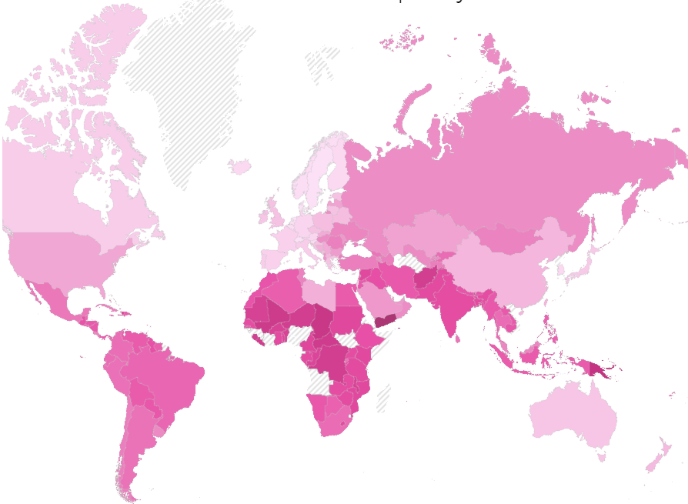
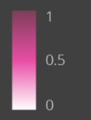
Today : Gender Inequality Index:
Statistics used in the calculation:
Rate of high school graduation
Rate of employment
Share of female managers
Share of parliamentary seats
Maternal mortality ratio
Adolescent birth rate
Notes:
INFORMATION FOR STUDENTS
The Gender Inequality Index is a measurement developed by the United Nations Development Program (UNDP) in 2010. It is calculated every year. The following information will help better understand the map and the legend:
An index of 0 would mean full equality between men and women. No country has reached full equality.
These are some of the statistics used to calculate the Gender Inequality Index:
The difference between men and women is calculated for:
rate of high school graduation (or equivalent)
rate of employment
share of female managers
share of parliamentary seats
Reproductive health: maternal mortality ratio and adolescent birth rates
Source :
La carte est tirée du site suivant : https://www.arcgis.com/apps/Cascade/index.html?appid=a06bb4f423df453baf11ab7bbcae51f2 (ANGLAIS SEULEMENT)
Vous y trouverez beaucoup d’explications, de statistiques intéressantes et de pistes de discussion.

Slide 10
Discrimination

Slide 11
La discrimination
Discrimination
Prohibited behaviours:
Disobeying a municipal law
Crimes
And more
Notes:
INFORMATION FOR STUDENTS
Despite what many people believe, discriminating against a person is not a crime. It is a prohibited behaviour that can lead to consequences, but a person can’t be jailed for discriminating against someone.
A crime is a very well-defined category of prohibited behaviours. Students should be able to understand the following distinction: you can ask them whether it’s a situation where they would call the police. For example, if another student insults them, they wouldn’t call the police but they would speak to a member of the school staff instead.
However, if this same student follows them home every night (criminal harassment or stalking), sends them death threats or steals their property, this is a crime and they can call the police. The government determines what behaviour is acceptable and what is not. This is written in a law called the Criminal Code, which defines all crimes and punishments (prison, fines, etc.).
Crimes are generally behaviours that go against the values of society. Crimes can be committed against people (e.g., murder, physical violence, sexual assault, terrorism) or against things (e.g., theft, vandalism, fraud, forced entry). Crimes also include other behaviours that are prohibited in society, such as drug trafficking. A person who commits a crime can be charged. They will go to trial and will be prosecuted by a criminal and penal prosecuting attorney (formerly called a crown prosecutor), who represents the government. If the accused is found guilty, a judge will decide on a sentence. Most crimes are defined in the Criminal Code, which is a federal law that applies all over Canada.
In other situations, a person may be fined if they do something that is prohibited. Examples include speeding, being in a park after it’s closed, smoking in places where it’s not allowed, painting graffiti, destroying city property (bus shelters, trash cans, park facilities, etc.). Tickets can be issued to people 14 years old and up.
Other behaviours are also covered by the law but don’t have the same consequences. In other situations where people do something wrong, they may have to compensate the person who was harmed (pay them money), for example, in copyright, defamation and image rights cases. In these situations, the person who claims they were harmed takes legal action in a civil case against the person they believe is responsible for the damage.
RESOURCES
Éducaloi’s articles on these topics:
Laws of Quebec and Canada: https://educaloi.qc.ca/en/capsules/laws-of-quebec-and-canada/
Understanding Criminal Law: https://educaloi.qc.ca/en/capsules/understanding-criminal-law/
Understanding “Civil” law: https://educaloi.qc.ca/en/capsules/understanding-civil-law/
SOURCES
Discrimination : définition et recours
Charte des droits et libertés de la personne, RLRQ c C-12, art. 10 (définition et interdiction de la discrimination)
Charte des droits et libertés de la personne, RLRQ c C-12, arts 49, 130 (recours en cas de discrimination et conséquences d’une décision du Tribunal des droits de la personne)
Charte canadienne des droits et libertés, Loi de 1982 sur le Canada, Annexe B, 1982 (R-U), c 11, arts 15, 24 (droits à l’égalité, recours en cas d’atteinte au droit à l’égalité)
Infractions prévues au Code criminel et dans d’autres lois
Code criminel, LRC 1985, c C-46, art. 21 (modes de participation à une infraction)
Code criminel, LRC 1985, c C-46, art. 264 (harcèlement criminel)
Code criminel, LRC 1985, c C-46, art. 222 (homicide)
Code criminel, LRC 1985, c C-46, arts 264.1, 265 (voies de fait)
Code criminel, LRC 1985, c C-46, arts 83.01 et suivants (terrorisme)
Code criminel, LRC 1985, c C-46, arts 318, 319 (crime de propagande haineuse) :
Code criminel, LRC 1985, c C-46, art. 322 (vol)
Code criminel, LRC 1985, c C-46, art. 380 (fraude)
Code criminel, LRC 1985, c C-46, art. 348 (introduction par effraction)
Loi réglementant certaines drogues et autres substances, LC 1996, c 19, art. 5 (trafic de drogues)
Loi sur le directeur des poursuites criminelles et pénales, RLRQ c D-911, art. 13.
Code civil du Québec, RLRQ c CCQ-1991, art. 1457 (principe général)
Aubry c. Éditions Vice-Versa, [1998] 1 RCS 591 (droit à l’image)
Prud’homme c. Prud’homme, 2002 CSC 85 (diffamation)

Slide 12
How does the law define discrimination?
Quebec’s Charter of Human Rights and Freedoms prohibits 17 types of discrimination. How many can you name?
Notes:
INFORMATION FOR STUDENTS
Write down students’ answers in the orange square. The next slide provides the answers, along with additional explanations in the notes.
Two charters protect people’s rights and freedoms in Quebec: the Canadian Charter of Rights and Freedoms and Quebec’s Charter of Human Rights and Freedoms (also called the “Quebec Charter”). These two laws have a special status, which means it’s difficult for the House of Commons or the National Assembly to amend them.
Charter of Human Rights and Freedoms: https://www.legisquebec.gouv.qc.ca/en/document/cs/C-12
“The Charter of Human Rights and Freedoms Made Easy”: https://www.cdpdj.qc.ca/storage/app/media/publications/Charte_simplifiee_EN.pdf
We recommend that you provide additional examples of rights and freedoms guaranteed by the Charter. For example, the Quebec Charter states that all Quebecers have the right to life, personal security, inviolability, freedom and the right to the respect of their dignity, honour, reputation and privacy. It also guarantees several freedoms, such as freedom of religion, conscience and opinion.
Éducaloi’s article on the Charters and different types of laws: https://educaloi.qc.ca/en/capsules/laws-of-quebec-and-canada/
SOURCES
Charte des droits et libertés de la personne, RLRQ c C-12, art. 10 (définition et interdiction de la discrimination)
Charte canadienne des droits et libertés, Loi de 1982 sur le Canada, Annexe B, 1982 (R-U), ch11, arts 15, 24 (droits à l’égalité, recours en cas d’atteinte au droit à l’égalité)

Slide 13
The 17 grounds for discrimination
Age
Sex
Ethnic or national origin, race or colour
Pregnancy
Religion
Disability or any means used to reduce the impact of a disability
Gender identity or expression
Political convictions
Language
Social condition
Sexual orientation
Civil status
Notes:
INFORMATION FOR STUDENTS
Some of these grounds for discrimination have been grouped into categories.
If time permits, you can also talk about the freedoms guaranteed under the Charter. Here are a few:
You have the right to life, personal security, inviolability and freedom. For example, you have the right to protection against threats of violence and against physical or psychological violence.
You have the right to freedom of conscience and freedom of religion. For example, you have the right to practise whatever religion you choose or to not follow any beliefs or religion. Freedom of religion means that the government can’t force a religion on the population or favour one religion over another.
You have the right to freedom of peaceful assembly and association. For example, you have the right to take part in a peaceful assembly, and you have the right to be a member of a union or association.
You have the right to respect for your dignity, honour and reputation. For example, a person isn’t allowed to publish false information about you.
You have the right to respect for your private life. For example, you have the right to protect your privacy, which includes your privacy at home and your physical integrity, (such as protection against unauthorized searches of your home or taking blood samples without your consent).
You have the right to the confidentiality of information you provide to certain professionals as part of their job. For example, information that you provide to your doctor during a medical visit are protected by their duty of confidentiality.
RESOURCES
Website of the Commission des droits de la personne et des droits de la jeunesse (human rights commission) concerning discrimination: https://www.cdpdj.qc.ca/fr/formation/accommodement/Pages/html/motifs-discrimination.html
https://cdpdj.qc.ca/en/your-rights/what-is/right-equality
SOURCES
Charte des droits et libertés de la personne, RLRQ c C-12, art. 10 (motifs de discrimination et interdiction de la discrimination)

Slide 14
In Quebec: Protection against hate speech
 | Discrimination | Hate speech
What is it? | Discrimination is a prohibited behaviour. It prevents a person from receiving equal treatment based on a personal characteristic. | Hate speech is a crime. It targets an identifiable group and encourages violence toward this group.
What should I do if I witness it or it happens to me? | File a complaint with the Commission des droits de la personne et des droits de la jeunesse (human rights commission). | If you witness or are a victim of hate speech that is serious and causes you to fear for your safety or for somebody else’s safety, you can report it to the police.
Do you agree that freedom of expression has certain limits?
Notes:
Discrimination might not be a crime, but it is prohibited and there are resources to help people who have been discriminated against.
The courts have had many opportunities to address the issue of limits to freedom of expression. They have concluded that it is possible to limit freedom of expression if the words used promote hatred of certain identifiable groups of people.
This might be a sensitive topic. However, students must understand that freedom of expression is not absolute.
Important! The legal definition of hate speech (or hate propaganda) might not be what students imagine. It is not simply hating a person and expressing that hate. The hate speech must target a group of identifiable people and must have the potential to lead to a “breach of the peace.” An “identifiable group” is a group that is distinguished from others by colour, race, religion, national or ethnic origin, age, sex, sexual orientation, gender identity or expression, or mental or physical disability.
A few examples of hate speech:
Blaming a problem on an ethnic or religious group and suggesting that people in this group be eliminated to settle the problem.
Threatening to injure, kill or destroy the property of people belonging to an identifiable group simply because they belong to that group.
Additional questions:
Do you agree that freedom of expression should have certain limits?
Do you agree with the limits on freedom of expression that the law now provides?
In your opinion, are there other limits to freedom of expression that should be put into place?
To file a complaint with the Commission des droits de la personne et des droits de la jeunesse: https://www.cdpdj.qc.ca/en/file-a-complaint/i-want-to/file-complaint-discrimination-or-harassment
SOURCES
Code criminel, LRC 1985, c C-46, arts 318(4), 319 (propagande haineuse)
R c Keegstra, [1990] 3 RCS 697 (limites à la liberté d’expression : interdiction de la propagande haineuse)
R. c. Zundel, [1992] 2 R.C.S. 731 (liberté d’expression)
Charte des droits et libertés de la personne, RLRQ c C-12, art. 74 (plainte à la Commission des droits de la personne et des droits de la jeunesse).
Julian Walker, Discours haineux et liberté d’expression: balises légales au Canada, en ligne: https://lop.parl.ca/sites/PublicWebsite/default/fr_CA/ResearchPublications/201825E

Slide 15
Changing the Laws

Slide 16
Many of these changes came into effect when laws were amended. Who decides on the laws?
Law
In Quebec, the 125 Members of the National Assembly elected by the people of Quebec introduce bills in the National Assembly.
Each MNA represents the residents living in their area (riding).
Representative
(Member of the National Assembly)
Notes:
INFORMATION FOR STUDENTS
In an indirect democracy like ours, people don’t vote directly for or against a bill. They vote for a representative called a “Member of the National Assembly” (MNA) in Quebec or a “Member of Parliament” (MP) at the federal level. MNAs and MPs represent the people of their riding (district), vote for or against bills, and can also introduce bills.
SOURCES
Députés
Assemblée nationale du Québec, « Députés » : http://www.assnat.qc.ca/fr/deputes/index.html?appelant=MC (Consulté le 5 avril 2022)
Pouvoir législatif des députés
Loi constitutionnelle de 1867, 30 & 31 Vict, c3, art. 71.
Loi sur l’Assemblée nationale, RLRQ c A-23.1, art. 2, 3

Slide 17
How does a bill become a law?
1. Introduction of the bill
2. Passage in principle
3. Committee stage
4. Report stage
5. Passage
6. Assent
Optional
1.5 Consultation in a parliamentary committee
Legend:
= At the National Assembly
= At the office of the Lieutenant-
Governor
= In a parliamentary committee
Notes:
The following diagram is based mainly on the one in Par ici la démocratie (see resources below) and summarizes the legislative process at the provincial level.
RESOURCES:
National Assembly, Par ici la démocratie, Le processus d’adoption d’une loi: http://www.paricilademocratie.com/approfondir/parlementarisme-et-elections/685-le-processus-d-adoption-d-une-loi [consulted on April 5, 2022]

Slide 18
Instagram/educaloi_en
YouTube/educaloi
Facebook/educaloi
educaloi.qc.ca/en

