Slide 1
The Internet and the law

Slide 2
What we'll discuss:
The law
The Internet
What is not allowed on the Internet?
The Internet and personal information
What can I do if I'm being targeted online?
Our charter

Slide 3
The law

Slide 4
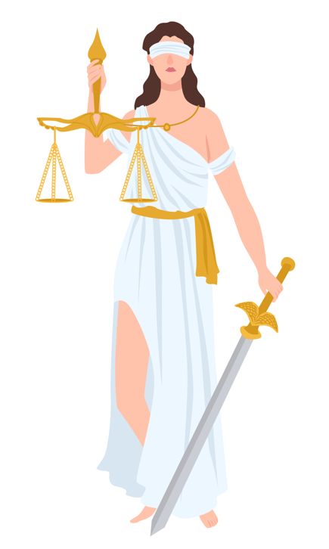
What are laws?
Can you explain the difference between a law and a rule?
Notes:
NOTES FOR TEACHER
Students to answer the question
Ask the first question and let the students answer.
If an answer seems thoughtful or if it comes up several times, you could note it down on the slide.
If the students have trouble giving an answer, you can point out the visual clues on the right side of the slide.
The image represents Themis, goddess of justice. The scales, as a symbol of justice, mean that the judge must weigh each argument before making a decision. The sword represents the idea that the judge must make a decision, and sometimes impose a penalty. The blindfold that Themis sometimes wears means that the judge must apply impartial justice. He or she must not favor one party at the expense of the other.
What are laws?
Rules that govern behavior in society: crimes, driving, contracts, marriage, divorce, etc.
A system of justice for determining the guilt or innocence of an accused person.
Punishments for breaking the law.
Rules that are the same for everybody.
The law (or laws) can be defined as a set of rules of behaviour that all members of society must follow. In other words, the law tells us what we must do, what we’re allowed to do, and what we’re not allowed to do. We must all obey the rule of law – that means ordinary citizens as well the prime minister!
The law is set down in various codes of law (the Criminal Code of Canada, the Civil Code of Quebec, etc.)
The law is not secret; anyone can consult the codes online. For example, the Criminal Code is available online on the Justice Canada website: https://laws-lois.justice.gc.ca/eng/acts/c-46/
What is the difference between a law and a rule?
Rules at home and at school are not always the same for everyone. For example, in the same family, a five-year-old and an 11-year-old may have different bedtimes. At school, students must do homework, but teachers or supervisors don’t. However, laws apply to everybody!
Laws are enforced by the police and the courts. For example, anybody who robs or assaults somebody will be arrested by the police and then tried in court. But kids who don’t their homework or don’t go to bed when their parents tell them to, won’t be arrested by the police because they’re only breaking rules, not the law.
At this point It would be worth mentioning that the age of criminal responsibility is 12. This means that from the age of 12, children are considered criminally responsible for their actions and can be charged with the same crimes and offences as an adult .
However, the law that applies to children between the ages of 12 and 17 is the Youth Criminal Justice Act.
To learn more, consult the teaching tool entitled The Criminal Legal System for Teenagers on the Éducaloi website or the Justice Canada website.

Slide 5
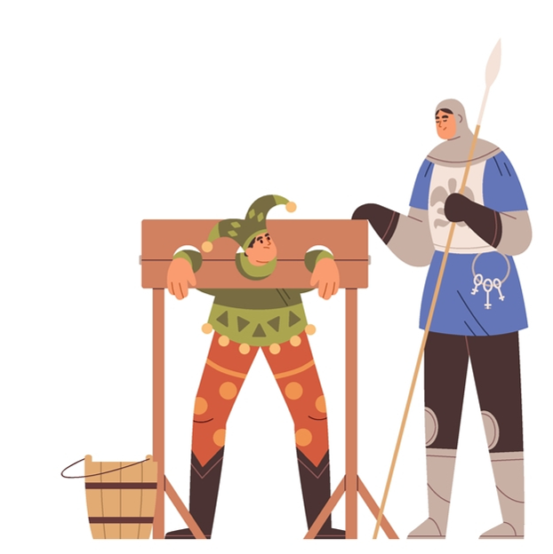
Do laws change?
Do they keep changing?
Notes:
NOTES FOR TEACHER
Lead a discussion on the following two questions:
Do laws change?
If students have difficulty answering, ask them if they know of anything that used to be forbidden but is now allowed, or vice versa.
Some current examples: legalization of cannabis, women's right to vote, abortion, same-sex marriage, euthanasia for the terminally ill, etc.
2. Do they keep changing?
Following discussion of the first question on this slide, students should now understand that laws evolve and change as society changes. The law should usually reflect society's values. It must also adapt to new realities and to new and developing technologies. For example, once we could record music, the law had to adapt to changed notions of intellectual property.
The law has also had to adapt to the rapid development of the Internet and social networking sites. This will be the main subject of this activity.

Slide 6
Is the law the same everywhere?
Does the law apply on the Internet?
Do you think it's harder or easier to "reprimand" someone who does something wrong on the Internet?
Notes:
NOTES FOR TEACHER
Students should keep thinking about the fact that the law is a relative concept and is constantly evolving.
First question
The law differs enormously depending on where you happen to live.
To answer the question, students will probably give one of the following examples: the right to bear arms in the U.S., the death penalty in some countries, the ban on same-sex marriage and the legal drinking or voting age in other countries (or other provinces!)…
In Canada, some laws are the same everywhere (e.g. Criminal Code) while others differ from one province to another (e.g. the legal drinking age or the rules governing certain contracts)…
Second question
The law also applies on the Internet even though it’s not a physical place.
Additional questions:
As a general rule, would you say that if something is forbidden in everyday life, it would also be forbidden on the Internet?
Can you give an example of something that is forbidden in everyday life and on the Internet?
SUPPLEMENTARY QUESTION:
Do you think it's harder or easier to "reprimand" someone who does something wrong on the Internet?
Information to stimulate discussion:
Every computer has a "signature" called an IP Address. It consists of four numbers between 0 and 255, separated by dots. Example: "192.46.254.1". This allows specialists to trace a computer that has sent a message, photo or video that is inappropriate or that could cause problems.
Also, anyone who makes a payment online with a credit card can be traced through their card number.

Slide 7
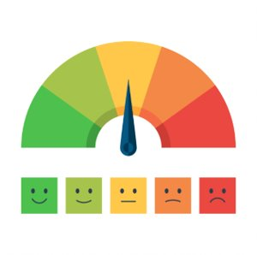
What does “criminal” mean?
Just because something is forbidden doesn’t mean it’s a criminal offence!
Notes:
NOTES FOR TEACHER
Most of the things mentioned by the students are prohibited by law. However, they are not all crimes.
Generally, a crime is behaviour that violates society's values. Crimes can be committed against people (murder, physical violence, sexual assault, terrorism) or against things (theft, vandalism, fraud, breaking and entering). Crimes can also be other behaviors prohibited in society: e.g., drug trafficking. Anyone who commits a crime can be charged and convicted of that crime. The consequences will be decided by a judge. Most crimes are set out in the Criminal Code, which is a federal law that applies everywhere in Canada.
In other situations, a person may get a ticket if they do something prohibited by law. For example, speeding, being in a park after the park has closed, smoking in a prohibited area, painting graffiti, destroying or damaging city property (bus shelters, garbage bins, park facilities, etc.). Anyone over the age of 14 can be given a ticket.
Other behaviours are also regulated by law, but don’t have the same consequences. In such cases, if you do something wrong, you may have to compensate the person who has been harmed (pay them a specified sum of money, for example in cases involving copyright, defamation, image rights, discrimination, etc.
Sources:
Code criminel, art. 21.

Slide 8
The Internet

Slide 9
The Internet: a brief history
How long has the Internet been around?
How long have social networks been around?
Notes:
NOTES FOR TEACHER
The answer to the first question is complex. The following dates may be worth mentioning:
1971: The first closed network was created with 23 computers. This is also the year the first email was sent.
1984: However, it wasn’t until 13 years later, in 1984, that 1,000 computers were connected to the initial closed network.
1990: Appearance of the World Wide Web, web browsers and web pages. This was the embryonic version of the Internet as we know it today.
Between 1996 and 2000: Explosion in the number of computers connected to the Internet. In four years, the number went from 30 million computers to 368.5 million!
The answer to the second question is simpler:
The first large scale social network, Facebook, was launched in 2004.
Then, Twitter, now known as X, in 2006, Instagram in 2010, Snapchat in 2011, Tik Tok in 2018 (after a merger with musical.ly)
Additional questions for students:
Do you think Internet use has changed a lot in the past 20 years? What are people doing more online than they did before?
Do you think having access to the Internet is essential today? What would the consequences be for someone who has no way to access the Internet?
Sources:
Innovation disruptive et naissance d'un écosystème: voyage aux origines de l'Internet, online: <https://journals.openedition.org/rei/5787>.
Facebook, Twitter et les autres..., online: <https://www.researchgate.net/profile/David-Fayon/publication/49136445_Facebook_Twitter_et_les_autres_integrer_les_reseaux_sociaux_dans_une_strategie_d%27entreprise/links/5b72f5c0299bf14c6da210b9/Facebook-Twitter-et-les-autres-integrer-les-reseaux-sociaux-dans-une-strategie-dentreprise.pdf>.

Slide 10
The Internet and social networks
What are social networks? What do people use them for?
How about you? Are you on any social networks? Which ones?
How old do you have to be to have a TikTok or Instagram account?
Notes:
NOTES FOR TEACHER
It might be worthwhile to get students thinking about the meaning of the word social; that social implies society. Social networks are a part of the Internet that mimics our relationships with other members of society. We can chat, organize events, share thoughts or photos, read about and comment on current events, etc.
Minimum age to have an account:
The terms of use for Facebook, Instagram, TikTok, YouTube and most social networks, state that a person must be 13 years old to have an account.
Sources:
Facebook: https://www.facebook.com/legal/terms
Instagram: https://www.facebook.com/help/instagram/478745558852511
Tik Tok: https://www.tiktok.com/legal/terms-of-use?lang=fr
YouTube: https://support.google.com/accounts/answer/1350409

Slide 11
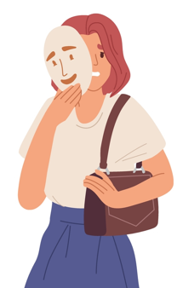
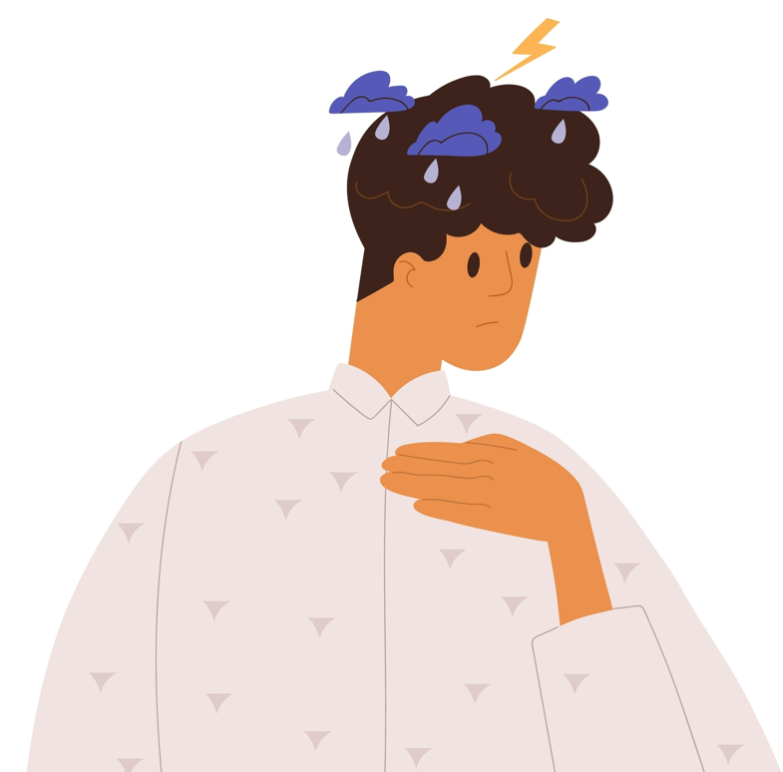
Are there any consequences for what I do online?
For other people?
For me?
What about legal consequences?
Notes:
NOTES FOR TEACHER
The purpose of these questions is to encourage students to develop a more altruistic perspective. Students need to realize that they’re not the only ones who could be negatively affected by inappropriate online conduct. The people you chat with online are real people, who sometimes could be hurt or seriously affected by what you do without really thinking about it.
Some of the behaviours identified later in this activity are crimes, and others, while prohibited by law, are not crimes. For example, many students probably said they have an Instagram account, even though they are under the mandatory age of 13 stated in the terms of use. Will the police come and arrest them in their homes? Of course not. The description of each behaviour discussed below will indicate whether it is a crime or not.
It may also be instructive to tell students that they can be held criminally responsible from the age of 12. This means that from the age of 12, they could be charged with a crime.
NB! A teenager who commits a crime is not sent to jail with adults and very few teens go to a youth centre if they do (usually because the crime is serious, or the teen is a frequent offender). A teenager convicted of a crime can be punished by having to do certain things such as performing a certain number of hours of community service, complying with specific conditions (e.g. curfew), attending meetings with counsellors, etc. To learn more, visit our website: educaloi.qc.ca and consult the “Crimes and Tickets” section.
Sources:
Code criminel, art. 13.
Loi sur le système de justice pénale pour les adolescents, art. 2(1), 3, 4 et 5.

Slide 12
What is not allowed on the Internet?

Slide 13
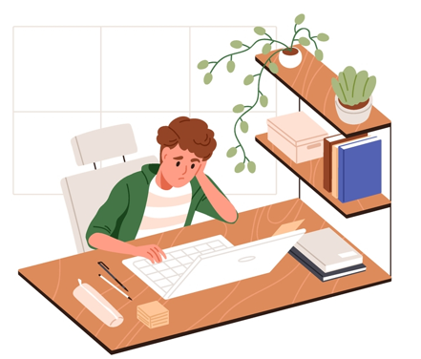
What sort of things are you not allowed to do on the Internet?
Can you name actions related to bullying and cyber-bullying?
Notes:
NOTES FOR TEACHER
Cyber-bullying is bullying that takes place on the Web, by text message, e-mail, etc. Often times, these gestures are repeated and seek to belittle the victim.
Examples of actions that can be considered bullying: ​
Insulting someone (“You’re stupid!” or “You’re ugly!”),​
Threatening someone (“Show me your boobs or else I’ll post an embarrassing picture of you on social media!”),
Belittling someone with unkind remarks, or
Stealing someone else’s identity; pretending to be someone else.
Certain actions can be considered bullying even if they aren’t carried out directly in front of the victim, such as saying hurtful words the victim learns about later.
Other things that are not allowed on the Internet:
Accessing pornography, sharing intimate images or distributing child pornography.
Sharing confidential Information
Using an artist’s images, songs or videos without their permission or without paying copyright fees.
Slides 14 to 24 explain in greater detail the kinds of online behaviour that should be avoided.
Sources:
Code criminel, art. 163.1a)(i) et 163.1a)(ii): pornographie juvénile; 162.1(2)a): distribution d’images intimes, 264: harcèlement criminel, 298 et 299: diffamation
Code civil du Québec, art. 35 et 36.
Loi sur le droit d'auteur, art. 3, 5 et 6.
Loi sur l’instruction publique, art. 13 al. 1(1.1°).
Loi sur l’enseignement privé, art. 9 al. 2.

Slide 14
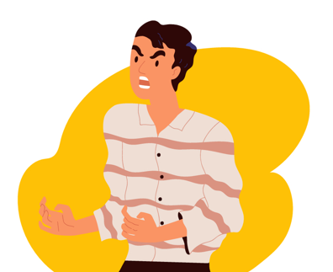
1. Making threats
Forbidden on the Internet
It’s a crime to:
threaten to harm someone or an animal belonging to them
threaten to destroy their property
It's a crime even if you make those threats online.
Notes:
NOTES FOR TEACHER
Threats
Not every threat is a crime. No one is going to call the police if a student threatens to end her friendship with another student!
It’s a crime to threaten to:
kill or injure a person or his or her animal;
burn, destroy or damage property.
A threat is a crime if it is made with the intention to intimidate or be taken seriously. It is not necessary to prove that the threat was going to be carried out.
Sources:
Code criminel, art. 264.1.
R. c. McRae, 2013 CSC 68 aux para 17-18.

Slide 15
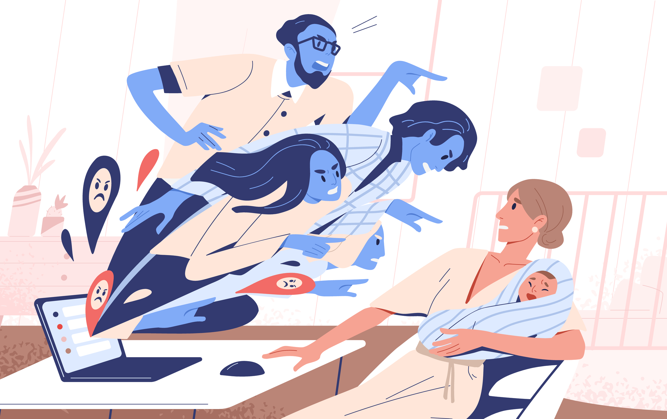
2. Stalking
Forbidden on the Internet
To stalk someone is to act in such a way that the person fears for their safety.
For example, following a classmate home after school or texting them repeatedly.
Notes:
NOTES FOR TEACHER
Stalking (criminal harassment) is a specific crime with a precise definition. For more information on the behaviours associated with stalking, visit our website at: https://educaloi.qc.ca/en/capsules/criminal-harassment-stalking. The definition is a bit different from what is commonly understood as harassment.
Criminal harassment (stalking): the legal definition
Criminal harassment is when someone behaves in a way that makes the victim fear for his or her safety or the safety of someone the victim knows.
The following behaviours could amount to criminal harassment (stalking):
Repeatedly following the victim or someone the victim knows;
Repeatedly contacting the victim or a member of the victim’s family;
Watching the victim’s home, place of work, or anywhere else the victim or a member of the victim’s family happens to be;
Acting in a threatening way toward the victim or a member of the victim’s family.
Further Information
You should explain that harassment doesn’t have to be criminal harassment for the victim to tell an adult about it (a parent, teacher, school counsellor). If the victim is afraid, it should be reported to the police.
Sources:
Code criminel, art. 264, 264.1.
Loi sur l’instruction publique, art. 75.1.
Loi sur l’enseignement privé, art. 63.1.

Slide 16
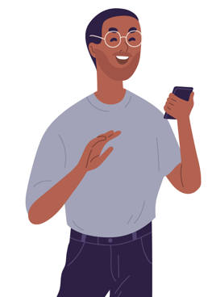
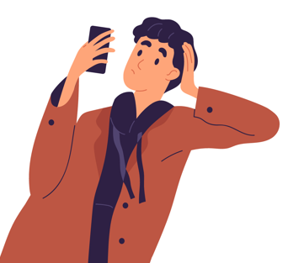
3. Blackmail (or extortion)
Forbidden on the Internet
Using threats to get money or anything else from
a person is called extortion.
For example, threatening to post an embarrassing photo of someone unless they give you $50 is extortion.
Notes:
NOTES FOR TEACHER
Blackmail and extortion are the same thing. Extortion is the correct legal term, but most people, especially teens, call it blackmail. It’s a crime.
Blackmail or extortion is when a person, with the intent of obtaining money or anything else, forces another person to do anything, using threats, accusations or violence. For example: "Give me your money or I'll whack you"; "Send me more nude photos of yourself or I'll send the ones I’ve already got to your parents".
Sources:
Code criminel, art. 346.

Slide 17
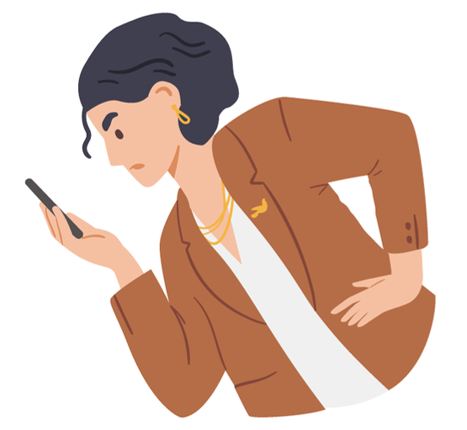
4. Defamation
Forbidden on the Internet
Everyone is entitled to the protection of their reputation.
Defamation means harming someone’s reputation, for example by spreading false rumours about them or demeaning them to other people.
Notes:
NOTES FOR TEACHER
To find out more about defamation, visit our web site at:
https://educaloi.qc.ca/en/publications/freedom-of-expression-internet/
Defamation isn’t allowed, but it is not a crime.
The right to protection of reputation
Everyone has the right to express themselves and state their opinion. However, everyone also has the right to the protection of their reputation!
Depending on the context, the law recognizes that a person’s reputation could be damaged if:
1. someone spreads false information, maliciously, deliberately and with the intention to hurt them;
2. someone spreads negative information that they should know is untrue; or
3. someone discloses true information for the purpose of ridiculing, humiliating a person or exposing them to hatred or contempt.
The rule is the same whether the defamation happens in person or online
A person's right to protection of their reputation applies even if the defamation takes place electronically!
A Quebec Superior Court judge put it like this: “The Internet can make someone famous in an instant, but it can also damage or destroy their reputation with a single click.” A Supreme Court judge explained it in the following words: “Because the Internet is a powerful medium for all kinds of expression, it is also a potentially powerful vehicle for expression that is defamatory.” You could ask students what they think about these statements.
A person's right to protection of their reputation can be violated with words, images or videos. For example, circulating an embarrassing or offensive photo of a person could violate their right to protection of their reputation. The victim could ask for financial compensation (money) if their reputation is damaged.
Sources:
Charte des droits et libertés de la personne, art. 3 et 4.
Code civil du Québec, art. 3, 35, 36, 1457.
Prud’homme c. Prud’homme, 2002 CSC 85.

Slide 18
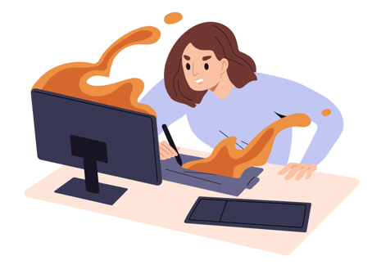
5. Hate speech
Forbidden on the Internet
You’re not allowed to threaten an identifiable group of people because of:
their skin colour,
religion,
gender...
Can you name other identifiable groups?
Notes:
NOTES FOR TEACHER
The courts have on several occasions considered the issue of limitations on freedom of expression and have ruled that limitations could be placed on that freedom when the words promote hatred against certain identifiable groups of people.
This could be a rather sensitive issue. However, students must understand that freedom of expression is not absolute.
NB! Hate speech (or hate propaganda), as defined by the law, does not mean what students might think it means. It's not just about hating someone and expressing it. To be considered hate speech, it must be directed at an identifiable group of people and must be likely to result in a "breach of the peace". The term "identifiable group" is defined as a group distinguished from others by color, race, religion, national or ethnic origin, age, sex, sexual orientation, gender identity or expression, or mental or physical disability.
Some examples of hate speech:
Blaming a specific ethnic or religious group for a particular problem and proposing the elimination of members of that group as a solution to the problem.
Threatening to injure or kill members of an identifiable group or destroy their property simply because they belong to that group.
Supplemental question:
Do you agree that freedom of expression should have some limitations?
Do you agree with the limitations currently set by the law?
Are there any other limitations that you would place on freedom of expression?
Sources:
Code criminel, art. 319, 318(4).
R. c. Zundel, [1992] 2 R.C.S. 731.
Julian Walker, Discours haineux et liberté d’expression: balises légales au Canada, en ligne: https://lop.parl.ca/sites/PublicWebsite/default/fr_CA/ResearchPublications/201825E

Slide 19
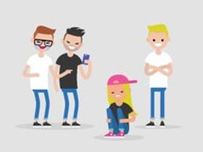
6. Sharing certain images
Forbidden on the Internet
Describe the kinds of personal images you wouldn’t want to share over the Internet.
Notes:
NOTES FOR TEACHER
If students can’t give any answers, make the clues on the slide appear by clicking once for each image.
Answers:
- Embarrassing photos (for all kinds of reasons...)
- Photos in which you appear nude.

Slide 20
6.1 Everyone has the right to control their personal images and to the protection of their reputation
Forbidden on the Internet
6. Sharing certain images
Notes:
NOTES FOR TEACHER
Go back to the Information on slide 17 (Defamation).
A person’s right to control their personal images is part of the right to protection of their reputation and the same rules apply.
Sources:
Charte des droits et libertés de la personne, art. 3 et 4.
Code civil du Québec, art. 3, 35, 36.
Prud’homme c. Prud’homme, 2002 CSC 85 au para 36.
Aubry c. Éditions Vice‑Versa, [1998] 1 R.C.S. 591.
Laforest c. Collins, 2012 QCCS 3078 para 117.
Crookes c. Newton, 2011 CSC 47 para 37.

Slide 21
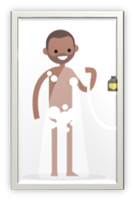
Forbidden on the Internet
6. Sharing certain images
6.2 Intimate images
What is an intimate image?
Notes:
NOTES FOR TEACHER
It can be difficult to broach this topic with students. You may feel that they’re too young to take part in such a discussion. However, we recommend having this discussion with them, as this type of problem can occur in primary school. The students know it exists, even though most of them say they wouldn't do it. It's important to make them aware, before they reach the age of criminal responsibility, of the consequences of sharing intimate images.
Ask the students the following question: What is an intimate image? (Students usually call such images “nudes”.)
INFORMATION TO BE PROVIDED:
Examples of an “intimate image“:
- An image with a sexual connotation showing mainly genitals, breasts or buttocks.
- An image of someone engaged in explicit sexual activity, which often involves nudity. An explicit sexual activity is more than just a kiss or a caress.
Sometimes an intimate image consisting of a photo or video is e-mailed or posted personally by the subject. Sometimes someone else takes the photo or shoots the video with the subject’s consent. Such images could also be taken without the subject’s knowledge. For example, in the locker room after gym class.
Additional questions:
Is an intimate image of a child or a minor (child under 18) the same thing as an intimate image of an adult?
Is a photo of a naked baby, taken by the parents at bath time, an intimate image?
Sources:
Code criminel, art. 163.1a)(i) et 163.1a)(ii): pornographie juvénile; 162.1(2)a): distribution d’images intimes.
LSJPA – 1811, 2018 QCCA 597 aux para 12 à 19.
R c. Sharpe, [2001] 1 RCS 45 aux para 49, 51, 53.

Slide 22
Why is it serious to share intimate images over the Internet?
To share images, consent is important!
Consent, what is it?
Notes:
NOTES FOR TEACHER
Make sure that students understand the concept of consent (and therefore, the term “non-consensual”). To find out if a person consents to having their personal image sent or posted, you must ask them first. Consent must be "free and informed“, which means that the person did not consent under threat or because they felt compelled to do so.
We often hear about the notion of consent in the context of sexual activity (sexual consent). However, consent is a much broader legal concept. For example, the crime of "non-consensual sharing of intimate images" refers to consent in relation to the sharing of the intimate image, not the taking of it.
Consult the Éducaloi article (including a short video) on the subject:
https://educaloi.qc.ca/en/capsules/sharing-intimate-images
A person who shares intimate images of a person under the age of 18 could be charged with two crimes: non-consensual sharing of intimate images and distribution of child pornography (if the person in the image is under 18).
Additional Information for the teacher: A student who takes an intimate selfie and sends it to other people will not normally be charged with distributing child pornography. The police would generally consider the student to be a victim.
Sources:
Code criminel, art. 162,1, 163.1.

Slide 23
7. Sharing certain songs, videos or works of art
Forbidden on the Internet
Do you know what copyright is?
Notes:
NOTES FOR TEACHER
It is not always easy to understand and respect copyright.
It’s important for students to understand at this stage in their lives that artistic works (written, visual, musical, etc.) "belong" to a particular person or group.
Sources:
Loi sur le droit d'auteur, art. 3, 5 et 6.

Slide 24
Copyright
Do you know what copyright is?
Why do we need copyright?
What do some websites, such as YouTube, do to help artists protect their work?
Notes:
NOTES FOR TEACHER
The person who holds the copyright in a work is the only one who can "use the work". For example, no one may reproduce, publish, broadcast or perform a substantial part of a work without the permission of the person who holds the rights to the work. To use these works, you must ask for permission, and, in some cases pay a fee to the artist or creator for the right to use their work.
Additional questions to ask the students:
Do you think copyright laws should be different depending on whether an artist's work is used over the Internet, on television, or in a book?
If there weren’t any copyright laws, what would be the consequences for artists and creators?
For more information and to prepare for student questions:
https://educaloi.qc.ca/en/capsules/copyright-protecting-creative-works
Sources:
Loi sur le droit d'auteur, art. 3, 5 et 6
Théberge c. Galerie d’Art du Petit Champlain inc., [2002] 2 R.C.S. 336, 2002 CSC 34, para 30-32
Cinar Corporation c. Robinson, 2013 CSC 73

Slide 25
The Internet and personal information

Slide 26
The Internet and personal information
What is personal information?
Why should personal information be protected?
What is identity theft?
What could be the consequences?
Notes:
NOTES FOR TEACHER
Personal information is any information or document used to establish someone’s identity:
Name
Address
Date of birth
Social Insurance Number
Bank account number
Additional questions:
What kind of information would you want to keep secret?
Did your parents ever share a picture of you that embarrassed you?
What kind of information about your personal life or your parents' personal life could dishonest people use to do something harmful?
Identity theft:
Identity theft occurs when an individual uses your personal information for criminal purposes. For example:
Accessing your bank account (to buy things online, for example).
Obtaining a passport.
Selling your personal Information to dishonest people.
Would you want just anyone to be able to log into your Facebook or Instagram account? Why or why not?
Additional resources:
The Office of the Privacy Commissioner of Canada provides several resources for discussing this topic with students:
https://www.priv.gc.ca/en/about-the-opc/what-we-do/awareness-campaigns-and-events/privacy-education-for-kids/
Sources:
Code criminel, art. 56.1, 402.2(1).
Loi sur la protection des renseignements personnels dans le secteur privé, art. 2.

Slide 27
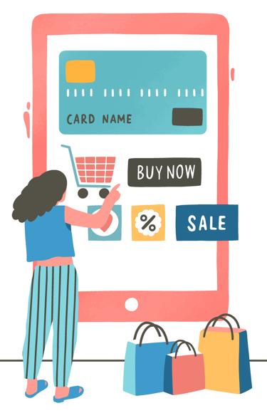
How to protect personal information?
Don’t share any personal information online
Create good passwords
What are the basic features of a good password?
Notes:
NOTES FOR TEACHER
Quickly review some examples of personal information.
Ask students to give some examples of situations where a person might unintentionally disclose personal information:
Date of birth
Address
Answers to security questions (pet's name, etc.)
The characteristics of a good password:
An uncommon password (see article ”Protégez-vous”: https://www.protegez-vous.ca/nouvelles/technologie/les-15-types-de-mots-de-passe-les-plus-repandus-sur-le-web).
A password that is not your date of birth, address or other Information that someone who knows you could figure out.
A good password can contain upper- and lower-case letters, numbers and symbols, but that can be hard to remember.
You can create a strong password using a phrase that is easy to remember.
ADDITIONAL QUESTION:
What would be a good trick for remembering a password?
Additional resource:
The Office of the Privacy Commissioner offers several interesting activities to raise kids’ awareness of privacy issues.
https://www.priv.gc.ca/en/about-the-opc/what-we-do/awareness-campaigns-and-events/

Slide 28
What can I do if I’m being targeted online?

Slide 29
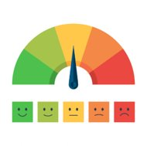
1. Understanding the seriousness of the situation
What can I do if I'm being targeted online?
As we’ve seen, certain behaviours can have relatively serious consequences for ourselves and others.
As the degree of severity of such behaviours can vary greatly, our response must be adapted to the situation!
Notes:
NOTES FOR TEACHER
Remind students that they can talk to their parents or someone at school if they have concerns about a negative experience on the Internet they experienced.
If your school has specific resources, you should discuss this with them.
Student resources:
Tel-jeune: 1-800-263-2266
Kiids Help Phone (by phone or by text): 1-800 668-6868
cybertip.ca: A site for reporting child pornography on the Internet. This resource can also help a minor and their parents if an intimate image of the minor is circulating on the Internet.
NeedHelpNow.ca: Site offering help to young people who are the victims of cyber-bullying or online extortion.

Slide 30
2. What specific actions can I take?
What can I do if I'm being targeted online?
​ | Block the person | Tell a parent | Tell a school staff member | Report it to the police
Situation a)​ | ​ | ​ | ​ | ​
Situation b)​ | ​ | ​ | ​ | ​
Situation c)​ | ​ | ​ | ​ | ​
Another situation ?​ | ​ | ​ | ​ | ​
Can you think of other solutions?
Notes:
NOTES FOR TEACHER
Have the students do Exercise 6
When the students have completed the exercise, return to the main group and complete the following table by leading a discussion about each of the situations presented on the worksheet. Put an X or a check mark in the box(es) corresponding to the actions to be taken.

Slide 31
Our Charter of Online Conduct

Slide 32
Our Charter of Online Conduct
What is a charter?
It’s a law that contains rules.
But it’s a special law, one that’s often more important than the others.
Notes:
NOTES FOR TEACHER
Here is an instructive example to explain this difficult concept.
"Let's say your parents drafted a house charter. One of the rules in the charter says that all family members must go to bed at 9:00 p.m.
You can’t create a separate rule such as “Everybody must do the dishes at 9:30 p.m.” because that would mean that family members would be disobeying the house charter!”
Sources:
Charte des droits et libertés de la personne.
Charte canadienne des droits et libertés.

Slide 33
An example of a charter:
The Charter of Human Rights and Freedoms
It says that all Quebecers, children and adults alike, have the right to:
Life
Freedom
Security
Personal integrity (physical and psychological well-being)
Notes:
NOTES FOR TEACHER
Have the students do Exercise 7
In Quebec, two charters protect the rights and freedoms of all Quebecers. There is the Canadian Charter of Rights and Freedoms and the Quebec Charter of Human Rights and Freedoms (also called the Quebec Charter). Both of these laws have special status that makes it difficult for them to be amended by Canada’s House of Commons or Quebec’s National Assembly.
The Charter of Human Rights and Freedoms: http://legisquebec.gouv.qc.ca/en/showdoc/cs/c-12
We strongly suggest that you give other examples of the rights and freedoms guaranteed by the Charter so that the students will understand that the law does not exist solely to forbid them from doing certain things.
Simplified version of the Charter of Human Rights and Freedoms:
https://www.cdpdj.qc.ca/storage/app/media/publications/Charte_simplifiee_EN.pdf
Éducaloi article explaining the charters and the various kinds of laws:
https://educaloi.qc.ca/en/capsules/laws-of-quebec-and-canada
Sources:
Charte des droits et libertés de la personne.
Charte canadienne des droits et libertés.

Slide 34
Our Charter of Online Conduct
Name of Charter?
Notes:
NOTES FOR TEACHER
Ask the students to draft a Charter of Online Conduct.
We recommend that you review the charter with the students after a few weeks or months, especially if they drafted it early in the school year.
How to decide what should be included in the charter? We suggest the following procedure:
Divide the class into teams of 3 to 5 students. For about half the period, let them discuss and write down their recommendations.
Then, ask each team to present its recommendations.
Have the rest of the class vote on the recommendations presented by each team. The recommendations with the most votes would then be accepted and included in the charter.

Slide 35
Our Charter of Online Conduct
...
Notes:
NOTES FOR TEACHER
Ask the students to suggest charter provisions. Then ask them to give their opinion on the suggestions that were made. When a suggestion is unanimously approved, enter it in the text box and then ask the students to write it in their workbook.
Note that the number of sections is arbitrary. Your charter could be longer or shorter than six sections.

Slide 36
Our Charter of Online Conduct
...
Notes:
NOTES FOR TEACHER
Ask the students to suggest charter provisions. Then ask them to give their opinion on the suggestions that were made. When a suggestion is unanimously approved, enter it in the text box and then ask the students to write it in their workbook.
Note that the number of sections is arbitrary. Your charter could be longer or shorter than six sections.

Slide 37
Our Charter of Online Conduct
...
Notes:
NOTES FOR TEACHER
Ask the students to suggest charter provisions. Then ask them to give their opinion on the suggestions that were made. When a suggestion is unanimously approved, enter it in the text box and then ask the students to write it in their workbook.
Note that the number of sections is arbitrary. Your charter could be longer or shorter than six sections.

Slide 38
Our Charter of Online Conduct
...
Notes:
NOTES FOR TEACHER
Ask the students to suggest charter provisions. Then ask them to give their opinion on the suggestions that were made. When a suggestion is unanimously approved, enter it in the text box and then ask the students to write it in their workbook.
Note that the number of sections is arbitrary. Your charter could be longer or shorter than six sections.

Slide 39
Our Charter of Online Conduct
...
Notes:
NOTES FOR TEACHER
Ask the students to suggest charter provisions. Then ask them to give their opinion on the suggestions that were made. When a suggestion is unanimously approved, enter it in the text box and then ask the students to write it in their workbook.
Note that the number of sections is arbitrary. Your charter could be longer or shorter than six sections.

Slide 40
Our Charter of Online Conduct
...
Notes:
NOTES FOR TEACHER
Ask the students to suggest charter provisions. Then ask them to give their opinion on the suggestions that were made. When a suggestion is unanimously approved, enter it in the text box and then ask the students to write it in their workbook.
Note that the number of sections is arbitrary. Your charter could be longer or shorter than six sections.

Slide 41
Resources
Tel-jeune: 1-800 263-2266
Kids Help Phone (phone call or text messages): 1-800 668-6868
cyberaide.ca/en/: This website allows you to report child pornography material on the web. This resource can also help young people and their parents in cases where an intimate image of them is circulating on the web.
needhelpnow.ca: This website offers help to young people experiencing cyber-bullying or extortion online.

Slide 42
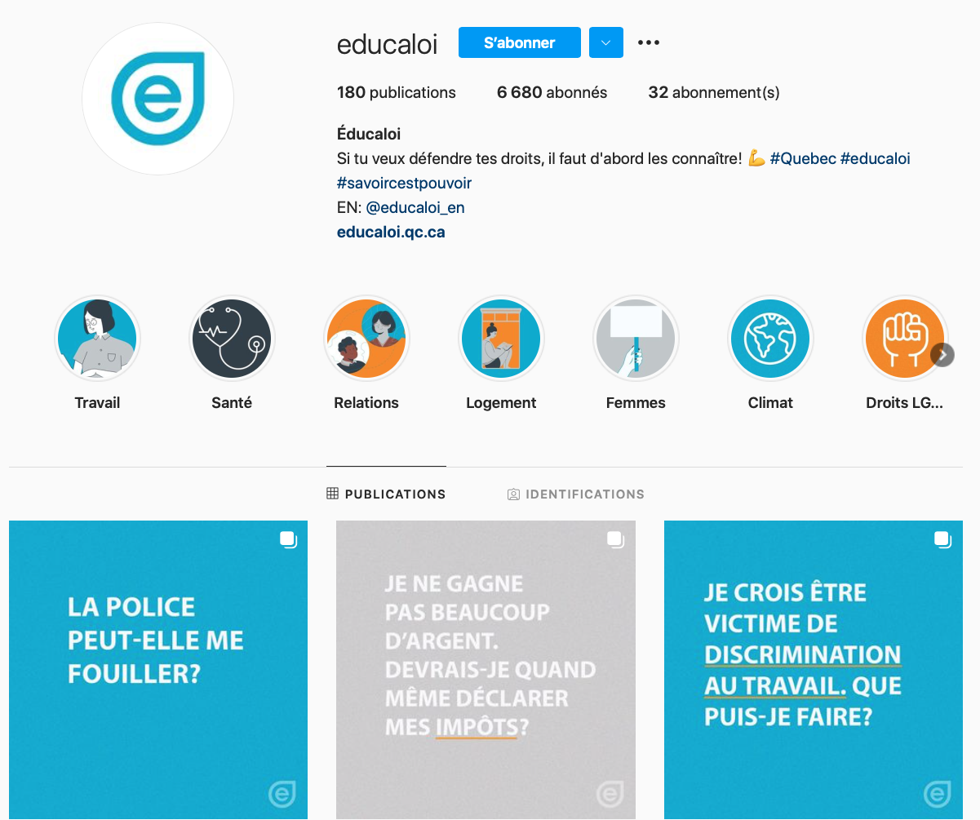
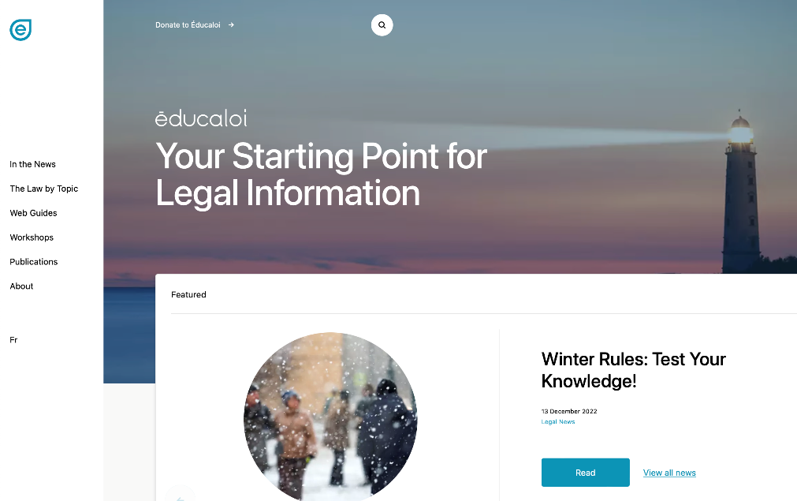
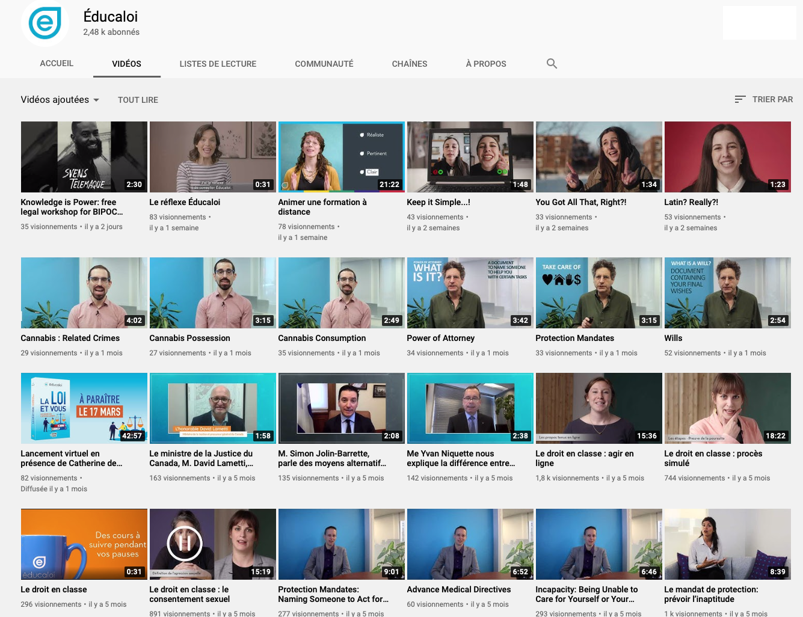
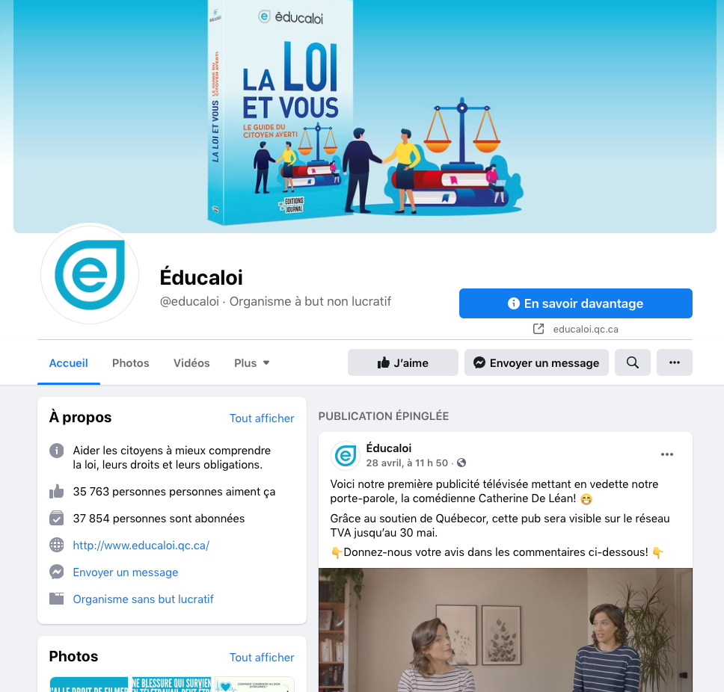
Instagram/educaloi_en
YouTube/educaloi
Facebook/educaloi
educaloi.qc.ca/en

