Slide 1
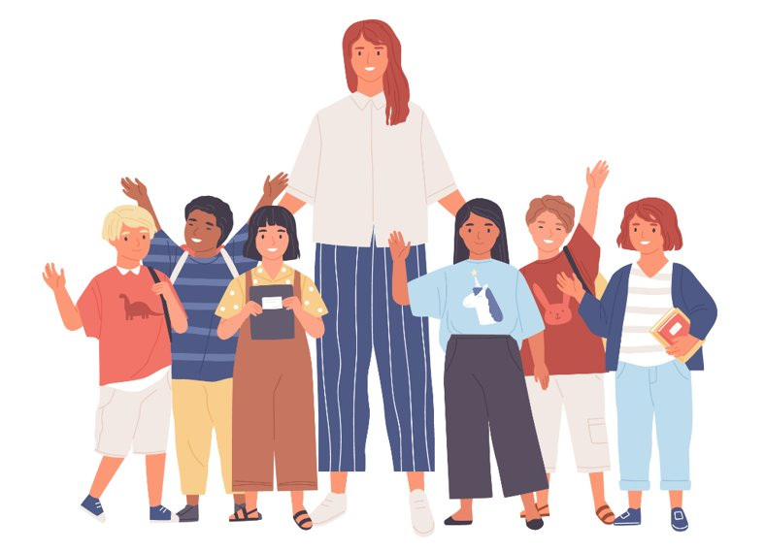
Are You Old Enough?​
What are your responsibilities, freedoms, and protections?
Notes:
NOTES FOR THE TEACHER
The material in this Teaching Kit is the exclusive property of Éducaloi. Teachers in Québec can use it for non-commercial purposes only.
The information in this kit does not constitute a legal opinion.
Éducaloi is dedicated to providing reliable legal information. To ensure the reliability of the legal information in this kit, the documents must be used in their original form, without any modification.
The law is constantly evolving. This document is up to date as of January 2026.

Slide 2
Do you know the responsibilities, freedoms, and protections of children?
Notes:
NOTES FOR THE TEACHER
Ask the students about their prior knowledge on this subject.
Ask them the question on the slide and add the following question: "As of what age do these apply?"
Ask the students to complete the question in the Student Workbook, p. X.
Discuss a few answers as a class.
Ask the students the following questions: What is a responsibility? Is there a difference between a responsibility at home and a responsibility in society? The students can give examples of responsibilities in society, such as: the responsibility to throw garbage in a trash can, to not damage city property, etc.

Slide 3

Responsibilities

Slide 4
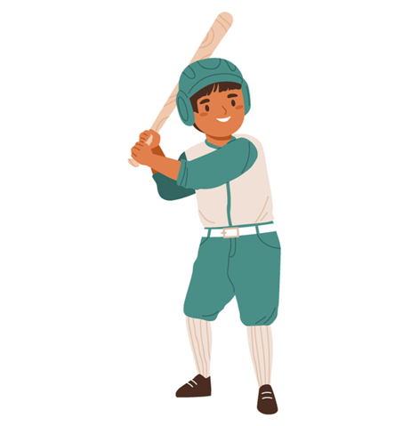
My responsibilities
The Broken Window
Romeo, 12 years old, breaks his neighbour’s window while playing baseball.
The neighbour asks to be reimbursed for the cost of his new window.
Who will pay to replace the window?
Notes:
NOTES FOR THE TEACHER
As a class, read scenario 1.
Ask the students to write their hypothesis individually in the Student Workbook, p. X.
Discuss a few answers as a class.
Look for an answer on Éducaloi’s website in the article Legal Responsibility of Parents.

Slide 5
What the law says
The Broken Window
Romeo could be responsible for the damage since civil liability applies as of about 7 years of age.
The neighbour could also sue Romeo’s parents for reimbursement.
Notes:
NOTES FOR THE TEACHER
Correct this exercise as a class.
Have the students write down the main elements under the question “What the law says” in the Student Workbook.
More detailed answer:
Romeo is 12 years old. He’s old enough to understand the difference between right and wrong. This means he can be held responsible for his actions.
If Romeo breaks the neighbour’s window, the neighbour can sue Romeo for the cost of the window repair. Suing someone means going to court and appearing before a judge to ask, for example, that this person pay for or repair something that was broken or damaged.
Romeo’s parents
Sometimes, parents can also be held responsible for the actions of their minor child, regardless of the child’s age.
Why? Because it’s their responsibility to properly look after their children, to educate them, supervise them, and teach them to be careful.
But if the parents can show the judge that they did a good job, that they supervised Romeo well, they may not be held responsible for Romeo’s actions.
Also, the older the child, the less the parents are responsible. For example, the parents of a 17-year-old are less responsible for their child’s actions than the parents of a 12-year-old.
What about insurance?
Sometimes, the parents have insurance that can help pay for the repairs if their child harms someone or something. This is called liability insurance.
SOURCES ​​
Code civil du Québec, RLRQ c CCQ-1991, art 1457 (principe général de la responsabilité civile et nécessité d’être doué de raison)​, 1459 (responsabilité des titulaires de l’autorité parentale).
Boyer c Hydro-Québec, (1985) RL 129 (QCCS); Baudouin, Jean-Louis. La responsabilité civile, 8e éd., Cowansville, Québec, Éditions Yvon Blais, 2014, par. 1-111 (responsabilité civile – 7 ans) ​​
Jean-Louis Baudouin, La responsabilité civile, 8e éd., Cowansville, Éditions Yvon Blais, 2014 au para 1‑102, 104-106, 111, 164, 166, 331, 437​​
Ginn c. Sisson, [1969] C.S. 585 (un enfant âgé de 6 ans et 9 mois a été considéré comme étant doué de raison)
Laverdure c. Bélanger, (C.S., 1975-01-10), SOQUIJ AZ-75021206, [1975] C.S. 612 (appel rejeté par (C.A., 1977-10-21), SOQUIJ AZ-77012161, J.E. 77-75) (Responsabilité des parents, peu importe si l’enfant a la capacité de discerner le bien du mal)

Slide 6

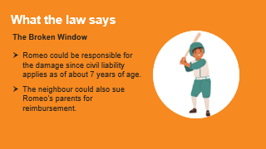
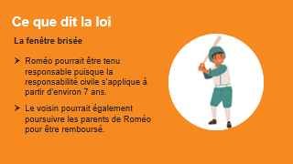
Around age 7
Civil liability
My responsibilities
Around 7 years of age, children can be held responsible for damage they cause. ​
Notes:
NOTES FOR THE TEACHER
As a class, read the information on civil liability and complete it with the following example:
For example, children can be sued if they break or damage property that doesn’t belong to them.
Ask the students to add the correct age (7 years old) in the definition of civil liability in the Student Workbook, p. X.
SOURCES ​​
Code civil du Québec, RLRQ c CCQ-1991, art 1457 (principe général de la responsabilité civile et nécessité d’être doué de raison) ​​
Boyer c Hydro-Québec, (1985) RL 129 (QCCS) ; Baudouin, Jean-Louis. La responsabilité civile, 8e éd., Cowansville, Québec, Éditions Yvon Blais, 2014, par. 1-111 (responsabilité civile – 7 ans) ​​
Ginn c. Sisson, [1969] C.S. 585 (un enfant âgé de 6 ans et 9 mois a été considéré comme étant doué de raison) ​

Slide 7

My responsibilities
A Very Bad Day
Martina, 13 years old, is having a very bad day at school. She’s really at her wit’s end. After school, Shing Yan makes fun of her. Martina explodes and punches her in the face, breaking her nose. Shing Yan’s parents are furious.
What can Shing Yan’s parents do in this situation?
Notes:
NOTES FOR THE TEACHER
As a class, read scenario 2. (You can choose to quickly go over scenarios 2 and 3, then give the students time to complete them.)
Ask students to write their hypothesis individually in the Student Workbook, p. X.
Discuss a few answers as a class.
Look for an answer on Éducaloi’s website in the article Teens Accused of Crimes: Possible Outcomes.

Slide 8
What the law says
A Very Bad Day
The parents could file a police complaint.
The parents could also sue Martina and/or her parents for reimbursement of the medical costs.
Notes:
NOTES FOR THE TEACHER
Correct this exercise as a class.
Have the students write down the main elements under the question “What the law says” in the Student Workbook.
More detailed answer:
Martina is 13 years old. Therefore, she is old enough to be held criminally responsible and to face consequences if she commits a crime. Since she hit Shing Yan, Shing Yan’s parents can file a police complaint, and Martina could be charged with hitting Shing Yan. When you hit someone on purpose, that’s called “assault”, which is a crime.
Since Martina can also be held civilly liable, Shing Yan’s parents could also ask that Martina or her parents pay the medical costs as well ask for compensation for the pain Shing Yan experienced. In short, Martina could have to pay compensation for the harm she caused Shing Yan.
SOURCES ​​
Code criminel, LRC, (1985) ch C-46, arts 265 et suivants (voies de fait).
Code civil du Québec, RLRQ c CCQ-1991, art 1457, 1459.
Paquette Sauriol c. Correnti, 2013 QCCQ 15891, aux paras 91 et 95 (frais médicaux)
Côté c Provençal, 2001 QCCS 24851, aux paras 169 à 173, 187 et 188. (douleurs)

Slide 9

Age 12
Criminal responsibility
My responsibilities
As of 12 years of age, children can be charged with a crime, such as theft, assault, and drug possession or dealing.​
Notes:
NOTES FOR THE TEACHER
As a class, read the information on criminal responsibility and complete it with the following information:
However, young people are not treated as adults by the criminal justice system. Rather, the goal is to educate and reintegrate them into society. Therefore, the consequences are generally not as serious. For example, unlike adults, young people are not sent to prison, even if they’re found guilty of a serious crime. Instead, they’re placed in a youth centre or another adapted facility. However, certain exceptions apply, for example 14-year-olds that are in exceptional situations.
Ask the students to add the correct age (12 years old) in the definition of criminal responsibility in the Student Workbook, p. X.
SOURCES ​​
Code criminel, LRC, (1985) ch C-46, art 13 (12 ans).
Loi sur le système de justice pénale pour les adolescents, LC 2002, c 1, art 3 (réadaptation et réinsertion sociale des ados), 39 (placement sous garde), 64 (peine adulte pour les jeunes de 14 ans et plus).

Slide 10
My responsibilities
The Red Light
Lara, 14 years old, is walking to school. She realizes she might be late. There are no cars on the road so she decides to run across the street even though there’s a red light. She’s stopped by the police.
What are the possible consequences Lara can face?
Notes:
NOTES FOR THE TEACHER
As a class, read scenario 3. (You can choose to quickly go over scenarios 2 and 3, then give students time to complete them.)
Ask the students to write their hypothesis individually in the Student Workbook, p. X.
Discuss a few answers as a class.
Look for an answer on Éducaloi’s website in the article Teenagers: Tickets and Fines.

Slide 11
What the law says
The Red Light
Possible fine: between $15 and $30.
Children can be fined as of age of 14.
Lara could be fined, or could be given a warning.
Notes:
NOTES FOR THE TEACHER
Correct this exercise as a class.
Have the students write the down main elements under the question “What the law says” in the Student Workbook.
More detailed answer:
A person who crosses the street against a red light can be fined $15 to $30, even if there were no cars in sight.
However, children can only be fined as of the age of 14. So, Lara, who’s 14, could be fined, or she could be given a warning. The police could also inform her parents of the situation.
SOURCES ​​
Code de la sécurité routière, RLRQ c C-242, arts 444, 505. (Amende pour non-respect des signaux de circulation)
Code de procédure pénale, RLRQ c C-25.1, art 5. (Amendes à partir de 14 ans)

Slide 12
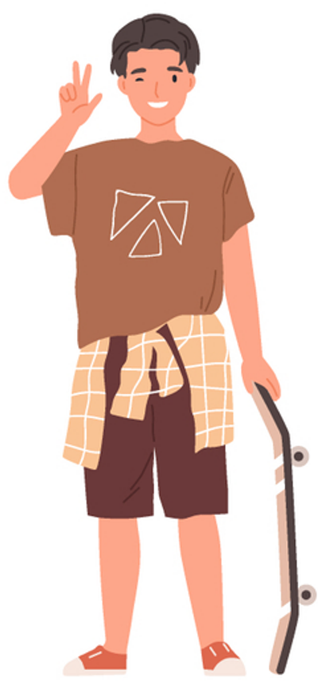
Age 14
Receive a fine
My responsibilities
Children can be fined as of 14 years of age. A fine is sometimes also called a “ticket”.
​
Notes:
NOTES FOR THE TEACHER
As a class, read the information on the legal age for receiving a fine and complete it with the following information:
A fine (also sometimes called a “ticket”) is a document that police give to someone who violated a law or regulation. The document given indicates the amount to pay for this violation. Children can be fined as of the age of 14.
For example, a police officer could give you a ticket if you’re in a park after hours, or if you litter.
Ask the students to add the correct age (14 years old) in the definition of fine in the Student Workbook, p. X.
SOURCE
Code de procédure pénale, RLRQ c C-25.1, art 5. (Amendes à partir de 14 ans)

Slide 13

Age 18
Age of majority
My responsibilities
The legal age at which a person is considered an adult under the law. They have all the responsibilities and freedoms of an adult.
The age of majority is 18.
Notes:
NOTES FOR THE TEACHER
As a class, read the information on legal age of majority.
Ask the students to add the correct age (18 years old) in the definition of age of majority in the Student Workbook, p. X.
SOURCE
Code civil du Québec, RLRQ c CCQ-1991, art 153.

Slide 14
As we grow up, society gives us more responsibilities ...
Around age 7
Civil
liability
Age 12
Criminal responsibility
Age 14
Receive a fine
Age 18
Age of majority
Notes:
NOTES FOR THE TEACHER
With the students, complete this summary of responsibilities in the Student Workbook, p. X.
SOURCES
Code civil du Québec, RLRQ c CCQ-1991, art 1457 (principe général de la responsabilité civile et nécessité d’être doué de raison) ​​
Boyer c Hydro-Québec, (1985) RL 129 (QCCS) ; Baudouin, Jean-Louis. La responsabilité civile, 8e éd., Cowansville, Québec, Éditions Yvon Blais, 2014, par. 1-111 (responsabilité civile – 7 ans) ​​
Code criminel, LRC, (1985) ch C-46, art 13 (Responsabilité criminelle à partir de 12 ans).
Code de procédure pénale, RLRQ c C-25.1, art 5. (Amendes à partir de 14 ans)
Code civil du Québec, RLRQ c CCQ-1991, art 153. (Majorité)

Slide 15
Freedoms

Slide 16
My freedoms
First Love
Mallory is 14 years old and madly in love with her neighbour, Antoine, who’s 18. Mallory’s parents strongly disapprove. They say Mallory is too young to go out with an 18-year-old and sleep at his place.
Can Mallory go out with Antoine?
Notes:
NOTES FOR THE TEACHER
As a class, read scenario 4. It’s a little more detailed in the Student Workbook. (You can choose to quickly go over scenarios 4 and 5, then give students time to complete them.)
Ask the students to write their hypothesis in the Student Workbook, p. X.
Share a few of the answers as a class.
Look for an answer on Éducaloi’s website in the article Sexual Consent of Teenagers.

Slide 17
What the law says
First Love
When a young person is 12 or 13 years old, the age difference between partners must be less than 2 years to engage in sexual activities.
When a young person is 14 or 15 years old, the age difference between partners must be less than 5 years. This means Mallory and Antoine’s relationship is legal.
Notes:
NOTES FOR THE TEACHER
Correct as a class.
Have the students write down the main elements under the question “What the law says” in the Student Workbook.
More detailed answer:
Consent is a person’s agreement to an action or a project. It is a very broad concept that applies to many situations. For example, a person can consent to health care or to engaging in sexual activities (kissing, caressing, or sexual relations) with someone else.
When the younger partner is 14 or 15 years old, the age difference must be less than 5 years to engage in sexual activities.
If the age difference between Mallory and Antoine had been 5 years or more, and they engaged in sexual activities, (such as kissing, caressing or sexual relations), Antoine would be committing a crime because Mallory’s consent would be invalid. Here we’re talking about crimes like sexual assault, but there are other crimes related to sexual offences involving minors, such as luring (communicating with someone under 18 with the intent of committing a sexual offence).
Also, the consent of a person under 18 is invalid if there’s a power imbalance between the two people, for example, if a tutor or a sports coach dates their student.
Parents’ role: Parents have the obligation to look after their children and supervise them. This means that parents have a say in who gets to be around their children. Parents can forbid their child from seeing or going out with someone if they believe that’s in their child’s best interest.
SOURCES
Code criminel, LRC 1985, c C-46, art 150.1 (consentement sexuel et écarts d’âges), 153 et 153.1 (rapport de force)
Code civil du Québec, RLRQ c CCQ-1991, art 598, 599 (autorité parentale des parents et devoirs)

Slide 18




Age 12
Sexual consent with other teens
My freedoms
If you’re
Allowable age difference
12-13 years old
Less than 2 years
14-15 years old
Less than 5 years
Before you’re 18, your consent is not valid if there’s a power imbalance between you and the other person.
Notes:
NOTES FOR THE TEACHER
As a class, read the information on sexual consent with other teens and complete it with the following examples:
For example, there’s a power imbalance if:
the older person is in a position of trust or authority (e.g., the partner is the teen’s teacher or employer),​
there’s a situation of dependency or exploitation between the two people (e.g., the partner is housing the teen when they have nowhere else to go).
Ask the students to add the correct ages (12 years old and 16 years old) in the description of sexual consent in the Student Workbook, p. X.
SOURCE
Code criminel, LRC 1985, c C-46, art 150.1 (consentement sexuel et écarts d’âges), 153 et 153.1 (rapport de force)

Slide 19
My freedoms
A New Name
Gabriel Hilal is 15 years old and wants to change his name to Ronaldo Hilal. He’s always dreamed of having the same first name as his favourite soccer player!
Does he have the right to do this?
Notes:
NOTES FOR THE TEACHER
As a class, read scenario 5. (You can choose to quickly go over scenarios 4 and 5, then give the students time to complete them.)
Ask the students to write their hypothesis individually in the Student Workbook, p. X.
Discuss a few answers as a class.
Look for an answer on Éducaloi’s website in the article article Changing Your Name.

Slide 20
What the law says
A New Name
A person can only request a name change for a serious reason.
Therefore, Gabriel won’t be able to change his name. Even if he was an adult he wouldn’t be allowed to do so.
Notes:
NOTES FOR THE TEACHER
Correct this exercise as a class.
Have the students write down the main elements under the question “What the law says” in the Student Workbook.
More detailed answer:
A person can only request a name change for a serious reason. For example, someone can request a name change if their name is too difficult to write or if it’s made fun of. For example, in a real case, parents wanted to name their child “Spatula”, but the government opposed this choice, finding that the first name was unusual and could lead to ridicule.
Gabriel will probably not be allowed to change his name because he doesn’t have a serious reason.
This is a case where the same rule applies regardless of the person’s age. Even if Gabriel was an adult, the same principle would apply.
SOURCES
Code civil du Québec, RLRQ c CCQ-1991, art 58 al .1 (changement de nom).
Lavigne c. Beaucaire, 1996 CanLII 4381 (QC CS) (Prénom inusité et prêtant au ridicule, Spatule).

Slide 21
Age 14
Consent to care
My freedoms
As of 14 years of age, a person can accept or refuse health care on their own.
​
Can you name examples of health care?
Notes:
NOTES FOR THE TEACHER
As a class, read the information on consent to care and the following explanations:
In general, before the age of 14, parents make these decisions.
For example: going to see a doctor, taking medication, or undergoing a medical test.
However, parents must decide based on what’s best for their child, not simply based on their own beliefs. And, if possible, they should take their child’s views into account.
As of the age of 14, the rules change: young people can decide for themselves if they want to receive care that is necessary for their health. Care that is “necessary for health” can be, for example
a blood test,
medication,
surgery,
an abortion, or
deciding to see a psychologist.
As always, there are some exceptions:
If a young person must stay at the hospital for more than 12 hours, their parents must be informed.
If a young person refuses care that is essential to their health, the hospital can ask a judge for permission to provide that care.
If the parents refuse care that is essential to the teen’s health (under 14) without a good reason, the hospital can also ask for a judge’s help.
Finally, in an emergency, when a child’s life is in danger, doctors have the right to take immediate action and to inform the parents later.
For care that’s not essential to health:
In this situation, the rules are different.
For example, if a young person wants surgery to change the shape of their nose, and the procedure is not medically necessary and carries significant risks or potential permanent consequences, parental consent is still required, even after age 14.
For less risky procedures, such as tattoos or piercings, there are no legal rules stating that you must be over 18. Judges feel that most young people can decide on their own if they want to get a tattoo or a piercing. However, tattoo and piercing salons have the right to refuse to serve minors.
Ask the students to add the correct age (14 years old) in the description of consent to care in the Student Workbook, p. X.
SOURCES
Code civil du Québec, RLRQ c CCQ-1991, art 11, 12 (intérêt de l’enfant), 13 (urgence), 14 (âge pour consentir aux soins requis par l’état de santé), 16 (demande au tribunal), 17 (consentement aux soins non-requis par l’état de santé).
Droit de la famille - 152118, 2015 QCCS 3966 (avortement)
Centre universitaire de santé McGill (CUSM--Hôpital général de Montréal) c. X, 2017 QCCS 3946 (CanLII), au para 34 (transfusion sanguine).
Corbeil c. Ladouceur (Boutique Enigma), 2012 QCCQ 402. NB: IL s'agissait d'un cas de perçage et non du tatouage. Le tatouage était un obiter dans cette décision.

Slide 22
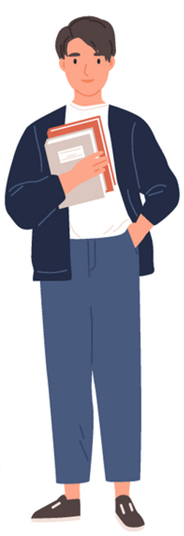
Age 16
Driving
My freedoms
As of 16 years of age a person can receive a driver’s licence. They must follow the rules in the Highway Safety Code.
Do you know any of the obligations and prohibitions in the Code?
What happens if someone violates the rules frequently?
​
Notes:
NOTES FOR THE TEACHER
As a class, read the information on the right to drive and the following explanations:
​
As of age 16, a person can receive their licence and start driving. Of course, they must follow the rules in the Highway Safety Code.
Do you know any of the rules to follow when you’re on the road?
speed limits
red lights
stop signs
always wearing a seatbelt
not using a cell phone while driving
Etc.
Do you know what happens if someone frequently violates these rules?
They could be fined and lose demerit points on their licence.
They could even lose their licence!
But the Highway Safety Code is not just for drivers! It also has rules for:
cyclists, for example, riding in the same direction as car traffic,
pedestrians, such as not crossing the street against a red light,
there are also rules for maintaining your car, changing the tires, and registering the car (registering it to be able to drive it legally),
the Code also explains the steps needed to receive a driver’s licence.
When you start driving at 16, you first receive a “probationary” licence. It’s a special licence for new drivers, which lasts 2 years. During this time, there are special rules to follow. For example:
For alcohol: Zero tolerance. You don’t have the right to drink at all before driving. As an adult, you have right to drink a little, up to a certain limit, but not with a probationary licence.
Ask the students to add the correct age (16 years old) in the description of driving in the Student Workbook, p. X.
SOURCES
Code de la sécurité routière, RLRQ c C-242, art. 67 al. 2 (conduite automobile – 16 ans).
Code de la sécurité routière, RLRQ c C-242, art. 1 al. 1 (le Code de la sécurité routière s’applique aussi aux cyclistes et aux piétons).
Code de la sécurité routière, RLRQ c C-242, arts 6-60 (immatriculation).
Code de la sécurité routière, RLRQ c C-242, arts 270 (pneus doivent respecter normes établies par règlement)​​.
Code de la sécurité routière, RLRQ c C-242, arts 65-83.1 (conditions pour obtenir son permis).

Slide 23
Age 18
Age of majority
My freedoms
When a person turns 18, they’re an adult under the law. They have all the freedoms of a major. ​
​
What freedoms does an 18-year-old have that a 17-year-old doesn’t?
Notes:
NOTES FOR THE TEACHER
As a class, read the information on age of majority and the following explanations:
When someone turns 18, they become an adult under the law. This means they can do a lot of things that younger people can’t.
Here are a few examples of things an 18-year-old can do that a 17-year-old can’t:
buy alcohol, cigarettes or lottery tickets,
manage their money on their own, without asking their parents or someone else for permission,
vote in elections and even run as a candidate if they wish.
SOURCES
Code civil du Québec, RLRQ c CCQ-1991, art 153 (âge de la majorité), 208 et suivants (administration des biens du mineur).
Loi sur les infractions en matière de boissons alcooliques, RLRQ c I-8.1, art 109 (3) c).
Loi électorale, RLRQ c E-3.3, art 1.

Slide 24
As we get older, society gives us more freedoms ...
Age 12 ​
Age 14 ​
Age 16 ​
Age 18
Sexual consent with other teens
Consent to care
Driving
Age of majority​
Notes:
NOTES FOR THE TEACHER
With the students, complete this summary of freedoms in the Student Workbook, p. X.
SOURCES
Code civil du Québec, RLRQ c CCQ-1991, art 153 (âge de la majorité).

Slide 25
Protections

Slide 26
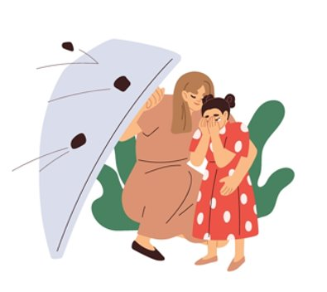
The Convention on the Rights of the Child
An international document dating back to 1989 with more than 50 children rights that must be respected all around the world.
Do you know any of the rights in this document?
Link to the Convention
Notes:
NOTES FOR THE TEACHER
As a class, read the information on the Convention on the Rights of the Child.
Ask the students if they know any of the rights in this document.
If you can, consult the more detailed version of the Convention using the link on the slide.
Complete the summary in the Student Workbook, p. X by reading the following explanations:
Almost every country in the world, including Canada, has signed the Convention. One of the few countries that hasn’t signed it is - the United States. This is due to the States still having laws that allow severe sentences for young people who have committed crimes, such as life in prison, which is prohibited by the Convention.
This convention is not a law like those applied in a court, but rather a “declaration of principles.”
It’s like a promise countries make to protect children and respect their rights. More specifically, the countries promise to act in the best interests of children.
This means that when adults or judges make a decision about a child or a teen, they must choose what’s best for you, not what best suits the adults around you.
For example, if it must be decided which parent you’ll live with, the primary concern is what’s best for you. Or, if an important decision involves you, your opinion must be considered.
Each year, on November 20, we celebrate the World Children’s Day to remember this promise that countries have made.
SOURCES
Code civil du Québec, RLRQ c CCQ-1991, art 33.
Nations Unies, Convention relative aux droits de l’enfant.

Slide 27
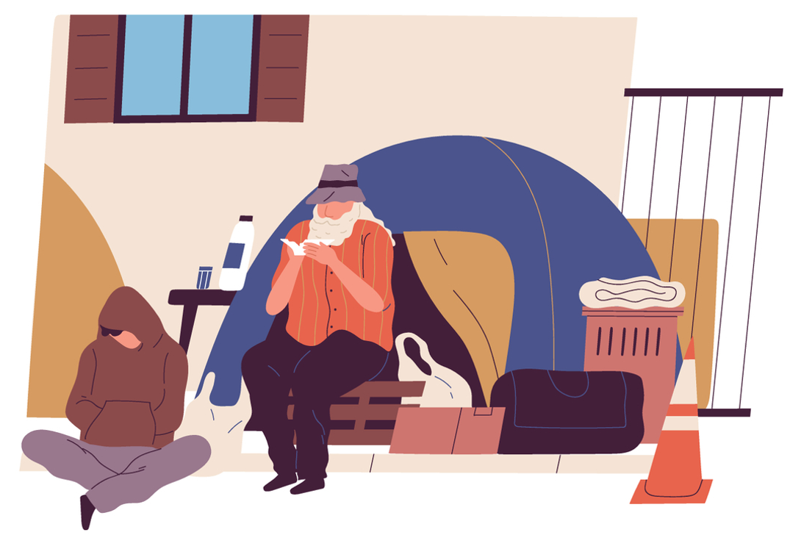
The Youth Protection Act
The Youth Protection Act protects minors (people under 18 years of age).​
It enables the Director of Youth Protection (DYP) to intervene when a child’s security or development is in danger.
Notes:
NOTES FOR THE TEACHER
As a class, read the information on the DYP.
Ask the students if they know examples of situations where the DYP should be called.
Complete the summary in the Student Workbook, p. Xby reading the following explanations:
​
The Youth Protection Act applies to youth under 18 years of age.
The Director of Youth Protection (DYP) is the organization that gets involved when a child’s security or development is in danger. The Youth Protection Act gives the DYP this power. Anyone can report a problematic situation involving a child to the Director of Youth Protection. Here are a few examples:
If the child does not have enough food or clothing or does not live in a safe place.
If the child is not receiving the necessary physical or mental health care.
If the child is a victim of physical or sexual violence.
If the child is treated cruelly or is being psychologically abused.
If the child doesn’t go to school or is not receiving the necessary education.
If the child has serious or repeated behavioural problems and their parents do not take the necessary steps to resolve the situation.
All adults who work with children (such as teachers, social workers, the police, etc.) are required to alert the DYP if they think a minor is in danger or their needs are not being fulfilled.
Other adults can also report a situation, but they are not required to do so.
If you notice a situation of concern, talk to an adult!
SOURCE
Loi sur la protection de la jeunesse, RLRQ c P-34.1, art art 1, 2 (définition « enfant »), 32 (rôle du DPJ), 38 (motifs de compromission), 39 (signalement),

Slide 28

My protections
An Agonizing Choice
Amber is 15 years old and her parents are separating. Her mother wants to move to Saint-Jérôme. She’d like Amber to stay with her every second week, but her father would prefer her spending as much time as possible with him in Longueuil, close to her best friends and cousins. Amber would prefer to stay in Longueuil.
Who will decide where Amber lives? Where will she live?
Notes:
NOTES FOR THE TEACHER
As a class, read scenario 6. (You can choose to quickly go over scenarios 6 and 7, then give students time to complete them.)
Ask the students to write their hypothesis individually in the Student Workbook, p. X.
Discuss a few answers as a class.
Look for an answer on Éducaloi’s website in the article Choosing Which Parent to Live With.

Slide 29
What the law says
An Agonizing Choice
If the parents can’t come to an agreement, a judge will have to decide where Amber lives.
Children have the right to provide their views on questions affecting them. It’s a factor to consider when deciding what’s in their best interest.
Notes:
NOTES FOR THE TEACHER
Correct this exercise as a class.
Have the students write the down main elements under the question “What the law says” in the Student Workbook.
More detailed answer:
If the parents can’t come to an agreement, a judge will have to decide which parent Amber will live with. Judges don’t make random decisions: they must always think about what’s best for the child. In this case, what’s best for Amber. This is called “the best interest of the child”. What the parents want is not what’s most important, but rather what’s best for the child.
Under Article 12 of the Convention on the Rights of the Child, children have the right to give their opinion on matters that affect them, such as the time Amber would like to spend with her parents. In Quebec, Amber could choose to speak directly with her parents, speak with the experts involved in her parents’ separation, or even speak directly with a judge.
Around the age of 12, a child’s opinion becomes very important when deciding what’s in their best interest. Amber doesn’t decide on her own, but the judge must listen to her and consider what she says, especially if she clearly explains why she wants one thing more than another.
For example, if Amber says that she wants to stay in Longueuil because her school, friends and family are there, the judge could find that it’s a good idea. But remember: this is not automatic. There’s no magic age—like 12, 13 or 14—when a child can make their own decision about whom they want to live with.
The judge will also verify other important elements, such as: Is each parent able to properly look after Amber? Does Amber feel good and safe?
In short: Amber can express her opinion, and the judge will listen to her, especially if she is old enough to express herself clearly. But if the parents are not in agreement, it’s neither Amber nor a parent alone who decides: it’s the judge who will decide what’s in Amber’s best interests.
SOURCE
Code civil du Québec, RLRQ c CCQ-1991, art 33 (meilleur intérêt).

Slide 30
My protections
A Friend’s Distress
You notice that your classmate, Giovanie, is increasingly unhappy since her mother’s new boyfriend moved in with them. During the weeks Giovanie spends at her mother’s house, she never seems to want to go home. You’ve also noticed that her new stepfather always wants to be alone with Giovanie. You’re worried about your friend.
What can you do?
Notes:
NOTES FOR THE TEACHER
As a class, read scenario 6. It’s a little more detailed in the Student Workbook. (You can choose to quickly go over scenarios 6 and 7, then give students time to complete them.)
Ask the students to write their hypothesis individually in the Student Workbook, p. X.
Discuss a few answers as a class.
Look for an answer on Éducaloi’s website in the articles How to Report a Situation to the DYP” (Director of Youth Protection) and The Role of the Director of Youth Protection (DYP).

Slide 31
What the law says
A Friend’s Distress
You could talk about the situation with your parents or an adult at school. The adults at school will be required to inform the DYP.
Children must be protected from violence and mistreatment.
Notes:
NOTES FOR THE TEACHER
Correct as a class.
Have the students write down the main elements under the question “What the law says” in the Student Workbook.
More detailed answer:
Under Article 19 of the Convention on the Rights of the Child, children must be protected from violence and mistreatment.
The DYP can intervene when a child’s security or development is at risk. For example, it may sign an agreement with the parents, ask a judge to prohibit certain people from contacting the child, or require the parents or the child to undergo therapy.
SOURCES
Loi sur la protection de la jeunesse, RLRQ c P-341, art 39 al 1 (signalement au DPJ).
Loi sur la protection de la jeunesse, RLRQ c P-341, art 29, 32, 45.2, 51, 54 (interventions possibles du DPJ).

Slide 32


The Education Act
Children in Quebec are required to go to school from age 6 to 16. Public school must be free (except for school supplies).​
School staff must:
  educate the students according to the curriculum,
  treat all students fairly​,
  protect students from violence.​
Notes:
NOTES FOR THE TEACHER
As a class, read the information on the Education Act.
Complete the summary in the Student Workbook, p. X by reading the following explanations:
Another way of protecting children and youth is to make school mandatory until a certain age.
Children in Quebec are required to go to school from age 6 to 16. Of course, that doesn’t mean they have to stop when they turn 16!
Teachers much look after their students, their education, and their development. They must also treat all students fairly.
Schools must adopt an action plan against bullying.
ADDITIONAL INFORMATION
​​
The law requires every school to have an action plan against bullying and violence. The plan must state:
how to prevent bullying,
how to report bullying,
how to ensure the confidentiality of complaints and information,
how to protect student victims and witnesses,
And be distributed to parents.
Before hiring a person to work with minor or disabled students, schools must ensure this person has not done anything that could reasonably raise concerns for the students’ physical or psychological safety.
SOURCE
Loi sur l'instruction publique, RLRQ c I-13.3, art 14 (16 ans), 22 (4) (responsabilités des enseignant(e)s), 75.1 (plan de lutte contre l’intimidation et la violence), 261.0.1 (vérification des antécédents judiciaires avant l’embauche).

Slide 33

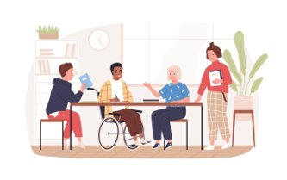
The Charter of Human Rights and Freedoms
This document protects all Quebecers, children and adults alike! The Charter guanrantees:​
​
your right to life and security,
your freedom of expression,
your right to be protected from discrimination.
Notes:
NOTES FOR THE TEACHER
As a class, read the information on the Charter of Human Rights and Freedoms.
Complete the summary in the Student Workbook, p. X by reading the following explanations:
​
There’s a very important document that protects all Quebecers, children and adults alike! It’s called the Charter of Human Rights and Freedoms.
The Charter gives us important rights, such as:
the right to life and security: this means no one has the right to harm you,
the right to say what you think (also knowns as freedom of expression),
and the right to be protected from discrimination (for example, no one can treat you differently because of the colour of your skin, your origin, or because you’re a girl or a boy).
SOURCE
Charte des droits et libertés de la personne, RLRQ c C-12, art 1, 3, 5, 10.

Slide 34

Additional scenarios, review exercise, and conclusion
Complete the final exercises in your workbook as well as the conclusion.
Notes:
NOTES FOR THE TEACHER
Read the instructions related to the additional scenarios and the review exercise: True or False?
Give students time to complete these exercises in the Student Workbook, pp. X to XX.
If you can, allow students to research their answers on the Éducaloi website.
As a class, correct the excercises using the Answer Key in the Student Workbook.
Conclude the activity by using the conclusion questions. Discuss a few of answers as a class.
If you wish, you can complete the additional scenarios that start with the next slide. They can be printed from the Teacher’s Guide.

Slide 35
My responsibilities
The Stolen Cell Phone
Theo brought his cell phone to school. It disappeared from his locker the next morning during second period. Fortunately, the cell was found in the coat pocket of Oniks, who’s 13 years old. Theo’s parents want Oniks to understand the gravity of his actions, so they call the police to report the incident.
What are the possible consequences for Oniks?
Notes:
NOTES FOR THE TEACHER
As a class, read scenario 8. It’s a little more detailed on the activity sheet in the appendix in the Teacher’s Guide. (You can choose to quickly go over several scenarios, then give students time to complete them.)
Ask the students to write their hypothesis individually on the additional sheet printed from the Teacher’s Guide.
Share a few of the answers as a class.
Look for an answer on Éducaloi’s website in the article Teens in Trouble with the Law: What You Need to Know.

Slide 36
What the law says
The Stolen Cell Phone
Often, consequences at school are decided by the principal: suspension, detention, etc.
When a crime is committed by someone 12 years of age or over, the police could be called.
Notes:
NOTES FOR THE TEACHER
Correct this exercise as a class.
Have the students write down the main elements under the question “What the law says” on the activity sheet.
More detailed answer:
It’s the principal’s decision. The consequences resulting from a criminal process could be more serious than those at school.
SOURCES
Code criminel, LRC, (1985) ch C-46, art 13.
Loi sur le système de justice pénale pour les adolescents, LC 2002, art 2(1).

Slide 37
My freedoms
A New Nose
SImon is 16 years old and has always hated his nose. Since he was small, people have made comments and even called him hurtful nicknames. He made an appointment with a cosmetic surgeon for next week to find out if he can have surgery to improve his nose.
Do you think he’s allowed to do this?
Notes:
NOTES FOR THE TEACHER
As a class, read scenario 9. (You can choose to quickly go over several scenarios, then give students time to complete them).
Ask the students to write their hypothesis individually on the additional sheet printed from the Teacher’s Guide.
Discuss a few answers as a class.
Look for an answer on Éducaloi’s website in the article Medical Decisions for Children 14 to 17 Years Old.

Slide 38
What the law says
A New Nose
The surgery Simon wants isn’t required for health reasons. It also comes with significant risks and could have serious and permanent consequences.
Therefore, he will need his parents’ permission to go ahead with the surgery, even though he’s over 14.
Notes:
NOTES FOR THE TEACHER
Correct this exercise as a class.
Have the students write down the main elements under the question “What the law says” on the activity sheet.
SOURCES
Robert P. Kouri et Suzanne. Philips-Nootens, L’intégrité de la personne et le consentement aux soins, 4e éd, Montréal, Éditions Yvon Blais, 2017 au para 551 (chirurgie esthétique).
Jimenez c. Pehr, 2002 CanLII 5691 (QC CS) (risques sérieux des chirurgies esthétiques).
Code civil du Québec, RLRQ c CCQ-1991, art 17 (consentement aux soins).

Slide 39
My freedoms
The Wind in Her Hair
Mayar, 14 years old, loves her new e-bike. And she loves riding it with her hair blowing in the wind, even though her parents tell her to wear a helmet. One sunny afternoon, she’s stopped by the police.
What are the possible consequences for Mayar?
Notes:
NOTES FOR THE TEACHER
As a class, read scenario 10. (You can choose to quickly go over several scenarios, then give students time to complete them).
Ask the students to write their hypothesis individually on the additional sheet printed from the Teacher’s Guide.
Discuss a few answers as a class.
Look for an answer on the SAAQ’s website in the article On an Electric Bike.

Slide 40
What the law says
The Wind in Her Hair
It’s mandatory to wear a helmet.
Only people 18 years of age and over are permitted to ride e-bikes, with some exceptions.
Consequently, Mayar doesn’t yet have the right to use this form of transportation.
Notes:
NOTES FOR THE TEACHER
Correct this exercise as a class.
Have the students write down the main elements under the question “What the law says” on the activity sheet.
More detailed answer:
Under the Highway Safety Code, all of these infractions are punishable by a fine of $60 to $100.
As of the age of 14, children can be fined. This means Mayar could receive a fine. Or the police could decide to simply give her a warning. The police could also inform her parents of the situation.
ADDITIONAL INFORMATION
Youths aged 14 to 17 who hold a Class 6D (moped or scooter) licence are also allowed to ride an electric bike.
SOURCES
Code de la sécurité routière, RLRQ c C-24.2, art 492.2 au para 1 (casque obligatoire), 492.2 au para 2 (18 ans), 507 (amende).
Code de procédure pénale, RLRQ c C-25.1, art 5 (amendes à partir de 14 ans).

Slide 41
My protections
A Thousand and One Classes
Clement is 13 years old. His parents want him to succeed in life. They register him for violin, Spanish and swimming classes. Clement asks his parents to reduce the number of evening classes because he feels overwhelmed and very anxious. His parents refuse, telling him it’s for his own good.
What should Clement do?
Notes:
NOTES FOR THE TEACHER
As a class, read scenario 11. This exercise is more detailed on the activity sheet found in the appendix in the Teacher’s Guide. (You can choose to quickly go over several scenarios, then give students time to complete them.)
Ask the students to write their hypothesis individually on the additional sheet printed from the Teacher’s Guide.
Discuss a few answers as a class.
Look for an answer on Éducaloi’s website in the articles How to report a situation to the DYP and The Role of the Director of Youth Protection (DYP).

Slide 42
What the law says
A Thousand and One Classes
Clement could talk to an adult at his school, and this person could talk to his parents.
The adult at his school could also report the situation to the Director of Youth Protection if they think it’s necessary.
The DYP will decide if they should intervene.
Notes:
NOTES FOR THE TEACHER
Correct this exercise as a class.
Have the students write down the main elements under the question “What the law says” on the activity sheet.
SOURCES
Loi sur la protection de la jeunesse, RLRQ c P-34.1,art 39, 45.

Slide 43
My protections
New Shoes
Fourteen-year-old Abdoulaye has holes in the soles of his running shoes and asks his parents to buy him a new pair. His parents suggest him to use his older brother used shoes, the ones he wore when he was younger. The shoes are in good condition, and the parents think it’s a reasonable decision. Abdoulaye disagrees and tells them his clothing needs are not being met.
Is he right?
Notes:
NOTES FOR THE TEACHER
As a class, read scenario 12. It’s a little more detailed on the activity sheet in the appendix in the Teacher’s Guide. (You can choose to quickly go over several scenarios, then give students time to complete them).
Ask the students to write their hypothesis individually on the additional sheet printed from the Teacher’s Guide.
Discuss a few answers as a class.

Slide 44
What the law says
New Shoes
Parents are required to feed and provide for their children.
But that doesn’t include the obligation to provide their children with new clothing and shoes every season!
Notes:
NOTES FOR THE TEACHER
Correct this exercise as a class.
Have the students write down the main elements under the question “What the law says” on the activity sheet.
SOURCES
Code civil du Québec, RLRQ c CCQ-1991, art 599.

