Slide 1
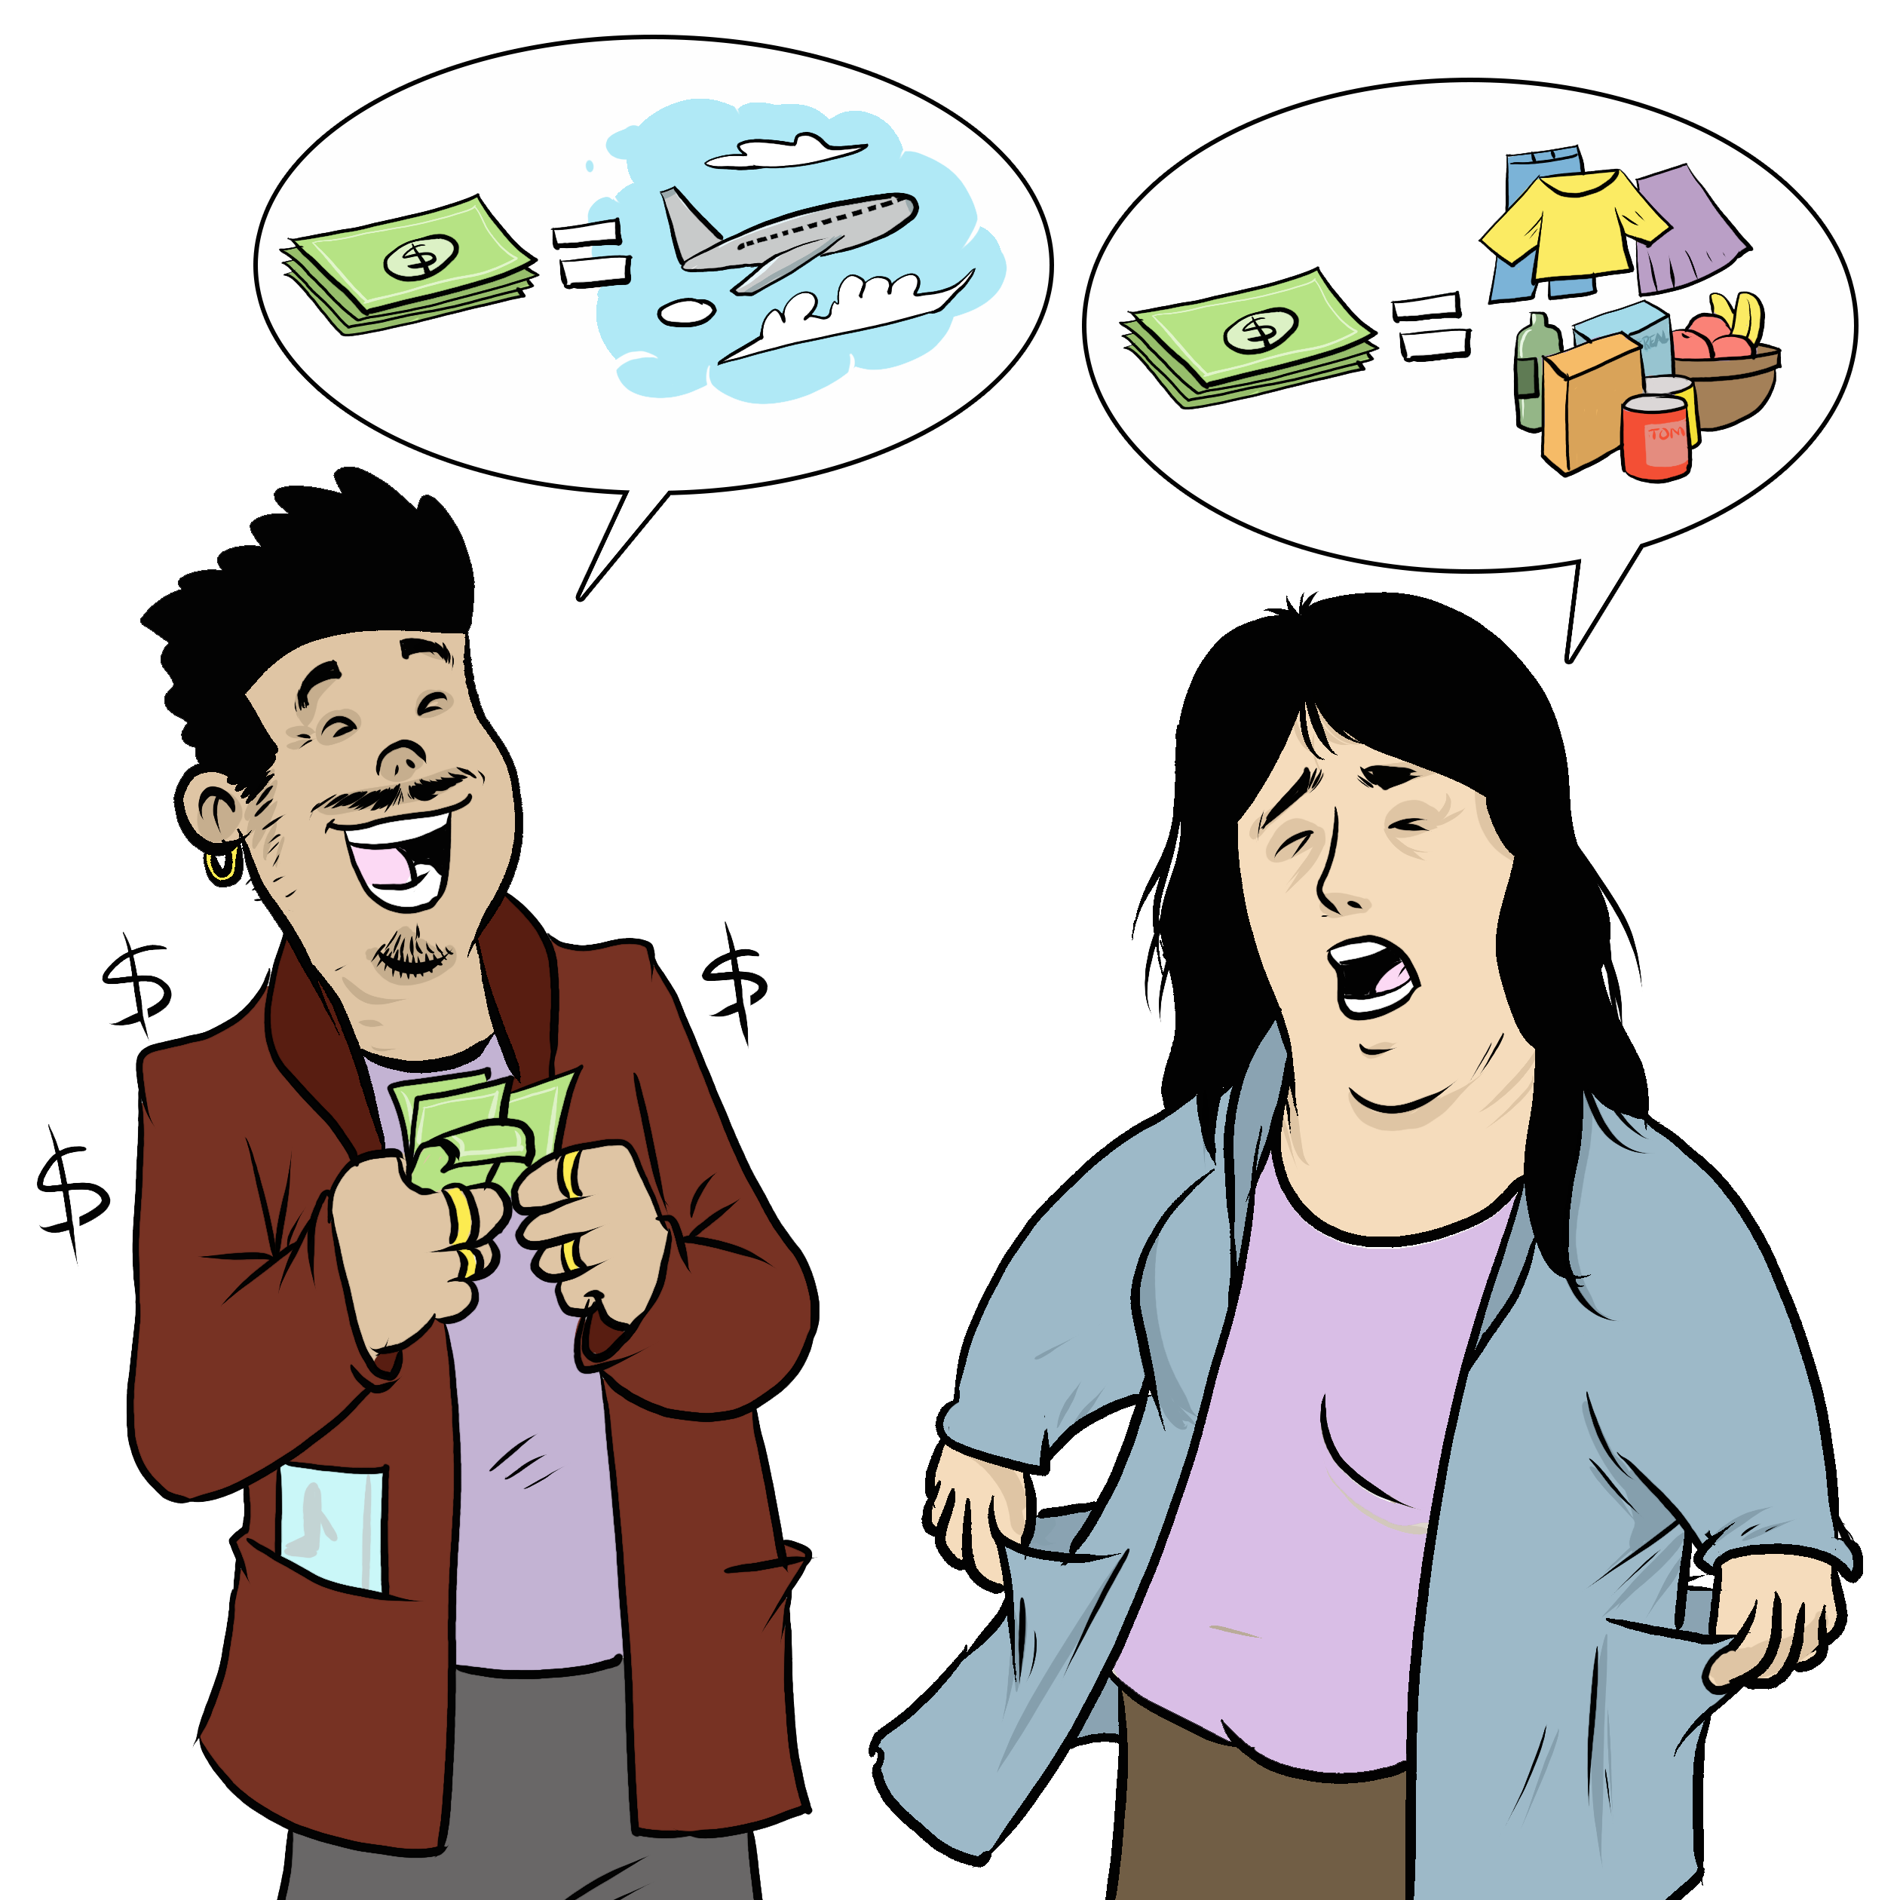
My Children My Relationship
Notes:
Instructions for the workshop facilitator
To prepare to lead this workshop:
Read the Facilitator’s Guide.
Watch the associated videos.
Read the notes at the bottom of each slide.
Read the instructions for the workshop facilitator.
Go over the legal information that you will share with participants.
Read the additional information to deepen your understanding of the theme addressed in this workshop.
If you have time, read the notes at the bottom of each slide of the PowerPoint presentations for the other workshops. All the themes covered in the different workshops are connected. Your explanations during this workshop could bring up questions on topics discussed in other workshops.
Don’t forget to:
Arrange for an interpreter, if necessary.
Add local legal services and resources to the slides.
Combine this workshop with other psychosocial support activities, if necessary.
Take the time to address delicate situations that may arise during the workshop.
This workshop addresses issues relating to separation and violence. The participants have different experiences. Some may be comfortable with the possibility of separation, and others may be strongly opposed to it. Be mindful of this diversity of perspectives when setting the tone for the workshop.
Legal information contained in this activity is valid as of June 30th, 2025.
The information contained in this workshop applies only to Quebec and should not be considered legal advice.

Slide 2
Examining the situation What do you see here?
Notes:
3 minutes
Instructions for the workshop facilitator
Before starting the workshop, mention that you are in a safe space where participants can express themselves freely and without judgment. The discussions that take place during the workshop are confidential.
Lead a discussion based on the following questions:
What is happening in this image?
What does this image tell us about the couple?
What more can you say about the situation if we assume that the woman wants to leave her husband or partner?
What more can you say about the situation if we assume that the woman has a precarious (uncertain) immigration status?
Summarize by repeating the key words that were mentioned by the participants and that are related to the topic of this workshop.

Slide 3
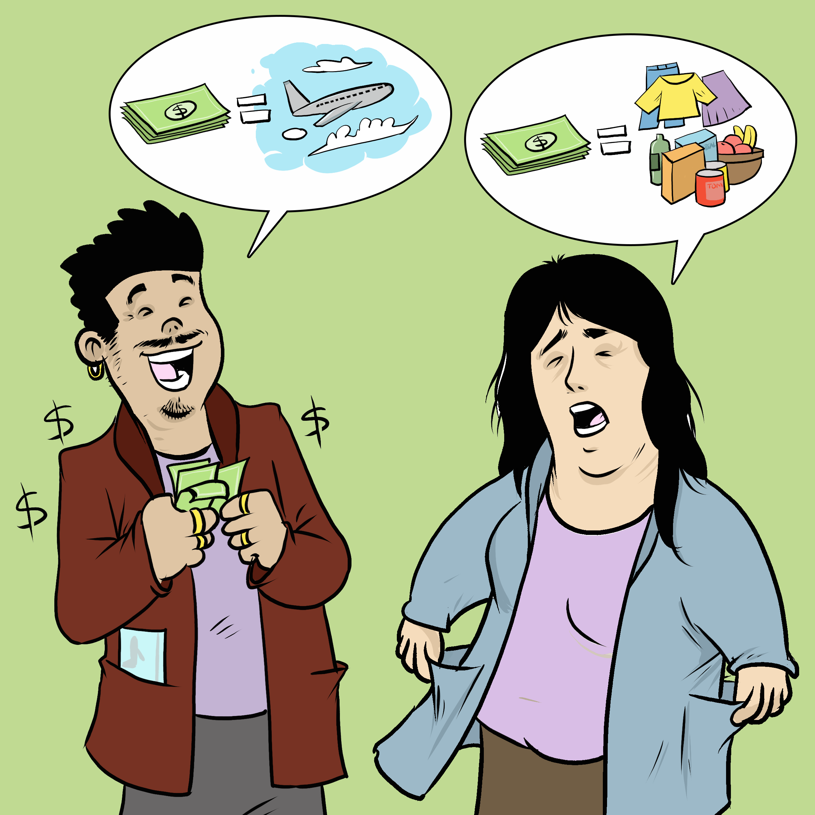
Understanding the legal issues Giulia's story
"I have the children full-time."
"I'm struggling to pay for everything."
"This trip is bothering me."
"I want to make decisions myself."
Notes:
5 minutes
Instructions for the workshop facilitator
Read the following scenario aloud:
Giulia’s ex-partner moved out of their apartment 8 months ago, when they decided to separate. Since then, Giulia has been taking care of their 2 children full-time, and her ex-partner, Jamie, rarely helps her pay for food, housing and clothes. Suddenly, Jamie calls her and tells her that he wants to travel to the United States with the children for two weeks. Giulia is surprised, because her ex has not seen the children for two months. In addition, they are in the middle of the school year. It would be more useful if he spent that money to pay for the children’s daily expenses.
Lead a discussion using the following questions:
Have you ever experienced a similar situation?
What are the main concerns or issues in this situation?
What are the rights and responsibilities related to these concerns or issues?
What should Giulia do to solve the problem?
Mention that you will share legal information to help the participants better understand the legal issues, rights and responsibilities involved in this scenario and that you will come back to the scenario at the end of this workshop. Let participants know you will be covering some basic legal rules. Acknowledge that everyone’s experience with the justice system is different and can be shaped by past challenges, as well as cultural and language barriers. Remind participants that the goal of the workshop is to inform them about their rights, so that they can make informed decisions and protect themselves.
Then explain the goals of this workshop:
To understand the rights and obligations of parents.
To understand the consequences of separation on child custody.
To understand how child support works.
Name the main topics that will be discussed: Parental authority, child custody (or "parenting time"), child support.

Slide 4
Making decisions about the children together
Both parents should make important decisions together
School, medical treatments, activities, travel, etc.
Notes:
2 minutes
Instructions for the workshop facilitator
Explain the information below by making connections with the scenario.
Information to share
A child’s parents should make important decisions about their children together. This is the case even if the parents are separated, and even if one parent spends more time with the children. This is called “parental authority.” It ends when the child turns 18.
For example, parents should make the following decisions together:
Decisions about their children’s medical treatments,
Decisions about their children’s school,
Decisions about activities and hobbies,
Decisions about travel.
In Giulia’s case, even though the children spend most of their time with her, she still needs to consult Jamie for important decisions.
Regarding travel: A parent must have the other parent's consent to travel abroad with the children. Jamie is therefore required to have Giulia's consent to travel to the United States with their children.
Additional information
Border control authorities sometimes require a letter of authorization signed by the parent who is not traveling with the children. There is a letter template on the federal government’s website (“consent letter for children travelling outside Canada”).
If a parent refuses to give consent, the other parent can ask a court to authorize the trip. Courts authorize travel when it is in the best interest of the child. In particular, they consider the reasons for the trip and the safety of the destination.
Sources
Civil Code of Québec, RLRQ, c C-1991, art 600 al 1 (Parents should make decisions concerning the children together)
Civil Code of Québec, RLRQ, c C-1991, art 605 (Obligation to make decisions together even in the case of separation and even if one parents spends more time with the child than the other)
Family Law — 09746, 2009 QCCA 623 para 4 (Illustration : obligation to make decisions together even if one parents spends more time with the child than the other)
Civil Code of Québec, RLRQ, c C-1991, art 600 al 1 (Source of the term "parental authority")
Civil Code of Québec, RLRQ, c C-1991, art 598 (Parental authority ends when the child reaches the age of 18 years old)
Family Law — 09746, 2009 QCCA 623 paras 45, 46 (Examples of decision that parents should make together)
Civil Code of Québec, RLRQ, c C-1991, art 605 ; Family Law — 113962, 2011 QCCA 2318 para 9 and Family Law — 14194, 2014 QCCS 430 para 37 (a parent should have the consent of the other parent to travel)
Family Law — 14194, 2014 QCCS 430 para. 37 ; Lettre de consentement recommandée pour les enfants voyageant à l’étranger - Voyage.gc.ca (border authorities require a travel authorization signed by the non-traveling parent)
Lettre de consentement recommandée pour les enfants voyageant à l’étranger - Voyage.gc.ca (letter template authorising travel)
Civil Code of Québec, RLRQ c CCQ-1991, art. 604. ; See, for example, Family Law— 09567, 2009 QCCS 1113 paras 27 and 38 (possibility to ask a court to authorise travel)
Civil Code of Québec, RLRQ c CCQ-1991, art 33 ; see, for example, Family Law — 191479, 2019 QCCS 3247 paras 3 and 8 ; Family Law— 162902, 2016 QCCS paras 17 à 19. ; For the criteria taken into account f=by the court, see Family Law — 191479, 2019 QCCS 3247 para. 9 (travel should be in the best interest of the child)
Family Law — 191479, 2019 QCCS 3247 paras 9, 46 and 47 (the courts consider the reasons for traveling and the security of the destination)

Slide 5
Custody after a separation or divorce: How does it work?
Both parents can have custody
Agreeing together or going to court
Notes:
7 minutes
Instructions
Explain the information below by making connections with the scenario.
Information to share
Terminology: “custody” and “parenting time.”
After a separation, the time each parent spends with their children is called “custody”[1]. When parents are or were married, it is sometimes also called “parenting time”[2].
Who can have custody?
Both parents have the right to request custody of the children[3].
Depending on the circumstances, the children will sometimes spend half the time with one parent and half the time with the other [4] (this is called “shared custody”[5]).
In other cases, one parent may spend most or all of the time with the children [6] (this is called “sole custody”[7]).
Agreeing on custody (alone or with the help of a mediator)
Parents can agree on custody together [8]. Parents can also ask a court to make this agreement official [9] (“homologate” [10] their agreement).
Parents who can’t agree on how to share custody of their children can get help to reach an agreement. For example, parents can ask for help from a person called a family “mediator,” if that’s appropriate for their situation[11].
This person will try to help them find a solution[12].
Parents are usually eligible for free mediation hours[13].
They can also choose a mediator who speaks their native language. For example, there are mediators who speak Spanish, Arabic, and Italian.
Asking a court to decide custody
If parents can’t agree on custody, one parent can also ask a court to decide for them[14]. The court will make the decision that is in the best interest of the children.[15].
To decide what is in the best interest of the children, the court will look at several factors. For example:
The children's ages [16],
Their needs [17],
Their relationship with each parent [18],
The stability of the parents' daily lives [19],
The parenting abilities of each parent [20].
Some factors do not impact the court’s decision. For example, mothers are not more likely to get custody [21]. Similarly, the fact that one parent cheated on the other [22] or is now in a relationship with someone else generally [23] does not impact custody [24].
How would this work in Giulia’s case?
In Giulia’s case, she could establish a more formal custody plan with her ex, for example by signing an agreement that details how time with the children will be shared. This agreement can also specify how time with the children will be divided during vacations (for example, during the summer or winter break). Giulia and her ex can then ask a court to make this agreement official (homologate it).
Giulia can also go to court alone to request custody of the children.
Additional information
Regarding mediation and agreements made outside of court
It is generally not recommended to use mediation when there was violence between the people in conflict[25]. That said, some mediators specialize in mediation in the context of domestic violence. To find them, the person can go to the Association des médiateurs familiaux du Québec’s website (association of family mediators) and click on “Find a mediator.” They can then select “Violence familiale et conjugale” (family and domestic violence) under the “Champ(s) d’expertise(s)” field.
If parents have a custody agreement that they want homologated, they must file a request with the Superior Court of Québec [26]. If the court homologates the agreement, it will have the same legal weight as a court judgment and both parents will be required to respect it[27].
For more information on family mediation, you can consult this Éducaloi article: Family Mediation in Six Steps | Éducaloi
Regarding going to court
In some cases, parents might have no other option but to go to court. For example, this could be the case in certain situations of violence. During the workshop, you can point out that participants may not always be able to reach an agreement with the other person.
The court must take any violence that happened between the partners into account when making a decision. That said, the fact that one parent behaved or behaves violently towards the other does not necessarily mean that they will have less time with the children. The court's final decision depends on what is in the best interest of the children in the given circumstances. [28].
Sources
[1] Civil Code of Québec, RLRQ, c C-1991, art 599
[2] Divorce Act, LRC (1985), art 2 (1) ‘parenting time’.
[3] Civil Code of Québec, RLRQ, c C-1991, art 599 al 1.
[4] Regulation respecting the determination of child support payments, RLRQ c C-25.01, r 0.4, art 6 al 1.
[5] Regulation respecting the determination of child support payments, RLRQ c C-25.01, r 0.4, art 6 al 1.
[6] Regulation respecting the determination of child support payments, RLRQ c C-25.01, r 0.4, art 4 al 1.
[7] Regulation respecting the determination of child support payments, RLRQ c C-25.01, r 0.4, art 4 al 1.
[8] Code of Civil Procedure, RLRQ, c C-25, art 72 al 2.
[9] Code of Civil Procedure, RLRQ, c C-25, art 72 al 2.
[10] Code of Civil Procedure, RLRQ, c C-25, art 72 al 2.
[11] Code of Civil Procedure, RLRQ, c C-25, arts 605 al 2, 616.
[12] Code of Civil Procedure, RLRQ, c C-25, art 605 al 2, 616.
[13] Code of Civil Procedure, RLRQ, c C-25, art 619 ; Regulation respecting family mediation, c. C-25-01, r. 0.7, art.10.1.
[14] Code of Civil Procedure, RLRQ, c C-25, arts 409, 411.
[15] Civil Code of Québec, RLRQ, c C-1991, art 33.
[16] Civil Code of Québec, RLRQ, c C-1991, art 33 al 2.
[17] Civil Code of Québec, RLRQ, c C-1991, art 33 al 2.
[18] Family Law— 172050, 2017 QCCA 1325, para 60.
[19] Family Law— 172050, 2017 QCCA 1325 para 60.
[20] Family Law— 172050, 2017 QCCA 1325, para 60.
[21] Family Law— 091541, 2009 QCCA 1268, paras 28, 44.
[22] Divorce Act, LRC (1985), art 16 (5) (for married couples)
[23] Unless these éléments are or could be harmful to children.
[24] SG c JL, 2006 QCCS 211 (related case : remarriage of a parent).
[25] For example : 13 Frequently Asked Family Law Questions About Situations of Intimate Partner Violence — SOS violence conjugale
[26] Code of Civil Procedure, RLRQ, c C-25, art 33 al 1.
[27] Code of Civil Procedure, RLRQ, c C-25, art 72 al 3.
[28] Civil Code of Québec, RLRQ, c C-1991, art 33.

Slide 6
Paying expenses for the children: Child support
Requesting money from the other parent
Calculated according to income, number of children, needs of the children and time spent with the children by each parent
Usually automatically collected each month
Notes:
5 minutes
Instructions
Explain the information below by making connections with the scenario.
Information to share
Parents must both contribute to the needs of their children. This includes feeding and financially supporting them [1].
If parents separate, one parent may owe the other money to cover the children's basic expenses (food, health care, clothing, activities, etc.) [2]. This money is called "child support" [3]. Giulia could therefore ask Jamie to pay child support. Jamie is supposed to contribute to paying for the children's needs.
Child support is calculated based on what each parent is able to contribute, the number of children involved, the needs of the children and the time each parent spends with the children[4]. The law gives a specific formula that must be used to calculate child support [5]. For example, if the mother is unemployed and the father has a stable and high income, he may have to pay child support.
Parents can agree on child support [6] (alone or with the help of a mediator). If Giulia and Jamie cannot agree on a child support amount, she could suggest mediation to reach a decision together.
One of the parents can also go to court to ask a judge to set the child support amount [7], or to make their agreement with the other parent official (homologate) [8]. In both cases, child support will generally be collected by Revenu Québec each month from the salary of the parent who pays child support [9]. Revenu Québec will then pay the money to the other parent [10] (usually twice a month [11]). In other words, the parent who receives child support will not need to contact the other parent each month to get the money.
Additional information
The Child Support Payments Calculation tool on the Quebec government’s website allows you to run a simulation and calculate child support. Parents can use this to get an idea of how much child support they could receive if they go to court after a separation. However, this amount is not final. Courts may set a different amount depending on the circumstances.
In some cases, if the parents were or are married, a parent can ask their ex to pay them spousal support (or “alimony”)[12]. For more information, you can refer to the “My Money” workshop.
Sources
[1] Civil Code of Québec, RLRQ, c C-1991, art 585.
[2] Civil Code of Québec, RLRQ, c C-1991, arts 585, 587.2.
[3] Civil Code of Québec, RLRQ, c C-1991, arts 589.
[4] Civil Code of Québec, RLRQ, c C-1991, art 587 ; Regulation respecting the determination of child support payments, RLRQ c C-25.01, r 0.4, art 3.
[5] Regulation respecting the determination of child support payments, RLRQ c C-25.01, r 0.4, art 3, Annex I.
[6] Code of Civil Procedure, RLRQ, c C-25, art 72 al 2.
[7] Code of Civil Procedure, RLRQ, c C-25, arts 409, 411.
[8] Code of Civil Procedure, RLRQ, c C-25, art 72 al 2.
[9] Act to facilitate the payment of support, RLRQ, c P-2.2, arts 6, 7, 8, 11.
[10] Act to facilitate the payment of support, RLRQ, c P-2.2, art 36 al 1.
[11] Act to facilitate the payment of support, RLRQ, c P-2.2, art 36 al 1.
[12] Divorce Act, LRC (1985), art 15.2 (1) et (2).

Slide 7
Where to find help?
Notes:
2 minutes
Instructions
In the following slides, you will find resources that you can present to participants. You can customize the workshop by adding slides presenting other relevant resources.
Feel free to print the slides with the resources.
Feel free to offer to help participants contact one of the mentioned resources or even to go with them if needed. You can also explore the websites together.
Mention that they can look at these resources even if they do not intend to leave their spouse or partner, or if they are still deciding what to do. They can consult these resources simply to inform themselves.

Slide 8
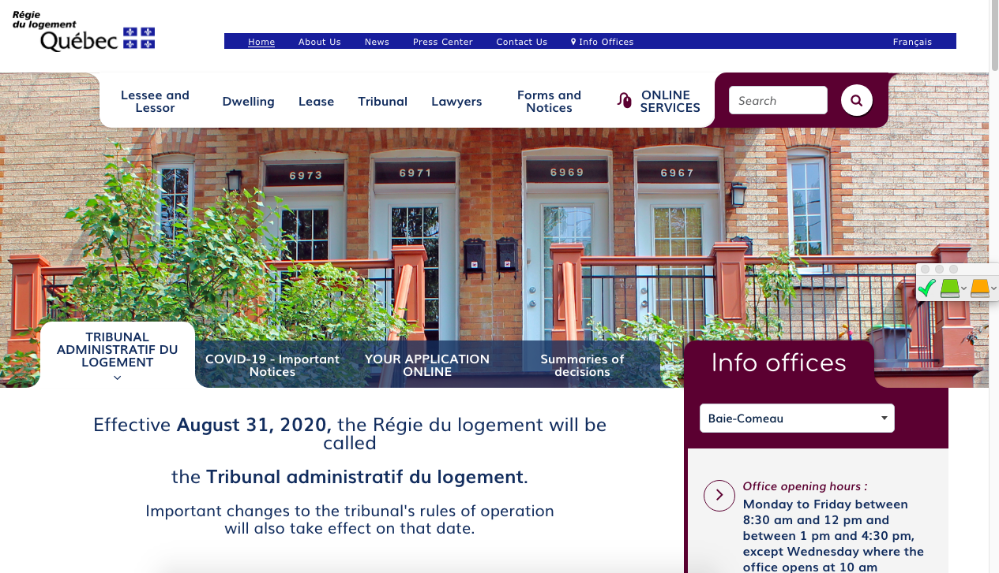
Finding help (Name of the organisation)
(Short description of their service)
(Link to their website)
(Screenshot of the organisation's website)
Notes:
1 minute​
Instructions​
You can customize this slide if you want to add resources other than those presented in the following slides.

Slide 9
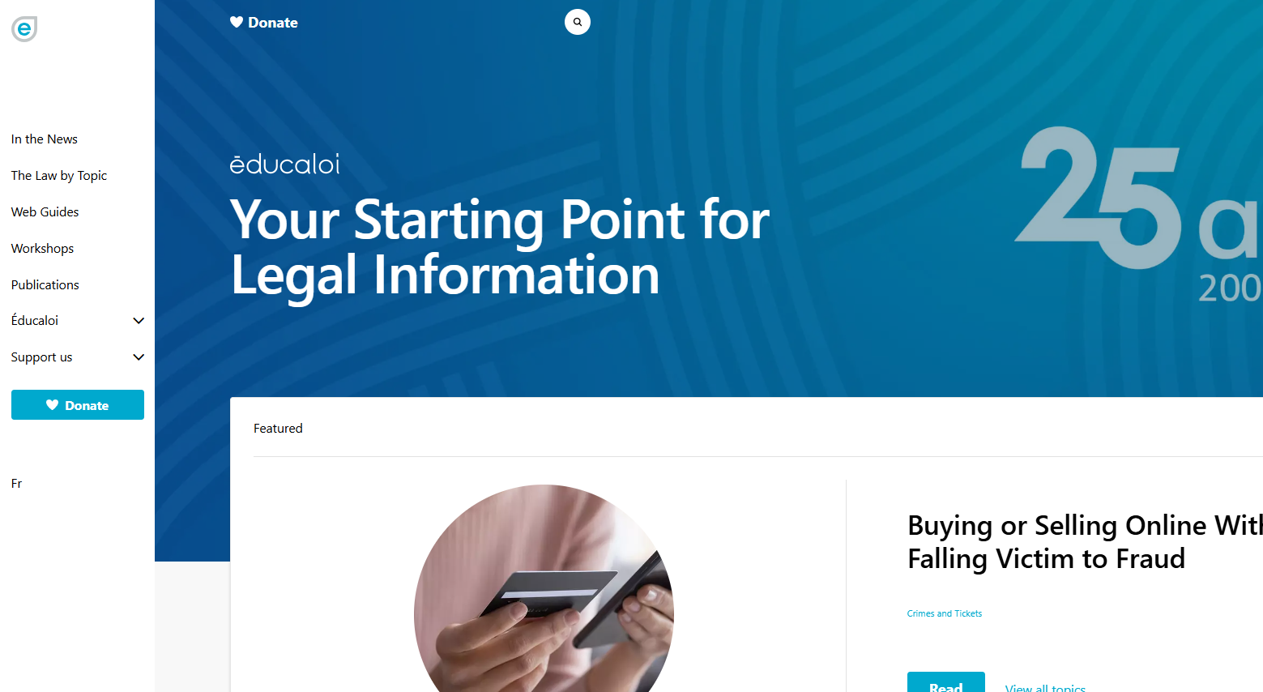
Finding help Éducaloi
Free online legal information on:
Family, couples, separation and divorce
Housing
Work
Éducaloi - Your starting point for legal information
Notes:
1 minute​
Instructions​
Explain that Éducaloi is a non-profit whose mission is to explain the law in Quebec in a simple way. Éducaloi is especially known for its website that covers various legal topics, including family and couples, separation and divorce, housing, work and more. Most of Éducaloi's content is available in French and English.

Slide 10
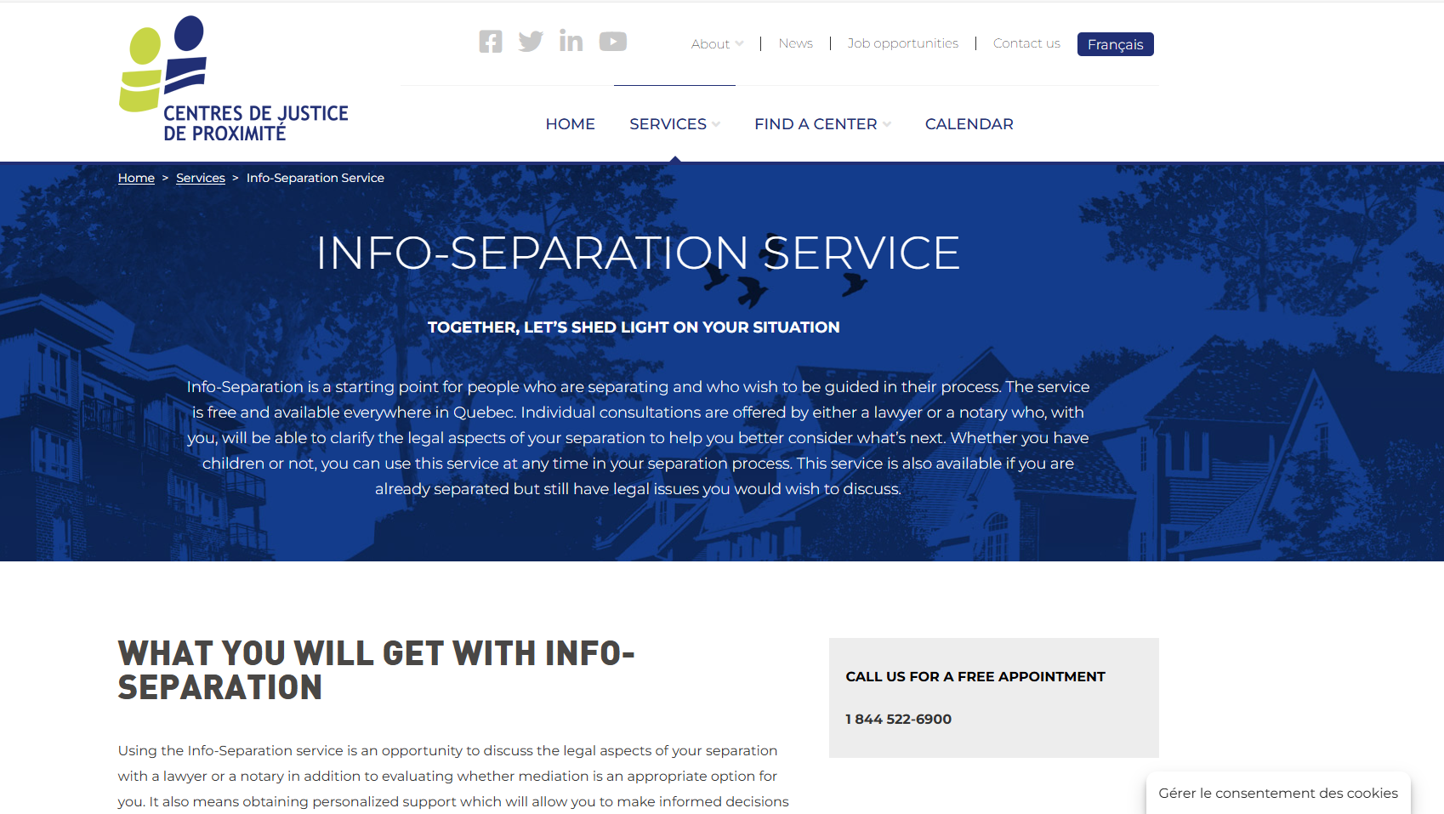
Finding help Community Justice Centers
Info-Separation
Service
Free legal information
Info-Separation Service - Centres de justice de proximité l Centres de justice de proximité
Notes:
1 minute​
Instructions​
Explain that this resource is available to participants if they encounter legal issues related to their life as a couple. The "Info-Separation" service of the Community Justice Centers (CJP) offers free legal consultations with lawyers or notaries to ask legal questions related to separation.
​
To contact them: Contact us - Centres de justice de proximité l Centres de justice de proximité

Slide 11
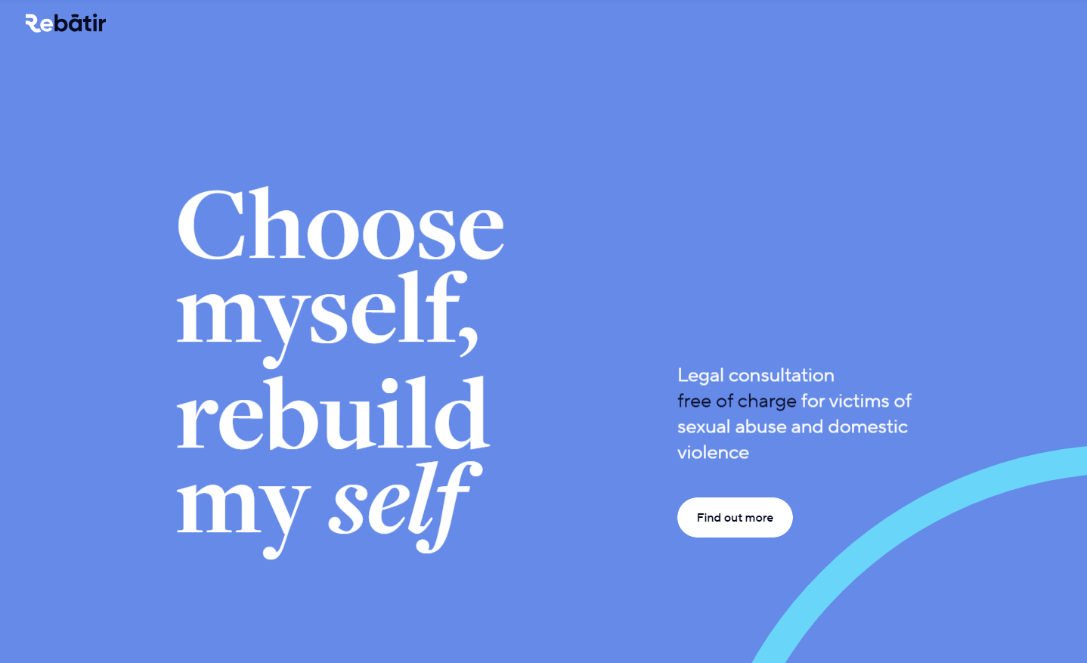
Finding help ReBâtir
4 hours of free legal consultation
1-833-732-2847
Rebâtir
Notes:
1 minute​
Instructions​
Explain that this resource is available to participants if they encounter legal issues related to their life as a couple. Rebâtir is the name of a legal consultation service provided by the Commission des services juridiques (legal aid). It offers 4 hours of free legal consultation to people who experience domestic or sexual violence in all areas of law.
To contact them: call 1-833-REBÂTIR (1-833-732-2847) or write to projet@rebatir.ca

Slide 12
Other resources
Justice Pro Bono – "Porte 33" Program
Directory of family mediators in Quebec (French only)
Notes:
2 minutes
Instructions
Introduce the resources below.
Information to share
Justice Pro Bono – “Porte 33” Program: Free, confidential, one-on-one meetings with volunteer lawyers, notaries or psychosocial counsellors to provide parents who are separating with valuable information.
Association des médiateurs familiaux du Québec (association of family mediators) – Directory of family mediators in Quebec (French only).

Slide 13
Taking action What could Giulia do?
Find help with the calculation for child support
Download the template for travel authorisation
Ask an organisation to inform her on her recourses
Notes:
3 minutes
Instructions
Remind the participants about the scenario shared at the beginning of the workshop.
Ask participants to answer the following question:
In light of all the information and resources we have given you, what could Giulia do?
Complete the participants’ answers by sharing some possible courses of action. Click to make these options appear on the screen.
Conclude with these three key messages:
Parents must make important decisions concerning their children together, even after a separation, and even if one of them spends more time with the children.
Both parents have the right to have custody of their children. The decision must be made in the best interest of the children. A mediator or the courts can help make a decision.
Both parents must contribute to the needs of their children according to what they are able to contribute. After separation, one parent may have to pay child support to the other to help pay for the needs of the children.

Slide 14
Questions?
Notes:
1 minute​
Instructions​
Answer the participants’ questions.
If you have time, ask the following questions and write down the answers:
Did you enjoy the workshop? Why?
What new things did you learn?
Is the information shared in this workshop useful to you? In what situation will you use it?
Feel free to thank everyone for participating in the workshop, asking questions and sharing their perspective.

Slide 15
Éducaloi thanks the Maison Bleue and Femmes du Monde à Côte-des-Neiges for their valuable collaboration
This workshop was made possible with the support of

