Slide 1
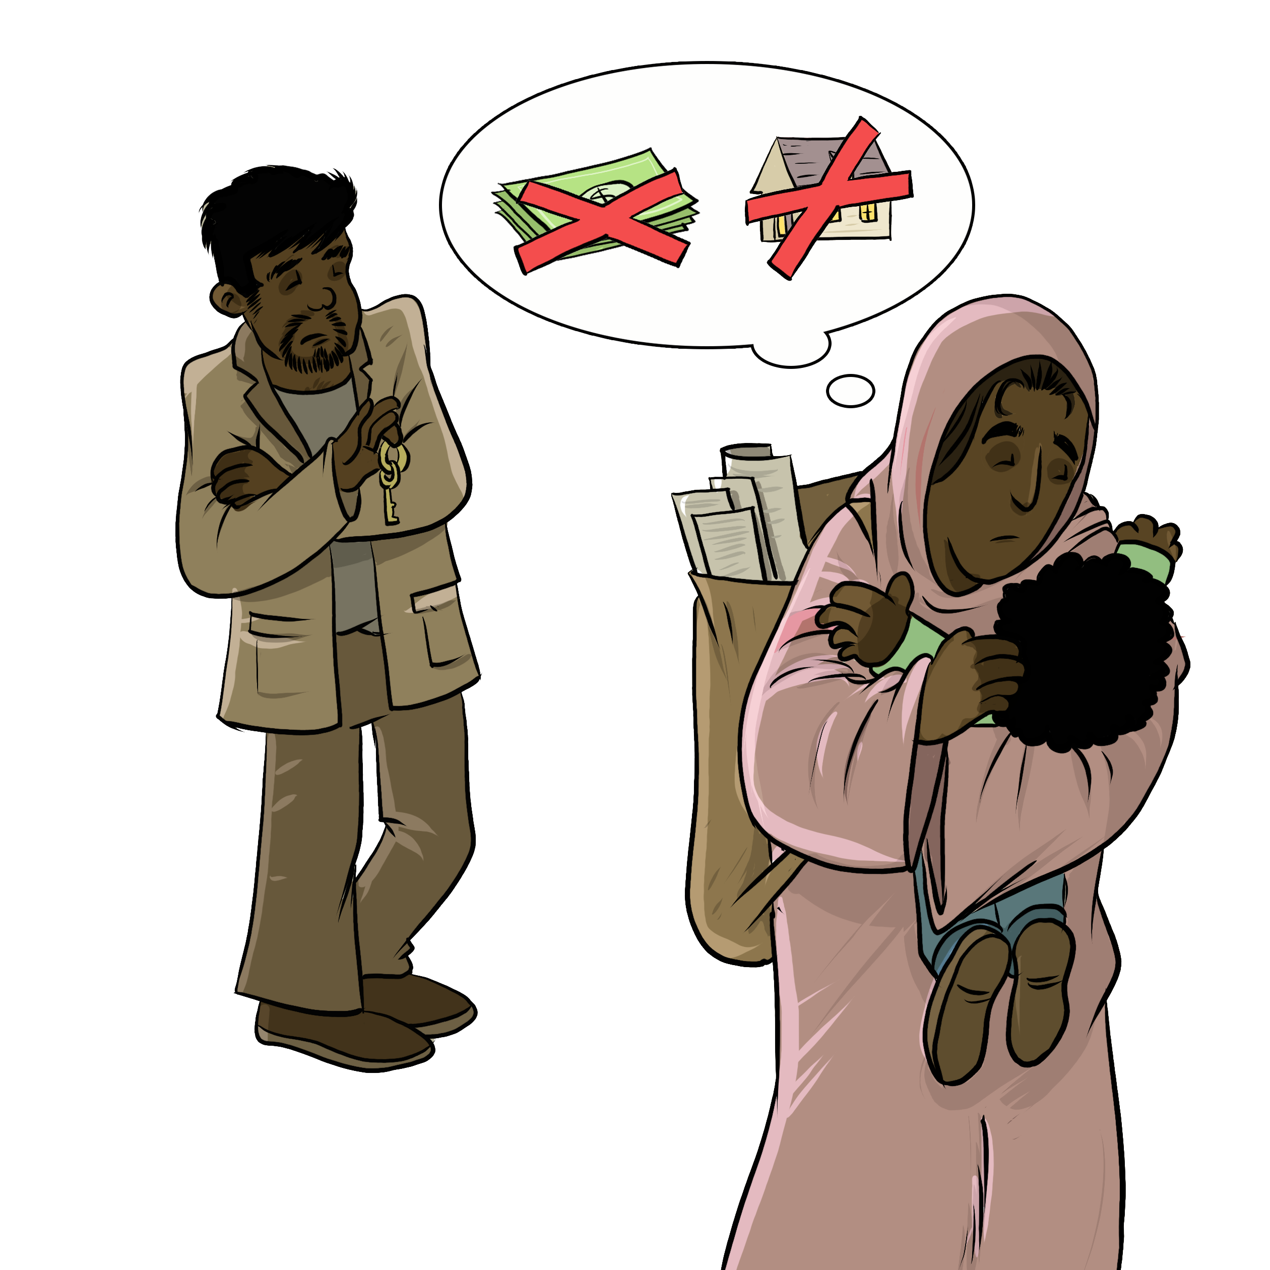
My Housing My Relationship
Notes:
Instructions for the workshop facilitator
To prepare to lead this workshop:
Read the Facilitator’s Guide.
Watch the associated videos.
Read the notes at the bottom of each slide.
Read the instructions for the workshop facilitator.
Go over the legal information that you will share with participants.
Read the additional information to deepen your understanding of the theme addressed in this workshop.
If you have time, read the notes at the bottom of each slide of the PowerPoint presentations for the other workshops. All the themes covered in the different workshops are connected. Your explanations during this workshop could bring up questions on topics discussed in other workshops.
Don’t forget to:
Arrange for an interpreter, if necessary.
Add local legal services and resources to the slides.
Combine this workshop with other psychosocial support activities, if necessary.
Take the time to address delicate situations that may arise during the workshop.
This workshop addresses issues relating to separation and violence. The participants have different experiences. Some may be comfortable with the possibility of separation, and others may be strongly opposed to it. Be mindful of this diversity of perspectives when setting the tone for the workshop.
Legal information contained in this activity is valid as of June 30th, 2025.
The information contained in this workshop applies only to Quebec and should not be considered legal advice.

Slide 2
Examining the situation What do you see here?
Notes:
3 minutes
Instructions for the workshop facilitator
Before starting the workshop, mention that you are in a safe space where participants can express themselves freely and without judgment. The discussions that take place during the workshop are confidential.
Lead a discussion based on the following questions:
What is happening in this image?
What does this image tell us about the couple?
What more can you say about the situation if we assume that the woman wants to leave her husband or partner?
What more can you say about the situation if we assume that the woman has a precarious (uncertain) immigration status?
Summarize by repeating the key words that were mentioned by the participants and that are related to the topic of this workshop.

Slide 3
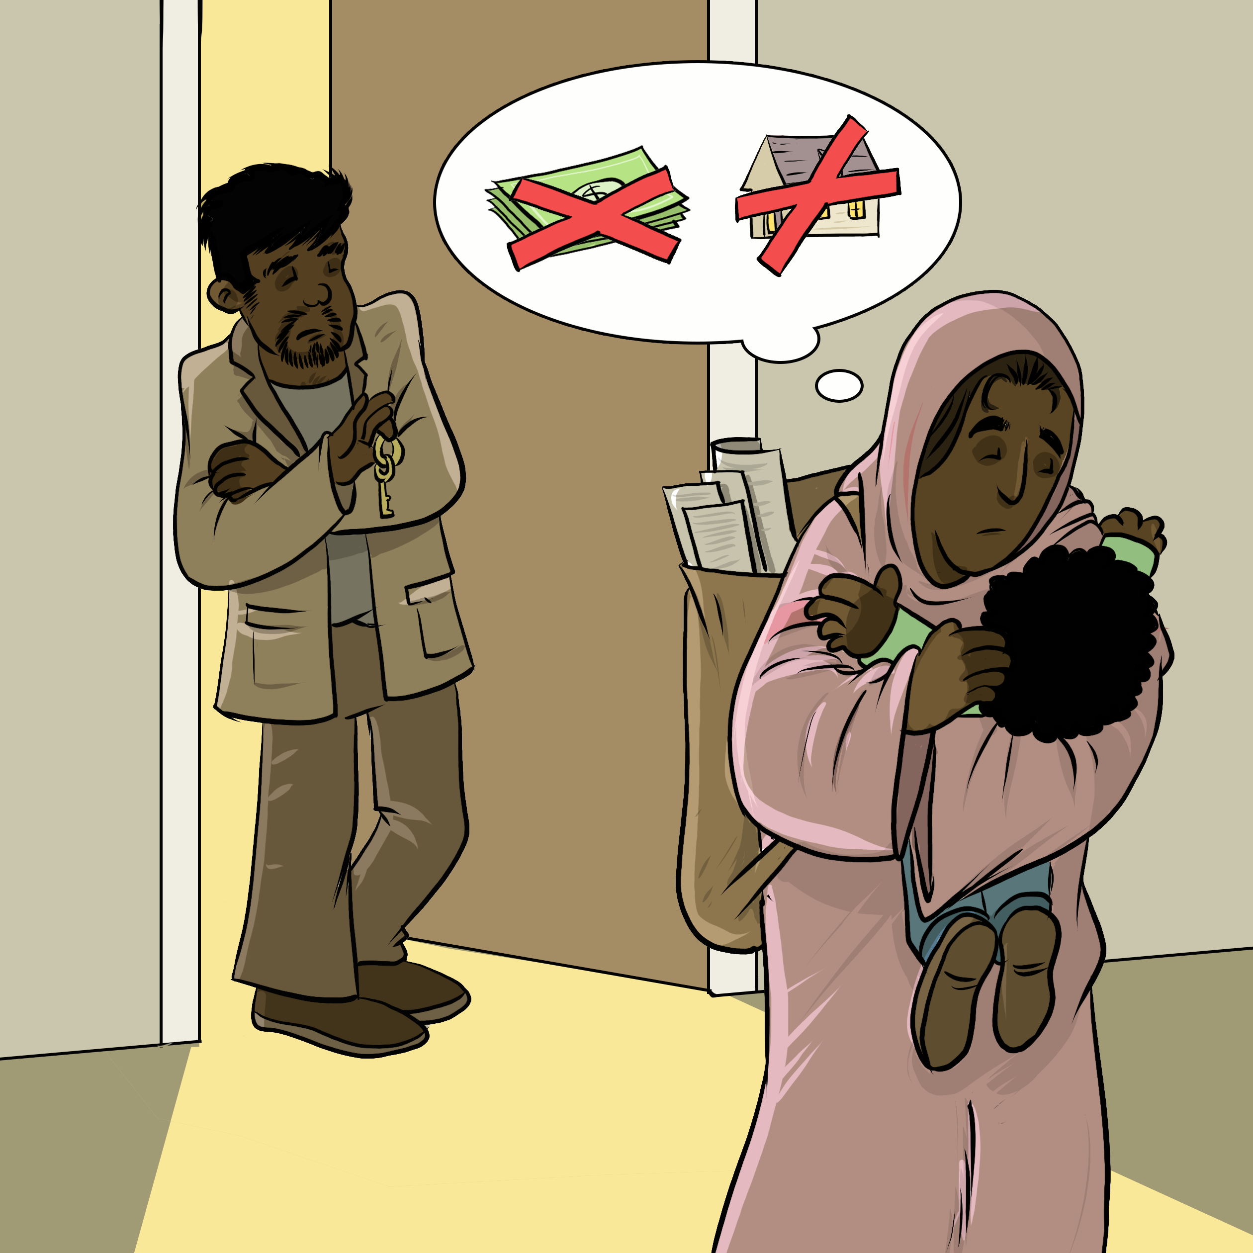
Understanding legal issues Shazia's story
" I like my apartment."
" He wants us to leave."
"I don't know where to go."
"I would like to stay here."
Notes:
5 minutes
Instructions
Read the following story out loud:
Shazia and her partner have been living in an apartment since they arrived in Quebec 3 years ago. She has decorated everything, especially their four-year old son Hasan’s room. They are lucky because they got the apartment at a very good price. A week ago, her partner told her that he had met someone else and wanted to separate. He asked her to leave their apartment with their child. Shazia has no idea where to go, and she would like to stay in this apartment. In any case, she cannot afford to pay an apartment on her own.
Lead a discussion using the following questions:
Have you ever experienced a similar situation?
What are the main concerns or issues in this situation?
What are the rights and responsibilities related to these concerns or issues?
What should Shazia do to solve the problem?
Mention that you will share legal information to help the participants better understand the legal issues, rights and responsibilities involved in this scenario and that you will come back to the scenario at the end of this workshop. Let participants know you will be covering some basic legal rules. Acknowledge that everyone’s experience with the justice system is different and can be shaped by past challenges, as well as cultural and language barriers. Remind participants that the goal of the workshop is to inform them about their rights, so that they can make informed decisions and protect themselves.
Then explain the goal of this workshop: to know the housing options after a separation.
Name the main topics that will be discussed: Housing (staying or leaving the home).

Slide 4
Staying in the apartment
The official or unofficial tenants can stay
There are available options even if your name is not on the lease
Notes:
5 minutes
Instructions for the workshop facilitator
Explain the information below by making connections with the scenario.
Information to share
General rule: It is the people who signed the lease (the official tenants) who have the legal right to stay.[1].
If one partner is the sole tenant: they are the one who theoretically have the right to stay. However, they can decide to leave the lease to their ex[2]. The ex can then officially become the tenant in their place by notifying the landlord a maximum of two months after the separation.[3].
If both partners are tenants: both have the right to stay. They will have to decide together who stays and who leaves. Generally, courts do not order one of the tenants to leave in this type of situation[4]. A family mediator can help the two partners find a solution, if mediation is appropriate in their situation[5]. A court can also step in and decide that the parent who has custody of the children will temporarily stay in the apartment with them [6].
In Shazia’s case, she and her partner both signed the lease. They are both tenants. She can suggest that they go to mediation to find a housing solution if that is appropriate in her situation.
There are options for those whose name is not on the lease
If the couple has children and one parent spends the majority of the time with them (“sole custody”), that parent can ask a court to allow them to stay in the apartment temporarily by proving that it is in the best interests of the children[6].
One parent can also ask a court to “award the lease” to them[7]: this means that they will officially replace the other on the lease[8].
Establishing protective measures
If the person remaining in the apartment had experienced violence from their partner, they can consult an organization that supports people experiencing violence to set up measures to protect themselves ("protective measures"). For more information, visit SOS violence conjugale’s website: Safety planning : the empowerment power tool — SOS violence conjugale
Additional information
Here are examples of cases where a court has given the parent with sole custody of children the right to temporarily remain in the family home:
Family Law — 113973, 2011 QCCA 2320 at para 6: The court allowed the mother to temporarily remain in the apartment with the couple's minor child so as not to disrupt her school year due to a sudden move.
S. (C.) c. P. (M.), 2000 CanLII 19266 (QC CS) at paras 25 and 26: The spouses were co-owners of their residence. The court gave the mother an exclusive right to stay there temporarily with the children because she was the main caregiver and the children’s well-being justified it.
For a tenant to leave the lease to their ex, several conditions must be met[9]:
The non-tenant must continue to live in the apartment for at least two months after the separation,
They must notify their landlord of the separation, maximum two months after the separation,
If the couple isn’t married and doesn’t have children together, they must have lived together for at least 6 months.
This slide focuses on the case where the spouses or partners live in a rented apartment. Other rules apply if both people own a house or condo together, or if one of them owns the house or condo. Similarly, in the case of a married couple, the rules on the division of family patrimony apply [10]. Other rules may also apply to unmarried parents with kids born starting June 30, 2025 (couples in a “parental union”) [11]. The following articles address some of these situations in detail:
Separation of Common-Law Couples: Who Stays in the Family House? | Éducaloi
The Family Home When Spouses Separate | Éducaloi
Property Included in the "Family Patrimony" | Éducaloi
Dividing the "Family Patrimony" | Éducaloi
It is generally not recommended to use mediation when there was violence between the people in conflict[10]. That said, some mediators specialize in mediation in the context of domestic violence. To find them, the person can go to the Association des médiateurs familiaux du Québec’s website (association of family mediators) and click on “Find a mediator.” They can then select “Violence familiale et conjugale” (family and domestic violence) under the “Champ(s) d’expertise(s)” field.
Sources
[1] Civil code of Quebec, RLRQ, c C-1991, art 1440.
[2] Civil code of Quebec, RLRQ, c C-1991, art 1938 al 1.
[3] Civil code of Quebec, RLRQ, c C-1991, art 1938 al 1.
[4] Sandra Fontaine, « La séparation de corps et le divorce : aspects généraux du traitement du litige conjugal » dans École du Barreau du Québec, Droit de la famille, Collection de droit 2022-2023, vol. 4, Montréal (Qc), Éditions Yvon Blais, 2022, 57.
[5] Civil code of Quebec, RLRQ c C-25.01, art 605 al 2.
[6] Civil code of Quebec, RLRQ, c C-1991, arts 32, 33, 599.
[7] Civil code of Quebec, RLRQ, c C-1991, arts 409 al 1, 521.24 al 1.
[8] Civil code of Quebec, RLRQ, c C-1991, arts 409 al 2, 521.24 al 1.
[9] Civil code of Quebec, RLRQ, c C-1991, art 1938 al 1.
[10] Civil code of Quebec, RLRQ, c C-1991, arts 414, 415, 416.
[11] Civil code of Quebec, RLRQ, c C-1991, arts 521.20, 521.29, 521.34 ; Act respecting family law reformm and establishing the parental union regime, LQ 2024, c 22, art 45.
[12] For example : 13 Frequently Asked Family Law Questions About Situations of Intimate Partner Violence — SOS violence conjugale

Slide 5
Leaving the apartment
Option 1: Reaching and agreement with the landlord
Option 2 : Ending your lease because of violence
Option 3 : Transferring the lease or subletting the apartment
Notes:
7 minutes
Instructions
Explain the information below by making connections with the scenario.
Informations to share
In some cases, a person who is separating may want to leave their apartment. There are options for them to leave before the end of their lease.
Option 1: Trying to reach an agreement with the landlord
A person who is separating can try to reach an agreement with their landlord to end their lease earlier than the scheduled date. Their ex-spouse or ex-partner must also agree if they are also a tenant.
How to do it?
1. Talk to the landlord and try to get their agreement to end the lease early.
2. If the landlord agrees, a good practice is to ask them to sign a document confirming:
their agreement,
the new end date of the lease,
and any other relevant details, such as the move-out date.
JuridiQC has a lease resiliation agreement template that tenants can use.
Option 2: Ending your lease because of domestic violence
The law allows tenants to end their lease if their safety or that of their children is threatened because of violence[1].
How can a tenant do this? (see additional information for more details)
1. Get an attestation confirming that you’re ending the lease because of domestic violence[2],
2. Notify the landlord by sending the attestation and a written notice indicating that you are ending your lease[3].
Option 3: Transferring the lease or subletting the apartment
A person who is experiencing violence can also decide to assign (transfer) their lease to someone else[4]. In this case, they will no longer have to pay the rent, because the new tenant takes over that responsibility[5].
Another option is to sublet the apartment[6]. This is usually a temporary arrangement where someone else lives in the apartment. In this case, the partner remains responsible for the lease if the person subletting does not pay[7].
In both cases, the landlord must agree to let the person sublet or assign the lease[8].
Additional information
Regarding ending a lease because of domestic violence:
The person must request the attestation from a civil servant or public officer[9].
The person must provide 3 documents to obtain the attestation[10]:
The “Request for an attestation for the purpose of resiliating a lease on grounds of sexual violence, spousal violence or violence towards a child living in the dwelling covered by the lease” form,
A copy of the lease,
A document, like a letter, from a someone close to the person who supports the request, or a copy of the police statement or the name of the police service involved in the case.
Sending a written notice and the attestation to the landlord does not automatically end the lease[11]. The person must generally continue to pay their rent for some time[12]. This time varies depending on the length of the lease[13]. In the case of a 12-month lease, this period is two months after the notice is sent [14].
For more information on this process, see:
Ending a Lease for Spousal or Sexual Violence | Éducaloi
Termination of a lease – Spousal violence or sexual aggression – Tribunal administratif du logement
Regarding assigning a lease and subletting:
The following article contains more information on assigning a lease and subletting: Assigning a Lease or Subletting | Éducaloi
Sources
[1] Civil code of Quebec, RLRQ, c C-1991, art 1974.1 al 1.
[2] Civil code of Quebec, RLRQ, c C-1991, art 1974.1 al 3.
[3] Civil code of Quebec, RLRQ, c C-1991, art 1974.1 als 2 et 3.
[4] Civil code of Quebec, RLRQ, c C-1991, art 1870.
[5] Civil code of Quebec, RLRQ, c C-1991, art 1873.
[6] Civil code of Quebec, RLRQ, c C-1991, art 1870.
[7] See, for example, Civil code of Quebec, RLRQ, c C-1991, art 1874
[8] Civil code of Quebec, RLRQ, c C-1991, arts 1870, 1871 al 1.
[9] Civil code of Quebec, RLRQ, c C-1991, art 1974.1 al 3.
[10] Civil code of Quebec, RLRQ, c C-1991, art 1974.1 al 3 ; Gouvernement du Québec.
[11] Civil code of Quebec, RLRQ, c C-1991, art 1974.1 al 2.
[12] Civil code of Quebec, RLRQ, c C-1991, art 1974.1 al 2.
[13] Civil code of Quebec, RLRQ, c C-1991, art 1974.1 al 2.
[14] Civil code of Quebec, RLRQ, c C-1991, art 1974.1 al 2.

Slide 6
Where to find help?
Notes:
2 minutes​
​
Instructions​
​
In the following slides, you will find resources that you can present to participants. You can customize the workshop by adding slides presenting other relevant resources.
Feel free to print the slides with the resources.
Feel free to offer to help participants contact one of the mentioned resources or even to go with them if needed. You can also explore the websites together.
Mention that they can look at these resources even if they do not intend to leave their spouse or partner, or if they are still deciding what to do. They can consult these resources simply to inform themselves.

Slide 7
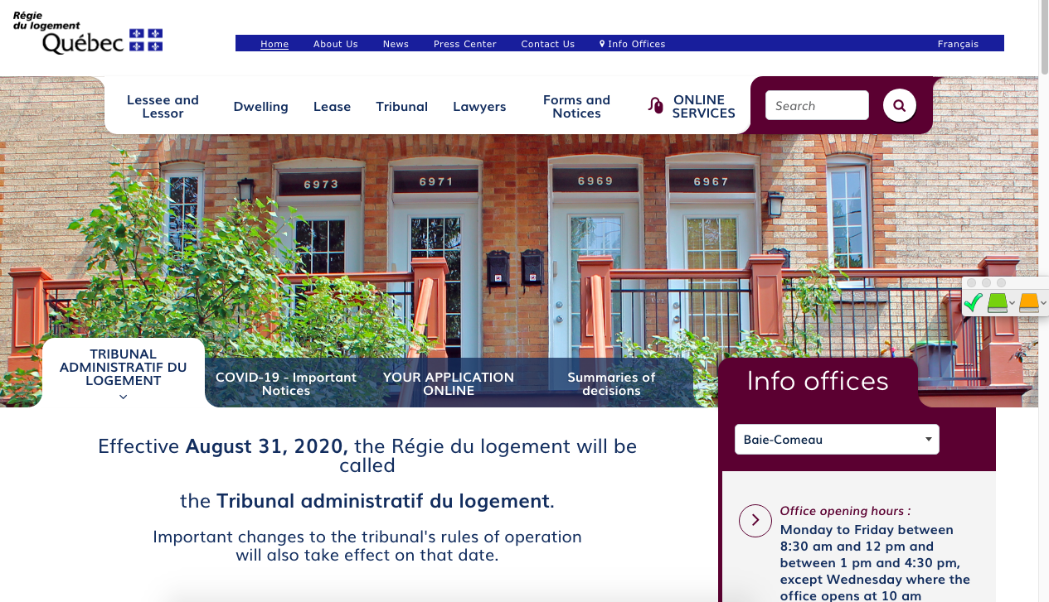
Finding help (Name of the organisation)
(Short description of their service)
(Link to their website)
(Screenshot of the organisation's website)
Notes:
1 minute​
Instructions​
You can customize this slide if you want to add resources other than those presented in the following slides.

Slide 8
Finding help Éducaloi
Free online legal information on:
Family, couples, separation and divorce
Housing
Work
Éducaloi - Your starting point for legal information
Notes:
1 minute​
Instructions​
Explain that Éducaloi is a non-profit whose mission is to explain the law in Quebec in a simple way. Éducaloi is especially known for its website that covers various legal topics, including family and couples, separation and divorce, housing, work and more. Most of Éducaloi's content is available in French and English.

Slide 9
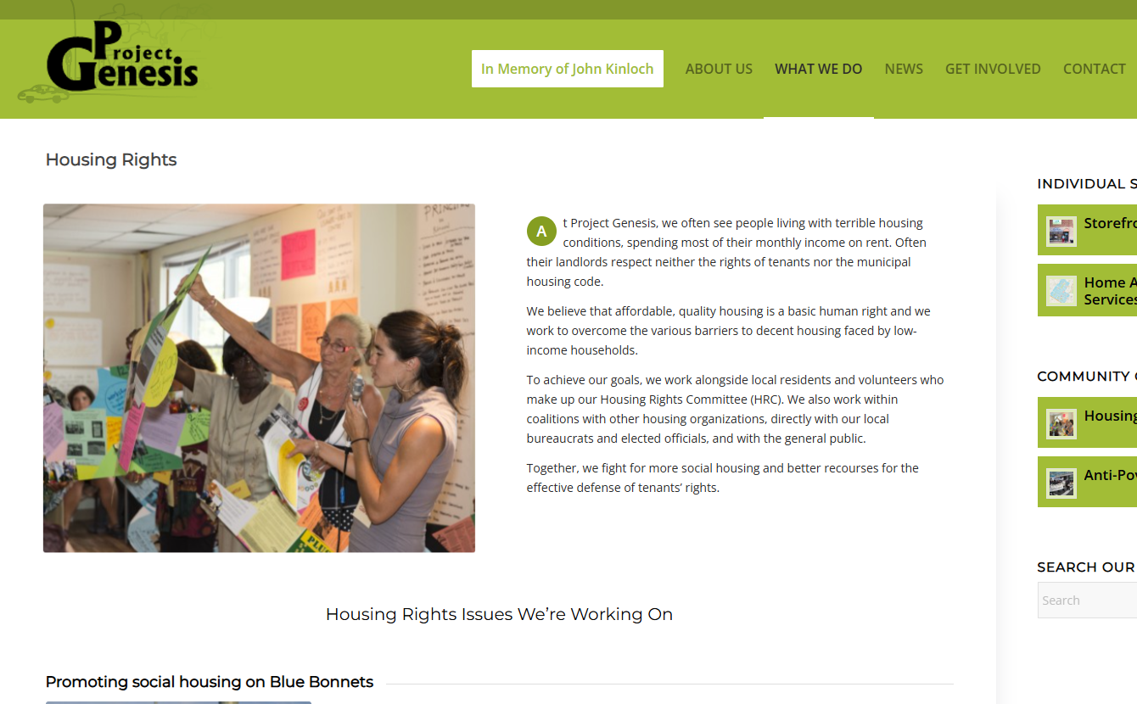
Finding help Project Genesis
Free legal information :
housing
social assistance
pensions and family allowance
514-738-2036
Housing Rights – Project Genesis
(Capture d'écran du site web de l'organisme)
Notes:
1 minute​
Instructions​
Exlain that the participants can contact this resource if they have questions on housing, social assistance, pensions or family allowances.
To reach them : 514-738-2036

Slide 10
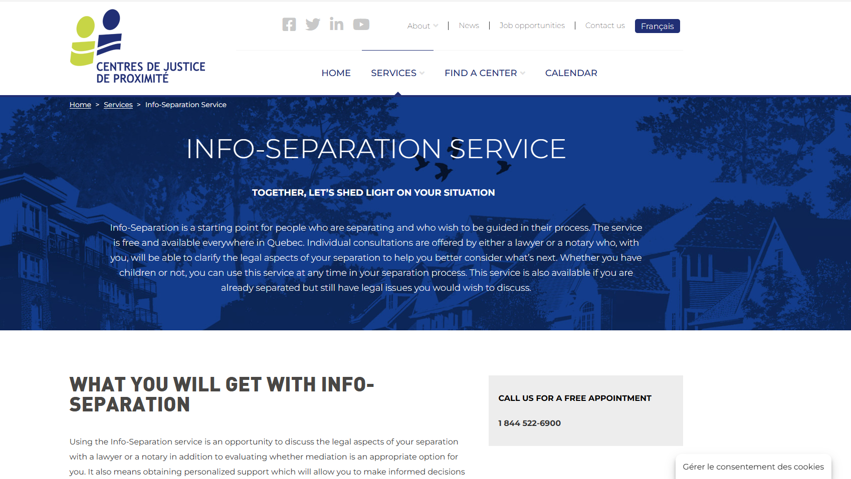
Finding help Community Justice Centers
Info-Separation
Service
Free legal information
Info-Separation Service - Centres de justice de proximité l Centres de justice de proximité
Notes:
1 minute​
Instructions​
Explain that this resource is available to participants if they encounter legal issues related to their life as a couple. The "Info-Separation" service of the Community Justice Centers (CJP) offers free legal consultations with lawyers or notaries to ask legal questions related to separation.
​
To contact them: Contact us - Centres de justice de proximité l Centres de justice de proximité

Slide 11
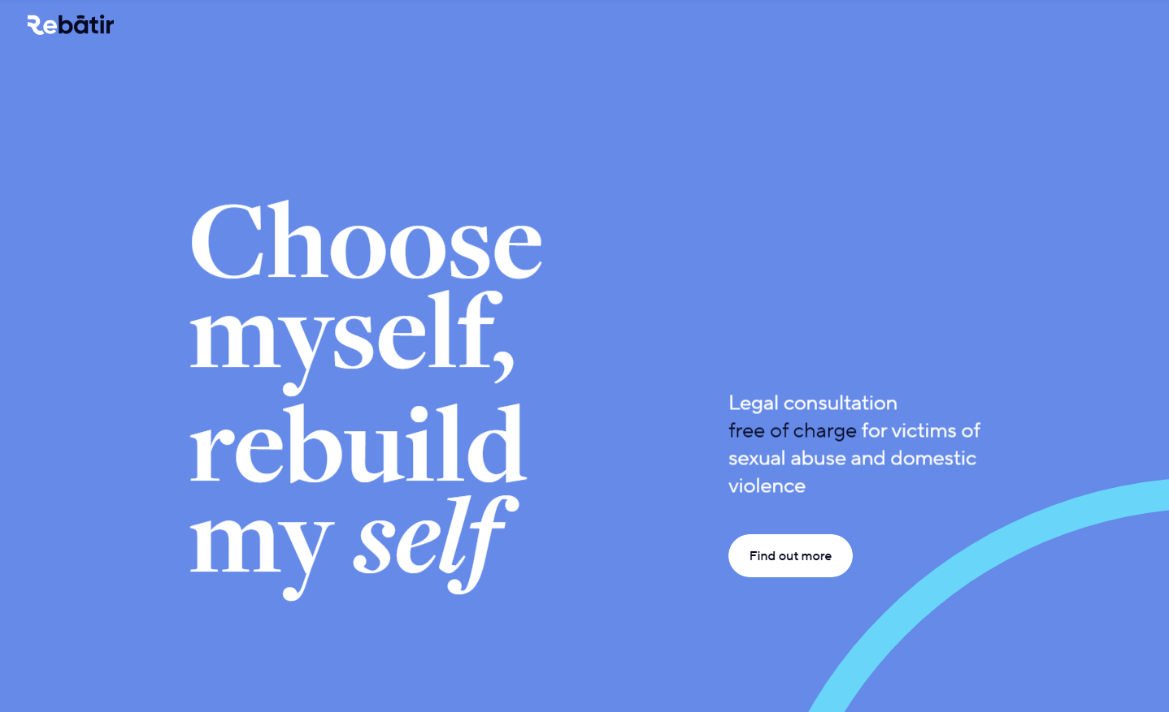
Finding help ReBâtir
4 hours of free legal consultation
1-833-732-2847
Rebâtir
Notes:
1 minute​
Instructions​
Explain that this resource is available to participants if they encounter legal issues related to their life as a couple. Rebâtir is the name of a legal consultation service provided by the Commission des services juridiques (legal aid). It offers 4 hours of free legal consultation to people who experience domestic or sexual violence in all areas of law.
To contact them: call 1-833-REBÂTIR (1-833-732-2847) or write to projet@rebatir.ca

Slide 12
Finding help Housing Committees
Free legal information and tenants' rights advocacy
(514) 521-7114
Find a housing committee - Regroupement des comités logement et associations de locataires du Québec
Notes:
1 minute
Instructions
Explain that this resource is available to participants if they encounter legal issues related to the consequences of a separation on housing. Housing committees defend the rights of tenants and can answer tenants' questions related to residential leases.
To find a housing committee: Find a housing committee - Regroupement des comités logement et associations de locataires du Québec

Slide 13
Other resources
Justice Pro Bono – "Porte 33" Program
Inform'elle (Montreal South Shore) (French only)
Notes:
2 minutes
Instructions
Introduce the resources below.
Informations à transmettre
Justice Pro Bono – Programme « Porte 33 » : Free, confidential, one-on-one meetings with volunteer lawyers, notaries or psychosocial counsellors to provide parents who are separating with valuable information.
Inform'elle : Legal information service for family law on the South Shore of Montreal (French only).

Slide 14
Taing action What could Shazia do?
Check if her name is on the lease
Make a copy of the lease
Find the phone number or the address of an organisation
Notes:
3 minutes
Instructions
Remind the participants about the scenario shared at the beginning of the workshop.
Ask participants to answer the following question:
In light of all the information and resources we have given you, what could Shazia do?
Complete the participants’ answers by sharing some possible courses of action. Click to make these options appear on the screen.
Conclude with these two key messages:
When a couple separates, there are often different options for someone who wants to stay in their home, even if they’re not the tenant on the lease.
Someone who wants to leave their home after a separation may, in some cases, be able to end their lease early.

Slide 15
Questions?
Notes:
1 minute​
Instructions for the workshop facilitator
Answer the participants’ questions.
If you have time, ask the following questions and write down the answers:
Did you enjoy the workshop? Why?
What new things did you learn?
Is the information shared in this workshop useful to you? In what situation will you use it?
Feel free to thank everyone for participating in the workshop, asking questions and sharing their perspective.

Slide 16
Éducaloi thanks the Maison Bleue and Femmes du Monde à Côte-des-Neiges for their valuable collaboration
This workshop was made possible with the support of

