Slide 1
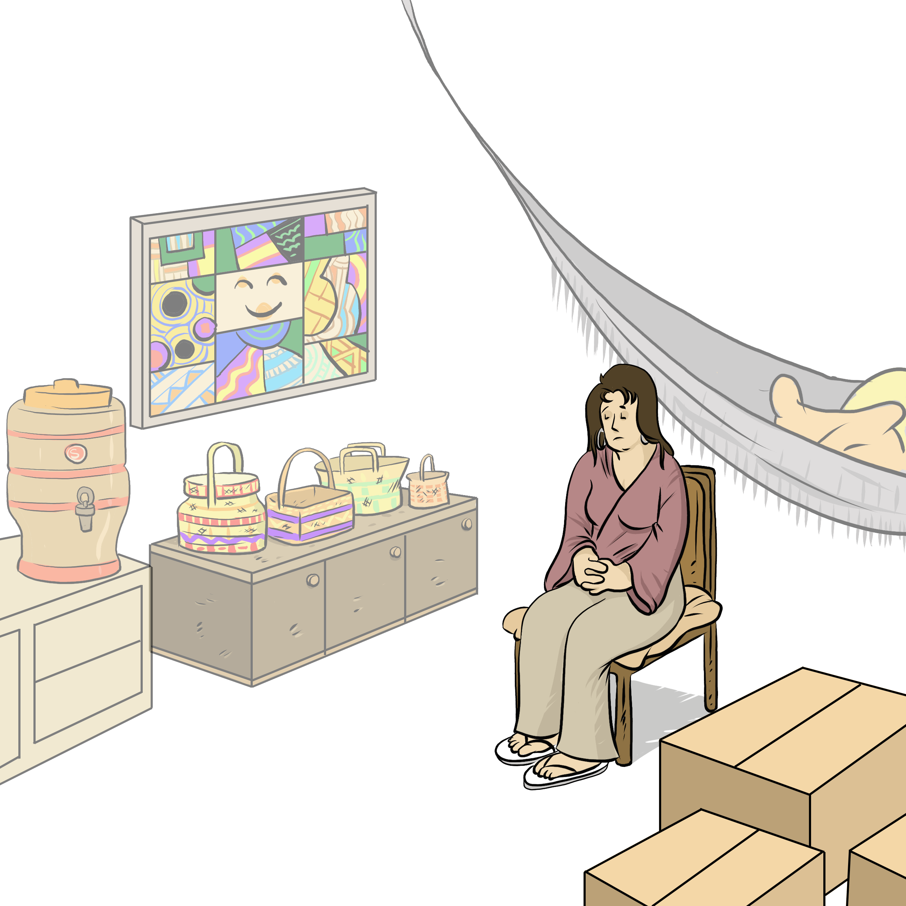
My property My Relationship
Notes:
Instructions for the workshop facilitator
To prepare to lead this workshop:
Read the Facilitator’s Guide.
Watch the associated videos.
Read the notes at the bottom of each slide.
Read the instructions for the workshop facilitator.
Go over the legal information that you will share with participants.
Read the additional information to deepen your understanding of the theme addressed in this workshop.
If you have time, read the notes at the bottom of each slide of the PowerPoint presentations for the other workshops. All the themes covered in the different workshops are connected. Your explanations during this workshop could bring up questions on topics discussed in other workshops.
Don’t forget to:
Arrange for an interpreter, if necessary.
Add local legal services and resources to the slides.
Combine this workshop with other psychosocial support activities, if necessary.
Take the time to address delicate situations that may arise during the workshop.
This workshop addresses issues relating to separation and violence. The participants have different experiences. Some may be comfortable with the possibility of separation, and others may be strongly opposed to it. Be mindful of this diversity of perspectives when setting the tone for the workshop.
Legal information contained in this activity is valid as of June 30th, 2025.
The information contained in this workshop applies only to Quebec and should not be considered legal advice.

Slide 2
Examining the situation What do you see here?
Notes:
3 minutes
Instructions for the workshop facilitator
Before starting the workshop, mention that you are in a safe space where participants can express themselves freely and without judgment. The discussions that take place during the workshop are confidential.
Lead a discussion based on the following questions:
What is happening in this image?
What does this image tell us about the couple?
What more can you say about the situation if we assume that the woman wants to leave her husband or partner?
What more can you say about the situation if we assume that the woman has a precarious (uncertain) immigration status?
Summarize by repeating the key words that were mentioned by the participants and that are related to the topic of this workshop.

Slide 3
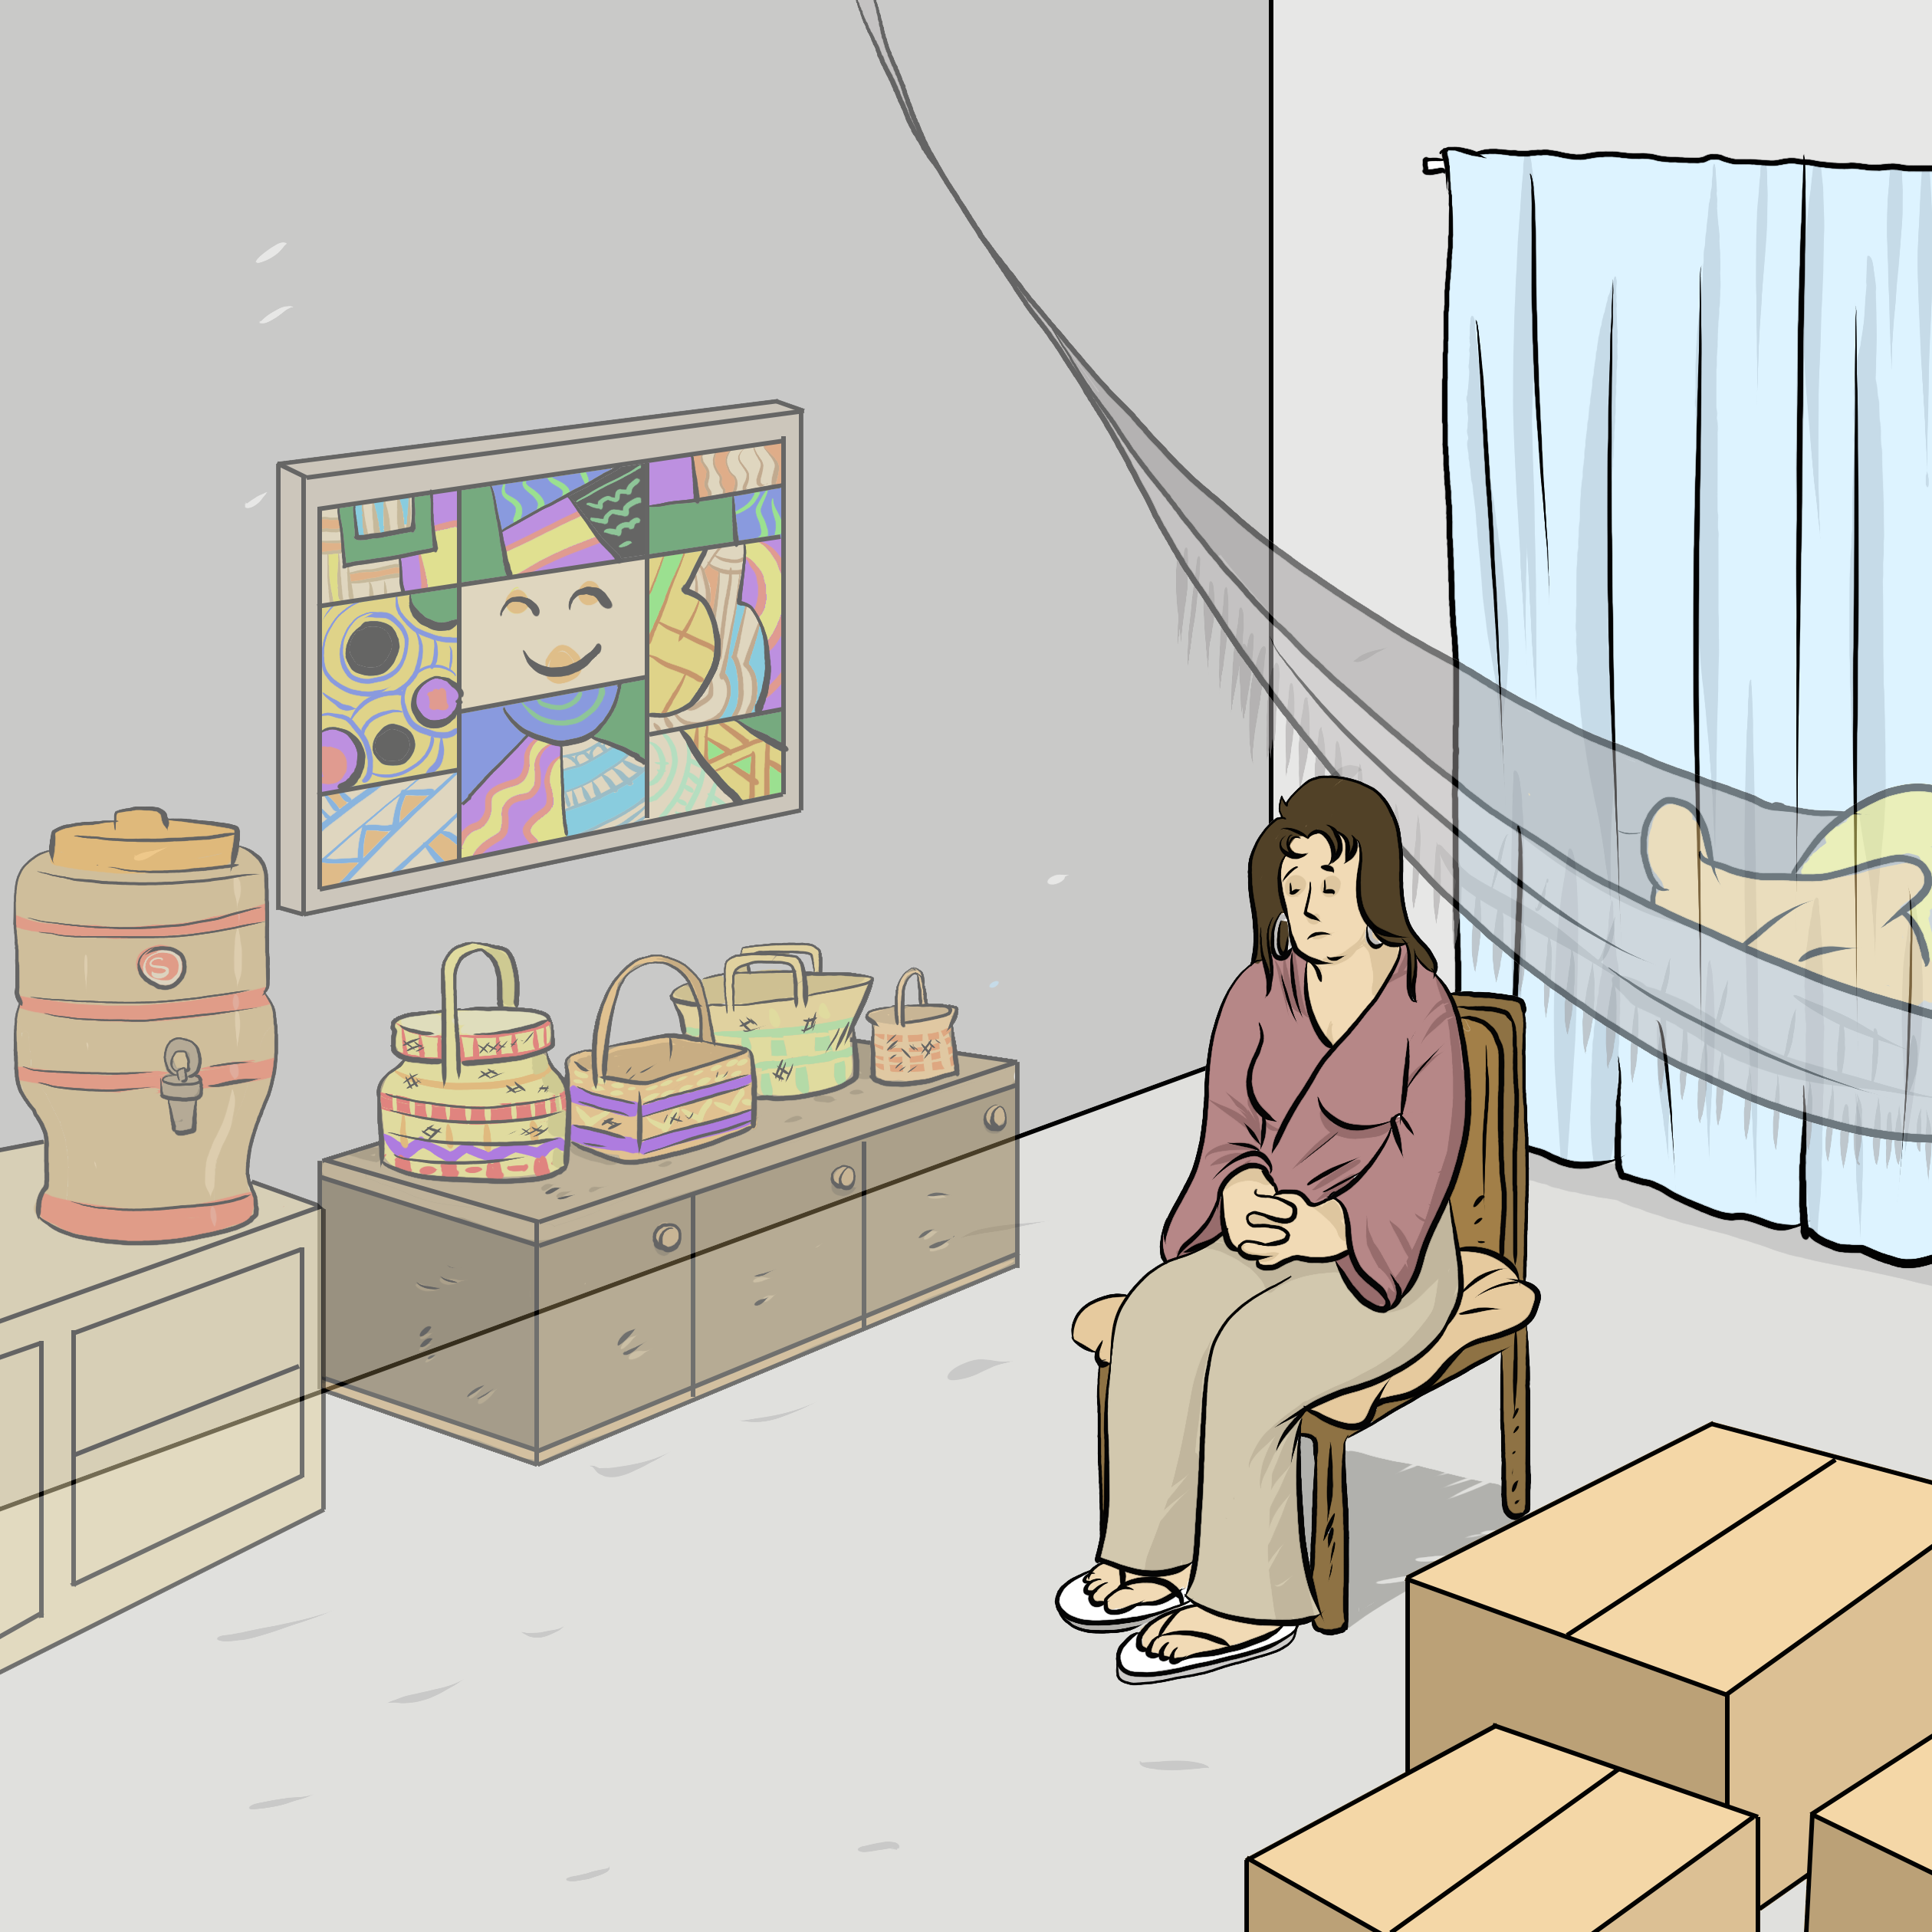
Understanding the legal issues Ana Júlia's Story
"These are our funiture and objects."
"We're going to divorce."
"He'll stay in the apartment."
"I don't want to leave everything behind."
Notes:
5 minutes
Instructions
Read the following story aloud:
Ana Júlia and her husband, Lucas, arrived in Quebec four years ago. They found a beautiful apartment, and made it their own, decorating the walls and shelves with Brazilian art and other things that remind them of their home country. This week, they decided to divorce. They agreed that Lucas would stay in the apartment, because Ana Júlia wants to start fresh in a new space. But Ana Júlia worries that she will have to leave everything behind, even her cherished furniture and other belongings.
Lead a discussion using the following questions:
Have you ever experienced a similar situation?
What are the main concerns or issues in this situation?
What are the rights and responsibilities related to these concerns or issues?
What should Ana Júlia do to solve the problem?
Mention that you will share legal information to help the participants better understand the legal issues, rights and responsibilities involved in this scenario and that you will come back to the scenario at the end of this workshop. Let participants know you will be covering some basic legal rules. Acknowledge that everyone’s experience with the justice system is different and can be shaped by past challenges, as well as cultural and language barriers. Remind participants that the goal of the workshop is to inform them about their rights, so that they can make informed decisions and protect themselves.
Then explain the goal of this workshop: To understand the legal effects of separation or divorce on the couple’s property (furniture, vehicles, etc.).
Name the main topics that will be discussed: The division of property when a married or unmarried couple separates.

Slide 4
Division of property for married couples
Family property : generally shared half-half Examples: family car, furniture, coffee maker, microwave
Some exceptions
Solutions in case of disagreement
Notes:
5 minutes
Instructions for the workshop facilitator
Explain the information below by making connections with the scenario.
Informations to share
When a married couple divorces, certain property used by the family is usually divided equally between both spouses[1], even if certain items legally belong to just one of them[2]. This property is called the “family patrimony”[3].
For example, the value of the following property is typically divided equally between the spouses [4]:
Household furniture (bed, sofa, tables, etc.),
Appliances (microwave, coffee maker, etc.),
The family vehicle,
The family home (if one or both spouses own the home).
This is not an exhaustive list[5].
In Ana Júlia’s case, the value of the furniture in their home would normally be divided 50/50 between her and her husband.
There are exceptions. Certain property used by the family is not divided, like property that one of the spouses has received as an inheritance or gift[6]. For example, if Ana Júlia had inherited some of the furniture from her late father, that furniture would remain hers alone, and would not be shared with her husband after their divorce.
How does this work in practice?
Usually, the spouses divide the value of the property rather than dividing the property itself[7]. For instance, if their shared property is worth $5,000 in total, the spouse who keeps it would pay $2,500 to the other spouse.
They can also choose to physically divide the property equally between them (half-half)[8]. For example, Ana Júlia keeps the living room furniture and her husband keeps the bedroom furniture.
If they can’t agree on how to divide the property or determine its value, they can get professional help. A family mediator, if appropriate [9].
This person will help them to find solutions[10].
Couples that are separating are usually eligible for free mediation hours.[11].
Ils peuvent aussi choisir une médiatrice ou un médiateur qui parle leur langue maternelle. Par exemple, il y a notamment des médiatrices et médiateurs qui parlent l’espagnol, l’arabe et l’italien.
Le tribunal peut aussi prendre la décision pour les époux (par exemple, si les époux n’arrivent pas à s’entendre en médiation)[12].
Additional information
Quebec’s family patrimony rules generally apply even if the couple was married abroad[13], provided they live in Quebec at the time of the divorce[14] [15].
The list of family patrimony property on this slide is not exhaustive[16]. Other property, including cottages (other homes used by the family)[17] or RRSPs[18]) may also be considered part of the family patrimony. For more information, see our article: Property Included in the "Family Patrimony" | Éducaloi
In Quebec, the rules for dividing the family patrimony are mandatory because they are matters of “public order” [19]. This means that couples cannot agree before or during their marriage to exclude these rules. Par contre, au moment du divorce, ils peuvent décider ensemble de ne pas les appliquer[20]. They can do so at the time of a divorce, however, if the court approves their decision[21].
Dividing family patrimony can be complex, especially when calculating each spouse’s share, and many exceptions apply. See our article for examples of how this division works: Examples of How to Calculate and Divide the Family Patrimony | Éducaloi. To learn how property would be divided in a particular situation, participants can consult a lawyer or notary that practices in family law.
The rules explained on this slide apply to property that is included in the family patrimony. But spouses may also own other property, like rental properties, that are not part of the family patrimony. This property falls under a separate category, called the “matrimonial regime”[22], which follows different rules for the division of property. For more information, see our article: Dividing Property | Éducaloi
It is generally not recommended to use mediation when there was violence between the people in conflict[23]. That said, some mediators specialize in mediation in the context of domestic violence. To find them, the person can go to the Association des médiateurs familiaux du Québec’s website (association of family mediators) and click on “Find a mediator.” They can then select “Violence familiale et conjugale” (family and domestic violence) under the “Champ(s) d’expertise(s)” field. For more information on family mediation, see our article: Family Mediation in Six Steps | Éducaloi
Sources
[1] Civil code of Quebec, RLRQ, c C-1991, art 416 al 1.
[2] Civil code of Quebec, RLRQ, c C-1991, arts 414, 415.
[3] Civil code of Quebec, RLRQ, c C-1991, art 414.
[4] Civil code of Quebec, RLRQ, c C-1991, arts 415 al 1, 416 al 1.
[5] Civil code of Quebec, RLRQ, c C-1991, arts 415 al 1, 416 al 1.
[6] Civil code of Quebec, RLRQ, c C-1991, art 415 al 4.
[7] Civil code of Quebec, RLRQ, c C-1991, arts 416 al 1, 419.
[8] Civil code of Quebec, RLRQ, c C-1991, art 419.
[9] Code of civil procedure, RLRQ, c C-25, arts 605 al 2, 616.
[10] Code of civil procedure, RLRQ, c C-25, art 605 al 2, 616.
[11] Code of civil procedure, RLRQ, c C-25, art 619 ; Regulation respecting family mediation, c. C-25-01, r. 0.7, art. 10.1, 10.4.
[12] Code of civil procedure, RLRQ, c C-25, art 409.
[13] Civil code of Quebec, RLRQ, c C-1991, art 3089.
[14] According to Civil code of Quebec, RLRQ c CCQ-1991, art 3089 al.2., "Where the spouses are domiciled in dfferent countries, the applicable law is the law of their common residence or, failing that, the law of their last common residence or, failing that, the law of the place of solemnization of the marriage". Definition of domicile : Civil code of Québec, RLRQ c CCQ-1991, art 75.
[15] Civil code of Quebec, RLRQ c CCQ-1991, art 414, 415, 3089., « R.B. c. L.D., [2002] J.Q. no 914 » at para 15.; Family Law — 102718, 2010 Québec › at para 36.
[16] Civil code of Quebec, RLRQ, c C-1991, arts 415 al 1, 416 al 1.
[17] Civil code of Quebec, RLRQ, c C-1991, arts 415 al 1.
[18] Civil code of Quebec, RLRQ, c C-1991, arts 415 al 1.
[19] Civil code of Quebec, RLRQ, c C-1991, art 423 al 1.
[20] Civil code of Quebec, RLRQ, c C-1991, art 423 al 2.
[21] Civil code of Quebec, RLRQ, c C-1991, art 423 al 2.
[22] Civil code of Quebec, RLRQ, c C-1991, arts 414, 415, 433.
[23] For example : 13 Frequently Asked Family Law Questions About Situations of Intimate Partner Violence — SOS violence conjugale

Slide 5
Devision of property of unmarried couples, "common-law partners with children"
Only for couples who had children as of June 30, 2025
Family property: generally shared half-half Examples: family car, furniture, coffee maker, microwave
Some exceptions
Solutions in case of disagreement
Notes:
5 minutes
Instructions for the workshop facilitator
Explain the information below by making connections with the scenario.
Information to share
For unmarried couples who live together[1] and have children together on or after June 30, 2025[2], some property used by the family will generally be divided equally if they break up[3]. Under the law, this type of relationship is known as a “parental union” [4]. The division of their family property is called the “division of the parental union patrimony.” [5].
For example, the value of the following property is typically divided equally between the parents[6] :
Household furniture (bed, sofa, tables, etc.)
Appliances (microwave, coffee maker, etc.)
The family vehicle
The family home (if one or both parents own the home)
The list is similar to that of married couples, but there are also some differences (which we won’t cover in this workshop) [7].
There are some exceptions. Dans certains cas, des biens qui ont servi à la famille ne sont pas partagés. Certain property used by the family is not divided, like property that one of the parents has received as an inheritance or gift[8].
How does this work in practice?
Usually, the parents divide the value of the property rather than dividing the property itself[9]. For instance, if their shared property is worth $5,000 in total, the parent who keeps it would pay $2,500 to the other parent. It works the same way as it does for married couples.
They can also choose to physically divide the property equally between them.[10].
If they can’t agree on how to divide the property or determine its value, they can get professional help. Just like married couples, they can work with a family mediator if that makes sense for their situation[11].
The family mediator can try to help them reach an agreement[12].
Couples that are separating are usually eligible for free mediation hours[13].
They can also choose a mediator who speaks their native language. For example, there are mediators who speak Spanish, Arabic, and Italian.
The court can also make a decision for them (for example, if mediation does not resolve the matter)[14].
Additional information
The parental union regime was created by the Act respecting family law reform and establishing the parental union regime, LQ 2024, c. 22. In principle, the division of parental union patrimony only applies to couples whose children are born on or after June 30, 2025 [15]. However, couples who had children together before that date can choose to voluntarily opt into the parental union regime[16]. They can do this through a notarial act[17]. They can also do it without a notary, by signing a document stating their intention to opt into the regime, in front of two witnesses [18].
Unlike married couples[19], those in a parental union have the right to decide which property is included in the parental union patrimony [20]. A couple in a parental union could choose to add or remove specific property from what’s included[21]. For example, they might decide that the family car won’t be part of the parental union property[22]. To remove property that would normally be included under the law (like the family car), the couple must go through a notary[23].
It is generally not recommended to use mediation when there was violence between the people in conflict[24]. That said, some mediators specialize in mediation in the context of domestic violence. To find them, the person can go to the Association des médiateurs familiaux du Québec’s website (association of family mediators) and click on “Find a mediator.” They can then select “Violence familiale et conjugale” (family and domestic violence) under the “Champ(s) d’expertise(s)” field. For more information on family mediation, see our article: Family Mediation in Six Steps | Éducaloi
Sources
[1] Civil code of Quebec, RLRQ, c C-1991, art 521.20 al 1.
[2] Act respecting family law reform and establishing the parental union regime, LQ 2024, c 22, art 45.​
[3] Civil code of Quebec, RLRQ, c C-1991, arts 521.30, 521.34.
[4] Civil code of Quebec, RLRQ, c C-1991, art 521.20.
[5] Civil code of Quebec, RLRQ, c C-1991, arts 521.29, 521.34.
[6] Civil code of Quebec, RLRQ, c C-1991, art 521.30 al 1.
[7] For example: RRSPs are part of the family patrimony of married couples according to the Civil code of Quebec, RLRQ, c C-1991, arts 415 al 1. For common-law partners with children, RRSPs are not included in the share of the parental union patrimony (Civil code of Quebec, RLRQ, c C-1991, art 521.30 a contrario)
[8] Civil code of Quebec, RLRQ, c C-1991, art 521.30 al 2.
[9] Civil code of Quebec, RLRQ, c C-1991, art 521.34, 521.37 al 1.
[10] Civil code of Quebec, RLRQ, c C-1991, art 521.37.
[11] Code of civil procedure, RLRQ, c C-25, arts 605 al 2, 616.
[12] Code of civil procedure, RLRQ, c C-25, art 605 al 2, 616.
[13] Code of civil procedure, RLRQ, c C-25, art 619 ; Regulation respecting family mediation, c. C-25-01, r. 0.7, art. 10.1.
[14] Code of civil procedure, RLRQ, c C-25, art 409.
[15] Act respecting family law reform and establishing the parental union regime, LQ 2024, c 22, art 45.​
[16] Act respecting family law reform and establishing the parental union regime, LQ 2024, c 22, art 46.
[17] Act respecting family law reform and establishing the parental union regime, LQ 2024, c 22, art 46 al 1.
[18] Act respecting family law reform and establishing the parental union regime, LQ 2024, c 22, art 46 al 1.
[19] Civil code of Quebec, RLRQ, c C-1991, art 423.
[20] Civil code of Quebec, RLRQ, c C-1991, art 521.31 al 1.
[21] Civil code of Quebec, RLRQ, c C-1991, art 521.31 al 1 et 2.
[22] Civil code of Quebec, RLRQ, c C-1991, art 521.31 al 1 et 2.
[23] Civil code of Quebec, RLRQ, c C-1991, art 521.31 al 2.
[24] For example : 13 Frequently Asked Family Law Questions About Situations of Intimate Partner Violence — SOS violence conjugale

Slide 6
Division of property for unmarried couples with children
The rules are different for unmarried couples without children + unmarried couples who had children together before June 30, 2025.
Each person leaves with their things
If both are owners together: will have to decide together
Solutions in case of disagreement
Notes:
5 minutes
Instructions for the workshop facilitator
Explain the information below by making connections with the scenario.
Information to share
Now, let's talk about the rules that apply in the following cases:
The couple doesn’t live together,
The couple doesn’t have children together,
The couple has children together who were born before June 30, 2025.
For unmarried couples who live together but do not have children together[1], the rules for dividing property after a separation are different from those for married couples or couples in a “parental union.” So, if Ana Júlia hadn’t been married, the rules would have been different, since she didn’t have children with her partner. The same applies to unmarried couples who had children together before June 30, 2025[2] and to couples who do not live together[3].
In these cases, each partner usually keeps the property that belongs to them[4], There is no “division of family patrimony” or “division of a parental union”. For example, if Ana Júlia's partner owned the family car, he would keep it after they separated.
If the partners own something together, they must agree on who will keep it and whether one of them will reimburse the other for their share[5].
If they can’t agree on how to divide their shared property, they can get professional help from a family mediator, like married couples and couples in a parental union[6].
They are usually eligible for free mediation hours[7].
Couples that are separating are usually eligible for free mediation hours[8].
They can also choose a mediator who speaks their native language. For example, there are mediators who speak Spanish, Arabic, and Italian
The court can also make a decision for them (for example, if mediation does not resolve the matter)[9].
Additional information
Unmarried couples who don’t have children together can create a contract during their relationship to decide what would happen if they separate, including how they want to divide their property. This is sometimes called a “cohabitation agreement.” For more information, see our article: Written Agreements Between Common-Law Couples | Éducaloi
It is generally not recommended to use mediation when there was violence between the people in conflict[10]. That said, some mediators specialize in mediation in the context of domestic violence. To find them, the person can go to the Association des médiateurs familiaux du Québec’s website (association of family mediators) and click on “Find a mediator.” They can then select “Violence familiale et conjugale” (family and domestic violence) under the “Champ(s) d’expertise(s)” field. For more information on family mediation, see our article: Family Mediation in Six Steps | Éducaloi
Sources
[1] Civil code of Quebec, RLRQ, c C-1991, art 521.20 al 1 a contrario.
[2] Act respecting family law reform and establishing the parental union regime, LQ 2024, c 22, art 45.​
[3] Code civil du Québec, RLRQ, c C-1991, art 521.20 al 1 a contrario.
[4] Civil code of Quebec, RLRQ, c C-1991, art 947.
[5] Civil code of Quebec, RLRQ, c C-1991, art 1026, 1030.
[6] Code of civil procedure, RLRQ, c C-25, arts 605 al 2, 616.
[7] Code of civil procedure, RLRQ, c C-25, art 605 al 2, 616.
[8] Code of civil procedure, RLRQ, c C-25, art 619 ; Regulation respecting family mediation, c. C-25-01, r. 0.7, art. 10.1, 10.4.
[9] Code of civil procedure, RLRQ, c C-25, art 409.
[10] For example : 13 Frequently Asked Family Law Questions About Situations of Intimate Partner Violence — SOS violence conjugale

Slide 7
Where to find help?
Notes:
2 minutes​
​
Instructions​
​
In the following slides, you will find resources that you can present to participants. You can customize the workshop by adding slides presenting other relevant resources.
Feel free to print the slides with the resources.
Feel free to offer to help participants contact one of the mentioned resources or even to go with them if needed. You can also explore the websites together.
Mention that they can look at these resources even if they do not intend to leave their spouse or partner, or if they are still deciding what to do. They can consult these resources simply to inform themselves.

Slide 8
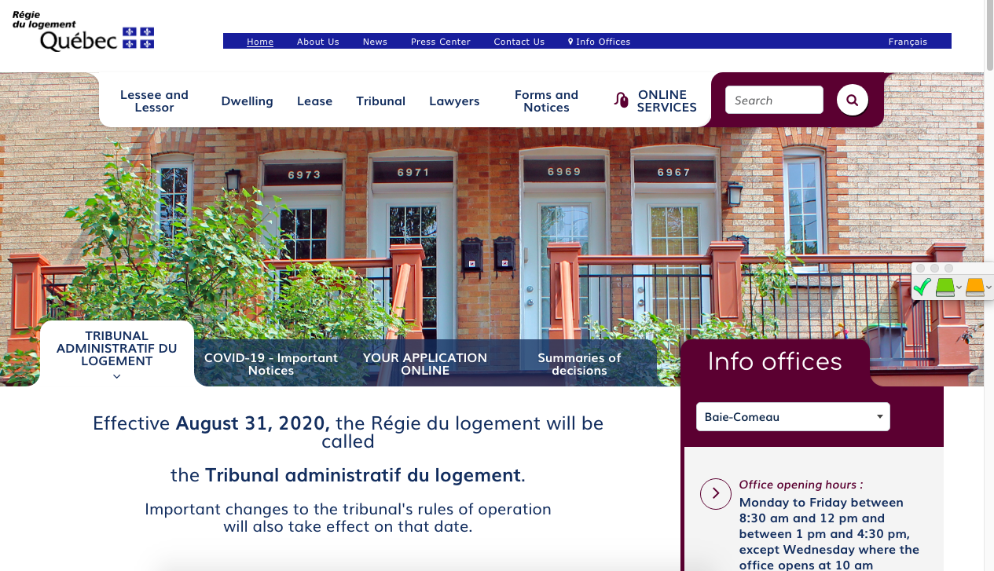
Finding help (Name of the organisation)
(Short description of their service)
(Link to their website)
(Screenshot of the organisation's website)
Notes:
1 minute​
Instructions​
You can customize this slide if you want to add resources other than those presented in the following slides.

Slide 9
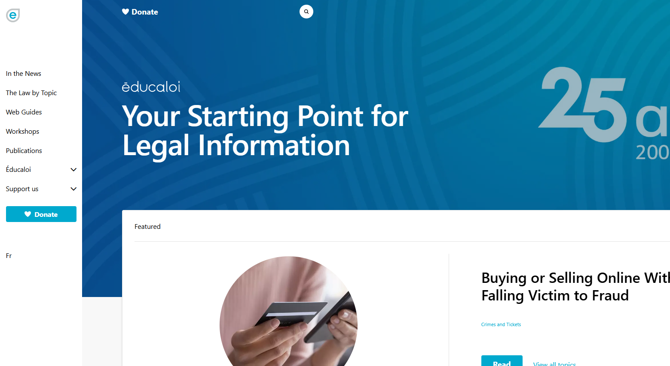
Finding help Éducaloi
Free online legal information on:
Family, couples, separation and divorce
Housing
Work
Éducaloi - Your starting point for legal information
Notes:
1 minute​
Instructions​
Explain that Éducaloi is a non-profit whose mission is to explain the law in Quebec in a simple way. Éducaloi is especially known for its website that covers various legal topics, including family and couples, separation and divorce, housing, work and more. Most of Éducaloi's content is available in French and English.

Slide 10
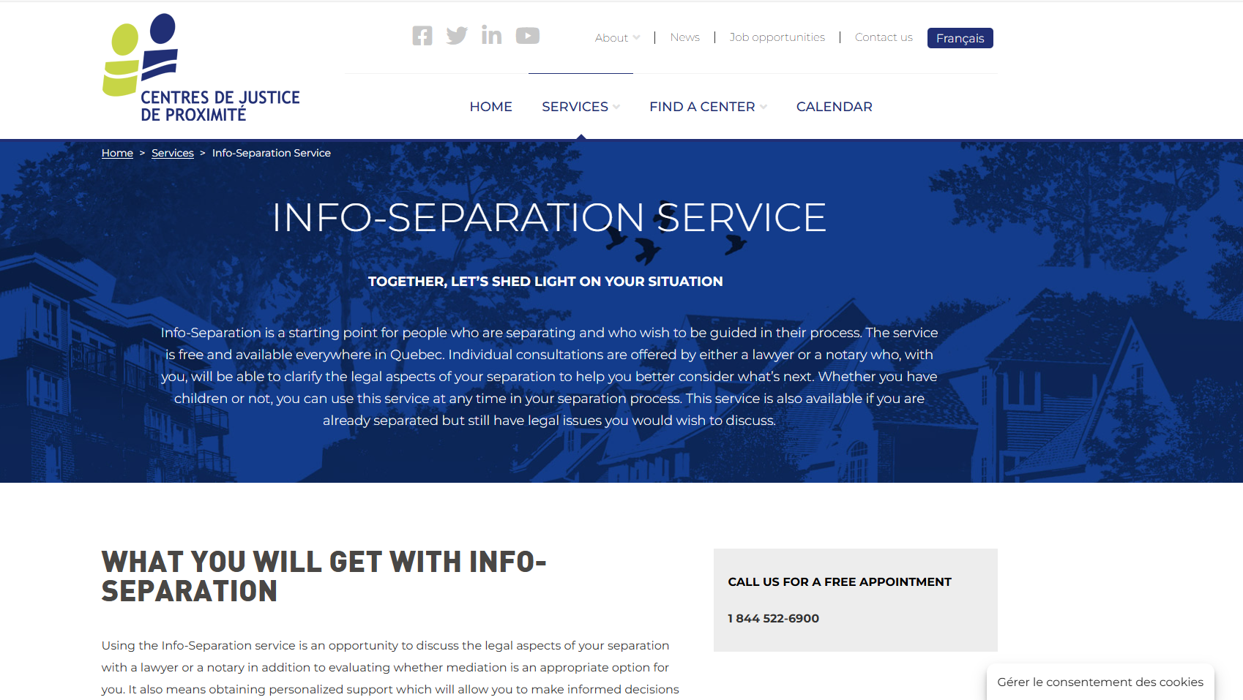
Finding help Community Justice Centers
Info-Separation
Service
Free legal information
Info-Separation Service - Centres de justice de proximité l Centres de justice de proximité
Notes:
1 minute​
Instructions​
Explain that this resource is available to participants if they encounter legal issues related to their life as a couple. The "Info-Separation" service of the Community Justice Centers (CJP) offers free legal consultations with lawyers or notaries to ask legal questions related to separation.
​
To contact them: Contact us - Centres de justice de proximité l Centres de justice de proximité

Slide 11
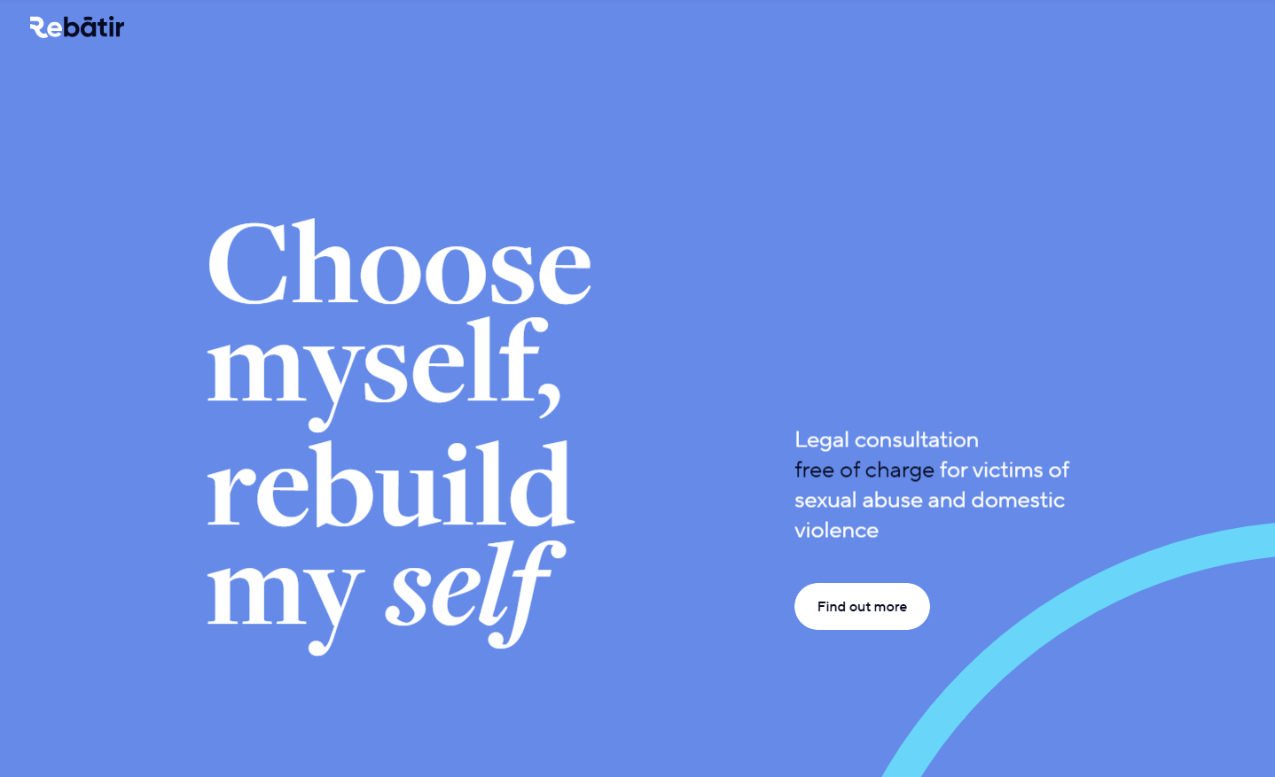
Finding help ReBâtir
4 hours of free legal consultation
1-833-732-2847
Rebâtir
Notes:
1 minute​
Instructions​
Explain that this resource is available to participants if they encounter legal issues related to their life as a couple. Rebâtir is the name of a legal consultation service provided by the Commission des services juridiques (legal aid). It offers 4 hours of free legal consultation to people who experience domestic or sexual violence in all areas of law.
To contact them: call 1-833-REBÂTIR (1-833-732-2847) or write to projet@rebatir.ca

Slide 12
Other resources
Justice Pro Bono – "Porte 33" Program
Directory of family mediators in Quebec (French only)
Inform'elle (Montreal South Shore) (French only)
Notes:
2 minutes
Instructions
Introduce the resources below.
Informations à transmettre
Justice Pro Bono – Programme « Porte 33 » : Free, confidential, one-on-one meetings with volunteer lawyers, notaries or psychosocial counsellors to provide parents who are separating with valuable information.
Association of des médiateurs familiaux du Québec (association of family mediators) – Directory of family mediators in Quebec (French only).
Inform'elle : Legal information service for family law on the South Shore of Montreal (French only).

Slide 13
Taking action What could Ana Júlia do?
Find a copy of the marriage certificate
Make a list of the furniture and objects
Notes:
3 minutes
Instructions
Remind the participants about the scenario shared at the beginning of the workshop.
Ask participants to answer the following question:
Based on the information and resources we’ve discussed today, what options does Ana Júlia have?
Complete the participants’ answers by sharing some possible courses of action. Click to make these options appear on the screen.
Conclude with these two key messages:
The way property is divided after separation depends on whether the couple is married.
Solutions are available for couples who cannot agree on how to divide their property.

Slide 14
Questions?
Notes:
1 minute​
Instructions for the workshop facilitator
Answer the participants’ questions.
If you have time, ask the following questions and write down the answers:
Did you enjoy the workshop? Why?
What new things did you learn?
Is the information shared in this workshop useful to you? In what situation will you use it?
Feel free to thank everyone for participating in the workshop, asking questions and sharing their perspective.

Slide 15
Éducaloi thanks the Maison Bleue and Femmes du Monde à Côte-des-Neiges for their valuable collaboration
This workshop was made possible with the support of

