Slide 1
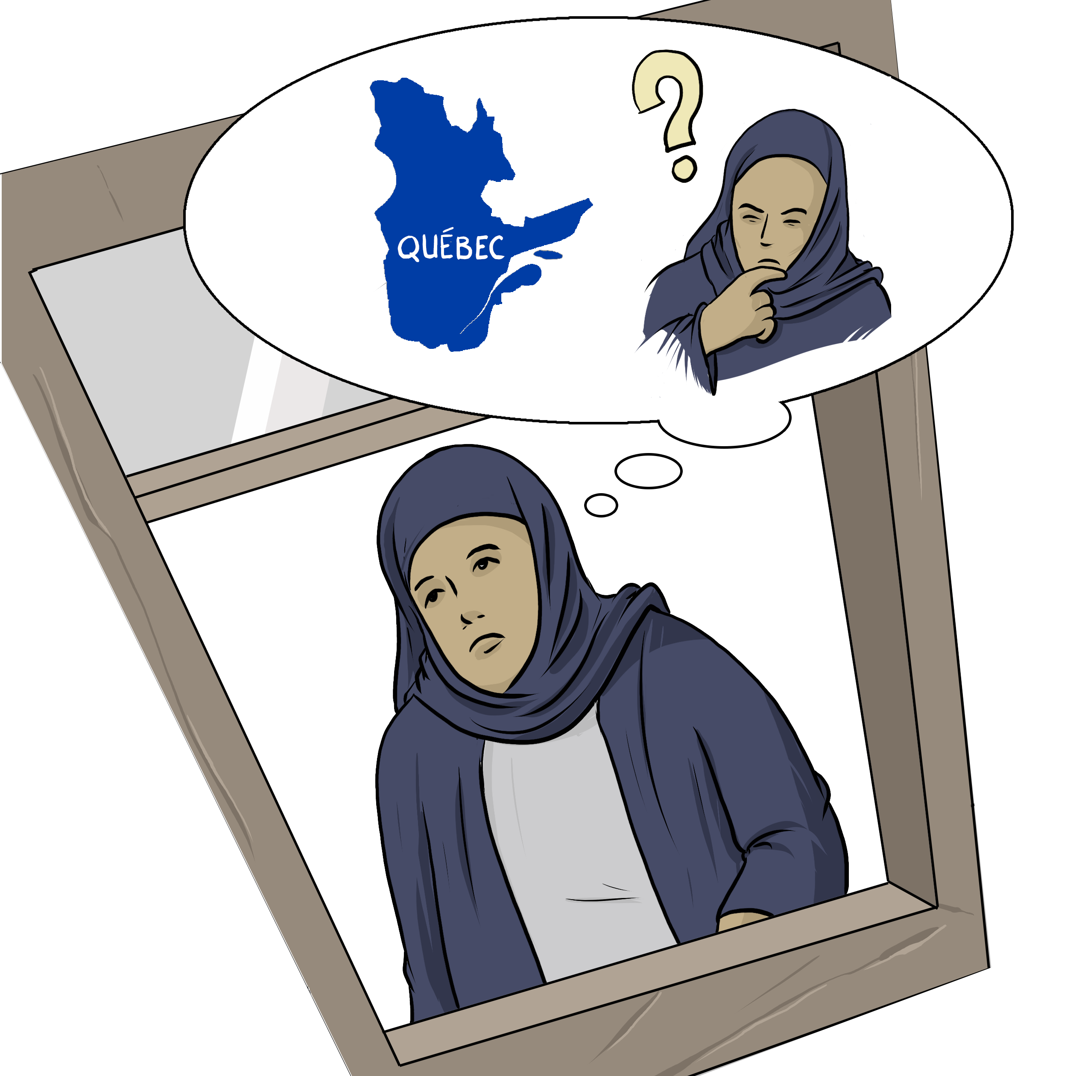
My immigration status My couple
Notes:
Instructions for the workshop facilitator
To prepare to lead this workshop:
Read the Facilitator’s Guide.
Watch the associated videos.
Read the notes at the bottom of each slide.
Read the instructions for the workshop facilitator.
Go over the legal information that you will share with participants.
Read the additional information to deepen your understanding of the theme addressed in this workshop.
If you have time, read the notes at the bottom of each slide of the PowerPoint presentations for the other workshops. All the themes covered in the different workshops are connected. Your explanations during this workshop could bring up questions on topics discussed in other workshops.
Don’t forget to:
Arrange for an interpreter, if necessary.
Add local legal services and resources to the slides.
Combine this workshop with other psychosocial support activities, if necessary.
Take the time to address delicate situations that may arise during the workshop.
This workshop addresses issues relating to separation and violence. The participants have different experiences. Some may be comfortable with the possibility of separation, and others may be strongly opposed to it. Be mindful of this diversity of perspectives when setting the tone for the workshop.
Legal information contained in this activity is valid as of June 30th, 2025.
The information contained in this workshop applies only to Quebec and should not be considered legal advice.

Slide 2
Examining the situation What do you see here?
Notes:
3 minutes
Instructions for the workshop facilitator
Before starting the workshop, mention that you are in a safe space where participants can express themselves freely and without judgment. The discussions that take place during the workshop are confidential.
Lead a discussion based on the following questions:
What is happening in this image?
What does this image tell us about the couple?
What more can you say about the situation if we assume that the woman wants to leave her husband or partner?
What more can you say about the situation if we assume that the woman has a precarious (uncertain) immigration status?
Summarize by repeating the key words that were mentioned by the participants and that are related to the topic of this workshop.

Slide 3
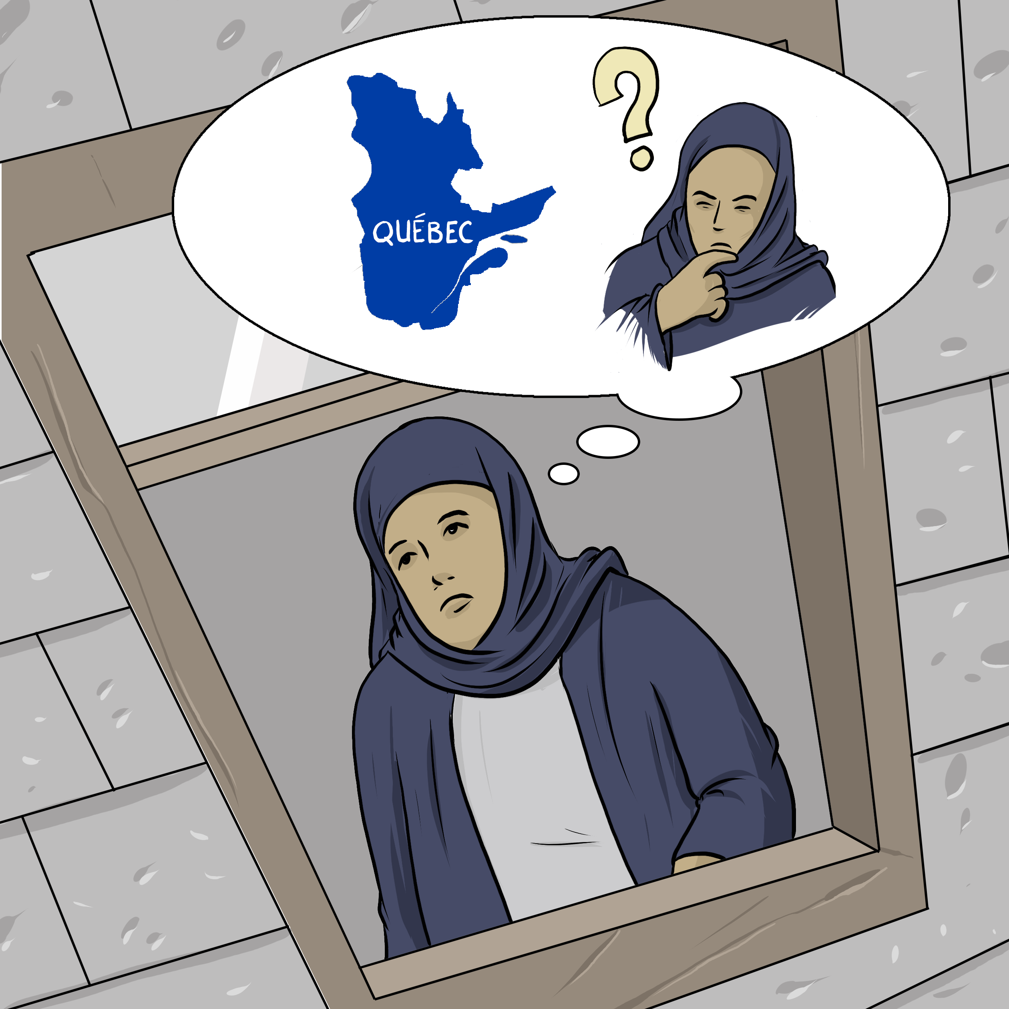
Understanding the legal issues Farah's story
"I want to leave."
"I don't want to lose my status."
Notes:
5 minutes
Instructions
Read the following story aloud:
Farah joined her husband in Quebec 14 months ago, when her sponsorship application was approved. Now, she is a permanent resident of Canada. Lately, her husband has been distant and often puts her down. She is very unhappy and has been thinking about separation, and possibly even divorce. Since she isn’t yet a citizen, and her husband is her sponsor, Farah is worried about what this would mean for her future in Canada.
Lead a discussion using the following questions:
Have you ever experienced a similar situation?
What are the main concerns or issues in this situation?
What are the rights and responsibilities related to these concerns or issues?
What should Farah do to solve the problem?
Mention that you will share legal information to help the participants better understand the legal issues, rights and responsibilities involved in this scenario and that you will come back to the scenario at the end of this workshop. Let participants know you will be covering some basic legal rules. Acknowledge that everyone’s experience with the justice system is different and can be shaped by past challenges, as well as cultural and language barriers. Remind participants that the goal of the workshop is to inform them about their rights, so that they can make informed decisions and protect themselves.
Then explain the goal of this workshop: to understand the legal effects of separation or divorce on the couple’s life.
Name the main topics that will be discussed: How separation and divorce can affect immigration status.

Slide 4
Separating or divorcing: consequences on the immigration status
The impact depends on the status
There are sometimes other options to stay in Canada
Notes:
1 minute
Instructions for the workshop facilitator
Explain the information below.
Use the following slides to discuss how separation and divorce can affect immigration status. If you know the participants’ immigration status, tailor the discussion accordingly.
Information to share
People like Farah, who aren’t Canadian citizens, may worry about how separation or divorce would affect their immigration status. It’s important for these people to know that separation or divorce does not necessarily impact immigration status; it depends on the status.
Furthermore, there may be ways for a person to remain in Canada even if they lose their status due to separation or divorce.
In this workshop, we will explore the consequences for people with different status.

Slide 5
Sponsored people who got permanent residency
Separation: no impact on the status
The other has to continue to support them financially
Notes:
3 minutes
Instructions for the workshop facilitaor
Explain the information below by making connections with the scenario.
Information to share
People who were sponsored by their spouse or partner and whose sponsorship application has been approved can separate without losing their status[1] because they are now permanent residents[2]. This is the case for Farah who was sponsored by her husband, but now she is a permanent resident.
Farah was sponsored by her husband, but now she is a permanent resident. Farah’s husband (her “sponsor” or “guarantor”) must support her for three years from the date she became a permanent resident[3], even if they no longer live together[4].
If they separate and her husband refuses to support her, Farah may qualify for social assistance. If so, her husband will likely have to reimburse the government for the benefits Farah receives[5].
Additional information
Sponsorship applications that have not yet been approved will be denied if the couple separates or divorces[6]. Couples are expected to live together until the sponsorship application is finalized and the person is granted permanent residence[7]. In some cases, there may be ways to stay in Canada under another status, for example, by applying for a Temporary Resident Permit for Victims of Family Violence, discussed in slide 8.
Even if a sponsor is experiencing domestic violence, they must continue to support their spouse or partner. For example, if Farah’s husband had experienced violence from Farah, he would still be obligated to support her. To be released from this obligation, sponsors should contact the Québec government centre for asylum seekers, defaulting guarantors and sponsored persons. A committee will review the application and decide whether to grant the exemption[8].
Sources
[1] Québec Immigration Regulation, chapiter I-021, r 3, art 59, 68 et 80 ; Québec Immigration Act, RLRQ c I-0.2.1, art 22, 23, 24.
[2] Immigration and Refugee Protection Act, LC 2011, ch 27, art 10.1 (1) ; Québec Immigration Act, RLRQ c I-021.
[3] Québec Immigration Act, RLRQ c I-021, art 22, 23, 24.
[4] Québec Immigration Act, RLRQ c I-0.2.1, art 22, 23, 24 ; Québec Immigration Regulation, RLRQ c I-021, r 3, art 68.
[5] Understanding the responsibilities and obligations related to the undertaking | Gouvernement du Québec
[6] Immigration and Refugee Protection Regulations, DORS/2002-227, arts 121, 124.
[7] Immigration and Refugee Protection Regulations, DORS/2002-227, arts 121, 124.
[8] Centre de services aux personnes parrainées (Sponsored Persons Service Centre) | Gouvernement du Québec

Slide 6
Asylum seekers
Separation: no impact on the right to claim asylum
Can have an impact on the motives behind the claim
A lawyer can analyse the situation
Notes:
3 minutes
Instructions for the workshop facilitator
Explain the information below by making connections with the scenario.
Information to share
Separation or divorce usually doesn’t affect a person’s right to seek refugee protection in Canada. But it could affect the basis of their claim—for example, if they applied because their spouse was being persecuted[1]. Even then, a person may have their own reasons for persecution, separate from their spouse’s.
Anyone who has experienced domestic violence should consult a lawyer to understand how separation might affect their situation.
Sources
[1] Immigration and Refugee Protection Act, LC 2011, ch 27, art 96; Immigration and Refugee Protection Regulations, DORS/2002-227, art 139.

Slide 7
Recognized refugees
Separation: no impact on the status
Notes:
1 minute
Instructions for the workshop facilitator
Explain the information below.
Information to share
Separation does not affect the immigration status of a protected person (refugee), i.e. someone whose claim has been approved[1].
Sources
[1] No official source. Simply no legal provision forsees that the status of a protected person would be revoked in the case of a separation.

Slide 8
A solution to staying: Temporary residence permit in case of violence
A solution to get out of a violent situation
The first application is free
The person can apply for a work permit afterwards
IRCC Customer Support Center: 1­888-242-2100
Notes:
5 minutes
Instructions for the workshop facilitator
Explain the information below.
Information to share
Some people may feel trapped in an abusive situation because they depend on their spouse for their status in Canada. It’s important for these people to know that there is a temporary option available: the temporary resident permit[1]. The children of the person experiencing family violence may also be eligible for this permit if they are in Canada[2].
This option allows people to leave a violent situation and gives them time to explore other ways to remain in Canada, such as applying for permanent residence on humanitarian grounds.
The first application for a temporary resident permit is free[3]. If granted, the person can also apply for a work permit at no cost[4].
For more information, participants can contact the Immigration, Refugees and Citizenship Canada Client Support Centre by calling 1-888-242-2100 or visiting their website.
Additional information
People with a temporary resident permit for victims of family violence may qualify for financial assistance for trauma counseling and health care. For details, participants can contact the immigration, Refugees and Citizenship Canada Client Support Centre by calling 1-888-242-2100 or visiting their website.
Some violent behaviour is a crime in Canada[5]. People experiencing violence from their spouse may consider calling the police.
Important note for the facilitator: Many people are afraid to call the police because they are in Canada without status. The risk of being deported in these cases depends on the situation. For example, calling the police is indeed risky for anyone who was ordered to leave Canada (for example, because their refugee claim was rejected).
Sources
[1] Immigration and Refugee Protection Act, LC 2011, ch 27, art 24(1).
[2] Immigration and Refugee Protection Act, LC 2011, ch 27, art 24(3) ; Governement of Canada, Ministry Instructions, "Temporary resident permit (TRP) for victims of family violence", at the address: Temporary resident permit (TRP) for victims of family violence - Canada.ca
[3] Immigration and Refugee Protection Regulations, DORS/2002-227, art 298 (2).
[4] Immigration and Refugee Protection Act, LC 2011, ch 27, art 24(3) ; Governement of Canada, Ministry Instructions, "Temporary resident permit (TRP) for victims of family violence", at the address: Temporary resident permit (TRP) for victims of family violence - Canada.ca
[5] For example: sexual assault (Criminla Code, LRC, (1985) ch C-46, art 265), harassing communication (Criminal Code, LRC, (1985) ch C-46, art 372 (3); see also: 14 criminal offenses in contexts of intimate partner violence — SOS violence conjugale

Slide 9
Where to find help?
Notes:
2 minutes​
​
Instructions​
​
In the following slides, you will find resources that you can present to participants. You can customize the workshop by adding slides presenting other relevant resources.
Feel free to print the slides with the resources.
Feel free to offer to help participants contact one of the mentioned resources or even to go with them if needed. You can also explore the websites together.
Mention that they can look at these resources even if they do not intend to leave their spouse or partner, or if they are still deciding what to do. They can consult these resources simply to inform themselves.

Slide 10
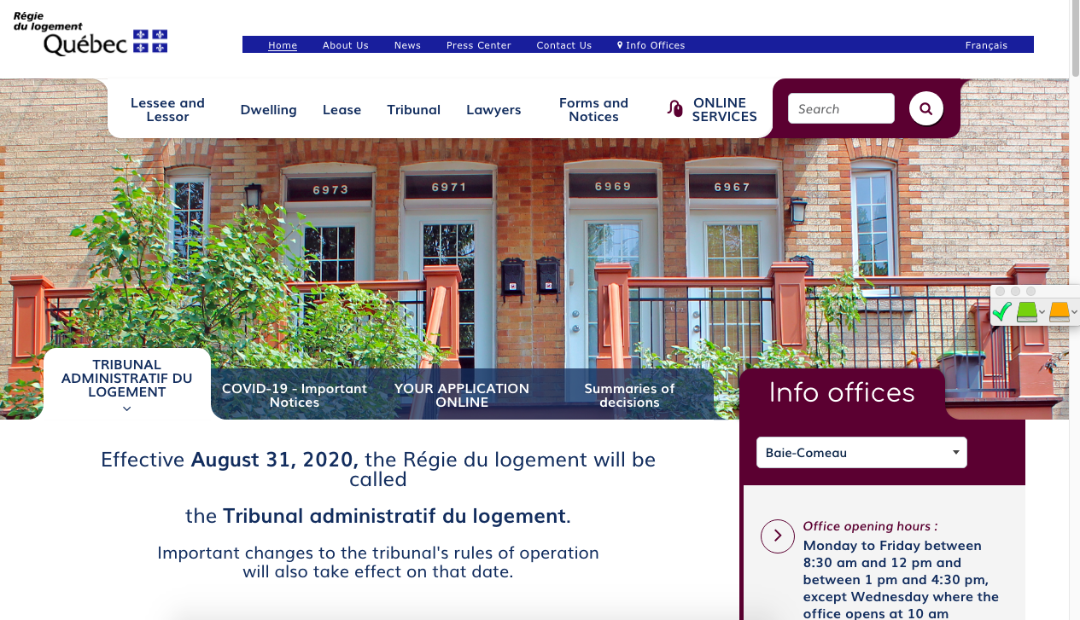
Finding help (Name of the organisation)
(Short description of their service)
(Link to their website)
(Screenshot of the organisation's website)
Notes:
1 minute​
Instructions​
You can customize this slide if you want to add resources other than those presented in the following slides.

Slide 11
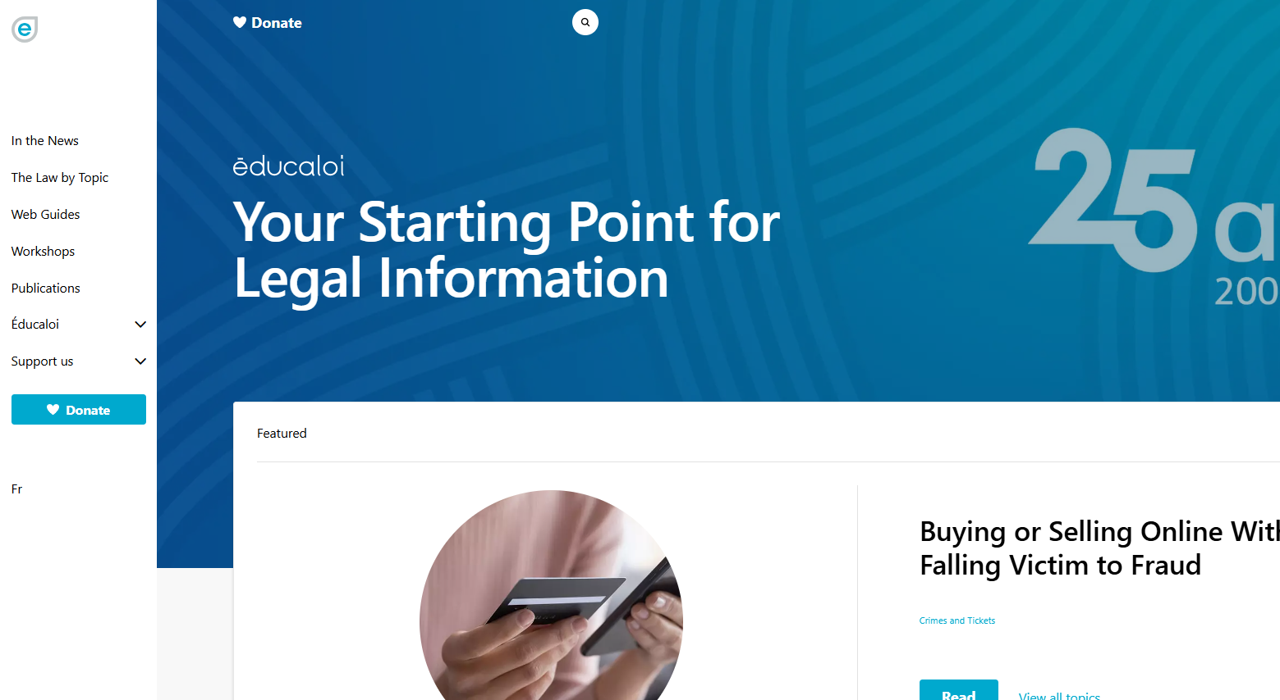
Finding help Éducaloi
Free online legal information on:
Family, couples, separation and divorce
Housing
Work
Éducaloi - Your starting point for legal information
Notes:
1 minute​
Instructions​
Explain that Éducaloi is a non-profit whose mission is to explain the law in Quebec in a simple way. Éducaloi is especially known for its website that covers various legal topics, including family and couples, separation and divorce, housing, work and more. Most of Éducaloi's content is available in French and English.

Slide 12
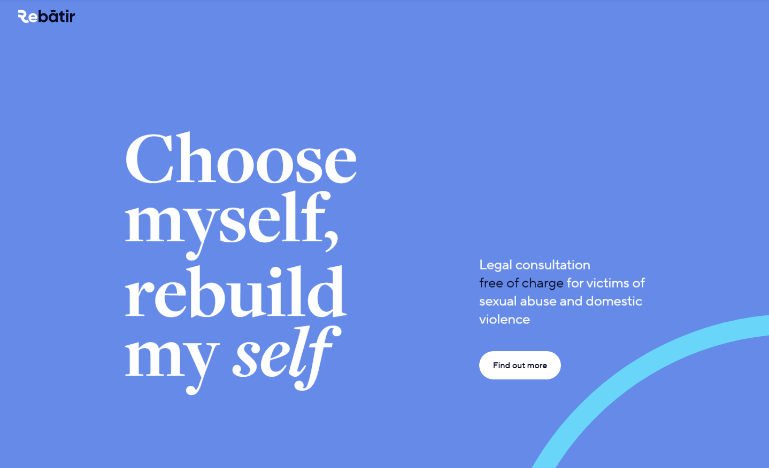
Finding help ReBâtir
4 hours of free legal consultation
1-833-732-2847
Rebâtir
Notes:
1 minute​
Instructions​
Explain that this resource is available to participants if they encounter legal issues related to their life as a couple. Rebâtir is the name of a legal consultation service provided by the Commission des services juridiques (legal aid). It offers 4 hours of free legal consultation to people who experience domestic or sexual violence in all areas of law.
To contact them: call 1-833-REBÂTIR (1-833-732-2847) or write to projet@rebatir.ca

Slide 13
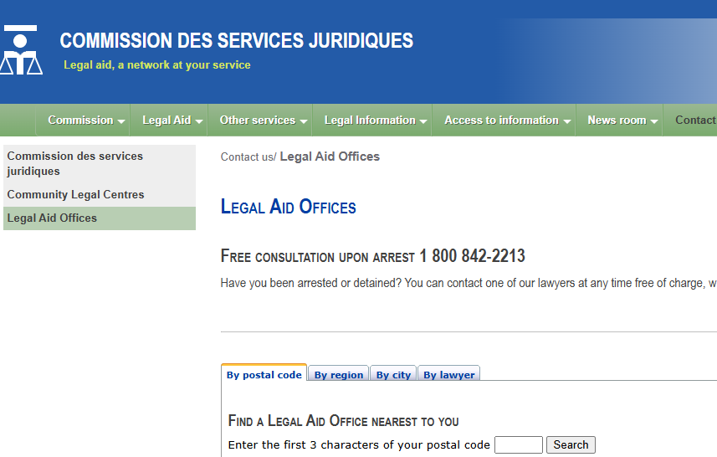
Finding help Commission des services juridiques (Legal Aid)
Free or low cost legal aid
Legal Aide Offices and Lawyers
Notes:
1 minute
Instructions
Explain that this legal resource is available to the participants if they experience legal issues relation to social assistance: the Commission des services juridiques (Legal Aid) offers free or low-cost services from lawyers to people eligible for legal aid. Legal aid includes legal services for questions relation to socail assitance.
To find a legal aid office: Legal Aide Offices and Lawyers

Slide 14
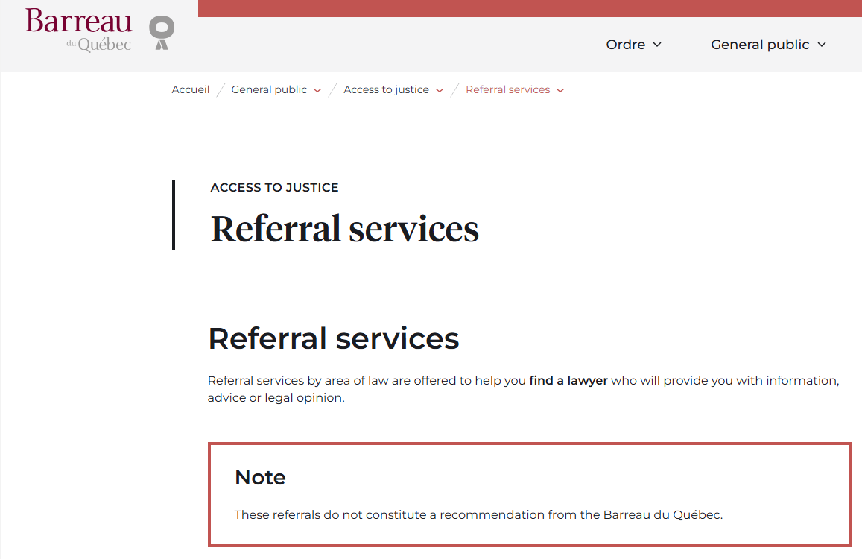
Finding help Barreau du Québec Referral Services
To find a lawyer
Referral services - Access to justice
Notes:
1 minute​
Instructions​
Explain that this legal resource is available to the participants if they need a lawyer for personalised legal advice.
To reach them: Referral services - Access to justice

Slide 15
Taking action What can Farah do?
Make a copy of her immigration documents
Check if she has the right to apply for social assitance
Find an organization that supports immigrants
Notes:
3 minutes
Instructions
Remind the participants about the scenario shared at the beginning of the workshop.
Ask participants to answer the following question:
Based on the information and resources we’ve discussed today, what options does Farah have?
Complete the participants’ answers by sharing some possible courses of action. Click to make these options appear on the screen.
Conclude with these three key messages:
Separation or divorce does not necessarily impact immigration status; it depends on the status.
There may be ways for a person to remain in Canada even if separation or divorce does affect their status.
Regardless of immigration status, anyone experiencing domestic violence can apply for a temporary resident permit.

Slide 16
Questions?
Notes:
1 minute​
Instructions for the workshop facilitator
Answer the participants’ questions.
If you have time, ask the following questions and write down the answers:
Did you enjoy the workshop? Why?
What new things did you learn?
Is the information shared in this workshop useful to you? In what situation will you use it?
Feel free to thank everyone for participating in the workshop, asking questions and sharing their perspective.

Slide 17
Éducaloi thanks the Maison Bleue and Femmes du Monde à Côte-des-Neiges for their valuable collaboration
This workshop was made possible with the support of

