Slide 1
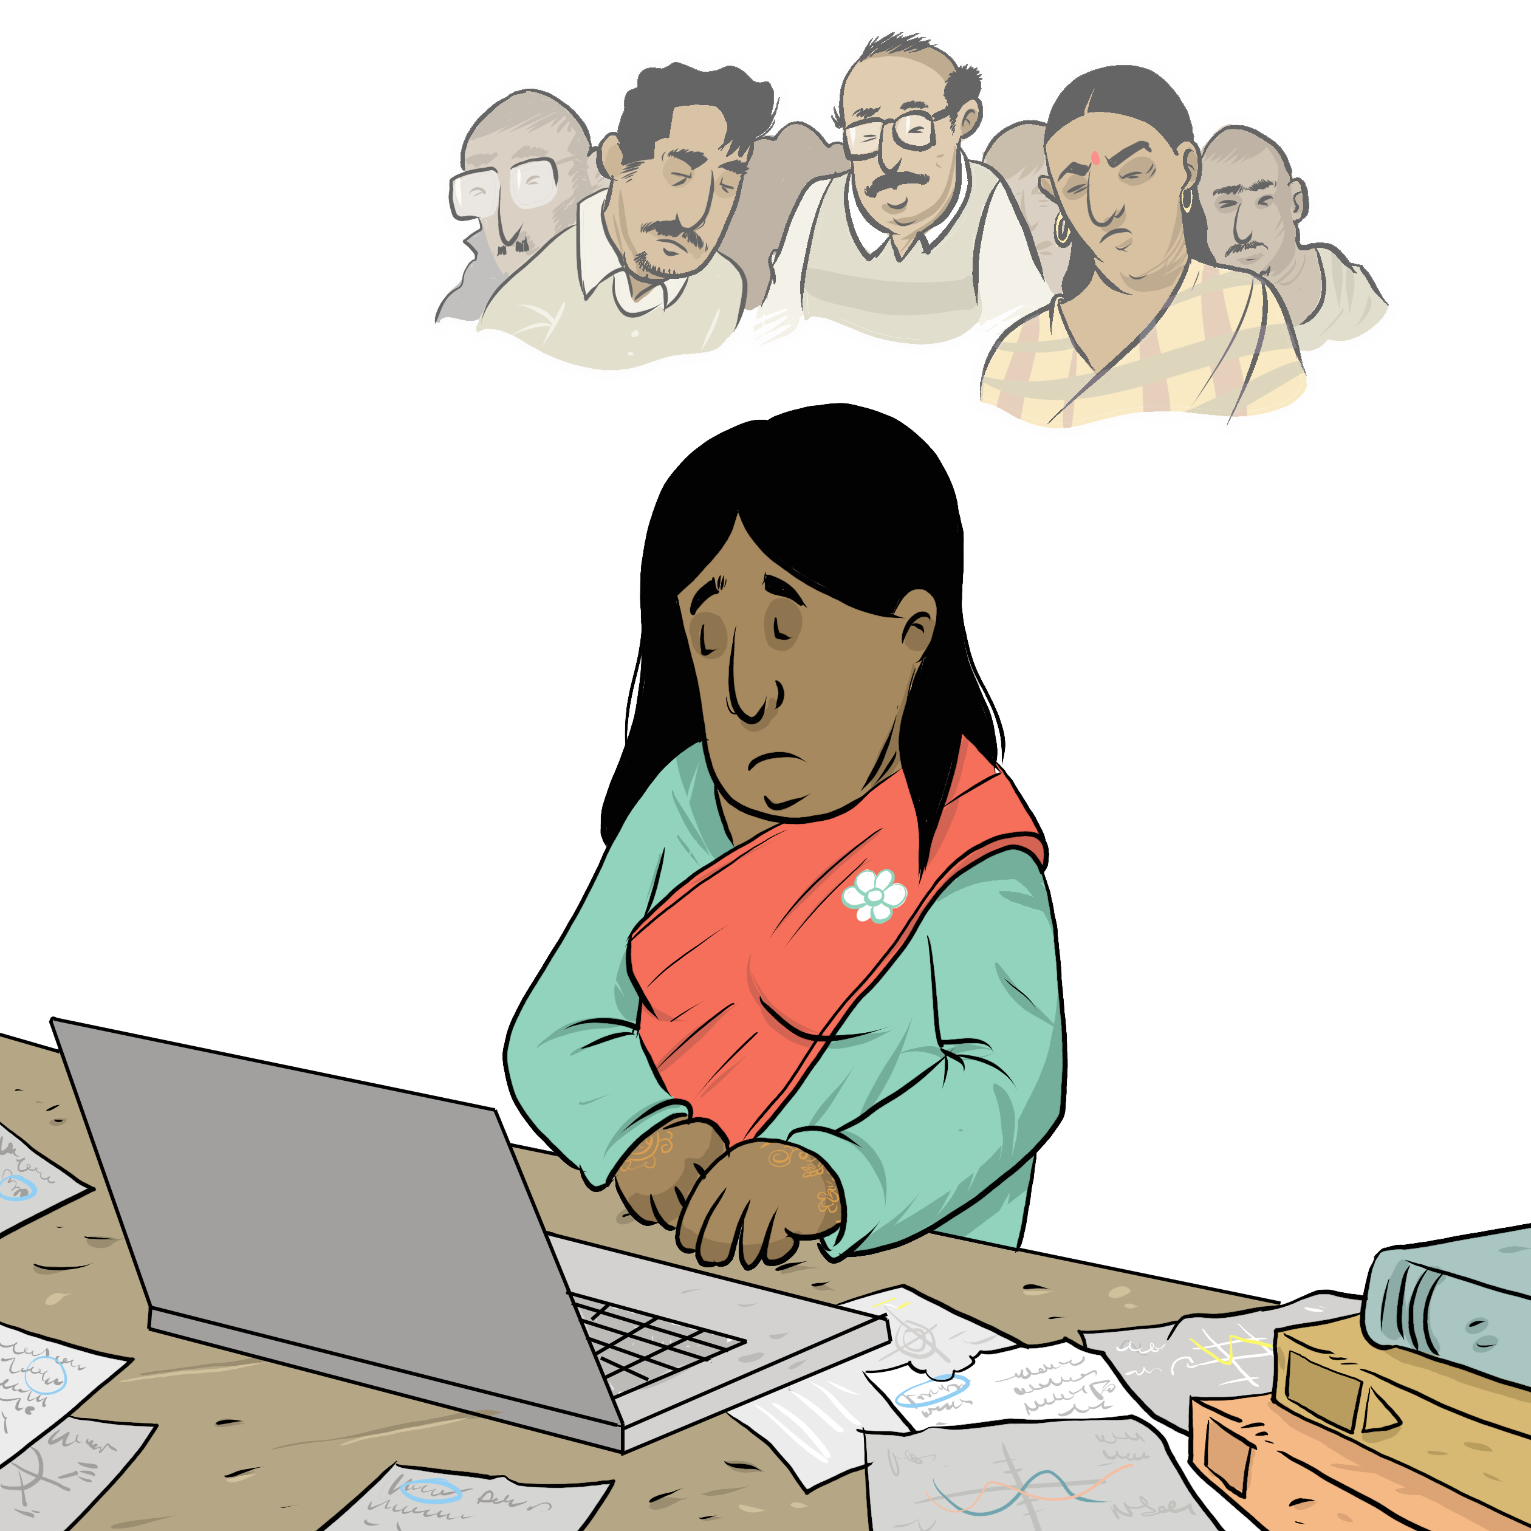
I'm Considering Separation My Relationship
Notes:
Instructions for the workshop facilitator
To prepare to lead this workshop:
Read the Facilitator’s Guide.
Watch the associated videos.
Read the notes at the bottom of each slide.
Read the instructions for the workshop facilitator.
Go over the legal information that you will share with participants.
Read the additional information to deepen your understanding of the theme addressed in this workshop.
If you have time, read the notes at the bottom of each slide of the PowerPoint presentations for the other workshops. All the themes covered in the different workshops are connected. Your explanations during this workshop could bring up questions on topics discussed in other workshops.
Don’t forget to:
Arrange for an interpreter, if necessary.
Add local legal services and resources to the slides.
Combine this workshop with other psychosocial support activities, if necessary.
Take the time to address delicate situations that may arise during the workshop.
This workshop addresses issues relating to separation and violence. The participants have different experiences. Some may be comfortable with the possibility of separation, and others may be strongly opposed to it. Be mindful of this diversity of perspectives when setting the tone for the workshop.
Legal information contained in this activity is valid as of June 30th, 2025.
The information contained in this workshop applies only to Quebec and should not be considered legal advice.

Slide 2
Examining the situation What do you see here?
Notes:
3 minutes
Instructions for the workshop facilitator
Before starting the workshop, mention that you are in a safe space where participants can express themselves freely and without judgment. The discussions that take place during the workshop are confidential.
Lead a discussion based on the following questions:
What is happening in this image?
What does this image tell us about the couple?
What more can you say about the situation if we assume that the woman wants to leave her husband or partner?
What more can you say about the situation if we assume that the woman has a precarious (uncertain) immigration status?
Summarize by repeating the key words that were mentioned by the participants and that are related to the topic of this workshop.

Slide 3
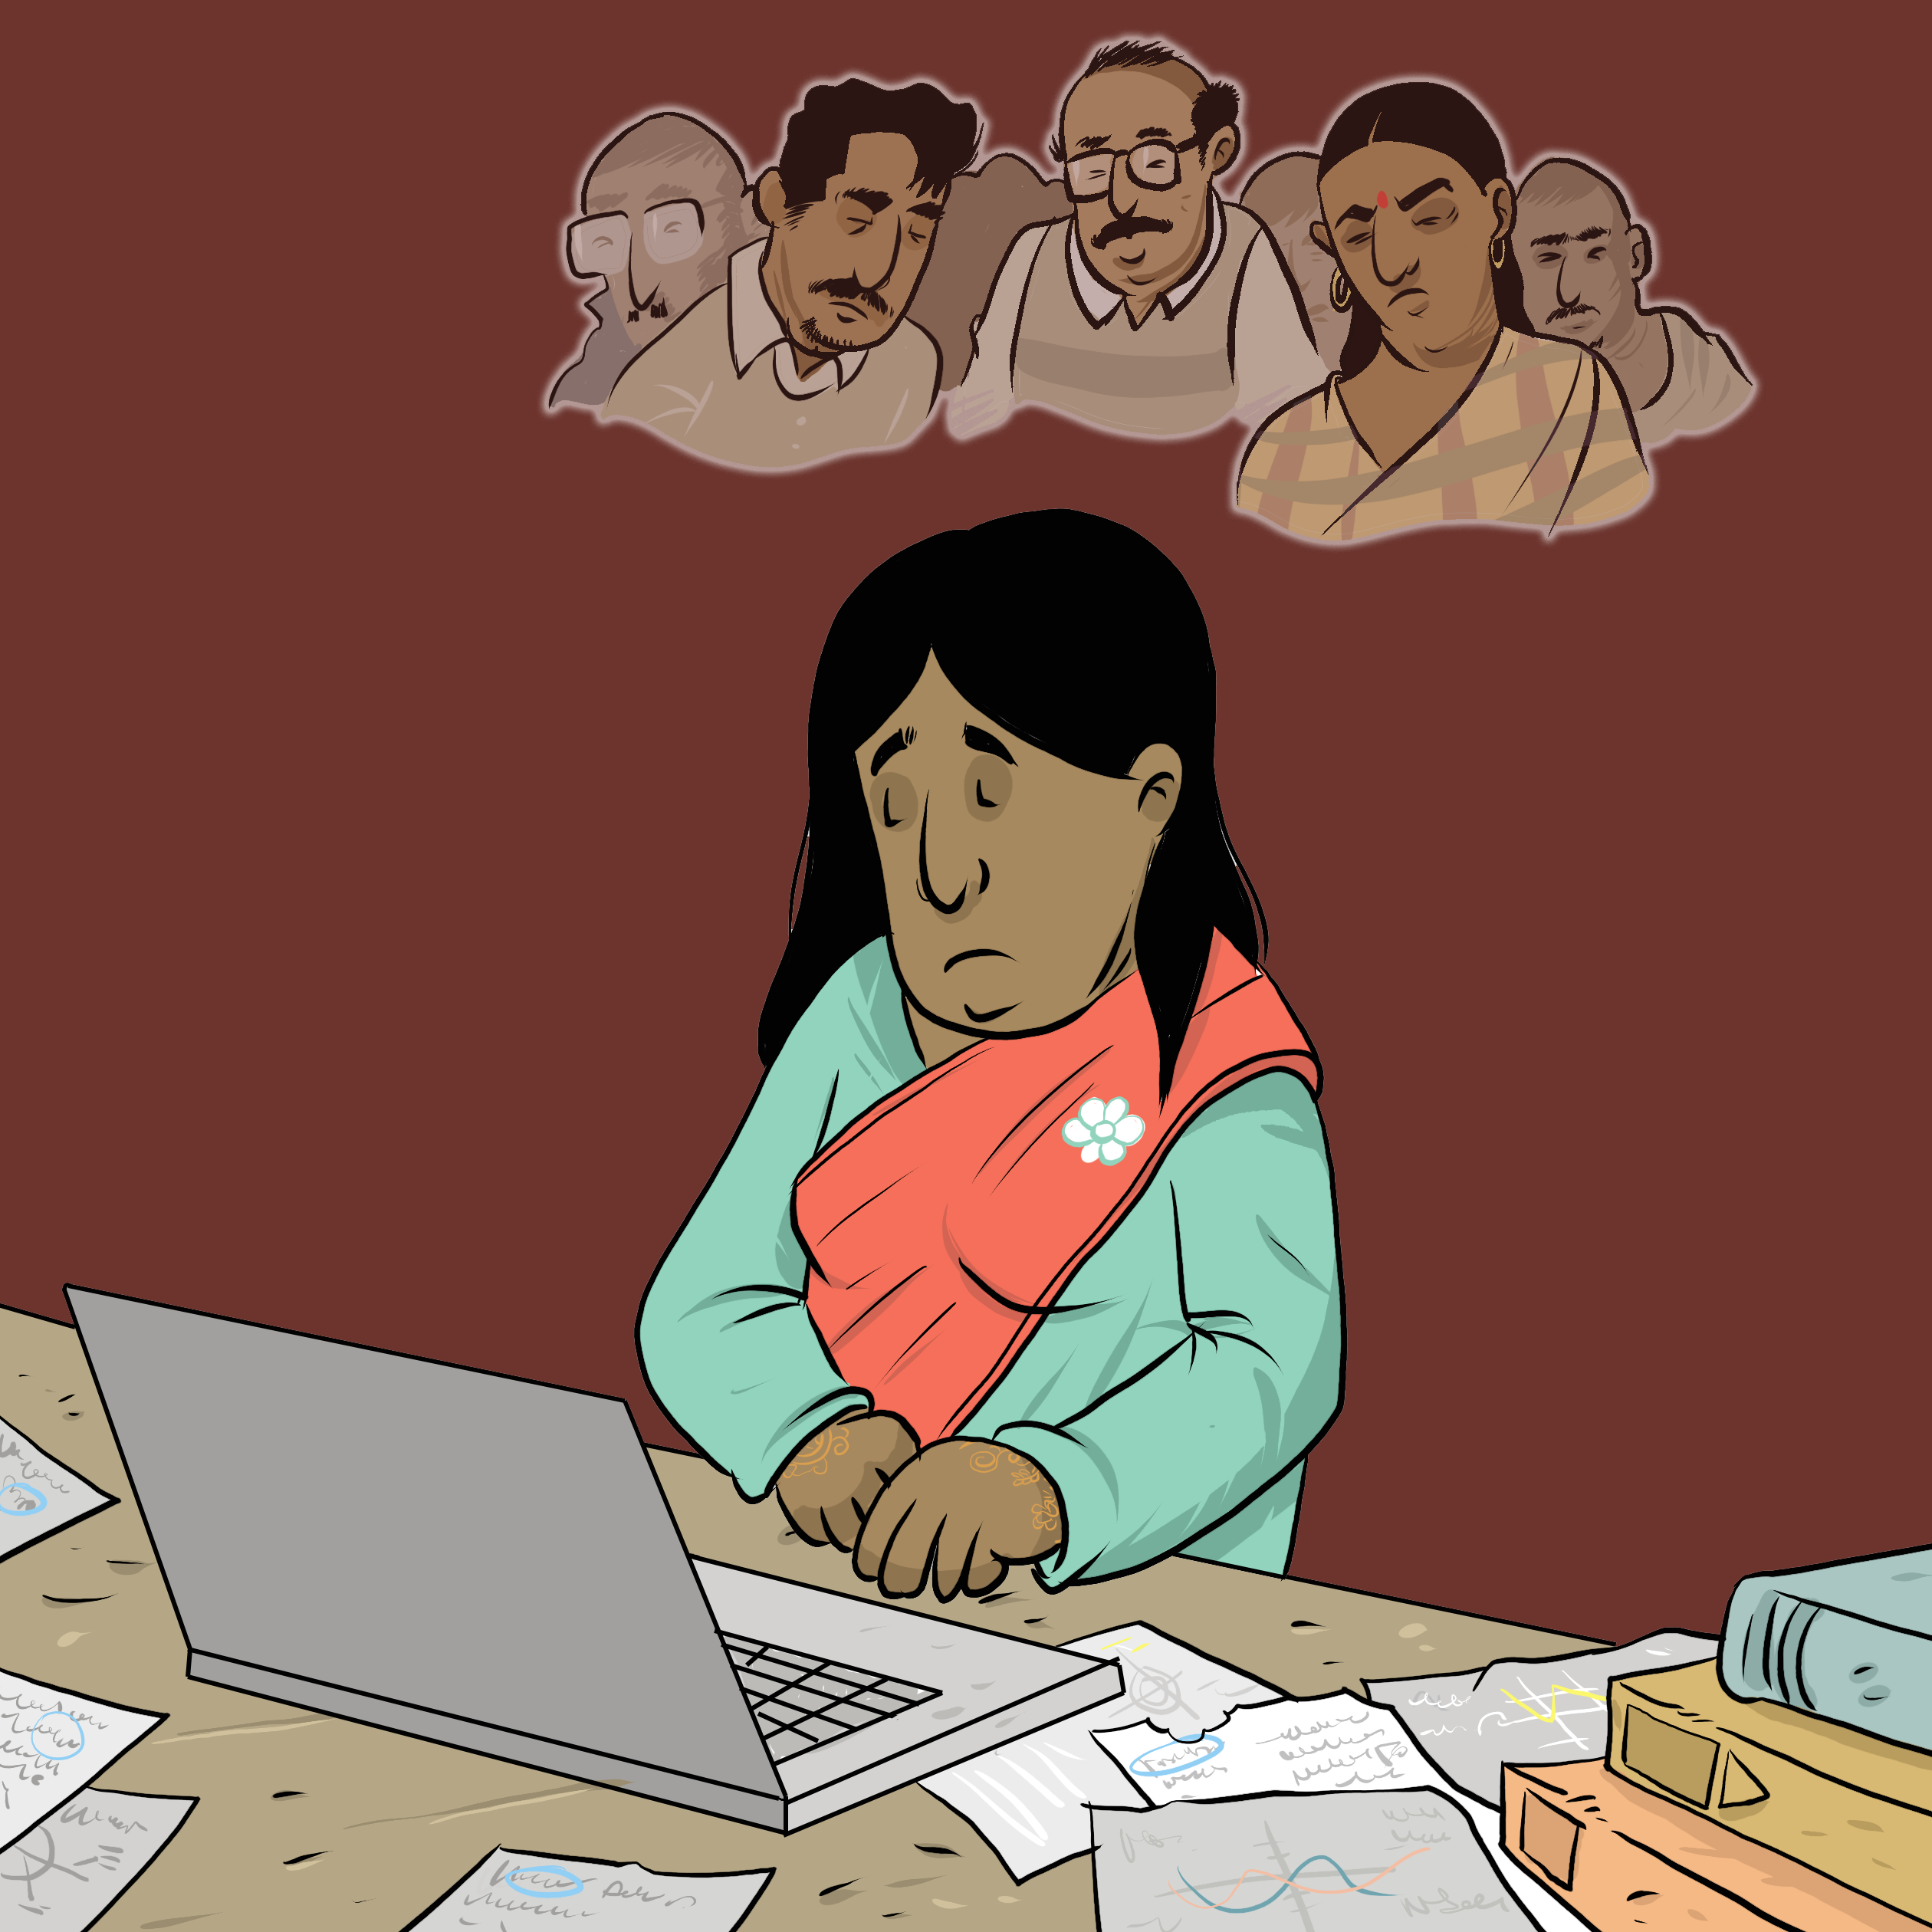
Understanding the legal issues Neha's Story
"I don't want to be with him anymore."
"Where to start?"
"It might be long and expensive."
Notes:
5 minutes
Instructions
Read the following story aloud:
Neha has made up her mind: she can’t stay with her husband, Gunjad, any longer. She’s not happy, and the tension between them has been growing for some time. She doesn’t want to live with him. Actually, she never wants to see him again. She thinks she wants a divorce, but she’s not completely sure. Her current situation is unbearable, but she doesn’t want to let her family down. She became even more discouraged when her friend told her about the paperwork involved. She’s worried that a divorce will be expensive and time-consuming.
Lead a discussion using the following questions:
Have you ever experienced a similar situation?
What are the main concerns or issues in this situation?
What are the rights and responsibilities related to these concerns or issues?
What should Neha do to solve the problem?
Mention that you will share legal information to help the participants better understand the legal issues, rights and responsibilities involved in this scenario and that you will come back to the scenario at the end of this workshop. Let participants know you will be covering some basic legal rules. Acknowledge that everyone’s experience with the justice system is different and can be shaped by past challenges, as well as cultural and language barriers. Remind participants that the goal of the workshop is to inform them about their rights, so that they can make informed decisions and protect themselves.
Then explain the goal of this workshop: To understand the main steps to take when getting divorced or separated.
Name the main topics that will be discussed: The steps for getting divorced (if the couple is married) or separated (if the couple is not married).

Slide 4
Divorcing in Quebec: principal rules
Three legal reasons to divorce – generally a 1 year separation
The costs and delays can vary
A lawyer can help with the process. Services can sometimes be free or low cost
Notes:
7 minutes
Instructions for the workshop facilitator
Explain the information below by making connections with the scenario
Informations to share
Legal reasons for divorce
In Canada, there are only three legal reasons for divorce[1]:
living apart for at least one year
adultery
physical or psychological violence (“physical or mental cruelty”)
One spouse does not need the other’s consent to get divorced. [2].
Costs
Estimating the costs of a divorce can be challenging, as they vary widely based on factors like:
Whether the spouses hire a lawyer, and how much the lawyer charges.
Whether the spouses are eligible for legal aid, which may provide financial assistance if they cannot afford a lawyer. In some cases, couples may not need to pay anything at all[3].
Whether the spouses agree on key issues, like the division of property and child custody arrangements. If they agree on everything, they can file for divorce together[4], which typically costs less than when there is a dispute.
Unless they qualify for legal aid, the spouses must pay court fees to file for divorce[5]. These fees are sometimes called the “judicial stamp.” If the spouses file for divorce together, the judicial stamp costs $115 (in 2024)[6]. If a spouse applies alone, the judicial stamp costs $345 (in 2024)[7]. The other spouse must then respond and pay the court fees[8]. The cost to file the response to the divorce applicaion is $173 (in 2024)[9].
Timeline and temporary measures
Divorces can take several months or several years.
Factors that influence this timeline include:
Whether the spouses agree on key issues (disagreements regarding children and other issues can extend the process).
The courthouse where the divorce is filed, as some take longer than others.
While their divorce is being finalized, spouses can request temporary court decisions[10] for things like child custody arrangements[11]. They can also reach temporary agreements themselves and ask the court to formalize them (“homologate”)[12].
Even if the spouses agree and collaborate on everything, all divorces must be formalized in court[13]. A lawyer can assist with this process.
Additional information
Separation after a year apart
Sometimes, a person can file for divorce even while still living with their spouse, if they can demonstrate their intent to separate[14]. For instance, they might show that[15]:
they have separate rooms,
they have no sexual relationship,
they talk to each other very little or not at all,
they don’t do any household chores together (like preparing meals or doing each other’s laundry).
Delays
Sometimes, an ex-spouse may use tactics to prolong the divorce process, such as refusing to provide employment records on time, initiating proceedings in multiple courts, or making threats. This is sometimes considered a type of domestic violence called “judicial violence.” People experiencing this should seek guidance from a specialized lawyer.
Foreign marriages
Couples can divorce in Quebec even if they got married elsewhere, as long as at least one of them has lived in Quebec for at least one year[16].
They might also need to take steps to formalize their divorce in the country where they got married, so consulting a lawyer there for guidance is advisable. Couples can also look for lawyers in Quebec who are familiar with the laws of the country where they got married.
.
More information on the divorce process
Éducaloi has a detailed guide on the divorce process. You can suggest this guide to participants who feel capable of navigating the process without a lawyer: Applying for a Divorce | Printable Guide | Éducaloi
You can find additional resources that help guide people through the divorce process on slide 7.
Legal aid
If someone wants to be represented by a legal aid lawyer, they should contact a legal aid office as soon as possible. If their ex contacts the office first, the office cannot take their case due to a conflict of interest.
Related workshops
This workshop covers the legal process of divorce and separation, not its effects on child custody, property, child support, housing, etc. If needed, pair this activity with other workshops covering these topics.
Divorce can also affect a person’s immigration status. If this topic is relevant, participants may benefit from attending the My Immigration Status workshop.
Sources
[1] Divorce Act, LRC (1985), arts 8(2) et 8(3).
[2] Divorce Act, LRC (1985), arts 8(1) et 8(2).
[3] Act respecting legal aid and the provision of certain other legal services, RLRQ c A-14, arts 4.1, 4.7(1).
[4] Divorce Act, LRC (1985), art 8(1) ; Code of Civil Procedure, RLRQ, c C-25, art 430.
[5] Act respecting legal aid and the provision of certain other legal services, RLRQ c A-14, art 4.7(1).
[6] Tariff of judicial fees in civil matters, RLRQ c T-16, r. 10, art 16 al 1.
[7] Tariff of judicial fees in civil matters, RLRQ c T-16, r. 10, art 5 (1) c).
[8] Code of Civil Procedure, RLRQ, c C-25, art 145 al 2.
[9] Tariff of judicial fees in civil matters, RLRQ c T-16, r. 10, art 5 (2) a).
[10] Code of Civil Procedure, RLRQ c C-25 01, arts 49 al 2, 158(8), 411 ; Divorce Act, LRC (1985), arts 15.1 (2), 15.2 (2), 16.1 (2), 16.5 (2).
[11] Divorce Act, LRC (1985), art 16.1 (2) ; Code of civil procedure, RLRQ c C-25 01, art 411.
[12] Code of Civil Procedure, RLRQ c C-25 01, arts 72 al 2, 415.
[13] Divorce Act, LRC (1985), art 12 (1).
[14] Divorce Act, LRC (1985), art 8(2).
[15] Family Law — 091479, 2009 QCCS 2782 para 23.
[16] Divorce Act, LRC (1985), art 3 (1).

Slide 5
Separating in Quebec (unmarried couples): principal rules
Going to court is not mandatory
Sometimes, a court can be useful
Notes:
7 minutes
Instructions for the workshop facilitator
Explain the information below by making connections with the scenario.
Information to share
Unlike married couples, unmarried couples do not need to go to court to separate.
However, court intervention is an option if they disagree on certain issues[1]. For example, one person can ask the court to make decision in the following cases[2]:
how to divide time with their children,
whether child support should be paid, and by whom,
how to divide their assets.
The court can intervene in urgent matters[3], like granting custody and enduring protection from violence.
Even if an unmarried couple agrees on everything, they can still go to court[4] to formalize (“homologate”) their agreement[5]. This has several advantages:
The agreement will have the same legal weight as a court judgment[6] , meaning both parties must respect it[7].
If child support is involved, Revenu Québec can automatically deduct payments from the paying parent’s salary and transfer them to the receiving parent[8].
Additional information
As mentioned earlier, this workshop covers the legal process of divorce and separation, not its effects on child custody, property, support, housing, etc. If needed, pair this activity with other workshops covering these topics.
Sources
[1] Code of Civil Procedure, RLRQ c C-25 01, arts 409, 411.
[2] Code of Civil Procedure, RLRQ c C-25 01, art 409.
[3] Code of Civil Procedure, RLRQ c C-25 01, arts 49 al 2, 158(8)
[4] Code of Civil Procedure, RLRQ c C-25 01, arts 72 al 2, 415.
[5] Code of Civil Procedure, RLRQ c C-25 01, art 72 al 2.
[6] Code of Civil Procedure, RLRQ c C-25 01, art 72 al 3.
[7] Code of Civil Procedure, RLRQ c C-25 01, art 72 al 3.
[8] Act to facilitate the payment of support, RLRQ, c P-2.2, arts 6, 7, 8, 11, 36 al 1.

Slide 6
Coming to an agreement in mediation
A mediator can help the couple come to an agreement
Free services for a certain number of hours
Can avoid lengthy and costly court procedings
Notes:
7 minutes
Instructions for the workshop facilitator
Explain the information below by making connections with the scenario.
Information to share
Sometimes, people need help reaching an agreement on the terms of their separation or divorce.
A family mediator, if appropriate, can help them find solutions[1][2].
Married and unmarried couples are usually eligible for free mediation hours[3].
Some mediators specialize in mediation in the context of domestic violence.
Couples can also choose a mediator who speaks their native language. For example, there are mediators who speak Spanish, Arabic, and Italian.
Successful mediation can help couples avoid long and costly court proceedings. However, married couples must still go to court to make their divorce official[4]. A lawyer can help with this process.
Additional information
It is generally not recommended to use mediation when there was violence between the people in conflict[5]. That said, some mediators specialize in mediation in the context of domestic violence. To find them, the person can go to the Association des médiateurs familiaux du Québec’s website (association of family mediators) and click on “Find a mediator.” They can then select “Violence familiale et conjugale” (family and domestic violence) under the “Champ(s) d’expertise(s)” field.
Sources
[1] Code of Civil Procedure, RLRQ, c C-25, arts 605 al 2, 616.
[2] Code of Civil Procedure, RLRQ, c C-25, art 605 al 2, 616.
[3] Code of Civil Procedure, RLRQ, c C-25, art 619 ; Regulation respecting family mediation, c. C-25-01, r. 0.7, art.10.1, 10.4.
[4] Divorce Act, LRC (1985), art 12 (1).
[5] For example : 13 Frequently Asked Family Law Questions About Situations of Intimate Partner Violence — SOS violence conjugale

Slide 7
Where to find help?
Notes:
2 minutes​
​
Instructions​
​
In the following slides, you will find resources that you can present to participants. You can customize the workshop by adding slides presenting other relevant resources.
Feel free to print the slides with the resources.
Feel free to offer to help participants contact one of the mentioned resources or even to go with them if needed. You can also explore the websites together.
Mention that they can look at these resources even if they do not intend to leave their spouse or partner, or if they are still deciding what to do. They can consult these resources simply to inform themselves.

Slide 8
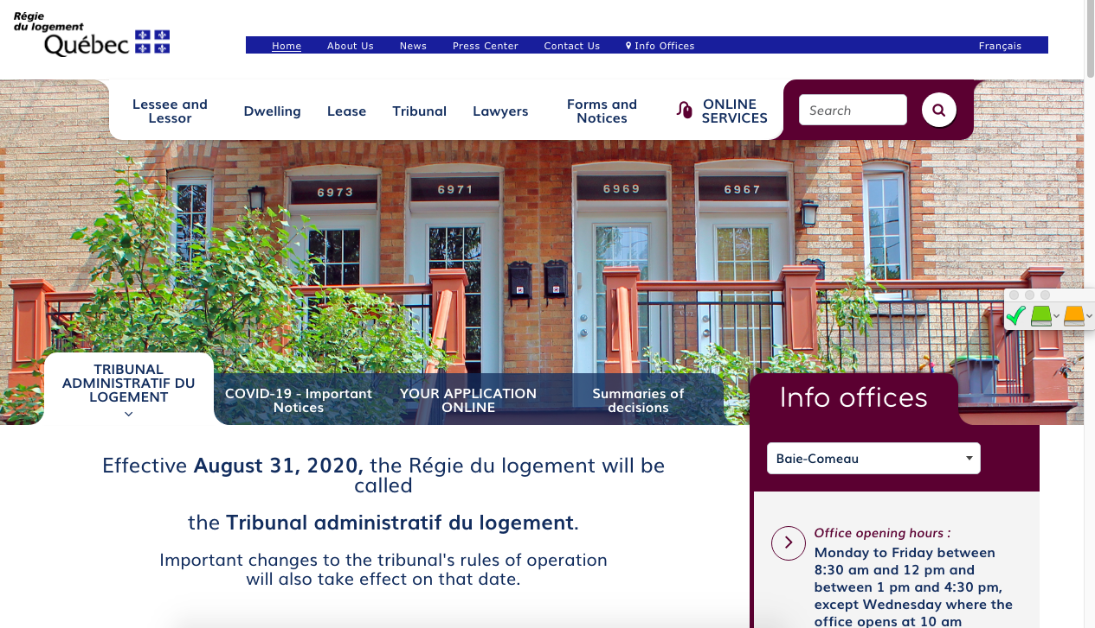
Finding help (Name of the organisation)
(Short description of their service)
(Link to their website)
(Screenshot of the organisation's website)
Notes:
1 minute​
Instructions​
You can customize this slide if you want to add resources other than those presented in the following slides.

Slide 9
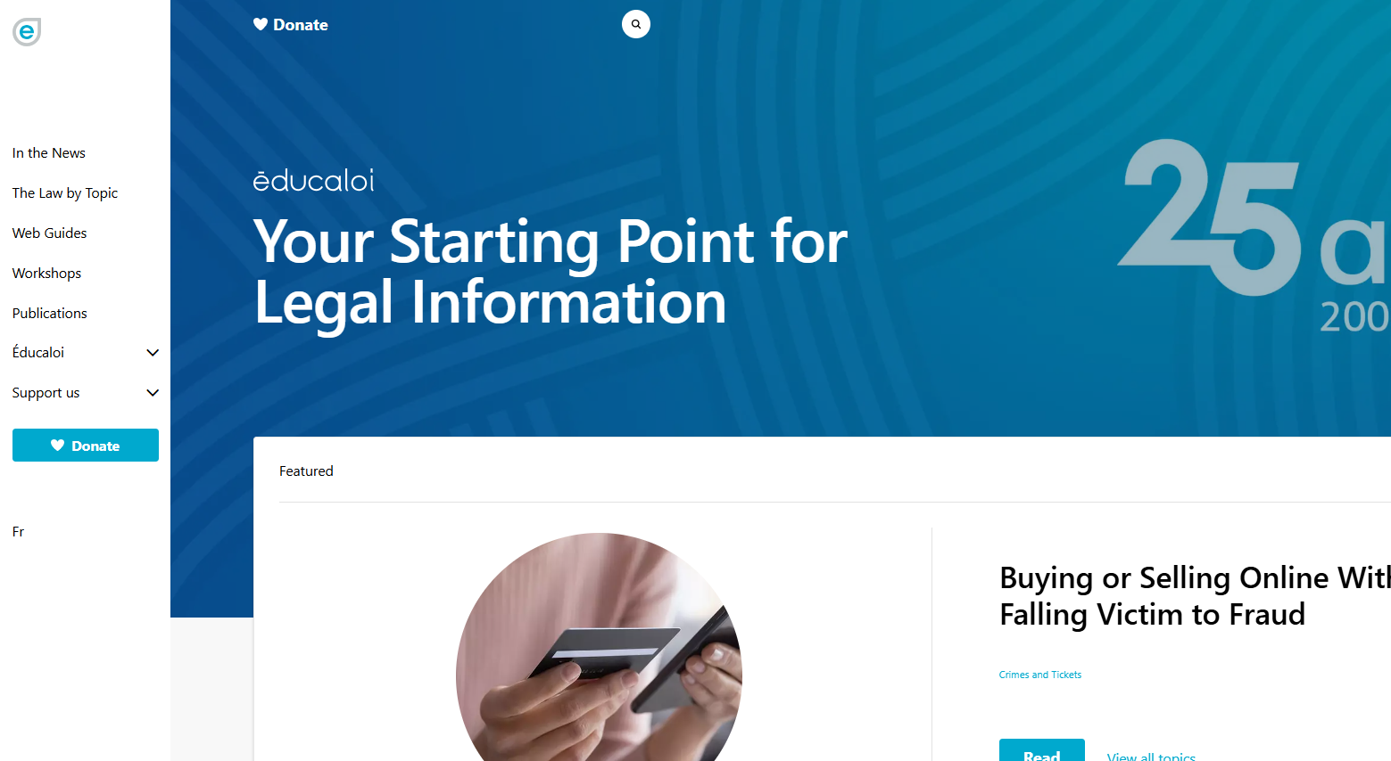
Finding help Éducaloi
Free online legal information on:
Family, couples, separation and divorce
Housing
Work
Éducaloi - Your starting point for legal information
Notes:
1 minute​
Instructions​
Explain that Éducaloi is a non-profit whose mission is to explain the law in Quebec in a simple way. Éducaloi is especially known for its website that covers various legal topics, including family and couples, separation and divorce, housing, work and more. Most of Éducaloi's content is available in French and English.

Slide 10
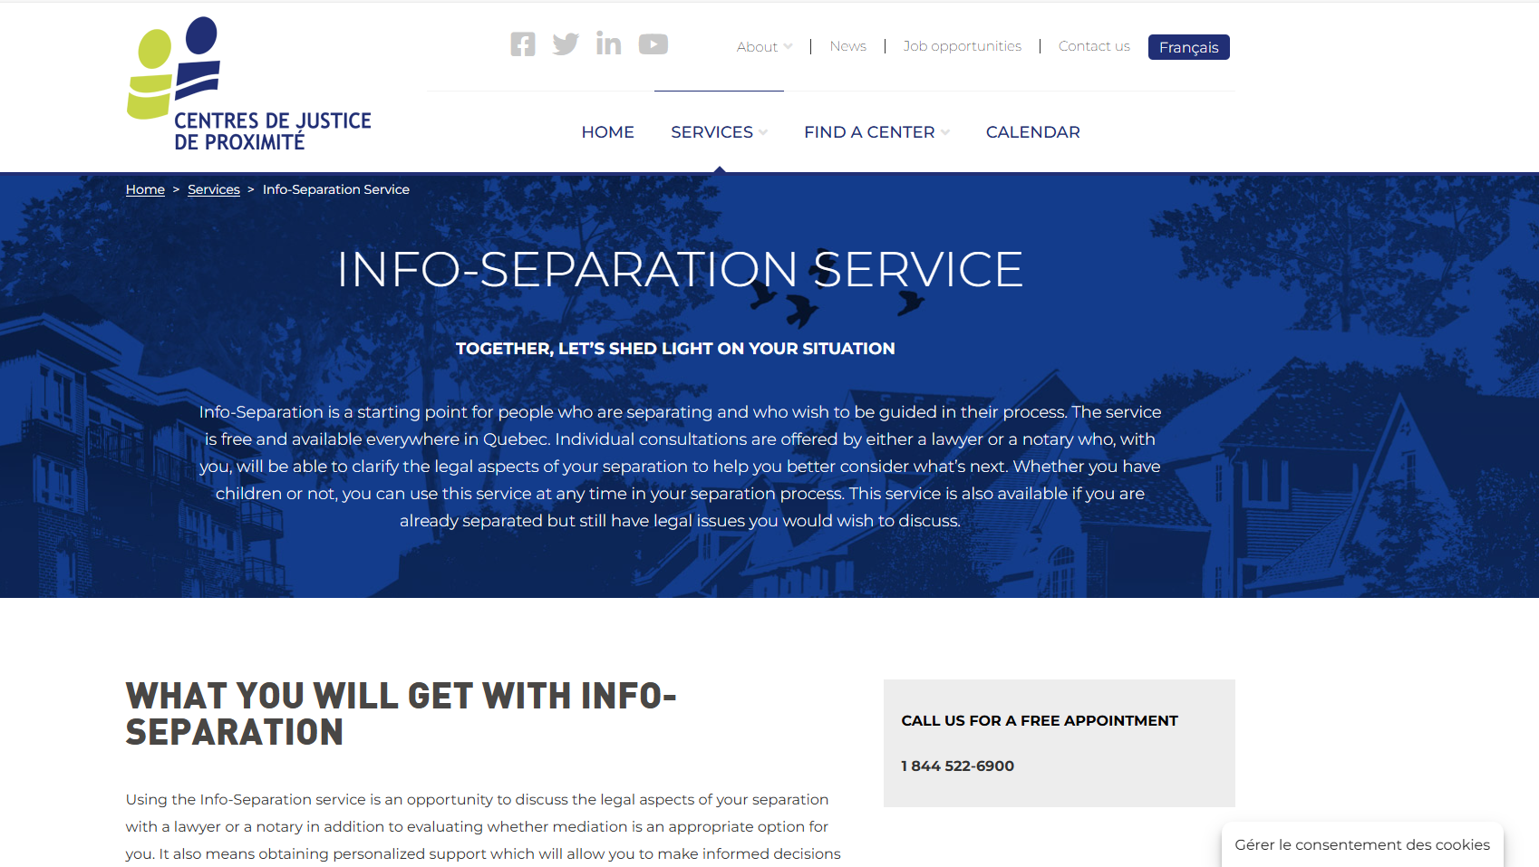
Finding help Community Justice Centers
Info-Separation
Service
Free legal information
Info-Separation Service - Centres de justice de proximité l Centres de justice de proximité
Notes:
1 minute​
Instructions​
Explain that this resource is available to participants if they encounter legal issues related to their life as a couple. The "Info-Separation" service of the Community Justice Centers (CJP) offers free legal consultations with lawyers or notaries to ask legal questions related to separation.
​
To contact them: Contact us - Centres de justice de proximité l Centres de justice de proximité

Slide 11
Finding help Inform'elle (French only)
Free legal information in family law
1-877-443-8221
https://informelle.org/
Notes:
1 minute
Instructions
Explain that this legal resource is available to the particpants if they wish to get information on the separation or divorce process: Inform'elle is a non-profit organisation whose mission is to make legal information in family law accessible and easy to understand.
To reach them: 1-877-443-8221 or write to droitpourelle@informelle.org

Slide 12
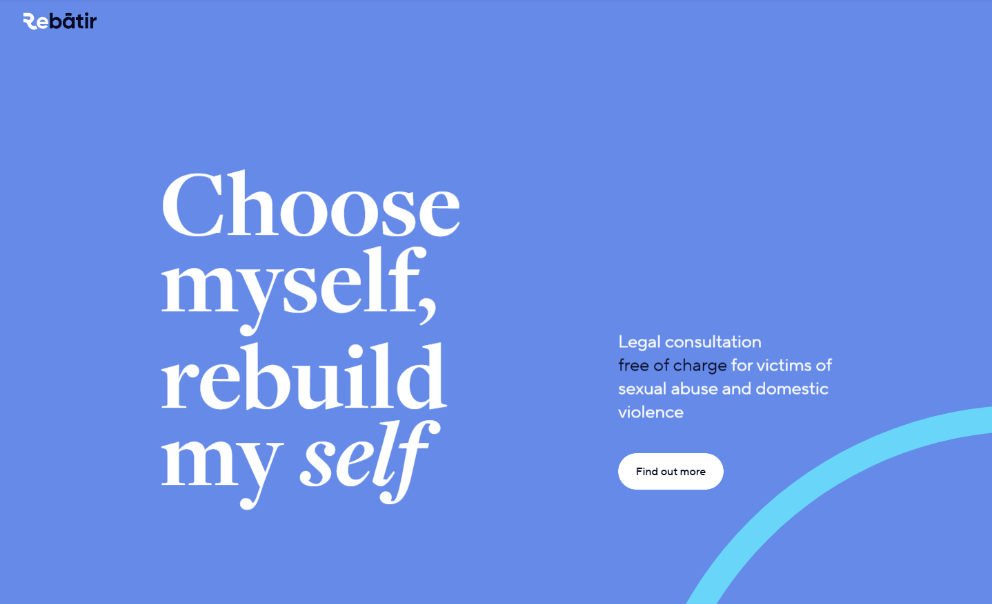
Finding help ReBâtir
4 hours of free legal consultation
1-833-732-2847
Rebâtir
Notes:
1 minute​
Instructions​
Explain that this resource is available to participants if they encounter legal issues related to their life as a couple. Rebâtir is the name of a legal consultation service provided by the Commission des services juridiques (legal aid). It offers 4 hours of free legal consultation to people who experience domestic or sexual violence in all areas of law.
To contact them: call 1-833-REBÂTIR (1-833-732-2847) or write to projet@rebatir.ca

Slide 13
Other resources
JuridiQC – tool to help with joint divorce (married couples without children)
Referral services from the Barreau du Québec
Association des médiateurs familiaux du Québec – Association of family mediators
Notes:
2 minutes
Instructions
Present the following resources.
Information to share
JuridiQC – Joint Divorce Help Tool: free tool to guide married couples without children who wish to go through the process together.
Referral services from the Barreau du Québec: this service offerred by the Quebec Bar helps you find a lawyer by legal filed, including family law.
Association des médiateurs familiaux du Québec – Find a mediator

Slide 14
Taking action What could Neha do?
Find her marriage certificate and make a copy
Check if she's eligible for legal aid
Notes:
3 minutes
Instructions for the workshop facilitator
Remind the participants about the scenario shared at the beginning of the workshop.
Ask participants to answer the following question:
Based on the information and resources we’ve discussed today, what options does Neha have?
Complete the participants’ answers by sharing some possible courses of action. Click to make these options appear on the screen.
Conclude with these four key messages:
Married couples who want a divorce in Quebec must go through court.
The costs and timeline for divorce vary widely. In some cases, divorce proceedings can be free or low-cost.
Unmarried couples don’t have to go to court to officially separate, but they may wish to do so to formalize (“homologate”) their agreement. They may also have to go to court if they cannot agree on certain issues or if they need urgent measures.
Mediation can help both married and unmarried couples reach an agreement without going to court.

Slide 15
Questions?
Notes:
1 minute​
Instructions for the workshop facilitator
Answer the participants’ questions.
If you have time, ask the following questions and write down the answers:
Did you enjoy the workshop? Why?
What new things did you learn?
Is the information shared in this workshop useful to you? In what situation will you use it?
Feel free to thank everyone for participating in the workshop, asking questions and sharing their perspective.

Slide 16
Éducaloi thanks the Maison Bleue and Femmes du Monde à Côte-des-Neiges for their valuable collaboration
This workshop was made possible with the support of

