Slide 1
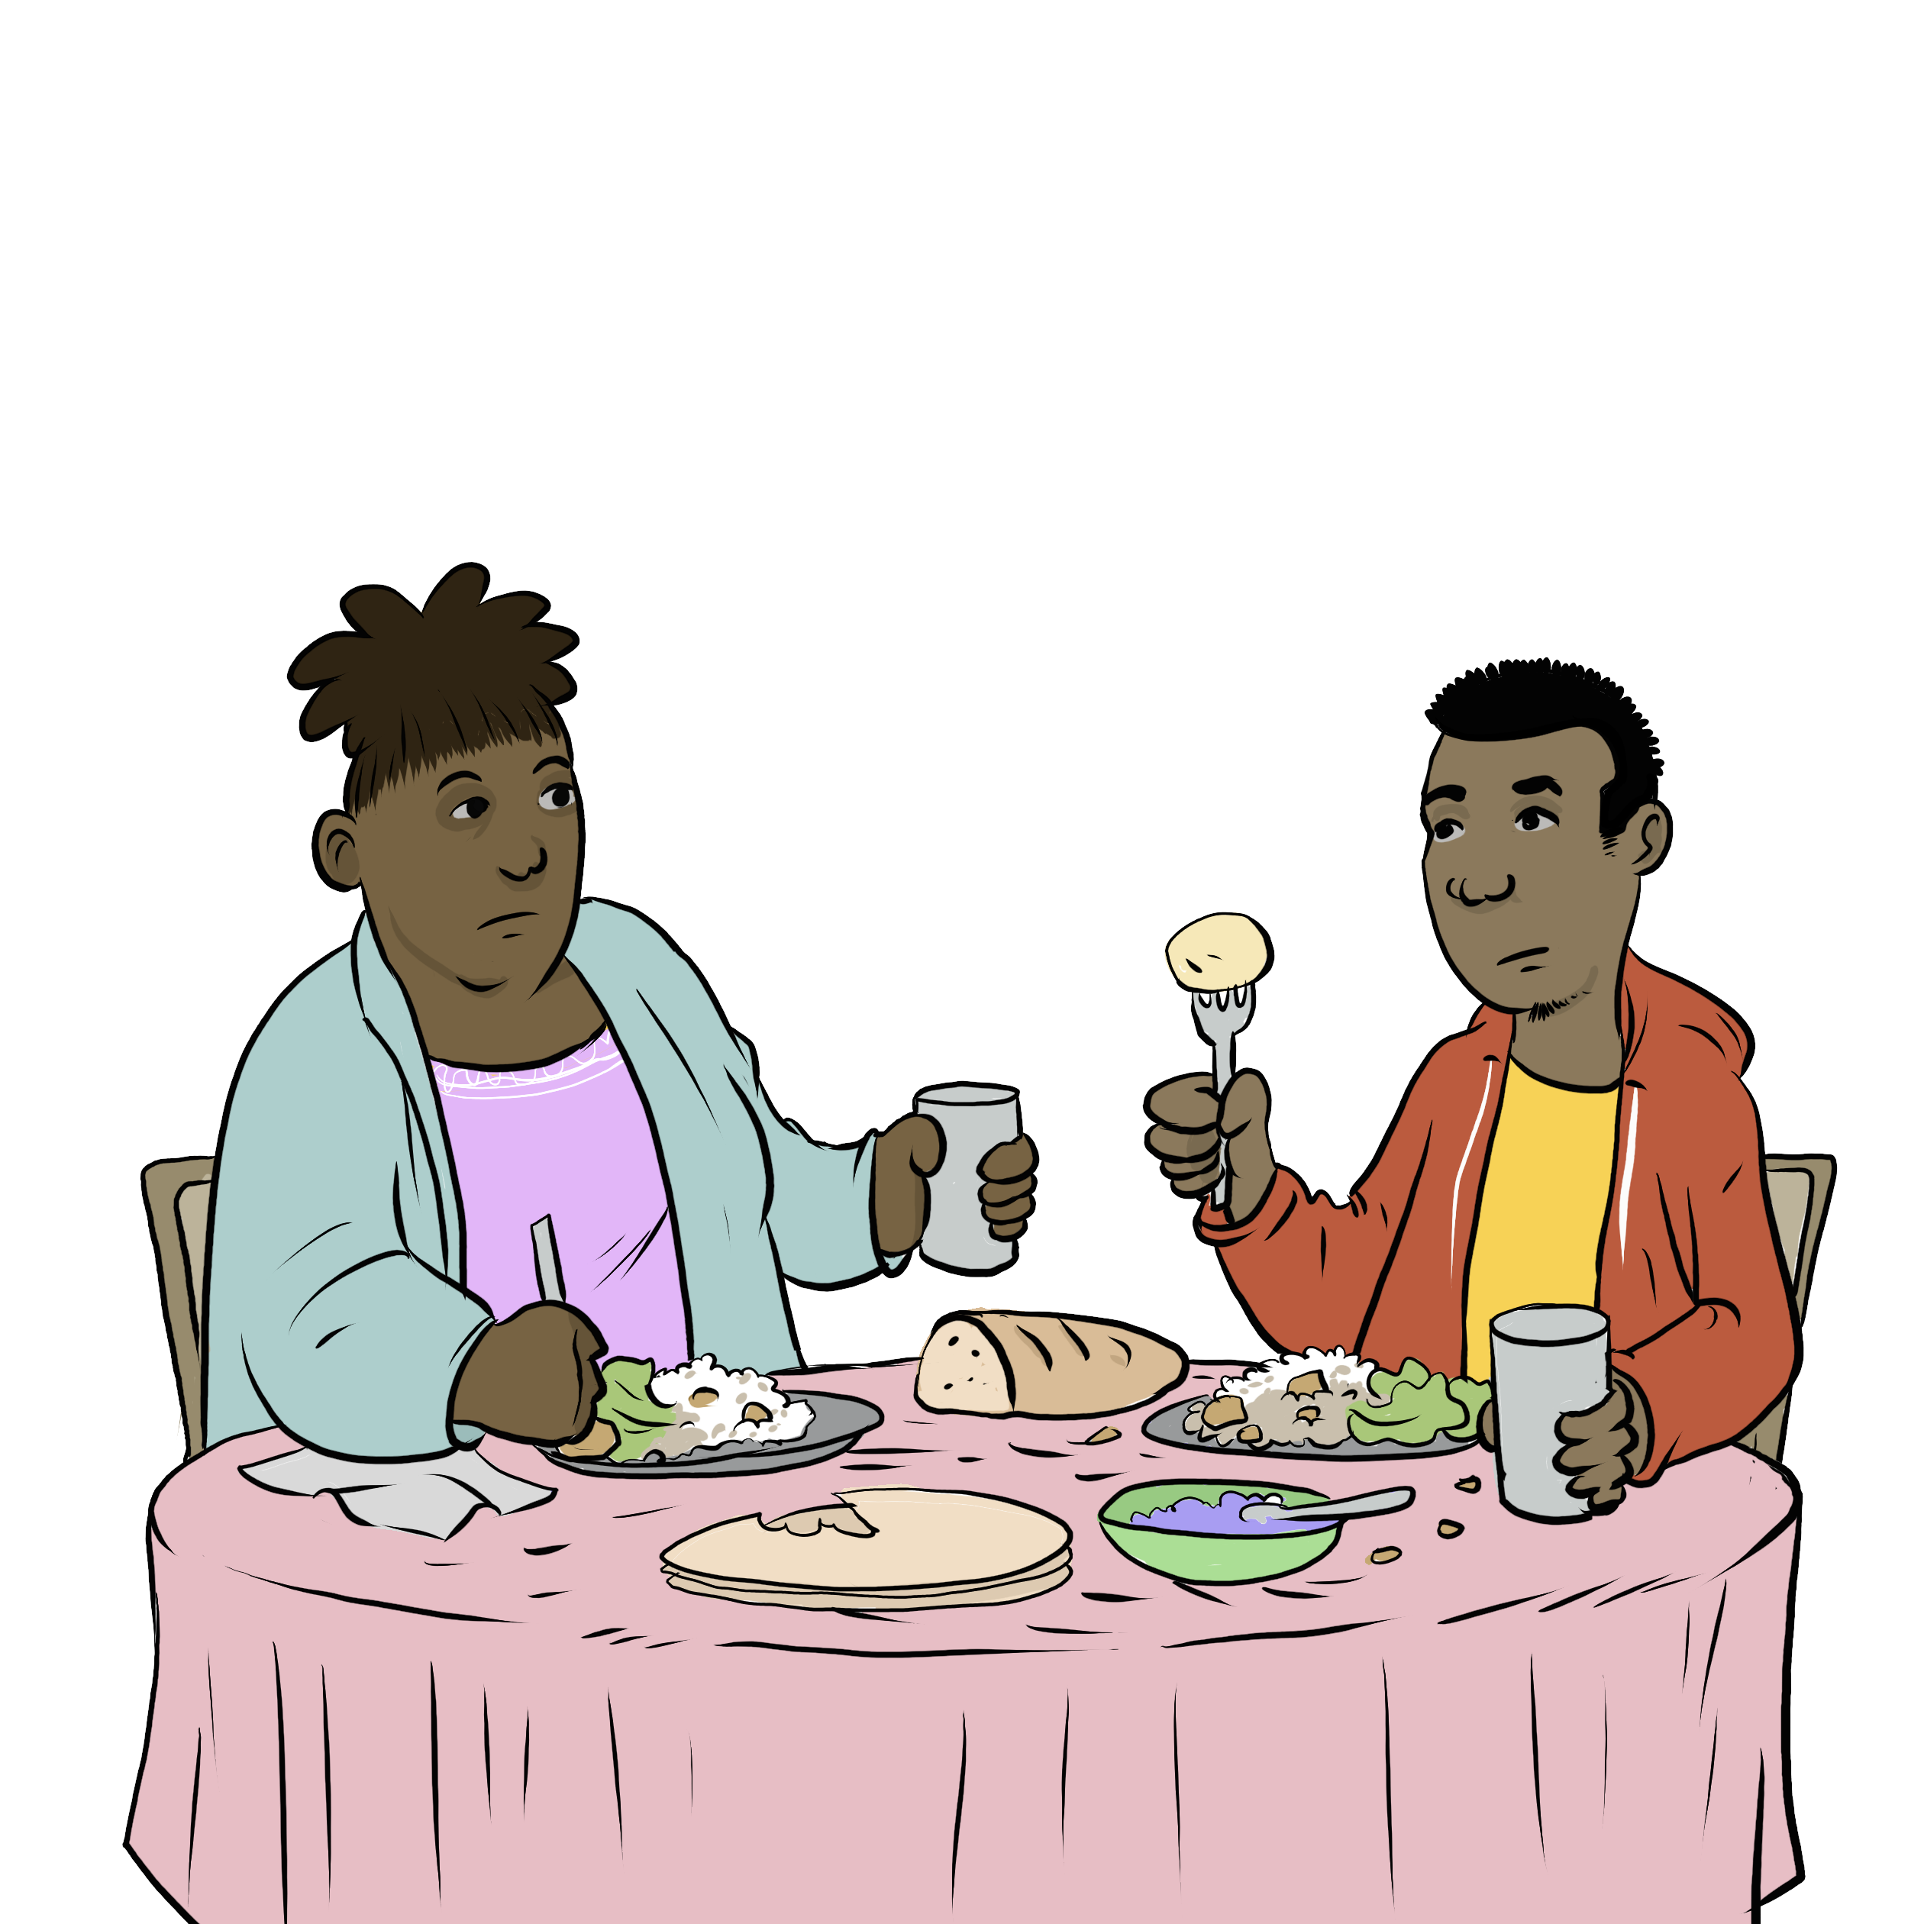
My Relationship

Slide 2
Notes:
Instructions for the workshop facilitator
To prepare to lead this workshop:
​
Read the Facilitator’s Guide.
Watch the associated videos.
Read the notes at the bottom of each slide.
Read the instructions for the workshop facilitator.
Go over the legal information that you will share with participants.
Read the additional information to deepen your understanding of the theme addressed in this workshop.
If you have time, read the notes at the bottom of each slide of the PowerPoint presentations for the other workshops. All the themes covered in the different workshops are connected. Your explanations during this workshop could bring up questions on topics discussed in other workshops.
Don’t forget to:
Arrange for an interpreter, if necessary.
Add local legal services and resources to the slides.
Combine this workshop with other psychosocial support activities, if necessary.
Take the time to address delicate situations that may arise during the workshop.
This workshop addresses issues relating to separation and violence. The participants have different experiences. Some may be comfortable with the possibility of separation, and others may be strongly opposed to it. Be mindful of this diversity of perspectives when setting the tone for the workshop.
Legal information contained in this activity is valid as of June 30th, 2025.
The information contained in this workshop applies only to Quebec and should not be considered legal advice.

Slide 3
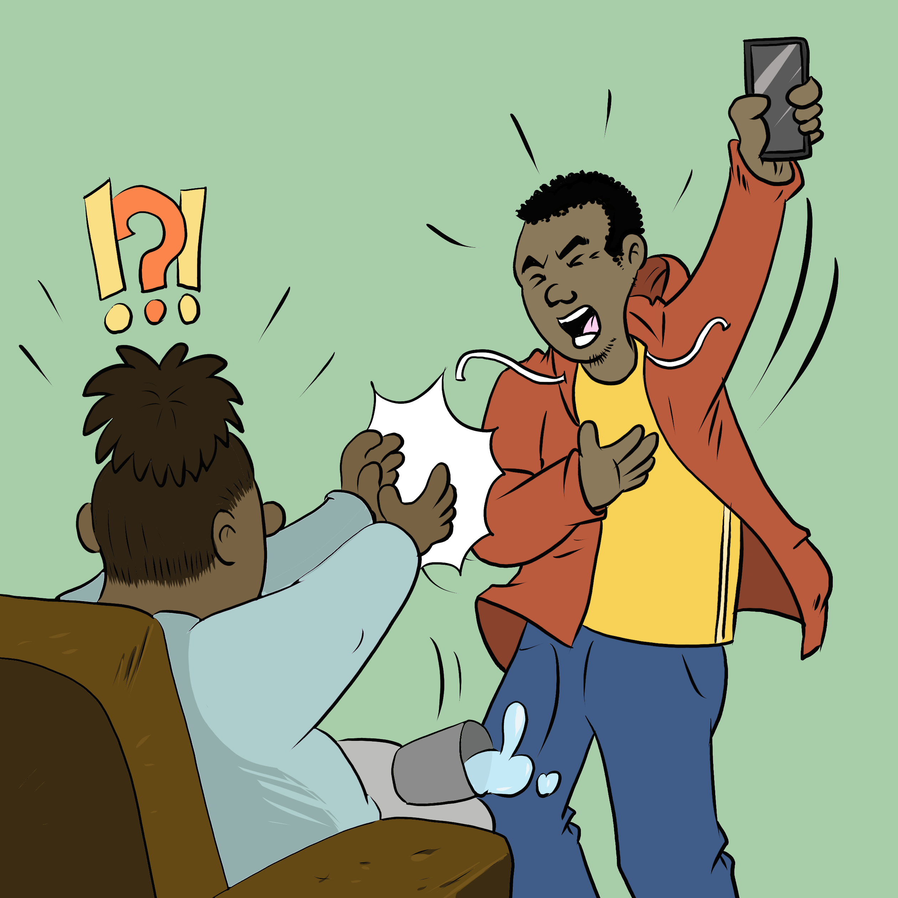
Examining the situation
What do you see here?
Notes:
3 minutes​
Instructions for the workshop facilitator
Before starting the workshop, mention that you are in a safe space where participants can express themselves freely and without judgment. The discussions that take place during the workshop are confidential.
Lead a discussion based on the following questions:
What is happening in this image?
What does this image tell us about the couple?
What more can you say about the situation if we assume that the woman wants to leave her husband or partner?
What more can you say about the situation if we assume that the woman has a precarious (uncertain) immigration status?
Summarize by repeating the key words that were mentioned by the participants and that are related to the topic of this workshop.

Slide 4

Understanding the legal issues
Marmarha's Story
"I do everything."​
"I'm lazy."​
"My cell phone isn't mine."​
"I don't have privacy."
Notes:
5 minutes​
Instructions for the workshop facilitator​
​
Read the following scenario aloud:
​
Marmarha is very tired. She spent the day at the hospital with her mother and came home to take care of the children, cook and clean. She feels like she takes care of everything. While she’s sitting on the couch after putting her children to bed, Marmarha’s husband comes in and tells her that she is nothing but lazy, that she has not finished washing the dishes yet. He suddenly takes her cell phone, tells her that it belongs to him because he is the one who pays the bills and starts looking at her text messages and emails. She does not like this.
Lead a discussion using the following questions
Have you ever experienced a similar situation?
What are the main concerns or issues in this situation?
What are the rights and responsibilities related to these concerns or issues?
What should Marmarha do to solve the problem?
​
Mention that you will share legal information to help the participants better understand the legal issues, rights and responsibilities involved in this scenario and that you will come back to the scenario at the end of this workshop. ​Let participants know you will be covering some basic legal rules. Acknowledge that everyone’s experience with the justice system is different and can be shaped by past challenges, as well as cultural and language barriers. Remind participants that the goal of the workshop is to inform them about their rights, so that they can make informed decisions and protect themselves.
Then explain the goal of this workshop: to know the rights and obligations of each person in a couple and recognize the signs of domestic violence.
Name the main topics that will be discussed: The rights and obligations of each person in a couple and the different types of domestic violence.

Slide 5


Life as a married couple in Québec : some obligations
Respect each other ​
Support + help each other
Making family decisions together
Taking care of the children together ​
Contributing to family tasks and expenses according to their capacities
Notes:
7 minutes​
Instructions for the workshop facilitator
Explain the information below by making connections with the scenario.
Information to share
In Quebec, spouses have rights and obligations within the couple. Both spouses have the same rights and obligations (for example, the law does not treat husbands and wives in a different way).
This means that:
Spouses must respect each other.
Spouses must support and help each other. For example, they must take care of one another if one spouse is sick.
Spouses run the family together and make decisions that concern the family together. For example, spouses who have children must make decisions about their health, education and religion together.
Spouses take care of the children together.
Each spouse contributes to family tasks and expenses (payments) according to their abilities. This contribution can take different forms: for example, one spouse can contribute through their salary, and the other, through household tasks.
Unmarried couples have the same rights and obligations as married couples regarding their children. For example, unmarried parents must make decisions regarding their children together.
Additional information
​Some of the obligations mentioned in this slide exist only for married people. For example, the obligations to respect, support and help one another are only explicitly recognized in law for married people (articles 392 and 394 of the Civil Code of Québec).
​​That said, other obligations exist for both married and unmarried couples, particularly when it comes to making decisions about children together (article 600 of the Civil Code of Québec).
​Also, even if the obligation to respect one another is not expressly stated in the law for unmarried couples, the absence of respect in a couple can lead to a situation of violence. The obligation to respect one's partner, even outside marriage, could also be inferred from the right to life, security and the protection of one's integrity (article 1 of the Charter of Human Rights and Freedoms).
​Sources​​
Civil Code of Québec, RLRQ, c C-1991, art 392 (duties of spouses: respect, help, assistance) ​
N. M. c. J.-C. F., 2004 CanLII 43019 (QC CS) aux paras 23, 24, 25 (illustration of duties to help and assist: caring for a sick husband or wife) ​
Civil Code of Québec, RLRQ, c C-1991, art 599, 600, 394 (duty to run the family together and make decisions about the children together + look after the children together) ​
Family Law - 192767, 2019 QCCS 5769 au para 69 (illustration of the duty to lead the family together and to make decisions about the children together: decisions about their health, education and religion) ​
Civil Code of Québec, RLRQ, c C-1991, art 396 (duty to contribute to family tasks and expenses according to one’s ability/contribution can take different forms, not necessarily financial)
Charter of human rights and freedoms, RLRQ c C-12, art 1 al 1 (the right to live in security and the right to protection of one’s integrity)

Slide 6
Without respect in the couple, there could be violence
Domestic violence goes beyond tensions in a couple
Power imbalance
Not necessarily physical
Notes:
5 minutes​
​
Instructions for the workshop facilitator
​
Explain the information below by making connections with the scenario.
Information to share
​
When a person does not respect their spouse or partner, there may be a situation of domestic violence (whether the couple is married or not).
Domestic violence goes beyond tensions in a couple. In a situation of violence, there is an imbalance of power between the two people in the couple (the person who acts violently takes control of their spouse or partner).
There are different types of domestic violence. It is not necessarily physical violence.
​
Some examples : ​
Psychological violence: isolating someone from those around them, ignoring them for days, pretending not to see them, etc.
Verbal violence: regularly criticizing or belittling someone, insulting them, yelling, etc.
Economic violence: controlling someone’s spending, taking away their ID or credit cards, forcing them to be financially dependent, not allowing them to work or study, etc.
Sexual violence: forcing someone to have sex or other sexual contact when they don’t want to, etc.
Physical violence: pushing someone, preventing them from sleeping, restricting their ability to move around (e.g. if the person is disabled), hitting a wall, etc.
Additional information
The list above is not exhaustive. Other types of violence can happen in a couple, including technological violence, judicial violence and coercive control.
If there are discussions about separation or divorce, mention that a person can decide to separate or divorce even if they have not experienced violence.
Sources​
​
Family Law — 163161, 2016 QCCS 6368 aux paras 31, 34 (lack of respect = possibly violence)​
Definition of Domestic Violence Gouvernement du Québec (domestic violence goes beyond tensions in a couple/is characterised by an imbalance of power)​
Formes of violence Gouvernement du Québec(forms of violence and examples)
Unmasking intimate partner violence — SOS violence conjugale

Slide 7
Where to find help?
Notes:
2 minutes​
​
Instructions​
​
In the following slides, you will find resources that you can present to participants. You can customize the workshop by adding slides presenting other relevant resources.
Feel free to print the slides with the resources.
Feel free to offer to help participants contact one of the mentioned resources or even to go with them if needed. You can also explore the websites together.
Mention that they can look at these resources even if they do not intend to leave their spouse or partner, or if they are still deciding what to do. They can consult these resources simply to inform themselves.

Slide 8

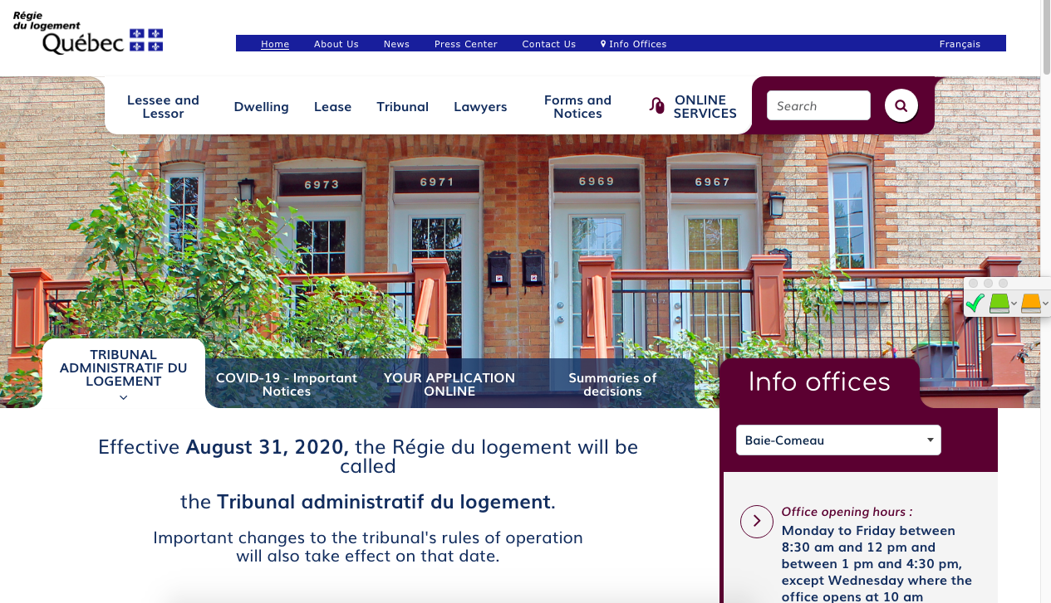

Finding help
(Name of the organisation)
(Short description of their service)
(Link to their website)
(Screenshot of the organisation's website)
Notes:
1 minute​
Instructions​
You can customize this slide if you want to add resources other than those presented in the following slides.

Slide 9

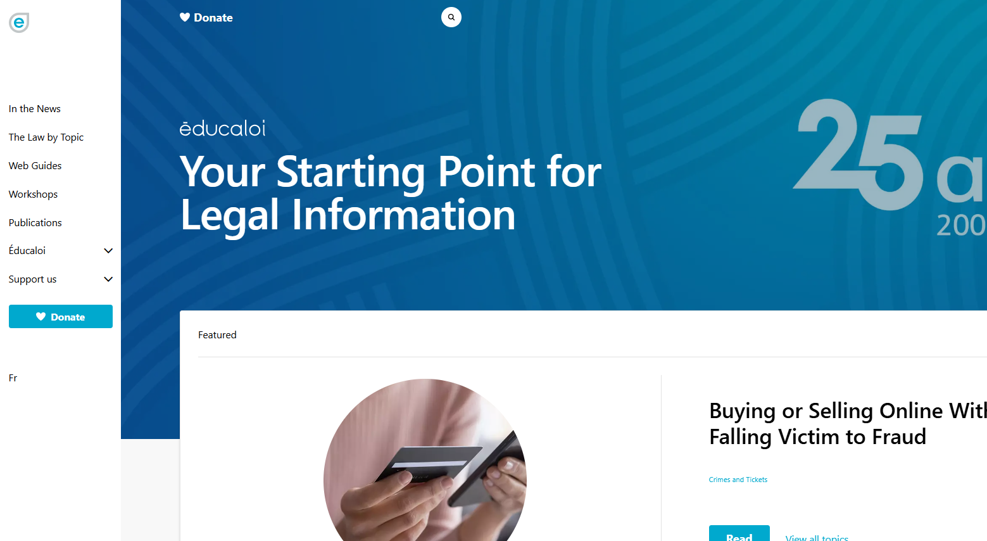

Finding help
Éducaloi
Free online legal information on:
Family, couples, separation and divorce
Housing
Work
Éducaloi - Your starting point for legal information
Notes:
1 minute​
Instructions​
Explain that Éducaloi is a non-profit whose mission is to explain the law in Quebec in a simple way. Éducaloi is especially known for its website that covers various legal topics, including family and couples, separation and divorce, housing, work and more. Most of Éducaloi's content is available in French and English.

Slide 10
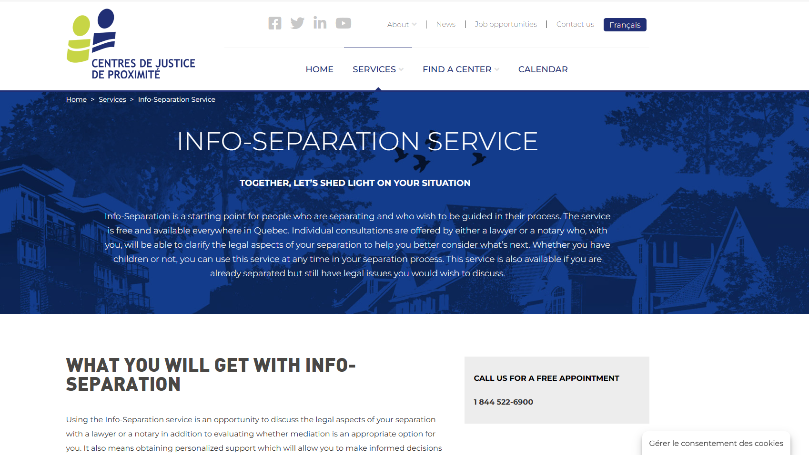
Finding help
Community Justice Centers
Info-Separation
Service
Free legal information
Info-Separation Service - Centres de justice de proximité l Centres de justice de proximité
Notes:
1 minute​
Instructions​
Explain that this resource is available to participants if they encounter legal issues related to their life as a couple. The "Info-Separation" service of the Community Justice Centers (CJP) offers free legal consultations with lawyers or notaries to ask legal questions related to separation.
​
To contact them: Contact us - Centres de justice de proximité l Centres de justice de proximité

Slide 11
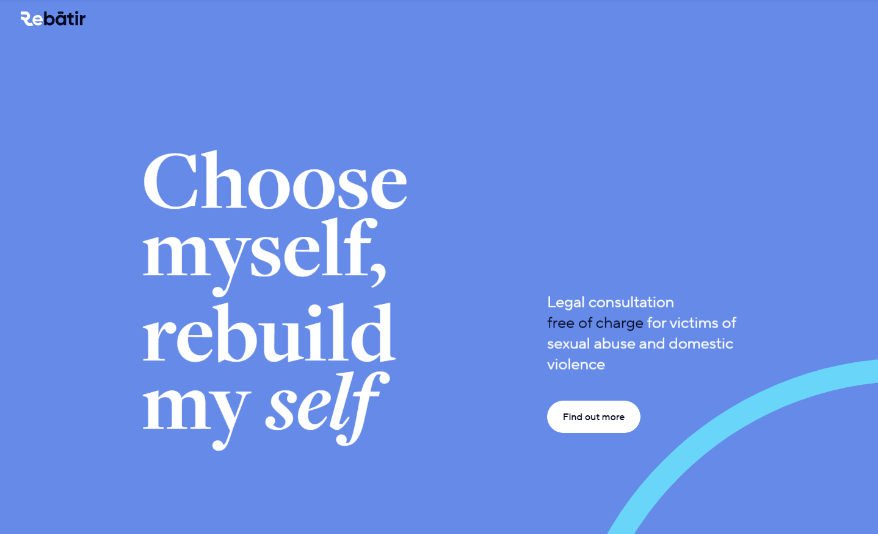
Finding help
ReBâtir
4 hours of free legal consultation
1-833-732-2847
Rebâtir
Notes:
1 minute​
Instructions​
Explain that this resource is available to participants if they encounter legal issues related to their life as a couple. Rebâtir is the name of a legal consultation service provided by the Commission des services juridiques (legal aid). It offers 4 hours of free legal consultation to people who experience domestic or sexual violence in all areas of law.
To contact them: call 1-833-REBÂTIR (1-833-732-2847) or write to projet@rebatir.ca

Slide 12
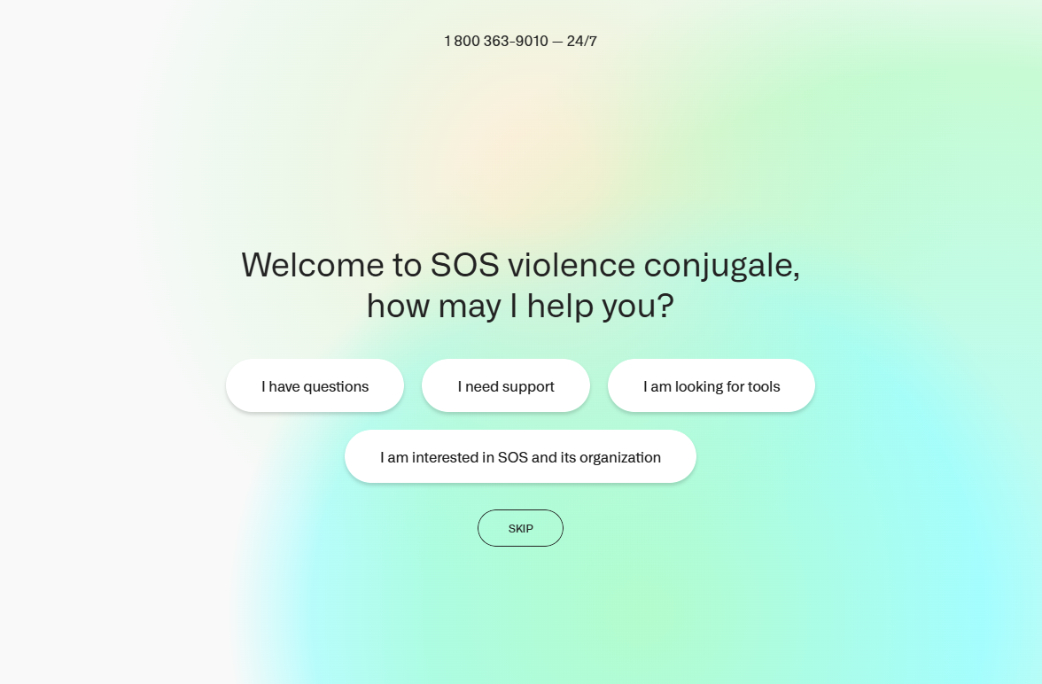
Finding help
SOS violence conjugale
Services for victims of domestic violence
1-800-363-9010
SOS violence conjugale
Notes:
1 minute​
Instructions​
Explain that this resource offers information, support and referral services to people who experience domestic violence. Their services are anonymous and confidential.
To contact them:
By phone: 1-800-363-9010 (24/7)
By email: sos@sosviolenceconjugale.ca
The organization also offers an online chat service: SOS violence conjugale: Webchat

Slide 13

Taking action
What could Marmarha do?
Choose an organisation to contact to explore options
Make a copy of important documents
Notes:
3 minutes​
Instructions for the workshop facilitator
​
Remind the participants about the scenario shared at the beginning of the workshop.
Ask participants to answer the following question:
In light of all the information and resources we have given you, what could Marmarha do?
Complete the participants’ answers by sharing some possible courses of action. Click to make these options appear on the screen.
Conclude with these three key messages:
Married and unmarried people have rights and obligations within the couple. In particular, they must respect each other.
In some cases, a person may experience violence from their spouse or partner. ​
Domestic violence is not necessarily physical. It can also be psychological or sexual, among others. There is no hierarchy between the different types of violence, all types are unacceptable. People who experience violence are never responsible for its consequences.

Slide 14
Questions?
Notes:
1 minute​
Instructions for the workshop facilitator
Answer the participants’ questions.
If you have time, ask the following questions and write down the answers:
Did you enjoy the workshop? Why?
What new things did you learn?
Is the information shared in this workshop useful to you? In what situation will you use it?
Feel free to thank everyone for participating in the workshop, asking questions and sharing their perspective.

Slide 15

Éducaloi thanks the Maison Bleue and Femmes du Monde à Côte-des-Neiges for their valuable collaboration
This workshop was made possible with the support of

