Slide 1
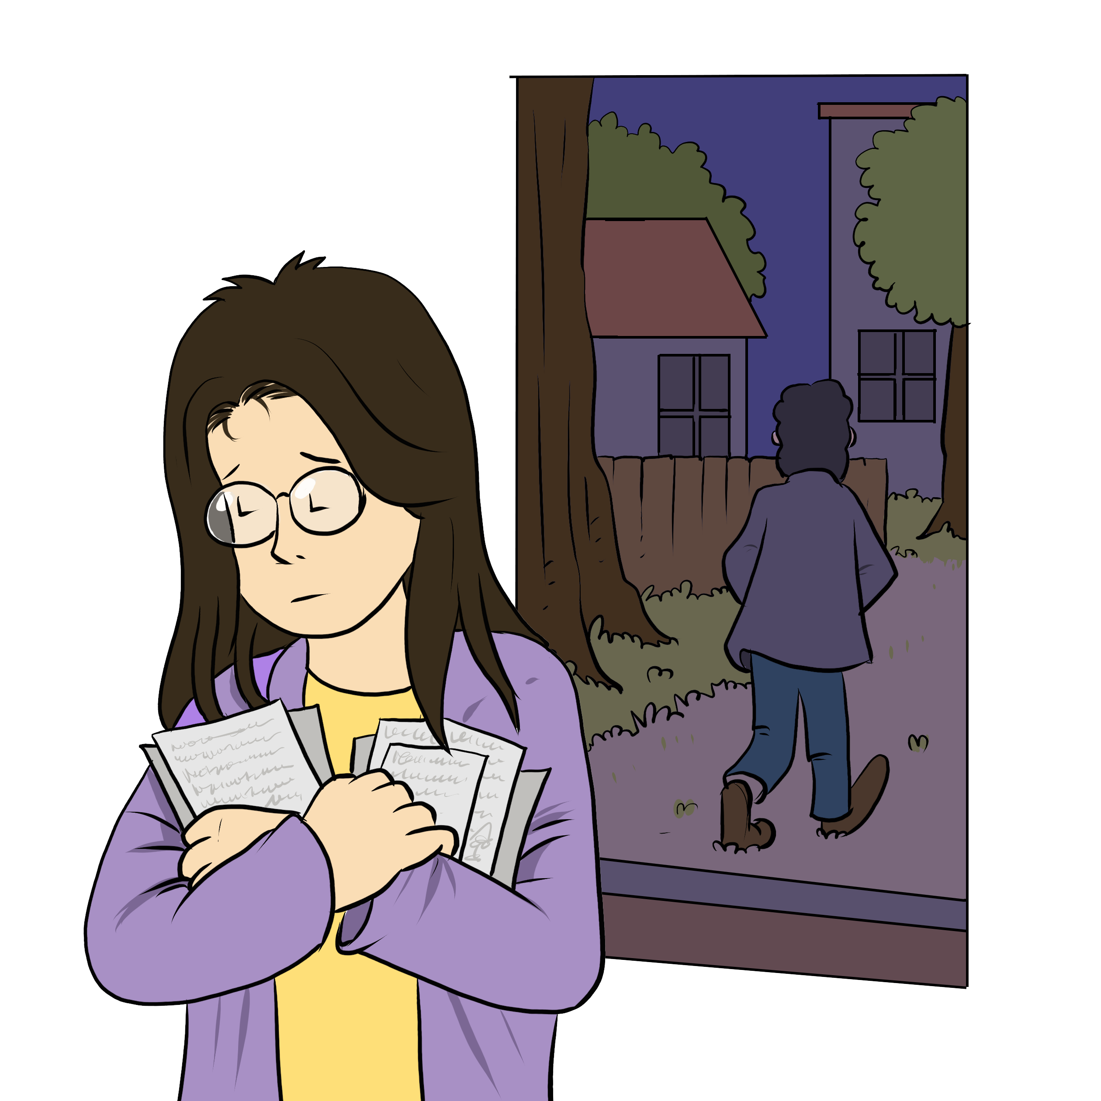
My Money
My Couple
Notes:
Instructions for the workshop facilitator​
​
To prepare to lead this workshop:​
​
Read the Facilitator’s Guide.​
Watch the associated videos.​
Read the notes at the bottom of each slide.​
Read the instructions for the workshop facilitator.​
Go over the legal information that you will share with participants.​
Read the additional information to deepen your understanding of the theme addressed in this workshop.​
If you have time, read the notes at the bottom of each slide of the PowerPoint presentations for the other workshops. All the themes covered in the different workshops are connected. Your explanations during this workshop could bring up questions on topics discussed in other workshops.​
​
Don’t forget to:​
Arrange for an interpreter, if necessary.​
Add local legal services and resources to the slides.​
Combine this workshop with other psychosocial support activities, if necessary.​
Take the time to address delicate situations that may arise during the workshop.​
This workshop addresses issues relating to separation and violence. The participants have different experiences. Some may be comfortable with the possibility of separation, and others may be strongly opposed to it. Be mindful of this diversity of perspectives when setting the tone for the workshop.​
​
Legal information contained in this activity is valid as of June 30th, 2025.​
The information contained in this workshop applies only to Quebec and should not be considered legal advice.

Slide 2
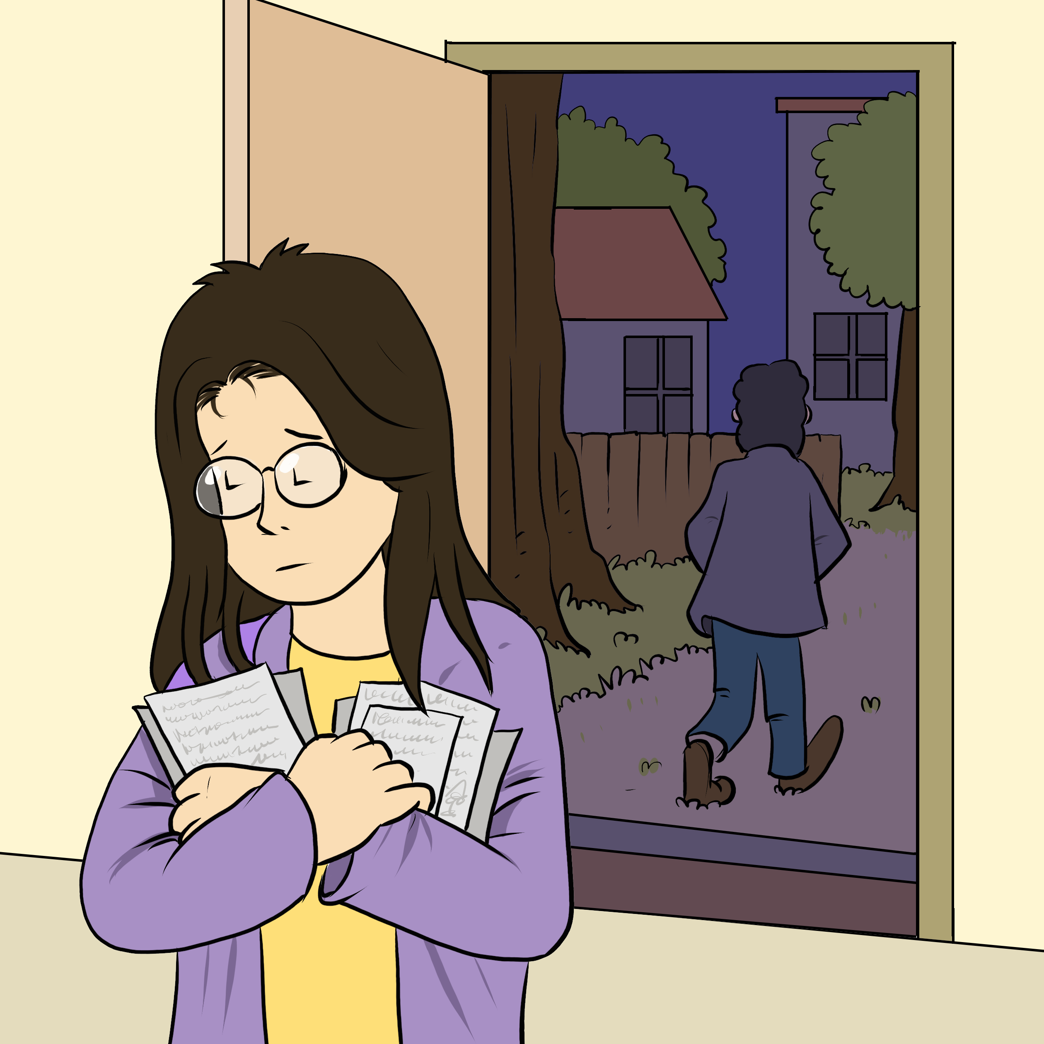
Examining the situation
What do you see here?
Notes:
3 minutes ​
Instructions for the workshop facilitator​
​
Before starting the workshop, mention that you are in a safe space where participants can express themselves freely and without judgment. The discussions that take place during the workshop are confidential.​
Lead a discussion based on the following questions:​
What is happening in this image?​
What does this image tell us about the couple?​
What more can you say about the situation if we assume that the woman wants to leave her husband or partner?​
What more can you say about the situation if we assume that the woman has a precarious (uncertain) immigration status?​
Summarize by repeating the key words that were mentioned by the participants and that are related to the topic of this workshop.​

Slide 3

Understanding the legal issues
Jennifer’s story
"I don’t have a job."
"He paid for everything."
"I want to leave him."
"I will not be able to pay all the bills on my own"
Notes:
5 minutes​
​
Instructions for the workshop facilitator​
​
Read the following scenario aloud:​
Jennifer has been living in Quebec with her partner and their 8 year old twins for a few months now. She still hasn’t been able to find a job, so her partner pays for everything. As for her, she takes care of the children and the housekeeping. However, her partner has been spending less and less time at home. Jennifer has had enough. She wants to leave him, but she's worried about money. She doesn’t know how she would be able to cover both her needs and her sons’ needs without a job.
Lead a discussion using the following questions​
Have you ever experienced a similar situation?​
What are the main concerns or issues in this situation?​
What are the rights and responsibilities related to these concerns or issues?​
What should Jennifer do to solve the problem?​
​​
Mention that you will share legal information to help the participants better understand the legal issues, rights and responsibilities involved in this scenario and that you will come back to the scenario at the end of this workshop. ​Let participants know you will be covering some basic legal rules. Acknowledge that everyone’s experience with the justice system is different and can be shaped by past challenges, as well as cultural and language barriers. Remind participants that the goal of the workshop is to inform them about their rights, so that they can make informed decisions and protect themselves. ​
​
Then explain the goal of this workshop: to know the rights and obligations of each person in a couple and recognize the signs of domestic violence.​
​
Name the main topics that will be discussed: The rights and obligations of each person in a couple and the different types of domestic violence.

Slide 4


Covering children’s expenses:
Child support
    Ask the other parent for money
    Amount is calculated based on income, number of children, children’s needs and how much time the children spend with each parent
    Usually deducted automatically each month from the salary
Notes:
5 minutes
Instructions for the workshop facilitator​
​
Explain the information below by making connections with the scenario.
Information to share
Parents must help meet their children’s basic needs. This includes food and financial support.
If the parents separate or divorce, one parent may have to pay money to the other to help cover basic expenses for the children (food, care, clothing, activities and others.) This is true both for married parents and unmarried couples. The amount one parent receives from the other for the children is called child support.
The amount is calculated based on each parent’s financial situation, the children’s needs, the number of children and how much time the children spend with each parent. The law establishes a specific way of calculating it [6].
For example, if the mother has no job while the father has a stable and high income, he might have to pay child support. In Jennifer’s case, she has no job and her husband is the one paying for everything. If they separate, she can ask him for child support for their son.
The parents can agree on the amount (with or without the help of a mediator).
Either parent can also ask the court to set the amount or to formalize the agreement the parents made together. In both cases, Revenu Quebec will usually deduct the support amount from the salary of the parent who must pay it. Revenu Quebec will then give it to the other parent (usually twice a month). In other words, the parent receiving the support will not need to reach out to the other parent every month to collect the money.
Additional information
Child support is also discussed in the workshop titled «My Children».
The Child Support Payments Calculation tool on the government's website helps calculate the child support. It can be used by a parent who wants to get a better idea of the amount of child support they might receive if they go to court after a seperation. However, the court has the final say ; a judge could set a different amount depending on the situation.
For more information on family mediation, you can read this Educaloi article : La médiation familiale en six étapes | Éducaloi (educaloi.qc.ca)
Sources
[1] Code civil du Québec, RLRQ, c C-1991, art 585.
[2] Code civil du Québec, RLRQ, c C-1991, arts 585, 587.2.
[3] Code civil du Québec, RLRQ, c C-1991, arts 522, 585.
[4] Code civil du Québec, RLRQ, c C-1991, arts 589.
[5] Code civil du Québec, RLRQ, c C-1991, art 587 ; Règlement sur la fixation des pensions alimentaires pour enfants, RLRQ c C-25.01, r 0.4, art 3.
[6] Règlement sur la fixation des pensions alimentaires pour enfants, RLRQ c C-25.01, r 0.4, art 3, Annexe I.
[7] Code de procédure civile, RLRQ, c C-25, art 72 al 2.
[8] Code de procédure civile, RLRQ, c C-25, arts 409, 411.
[9] Code de procédure civile, RLRQ, c C-25, art 72 al 2.
[10] Loi facilitant le paiement des pensions alimentaires, RLRQ, c P-2.2, arts 6, 7, 8, 11.
[11] Loi facilitant le paiement des pensions alimentaires, RLRQ, c P-2.2, art 36 al 1.
[12] Loi facilitant le paiement des pensions alimentaires, RLRQ, c P-2.2, art 36 al 1.

Slide 5
Spousal support (married couples)
    Not the same as child support
    Becoming financially independent is the end goal
    Amount and duration depend on the situation
    A court can decide if the parent qualifies
Notes:
5 minutes
Instructions​
​
Explain the information below by making connections with the scenario.
Information to share
When a married couple separates or gets divorced, one spouse can ask the other for spousal support. That is different from child support. Spousal support is used to :
cover a spouse’s needs until they can become financially independent.
prevent one spouse from experiencing financial hardship because of the divorce.
Spousal support can be paid in multiple ways. For example, it can be done in regular payments (for example, $200 a month), or in a one-time payment (for example, $20,000).
If someone wants to ask their ex-spouse for child support, the two of them can agree on an amount. They could also ask for help : for example, they can get help from a person called a «mediator» or «family mediator» if that applies to their situation.
This person will help them reach a solution.
Parents are usually eligible for free mediation hours.
They can also choose a mediator that speaks their mothertongue. For example, some mediators speak spanish, arabic and italian.
A person that wants spousal support can also ask the court. The judge will then decide whether they quality or not. The judge will also determine the amount and duration of the spousal support.
Unmarried couples that seperate («common-law partners») can’t ask for spousal support. However, there might be other ways for them to obtain financial support.
Additional information
A divorce judgement can take many months, or even more. However, someone can ask for the judge to make a temporary decision.
The judge will consider many things when deciding whether someone qualifies for spousal support in the context of a divorce. For example, he will consider these factors :
the financial needs of each spouse
their financial resources and situation
how long they lived together
their respective roles during the marriage
If a spouse can’t afford to pay both child support and spousal support, child support takes priority.
It is generally not recommended to use mediation when there was violence between the people in conflict[25]. That said, some mediators specialize in mediation in the context of domestic violence. To find them, the person can go to the Association des médiateurs familiaux du Québec’s website (association of family mediators) and click on “Find a mediator.” They can then select “Violence familiale et conjugale” (family and domestic violence) under the “Champ(s) d’expertise(s)” field.
Sources
[1] Loi sur le divorce, LRC (1985), art 15.2 (1) et (2).
[2] Loi sur le divorce, LRC (1985), art 15.2 (6) d).
[3] Loi sur le divorce, LRC (1985), art 15.2 (6) c).
[4] Loi sur le divorce, LRC (1985), art 15.2 (1)
[5] Loi sur le divorce, LRC (1985), art 15.2 (1)
[6] Loi sur le divorce, LRC (1985), art 15.2 (4) c)
[7] Code de procédure civile, RLRQ, c C-25, arts 605 al 2, 616.
[8] Code de procédure civile, RLRQ, c C-25, art 605 al 2, 616.
[9] Code de procédure civile, RLRQ, c C-25, art 619 ; Règlement sur la médiation familiale, c. C-25-01, r. 0.7, art.10.1.
[10] Loi sur le divorce, LRC (1985), art 15.2 (1).
[11] Loi sur le divorce, LRC (1985), art 15.2 (2).
[12] Loi sur le divorce, LRC (1985), art 15.2 (4).
[13] Loi sur le divorce, LRC (1985), art 15.2 (4).
[14] Loi sur le divorce, LRC (1985), art 15.3(1).
[15] Par exemple : 13 questions sur le droit familial en contexte de violence conjugale — SOS violence conjugale

Slide 6
Asking for social assistance
    Last resort financial aid
    Income and savings must fall below a certain amount
    All other financial resources must be used first
    Avalaible even to non-citizens
Notes:
3 minutes
Instructions
Explain the information below by making connections with the scenario.
Information to share
Some governement programs offer financial support to people whose income and savings don’t cover their basic needs. This is called social assistance (welfare).
The eligibility requirements will be different depending on the program. Usually, a person will be eligibile to social assistance if :
They have little or no income or liquid assets,
They have exhausted all other financial resources. For example, if they get separated and have children, they first must ask the other parent for child support.
Someone can receive amounts under the social assistance program even if they are not a Canadian citizen. For example, permanant residents, refugees and asylum seekers may be eligible for social assistance. People without legal status may also receive social assistance in certain emergency situations.
To apply for social assistance, people can visit the Government of Quebec website. Before applying, they can use the SimulAide tool on the Emploi Québec website to see if they might qualify.
Additional information
Even if you get child support from your ex, you can still be eligibile for social assistance. You could actually get both social assistance and child support. It will depend on your situation.
When it comes to social assistance, the rules apply to permanent residents that have been sponsored. If a permanent resident separates after being sponsored by their spouse or partner, the spouse or partner must keep supporting them for three years from the date when they became a permanant resident (even if they no longer live together). During that time, the permanent residence usually is not eligible to social assistance. However, there are two exceptions. The permenant resident can apply for social assistance if :
their sponsor refuses to provide for them, or
living with them becomes insufferable (domestic violence).
The sponsor would then have to reimburse the State.
If your application for social assistance gets declined, you can contest this decision. For more information, read our article : Contesting a Decision Regarding Social Assistance (Welfare) | Éducaloi
For more information on access to social services, read our guide : Immigration Status and Social Services | Printable Guide | Éducaloi
Sources
[1] Loi sur l’aide aux personnes et aux familles, RLRQ c A-1311, arts 1, 2.
[2] Loi sur l’aide aux personnes et aux familles, RLRQ c A-1311, art 63 al 1.
[3] Loi sur l’aide aux personnes et aux familles, RLRQ c A-1311, art 63 al. 1.
[4] Loi sur l’aide aux personnes et aux familles, RLRQ c A-1311, art 26 al. 1 au para 3.
[5] Loi sur l’aide aux personnes et aux familles, RLRQ c A-1311, art 26 al. 1 para 4; Règlement sur l’aide aux personnes et aux familles, RLRQ c A-1311, r 1, art 47.
[6] Règlement sur l’aide aux personnes et aux familles, RLRQ c A-1311, r 1, art 47.
[7] Loi sur l’aide aux personnes et aux familles, RLRQ c A-1311, art 49.
[8] Règlement sur l’aide aux personnes et aux familles, RLRQ c A-1311, r 1, art 111 (21).
[9] Loi sur l’immigration au Québec, RLRQ c I-021, art 22, 23, 24.
[10] Loi sur l’immigration au Québec, RLRQ c I-0.2.1, art 22, 23, 24 ; Règlement sur l’immigration au Québec, chapitre I-021, r 3, art 68.
[11] Loi sur l’aide aux personnes et aux familles, RLRQ c A-1311, art 48 al 1 ; Comprendre les responsabilités et les obligations liées à l’engagement | Gouvernement du Québec (quebec.ca)
[12] Loi sur l’aide aux personnes et aux familles, RLRQ c A-1311, art 48 al 1 ; Comprendre les responsabilités et les obligations liées à l’engagement | Gouvernement du Québec (quebec.ca)
[13] Comprendre les responsabilités et les obligations liées à l’engagement | Gouvernement du Québec (quebec.ca)

Slide 7
Where to find help?
Notes:
2 minutes ​
​
Instructions ​
​
In the following slides, you will find resources that you can present to participants. You can customize the workshop by adding slides presenting other relevant resources. Don’t hesistate to explore their websites together.​
Don’t hesitate to mention that you can help the participants contact one of the mentioned ressources, and even go with them if needed.​
Mention that they can look at these resources even if they do not intend to leave their spouse or partner, or if they are still deciding what to do. They can consult these resources simply to inform themselves.

Slide 8

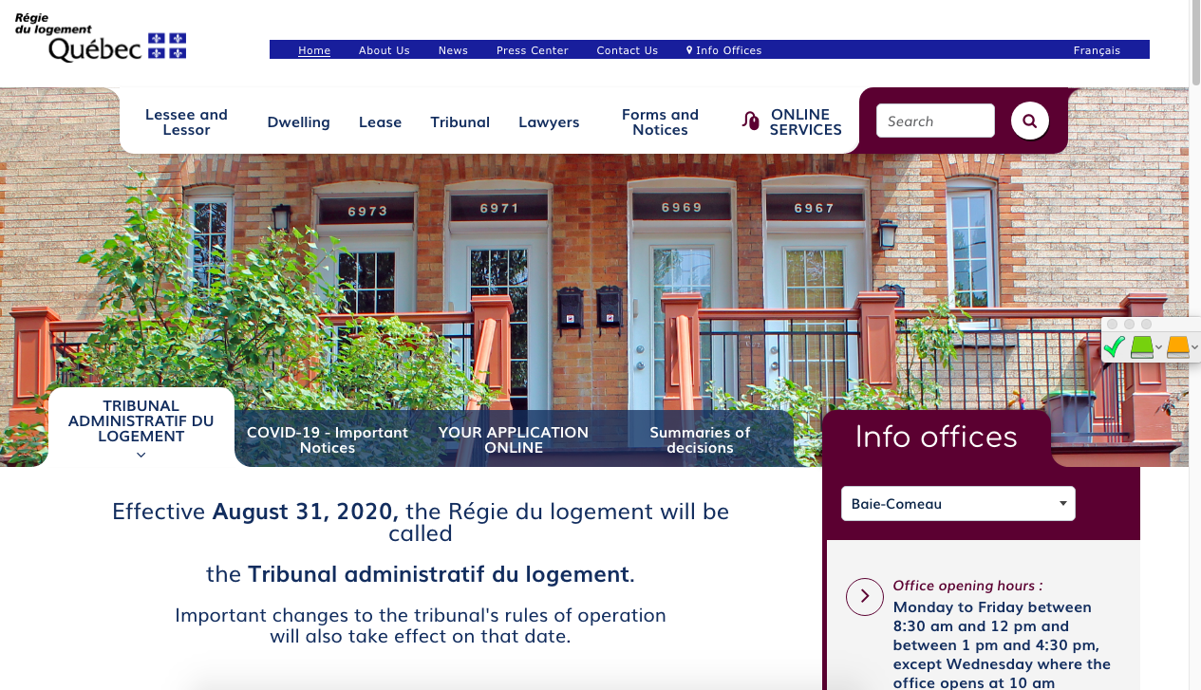

Finding help
(Name of the organisation)
(Short description of the service)
(Link to their website)
(Screenshot of the organisation’s websiite)
Notes:
1 minute​
Instructions​
You can customize this slide if you want to add resources other than those presented in the following slides. ​

Slide 9


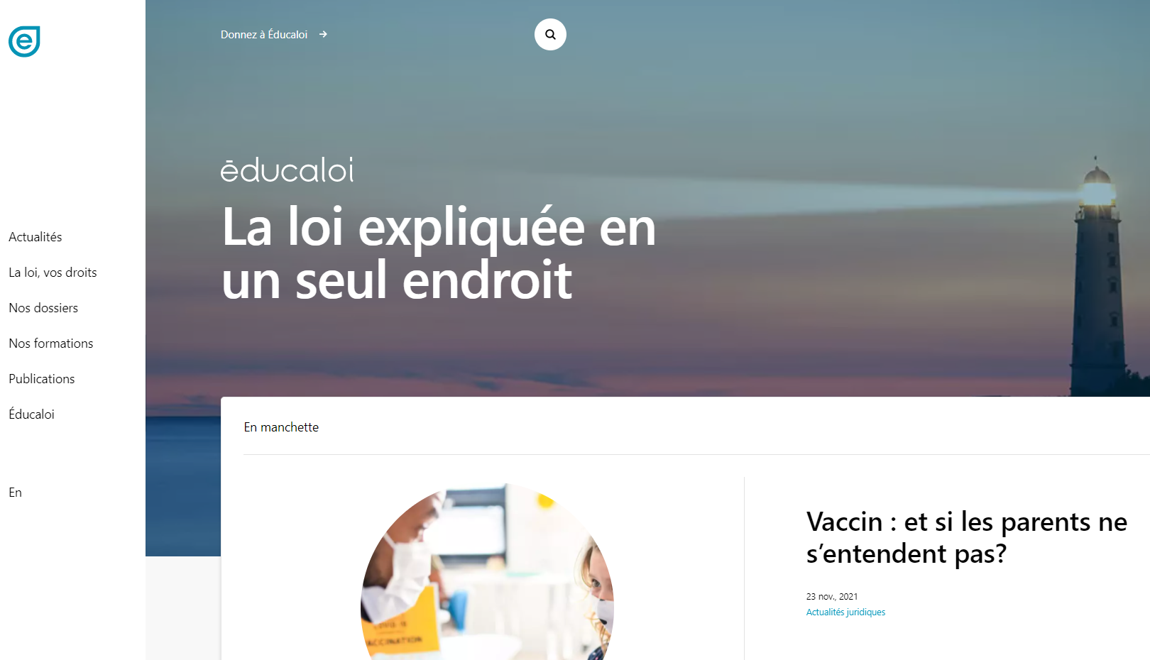

Finding help
Éducaloi
Free online legal information on :
:
Family, couples, seperation and divorce
Housing
Work
Éducaloi - Your starting point for legal information
Notes:
1 minute​
Instructions​
Explain that Éducaloi is a non-profit whose mission is to explain the law in Quebec in a simple way. Éducaloi is especially known for its website that covers various legal topics, including family and couples, separation and divorce, housing, work and more. Most of Éducaloi's content is available in French and English.

Slide 10
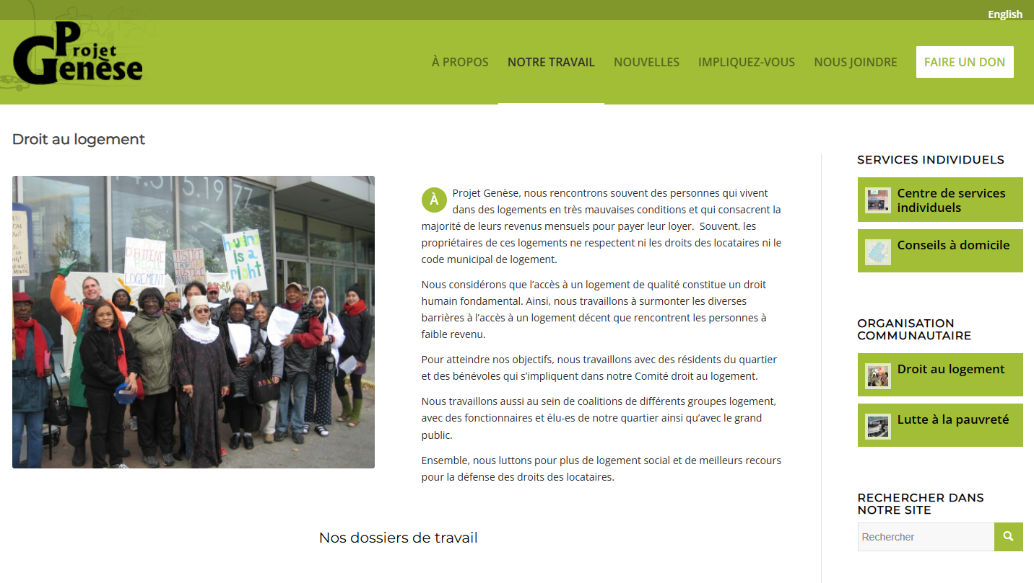
Finding help
Project Genesis
Free legal information:
housing
social assistance
pensions and family allowance
514-738-2036
https://genese.qc.ca/fr/pg/droit-au-logement/
(Capture d'écran du site web de l'organisme)
Notes:
1 minute​
Instructions​
Explain that participents can reach out to this resource if they have questions on housing, social assistance, pensions or family allowances.
To contact them: 514-738-2036

Slide 11

Finding help
L’Organisation Populaire des Droits Sociaux (OPDS)
Free legal information on social assistance
Support with some steps
514-527-0700 ou 514-322-5782
opdsrm.com
(Capture d'écran du site web de l'organisme)
Notes:
1 minute​
Instructions​
Explain to participants that they can reach out to this resource if they have questions on social assistance or would like to be supported with some steps related to social assiatance.
To contact them: Call the 514-527-0700 ou 514-322-5782 ou or write to info@opdsrm.com

Slide 12
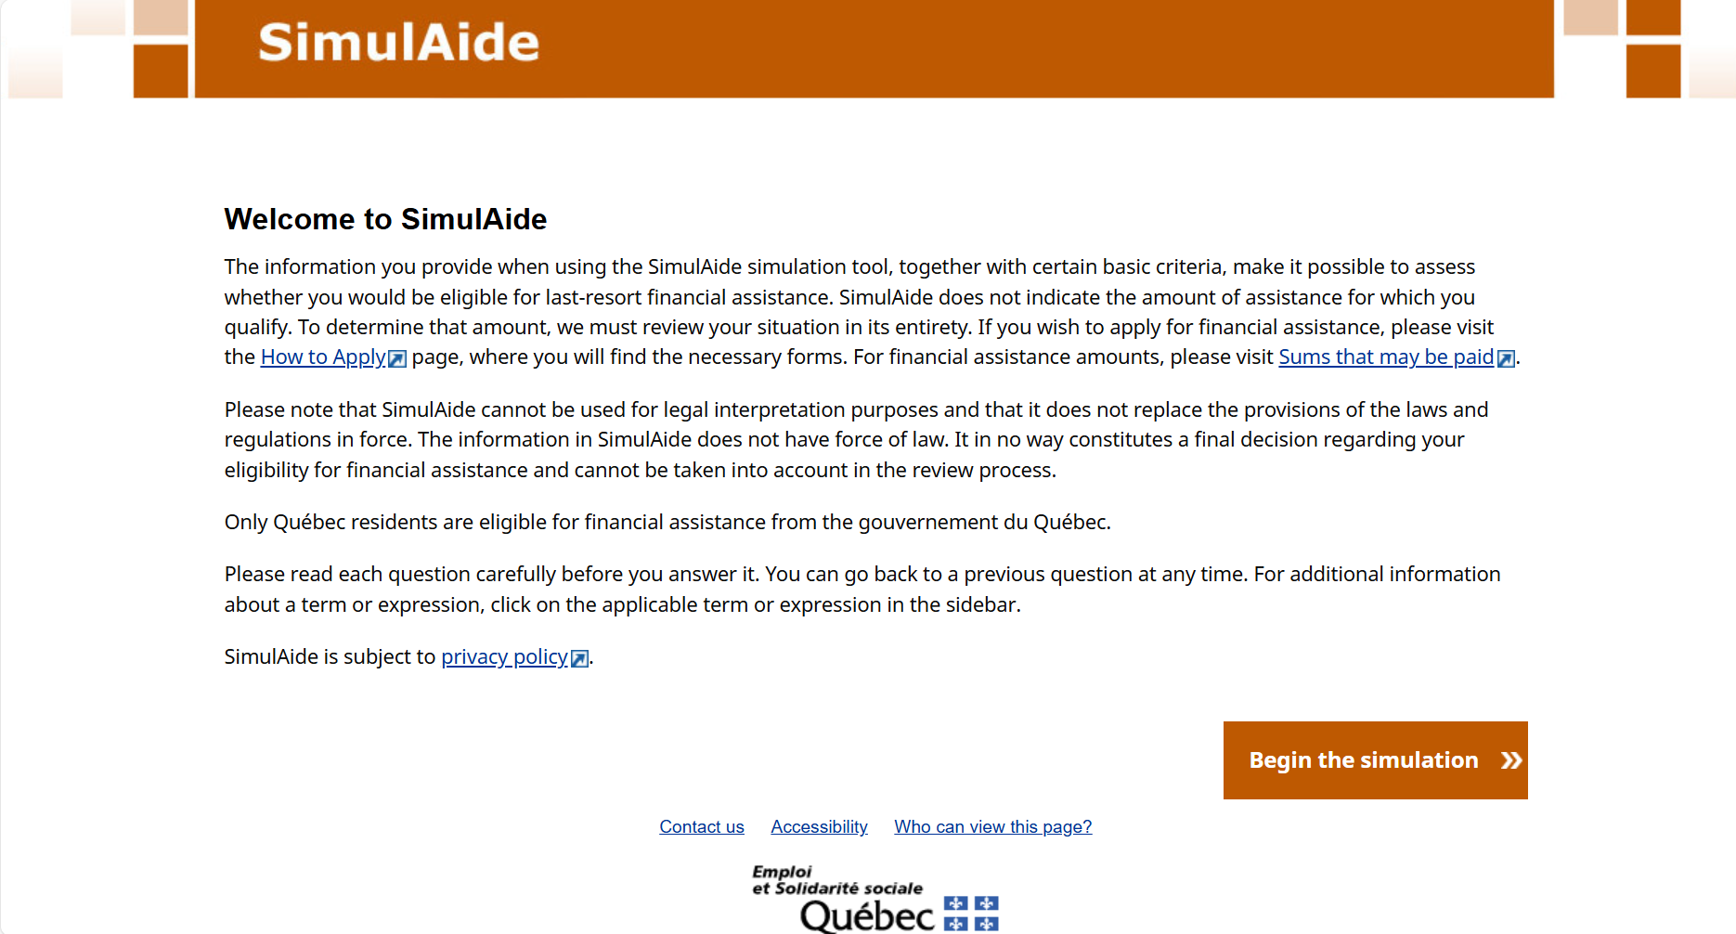
Finding help
SimulAide
Social assistance eligibility calculator tool
SimulAide
Notes:
1 minute​
Instructions​
Explain that this tool helps people see whether they might qualify for social assistance.

Slide 13
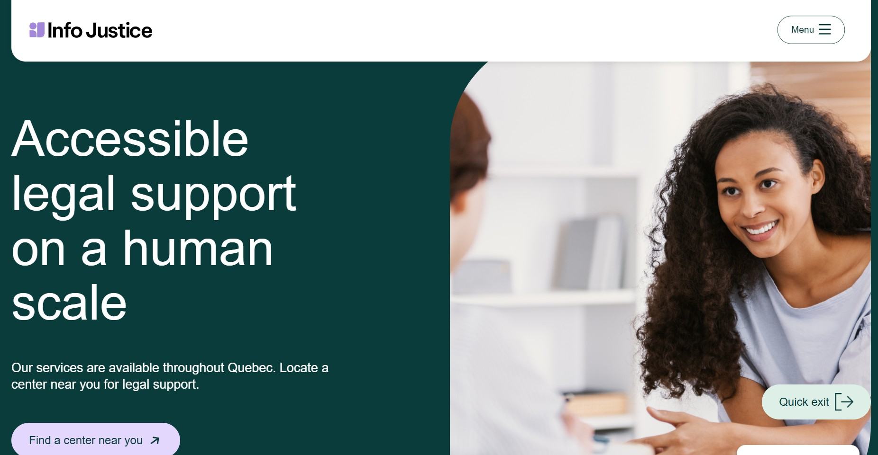
Finding help
Info Justice Centres
Info-Seperation Service
Free legal information
Separation Info - Info Justice
Notes:
1 minute​
Instructions​
Explain that this resource is available to participants if they encounter legal issues related to their life as a couple. The "Info-Separation" service of the Info Justice community centers offers free legal consultations with lawyers or notaries to ask legal questions related to separation.
​
To contact them: https://info-justice.ca/en/services/separation-info/

Slide 14

Finding help
ReBâtir
4 hours of free legal consultation
1-833-732-2847
Rebâtir
Notes:
1 minute​
Instructions​
Explain that this resource is available to participants if they encounter legal issues related to their life as a couple. Rebâtir is the name of a legal consultation service provided by the Commission des services juridiques (legal aid). It offers 4 hours of free legal consultation to people who experience domestic or sexual violence in all areas of law.
To contact them : Call 1-833-REBÂTIR (1-833-732-2847) or write to projet@rebatir.ca

Slide 15
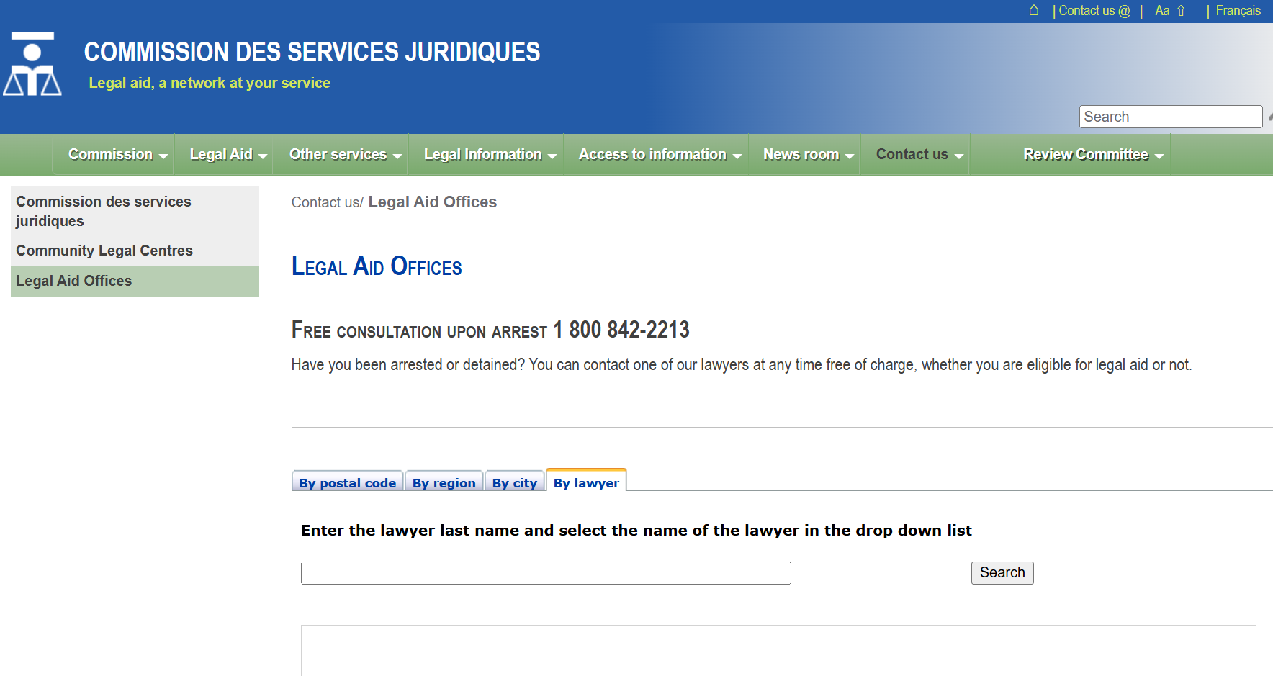
Finding help
Commission des services juridiques (legal aid)
Legal aid for free or at low cost
Legal Aide Offices and Lawyers
Notes:
1 minute
Instructions
Explain that this legal resources is avalaible to the participants if they face legal issues related to immigration : Expliquez que cette ressource juridique est à la disposition des participantes si elles rencontrent des enjeux juridiques liés à l'immigration : the Commission des services juridiques (legal aid) provides services for free or at low cost with the help of lawyers for people eligibile to legal aid. The Commission also offers legal services related to social security.
Pour trouver un bureau d'aide juridique : Bureaux et avocats de l’aide juridique (csj.qc.ca)

Slide 16
Other resources
    ACEF
    Répertoire des médiateurs familiaux du Québec (a list of family mediators in Quebec)
    Service d’Interprète d’Aide et de Référence aux Immigrants (SIARI)
    Francisation Québec
    Quebec.ca - Social Assistance and Social Solidarity
Notes:
3 minutes
Instructions for the workshop facilitator
Introduce the resources below
Informations to share
ACEF : Assistance in managing. To find your local ACEF, simply reserach "ACEF" with the name of your region or municipality.
Association des médiateurs familiaux du Québec – Répertoire des médiateurs familiaux au Québec
Service d’Interprète d’Aide et de Référence aux Immigrants (SIARI) : Linguistic support for immigrants of all age (ex: free french courses, support in administrative procedures, computer courses, etc.). Their services are offered in more than 30 languages.
Francisation Québec : Free french courses offered by the government, in particular to successfuly integrate the job market in Quebec.
Quebec.ca - Social assistance and social solidarity : Part of the website that talks about social assistance.
Number for Montral region and surroundings : 514 873-4000
Number for other Quebec regions (no fees) : 1 877 767-8773

Slide 17

Taking action
What could Jennifer do?
Find a resource that can help calculate child support
Find a job search club near her place
Check whether she qualifies for social assistance
Notes:
3 minutes
Instructions
Remind the participants about the scenario shared at the beginning of the workshop.​
Ask participants to answer the following question:​
In light of all the information and resources we have given you, what could Jennifer do?​
Complete the participants’ answers by sharing some possible courses of action. Click to make these options appear on the screen.​
Conclude with these three key messages:
When a person separates, they can sometimes ask for child support.
When a person separates, they can sometimes ask for spousal support if they were married before the separation.
Social assistance is a financial support for people whose income and savings don’t cover their basic needs.

Slide 18
Questions?
Notes:
1 minute​
Instructions for the workshop facilitator
Answer the participants’ questions.
If you have time, ask the following questions and write down the answers:
Did you enjoy the workshop? Why?
What new things did you learn?
Is the information shared in this workshop useful to you? In what situation will you use it?
Feel free to thank everyone for participating in the workshop, asking questions and sharing their perspective.

Slide 19

Éducaloi thanks the Maison Bleue and Femmes du Monde à Côte-des-Neiges for their valuable collaboration
This workshop was made possible with the support of

