Slide 1
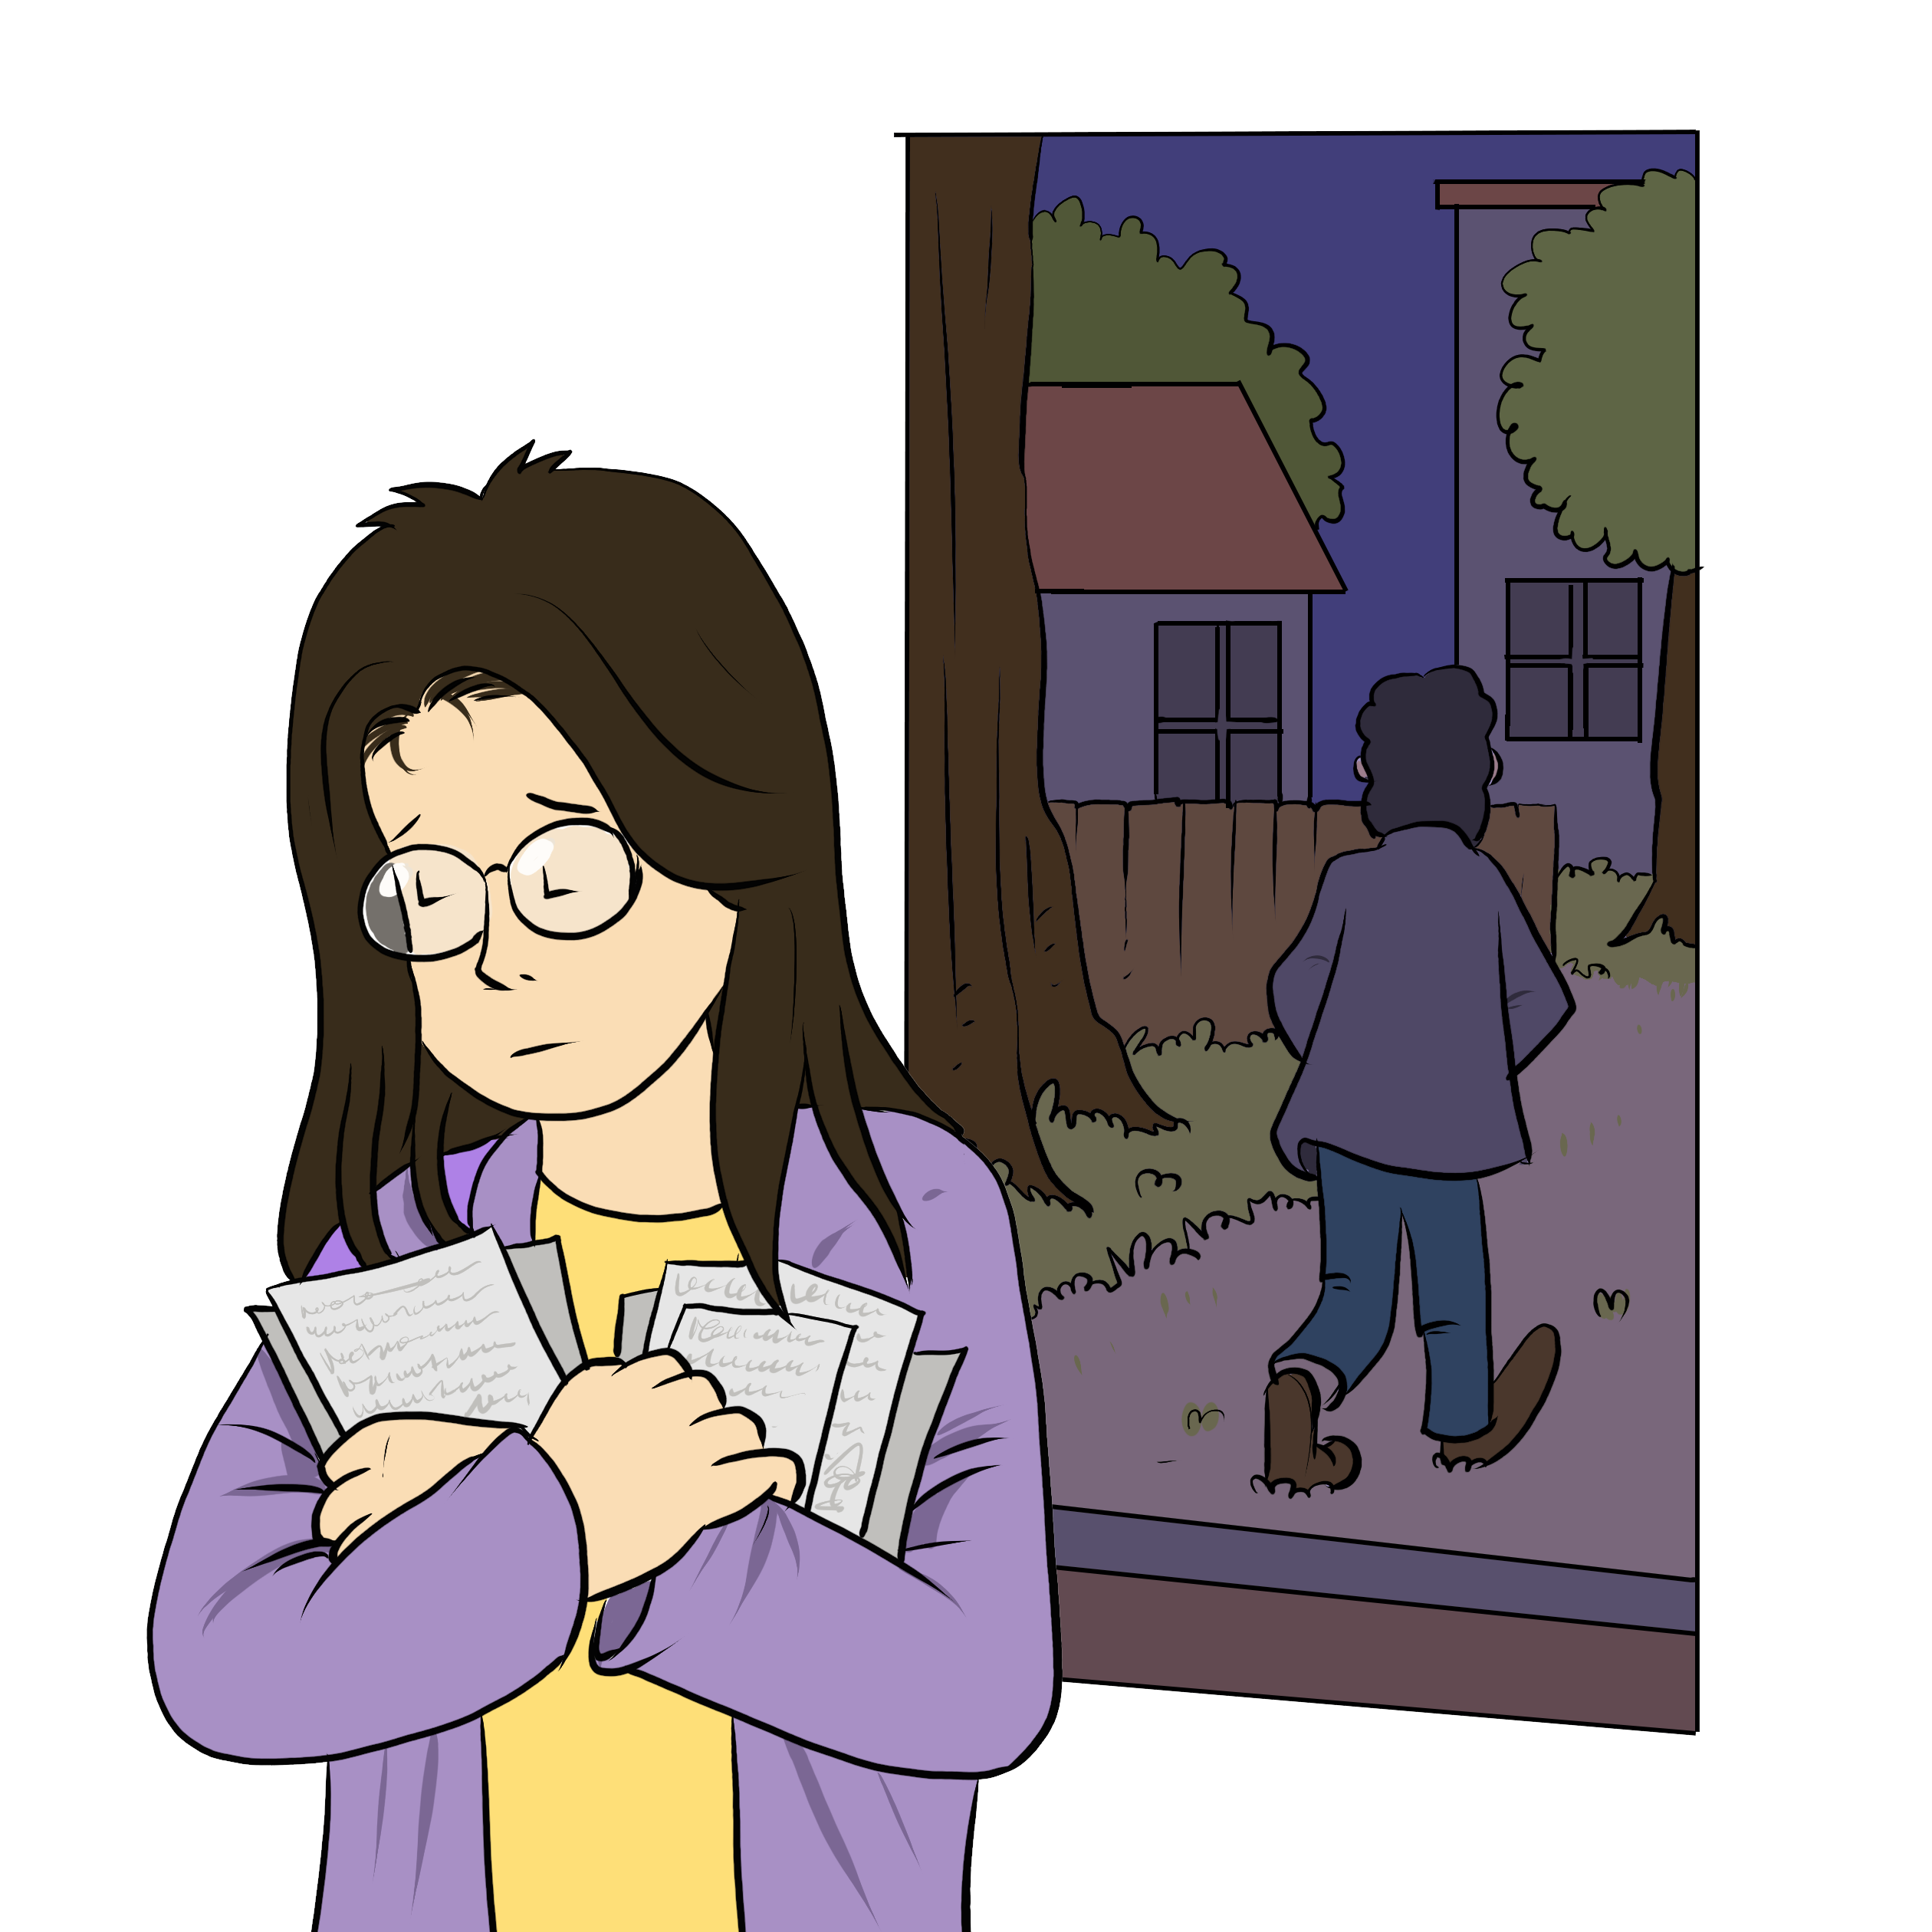
My Money
My Relationship
Notes:
Instructions for the workshop facilitator
To prepare to lead this workshop:
Read the Facilitator’s Guide.
Watch the associated videos.
Read the notes at the bottom of each slide.
Read the instructions for the workshop facilitator.
Go over the legal information that you will share with participants.
Read the additional information to deepen your understanding of the theme addressed in this workshop.
If you have time, read the notes at the bottom of each slide of the PowerPoint presentations for the other workshops. All the themes covered in the different workshops are connected. Your explanations during this workshop could bring up questions on topics discussed in other workshops.
Don’t forget to:
Arrange for an interpreter, if necessary.
Add local legal services and resources to the slides.
Combine this workshop with other psychosocial support activities, if necessary.
Take the time to address delicate situations that may arise during the workshop.
This workshop addresses issues relating to separation and violence. The participants have different experiences. Some may be comfortable with the possibility of separation, and others may be strongly opposed to it. Be mindful of this diversity of perspectives when setting the tone for the workshop.
Legal information contained in this activity is valid as of June 30th, 2025.
The information contained in this workshop applies only to Quebec and should not be considered legal advice.

Slide 2
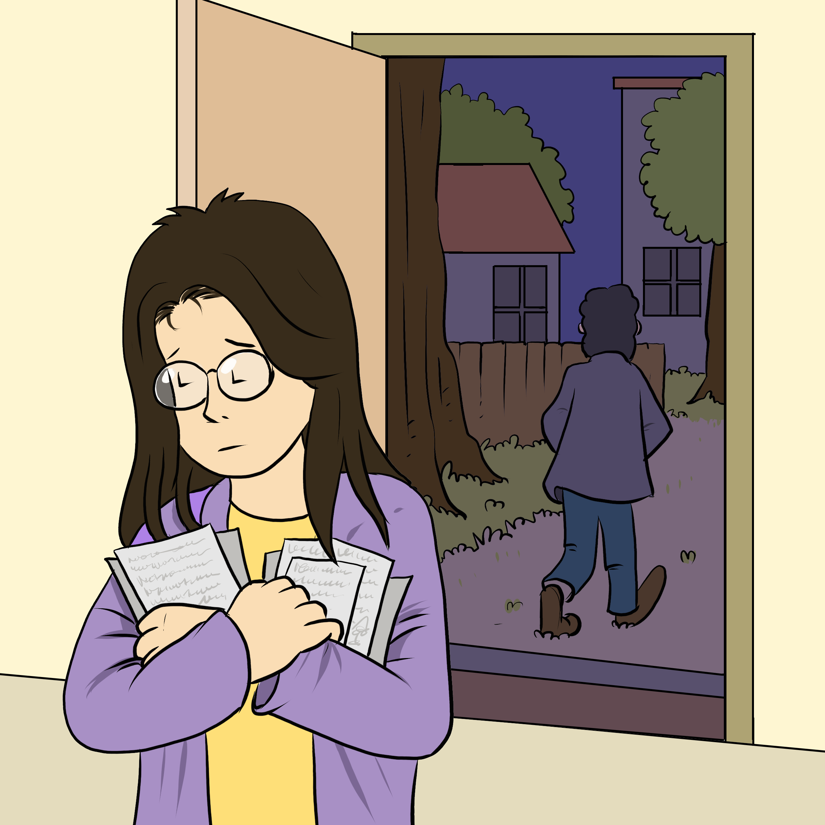
Examining the situation
What do you see here?
Notes:
3 minutes
Instructions for the workshop facilitator
Before starting the workshop, mention that you are in a safe space where participants can express themselves freely and without judgment. The discussions that take place during the workshop are confidential.
Lead a discussion based on the following questions:
What is happening in this image?
What does this image tell us about the couple?
What more can you say about the situation if we assume that the woman wants to leave her husband or partner?
What more can you say about the situation if we assume that the woman has a precarious (uncertain) immigration status?
Summarize by repeating the key words that were mentioned by the participants and that are related to the topic of this workshop.

Slide 3

Understanding the legal issues
Jennifer's story
"I don't have a job."
"He paid for everything."
"I want to leave him."
"I won't be able to pay all these expenses alone."
Notes:
5 minutes
Instructions
Read the following story aloud:
Jennifer has been living in Quebec with her boyfriend and their 8-year-old twins for a few months. She hasn’t found a job yet, so her boyfriend has been paying for everything. She takes care of their children and the household. Lately, her boyfriend has been away a lot, and Jennifer is struggling. She wants to separate but is worried about money. Without a job, she doesn’t know how she’ll support herself and her boys.
Lead a discussion using the following questions:
Have you ever experienced a similar situation?
What are the main concerns or issues in this situation?
What are the rights and responsibilities related to these concerns or issues?
What should Jennifer do to solve the problem?
Mention that you will share legal information to help the participants better understand the legal issues, rights and responsibilities involved in this scenario and that you will come back to the scenario at the end of this workshop. Let participants know you will be covering some basic legal rules. Acknowledge that everyone’s experience with the justice system is different and can be shaped by past challenges, as well as cultural and language barriers. Remind participants that the goal of the workshop is to inform them about their rights, so that they can make informed decisions and protect themselves.
Then explain the goal of this workshop: To learn about ways of getting financial help and becoming financially independent after a separation or divorce.
Name the main topics that will be discussed: child support, spousal support (“alimony”), social assistance, help finding work.

Slide 4


Paying expenses for children : child support
    Asking for a sum of money from the other parent
    Calculated based on income, number of children, needs of the children and time spent with the children
    Generally collected each month
Notes:
5 minutes
Instructions for the workshop facilitator
Explain the information below by making connections with the scenario.
Information to share
Parents must both contribute to the needs of their children. This includes feeding and financially supporting them.[1].
If parents separate, one parent may owe the other money to cover the children's basic expenses (food, health care, clothing, activities, etc.)[2]. This rule applies to both married and unmarried parents[3]. This money is called "child support." [4]
Child support is calculated based on what each parent is able to contribute, the number of children involved, the needs of the children and the time each parent spends with the children[5]. The law gives a specific formula that must be used to calculate child support[6].
For example, if the mother is unemployed and the father has a stable and high income, he may have to pay child support.
Since Jennifer doesn’t have a job and her boyfriend has been paying for everything, she can request child support after they separate to help cover their sons’ needs.
Parents can agree on child support[7] (alone or with the help of a mediator).
One of the parents can also go to court to ask a judge to set the child support amount[8], or to make their agreement with the other parent official (homologate)[9]. In both cases, child support is generally collected by Revenu Québec each month from the salary of the parent who pays child support[10]. Revenu Québec then pays the money to the other parent[11] (usually twice a month[12]). In other words, the parent who receives child support will not need to contact the other parent each month to get the money.
Additional information
Child support is also covered in the “My Children” workshop.
The Child Support Payments Calculation tool on the Quebec government’s website allows you to run a simulation and calculate child support. Parents can use this to get an idea of how much child support they could receive if they go to court after a separation. However, this amount is not final. Courts may set a different amount depending on the circumstances.
For more information on family mediation, you can consult this Éducaloi article: Family Mediation in Six Steps | Éducaloi
Sources
[1] Civil code of Quebec, RLRQ, c C-1991, art 585.
[2] Civil code of Quebec, RLRQ, c C-1991, arts 585, 587.2.
[3] Civil code of Quebec, RLRQ, c C-1991, arts 522, 585.
[4] Civil code of Quebec, RLRQ, c C-1991, arts 589.
[5] Civil code of Quebec, RLRQ, c C-1991, art 587 ; Regulation respecting the determination of child support payments, RLRQ c C-25.01, r 0.4, art 3.
[6] Regulation respecting the determination of child support payments, RLRQ c C-25.01, r 0.4, art 3, Annex I.
[7] Code of Civil Procedure, RLRQ, c C-25, art 72 al 2.
[8] Code of Civil Procedure, RLRQ, c C-25, arts 409, 411.
[9] Code of Civil Procedure, RLRQ, c C-25, art 72 al 2.
[10] Act to facilitate the payment of support, RLRQ, c P-2.2, arts 6, 7, 8, 11.
[11] Act to facilitate the payment of support, RLRQ, c P-2.2, art 36 al 1.
[12] Act to facilitate the payment of support, RLRQ, c P-2.2, art 36 al 1.

Slide 5
Spousal support for husband or wife (married couples)
    Different than child support for children
    Intended to help reach financial independence
    Amount and length depend on the situation
    A court can grant it or refuse to grant it
Notes:
5 minutes
Instructions for the workshop facilitator
Explain the information below by making connections with the scenario.
Information to share
When a married couple separates or divorces, one spouse can ask the other for spousal support (alimony)[1]. Spousal support is different from child support, and is mainly used to:
temporarily cover a divorcing spouse’s needs until they can become financially independent[2],
prevent one spouse from experiencing financial hardship because of the divorce[3].
Spousal support can take different forms. For example, one spouse may pay the other a regular amount (e.g., $200 every month)[4] or a single lump sum (e.g., $20,000)[5].
If someone wants spousal support from their ex-spouse, the former couple can agree on the amount privately[6], or can get professional help. A family mediator, if appropriate, can help them find solutions[7].
The family mediator can try to help them reach an agreement[8].
Parents are usually eligible for free mediation hours[9].
They can also choose a mediator who speaks their native language. For example, there are mediators who speak Spanish, Arabic, and Italian.
A person seeking spousal support can also go to court[10], where a judge will decide if they qualify, how much they will receive, and for how long.
Unmarried (common-law or de facto) partners cannot receive spousal support. Since Jennifer and her boyfriend are not married, she would not qualify for spousal support. However, she may have other options for financial support.
Additional information
It can take several months or longer to get a divorce judgment, but a person can request temporary spousal support until the divorce is finalized[11].
When deciding on spousal support in a divorce, the court considers factors[12] such as[13]:
each spouse’s financial needs
each spouse’s ability to pay
how long the spouses lived together
the roles each spouse had during the marriage
If a spouse cannot afford both child support and spousal support, child support takes priority[14].
It is generally not recommended to use mediation when there was violence between the people in conflict[15]. That said, some mediators specialize in mediation in the context of domestic violence. To find them, the person can go to the Association des médiateurs familiaux du Québec’s website (association of family mediators) and click on “Find a mediator.” They can then select “Violence familiale et conjugale” (family and domestic violence) under the “Champ(s) d’expertise(s)” field.
For more information on family mediation, you can consult this Éducaloi article: Family Mediation in Six Steps | Éducaloi
Sources
[1] Divorce Act, LRC (1985), art 15.2 (1) et (2).
[2] Divorce Act, LRC (1985), art 15.2 (6) d).
[3] Divorce Act, LRC (1985), art 15.2 (6) c).
[4] Divorce Act, LRC (1985), art 15.2 (1)
[5] Divorce Act, LRC (1985), art 15.2 (1)
[6] Divorce Act, LRC (1985), art 15.2 (4) c)
[7] Code of Civil Procedure, RLRQ, c C-25, arts 605 al 2, 616.
[8] Code of Civil Procedure, RLRQ, c C-25, art 605 al 2, 616.
[9] Code of Civil Procedure, RLRQ, c C-25, art 619 ; Regulation respecting family mediation, c. C-25-01, r. 0.7, art.10.1.
[10] Divorce Act, LRC (1985), art 15.2 (1).
[11] Divorce Act, LRC (1985), art 15.2 (2).
[12] Divorce Act, LRC (1985), art 15.2 (4).
[13] Divorce Act, LRC (1985), art 15.2 (4).
[14] Divorce Act, LRC (1985), art 15.3(1).
[15] For example : 13 Frequently Asked Family Law Questions About Situations of Intimate Partner Violence — SOS violence conjugale

Slide 6
Requesting social assistance
    Social assistance is a last resort
    Income and savings need to be below a certain amount
    Other financial resources should be used first
    Possible even for people who are not citizens
Notes:
3 minutes
Instructions for the workshop facilitator
Explain the information below by making connections with the scenario.
Information to share
Some government programs provide financial assistance to people who don’t have enough income or savings to meet their basic needs[1]. This is called “social assistance” (also known as “welfare”, or aide sociale in French).
The eligibility criteria for social assistance depend on the program. In general, a person must:
have little or no income or savings, and
have exhausted all other available financial resources[2]. For example, a separated parent with custody of children must ask the other parent for child support before applying for social assistance[3].
People can receive social assistance benefits even if they are not Canadian citizens. Permanent residents[4], refugees[5] and asylum seekers[6] may also qualify. People without status may also receive social assistance in certain emergency situations[7].
To apply for social assistance, participants can visit the website of the Government of Québec. Before applying, they can use the SimulAide tool on the Emploi Québec website to see if they might qualify.
Additional information
People receiving child support may still qualify for social assistance[8]. Depending on their situation, people can receive both.
If someone becomes a permanent resident through their spouse’s sponsorship and then separates, their sponsor must still support them for three years[9] even if they no longer live together[10]. During this time, the permanent resident can generally receive social assistance[11] under the following exceptions [12] :
their sponsor (or “guarantor”) is refusing to support them, or
life with the sponsor has become intolerable (e.g., due to violence).
In this situation, the sponsor usually has to pay the government back for social assistance payments made during the sponsorship period[13].
If a social assistance application is denied, the decision can be challenged. For more information, see our article: Contesting a Decision Regarding Social Assistance (Welfare) | Éducaloi
For more information on eligibility for social services according to immigration status, see our guide: Immigration Status and Social Services | Printable Guide | Éducaloi
Sources
[1] Individual and Family Assitance Act, RLRQ c A-1311, arts 1, 2.
[2] Individual and Family Assitance Act, RLRQ c A-1311, art 63 al 1.
[3] Individual and Family Assitance Act, RLRQ c A-1311, art 63 al. 1.
[4] Individual and Family Assitance Act, RLRQ c A-1311, art 26 al. 1 au para 3.
[5] Individual and Family Assitance Act, RLRQ c A-1311, art 26 al. 1 para 4; Individual and Family Assitance Regulation, RLRQ c A-1311, r 1, art 47.
[6] Individual and Family Assitance Regulation, RLRQ c A-1311, r 1, art 47.
[7] Individual and Family Assitance Act, RLRQ c A-1311, art 49.
[8] Individual and Family Assitance Regulation, RLRQ c A-1311, r 1, art 111 (21).
[9] Québec Immigration Regulation, RLRQ c I-021, art 22, 23, 24.
[10] Québec Immigration Regulation, RLRQ c I-0.2.1, art 22, 23, 24 ; Québec Immigration Regulation, chapiter I-021, r 3, art 68.
[11] Individual and Family Assitance Act, RLRQ c A-1311, art 48 al 1 ; Understanding the responsibilities and obligations related to the undertaking | Gouvernement du Québec
[12] Individual and Family Assitance Act, RLRQ c A-1311, art 48 al 1 ; Understanding the responsibilities and obligations related to the undertaking | Gouvernement du Québec
[13] Understanding the responsibilities and obligations related to the undertaking | Gouvernement du Québec

Slide 7
Where to find help?
Notes:
2 minutes​
​
Instructions​
​
In the following slides, you will find resources that you can present to participants. You can customize the workshop by adding slides presenting other relevant resources.
Feel free to print the slides with the resources.
Feel free to offer to help participants contact one of the mentioned resources or even to go with them if needed. You can also explore the websites together.
Mention that they can look at these resources even if they do not intend to leave their spouse or partner, or if they are still deciding what to do. They can consult these resources simply to inform themselves.

Slide 8

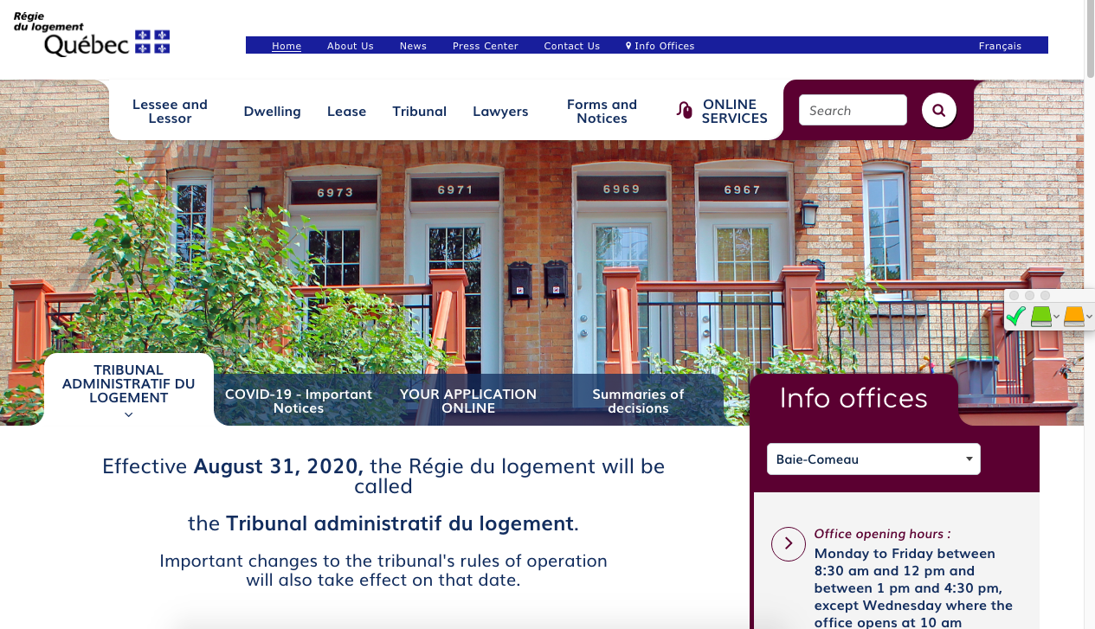

Finding help
(Name of the organisation)
(Short description of their service)
(Link to their website)
(Screenshot of the organisation's website)
Notes:
1 minute​
Instructions​
You can customize this slide if you want to add resources other than those presented in the following slides.

Slide 9

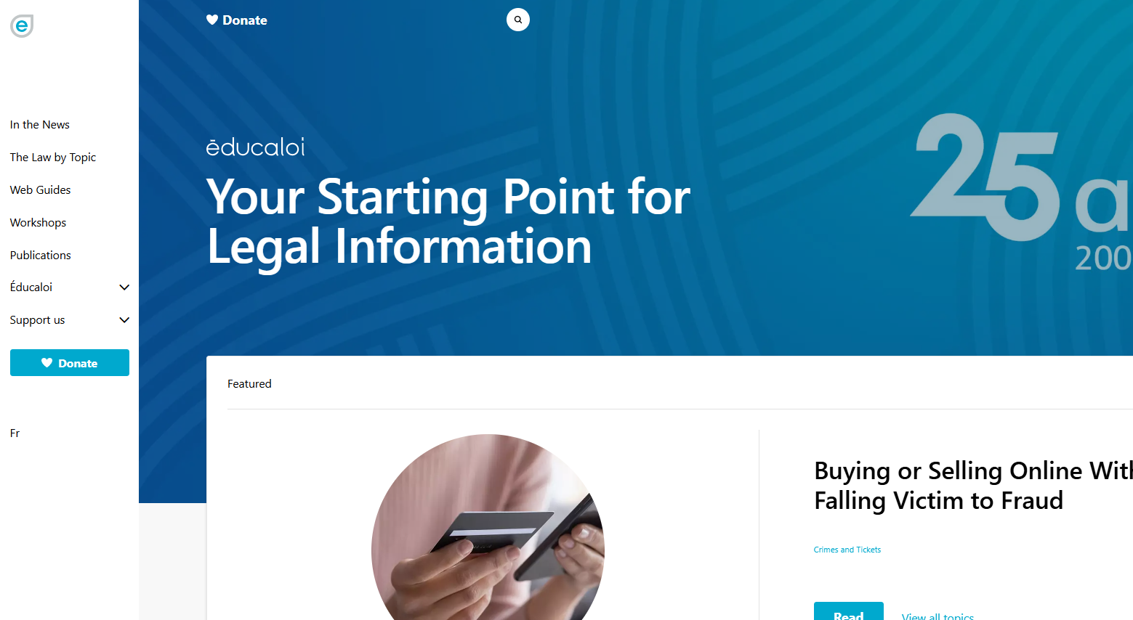

Finding help
Éducaloi
Free online legal information on:
Family, couples, separation and divorce
Housing
Work
Éducaloi - Your starting point for legal information
Notes:
1 minute​
Instructions​
Explain that Éducaloi is a non-profit whose mission is to explain the law in Quebec in a simple way. Éducaloi is especially known for its website that covers various legal topics, including family and couples, separation and divorce, housing, work and more. Most of Éducaloi's content is available in French and English.

Slide 10
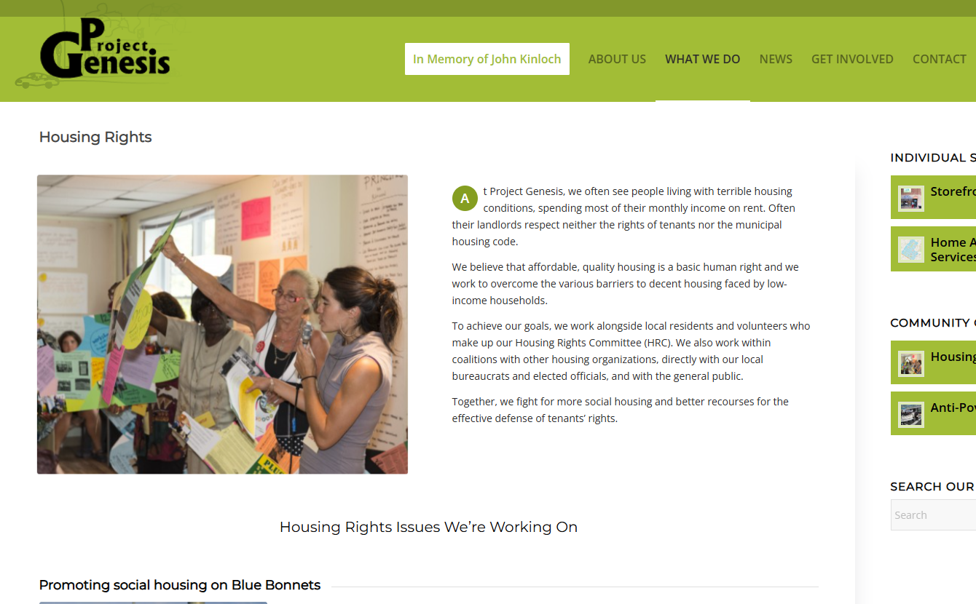
Finding help
Project Genesis
Free legal information :
housing
social assistance
pensions and family allowance
514-738-2036
Housing Rights – Project Genesis
(Capture d'écran du site web de l'organisme)
Notes:
1 minute​
Instructions​
Exlain that the participants can contact this resource if they have questions on housing, social assistance, pensions or family allowances.
To reach them : 514-738-2036

Slide 11

Finding help
L’Organisation Populaire des Droits Sociaux (OPDS) (French only)
Free legal information on social assistance
Support for certain processes
514-527-0700 or 514-322-5782
opdsrm.com
(Capture d'écran du site web de l'organisme)
Notes:
1 minute​
Instructions​
Explain that participants can contact this resource if they have questions on social assistance (welfare) or would like to be supported through some processes related to social assitance (French only).
To reach them, call 514-527-0700 or 514-322-5782 or write to info@opdsrm.com

Slide 12
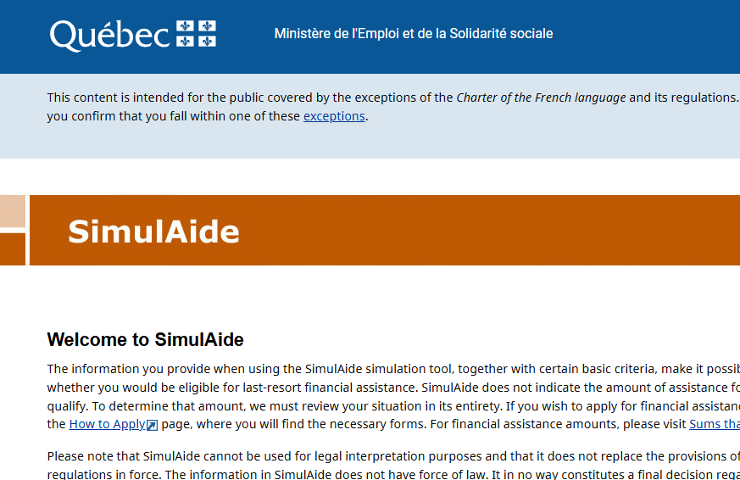
Finding help
SimulAide
Calculation tool for social welfare eligibility
SimulAide
Notes:
1 minute​
Instructions​
Explain that this tool helps calculate whether someone may qualify for social assistance.

Slide 13
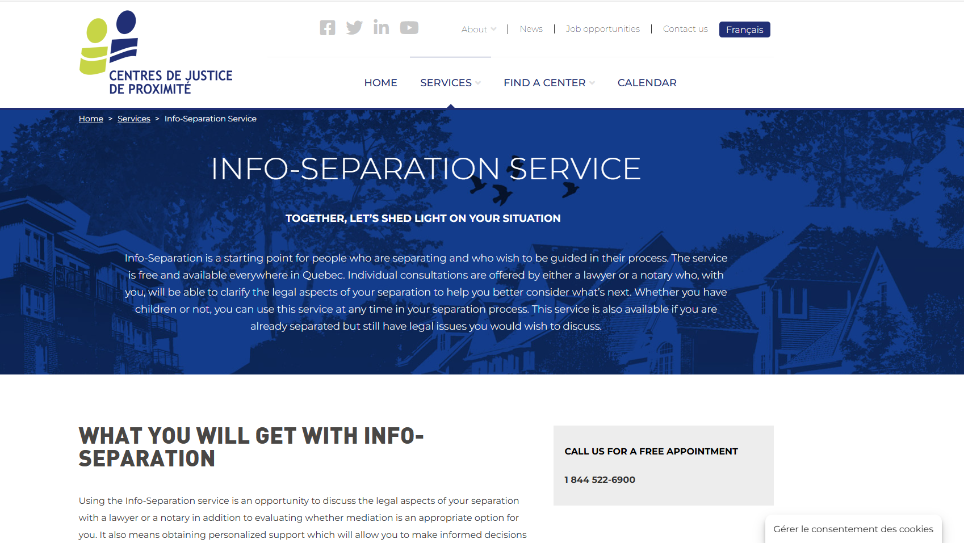
Finding help
Community Justice Centers
Info-Separation
Service
Free legal information
Info-Separation Service - Centres de justice de proximité l Centres de justice de proximité
Notes:
1 minute​
Instructions​
Explain that this resource is available to participants if they encounter legal issues related to their life as a couple. The "Info-Separation" service of the Community Justice Centers (CJP) offers free legal consultations with lawyers or notaries to ask legal questions related to separation.
​
To contact them: Contact us - Centres de justice de proximité l Centres de justice de proximité

Slide 14
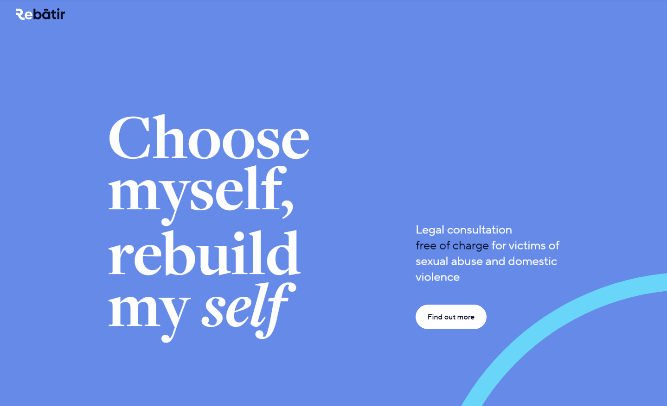
Finding help
ReBâtir
4 hours of free legal consultation
1-833-732-2847
Rebâtir
Notes:
1 minute​
Instructions​
Explain that this resource is available to participants if they encounter legal issues related to their life as a couple. Rebâtir is the name of a legal consultation service provided by the Commission des services juridiques (legal aid). It offers 4 hours of free legal consultation to people who experience domestic or sexual violence in all areas of law.
To contact them: call 1-833-REBÂTIR (1-833-732-2847) or write to projet@rebatir.ca

Slide 15
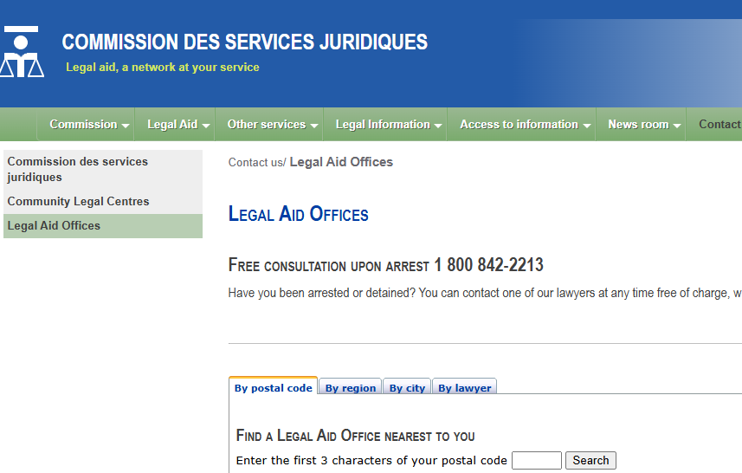
Finding help
Commission des services juridiques (Legal Aid)
Free or low cost legal aid
Legal Aide Offices and Lawyers
Notes:
1 minute
Instructions
Explain that this legal resource is available to the participants if they experience legal issues relation to social assistance: the Commission des services juridiques (Legal Aid) offers free or low-cost services from lawyers to people eligible for legal aid. Legal aid includes legal services for questions relation to socail assitance.
To find a legal aid office: Legal Aide Offices and Lawyers

Slide 16
Other resources
    ACEF
    Répertoire des médiateurs familiaux du Québec
    Service d’Interprète d’Aide et de Référence aux Immigrants (SIARI)
    Francisation Québec
    Quebec.ca - Social Assistance and Social Solidarity
Notes:
3 minutes
Instructions for the workshop facilitator
Share the following resources with the participants.
Information to share
ACEF: The Associations coopérative d’économie familiale (cooperative association for family economy) provides assistance with budgeting and debt management. To find your local ACEF, search for “ACEF” and the name of your region or municipality.
Association des médiateurs familiaux du Québec: A directory of family mediators in Quebec.
Service d’Interprète d’Aide et de Référence aux Immigrants (SIARI) (interpreter, assistance and referral service for immigrants): Language support services for immigrants of all ages (e.g., free French and English classes, help with administrative procedures, computer classes, etc.). Services available in more than 30 languages.
Francisation Québec: Government-funded free French courses geared toward helping people find jobs in Quebec.
Social Assistance and Social Solidarity | Gouvernement du Québec: A section of the government’s website focused on social assistance.
Contact info: Montreal and surrounding areas: 514-873-4000
Other regions in Quebec (Toll-Free): 1-877-767-8773

Slide 17

Taking action
What could Jennifer do?
Find an organisation to help calculate spousal support
Find an employment center near her
Check if she is eligible for social assistance
Notes:
3 minutes
Instructions
Remind the participants about the scenario shared at the beginning of the workshop.
Ask participants to answer the following question:
Based on the information and resources we’ve discussed today, what options does Jennifer have?
Complete the participants’ answers by sharing some possible courses of action. Click to make these options appear on the screen.
Conclude with these three key messages:
A person who separates can sometimes request child support.
A married person who separates can sometimes request spousal support ("alimony").
Social assistance provides financial support to people whose income and savings don’t cover their basic needs.

Slide 18
Questions?
Notes:
1 minute​
Instructions for the workshop facilitator
Answer the participants’ questions.
If you have time, ask the following questions and write down the answers:
Did you enjoy the workshop? Why?
What new things did you learn?
Is the information shared in this workshop useful to you? In what situation will you use it?
Feel free to thank everyone for participating in the workshop, asking questions and sharing their perspective.

Slide 19

Éducaloi thanks the Maison Bleue and Femmes du Monde à Côte-des-Neiges for their valuable collaboration
This workshop was made possible with the support of

