Slide 1
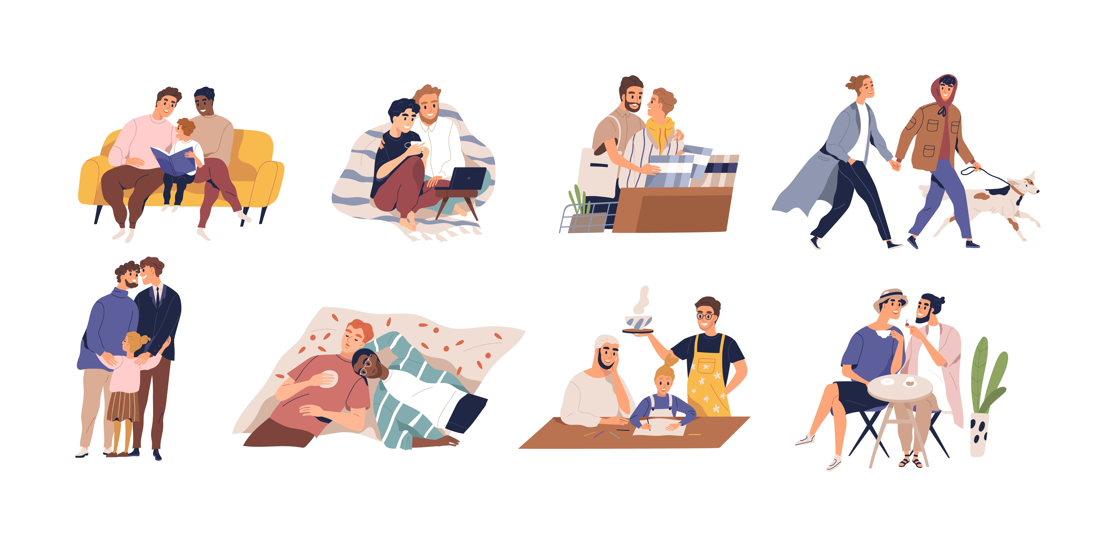
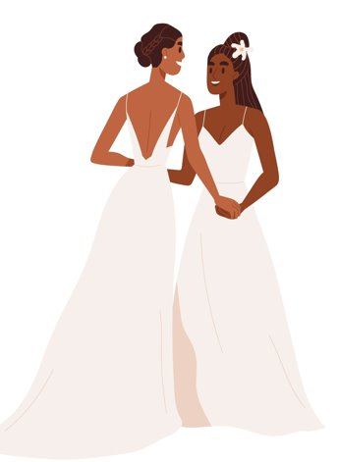

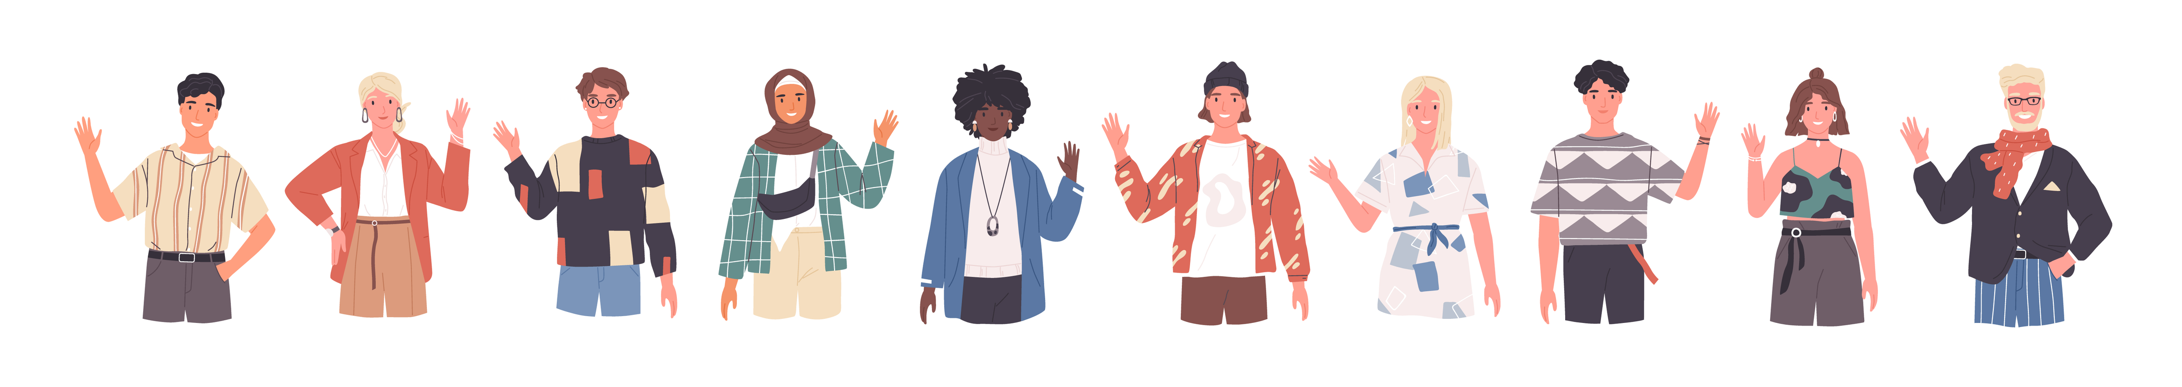
Same-Sex Marriage:
An Example of the Evolution of a Right
Notes:
NOTES FOR THE TEACHER
This PowerPoint presentation is a tool to assist you in leading the activity “The Evolution of a Right: Same-Sex Marriage”.
The proposed exercises are ready-to-use suggestions to lead the activity and encourage student participation.
The comments accompanying the slides include NOTES FOR THE TEACHER, providing specific information for the activity.
© Éducaloi, 2025. This material is the exclusive property of Éducaloi.
Note that the law is in constant evolution. This document is up to date on August 1, 2025.

Slide 2
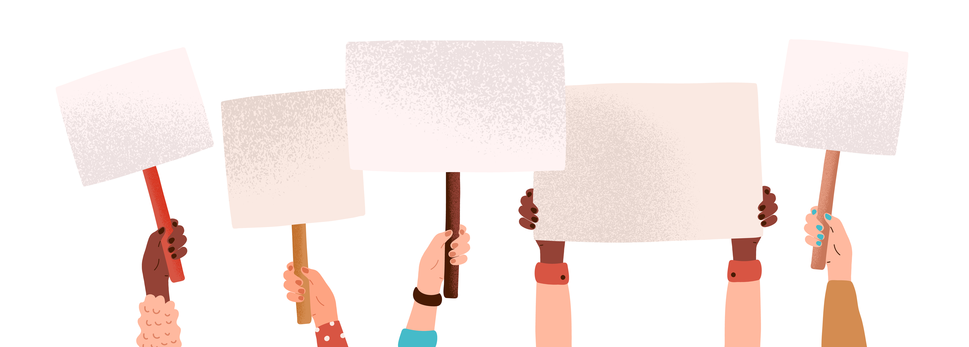
Objectives of the activity
Learn more about the recognition of the right to same-sex marriage in Quebec​.
Understand that the law evolves based on a society’s values.
Notes:
NOTES FOR THE TEACHER
This activity has two main objectives:
To understand that the law evolves along with society’s values.
To learn more about the rights of LGBTQ+ persons until they obtained the right to same-sex marriage.

Slide 3

Marriage

Slide 4
Today, two people of the same sex can get married in Quebec.
Marriage
Notes:
INFORMATION FOR THE STUDENTS
Today, the law permits two people of the same sex to get married in Quebec (and in the rest of Canada).
NOTES FOR THE TEACHER
To introduce the subject, you can hold an open discussion with the students on same-sex marriage. Here are some additional questions you can ask to encourage the discussion:
Do you know any LGBTQ+ couples? If so, are they married?
If so, do you know their reasons for getting married? If you don’t know, what do you think might have been their reasons for wanting to marry?
Are their reasons different from the reasons heterosexual couples get married?
The reasons same-sex couples get married are not different from those of heterosexual couples: to express their love, to benefit from legal protections, and to obtain social recognition of their union, among others.

Slide 5

Yet, this wasn’t always the case.
Marriage
How did it change?
When did it change?
Who changed the situation?
Notes:
NOTES FOR THE TEACHER
Ask the students the questions on the slide and wait for a few answers.
Note the answers on the board.
This possibility is recent. Societal values had to change for homosexuality to be accepted, and for the federal and Quebec governments to pass laws to permit same-sex marriage.
OTHER POSSIBLE QUESTIONS
But where do the rules governing marriage come from? Who has the power to permit same-sex marriage?
SOURCES
Code civil du Québec, RLRQ c CCQ-1991, art 365 (célébrant), 378 (acte de mariage).

Slide 6

What is marriage?
Definition of the concept
What do you think marriage is?
Notes:
INFORMATION FOR THE STUDENTS
To understand the importance of same-sex marriage, you first need to know what “marriage” is.
In your opinion, what does it mean to “get married”?
NOTES FOR THE TEACHER
Here are some other questions you can ask to encourage discussion:
Do you have any friends or acquaintances who are married?
Why do you think they chose to get married?
Do you think marriage has the same meaning across cultures?
Do you think marriage has changed over time? If so, how? Explain how you think it has evolved.

Slide 7
What is marriage?
Definition of the concept
A declaration of love: spending the rest of one’s life with a person you love.
A contract: People who marry have rights and responsibilities.
Notes:
INFORMATION FOR THE STUDENTS
Marriage today
For many people, marriage is a promise to spend the rest of their life with a person they love.
But marriage is also a contract that gives rights and responsibilities to the people getting married.
Married people commit to acting with respect toward each other, to help each other, to share duties, and to look after the education, care and supervision of children together.
They also commit to contributing to the family's expenses, based on each person’s means.
Marriage has certain benefits and legal protections that are not available to other couples.
Here are a few examples:
Inheriting without a will
If a married person dies without a will, their property automatically goes to their spouse and children, if any.
Sharing property during a divorce
In case of divorce, the law stipulates that some property must be shared equally, such as the family home, furniture and vehicles used for family transport. On the other hand, people who are not married keep only their own property in the event of separation, unless they agreed to divide their property differently.
Alimony
Married couples have the right to ask for alimony (support payments) from their spouse in case of separation. This is a sum of money that serves to meet the needs of the person receiving it.
SECONDARY INFORMATION
An evolving concept
In Western cultures today, many people see love as a pillar of marriage. However, this vision of marriage is relatively recent. The definition of marriage and the reasons why people marry have evolved over time and across cultures.
Marriage is not a static concept. People who have access to marriage, what marriage represents and the protections it offers … these aspects change based on (changing!) societal values.
SOURCES
Code civil du Québec, RLRQ c CCQ-1991, art 365 («Le mariage doit être contracté publiquement (…)», 392 et s. (droits et devoirs des époux).
Code civil du Québec, RLRQ c CCQ-1991, art 392 (respect, fidélité, secours et assistance, vie commune), 394 (exercent ensemble l'autorité parentale et les tâches qui en découlent), 396 (contribution aux charges du mariage).
BBC News, Ten key moments in the history of marriage (14 mars 2012): Ten key moments in the history of marriage - BBC News
LARANÉ, André, Le mariage dans tous ses états (24 août 2022): Hérodote.net https://www.herodote.net/L_essentiel-synthese-645.php#:~:text=Le%20mariage%20est%20l'institution,garantir%20leur%20dHérodote.net. roit%20%C3%A0%20h%C3%A9riter.
BOLOGNE, Jean-Claude (1995) Histoire du mariage en occident, Babelio, 478 p.

Slide 8
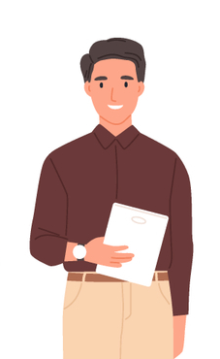

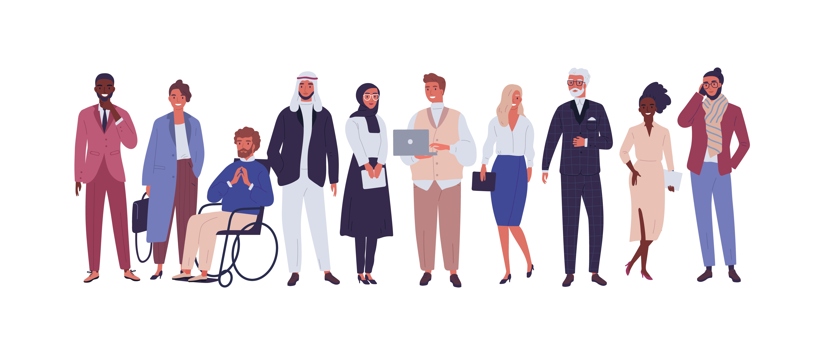
Why get married?
Definition of the concept
The legal benefits
The social recognition
The values, respect and maintenance of tradition or beliefs
Notes:
INFORMATION FOR THE STUDENTS
Why get married?
In Quebec, the differences between married and unmarried couples are less pronounced than in other societies. The advantages that married couples enjoy are generally also available to couples who’ve been living together for at least one year—a relationship referred to as a “common-law” or a “de facto” relationship.
For example, parents have the same rights regarding the education, supervision and custody of their children, whether they are married or not. Similarly, couples in a common-law relationship enjoy the same tax benefits as married couples.
But there are also differences.
Social recognition
Some people marry because marriage brings social recognition to their union. By publicly committing to one-another, they demonstrate to family, friends and the government that they want to be recognized as a couple.
Values, traditions and beliefs
For many people, marriage represents the ultimate expression of their love and a way to solidify their relationship. It’s a ritual that’s rooted in their values, culture, or beliefs.
Division of property
When two people marry, they automatically agree to rules that will determine how their property will be divided in the event of separation. These rules govern, among other things, who manages what, and to whom property belongs, such as the house, car, and savings, and who pays the debts.
Couples in a common-law relationship are not automatically subject to these rules. However, they can agree to adopt similar rules.
SOURCES
Code civil du Québec, RLRQ c CCQ-1991, art 415, 416 (patrimoine familial), 433, 518 (régime matrimonial), 585 (pension alimentaire), 653 (succession).
Madhu Chauhan, « Marriage: An Overview in Global Context » (2016) 1:4 Research Review International Journal of Multidisciplinary 56 at 59: https://old.rrjournals.com/wp-content/uploads/2022/11/56-62_RRIJM160104014.pdf

Slide 9
Who can marry?
Marriage
16 years old or over
Be “free” from any bond
Two consenting and capable people
Regardless of sex
Notes:
NOTES FOR THE TEACHER
Ask the students the question on the slide. Then, click to display the answer.
Read the text on the slide.
INFORMATION FOR THE STUDENTS
Persons 16 years old and over can marry. However, if they’re 16 or 17 years old at the time of marriage, they must obtain the court’s permission to marry.
The future spouses must be “free” from any matrimonial bond. They must be single, divorce or widowed.
They must also be able to give free and informed consent. In legal terms, a person must be considered “capable”: they must be able to understand and decide, express their wishes and be able to act on their own behalf.
In Canada, marriage is only possible between two people. Polygamy is not legally recognized.
Same-sex couples obtained the right to marry on July 20, 2005. It was a long and complicated process.
SOURCES
Code civil du Québec, RLRQ c CCQ-1991, art 378 (acte de mariage), 2166 al 1 (aptitude).

Slide 10
Do you know of other forms of union?
Marriage
Civil union
Common-law relationships
How are they different from marriage?
Notes:
NOTES FOR THE TEACHER
Ask the students the question on the slide and wait for a few answers.
Tell the students:
Today, we’re going to talk a lot about marriage. But first, it’s important to know that there are several ways of “being in a couple.“
Understanding these different forms of relationships will help us better understand what marriage represents.
Explain their differences (see below).
INFORMATION FOR THE STUDENTS
1. Romantic relationship
A “romantic relationship” is the simplest way to be in a couple.
It’s when one dates a person, whether or not it’s exclusive.
In principle, people in romantic relationships have no legal responsibility towards each other.
The government is not aware of the relationship.
No law applies to the relationship in case of separation.
2. Common-law relationship
A common-law (also known as “de facto”) relationship is when two people live together as a couple without getting married.
Someone is in a common-law relationship when they’ve been living with another person for at least one year (sometimes two years, depending on the laws).
It’s not necessary to marry or sign anything to be in a common-law relationship. Some laws will start to apply as soon as a couple have been living together for one year.
People in common-law relationships have fewer rights than married people. For example, they cannot ask for alimony (support payments) from the other person in the event of separation.
3. Civil union
A form of official union in Quebec since 2002. It doesn’t exist elsewhere in Canada.
It’s almost identical to marriage.
To be in a civil union, the couple must sign documents before an official.
Legally, the people in a civil union have rights and responsibilities towards each other. For example, the law stipulates how to divide property in the event of separation.
4. Marriage
Legally, this is the most comprehensive type of union. Marriage involves many rights and responsibilities.
There are two types of marriage.
Religious marriage is performed by a religious official such as a priest, imam or rabbi. Generally, it represents the union of two people before God. Religious marriage must be registered in the civil registry to be recognized by law. Otherwise, the law considers the couple to be in a romantic relationship or in a common-law relationship.
Civil marriage is performed by a celebrant. This type of marriage involves many rights and responsibilities. We’ll look at those in a moment.
Don’t forget about civil union—a little later we’ll look at why it was created and why it’s so similar to marriage.
SOURCES
Code civil du Québec, RLRQ c CCQ-1991, art 365 (célébrant), 378 (acte de mariage).

Slide 11

Division of Powers

Slide 12



The governments’ legislatures
Parliament of Canada
National Assembly of Quebec
Notes:
INFORMATION FOR THE STUDENTS
Who makes the laws?
Laws are made by governments, more specifically through their legislatures:
The Parliament of Canada for the entire country
The National Assembly of Quebec for the province of Quebec
At the federal level (Canada)
The Parliament of Canada is comprised of:
members elected by the population of Canada (House of Commons);
senators appointed by the government (Senate).
At the provincial level (Quebec)
The National Assembly is comprised of:
members elected by the population of Quebec.
How are laws made?
The members of Parliament and the National Assembly propose bills. They vote to approve them. Once approved, these bills become official laws that must be respected by the population.
Who does what?
To avoid creating contradictory laws, the Parliament and National Assembly divide the matters they’re responsible for. This division is set out in a very important document: the Constitution. The Constitution is the strongest law in the country because all other laws must comply with it.
Here’s what this division looks like.
The federal government (Canada) is responsible for:
the postal service
aviation
banks
criminal law
Important! It’s therefore the federal government which makes the laws specifying which behaviours are crimes, and the sentences for committing them.
The provincial government (Quebec) is responsible for:
education
health
civil rights
Note: These matters are referred to as “jurisdictions.” For example, we say that Parliament has jurisdiction over the postal service, aviation, and the banks, and the National Assembly has jurisdiction over education, health and civil rights.
SOURCES
Loi constitutionnelle de 1867, 30 & 31 Victoria, c 3, art 91 – 95.

Slide 13
The division of powers
Definition of the concept
Where does marriage fall?
Federal = marriage and divorce, criminal law
Provincial = celebration of marriage
Notes:
INFORMATION FOR THE STUDENTS
Does the provincial government or the federal government make laws regarding marriage?
Answer: Both! But to avoid contradictions, they’re each responsible for different aspects of marriage.
Here’s how the powers are divided:
The federal government
It has the power to make laws on marriage and divorce. It decides, in particular:
the minimum age for marriage,
who can marry (same-sex couples, heterosexual couples),
in which cases divorce is possible.
The provincial government
It is responsible for the laws related the celebration of marriage. This includes:
the documents necessary for getting married,
who can officiate at a marriage,
the rights and responsibilities of married couples,
how property is divided during a divorce.
Why is this important? You’ll find out soon …
NOTES FOR THE TEACHER
After providing the students with the information, give them the following scenario and ask the questions below:
Scenario: Recall that, before 2005, same-sex couples didn’t have the right to marry.
Questions for the students: (i) Who do you think had the power to permit same-sex couples to marry? Was it Parliament (federal) or the National Assembly (provincial)? (ii) What did they have to do to permit this type of marriage?
Answers: (i) Parliament; (ii) They had to make a law that authorized same-sex marriage.
SOURCES:
Loi constitutionnelle de 1867, 30 & 31 Victoria, c 3, art 91(26) (mariage et divorce), 27 (la loi criminelle), 92(12) (la célébration du mariage).

Slide 14
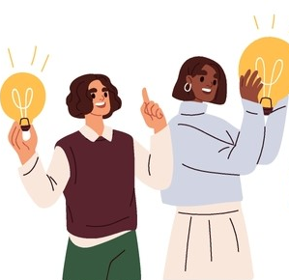
It’s Your Turn!

Slide 15


Reconstructing the timeline
Steps to follow:
1
Form teams.
2
Analyze the reference materials.
3
Place the key event sheets in chronological order.
4
Answer the reflection questions.
3
Notes:
NOTES FOR THE TEACHER
Present what happens during the activity:
Form teams.
Analyze the reference materials.
Place the key event sheets in chronological order.
Answer the discussion questions.
Do the activity and then present the next slides.

Slide 16
Same-Sex Marriage
Changes and Timeline

Slide 17
Change 1: Homosexuality is no longer a crime

Slide 18
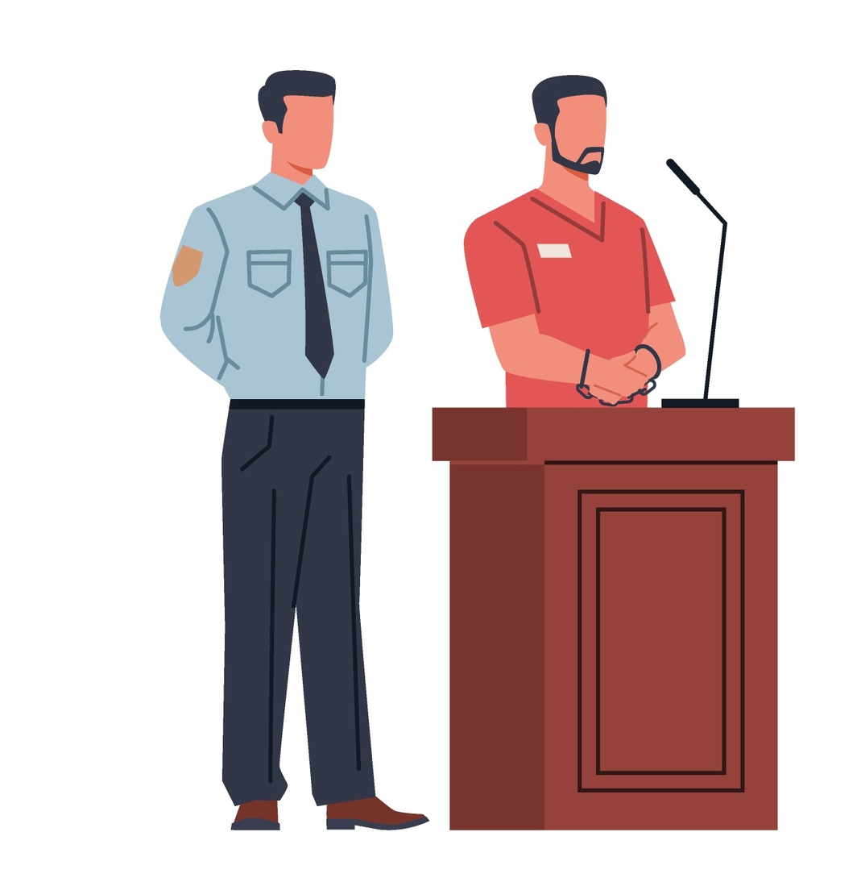
Homosexuality is a crime
Until 1969
Homosexuality was long prohibited.
Maximum sentence at the time: 5 years in prison and whipping.
Notes:
INFORMATION FOR THE STUDENTS
Homosexuality was long considered a crime.
From the British conquest to the creation of the Criminal Code in 1892, common law was in effect. Sexual acts between people of the same sex were prohibited. Common law was the legal system inherited from Great Britain in which the courts “create” the law through the judgments they render.
In 1892, Canada adopted the Criminal Code. The Criminal Code describes the behaviours that are prohibited and the associated sentences. The prohibited behaviours are called “crimes.”
The Criminal Code of 1892 considered “homosexual acts” committed by male adults to be crimes.
A “homosexual act” includes any sexual act between two men, including a kiss.
These acts are not classified as a distinct crime, but rather as gross indecency.
At the time, the maximum sentence for a homosexual act was 5 years in prison and whipping.
You could ask the students the following questions:
What do you notice about this definition of homosexuality?
What do you think of this sentence? Would it still be applicable today? Yes or no, explain your position.
SECONDARY INFORMATION
In 1959, a reform of the Criminal Code reformulated the section on homosexuality (178). After that, women could also be accused of “gross indecency” if they committed ”homosexual” acts.
TO LEARN MORE
https://www.historymuseum.ca/teachers-zone/2slgbtqia-history-and-identities-in-canada/
Sources
Code criminel, SC 1892, c 29, art 178 (première version du Code).
Patrice Corriveau, La répression des homosexuels en France et au Québec : du bûcher à la mairie, Québec, Septentrion, 2006.
Henri Mazeaud et al, Reviews and Notices, 1957 35-1 Canadian Bar Review 106, 1957 CanLIIDocs à la p 113: https://canlii.ca/t/t5tq (on y mentionne la réforme de 1959 et le fait que les femmes peuvent être accusées de « grossière indécence ».
Voir aussi: https://www66.statcan.gc.ca/eng/1959/195912671237_p.%201237.pdf (confirme qu’il y a eu une réforme du Code criminel en 1959).

Slide 19
1969: Homosexuality is decriminalized
Between consenting adults 21 years old or over.
For acts done in private.
Notes:
INFORMATION FOR THE STUDENTS
A few hours before the Stonewall Inn uprising, the government adopted a law that decriminalized homosexuality. Homosexual relations were no longer a crime.
Important! This decriminalization only applied to people 21 years old and over, that is, the age of majority at the time.
For people under 21 years of age, homosexuality was still a crime.
NOTES FOR THE TEACHER
(1) After providing the students with the information, ask them the following question:
Do you think it was Parliament (Canada) or the National Assembly (Quebec) that passed the law to decriminalize homosexuality?
Answer: Parliament, because criminal law is a federal jurisdiction.
(2) Then, ask the students the following question:
Does “decriminalize” mean the same thing as “legalize”?
Anwer: No, “decriminalize” and ”legalize” do not mean the same thing.
When a behaviour is decriminalized, there are no longer any criminal consequences. However, this behaviour can still be limited or regulated by other laws or regulations.
When a behaviour is legal, it’s fully permitted, without restriction.
In 1969, homosexual acts were decriminalized in Canada. Two people of the same sex no longer risked going to prison if they kissed or had sexual relations. However, homosexual acts were not entirely “legal,” as there were still restrictions. For example, same-sex couples still did not have the right to marry.
You could ask the students questions about the historical context of that time to help them make connections between changes in society and changes in the laws:
What was happening in 1969 in Canada? In Quebec?
Recognition of French as an official language
Modernization of Quebec (1967 World’s Fair in Montreal – Expo 67)
Woodstock and hippy movement
The baby boomer generation entered the labour market. Thirty percent of the Quebec population was young.
The year 1969 was one of “identity transformation” for Quebec and a clash of mentalities elsewhere in the world.
SECONDARY INFORMATION
In the reference material, the first document refers to the “omnibus bill”: this is the bill that decriminalized homosexuality. The term “omnibus” means that the bill seeks to modify several laws, generally with a common goal.
It was only in 1988 (almost 20 years later!) that homosexuality became permissible for people 18 years of age and older, reflecting the new age of majority.
TO LEARN MORE
The Stonewall Inn riots (1969)
Britannica, Stonewall riots: Stonewall riots | Definition, Significance, & Facts | Britannica
Library of Congress, 1969: The Stonewall Uprising: 1969: The Stonewall Uprising - LGBTQIA+ Studies: A Resource Guide - Research Guides at Library of Congress
The police raid on Truxx bar (1977)
Radio Canada, 40e de la descente policière du bar Truxx : un tournant pour les droits des homosexuels : 40e de la descente policière du bar Truxx : un tournant pour les droits des homosexuels | Radio-Canada
Interligne, Descente policière au bar le Truxx : DESCENTE POLICIÈRE AU BAR LE TRUXX - Interligne
Sources:
Loi de 1968‑69 modifiant le droit pénal, SC 1968‑69, c 38, art 7.
Loi constitutionnelle de 1867, 30 & 31 Victoria, c 3, art 91 (27).
Halm c. Canada (Ministre de l'Emploi et de l'Immigration), [1995] 2 C.F. 331 aux paras 61-66
Bibliothèque du Parlement, « Projets de loi omnibus: foire aux questions »: Projets de loi omnibus : foire aux questions.

Slide 20
Change 2: Discrimination based on sexual orientation is prohibited

Slide 21
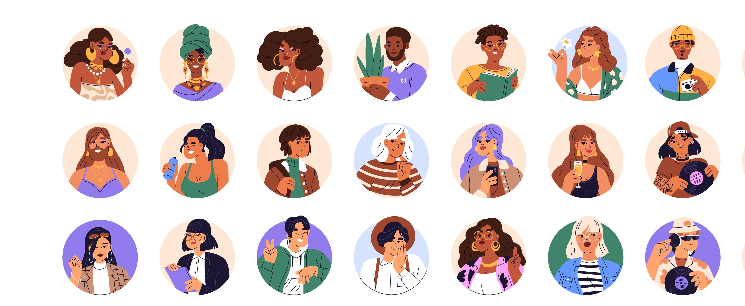
1977: Discrimination based on sexual orientation is prohibited in Quebec
Notes:
INFORMATION FOR THE STUDENTS
In response to demonstrations, Quebec prohibits discrimination based on sexual orientation in 1977. It’s the first Canadian province to do so.
What is discrimination?
In Quebec, everyone has the right to equality. This means that we have the right to be treated equally, regardless of the colour of our skin, our ethnic origin and our gender, for example.
Discrimination is when someone treats another person differently based on a personal characteristic.
For example, a person who is not hired because of their sexual orientation is experiencing discrimination.
How did Quebec prohibit discrimination?
In Quebec, there’s a law that protects every person from discrimination. It’s the Charter of Human Rights and Freedoms. It prohibits discrimination based on certain personal characteristics, such as race, age, religion, and ethnic or national origin.
The Quebec Charter has a quasi-constitutional status: all other laws and regulations in Quebec must comply with it. Otherwise, they risk being declared invalid by a court, and can no longer be applied.
The Quebec Charter was adopted in 1975. Two years later, sexual orientation was added as one of the prohibited grounds of discrimination.
TO LEARN MORE
AIDS epidemic
Le Soleil, Sida: de l’hystérie collective à l’indifférence: Sida: de l'hystérie collective à l'indifférence
Radio-Canada, Le VIH/sida à travers le temps: notre chronologie: Le VIH/sida à travers le temps : notre chronologie | Radio-Canada
Chambre des communes, retranscription des débats du 9 mai 1995: Tuesday, May 9, 1995-- com: HIV/AIDS (11)
Sources
Loi modifiant la Charte des droits et libertés de la personne, LQ 1977, c 6, art 1.
Gouvernement du Québec, Historique des droits des personnes LGBTQ+: Historique des droits des personnes LGBTQ+
Figoli c. Cabane à sucre Lalande Inc., 2003 CanLII 28558 (QC CQ) au para 82.

Slide 22
Canada adopts the Charter of Rights and Freedoms
1982
But sexual orientation is not included …
Notes:
NOTES FOR THE TEACHER
Read the text on the slide.
INFORMATION FOR THE STUDENTS
In 1982, the Canadian Charter of Rights and Freedoms was adopted. It’s a law that protects people in Canada from discrimination. It lists some of the prohibited grounds of discrimination such as:
race
sex
age
ethnic origin
But in 1982, sexual orientation was not mentioned. Theoretically, the government could pass laws or engage in conduct that treats homosexuals differently than heterosexuals.
SECONDARY INFORMATION
The Canadian Charter is part of the Constitution of Canada. Therefore, it has a higher status than other laws: all laws must comply with it. Otherwise, they risk being declared invalid by a court.
How is the Canadian Charter different from the Quebec Charter?
First, the Canadian Charter applies across Canada. The Quebec Charter applies only in Quebec.
Second, the parties who must comply with these charters are different. For the Quebec Charter, individuals, groups, private enterprises and the Quebec government must comply with it. The Canadian Charter applies mainly to the Canadian government and to provincial governments.
Example 1: A woman with a guide dog enters a restaurant. The waiter refuses to seat her at the table of her choice because of the guide dog. In this situation, she’s a victim of discrimination based on her disability. If this discrimination occurred in Quebec, she would be protected by the Quebec Charter. She could claim damages from the restaurant and the waiter for discriminatory behaviour.
In this example, the Canadian Charter would not apply because the discrimination was not done by the government.
Example 2: For a long time, the Criminal Code prohibited abortions in Canada. In 1988, the highest court in the country judged that the section prohibiting abortions violated one of the rights guaranteed by the Canadian Charter, that is, the right to life, liberty and security of the person. Consequently, this section of the Criminal Code was declared invalid.
Sources:
Charte canadienne des droits et libertés, Loi de 1982 sur le Canada, Annexe B, 1982 (R-U), ch11, art 15(1), 32.
Charte des droits et libertés de la personne, RLRQ c C-12, art 54.
Commission des droits de la personne et des droits de la jeunesse (Larochelle) c. 142006 Canada inc. (Caverne grecque), 2012 QCTDP 14 (exemple de discrimination).
R. c. Morgentaler, [1988] 1 RCS 30 aux paras 62,180, 261.
Henri Brun, Guy Tremblay et Eugénie Brouillet, Droit constitutionnel, 6e éd., Cowansville, 2014 aux paras XII-2.24, XII-2.41, XII-2.60, XII-2.66.

Slide 23
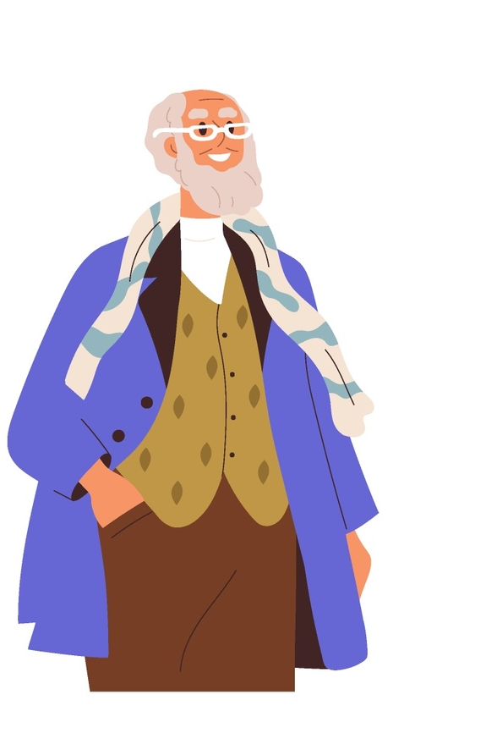
Egan takes the Canadian government to court
1995
Video to watch: Heritage Minutes: Jim Egan – YouTube
.
Notes:
NOTES FOR THE TEACHER
Read the information to the students.
Watch the video for an overview of the case.
INFORMATION FOR THE STUDENTS
See how sexual orientation became an analogous ground of discrimination.
Sources:
Egan c Canada, [1995] 2 RCS 513 aux pp 528, 540, 576, 599 à 602 et 624.
Charte canadienne des droits et libertés, Loi de 1982 sur le Canada, Annexe B, 1982 (R-U), ch11, art 15(1).
Andrea Batiston, "The Legal History of Same-Sex Marriage in Canada" (2014) 39:1 Canadian Law Library Review 8: JuriBistro UNIK - CAIJ

Slide 24
Egan takes the Canadian government to court
1995
The situation:
James Egan and John Norris Nesbit had lived together for 40 years.
In 1986, Egan received old age benefits from the Canadian government.
Under the law, the spouse of a person receiving old age benefits is also entitled to financial assistance.
The government refuses to pay this benefit because it does not consider a same-sex partner to be a “spouse.”
Following this refusal, James Egan takes the government to the Supreme Court.
Notes:
INFORMATION FOR THE STUDENTS
James Egan and John Norris Nesbit are a same-sex couple. They’d been living together for 40 years.
In 1986, Egan received old age benefits from the Canadian government.
Old age benefits are a form of financial assistance the government gives people aged 65 and over.
By law, the spouse of a person receiving old age benefits is also entitled to financial assistance. This financial assistance is called the Spouse’s Allowance.
Consequently, Nesbit, Egan’s partner, applied to the Canadian government to receive the Spouse’s Allowance.
The government refused his application because it did not consider a same-sex partner to be a “spouse.”
James Egan did not agree. He took the government to court to change the law.
He went all the way to the Supreme Court. This is the highest court in Canada to which one can appeal. Its decisions are final and often modify laws.
Sources:
Egan c Canada, [1995] 2 RCS 513 aux pp 528, 540, 576, 599 à 602 et 624.
Charte canadienne des droits et libertés, Loi de 1982 sur le Canada, Annexe B, 1982 (R-U), ch11, art 15(1).
Andrea Batiston, "The Legal History of Same-Sex Marriage in Canada" (2014) 39:1 Canadian Law Library Review 8: JuriBistro UNIK - CAIJ

Slide 25
A seemingly contradictory decision
1995
Decision
The definition of spouse does not contradict the Charter.
Discrimination based on sexual orientation is prohibited.
Consequence
A law cannot discriminate against same-sex couples.
Notes:
INFORMATION FOR THE STUDENTS
The Supreme Court’s analysis
The Supreme Court of Canada had to answer the following question: Is the definition of “spouse” in the law that allows the spousal benefit discriminatory? In other words, does the law comply with the Canadian Charter of Human Rights and Freedoms?
The Supreme Court’s decision
The Supreme Court concluded that the law was not discriminatory, and that the government could choose to give the benefit only to heterosexual couples.
But the Court also recognized sexual orientation as a prohibited ground of discrimination under the Canadian Charter of Rights and Freedoms.
But the Charter was not modified by a law … How was the Court able to state that the Charter prohibits discrimination based on sexual orientation?
First, it’s important to understand two things:
The Canadian Charter is a law written by Parliament.
The Supreme Court does not write the laws. It interprets their meaning.
We saw that the Canadian Charter protects people against discrimination. It prohibits discrimination based on characteristics such as race, sex or ethnic origin—what’s referred to as “prohibited grounds of discrimination.” But the Canadian Charter cannot anticipate everything. Consequently, the Supreme Court has the authority to say that, even if this ground (personal characteristic) is not on the list, it’s similar (“analogous”), so it must be treated in the same way.
This is what happened in Egan v. Canada, which we’ll look at shortly.
Even though sexual orientation was not originally included in the Charter, the Court decided that it was an “analogous ground” of discrimination. Therefore, sexual orientation had the same “legal value” as the other grounds listed in the Charter. Discrimination based on sexual orientation was therefore prohibited, and if a person was a victim of it, they could take legal action to rectify the situation.
Consequence: Since then, sexual orientation has been protected by the Charter. Future laws cannot discriminate against same-sex couples without justification.
Sources :
Egan c Canada, [1995] 2 RCS 513 aux pp 528, 540, 576, 599 à 602 et 624.
Charte canadienne des droits et libertés, Loi de 1982 sur le Canada, Annexe B, 1982 (R-U), ch11, art 15(1).
Andrea Batiston, "The Legal History of Same-Sex Marriage in Canada" (2014) 39:1 Canadian Law Library Review 8: JuriBistro UNIK - CAIJ

Slide 26
Canada prohibits discrimination based on sexual orientation
1995
Notes:
NOTES FOR THE TEACHER
Read the text on the slide.

Slide 27
Change 3: Same-sex couples obtain the same rights as heterosexual couples

Slide 28
Quebec creates the civil union
2002
A creative way to offer same-sex couples a union recognized by the government.
Rights and responsibilities that are identical to marriage.
Notes:
INFORMATION FOR THE STUDENTS
In 2002, the Quebec government passed the Act respecting the civil union of same-sex couples.
The law created the civil union.
Ask the students the following question: Why did Quebec create the civil union? Why did it not permit same-sex couples to marry instead?
Answer: Marriage is a federal jurisdiction, not a provincial one! Therefore, the Parliament of Canada would have had to change the rules and allow same-sex couples to marry. Consequently, the National Assembly had to be creative in establishing a separate system for same-sex couples. Civil union offered them the same rights and responsibilities as married couples, without being married.
If necessary, ask the students the following question: Do you remember what “civil union” is?
Civil union is a type of union that’s almost identical to marriage.
Couples in a civil union have the same rights and responsibilities as married couples.
For example: Duty to respect each other, fidelity, mutual assistance, right to alimony in the event of separation, etc.
Sources:
Loi instituant l’union civile et établissant de nouvelles règles de filiation, LQ 2002, c 6, art 30 (règles sur la filiation en cas de procréation assistée), art 34 (filiation en cas d'adoption).
Code civil du Québec, RLRQ c CCQ-1991, art 121.1 à 121.3., 521.1 à 521.19 et 538 à 542, 578.1.
Loi sur le mariage civil, LC 2005, c 33.
Andrea Batiston, "The Legal History of Same-Sex Marriage in Canada" (2014) 39:1 Canadian Law Library Review 8: JuriBistro UNIK - CAIJ
Isabelle Côté et Kevin Lavoie, La reconnaissance de l’homoparenté au Québec: Lorsque les stratégies de mobilisation de la communauté rencontrent l’avant-gardisme de l’État (2018) no 126 à p 21.

Slide 29

The law recognizes same-sex parents
2002
Access to parenthood
Two same-sex parents can:
adopt a child.
conceive a child through sperm or egg donation.
Same-sex parents now have the right to enter both their names on the child’s birth certificate.
Notes:
NOTES TO THE TEACHER
Under the same law, the Quebec government allows two same-sex parents to adopt a child.
Two women can also conceive a child with a sperm donation. They now have the right to enter their names on the child’s birth certificate.
​
​
Sources:​
Loi instituant l’union civile et établissant de nouvelles règles de filiation, LQ 2002, c 6, art 30 (règles sur la filiation en cas de procréation assistée), art 34 (filiation en cas d'adoption).​
Code civil du Québec, RLRQ c CCQ-1991, art 121.1 à 121.3., 521.1 à 521.19 et 538 à 542, 578.1.​
Loi sur le mariage civil, LC 2005, c 33.​
Andrea Batiston, "The Legal History of Same-Sex Marriage in Canada" (2014) 39:1 Canadian Law Library Review 8: JuriBistro UNIK - CAIJ

Slide 30
Another court case to gain the right to marry
2002
Michael Hendricks and René Leboeuf had lived together for close to 30 years.
On June 14, 2001, they ask to get married.
The government refused their request because the “law does not permit marriage between same-sex partners.”
Notes:
NOTE TO THE TEACHER
Another important step was taken in 2002: In the Hendricks v. Québec case, the Court decided that same-sex couples should have the right to marry.
Read the text on the slide.
Sources:
Hendricks c. Québec (Procureur général), 2002 CanLII 23808 (QC CS).
Charte canadienne des droits et libertés, Loi de 1982 sur le Canada, Annexe B, 1982 (R-U), ch11, art 15(1).
Andrea Batiston, "The Legal History of Same-Sex Marriage in Canada" (2014) 39:1 Canadian Law Library Review 10: JuriBistro UNIK - CAIJ

Slide 31
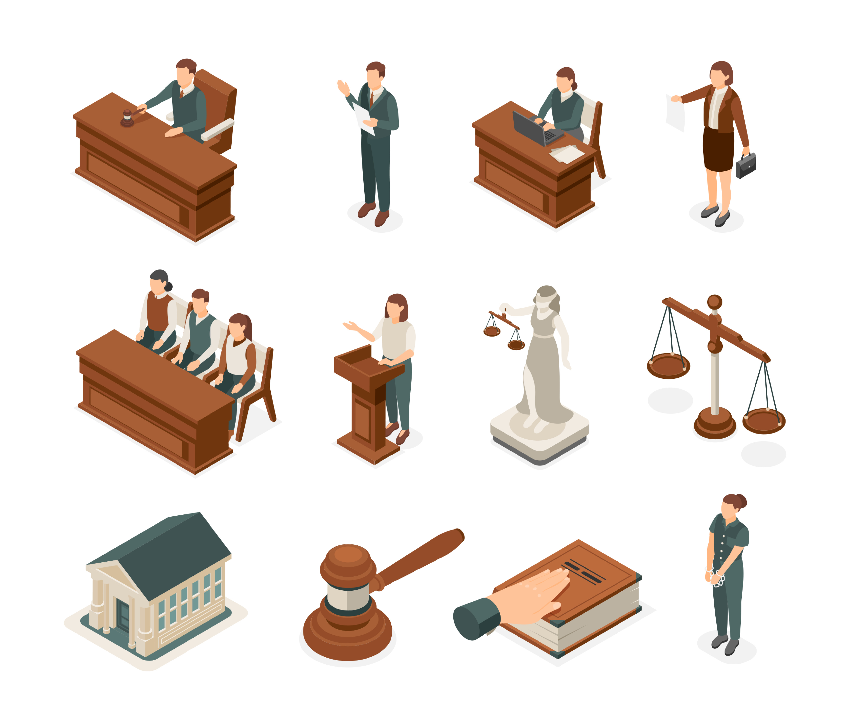
Hendricks takes Quebec to court
2002
Decision
The Quebec Superior Court concludes that the law discriminates against same-sex couples by preventing them from getting married.
Civil union is not an adequate substitute for marriage: it perpetuates the “special” status of heterosexual couples.
Consequence
Same-sex couples should have the right to marry!
The Court gives the federal government two years to pass a law permitting marriage between two people of the same sex.
Notes:
NOTES FOR THE TEACHER
Read the text on the slide.
Ask the students the following question: Why can’t a court grant same-sex couples the right to marry?
Answer: Because it’s not the role of a court to make laws. That’s the role of Parliament or the Legislative Assembly (the legislature). Judges interpret existing laws.
But, if a court decides that a law is unfair or discriminatory, it can say that this law must be changed. At that point, it’s up to the government to amend the law or create a new one.
Sources:
Hendricks c. Québec (Procureur général), 2002 CanLII 23808 (QC CS).
Charte canadienne des droits et libertés, Loi de 1982 sur le Canada, Annexe B, 1982 (R-U), ch11, art 15(1).
Andrea Batiston, "The Legal History of Same-Sex Marriage in Canada" (2014) 39:1 Canadian Law Library Review 10-11:
Alain Roy, "Les couples de même sexe en droit québécois" (2005) 35 Revue générale de droit 167-168: JuriBistro UNIK - CAIJ

Slide 32
Change 4: Same-sex couples can marry

Slide 33
The federal government introduces a bill
2004
In 2004, the federal government introduces a bill to confirm that same-sex couples can marry.
The federal government verifies with the Supreme Court of Canada that this law is constitutional.
Notes:
NOTES FOR THE TEACHER
Read the text on the slide.
SECONDARY INFORMATION
One of the roles of the Supreme Court is to answer the government’s questions. These questions are generally about the Constitution, jurisdiction, or government powers. This allows the government to avoid conflicts and verify the legitimacy of its actions or a bill. (This is called a “reference”.)
Additional questions for the students:
(1) Does the federal government have the jurisdiction to make a law that authorizes marriage between people of the same sex?
Yes!
(2) Does the bill comply with the Canadian Charter of Rights and Freedoms?
Yes. “The bill [. . .] far from violating the Charter, flows from it.”
(3) Can religious authorities refuse to celebrate a same-sex marriage?
Yes. Freedom of religions permits them to refuse to celebrate a marriage that runs counter to their beliefs.
Sources:
Renvoi relatif au mariage entre personnes du même sexe, 2004 CSC 79.
Charte canadienne des droits et libertés, Loi de 1982 sur le Canada, Annexe B, 1982 (R-U), ch11, art 15(1).
Loi sur la Cour suprême, LRC 1985, c S-26, art 53.
Andrea Batiston, "The Legal History of Same-Sex Marriage in Canada" (2014) 39:1 Canadian Law Library Review 11: JuriBistro UNIK - CAIJ
Alain Roy, "Les couples de même sexe en droit québécois" (2005) 35 Revue générale de droit 167-168: JuriBistro UNIK - CAIJ
Henri Brun, Guy Tremblay et Eugénie Brouillet, Droit constitutionnel, 6e éd., Cowansville, 2014 au para X.123.

Slide 34
Canada adopts the Civil Marriage Act
2005
Same-sex partners can officially marry.
Section 2: “Marriage, for civil purposes, is the lawful union of two persons to the exclusion of all others.”
Notes:
INFORMATION FOR THE STUDENTS
Based on the answers from the Supreme Court, the Parliament of Canada went ahead with its bill. On July 19, 2005, it adopted the Civil Marriage Act, which allows two persons of the same sex to marry.
Marriage between same-sex partners is officially permitted!
CONCLUSION
It took a long time to get there. But thanks to societal changes, citizen involvement, legal challenges, and, ultimately, changes to provincial and federal laws, all adults can now marry, regardless of sexual orientation!
Sources:
Loi sur le mariage civil, LC 2005, c 33.
Andrea Batiston, "The Legal History of Same-Sex Marriage in Canada" (2014) 39:1 Canadian Law Library Review 11: JuriBistro UNIK - CAIJ

Slide 35
Timeline Towards marriage for all
2004
Reference regarding same-sex marriage
1969
Bill C-150 – Omnibus Bill
1995
Egan v. Canada
From 1892 to 1969
Criminal Code (document 3)
2002
Hendrick v. Québec
-
Civil union
2005
Canada permits same-sex marriage
1977
Discrimination based on sexual orientation is prohibited in Quebec
Notes:
NOTES FOR THE TEACHER
Correct the chronological order of the reference materials with the students and share the additional information.
Click to display the elements on the slide.
INFORMATION FOR THE STUDENTS
From 1892 to 1969: Homosexuality is a crime, prohibited by the Criminal Code.
1969: The government of Prime Minister Pierre Elliott Trudeau adopts Bill C-150, which modifies the Criminal Code.
Consequence: The bill decriminalizes homosexual relationships between two consenting adults.
Important: The age of majority was 21 years at the time! It was changed to 18 years on January 1, 1972.
1977: Sexual orientation becomes a prohibited ground of discrimination in the Charter of Human Rights and Freedoms (Quebec), one year after the Quebec Charter came into effect.
1995: The Supreme Court of Canada declares that sexual orientation is a prohibited ground of discrimination under the Canadian Charter of Rights and Freedoms – Egan v. Canada decision.
2002: The Superior Court of Quebec declares inoperative the section of the Civil Code of Québec that states that marriage is between a man and a woman: Hendricks v. Québec (Attorney General), 2002 CanLII 23808 (QC CS), <https://canlii.ca/t/1cq14>.
This judgment was appealed by religious groups, but the appeal failed: Ligue catholique pour les droits de l'homme v. Hendricks, 2004 CanLII 76590 (QC CA), <https://canlii.ca/t/gnt50>
2002 :
Civil union is created, an institution that allows same-sex partners to form a union and enjoy the same rights as married couples.
Adoption is open to anyone, whether they’re single, married or in a civil union, and regardless of sexual orientation.
2004: The Supreme Court of Canada hears the reference regarding same-sex marriage.
2005: Canada allows same-sex marriage. It’s the fourth country in the world to permit it.

Slide 36
Timeline Towards marriage for all
2004
Reference regarding same-sex marriage
1969
Bill C-150 – Omnibus Bill
1995
Egan v. Canada
From 1892 to 1969
Criminal Code
2002
Hendrick v. Quebec
-
Civil union
2005
Canada permits same-sex marriage
Anne and Julie
Joel and Pierre
1977
Discrimination based on sexual orientation is prohibited in Quebec
Notes:
NOTES FOR THE TEACHER
Discuss and correct the questions in the activity.
Reflection question:
What did you learn about the evolution of the right to same-sex marriage by doing this exercise? Name at least two elements.
Scenarios:
Joel is deeply in love with Pierre. It’s 1902. Joel wants to show his love by kissing Pierre. Does the law of 1902 allow this? What are the possible consequences?
No. Homosexuality was criminalized at the time. Joel and Pierre could go to prison.
Anne and Julie have been a couple for 15 years. It’s 2003. They want to get married. Does the law allow it? Explain.
No. Same-sex marriage was legalized only in 2005. Anne and Julie can only celebrate their civil union.
Discuss the use of a timeline to understand a historical period.
Possible elements for discussion:
Timelines highlight specific events. However, the processes of social change overlap and extend over time. They’re also complex and involve various social players who may disagree.
The timeline is a tool to summarize and facilitate the interpretation of a subject through its chronology.

Slide 37
Additional Information
Notes:
NOTES FOR THE TEACHER
Present the resources on the next slide.

Slide 38
Resources
Rules on Marriage Ceremonies in Quebec | Éducaloi
Marriage in Quebec | Éducaloi
Civil Union | Éducaloi
LGBTQ+ | Éducaloi
Discrimination and Harassment Against LGBTQ+ Persons | Éducaloi
Notes:
NOTES FOR THE TEACHER
Time permitting, these resources could be consulted in class.

