Slide 1
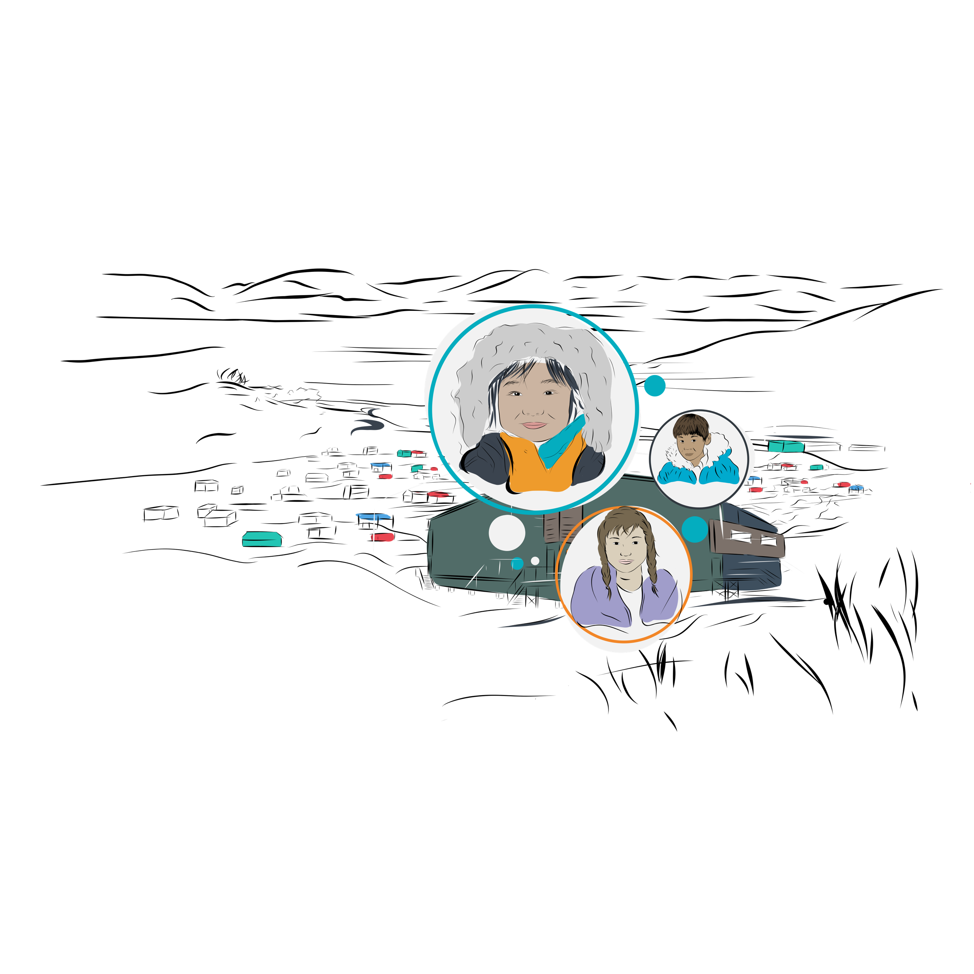


Have
Say!​
Your
workshop
Notes:
ABOUT ÉDUCALOI
Éducaloi is a neutral and independent organization with a recognized expertise in legal education and clear legal communication. Its mission is to explain the law to the population of Quebec in everyday language and to enhance their legal competencies.
ACKNOWLEDGEMENTS
This PowerPoint presentation was designed for volunteer legal professionals interested in facilitating the Have Your Say! workshop, a learning experience designed for schools in Inuit communities in Nunavik. Éducaloi thanks school personnel at Ulluriaq School in Kangiqsualujjuaq for their ongoing support, discussions and comments during the creation of this learning experience. Éducaloi thanks Ulluriaq School students for their participation in a week of activities that inspired the activities in this learning experience. Finally, Éducaloi also thanks Justice Pro Bono for their collaboration and support on this project.

Slide 2





Workshop goals
Have Your Say! workshop
Identify and understand some legal rules that affect your everyday life.
Decide what you think about these rules.
Express your opinion.
Notes:
SPECIAL INSTRUCTIONS FOR VOLUNTEER LEGAL PROFESSIONALS
If you are meeting these students for the first time, introduce yourself! Tell students about where you are from, talk about your background if you feel comfortable doing so, and name the Indigenous nation that inhabits the territory you live on. Talk about your professional journey as well. This might be the first time students meet a legal professional!
INSTRUCTIONS FOR TEACHERS AND VOLUNTEER LEGAL PROFESSIONALS
Explain the workshop’s learning objectives.
Explain that students will be asked to express their opinions about some legal rules.
Highlight that one of the workshop’s objectives is to give students space to talk about their experience and what they think about rules. Assure them that they are in a safe environment to share their opinions, but that they are not required to share if they don’t want to.
Also, acknowledge that students might each have their own experience of rules, and their experience might be neutral, negative, or positive. Set the expectation that it’s normal for different people to have different experiences and that it’s important for students to be respectful during the discussion. Mention that it’s important to know the rules that impact our lives, particularly if we want to help transform them.

Slide 3


Have Your Say! workshop
Where to get help
Talk to someone in your community who you trust.
Contact Tel-Jeunes by chat, text, or phone.
Notes:
INSTRUCTIONS FOR TEACHERS AND VOLUNTEER LEGAL PROFESSIONALS
Explain that you may be discussing some sensitive topics today.
Offer to students that it can sometimes help to talk to someone and ask for support if they’re going through something.
Explain the options for getting help that are on the slide: talking to someone in their community who they trust or contacting Tel-Jeunes by chat, text, or phone.
Tel-jeunes is a free and confidential helpline that’s available in French or English. Tel-jeunes counsellors can be reached by chat, text, or phone. They will listen without judgement and can suggest resources and provide information on many subjects: bullying and violence, sexuality, work, school, etc. See the website, http://en.teljeunes.com/home, text 514-600-1002 or call 1-800-263-2266.​

Slide 4
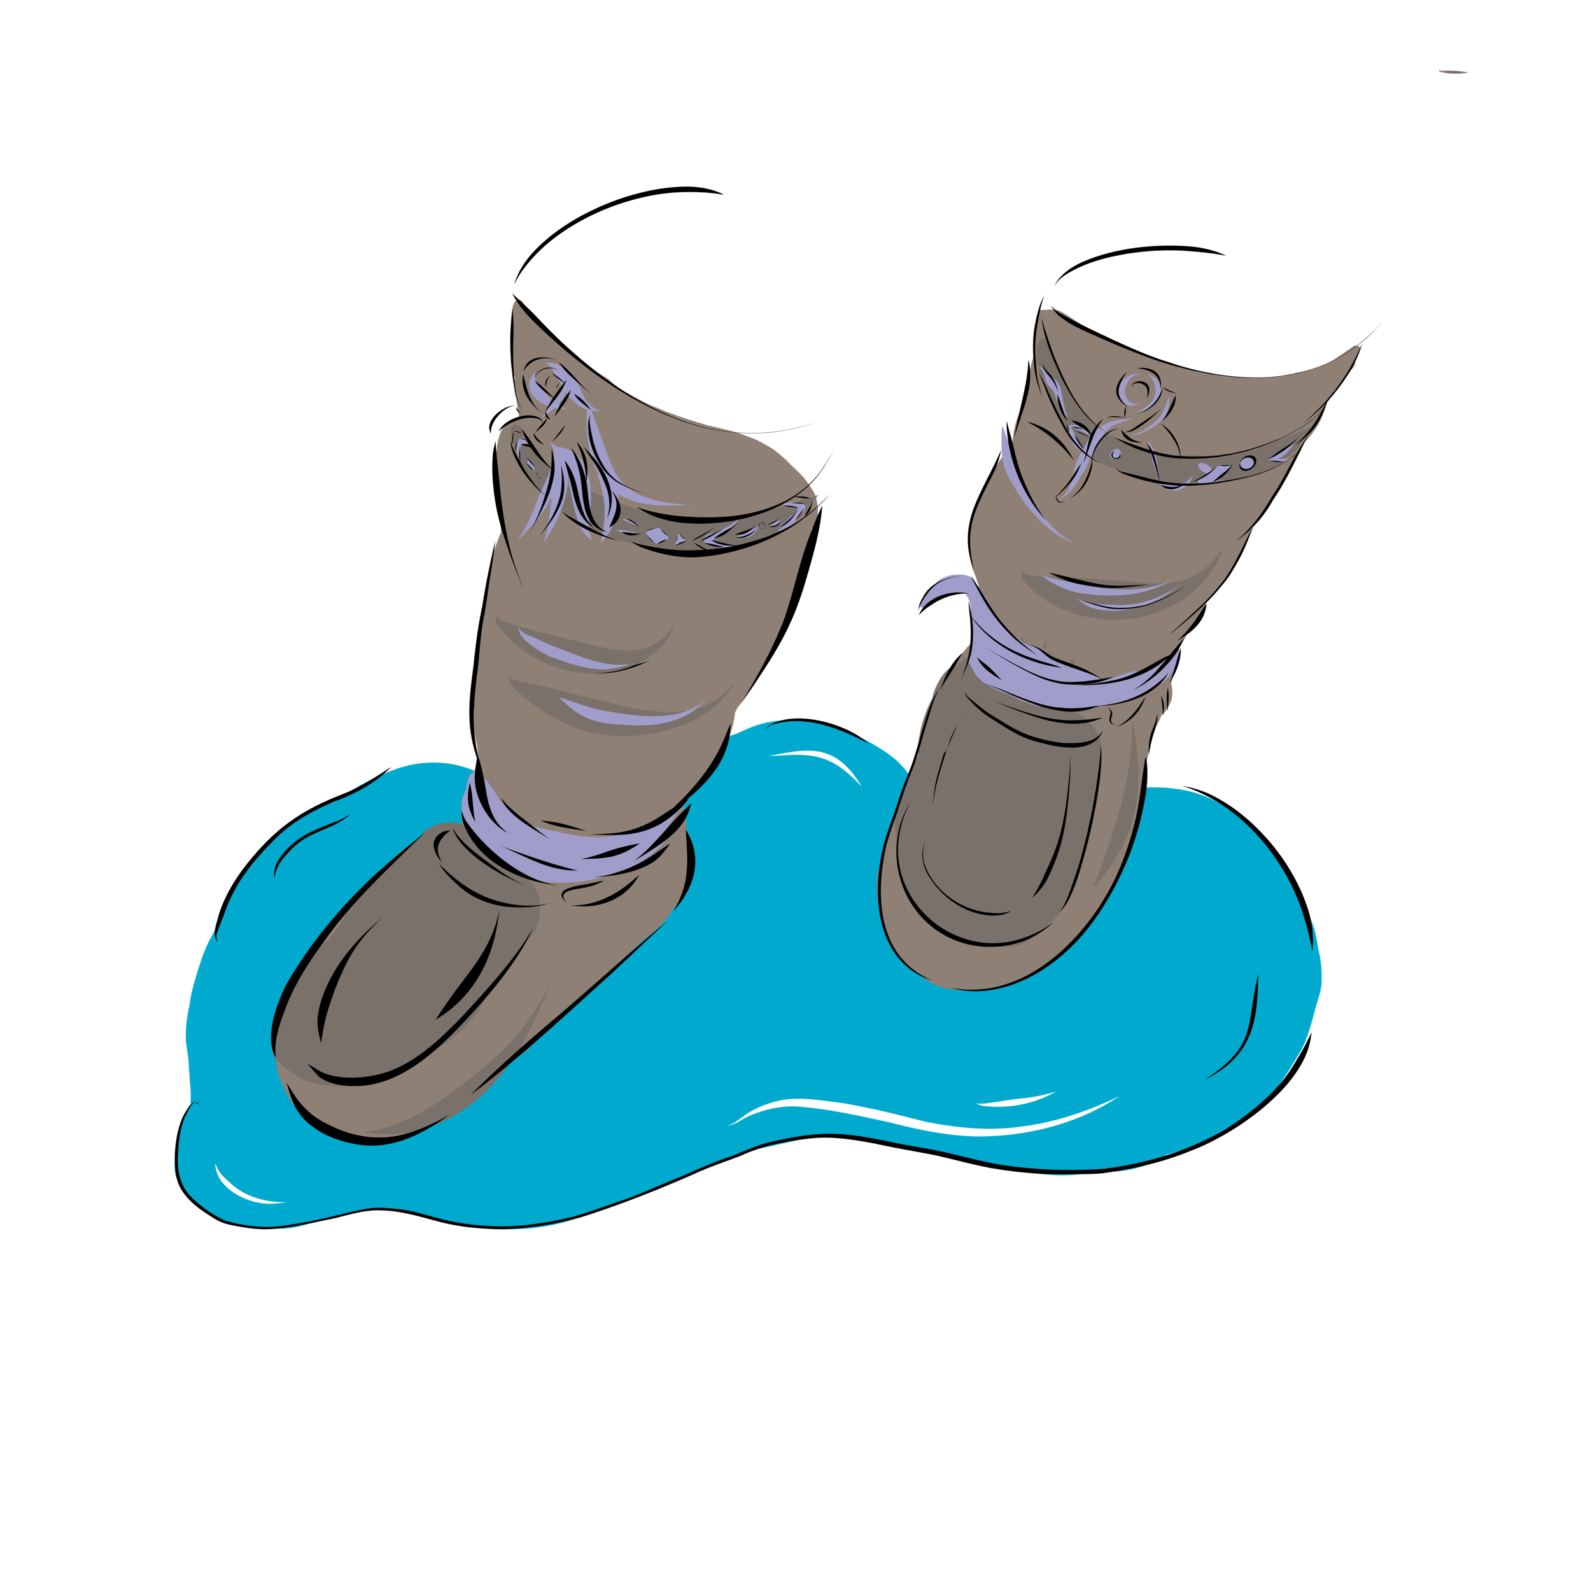
What are rules ?
Have Your Say! workshop
Notes:
INSTRUCTIONS FOR VOLUNTEER LEGAL PROFESSIONALS
Read out the text under « Information to present ».
INSTRUCTIONS FOR TEACHERS
If the students didn’t do the « What are rules? » pre-workshop activity, read out the text under « Information to present ».
If the students already did the « What are rules ? » pre-workshop activity, you can just remind them of the main points.
INFORMATION TO PRESENT
When you go inside your home or your school, do you take your outside boots off or do you leave them on? You probably take them off.
These places usually have a rule that you need to take off your boots when you come inside.
Rules tell us what we can and can’t do at home, at school and in our community.
You learn rules from your family, teachers, and members of your community, like elders.
Some rules are said out loud. Other rules are written down.
Different communities can have different rules. Sometimes, rules can change over time.
Rules tell us how to treat each other well. By taking off your outside boots when you come inside, you help keep the floor clean, and everyone’s socks dry!
(If you have time) What other rules do you know?
Today, we will be talking about some legal rules.

Slide 5

Yes,
totally!
Yes
and
no.
Do you agree with this rule?
Definitely
not!
I don’t
know.
Notes:
INSTRUCTIONS FOR TEACHERS AND VOLUNTEER LEGAL PROFESSIONALS
During the workshop, you will ask students if they agree with a rule, and they will each choose one of these four answers.
The goal is to encourage everyone to participate and to get the discussion going.
We have suggested some methods below for how to run this activity. Some of them are more involved and require some preparation. One of them doesn’t require any preparation.
You can choose to run this activity in whatever way works best for you and for the students. You can even choose a method we didn’t suggest.
If your chosen method isn’t working, you can change partway through the workshop and try something different.
STUDENTS RAISE HANDS (NO PREPARATION REQUIRED)
Explain that students will be able to use these four possible answers as a way to express whether they agree with a legal rule.
Point to each answer on the slide one after the other and tell students to raise their hand when you’re pointing at the answer they choose.
Students may raise their hand multiple times or not at all. That’s OK. Don’t scold them or force them to raise their hand once.
To test it out, ask a fun question as an icebreaker. Here’s an example: “Do you like music?“
STUDENTS SHOW ANSWERS ON A SHEET OF PAPER (PREPARATION REQUIRED)
Required preparation = The guide for this workshop includes an appendix with full-page-sized versions of the four possible answers. Print enough copies so that each student has one of each answer. Another option is to ask students to write each of the four answers on a separate sheet of paper.
Explain that students will be able to use these four possible answers as a way to express whether they agree with a legal rule.
Tell students to choose one of the four answers and lift up that sheet of paper so everyone can see it.
Students may change their answer to follow the majority or their friends. That’s OK. Don’t scold them or force them to go back to their original answer.
To test it out, ask a fun question as an icebreaker. Here’s an example: “Do you like music?“
STUDENTS MOVE AROUND (PREPARATION REQUIRED)
Required preparation = The guide for this workshop includes an appendix with full-page-sized versions of the four possible answers. Print out one of each answer and put them up in the four corners of the classroom. Another option is to write each of the four answers on a separate sheet of paper and put those up instead.
Explain that students will be able to use these four possible answers as a way to express whether they agree with a legal rule.
Tell students to choose one of the four answers and move to the corner of the room that matches their answer.
Students may change position to follow the majority or their friends. That’s OK. Don’t scold them or force them to go back.
To test it out, ask a fun question as an icebreaker. Here’s an example: “Do you like music?“

Slide 6
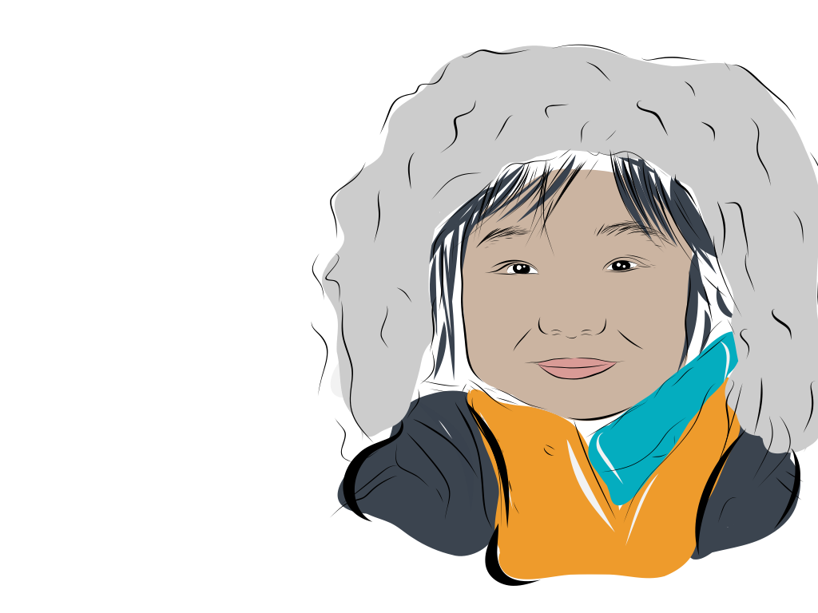



Hunting
and
fishing​
NEXT TOPIC
PREVIOUS TOPIC

Slide 7
Listen to Eliyassie’s story
Hunting and fishing
I am 12.
I go hunting for ptarmigan with my community.
I help clean the ptarmigan and prepare the meat.
I love going out on the land and preparing country food.
workshop
Notes:
INSTRUCTIONS FOR TEACHERS AND VOLUNTEER LEGAL PROFESSIONALS
Read the story.

Slide 8
Learn the rule
Hunting and fishing
Eliyassie and his community have the right to hunt and fish on their land all year long.
Notes:
INSTRUCTIONS FOR TEACHERS AND VOLUNTEER LEGAL PROFESSIONALS
Share legal information on the slide.
Share some additional information if you have time.
IDEAS FOR ADDITIONAL INFORMATION TO SHARE
The right to hunt and fish belongs to Inuit communities and Inuit beneficiaries.
Other people need to get permission before hunting or fishing on Inuit land.
SOURCES
Inuit right to hunt and fish: Act respecting hunting and fishing rights in the James Bay and New Québec territories, CQLR c D-13.1, s 1 al 1, paras (g) and (q), and ss 10, 12, 13, 13.1, 15, 15.3, 16, 19, 20, 21, 32.8, 32.10, 32.11, 35, 36, 37, 38.
See also Act respecting Cree, Inuit and Naskapi Native persons, CQLR c A-33.1.
See also Act respecting the land regime in the James Bay and New Québec territories, CQLR c R-13.1.

Slide 9
Yes,
totally!
Yes
and
no.
Do you agree with this rule?
Definitely
not!
I don’t
know.
Notes:
INSTRUCTIONS FOR TEACHERS AND VOLUNTEER LEGAL PROFESSIONALS
Ask students if they agree with this rule.
Run the activity where students choose one of the four answers using your chosen method (raise hands, show paper, move around, or other).
Ask if one or two students can share why they chose their answer. Thank anyone who shares and validate what they have to say.
You can refer back to the rule to prompt discussion. Here are some ideas for questions you can ask:
What do you like to hunt or fish for?
What does hunting and fishing mean to you and your community?
Why is it important to have this right?

Slide 10
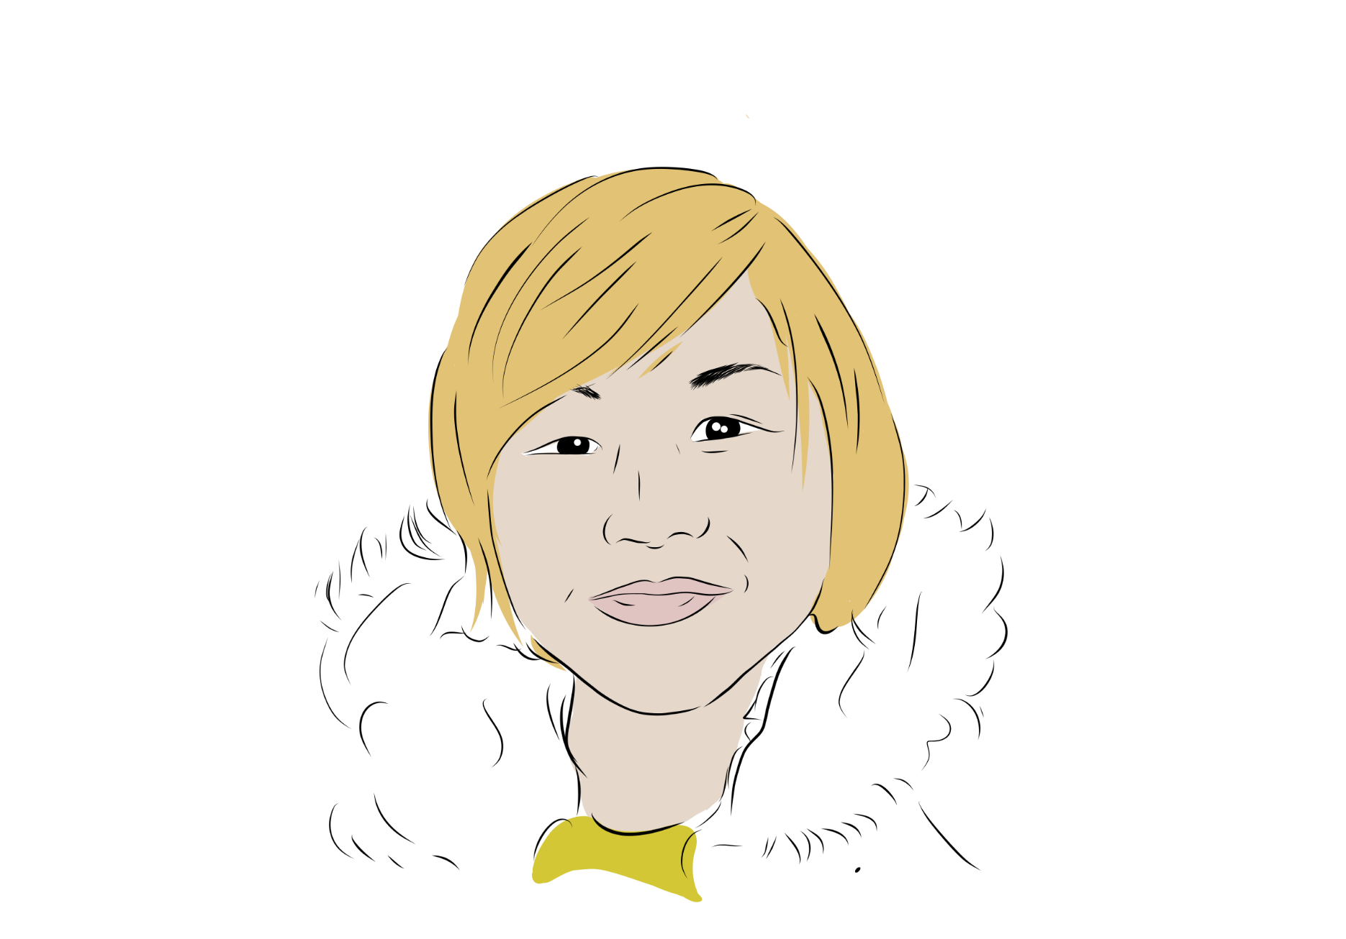

Going
to
school
NEXT TOPIC
PREVIOUS TOPIC

Slide 11
Going to school
Listen to Jaco’s story
I am 14.
I do not want to go to school.
I do not see the point.
I would rather go out on the land.
Notes:
INSTRUCTIONS FOR TEACHERS AND VOLUNTEER LEGAL PROFESSIONALS
Read the story.

Slide 12
Learn the rule
Going to school
Jaco has to go to school until the end of the school year when he turns 15.
Jaco can keep going to school if he wants to!
Notes:
INSTRUCTIONS FOR TEACHERS AND VOLUNTEER LEGAL PROFESSIONALS
Share legal information on the slide.
Share some additional information if you have time.
IDEAS FOR ADDITIONAL INFORMATION TO SHARE
Exceptions = People don’t have to go to school if they go to home school, have health problems or a disability, have been expelled, live too far away and don’t have access to free transportation, or if they need to work to support their family.
When you go to school, you learn knowledge and skills. Some jobs might require a certain level of schooling.
What’s next if you graduate with your high school diploma? You can participate in the Nunavik Sivunitsavut (NS) program if you’re a beneficiary of the James Bay Agreement or go to CÉGEP.
The Kativik School Board offers funding for post-secondary education.
SOURCES
Education Act, CQLR c I-13.3, s 722.
The Education Act for Cree, Inuit and Naskapi Native Persons, CQLR c I-14, ss 256 to 260, 604, 679.
College Education Regulations, CQLR c C-29, r 4, s 2 ; General and Vocational Colleges Act, CQLR c C-29, ss 18 and 19, al 1, para e.
Nunavik Sivunitsavut, « Future Students » (accessed on April 18, 2024), https://sivunitsavut.ca/future-students/
Kativik Ilisarniliriniq, « Policy on Post-secondary Education Sponsorship Program”, CC 2016/2017-48, CC 2019/2020-08, CC 2019/2020-85, CC 2020/2021-53, CC 2021/2022-51 and CC 2021/2022-78, https://www.kativik.qc.ca/wp-content/uploads/2021/09/SP-01-Post-Secondary-Education_Sponsorship-Program_E_2022-10.pdf

Slide 13
Yes,
totally!
Yes
and
no.
Do you agree with this rule?
Definitely
not!
I don’t
know.
Notes:
INSTRUCTIONS FOR TEACHERS AND VOLUNTEER LEGAL PROFESSIONALS
Ask students if they agree with this rule.
Run the activity where students choose one of the four answers using your chosen method (raise hands, show paper, move around, or other).
Ask if one or two students can share why they chose their answer. Thank anyone who shares and validate what they have to say.
You can refer back to the rule to prompt discussion. Here are some ideas for questions you can ask:
What do you like or not like about going to school?
What do you think about the age 15? Should it be younger or older?
Should it be a free choice at any age?

Slide 14
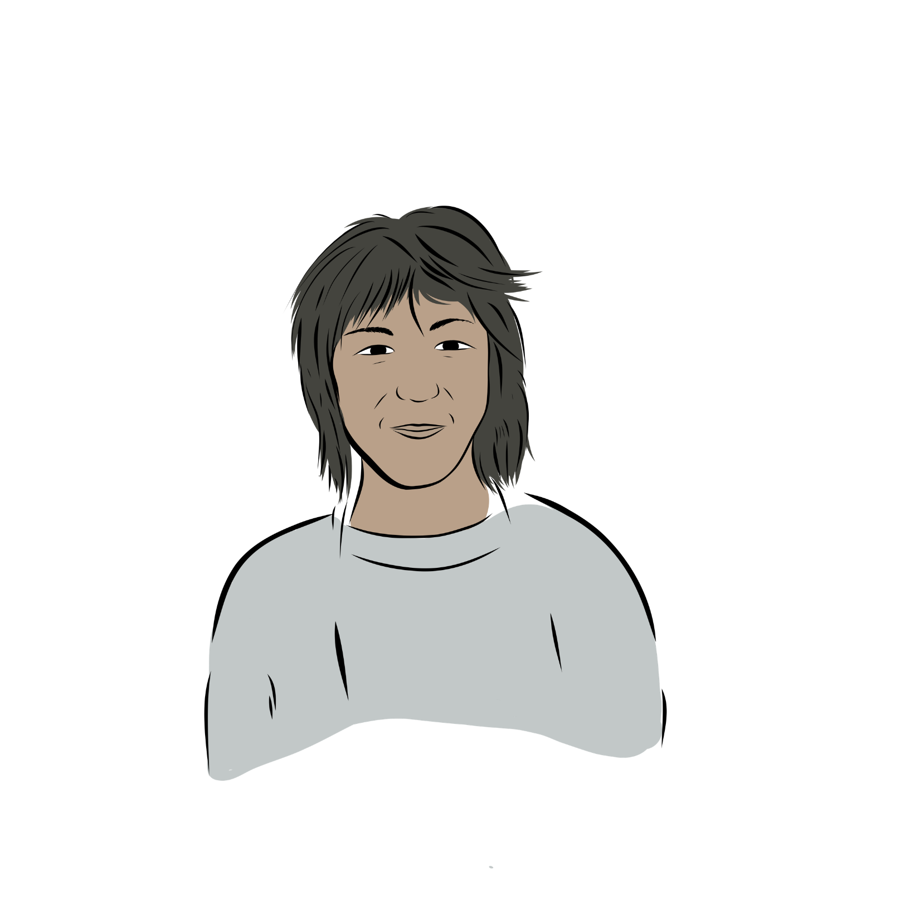
Working
and
school
NEXT TOPIC
PREVIOUS TOPIC

Slide 15
Working and school
Listen to Simon’s story
I am 15.
I work as a cashier at the co-op.
I scan things fast.
I am good at giving the right change.
I like having a job and making money.
Notes:
INSTRUCTIONS FOR TEACHERS AND VOLUNTEER LEGAL PROFESSIONALS
Read the story.

Slide 16
Learn the rule
Working and school
Simon can work most jobs because he is older than 14.
Students under 14 can work some jobs, like at their family’s small business.
Students usually can’t work during school hours.
Notes:
INSTRUCTIONS FOR TEACHERS AND VOLUNTEER LEGAL PROFESSIONALS
Share legal information on the slide.
Share some additional information if you have time.
IDEAS FOR ADDITIONAL INFORMATION TO SHARE
Students must be 14 or older to work most jobs.
Students under 14 can work some jobs, like being a babysitter or working at a small family business owned by one of their parents.
Until the end of the school year when a student turns 15, school usually has to come before work.
Students can’t work during school hours unless they need to support their family.
SOURCES
Act respecting labour standards, CQLR c N-1.1, ss 84.2-84.7.​
Regulation respecting labour standards, ss 35.0.3., 35.1, 35.2.​
Education Act, CQLR c I-13.3, s 722.
The Education Act for Cree, Inuit and Naskapi Native Persons, CQLR c I-14, ss 259, 260, 604, 679.

Slide 17
Yes,
totally!
Yes
and
no.
Do you agree with this rule?
Definitely
not!
I don’t
know.
Notes:
INSTRUCTIONS FOR TEACHERS AND VOLUNTEER LEGAL PROFESSIONALS
Ask students if they agree with this rule.
Run the activity where students choose one of the four answers using your chosen method (raise hands, show paper, move around, or other).
Ask if one or two students can share why they chose their answer. Thank anyone who shares and validate what they have to say.
You can refer back to the rule to prompt discussion. Here are some ideas for questions you can ask:
What jobs do you have? What jobs do you want?
Should students be allowed to work instead of going to school if they want to?
What can the community do to help people get jobs?

Slide 18

Hitting
in
sports
NEXT TOPIC
PREVIOUS TOPIC

Slide 19
Hitting in sports
Listen to Alec’s story
I am 12.
I am on the school’s hockey team.
During a game, I bodychecked another player.
The other player fell and sprained their ankle.
I feel bad the other player got hurt.
It was an accident.
Notes:
INSTRUCTIONS FOR TEACHERS AND VOLUNTEER LEGAL PROFESSIONALS
Read the story.

Slide 20
Learn the rule
Hitting in sports
Alec can bodycheck other players if the rules allow it.
Alec must bodycheck safely.
Notes:
INSTRUCTIONS FOR TEACHERS AND VOLUNTEER LEGAL PROFESSIONALS
Share legal information on the slide.
Share some additional information if you have time.
IDEAS FOR ADDITIONAL INFORMATION TO SHARE
When people agree to play a sport, they agree to the rules.
If the rules allow physical contact, players accept the risk that they might get a little hurt by accident.
But agreeing to play a sport doesn’t mean you agree to get seriously hurt. A player can get in trouble if they go too far.
SOURCES
Criminal Code, RCS 1985, c C-46, ss 14, 265(1).
LSJPA — 1166, 2011 QCCQ 18725 (CanLII) aux paras 16 à 19.
Zaccardo v Chartis Insurance Company of Canada, 2016 QCCS 398.
Appeal dismissed: Aig Insurance Company of Canada) v Zaccardo, 2016 QCCA 787.

Slide 21
Yes,
totally!
Yes
and
no.
Do you agree with this rule?
Definitely
not!
I don’t
know.
Notes:
INSTRUCTIONS FOR TEACHERS AND VOLUNTEER LEGAL PROFESSIONALS
Ask students if they agree with this rule.
Run the activity where students choose one of the four answers using your chosen method (raise hands, show paper, move around, or other).
Ask if one or two students can share why they chose their answer. Thank anyone who shares and validate what they have to say.
You can refer back to the rule to prompt discussion. Here are some ideas for questions you can ask:
What sports do you like to play?
What do you think about physical contact in sports?
What do you think should happen when someone gets hurt?

Slide 22
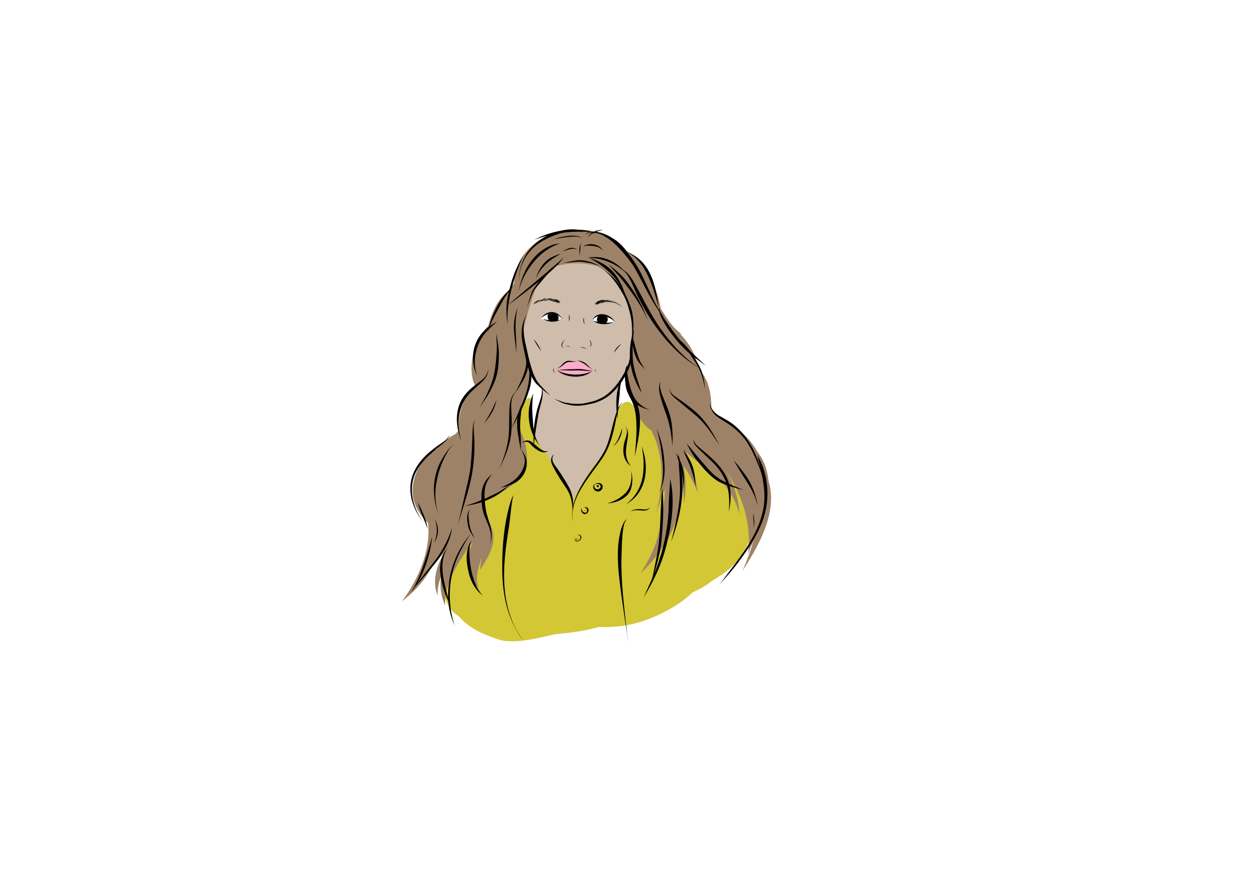
Voting
and
running
for office
NEXT TOPIC
PREVIOUS TOPIC

Slide 23
Voting and running for office
Listen to Louisa’s story
I am 13.
I want to be mayor of my community one day.
Notes:
INSTRUCTIONS FOR TEACHERS AND VOLUNTEER LEGAL PROFESSIONALS
Read the story.

Slide 24
Learn the rule
Voting and running for office
Louisa can be mayor when she is 18 or older.
Notes:
INSTRUCTIONS FOR TEACHERS AND VOLUNTEER LEGAL PROFESSIONALS
Share legal information on the slide.
Share some additional information if you have time.
IDEAS FOR ADDITIONAL INFORMATION TO SHARE
To be mayor of their community, students need to be 18 or older, a Canadian citizen, and living in the community for at least 36 months, among other things.
The mayor runs the community together with councillors.
The mayor and councillors are elected every three years by the community or chosen without an election.
Students also need to be 18 or older to run for provincial and federal government.
SOURCES
Act respecting elections and referendums in municipalities, CQLR c E-22, s 1.
Act respecting Northern villages and the Kativik Regional Government, CQLR c V-61, ss 19, 20, 22, 23, 31.
Election Act, CQLR c E-3.3, ss 1, 2, 234 to 236.
Canada Elections Act, SC 2000 c 9, ss 3, 6, 65.

Slide 25
Yes,
totally!
Yes
and
no.
Do you agree with this rule?
Definitely
not!
I don’t
know.
Notes:
INSTRUCTIONS FOR TEACHERS AND VOLUNTEER LEGAL PROFESSIONALS
Ask students if they agree with this rule.
Run the activity where students choose one of the four answers using your chosen method (raise hands, show paper, move around, or other).
Ask if one or two students can share why they chose their answer. Thank anyone who shares and validate what they have to say.
You can refer back to the rule to prompt discussion. Here are some ideas for questions you can ask:
Would you want to be mayor?
Who is the mayor of your community?
What do you think about the requirements for being mayor?
What do you think about the way mayors are chosen?

Slide 26

Photos
on social
media
NEXT TOPIC
PREVIOUS TOPIC

Slide 27
Photos on social media
Listen to Markusie’s story
I am 14.
I am classmates with Brianna.
Brianna took my photo when we were hanging out at my house.
Brianna put my photo on her public Facebook without my permission.
I want Brianna to take the photo down.
Notes:
INSTRUCTIONS FOR TEACHERS AND VOLUNTEER LEGAL PROFESSIONALS
Read the story.

Slide 28
Learn the rule
Photos on social media
Brianna needs to ask permission before posting a picture of Markusie.
Brianna needs to take the photo down if Markusie wants her to.
Notes:
INSTRUCTIONS FOR TEACHERS AND VOLUNTEER LEGAL PROFESSIONALS
Share legal information on the slide.
Share some additional information if you have time.
IDEAS FOR ADDITIONAL INFORMATION TO SHARE
Everyone has the right to their image and their private life.
If you take a photo of someone in private, you usually need their permission to share it on public social media.
Parents can give this permission for their children. For example, the school may have parents’ permission to take photos of students and post them.
Exception = someone can use a photo that they took in a public place if you just happen to be in the background or part of a crowd.
SOURCES
Civil Code of Québec, CQLR c CCQ-1991, ss 35 to 36.
Charter of Human Rights and Freedoms, CQLR c C-12, ss 4 and 5.
Aubry v Éditions Vice-Versa, [1998] 1 SCR 591 at paras 53-54, 58-59.
Chihane v Association de la sépulture musulmane au Québec, 2023 QCCQ 9911 (CanLII).

Slide 29
Yes,
totally!
Yes
and
no.
Do you agree with this rule?
Definitely
not!
I don’t
know.
Notes:
INSTRUCTIONS FOR TEACHERS AND VOLUNTEER LEGAL PROFESSIONALS
Ask students if they agree with this rule.
Run the activity where students choose one of the four answers using your chosen method (raise hands, show paper, move around, or other).
Ask if one or two students can share why they chose their answer. Thank anyone who shares and validate what they have to say.
You can refer back to the rule to prompt discussion. Here are some ideas for questions you can ask:
What do you like or not like about social media?
What do you think about posting photos on social media?
Should people need your permission to put your photo on social media?

Slide 30
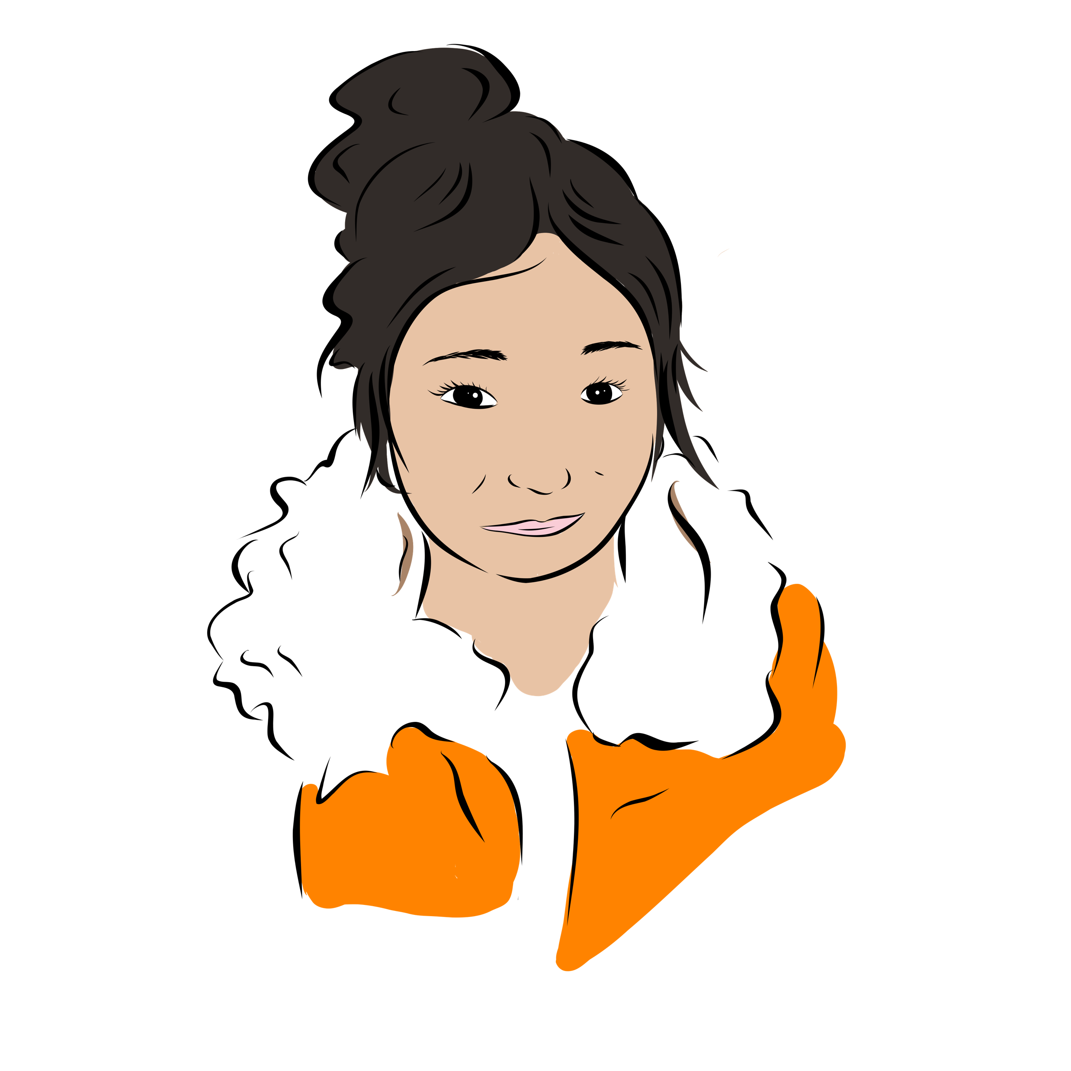
Comments
on social
media
NEXT TOPIC
PREVIOUS TOPIC

Slide 31
Comments on social media
Listen to Kathy’s story
I am 15.
I am Facebook friends with lots of people in my community.
I often see people getting into fights and calling each other names on Facebook.
I think it’s funny that people get so upset over nothing.
Notes:
INSTRUCTIONS FOR TEACHERS AND VOLUNTEER LEGAL PROFESSIONALS
Read the story.

Slide 32
Learn the rule
Comments on social media
People aren’t allowed to say things that:
hurt someone’s reputation,
threaten violence,
encourage others to hate a group of people.
Notes:
INSTRUCTIONS FOR TEACHERS AND VOLUNTEER LEGAL PROFESSIONALS
Share legal information on the slide.
Share some additional information if you have time.
IDEAS FOR ADDITIONAL INFORMATION TO SHARE
You can’t say whatever you want on social media or in person.
People have the right to their good reputation. Spreading nasty stories about someone isn’t allowed.
It’s also not allowed to threaten violence or encourage others to hate a group of people. A group of people might be based on race or religion, for example. The police might get involved in this case.
SOURCES
Charter of Human Rights and Freedoms, CQLR c C-12, ss 3, 4, 9.1.
Prud’homme v Prud’homme, 2002 SCC 85, at paras 36-43.
Criminal Code, RCS 1985, c C-46, ss 264.1, 319.
R v Keegstra, [1990] 3 SCR 697.
R v Gagné, 2011 QCCA 2157.

Slide 33
Yes,
totally!
Yes
and
no.
Do you agree with this rule?
Definitely
not!
I don’t
know.
Notes:
INSTRUCTIONS FOR TEACHERS AND VOLUNTEER LEGAL PROFESSIONALS
Ask students if they agree with this rule.
Run the activity where students choose one of the four answers using your chosen method (raise hands, show paper, move around, or other).
Ask if one or two students can share why they chose their answer. Thank anyone who shares and validate what they have to say.
You can refer back to the rule to prompt discussion. Here are some ideas for questions you can ask:
What do you like or not like about social media?
Can words hurt?
What do you think we should do when people say hurtful things?

Slide 34
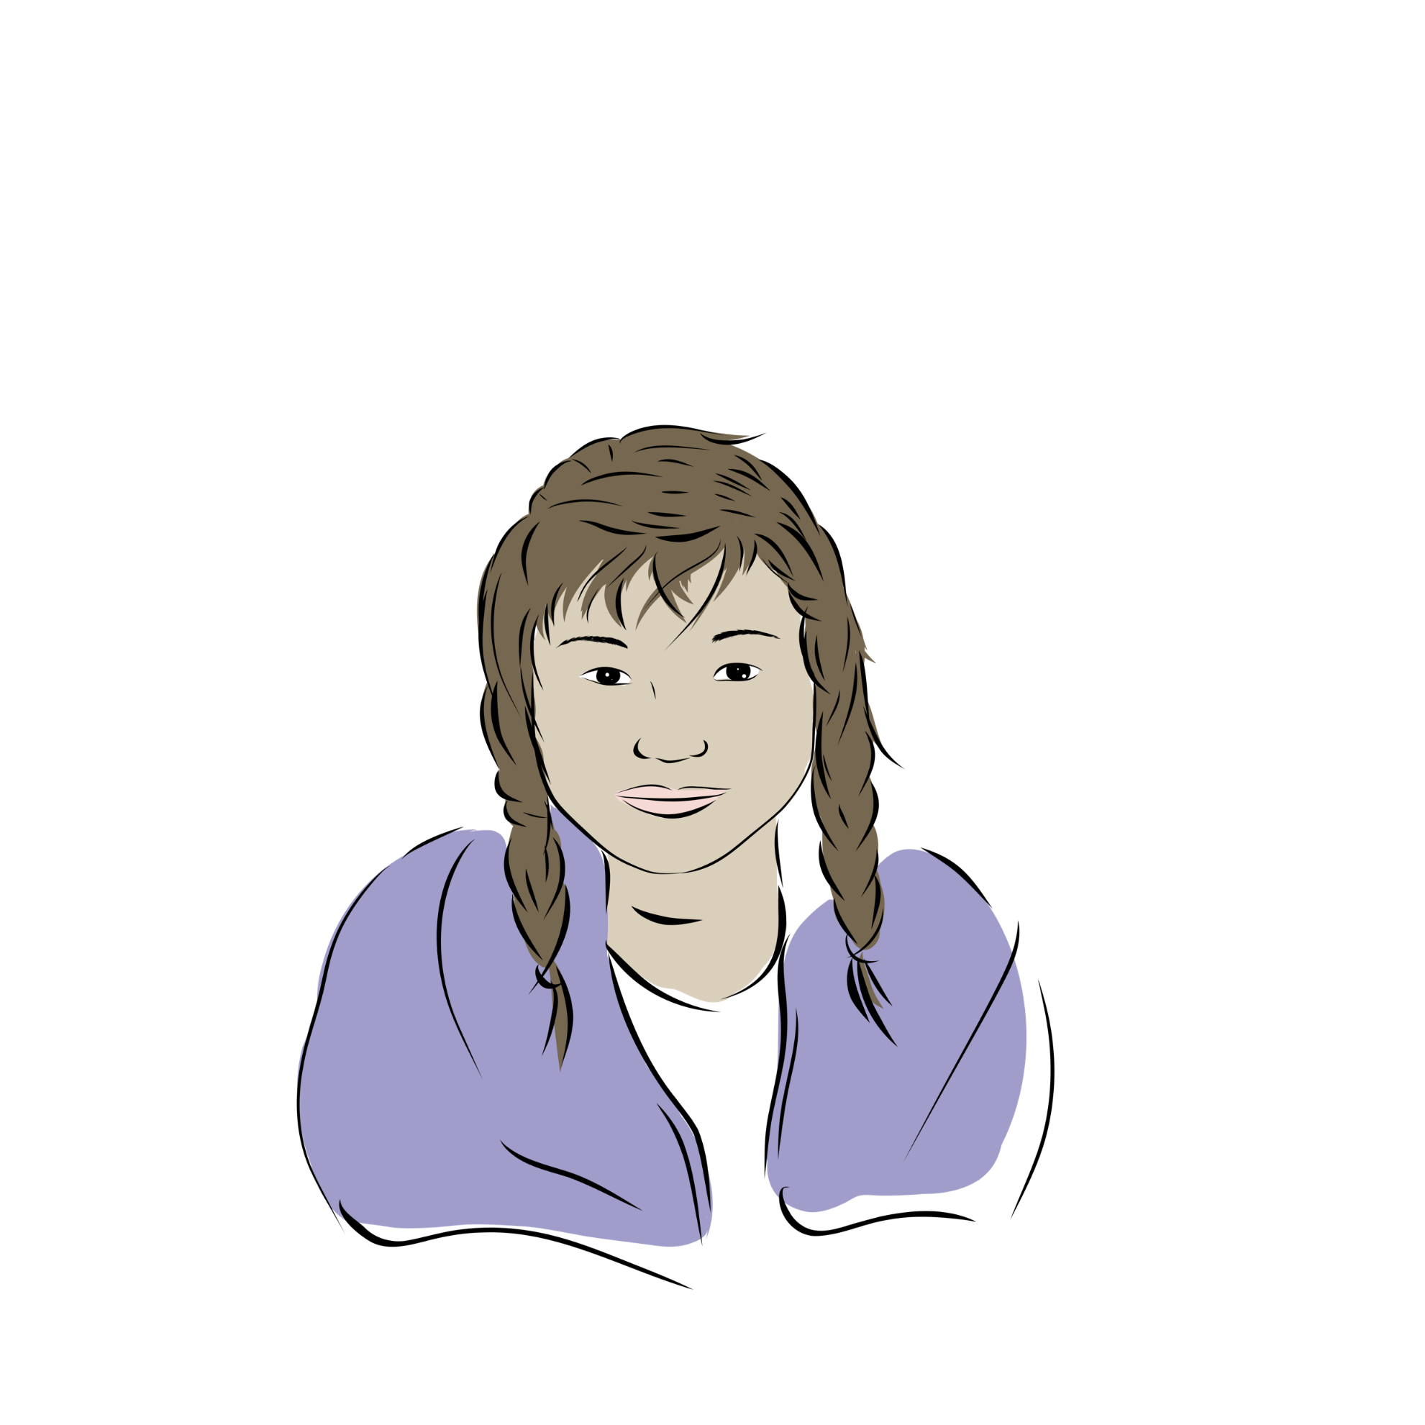
Crime
In the
community
NEXT TOPIC
PREVIOUS TOPIC

Slide 35
Crime in the community
Listen to Kaitlyn’s story (Part 1)
I am 12.
I threw rocks at a building in town.
I broke a window.
I didn’t realize the cops were right there.
The cops saw me do it.
I am scared about what will happen.
Notes:
INSTRUCTIONS FOR TEACHERS AND VOLUNTEER LEGAL PROFESSIONALS
Read the story.
This topic goes together with « Justice committees ». We suggest doing both if you have time.

Slide 36
Learn the rule
Crime in the community
Damaging property is a crime.
Sometimes, the police or justice committee workers might get involved.
Notes:
INSTRUCTIONS FOR TEACHERS AND VOLUNTEER LEGAL PROFESSIONALS
Share legal information on the slide.
Share some additional information if you have time.
This topic goes together with « Justice committees ». We suggest doing both if you have time.
IDEAS FOR ADDITIONAL INFORMATION TO SHARE
Damaging property is hurtful to the owner and the community. It might stop others from using the property and getting something good out of it. It costs money to repair.
Part of the police’s job is to keep the community peaceful and safe. They also get involved when someone commits a crime.
When someone under 18 commits a crime, the goal is to help them reconnect with their community and understand what to do differently in the future. Justice committee workers can help someone through this process.
SOURCES
Criminal Code, RSC 1985, c C-46, s 430.
Youth Criminal Justice Act, SC 2002, c 1, s 3.
James Bay and Northern Québec Agreement, sect 20, para 20.0.24, and sect 21.
Nunavik Police Service, “Public Security”, https://krg.ca/en-CA/departments/public-security
Makivvik Corporation, “Makivvik Justice Program”, https://www.makivvik.ca/current/makivik-justice-program/

Slide 37
Yes,
totally!
Yes
and
no.
Do you agree with this rule?
Definitely
not!
I don’t
know.
Notes:
INSTRUCTIONS FOR TEACHERS AND VOLUNTEER LEGAL PROFESSIONALS
Ask students if they agree with this rule.
Run the activity where students choose one of the four answers using your chosen method (raise hands, show paper, move around, or other).
Ask if one or two students can share why they chose their answer. Thank anyone who shares and validate what they have to say.
You can refer back to the rule to prompt discussion. Here are some ideas for questions you can ask:
Has something like this happened in your community?
What can communities do about property damage and other crime?
What do you think about having police in the community?

Slide 38
Justice
commitee
workers
NEXT TOPIC
PREVIOUS TOPIC

Slide 39
Justice committee workers
Listen to Kaitlyn’s story (Part 2)
I am 12.
I got arrested for throwing rocks at a building in town.
I meet with a justice committee worker.
The justice committee worker and I go fishing together.
We talk about what happened.
I want to do something good for the community now.
Notes:
INSTRUCTIONS FOR TEACHERS AND VOLUNTEER LEGAL PROFESSIONALS
Read the story.
This topic goes together with « Crime in the community ». We suggest doing both if you have time.

Slide 40
Learn the rule
Justice committee workers
Justice committee workers help people affected by crime or a conflict.
Justice committee workers use Inuit knowledge and ways.
Notes:
INSTRUCTIONS FOR TEACHERS AND VOLUNTEER LEGAL PROFESSIONALS
Share legal information on the slide.
Share some additional information if you have time.
This topic goes together with « Crime in the community ». We suggest doing both if you have time.
IDEAS FOR ADDITIONAL INFORMATION TO SHARE
Community justice workers might get involved before or after someone has committed a crime. They might also get involved when people have a conflict.
They support people who are rejoining their community after committing a crime.
They help people heal and find solutions to problems.
SOURCES
James Bay and Northern Québec Agreement, sect 20, para 20.0.24.
Makivvik Corporation, “Makivvik Justice Program”, https://www.makivvik.ca/current/makivik-justice-program/

Slide 41
Yes,
totally!
Yes
and
no.
Do you agree with this rule?
Definitely
not!
I don’t
know.
Notes:
INSTRUCTIONS FOR TEACHERS AND VOLUNTEER LEGAL PROFESSIONALS
Ask students if they agree with this rule.
Run the activity where students choose one of the four answers using your chosen method (raise hands, show paper, move around, or other).
Ask if one or two students can share why they chose their answer. Thank anyone who shares and validate what they have to say.
You can refer back to the rule to prompt discussion. Here are some ideas for questions you can ask:
Have you ever heard of justice committee workers?
Have you heard of people going to jail?
What should communities do when someone is part of a conflict?

Slide 42
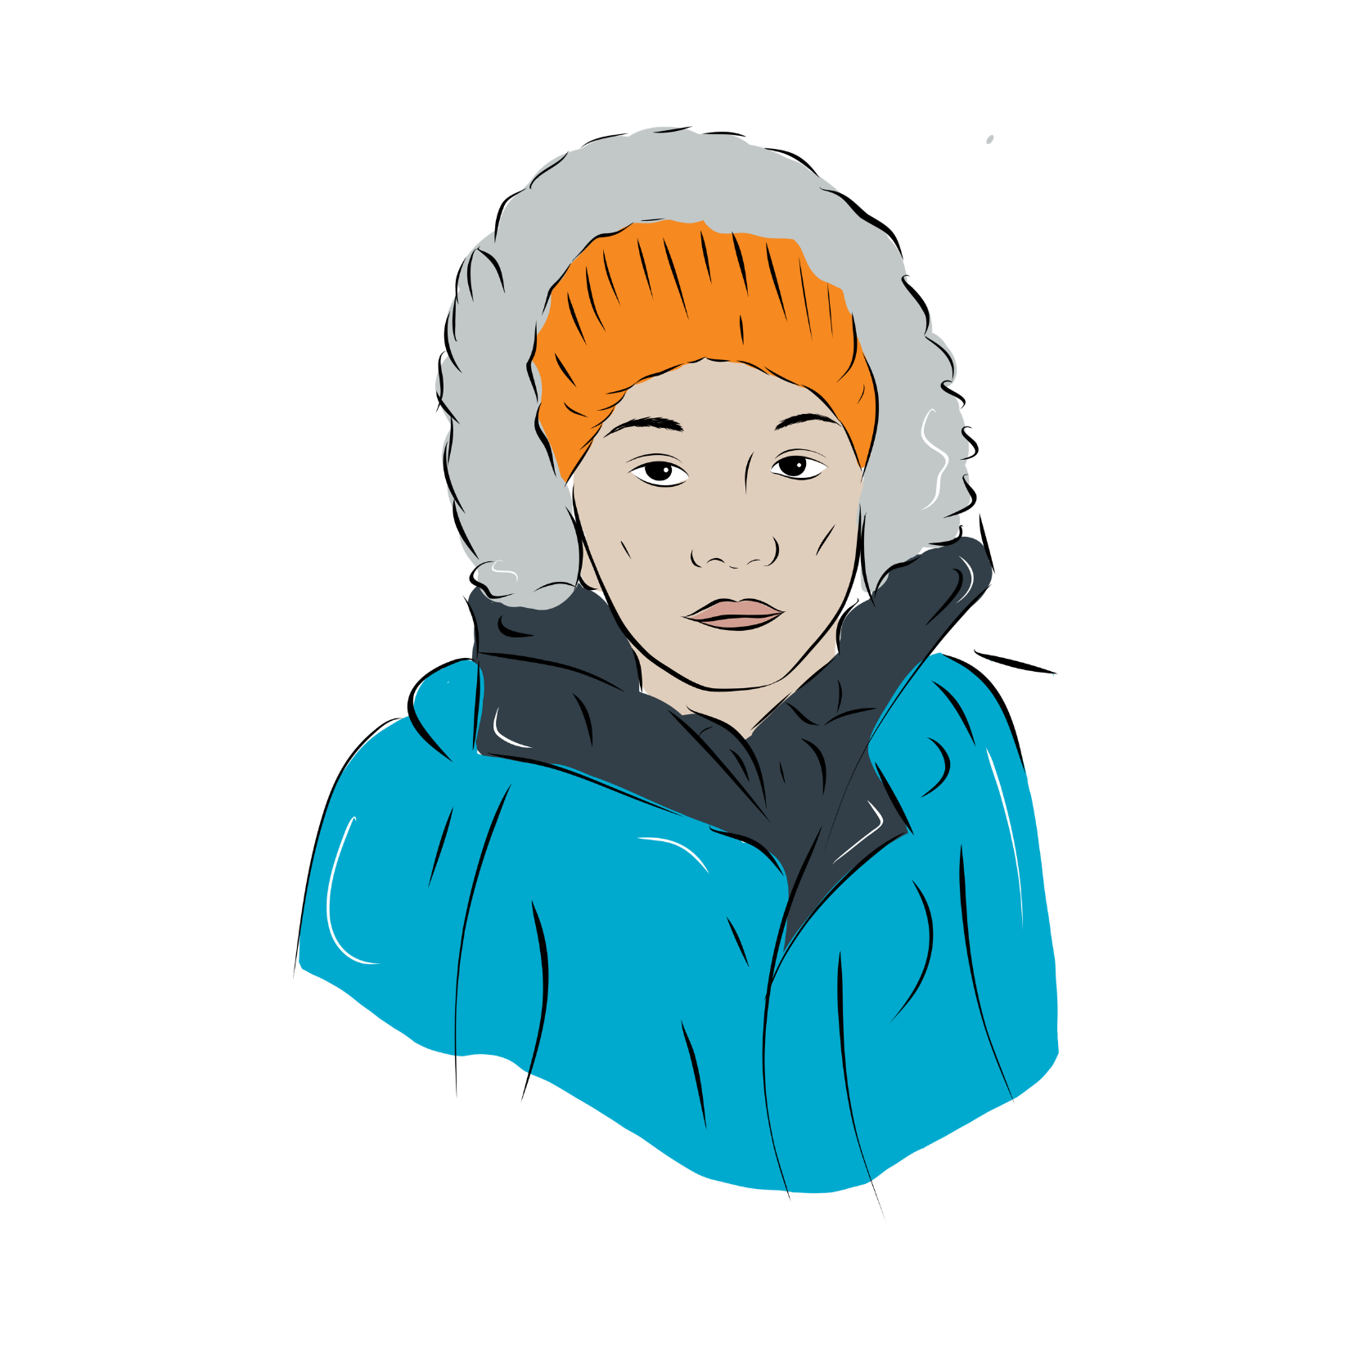
Bullying
NEXT TOPIC
PREVIOUS TOPIC

Slide 43
Bullying
Listen to Robert’s story
I am 14.
I don't have a lot of friends.
My classmates make fun of him.
They call me names all the time.
I am sad and anxious.
I don't like going to school.
Notes:
INSTRUCTIONS FOR TEACHERS AND VOLUNTEER LEGAL PROFESSIONALS
Read the story.

Slide 44
Learn the rule
Bullying
Robert’s classmates aren’t allowed to bully him.
Notes:
INSTRUCTIONS FOR TEACHERS AND VOLUNTEER LEGAL PROFESSIONALS
Share legal information on the slide.
Share some additional information if you have time.
IDEAS FOR ADDITIONAL INFORMATION TO SHARE
Bullying is unwanted and repeated aggressive behaviour. The person or people bullying have more power than the person being bullied.
Bullying can be words or actions. Bullying can happen in person or online. Bullying is harmful.
Bullying isn’t allowed. Schools must stop bullying and help students who are being bullied.
SOURCES
Education Act, CQLR c I-13.3, s 722.
The Education Act for Cree, Inuit and Naskapi Native Persons, CQLR c I-14, ss 605 to 607.
Kativik Ilisarniliriniq, “Directive Against Bullying And For The Promotion Of Peaceful And Responsive Schools”, CC 2005/2006-54, 2012/2013-14 and CC 2015/16-05, https://www.kativik.qc.ca/wp-content/uploads/2021/09/ADM-16-Directive-Against-Bullying-Promoting-Peaceful-Responsive-School-E.pdf

Slide 45
Yes,
totally!
Yes
and
no.
Do you agree with this rule?
Definitely
not!
I don’t
know.
Notes:
INSTRUCTIONS FOR TEACHERS AND VOLUNTEER LEGAL PROFESSIONALS
Ask students if they agree with this rule.
Run the activity where students choose one of the four answers using your chosen method (raise hands, show paper, move around, or other).
Ask if one or two students can share why they chose their answer. Thank anyone who shares and validate what they have to say.
You can refer back to the rule to prompt discussion. Here are some ideas for questions you can ask:
Have you talked about bullying in your school?
What should schools do about bullying?
How can you help someone who’s being bullying?

Slide 46

Drinking
and
driving
NEXT TOPIC
PREVIOUS TOPIC

Slide 47
Drinking and driving
Listen to Peggy’s story
I am 15.
I was drinking with my friends.
I drove my ATV home.
I lost control and rolled the ATV.
I thought I could drink and still drive safe.
I think I made a mistake.
Notes:
INSTRUCTIONS FOR TEACHERS AND VOLUNTEER LEGAL PROFESSIONALS
Read the story.

Slide 48
Learn the rule
Drinking and driving
Drinking and driving is a crime.
Sometimes, the police or child protection services might get involved.
Notes:
INSTRUCTIONS FOR TEACHERS AND VOLUNTEER LEGAL PROFESSIONALS
Share legal information on the slide.
Share some additional information if you have time.
IDEAS FOR ADDITIONAL INFORMATION TO SHARE
People 21 and under aren’t allowed to have any alcohol in their system when they drive.
Older adults aren’t allowed to go over a certain limit.
The police are allowed to stop someone and test for alcohol or drugs.
Child protection services or the police might get involved in this type of situation.
SOURCES
Highway Safety Code, CQLR c C-24.2, ss 202.1.2, 202.1.3, 202.1.4, 202.2, 202.3, 202.4, al 2, 202.8.
Criminal Code, RCS 1985, c C-46, ss 320.11 "operate," 320.13, 320.14, 320.19, 320.27, 320.28, 320.35, 320.38.
Blood Drug Concentration Regulations, SOR/2018-148.
Pronovost v R, 2018 QCCA 2212.
Loi sur la protection de la jeunesse, RLRQ P-34.1, ss 38 à 38.3, 49 à 51, 131.1 à 131.5.
James Bay and Northern Québec Agreement, sect 21.
Nunavik Police Service, “Public Security”, https://krg.ca/en-CA/departments/public-security

Slide 49
Yes,
totally!
Yes
and
no.
Do you agree with this rule?
Definitely
not!
I don’t
know.
Notes:
INSTRUCTIONS FOR TEACHERS AND VOLUNTEER LEGAL PROFESSIONALS
Ask students if they agree with this rule.
Run the activity where students choose one of the four answers using your chosen method (raise hands, show paper, move around, or other).
Ask if one or two students can share why they chose their answer. Thank anyone who shares and validate what they have to say.
You can refer back to the rule to prompt discussion. Here are some ideas for questions you can ask:
What do you think about drinking and driving?
What should happen when people drink and drive?

Slide 50

Using
weed
NEXT TOPIC
PREVIOUS TOPIC

Slide 51
Using weed
Listen to Amelia’s story
I am 14.
I hang out with my friends in an abandoned shack in town.
Sometimes my friends have weed.
I don’t always want to smoke weed.
I feel pressure to smoke weed to fit in.
Notes:
INSTRUCTIONS FOR TEACHERS AND VOLUNTEER LEGAL PROFESSIONALS
Read the story.

Slide 52
Learn the rule
Using weed
Amelia and her friends are too young to have weed.
People who are 21 or older can have weed.
Notes:
INSTRUCTIONS FOR TEACHERS AND VOLUNTEER LEGAL PROFESSIONALS
Share legal information on the slide.
Share some additional information if you have time.
IDEAS FOR ADDITIONAL INFORMATION TO SHARE
Someone under 21 isn’t allowed to buy weed.
Someone 21 or older isn’t allowed to buy weed for someone under 21.
It’s also not allowed to help or encourage someone else to do one of these things.
Sometimes, child protection services or the police might get involved.
SOURCES
Cannabis Regulation Act, CQLR c C-5.3, ss 4, 10, 25, 35, 38, 39, 88.
Cannabis Act, SC 2018, c 16, s 2, “young person”, and ss 8(1)(c), 8(2)(a)(ii), 8(2)(b)(ii), 9(1)(b), 9(5)(ii), 12(7), 12(10), 69(1), 69(3)(b).
Kativik Ilisarniliriniq, “Psychoactive Substance Use Procedure On School Grounds”, CS-03, https://www.kativik.qc.ca/wp-content/uploads/2024/03/CS-03-Psychoactive-substance-use-procedure-on-school-grounds-E-2024-03.pdf
Youth Protection Act, CQLR P-34.1, ss 38 à 38.3, 49 à 51, 131.1 à 131.5.
James Bay and Northern Québec Agreement, sect 21.
Nunavik Police Service, “Public Security”, https://krg.ca/en-CA/departments/public-security

Slide 53
Yes,
totally!
Yes
and
no.
Do you agree with this rule?
Definitely
not!
I don’t
know.
Notes:
INSTRUCTIONS FOR TEACHERS AND VOLUNTEER LEGAL PROFESSIONALS
Ask students if they agree with this rule.
Run the activity where students choose one of the four answers using your chosen method (raise hands, show paper, move around, or other).
Ask if one or two students can share why they chose their answer. Thank anyone who shares and validate what they have to say.
You can refer back to the rule to prompt discussion. Here are some ideas for questions you can ask:
What do you think about the age 21? Should it be younger or older?
Should it be a free choice at any age?

Slide 54
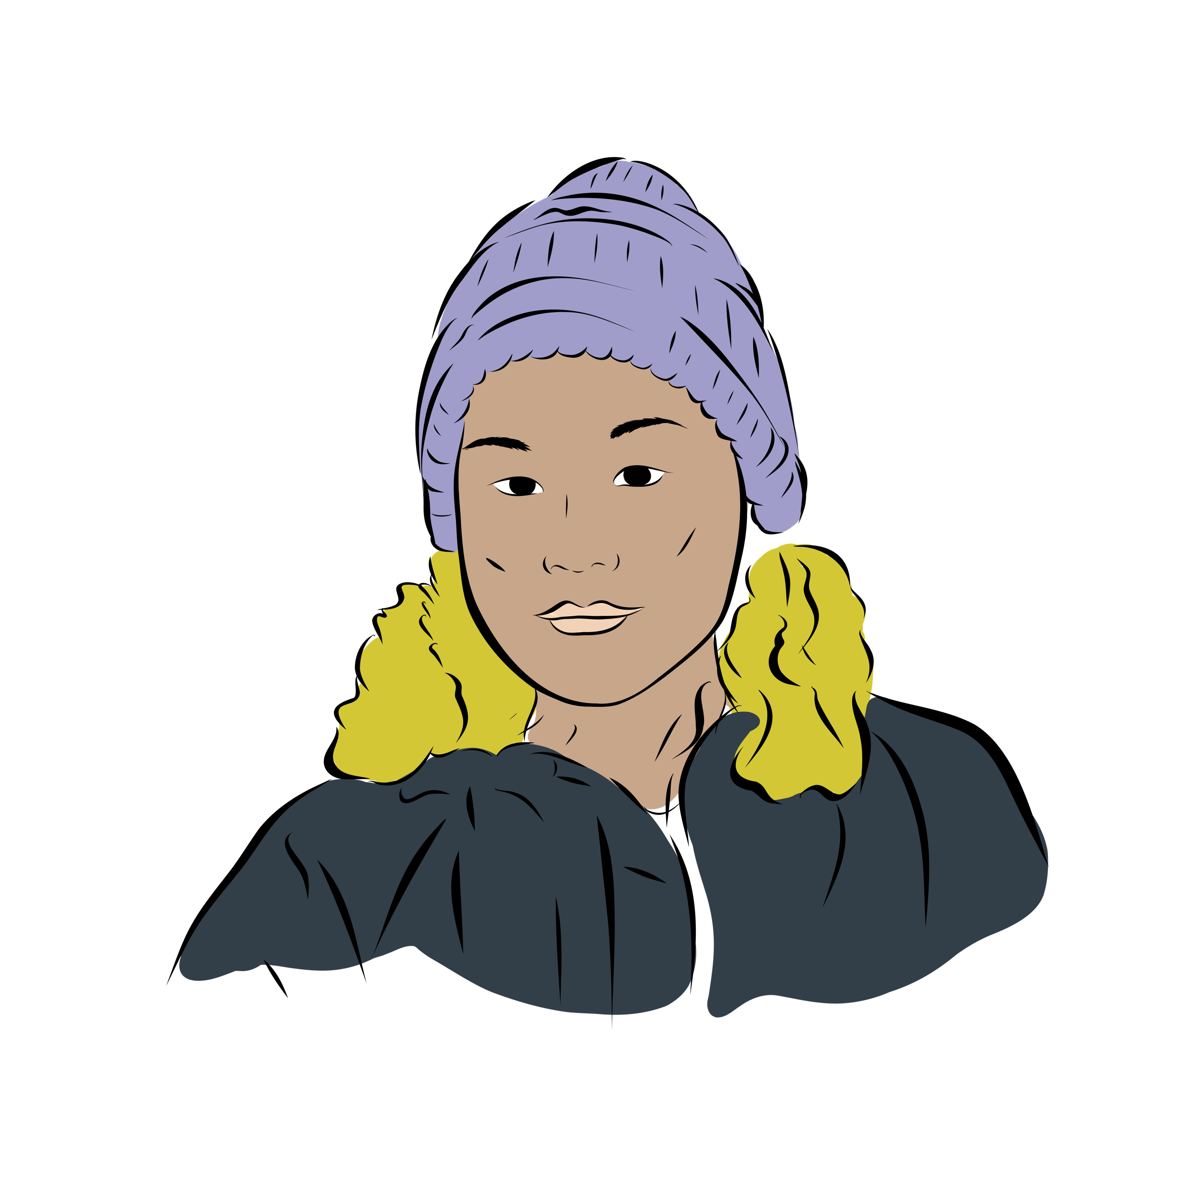
Choosing
Where to live after
parents
separate
NEXT TOPIC
PREVIOUS TOPIC

Slide 55
Choosing where to live after parents separate
Listen to Walter’s story
I am 12.
My parents are separating.
My parents will live in different houses.
I want to live with both of my parents.
Notes:
INSTRUCTIONS FOR TEACHERS AND VOLUNTEER LEGAL PROFESSIONALS
Read the story.

Slide 56
Learn the rule
Choosing where to live after parents separate
Walter can say who he wants to live with.
His parents or a judge must keep what he says in mind.
His parents or a judge will decide what’s best.
Notes:
INSTRUCTIONS FOR TEACHERS AND VOLUNTEER LEGAL PROFESSIONALS
Share legal information on the slide.
Share some additional information if you have time.
IDEAS FOR ADDITIONAL INFORMATION TO SHARE
After separating, parents can agree on what will happen next or ask a judge to decide.
A child can say where they want to live. A judge must take what they say seriously and keep it in mind. Parents should also do this when they’re coming to an agreement.
As a child gets older and more mature, what they want becomes more of a deciding factor. As of age 12, judges usually go with what the child wants.
But judges and parents always have to do what’s best for the child. This can sometimes be different from what the child wants, because other factors matter too.
Here are some examples of other factors to consider when deciding what’s best for a child:
the child’s age,
the child’s needs,
each parent’s ability to care for the child,
the relationship between the child, each parent and the other members of the child’s family,
the willingness of each parent to maintain the relationship between the child and the other parent,
the physical and mental health of the child and each parent,
each parents’ lifestyle, if it has a direct impact on the child,
keeping siblings together (brothers and sisters),
stability for the child.
SOURCES
Civil Code of Québec, CQLR c CCQ-1991 ss 33, 34.
Divorce Act, RSC 1985, c 3 (2nd Supp), s 16.
Droit de la famille - 071132, 2007 QCCA 697, confirmed by Droit de la famille-072706, 2007 QCCS 5266, at para 58 and following.
Droit de la famille - 091617, 2009 QCCS 3065.
Droit de la famille - 091635, 2009 QCCS 3083.
Droit de la famille - 111013, 2011 QCCS 1727, at para 25.
Droit de la famille - 19983, 2019 QCCS 2046.
Suzanne Guillet, «Les droits de l'enfant à l'occasion d'un litige familial» in École du Barreau du Québec, Droit de la famille, Collection de droit 2023-2024, vol. 4, Montréal, CAIJ, 2023, 79, pp. 124-125.

Slide 57
Yes,
totally!
Yes
and
no.
Do you agree with this rule?
Definitely
not!
I don’t
know.
Notes:
INSTRUCTIONS FOR TEACHERS AND VOLUNTEER LEGAL PROFESSIONALS
Ask students if they agree with this rule.
Run the activity where students choose one of the four answers using your chosen method (raise hands, show paper, move around, or other).
Ask if one or two students can share why they chose their answer. Thank anyone who shares and validate what they have to say.
You can refer back to the rule to prompt discussion. Here are some ideas for questions you can ask:
What should happen when parents separate?
Do you think children should get to decide where they want to live?

Slide 58
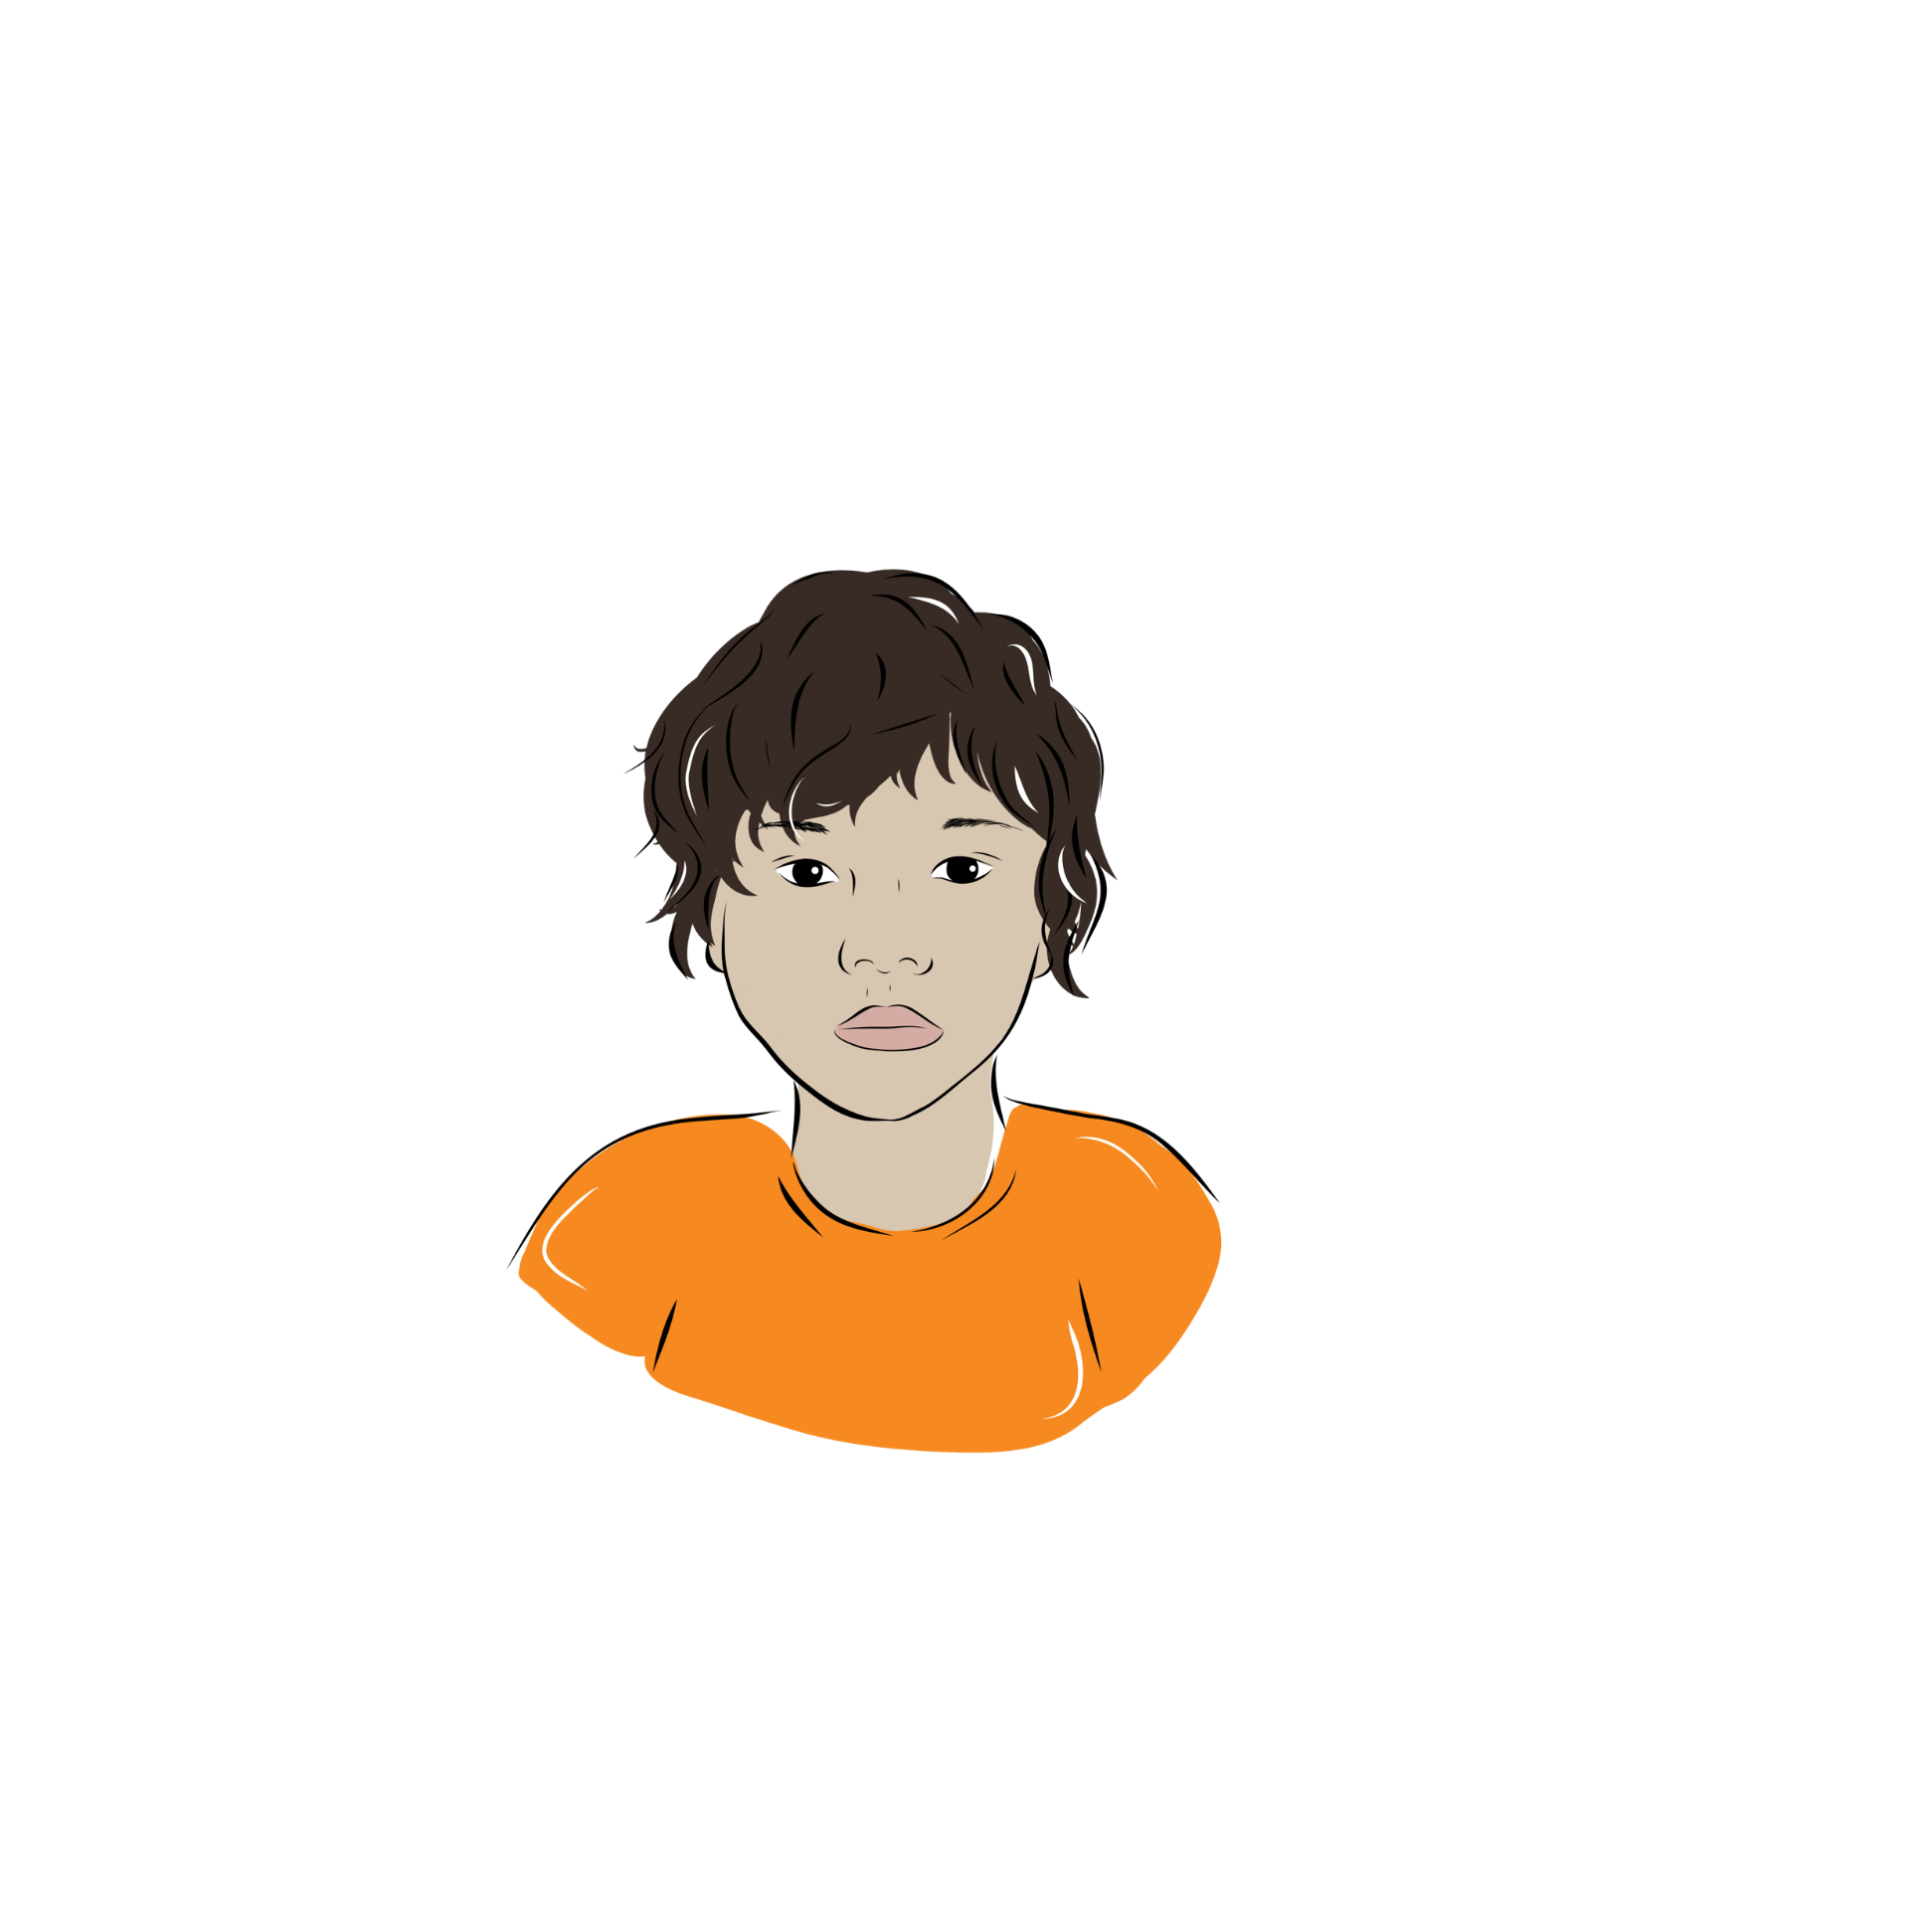
Parents
using
physical
punishment
NEXT TOPIC
PREVIOUS TOPIC

Slide 59
Parents using physical punishment
Listen to Adamie’s story
I am 13.
I got in a fight with my mom.
I didn’t want to listen to her because she had been drinking.
My mom got angry and slapped me in the face.
I feel hurt, scared and angry.
Notes:
INSTRUCTIONS FOR TEACHERS AND VOLUNTEER LEGAL PROFESSIONALS
Read the story.

Slide 60
Learn the rule
Parents using physical punishment
Adamie’s mom isn’t allowed to slap him in the face.
Notes:
INSTRUCTIONS FOR TEACHERS AND VOLUNTEER LEGAL PROFESSIONALS
Share legal information on the slide.
Share some additional information if you have time.
IDEAS FOR ADDITIONAL INFORMATION TO SHARE
Parents aren’t allowed to use any physical punishment with a teenager or a child under two.
For children between these ages, parents are allowed to discipline them with light physical punishment. But parents aren’t allowed to hit their children in anger.
Parents are never allowed to seriously hurt the child, be degrading or inhumane, hit the child using objects, or hit the child in the face or head. This type of punishment is too extreme.
Child protection services or the police might get involved in this type of situation to keep the child safe.
SOURCES
Canadian Foundation for Children, Youth and the Law v AG, 2004 SCC 4, at paras 24-25, 30, 38, 40, 46, 81.
Criminal Code, RCS 1985, c C-46, s 43.
Youth Protection Act, CQLR P-34.1, ss 38 à 38.3, 49 à 51, 131.1 à 131.5.
James Bay and Northern Québec Agreement, sect 21.
Nunavik Police Service, “Public Security”, https://krg.ca/en-CA/departments/public-security

Slide 61
Yes,
totally!
Yes
and
no.
Do you agree with this rule?
Definitely
not!
I don’t
know.
Notes:
INSTRUCTIONS FOR TEACHERS AND VOLUNTEER LEGAL PROFESSIONALS
Ask students if they agree with this rule.
Run the activity where students choose one of the four answers using your chosen method (raise hands, show paper, move around, or other).
Ask if one or two students can share why they chose their answer. Thank anyone who shares and validate what they have to say.
You can refer back to the rule to prompt discussion. Here are some ideas for questions you can ask:
How should parents treat their children?
Do you think physical punishment should be allowed?

Slide 62
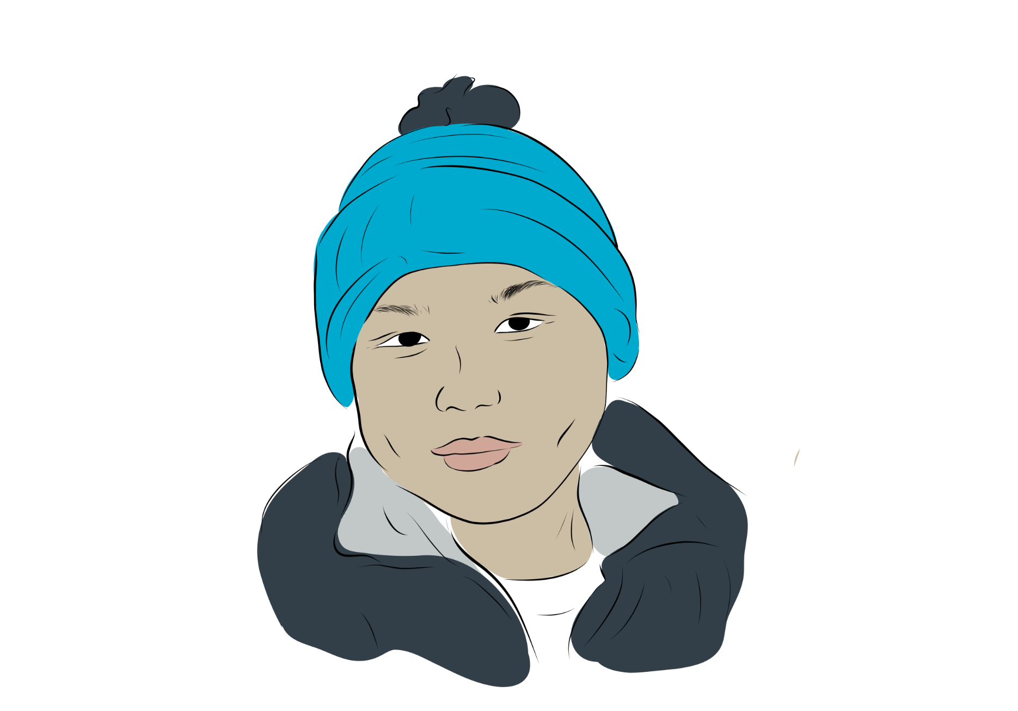
Child
protection
services
NEXT TOPIC
PREVIOUS TOPIC

Slide 63
Child protection services
Listen to Brian’s story
I am 16.
I feel angry and depressed.
I yell at my parents when they try to talk to me.
Sometimes, I run away from home for a while.
Notes:
INSTRUCTIONS FOR TEACHERS AND VOLUNTEER LEGAL PROFESSIONALS
Read the story.

Slide 64
Learn the rule
Child protection services
Brian and his parents can get help from the community.
Sometimes, child protection services might get involved.
Notes:
INSTRUCTIONS FOR TEACHERS AND VOLUNTEER LEGAL PROFESSIONALS
Share legal information on the slide.
Share some additional information if you have time.
IDEAS FOR ADDITIONAL INFORMATION TO SHARE
Indigenous communities in Canada have the right to create their own child protection services. If a community doesn’t have their own child protection services, they use the government’s services.
Nunavimmi Ilagiit Papatauvinga offers child protection services based on Inuit knowledge in some Northern communities.
Child protection services are supposed to make sure children are safe and taken care of.
The government’s child protection services must maintain Inuit children’s connection with their culture. They must keep the child in the family or in the community if they can.
Child protection services might get involved if a child:
has no one to take care of them,
isn’t being cared for by the people who are supposed to do that,
is being abused psychologically, physically, or sexually,
is a danger to themselves or others,
runs away from home.
SOURCES
Nunavimmi Ilagiit Papatauvinga, https://nunavimmiilagiit.ca/
Nunavik Regional Board of Health and Social Services, ‘’Nunavimmi Ilagiit Papatauvinga: a Project for Family Services in Nunavik Supported by the NRBHSS’’,https://nrbhss.ca/sites/default/files/Press_release_NIP_EN.pdf
Youth Protection Act, CQLR P-34.1, ss 38 à 38.3, 49 à 51, 131.1 à 131.5.
An Act Respecting First Nations, Inuit and Métis Children, Youth and Families, SC 2019, c 24.
Reference re An Act respecting First Nations, Inuit and Métis Children, Youth and Families, 2024 SCC 5.

Slide 65
Yes,
totally!
Yes
and
no.
Do you agree with this rule?
Definitely
not!
I don’t
know.
Notes:
INSTRUCTIONS FOR TEACHERS AND VOLUNTEER LEGAL PROFESSIONALS
Ask students if they agree with this rule.
Run the activity where students choose one of the four answers using your chosen method (raise hands, show paper, move around, or other).
Ask if one or two students can share why they chose their answer. Thank anyone who shares and validate what they have to say.
You can refer back to the rule to prompt discussion. Here are some ideas for questions you can ask:
Should your community make its own child protection services?
What services would you want?

Slide 66
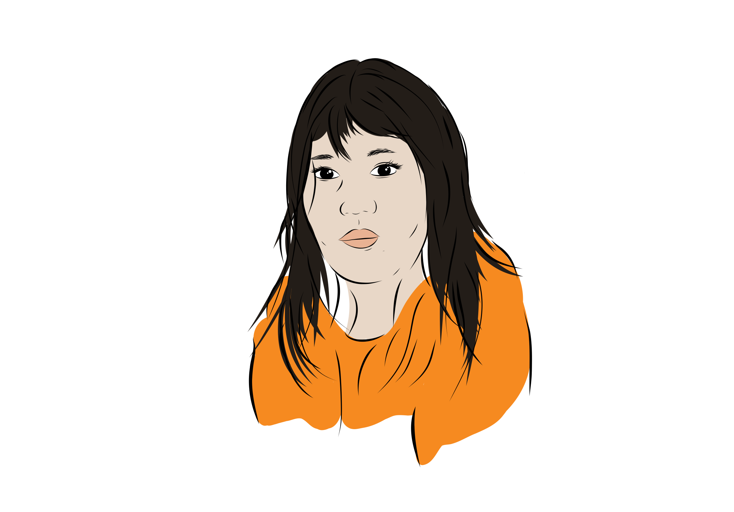
Age of
consent for
physical
intimacy
NEXT TOPIC
PREVIOUS TOPIC

Slide 67
Age of consent for physical intimacy
Listen to Angelina’s story
I am 14.
My 15th birthday is coming up.
I am going to hang out with some friends to celebrate.
I hope that my brother’s friend, Douglas, will come.
I have a crush on Douglas.
Douglas is 21.
Notes:
INSTRUCTIONS FOR TEACHERS AND VOLUNTEER LEGAL PROFESSIONALS
Read the story.

Slide 68
Learn the rule
Age of consent for physical intimacy
Douglas is too old to have physical intimacy with Angelina.
Physical intimacy includes kissing, sexual touching and sex.
Angelina can have physical intimacy with someone who is less than 5 years older and has no power over her.
Notes:
INSTRUCTIONS FOR TEACHERS AND VOLUNTEER LEGAL PROFESSIONALS
Share legal information on the slide.
Share some additional information if you have time.
IDEAS FOR ADDITIONAL INFORMATION TO SHARE
Physical intimacy includes kissing and touching, it’s not just sex.
Angelina is 14 turning 15, so she can only be physically intimate with someone less than 5 years older than her. This person also can’t have power over Angelina.
It doesn’t matter if Angelina wants to be physically intimate with Douglas. It’s not allowed.
Child protection services or the police might get involved in this type of situation. Angelina won’t get in trouble, but Douglas could.
SOURCES
Criminal Code, RCS 1985, c C-46, ss 150.1(1), (2), (2.1), 151, 152, 153 (1).
Civil Code of Québec, CQLR c CCQ-1991, ss 33, 599, 601.
Youth Protection Act, CQLR P-34.1, ss 38 à 38.3, 49 à 51, 131.1 à 131.5.
James Bay and Northern Québec Agreement, sect 21.
Nunavik Police Service, “Public Security”, https://krg.ca/en-CA/departments/public-security

Slide 69
Age of consent for physical intimacy
Age |  | Who can have physical intimacy with someone this age?
11 and younger |  | No one. They’re too young for physical intimacy.
12 to 13 |  | Someone less than 2 years older who has no power over them.
14 to 15 |  | Someone less than 5 years older who has no power over them.
16 to 17 |  | Someone who has no power over them.
18 and older |  | Anyone.
Notes:
INSTRUCTIONS FOR TEACHERS AND VOLUNTEER LEGAL PROFESSIONALS
Share legal information on the slide.
Share some additional information if you have time.
IDEAS FOR ADDITIONAL INFORMATION TO SHARE
No matter what, both people must say yes before having physical intimacy. If one person doesn’t clearly say yes, then they can’t have physical intimacy.
But depending on their age and relationship, some people still can’t have physical intimacy even if they both say yes. This slide explains which age gaps are allowed and which aren’t. It also explains when it matters whether the older person has power over the younger person.
Examples of someone who has power over a young person include a teacher or a coach.
The person who’s younger or under someone else’s power can ask for help in this situation. They won’t get in trouble.
Child protection services or the police might get involved in this type of situation. The person who’s older or has power over the other person could get in trouble.
SOURCES
Criminal Code, RCS 1985, c C-46, ss 150.1(1), (2), (2.1), 151, 152, 153 (1).
R c Lapointe, 2016 QCCQ 1951; R c Brunet, 2021 QCCQ 13162.
Civil Code of Québec, CQLR c CCQ-1991, ss 33, 599, 601.
Youth Protection Act, CQLR P-34.1, ss 38 à 38.3, 49 à 51, 131.1 à 131.5.
James Bay and Northern Québec Agreement, sect 21.
Nunavik Police Service, “Public Security”, https://krg.ca/en-CA/departments/public-security

Slide 70
Yes,
totally!
Yes
and
no.
Do you agree with this rule?
Definitely
not!
I don’t
know.
Notes:
INSTRUCTIONS FOR TEACHERS AND VOLUNTEER LEGAL PROFESSIONALS
Ask students if they agree with this rule.
Run the activity where students choose one of the four answers using your chosen method (raise hands, show paper, move around, or other).
Ask if one or two students can share why they chose their answer. Thank anyone who shares and validate what they have to say.
You can refer back to the rule to prompt discussion. Here are some ideas for questions you can ask:
Do you think there should be a maximum age difference for physical intimacy?
Do you think the maximum age difference should be bigger or smaller?

Slide 71
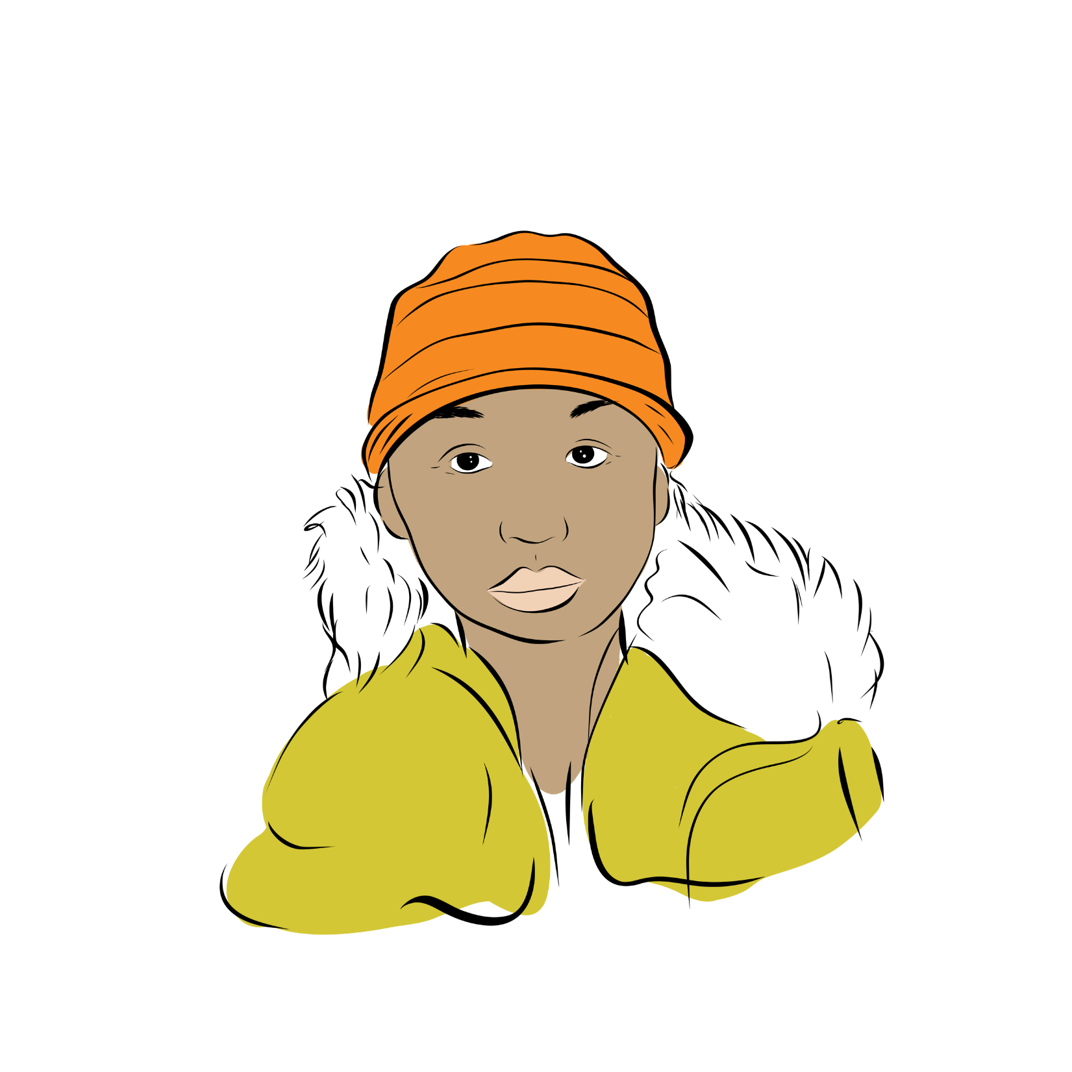
Sharing
sexual pictures
and videos
NEXT TOPIC
PREVIOUS TOPIC

Slide 72
Sharing sexual pictures and videos
Listen to Davidee’s story
I am 16.
I was going out with Kimberly.
Kimberly sent me some nudes when we were together.
Kimberly broke up with me.
I feel very angry and sad.
I am thinking about sharing Kimberly’s nudes on social media to get back at her.
Notes:
INSTRUCTIONS FOR TEACHERS AND VOLUNTEER LEGAL PROFESSIONALS
Read the story.

Slide 73
Learn the rule
Sharing sexual pictures and videos
Sharing someone’s nudes on social media is a crime.
Sometimes, the police or child protection services might get involved.
Notes:
INSTRUCTIONS FOR TEACHERS AND VOLUNTEER LEGAL PROFESSIONALS
Share legal information on the slide.
Share some additional information if you have time.
IDEAS FOR ADDITIONAL INFORMATION TO SHARE
Sexual pictures or videos show a naked person, private parts of the body like someone’s boobs or butt, or people having sex.
Usually, no one is allowed to make, share, have, or look at sexual pictures or videos of someone under 18.
Exception = people under 18 in a relationship can make and share sexual pictures and videos with each other as long as they don’t share them with anyone else.
If the person in the sexual picture or video is 18 or older, people are only allowed to share it if the person in it gives their permission.
The person in the picture or video can get help from someone in the community or an organization like CAVAC Nunavik (Sapummijiit). They can also fill out an online form to get a court order for the picture or video to be taken down.
When sexual pictures or videos of someone under 18 are shared, child protection services or the police might get involved. The person who shared the picture or video could get in trouble. The person in the picture or video won’t get in trouble.
SOURCES
Criminal Code, RCS 1985, c C-46, ss 150.1, 162.1, 163.1, 171.1, 173, 264, 273.1, 372(3).
R v Sharpe, [2001] 1 SCR 45.
Youth Protection Act, CQLR P-34.1, ss 38 à 38.3, 49 à 51, 131.1 à 131.5.
James Bay and Northern Québec Agreement, sect 21.
Nunavik Police Service, “Public Security”, https://krg.ca/en-CA/departments/public-security
Act to counter non-consensual sharing of intimate images, CQLR P-9.0002, s 2, 3, 6, 7, 8.
Gouvernement du Québec, “Non-consensual sharing of an intimate image” (consulted on November 28, 2025), https://www.quebec.ca/en/justice-and-civil-status/support-victims-crime/non-consensual-sharing-intimate-image

Slide 74
Yes,
totally!
Yes
and
no.
Do you agree with this rule?
Definitely
not!
I don’t
know.
Notes:
INSTRUCTIONS FOR TEACHERS AND VOLUNTEER LEGAL PROFESSIONALS
Ask students if they agree with this rule.
Run the activity where students choose one of the four answers using your chosen method (raise hands, show paper, move around, or other).
Ask if one or two students can share why they chose their answer. Thank anyone who shares and validate what they have to say.
You can refer back to the rule to prompt discussion. Here are some ideas for questions you can ask:
What should the rules be for sending and sharing nudes?
What should happen when someone shares nudes on social media?

Slide 75


Conclusion
What did you learn?
Questions?
PREVIOUS TOPIC
Notes:
INSTRUCTIONS FOR TEACHERS AND VOLUNTEER LEGAL PROFESSIONALS
If students are doing the optional questionnaire, hand it out.
If you’re not using the printed questionnaire, ask the following questions to get feedback on the workshop and help students reflect on their learning:
What did you learn during the workshop?
How will you use what you learned in your life?
Invite the students to share their answers aloud.
Wrap up the workshop.

Slide 76


Slide 78




Important Notice
December 2025 Version
This information applies to Inuit communities in Quebec and isn’t legal advice. This presentation can’t be reproduced without Éducaloi’s written permission.
© Éducaloi

