Slide 1
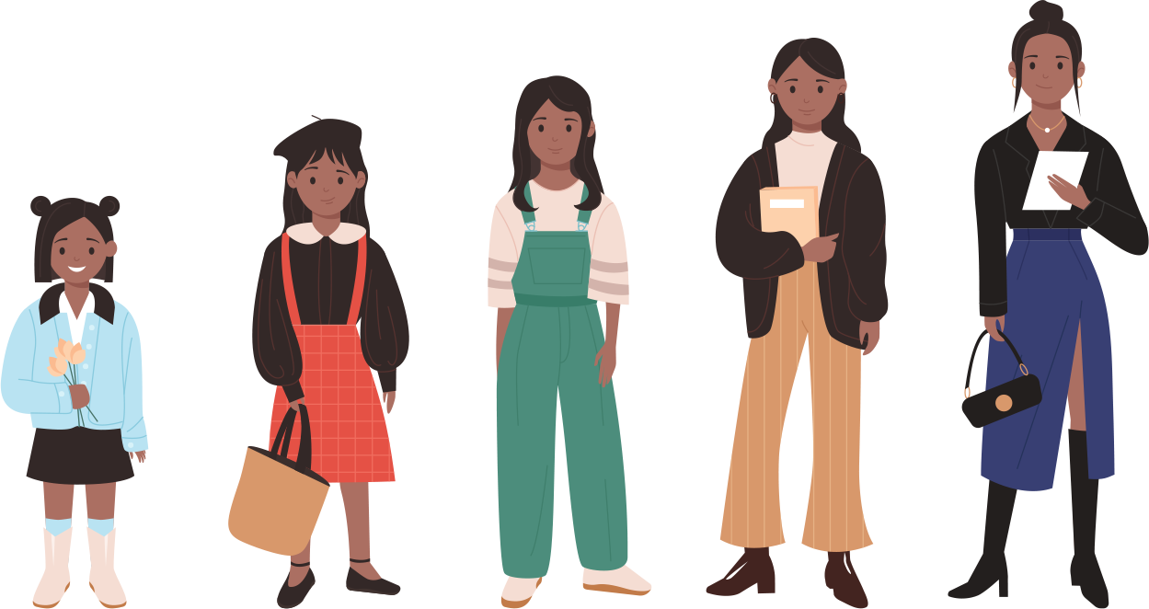
Are You Old Enough?
What are your responsibilities, freedoms, and protections?
Notes:
NOTES FOR THE TEACHER
The material in this Teaching Kit is the exclusive property of Éducaloi. Teachers in Québec can use it for non-commercial purposes only.
The information in this kit does not constitute a legal opinion.
Éducaloi is dedicated to providing reliable legal information. To ensure the reliability of the legal information in this kit, the documents must be used in their original format, without any modification.
The law is constantly evolving. This document is up to date as of December 2025.

Slide 2
Do you know the responsibilities, freedoms, and protections of children?
Notes:
NOTES FOR THE TEACHER
Ask the students about their prior knowledge on this subject.
Ask them the question on the slide and add the following question: “Starting at what age do these apply?"
Ask the students to complete the question in the Student Workbook, p. 5.
Discuss some of the answers as a class.
Ask students the following questions: What is a responsibility? Is there a difference between a responsibility at home and a responsibility in society? The students can give examples of responsibilities in society, such as putting their garbage in trash cans, not damaging city property, etc.

Slide 3

Responsibilities

Slide 4

My responsibilities
The Broken Window
Maxime, 10 years old, broke his neighbour’s window while playing baseball.
His neighbour demands that he be reimbursed for his new window.
Who will pay to replace the window?
Notes:
NOTES FOR THE TEACHER
As a class, read scenario 1.
Ask the students to write their hypothesis individually in the Student Workbook, p. 6.
Discuss some of the answers as a class.​

Slide 5
What the law says
The Broken Window
Maxime could be held responsible for the damage since civil liability applies from around age 7.
The neighbour could also sue Maxime’s parents for reimbursement.
Notes:
NOTES FOR THE TEACHER
Correct this exercise as a class.
Have the students write down the main elements under the question “What the law says” in the Student Workbook.
More detailed answer:
Maxime is 10 years old. He’s old enough to understand the difference between right and wrong. Therefore, he can be held responsible for his actions.
If Maxime breaks the neighbour’s window, the neighbour can sue Maxime for payment of the window repair. Suing someone means going to court before a judge to demand, for example, that this person pay for or repair something that was broken or damaged.
The judge will determine if Maxime acted cautiously, that is, was attentive and responsible enough while he was playing.
Maxime’s parents
Sometimes, parents can also be held responsible for the actions of their minor child, regardless of the child’s age.
Why? Because it’s their responsibility to properly look after their children, to educate them, supervise them, and teach them to be careful.
But if the parents can show a judge that they did their work well, meaning that they supervised Maxime well, they may not be held responsible for Maxime’s actions.
Also, the older the child, the less the parents are responsible. For example, the parents of a 17-year-old are less responsible for their child’s actions than the parents of a 10-year-old.
What about insurance?
Sometimes, parents have insurance that can help pay for the repairs if their child harms someone or something. This is called liability insurance.
SOURCES ​​
Code civil du Québec, RLRQ c CCQ-1991, art 1457 (principe général de la responsabilité civile et nécessité d’être doué de raison)​, 1459 (responsabilité des titulaires de l’autorité parentale).
Boyer c Hydro-Québec, (1985) RL 129 (QCCS); Baudouin, Jean-Louis. La responsabilité civile, 8e éd., Cowansville, Québec, Éditions Yvon Blais, 2014, par. 1-111 (responsabilité civile – 7 ans) ​​
Jean-Louis Baudouin, La responsabilité civile, 8e éd., Cowansville, Éditions Yvon Blais, 2014 au para 1‑102, 104-106, 111, 164, 166, 331, 437​​
Ginn c. Sisson, [1969] C.S. 585 (un enfant âgé de 6 ans et 9 mois a été considéré comme étant doué de raison)
Laverdure c. Bélanger, (C.S., 1975-01-10), SOQUIJ AZ-75021206, [1975] C.S. 612 (appel rejeté par (C.A., 1977-10-21), SOQUIJ AZ-77012161, J.E. 77-75) (Responsabilité des parents, peu importe si l’enfant a la capacité de discerner le bien du mal)

Slide 6
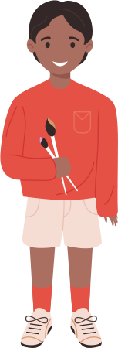
My responsibilities
Around age 7
Civil liability
Around 7 years of age, children can be held responsible for the damage they cause. ​
Notes:
NOTES FOR THE TEACHER
As a class, read the information on civil liability and complete it with the following example:
For example, children can be sued if they break or damage property that doesn’t belong to them.
Ask the students to add the age (7 years old) in the definition of civil liability in the Student Workbook, p. 6.
SOURCES ​​
Code civil du Québec, RLRQ c CCQ-1991, art 1457 (principe général de la responsabilité civile et nécessité d’être doué de raison) ​​
Boyer c Hydro-Québec, (1985) RL 129 (QCCS) ; Baudouin, Jean-Louis. La responsabilité civile, 8e éd., Cowansville, Québec, Éditions Yvon Blais, 2014, par. 1-111 (responsabilité civile – 7 ans) ​​
Ginn c. Sisson, [1969] C.S. 585 (un enfant âgé de 6 ans et 9 mois a été considéré comme étant doué de raison) ​

Slide 7

My responsibilities
A Very Bad Day
Leah is 12 years old and is having a very bad day at school. She’s really at the end of her rope. After school, Marie makes fun of her. Leah loses her temper and punches her in the face, breaking her nose. Marie’s parents are furious.
What can Marie’s parents do in this situation ?
Notes:
NOTES FOR THE TEACHER
As a class, read scenario 2. (You can choose to quickly go over scenarios 2 and 3, then give the students time to complete them.)​
Ask the students to write their hypothesis individually in the Student Workbook, p. 7.
Discuss some of the answers as a class.

Slide 8
What the law says
A Very Bad Day
The parents could file a police complaint.
The parents could also sue Lea and/or her parents for reimbursement of the medical costs.
Notes:
NOTES FOR THE TEACHER
Correct this exercise as a class.
Have the students write the main elements under the question “What the law says” in the Student Workbook.
More detailed answer:
Leah is 12 years old. Therefore, she is of age to be held criminally responsible and face consequences if she commits a crime. If she hits Marie, then Marie’s parents can file a police complaint, and Leah could be charged with hitting Marie. When you hit someone on purpose, that’s called “assault”, which is a crime.
Since Leah is also at the age where her civil liability could be triggered, Marie’s parents could ask that Leah or her parents pay the medical costs as well as compensation for the pain Marie experienced. In short, Leah could have to pay compensation for the harm she caused Marie.
SOURCES ​​
Code criminel, LRC, (1985) ch C-46, arts 265 et suivants (voies de fait).
Code civil du Québec, RLRQ c CCQ-1991, art 1457, 1459.
Paquette Sauriol c. Correnti, 2013 QCCQ 15891, aux paras 91 et 95 (frais médicaux)
Côté c Provençal, 2001 QCCS 24851, aux paras 169 à 173, 187 et 188. (douleurs)

Slide 9
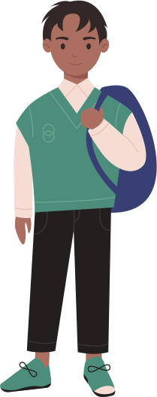
Age 12
Criminal responsibility
My responsbilities
Starting at 12 years of age, children can be charged with a crime, such as theft, assault, and drug possession or drug dealing.​
Notes:
NOTES FOR THE TEACHER
As a class, read the information on criminal responsibility and complete it with the following information:
However, young people are not treated as adults by the criminal justice system. Rather, the goal is to educate and reintegrate them into society. Therefore, the consequences are generally not as serious. For example, unlike adults, young people are not sent to prison, even if they’re found guilty of a serious crime. Instead, they’re placed in a youth centre or another adapted facility. There’s an exception for teens 14 years of age and over in exceptional situations.
Ask the students to add the age (12 years old) in the definition of criminal responsibility in the Student Workbook, p. 7.
SOURCES ​​
Code criminel, LRC, (1985) ch C-46, art 13 (12 ans).
Loi sur le système de justice pénale pour les adolescents, LC 2002, c 1, art 3 (réadaptation et réinsertion sociale des ados), 39 (placement sous garde), 64 (peine adulte pour les jeunes de 14 ans et plus).

Slide 10
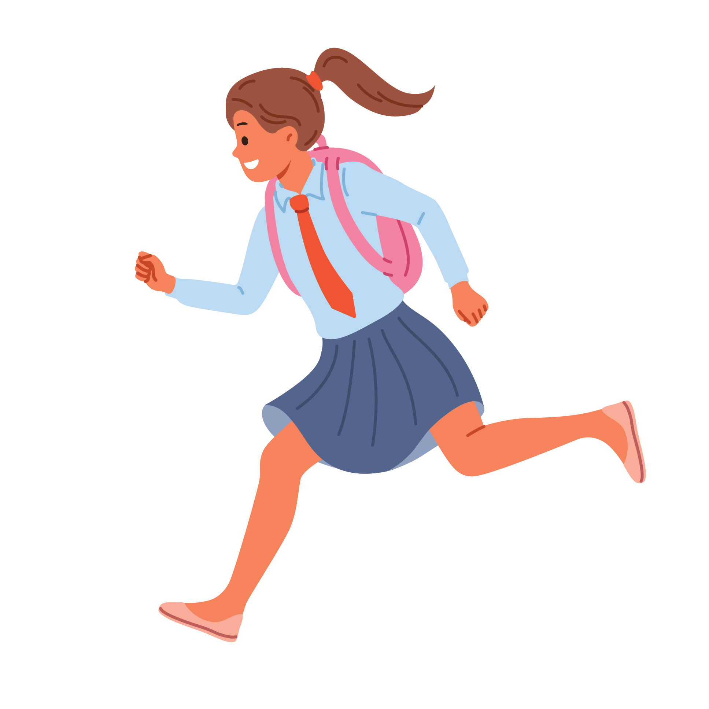
My responsibilities
The Red Light
Rosa, 13 years old, is walking to school. She realizes she might be late. There are no cars coming so she decides to run across the street against a red light. She’s stopped by the police.
What possible consequence(s) can Rosa face?
Notes:
NOTES FOR THE TEACHER
As a class, read scenario 3. (You can choose to quickly go over scenarios 2 and 3, then give students time to complete them.)​
Ask students to write their hypothesis individually in the Student Workbook, p. 7.
Discuss some of the answers as a class.​

Slide 11
What the law says
The Red Light
Possible fine: between $15 and $30.
Children can be fined as of age 14.
Rosa will not be fined, but she could be given a warning.
Notes:
NOTES FOR THE TEACHER
Correct this exercise as a class.
Have the students write the main elements under the question “What the law says” in the Student Workbook.
More detailed answer:
A person who crosses the street against a red light can be fined $15 to $30, even if there are no cars in sight.
However, children can only be fined as of age 14. So, Rosa who is 13, will not have to pay a fine, but she could be given a warning. The police could also inform her parents of the situation.
SOURCES ​​
Code de la sécurité routière, RLRQ c C-242, arts 444, 505. (Amende pour non-respect des signaux de circulation)
Code de procédure pénale, RLRQ c C-25.1, art 5. (Amendes à partir de 14 ans)

Slide 12

My responsibilities
Age 14
Receive a fine
Children can be fined as of 14 years of age. A fine is also called a “statement of offence” or a “ticket”.
​
Notes:
NOTES FOR THE TEACHER
As a class, read the information on the legal age for receiving a fine and complete it with the following information:
A fine is also called a “statement of offence” or a “ticket”, a fine is a document that police give to someone who violated a law or regulation. The document given indicates the amount to pay for this violation. Children can be fined as of 14 years of age.
For example, a police officer could give you a ticket if you’re in a park after opening hours, or if you litter.
Ask the students to add the age (14 years old) in the definition of fine in the Student Workbook, p. 8.
SOURCE
Code de procédure pénale, RLRQ c C-25.1, art 5. (Amendes à partir de 14 ans)

Slide 13

My responsibilities
The legal age at which a person is considered an adult under the law. They have all the responsibilities and freedoms of an adult.
The age of majority is 18.
Age 18
Age of majority
Notes:
NOTES FOR THE TEACHER
As a class, read the information on legal age of majority.
Ask the students to add the age (18 years old) in the definition of age of majority in the Student Workbook, p. 8.
SOURCE
Code civil du Québec, RLRQ c CCQ-1991, art 153.

Slide 14

As we grow up, society gives us more responsibilities . . .
Around age 7
Civil
liability
Age 12
Criminal responsibility
Age 14
Can receive fines
Age 18
Age of majority
Notes:
NOTES FOR THE TEACHER
With the students, complete this summary of responsibilities in the Student Workbook, p. 8.
SOURCES
Code civil du Québec, RLRQ c CCQ-1991, art 1457 (principe général de la responsabilité civile et nécessité d’être doué de raison) ​​
Boyer c Hydro-Québec, (1985) RL 129 (QCCS) ; Baudouin, Jean-Louis. La responsabilité civile, 8e éd., Cowansville, Québec, Éditions Yvon Blais, 2014, par. 1-111 (responsabilité civile – 7 ans) ​​
Code criminel, LRC, (1985) ch C-46, art 13 (Responsabilité criminelle à partir de 12 ans).
Code de procédure pénale, RLRQ c C-25.1, art 5. (Amendes à partir de 14 ans)
Code civil du Québec, RLRQ c CCQ-1991, art 153. (Majorité)

Slide 15
Freedoms

Slide 16
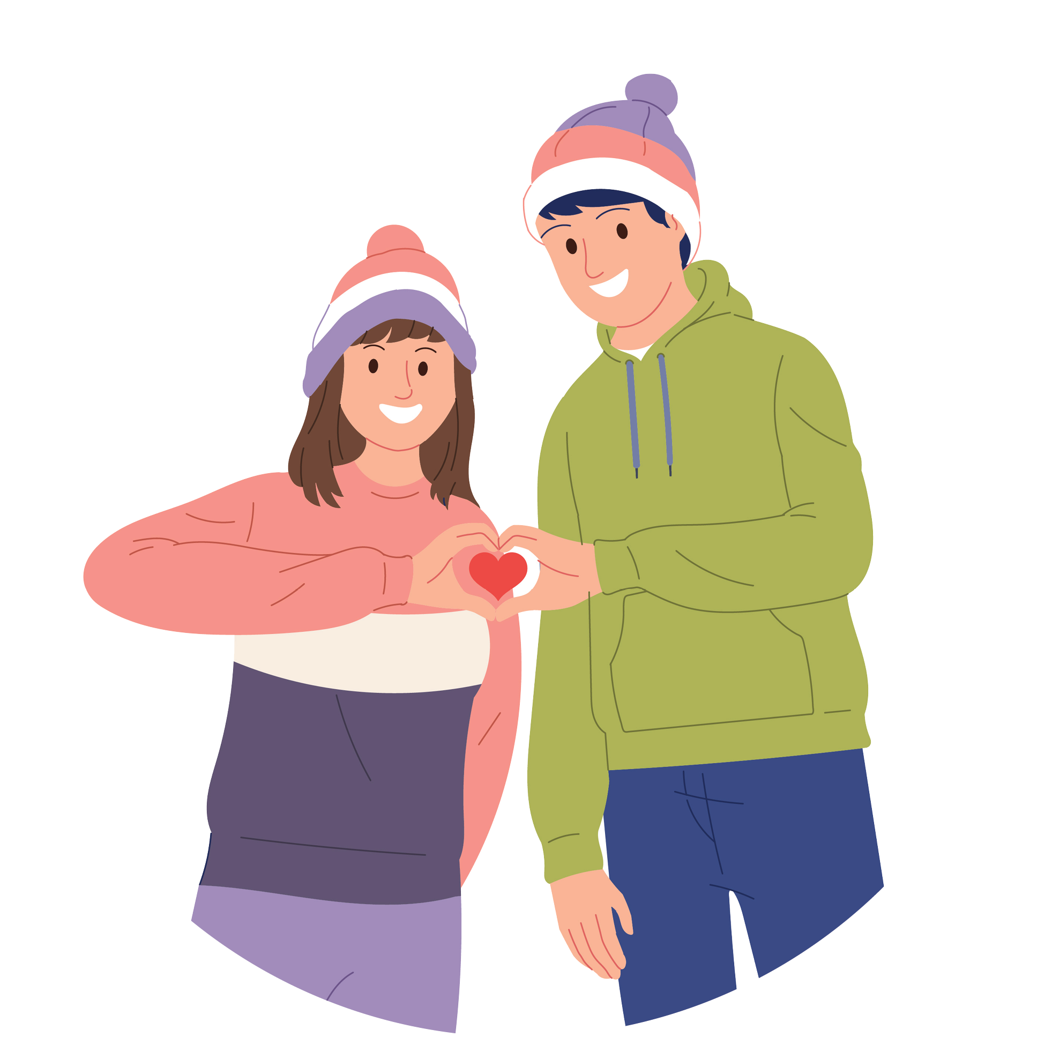
My freedoms
First Love
Mira is 12 years old. She is madly in love with her neighbour Romeo, who’s 16. Mira’s parents strongly disapprove of their relationship: Mira is too young to go out with a 16-year-old and sleep at his place!
Can Mira go out with Romeo?
Notes:
NOTES FOR THE TEACHER
As a class, read scenario 4. It’s a little more detailed in the Student Workbook. (You can choose to quickly go over scenarios 4 and 5, then give students time to complete them.)
Ask the students to write their hypothesis in the Student Workbook, p. 9.
Discuss some of the answers as a class.

Slide 17
What the law says
First Love
The consent of a child under 12 years of age is never valid.
When the younger partner is 12 or 13 years old, the age difference must be less than 2 years to engage in sexual touching.
Notes:
NOTES FOR THE TEACHER
Correct this exercise as a class.
Have the students write the main elements under the question “What the law says” in the Student Workbook.
More detailed answer:
Consent is a person’s agreement to an action or a plan. Consent is a very broad concept that applies to many situations. For example, a person can consent to health care or to engaging in sexual activities (kissing, caressing or sexual relations) with someone else.
When the younger partner is 12 or 13 years old: the age difference must be less than 2 years for them to engage in sexual activities. If Mira just turned 12, she can only consent to sexual activities with someone who is is no older than 14 years minus 1 day.
If Romeo and Mira engage in sexual activities (like kissing, caressing or sexual relations), Romeo would be committing a crime since Mira’s consent would be invalid. Here, we’re talking about crimes like sexual assault, but there are other crimes related to sexual offences involving minors, such as luring (communicating with someone under 18 with the intent of committing a “sexual offence”).
When the younger partner is 14 or 15 years old, the age difference must be less than 5 years for them to engage in sexual activities.
Also, the consent of a person under 18 is not valid if there’s a relationship of power between the two people, for example, if a tutor or a sports coach dates their student.
Parents’ role: Parents have the obligation to look after their children and supervise them. Consequently, parents have their say regarding who their children keep company with. They could forbid their child from seeing or going out with someone if they believe it’s in their child’s best interest.
SOURCES
Code criminel, LRC 1985, c C-46, art 150.1 (consentement sexuel et écarts d’âges), 153 et 153.1 (rapport de force)
Code civil du Québec, RLRQ c CCQ-1991, art 598, 599 (autorité parentale des parents et devoirs)

Slide 18




Age 12
Sexual consent with other teens
My freedoms
If you’re
Allowable age difference
12-13 years old
Less than 2 years
14-15 years old
Less than 5 years
Before you’re 18, your consent is not valid if there’s a relationship of power between you and the other person.
Notes:
NOTES FOR THE TEACHER
As a class, read the information on sexual consent with other teens and complete it with the following examples:
For example, there’s a relationship of power if
the older person is in a position of trust or authority (e.g., the partner is the teen’s teacher or employer),​
there’s a situation of dependency or exploitation between the two people (e.g., the partner is providing the teen with accommodation when they have nowhere else to go).
Ask the students to add the age (12 years old and 16 years old) in the description of sexual consent in the Student Workbook, p. 10.
SOURCE
Code criminel, LRC 1985, c C-46, art 150.1 (consentement sexuel et écarts d’âges), 153 et 153.1 (rapport de force)

Slide 19
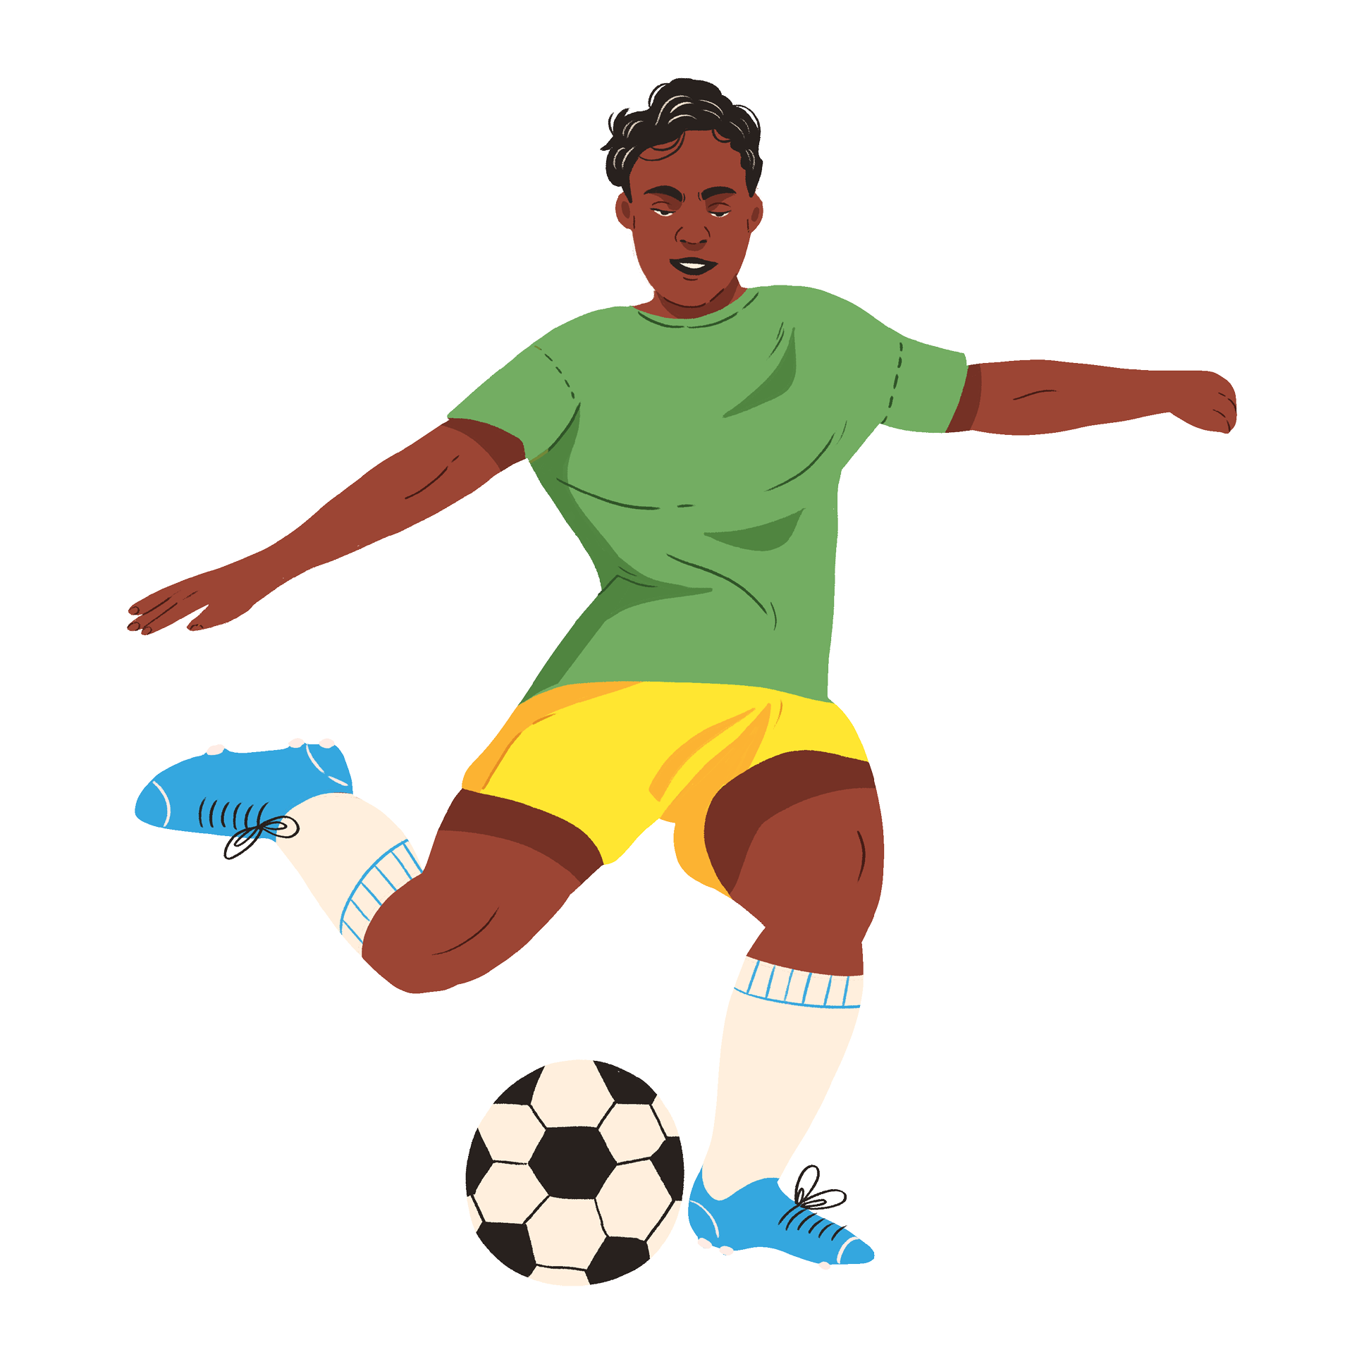
My freedoms
A New Name
Seth Abdou is 14 years old and wants to change his name to Ronaldo Abdou. It’s always been his dream to have the same first name as his favourite soccer player!
Does he have the right to do this?
Notes:
NOTES FOR THE TEACHER
As a class, read scenario 5. (You can choose to quickly go over scenarios 4 and 5, then give the students time to complete them.)
Ask the students to write their hypothesis individually in the Student Workbook, p. 10.
Discuss a few answers as a class. ​

Slide 20
What the law says
A New Name
A person can only request a name change for a serious reason.
Therefore, Seth won’t be able to change his name. Even if he were an adult, he wouldn’t be allowed to do so.
Notes:
NOTES FOR THE TEACHER
Correct this exercise as a class.
Have the students write the main elements under the question “What the law says” in the Student Workbook.
More detailed answer:
A person can only request a name change for a serious reason. For example, someone can request a name change if their name is too difficult to write or if it’s ridiculed. Here’s a real-life example: parents wanted to name their child Spatula, but the government opposed this choice because the first name was unusual and could lead to ridicule.
Seth will probably not be allowed to change his name because he doesn’t have a serious reason to do so.
The same rule applies regardless of the person’s age. Even if Seth were an adult, the same principle would apply.
SOURCES
Code civil du Québec, RLRQ c CCQ-1991, art 58 al .1 (changement de nom).
Lavigne c. Beaucaire, 1996 CanLII 4381 (QC CS) (Prénom inusité et prêtant au ridicule, Spatule).

Slide 21
Age 14
Consent to care
My freedoms
As of 14 years of age, a person can accept or refuse health care on their own.
​
Can you name examples of health care?
Notes:
NOTES FOR THE TEACHER
As a class, read the information on consent to care and the following explanations:
In general, before the age of 14, parents make decisions related to health care.
For example: going to see a doctor, taking medication, or undergoing a medical test.
However, parents must decide based on what’s best for their child, not just according to what they believe. And, if possible, they should listen to what their child thinks.
As of the age of 14, the rules change: young people can decide on their own if they want to receive care necessary for their health. Care “necessary for health” can be, for example:
a blood test,
medication,
surgery,
an abortion, or
deciding to see a psychologist.
As always, there are some exceptions:
If a young person must stay at the hospital for more than 12 hours, their parents must be informed of this fact.
If a young person refuses care that is essential to their health, the hospital can ask a judge for permission to provide that care.
If parents refuse care that is essential to the teen’s (under 14) health without a good, the hospital can also ask for a judge’s help.
Lastly, in an emergency, when a child’s life is in danger, doctors have the right to take immediate action and talk to the parents after.
For care that’s not essential to health:
In this instance, the rules are different.
For example, if a young person wants surgery to change their nose—care that’s not essential to their health—and this procedure poses a risk or could have serious, permanent effects, the parents’ consent is also required, even after age 14.
For less risky procedures, such as tattoos or piercings, there’s no rule under the law that says you must be 18 or over. Judges feel that most young people can decide on their own if they want to get a tattoo or a piercing. However, tattoo and piercing salons have the right to refuse to serve minors.
Ask the students to add the age (14 years old) in the description of consent to care in the Student Workbook, p. 10.
SOURCES
Code civil du Québec, RLRQ c CCQ-1991, art 11, 12 (intérêt de l’enfant), 13 (urgence), 14 (âge pour consentir aux soins requis par l’état de santé), 16 (demande au tribunal), 17 (consentement aux soins non-requis par l’état de santé).
Droit de la famille - 152118, 2015 QCCS 3966 (avortement)
Centre universitaire de santé McGill (CUSM--Hôpital général de Montréal) c. X, 2017 QCCS 3946 (CanLII), au para 34 (transfusion sanguine).
Corbeil c. Ladouceur (Boutique Enigma), 2012 QCCQ 402. NB: IL s'agissait d'un cas de perçage et non du tatouage. Le tatouage était un obiter dans cette décision.

Slide 22
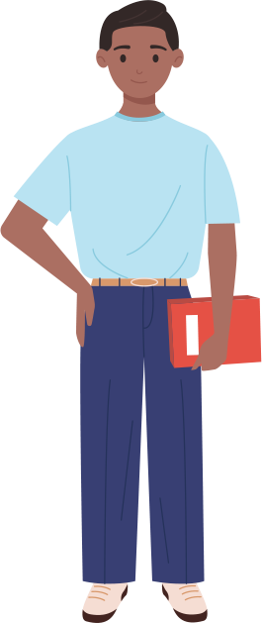
Age 16
Driving
My freedoms
As of 16 years of age a person can have a driver’s licence. They must follow the Highway Safety Code.
Do you know any of the obligations and prohibitions in this code?
What happens if someone breaks the rules often?
​
Notes:
NOTES FOR THE TEACHER
As a class, read the information on the right to drive and the following explanations:
​
As of age 16, a person can start driving if they get their licence. However, they must follow the rules in the Highway Safety Code.<
Do you know any of the rules to follow when you’re on the road?
Speed limits
Red lights
Mandatory stops
Always wearing a seatbelt
Not using a cell phone while driving
Etc.
Do you know what happens if someone frequently breaks these rules?
They could be fined or lose demerit points on their licence.
They could even lose their licence!
But the Highway Safety Code is not just for drivers! It also has rules for:
Cyclists, for example: riding in the same direction as car traffic.
Pedestrians, such as not crossing the street against a red light.
There are also rules related to car maintenance, changing tires, and registering the car (registering it to be able to drive it legally).
The Code also explains the steps needed to get a driver’s licence.
When you start driving at 16, you first receive a “probationary” licence. It’s a special licence for new drivers, which lasts 2 years. During this time, there are special rules to follow. For example:
For alcohol: Zero tolerance. You don’t have the right to drink at all before driving. As an adult, you have the right to drink a little, up to a certain limit. However, with a probationary licence, you’re allowed zero alcohol.
Ask students to add the age (16 years old) in the description of driving in the Student Workbook, p. 11.
SOURCES
Code de la sécurité routière, RLRQ c C-242, art. 67 al. 2 (conduite automobile – 16 ans).
Code de la sécurité routière, RLRQ c C-242, art. 1 al. 1 (le Code de la sécurité routière s’applique aussi aux cyclistes et aux piétons).
Code de la sécurité routière, RLRQ c C-242, arts 6-60 (immatriculation).
Code de la sécurité routière, RLRQ c C-242, arts 270 (pneus doivent respecter normes établies par règlement)​​.
Code de la sécurité routière, RLRQ c C-242, arts 65-83.1 (conditions pour obtenir son permis).

Slide 23
Age 18
Age of majority
My freedoms
When a person turns 18, they’re an adult under the law. They have all the freedoms of an adult. ​
​
What freedoms does an 18-year-old have that a 17-year-old doesn’t?
Notes:
NOTES FOR THE TEACHER
As a class, read the information on age of majority and the following explanations:
When someone turns 18, they become an adult under the law. This means they can do a lot of things that younger people can’t.
Here are a few examples of things an 18-year-old can do that a 17-year-old can’t:
Buy alcohol, cigarettes and lottery tickets.
Manage their money on their own, without asking their parents or someone else.
Vote in elections and even run as a candidate if they want to.
SOURCES
Code civil du Québec, RLRQ c CCQ-1991, art 153 (âge de la majorité), 208 et suivants (administration des biens du mineur).
Loi sur les infractions en matière de boissons alcooliques, RLRQ c I-8.1, art 109 (3) c).
Loi électorale, RLRQ c E-3.3, art 1.

Slide 24
As we grow up, society gives us more freedoms . . .
Age 12​
Age 14​
Age 16​
Age 18
Sexual consent with other teens
Consent to care
Driving
Age of majority​
Notes:
NOTES FOR THE TEACHER
With the students, complete this summary of freedoms in the Student Workbook, p. 11.
SOURCES
Code civil du Québec, RLRQ c CCQ-1991, art 153 (âge de la majorité).

Slide 25
Protections

Slide 26
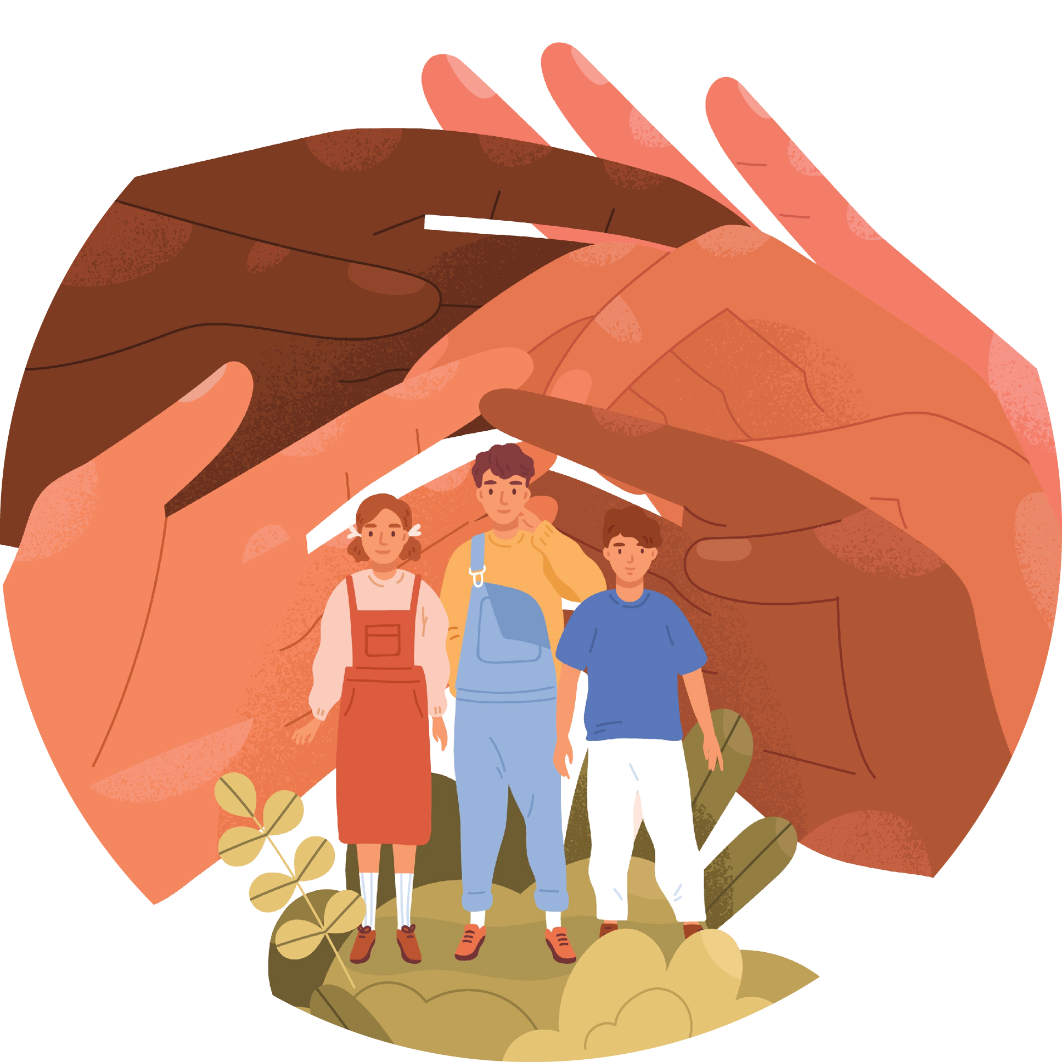
The Convention on the Rights of the Child
International document dating back to 1989 that sets out more than 50 rights that must be respected for all children around the world.
Do you know any of the rights in this document?
Link to the Convention
Notes:
NOTES FOR THE TEACHER
As a class, read the information on the Convention on the Rights of the Child.
Ask the students if they know any of the rights in this document.
If possible, consult the more detailed version of the Convention using the link on the slide.
Complete the summary in the Student Workbook, p. 11 by reading the following explanations:
Almost every country in the world, including Canada, has signed the Convention. One of the countries that has not signed it is the United States, because it still has laws that allow it to give a very severe sentence to young people who have committed a crime, such as life in prison, which is prohibited by the Convention.
It’s not a law like the ones in court, but rather what’s referred to as a “declaration of principles.”
It’s like a promise that countries make to protect children and respect their rights. More specifically, the countries promise to act in the best interest of children.
This means that when adults or judges make a decision regarding you, they must choose what’s best for you, not what best suits the adults around you.
For example, if it must be decided which parent you’ll live with, the first concern is what’s best for you. Or, if an important decision involves you, what you have to say about the situation must be taken into consideration.
Each year, on November 20, we celebrate the International Day of the Rights of the Child to remember this promise countries have made.
SOURCES
Code civil du Québec, RLRQ c CCQ-1991, art 33.
Nations Unies, Convention relative aux droits de l’enfant.

Slide 27
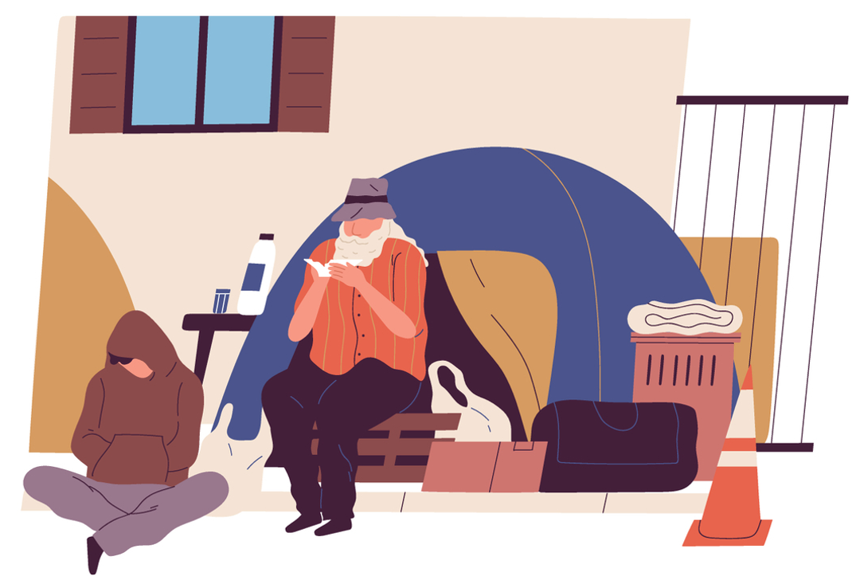
The Director of Youth Protection (DYP)
The Youth Protection Act protects minors (people under 18 years of age).​
It allows the Director of Youth Protection (DYP) to intervene when a child’s not safe or their development is at risk.
Notes:
NOTES FOR THE TEACHER
As a class, read the information on the DYP.
Ask the students if they know examples of situations where the DYP should be called.
Complete the summary in the Student Workbook, p. 14 by reading the following explanations:
​
The Youth Protection Act applies to youth under 18 years of age.
The Director of Youth Protection (DYP) is the organization that gets involved when a child’s safety or development is in danger. The Youth Protection Act gives the DYP this power. Anyone can report a problematic situation involving a child to the Director of Youth Protection. Here are a few examples:
If the child does not have enough food or clothing or does not live in a safe place.
If the child is not receiving the necessary physical or mental health care.
If the child is a victim of physical or sexual violence.
If the child is treated meanly or psychologically mistreated.
If the child doesn’t go to school or is not receiving the necessary education.
If the child has serious or repeated behavioural problems and their parents do not take the necessary steps to resolve the situation.
All adults who work with children (such as teachers, social workers, the police, etc.) are required to alert the DYP if they think a minor is in danger or their needs are not being met.
Other adults can also report a situation, but they are not required to do so.
If you notice a situation of concern, talk to an adult!
SOURCE
Loi sur la protection de la jeunesse, RLRQ c P-34.1, art art 1, 2 (définition « enfant »), 32 (rôle du DPJ), 38 (motifs de compromission), 39 (signalement),

Slide 28

My protections
An Agonizing Choice
Ines is 13 years old and her parents are separating. Her mother wants to move to Saint-Jérôme. She’d like Ines to stay with her every second week, but her father would prefer she spend as much time as possible with him in Longueuil, close to her best friends and cousins. Ines would prefer to stay in Longueuil.
Who will decide where Ines lives? Where will she live?
Notes:
NOTES FOR THE TEACHER
As a class, read scenario 6. (You can choose to quickly go over scenarios 6 and 7, then give students time to complete them.)
Ask the students to write their hypothesis individually in the Student Workbook, p. 12.
Discuss some of the answers as a class.

Slide 29
What the law says
An Agonizing Choice
If the parents can’t come to an agreement, a judge will have to decide where Ines lives.
Children have the right to give their views on questions affecting them. It’s a factor to consider when deciding what’s in their best interest.
Notes:
NOTES FOR THE TEACHER
Correct this exercise as a class.
Have the students write the main elements under the question “What the law says” in the Student Workbook.
More detailed answer:
If the parents can’t come to an agreement, a judge will have to decide which parent Ines lives with. The judge doesn’t make a random decision: they must always think about what’s best for the child, so in this case, what’s best for Ines. This is what’s called “the best interest of the child”. It’s not what the parents want that counts most, but what’s good for the child.
Under Article 12 of the Convention on the Rights of the Child, children have the right to give their view on questions affecting them, such as the time Ines would like to spend with her parents. In Quebec, for example, Ines could choose to speak directly with her parents, talk to the professionals involved in her parents’ separation, or even speak directly with a judge.
At about 12 years of age, the child’s views become very important when deciding what’s in their best interest. Ines doesn’t decide on her own, but the judge must listen to her and think about what she said, especially if she clearly explains why she wants one thing more than another.
For example, if Ines says that she wants to stay in Longueuil because her school, friends and family are there, the judge could find that to be a good idea. But take note: this is not automatic. There’s no magic age—like 12, 13 or 14—when children can make their own decision about who they want to live with.
The judge will also verify other important elements, such as: Is each parent able to properly look after Ines? Does Ines feel good and safe?
In short: Ines can express her views, and the judge will listen to her, especially if she is old enough to express herself clearly. But if the parents are not in agreement, it’s neither Ines alone nor a parent alone who decides: it’s the judge, in Ines’s best interest.
SOURCE
Code civil du Québec, RLRQ c CCQ-1991, art 33 (meilleur intérêt).

Slide 30
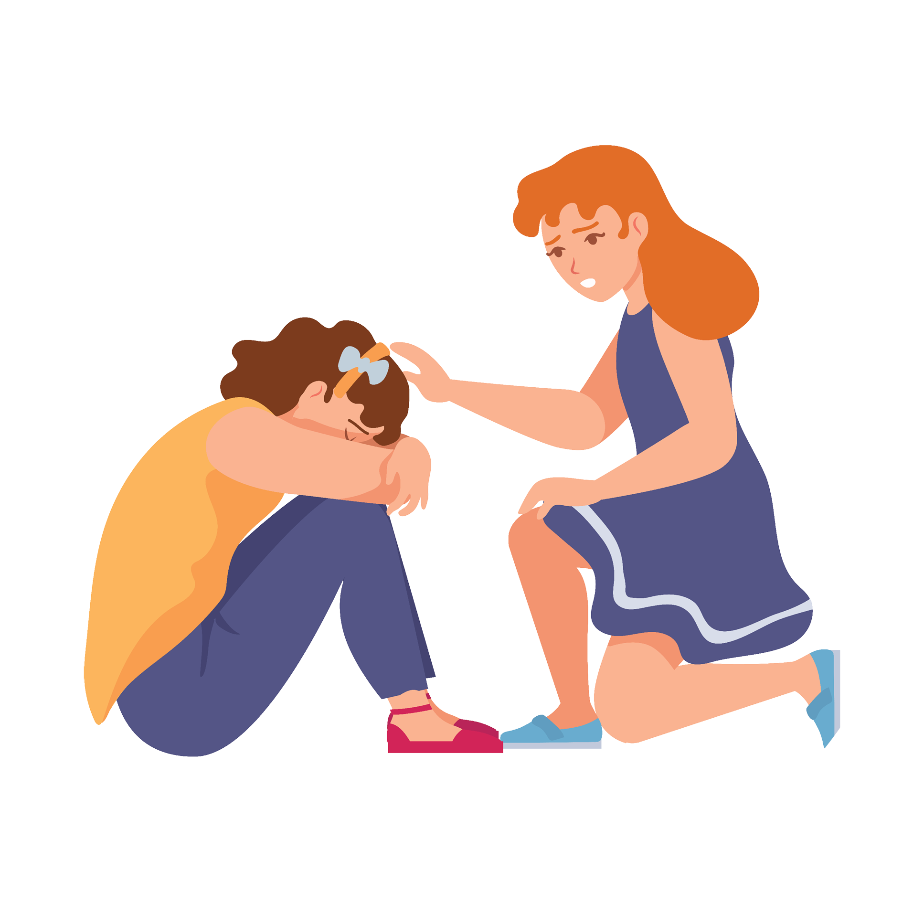
My protections
A Friend’s Distress
You notice that your classmate, Mallory, is increasingly unhappy since her mother’s new boyfriend moved in with them. When Mallory spends the week at her mother’s house, she never seems to want to go home. You’ve also noticed that her new stepfather always wants to be alone with Mallory. You’re worried about your friend.
What can you do?
Notes:
NOTES FOR THE TEACHER
As a class, read scenario 6. It’s a little more detailed in the Student Workbook. (You can choose to quickly go over scenarios 6 and 7, then give students time to complete them.)
Ask the students to write their hypothesis individually in the Student Workbook, p. 13.
Discuss some of the answers as a class.

Slide 31
What the law says
A Friend’s Distress
You could tell your parents or an adult at school about the situation. The adults at school will be required to report it to the DYP.
Children must be protected from violence and mistreatment.
Notes:
NOTES FOR THE TEACHER
Correct this exercise as a class.
Have the students write the main elements under the question “What the law says” in the Student Workbook.
More detailed answer:
Under Article 19 of the Convention on the Rights of the Child, children must be protected from violence and mistreatment.
The DYP can intervene when a child’s security or development is in danger. For example, the DYP can sign an agreement with the parents, or request that a judge order that certain people not come into contact with the child, or order that the. parents or the child undergo therapy.
SOURCES
Loi sur la protection de la jeunesse, RLRQ c P-341, art 39 al 1 (signalement au DPJ).
Loi sur la protection de la jeunesse, RLRQ c P-341, art 29, 32, 45.2, 51, 54 (interventions possibles du DPJ).

Slide 32
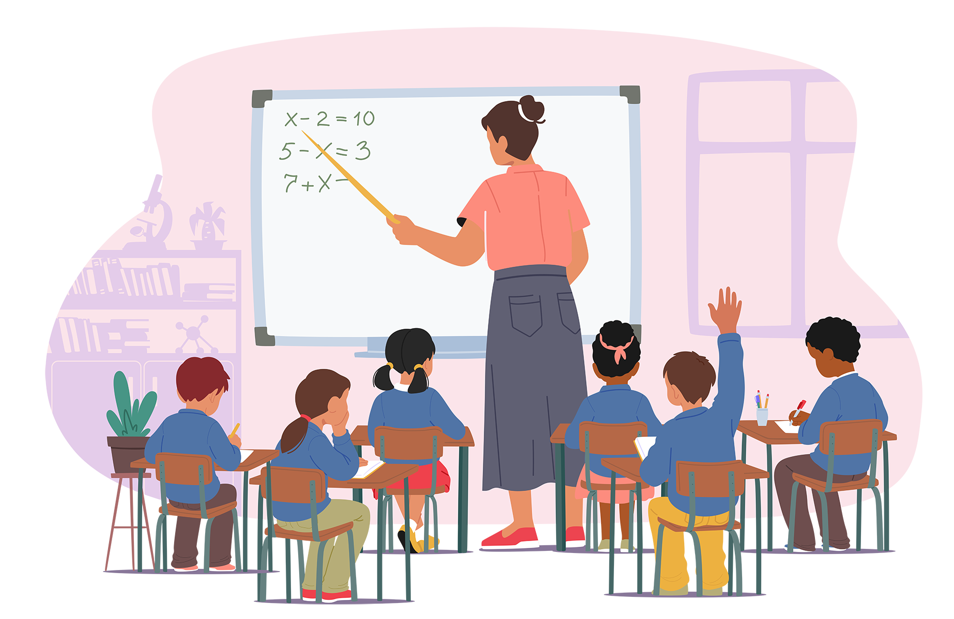
The Education Act
Children in Quebec are required to go to school from age 6 to 16. Public school must be free (except for school supplies).​
School staff must:
  teach the students according to the curriculum,
  treat all students fairly​, and
  protect students from violence.​
Notes:
NOTES FOR THE TEACHER
As a class, read the information on the Education Act.
Complete the summary in the Student Workbook, p. 14 by reading the following explanations:
Another way of protecting children and youth is to make school compulsory until a certain age.
Children in Quebec are required to go to school from age 6 to 16 . . . But that doesn’t mean they have to stop when they turn 16!
Teachers must look after their students, their education, and their development. They must also treat all students fairly.
Schools must adopt an action plan against bullying.
ADDITIONAL INFORMATION
​​
The law requires every school to have an action plan against bullying and violence. The plan must
set out how to prevent bullying,
set out how to report bullying,
set out how to ensure the confidentiality of complaints and information,
set out how to protect student victims and witnesses,
be distributed to parents.​
Moreover, before hiring someone to work with minor or disabled students, schools must ensure they have not engaged in conduct that could reasonably raise concerns for the students’ physical or psychological safety.
SOURCE
Loi sur l'instruction publique, RLRQ c I-13.3, art 14 (16 ans), 22 (4) (responsabilités des enseignant(e)s), 75.1 (plan de lutte contre l’intimidation et la violence), 261.0.1 (vérification des antécédents judiciaires avant l’embauche).

Slide 33

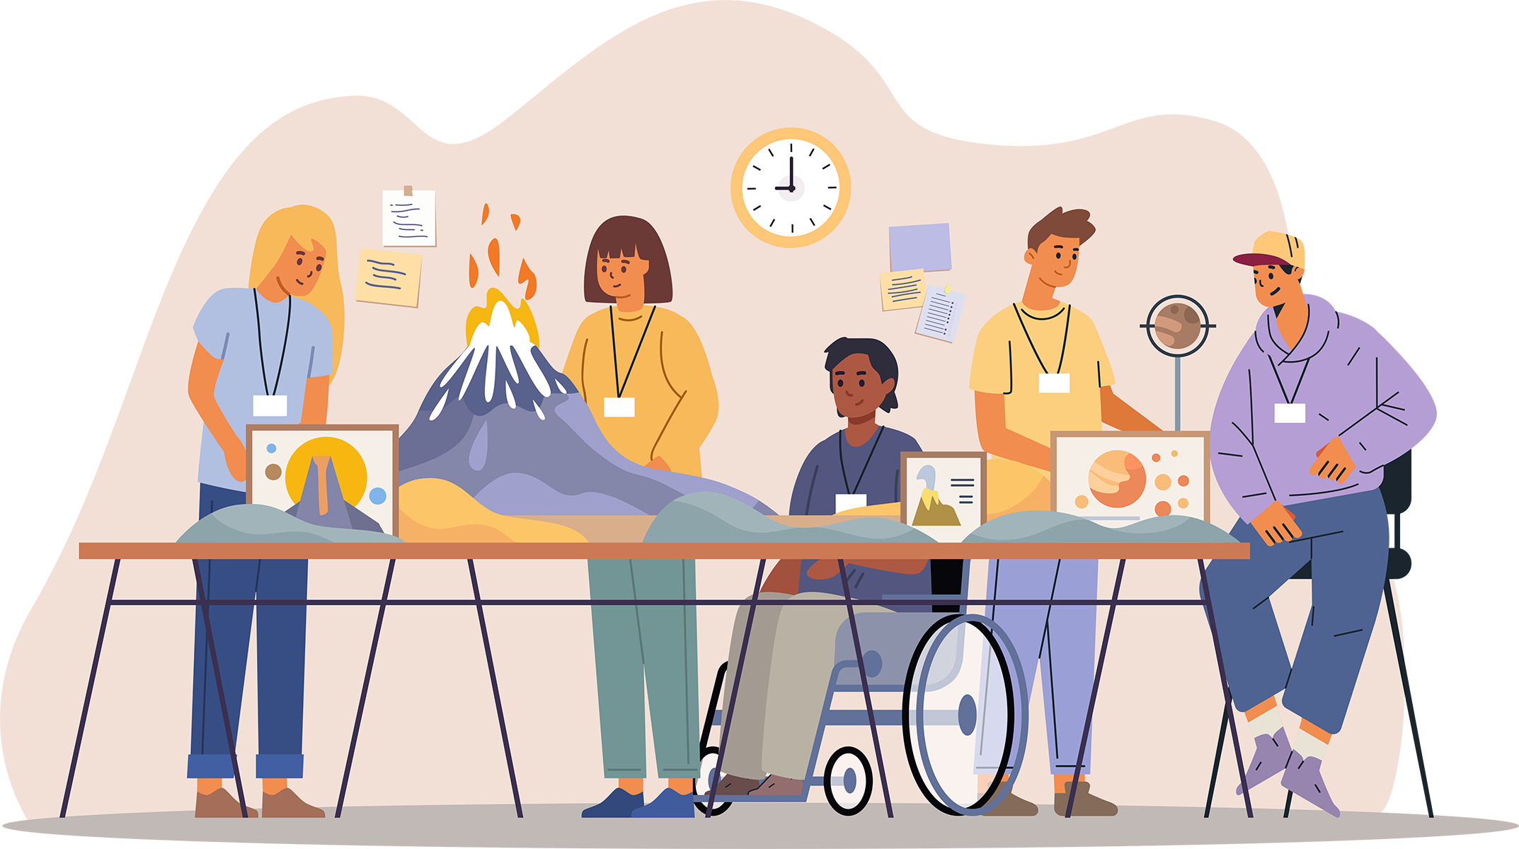
The Charter of Human Rights and Freedoms
This document protects all Quebecers, children and adults alike! The Charter guanrantees​
​
your right to life and security,
your freedom of expression, and
your right to be protected from discrimination.
Notes:
NOTES FOR THE TEACHER
As a class, read the information on the Charter of Human Rights and Freedoms.
Complete the summary in the Student Workbook, p. 14 by reading the following explanations:
​
There’s a very important document that protects all Quebecers, children and adults alike! It’s called the Charter of Human Rights and Freedoms.
The Charter gives us important rights, such as
the right to life and security: therefore, no one has the right to harm you,
the right to say what you think (referred to as freedom of expression), and
the right to be protected from discrimination (for example, no one can treat you differently because of the colour of your skin, your origin, or because you’re a girl or a boy).
SOURCE
Charte des droits et libertés de la personne, RLRQ c C-12, art 1, 3, 5, 10.

Slide 34
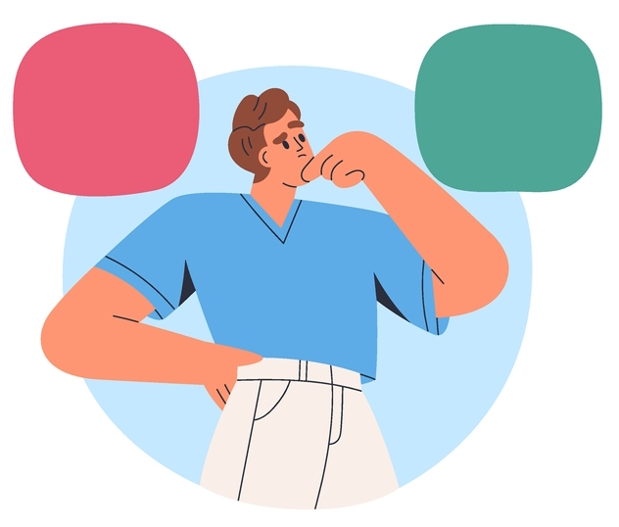
Additional scenarios, review exercise, and conclusion
Now complete the final exercises in your workbook and the conclusion.
Notes:
NOTES FOR THE TEACHER
Read the instructions regarding the additional scenarios and the review exercise: True or False?
Give the students time to complete these exercises in the Student Workbook, pp. 15 to 16.
As a class, correct the excercises using the Answer Key in the Student Workbook.
Conclude the activity using the conclusion questions. Share a few of the answers as a class.
If you wish, you can complete the additional scenarios as of the next slide. They can be printed from the Teacher’s Guide.

Slide 35

My responsibilities
The Stolen Cell Phone
Hamza brought his new cell phone to school. It disappeared from his locker during the second period. Fortunately, the phone was found in the coat pocket of Paul, who’s 12 years old. Hamza’s parents want Paul to understand the seriousness of his actions, so they call the police to report the incident.
What consequence(s) could Paul face?
Notes:
NOTES FOR THE TEACHER
As a class, read scenario 8. It’s a little more detailed on the activity sheet in the appendix in the Teacher’s Guide. (You can choose to quickly go over several scenarios, then give students time to complete them.)​
Ask the students to write their hypothesis individually on the additional sheet printed from the Teacher’s Guide.
Discuss some of the answers as a class.

Slide 36
What the law says
The Stolen Cell Phone
Often, consequences at school are the principal’s method of choice: suspension, detention, etc.
When a crime is committed by someone 12 years of age or over, the police could be called.
Notes:
NOTES FOR THE TEACHER
Correct this exercise as a class.
Have the students write the main elements under the question “What the law says” on the activity sheet.
More detailed answer:
It’s the principal’s decision. The consequences resulting from a criminal process could be more serious than those at school.
SOURCES
Code criminel, LRC, (1985) ch C-46, art 13.
Loi sur le système de justice pénale pour les adolescents, LC 2002, art 2(1).

Slide 37
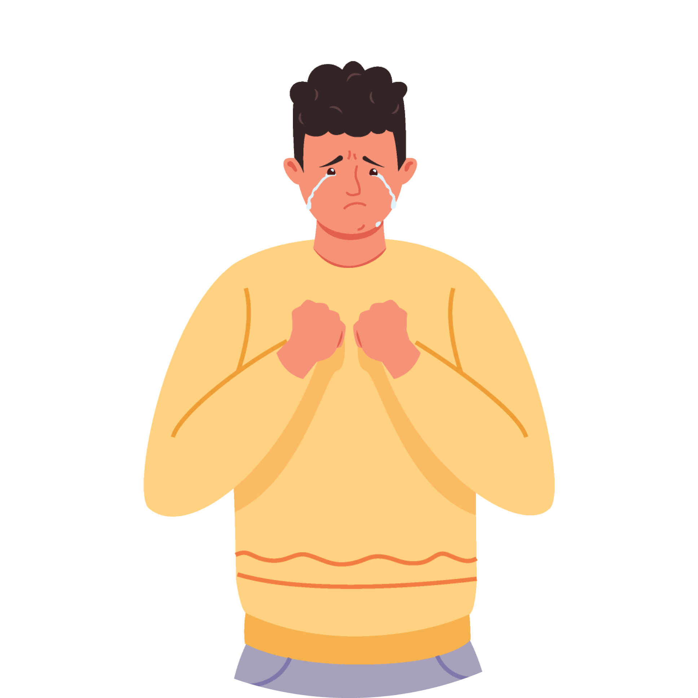
My Freedoms
A New Nose
Mathis is 15 years old and has always hated his nose. Since he was little, people have made comments and have come up with hurtful nicknames. He made an appointment with a cosmetic surgeon for next week to find out if he can have surgery to change the appearance of his nose.
Do you think he has the right to do this?
Notes:
NOTES FOR THE TEACHER
As a class, read scenario 9. (You can choose to quickly go over several scenarios, then give students time to complete them).
Ask the students to write their hypothesis individually on the additional sheet printed from the Teacher’s Guide.
Discuss some of the answers as a class.

Slide 38
What the law says
A New Nose
The surgery Mathis wants isn’t essential to his health. It also comes with significant risks and could have serious and permanent consequences.
Therefore, he will need his parents’ permission to go ahead with the surgery, even though he’s over 14.
Notes:
NOTES FOR THE TEACHER
Correct this exercise as a class.
Have the students write the main elements under the question “What the law says” on the activity sheet.
SOURCES
Robert P. Kouri et Suzanne. Philips-Nootens, L’intégrité de la personne et le consentement aux soins, 4e éd, Montréal, Éditions Yvon Blais, 2017 au para 551 (chirurgie esthétique).
Jimenez c. Pehr, 2002 CanLII 5691 (QC CS) (risques sérieux des chirurgies esthétiques).
Code civil du Québec, RLRQ c CCQ-1991, art 17 (consentement aux soins).

Slide 39
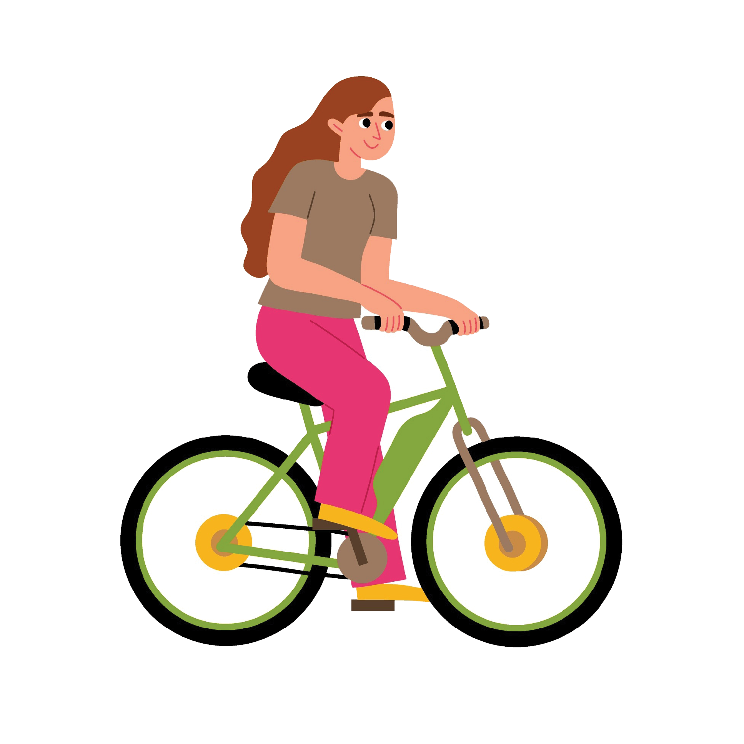
My freedoms
The Wind in Her Hair
Giovanie, 11, loves her new e-bike. And she loves riding it with her hair blowing in the wind, even though her parents ask her to wear a helmet. One sunny afternoon, she’s stopped by the police.
What consequence(s) could Giovanie face?
Notes:
NOTES FOR THE TEACHER
As a class, read scenario 10. (You can choose to quickly go over several scenarios, then give students time to complete them).
Ask the students to write their hypothesis individually on the additional sheet printed from the Teacher’s Guide.
Discuss some of the answers as a class.

Slide 40
What the law says
The Wind in Her Hair
Wearing a helmet is mandatory when riding an e-bike.
Only people 18 years or older are allowed to ride e-bikes, except in certain exceptional circumstances.
iovannie doesn’t yet have the right to use this form of transportation.
Notes:
NOTES FOR THE TEACHER
Correct this exercise as a class.
Have the students write the main elements under the question “What the law says” on the activity sheet.
More detailed answer:
Under the Highway Safety Code, all of these infractions are punishable by a fine of $60 to $100.
As of the age of 14, children can receive fines. This means that Giovanie, who’s 11 years old, will not be fined, but the police could decide to give her a warning. The police could also inform her parents of the situation.
SOURCES
Code de la sécurité routière, RLRQ c C-24.2, art 492.2 au para 1 (casque obligatoire), 492.2 au para 2 (18 ans), 507 (amende).
Code de procédure pénale, RLRQ c C-25.1, art 5 (amendes à partir de 14 ans).

Slide 41
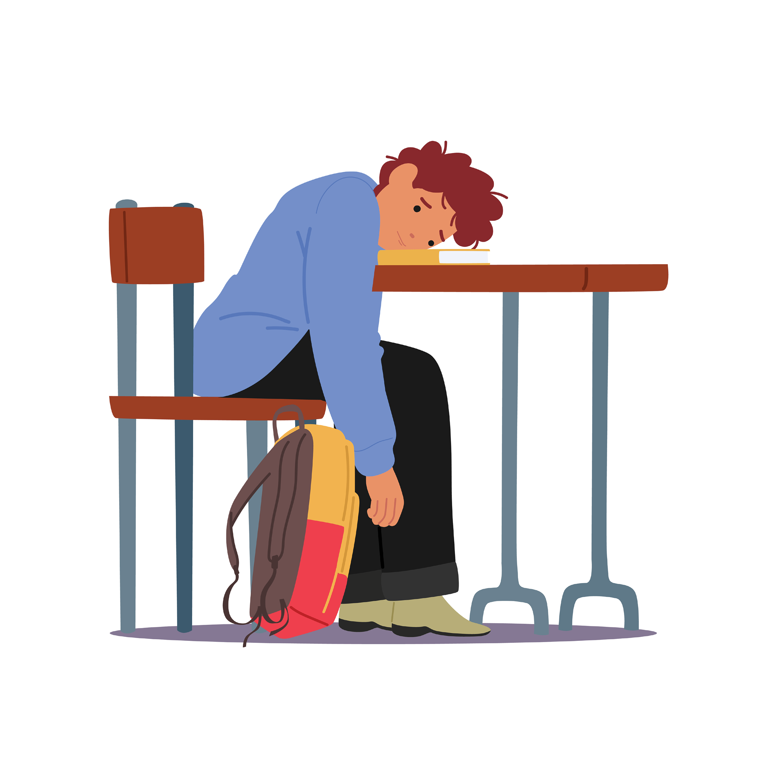
My protections
A Thousand and One Classes
Antoine is 12 years old. His parents want him to succeed in life, so they sign him up for violin, Spanish and swimming classes. Antoine asks his parents to reduce the number of evening classes because he feels overwhelmed and very anxious. His parents refuse, telling him it’s for his own good.
What should Antoine do?
Notes:
NOTES FOR THE TEACHER
As a class, read scenario 11. It’s a little more detailed on the activity sheet in the appendix in the Teacher’s Guide. (You can choose to quickly go over several scenarios, then give students time to complete them.)​
Ask the students to write their hypothesis individually on the additional sheet printed from the Teacher’s Guide.
Discuss some of the answers as a class.

Slide 42
What the law says
A Thousand and One Classes
Antoine could talk to an adult at school, who could speak with his parents.
This adult could also report the situation to the Director of Youth Protection (DYP) if they think it’s necessary.
The DYP will then decide whether to intervene.
Notes:
NOTES FOR THE TEACHER
Correct this exercise as a class.
Have the students write down the main elements under the question “What the law says” on the activity sheet.
SOURCES
Loi sur la protection de la jeunesse, RLRQ c P-34.1,art 39, 45.

Slide 43
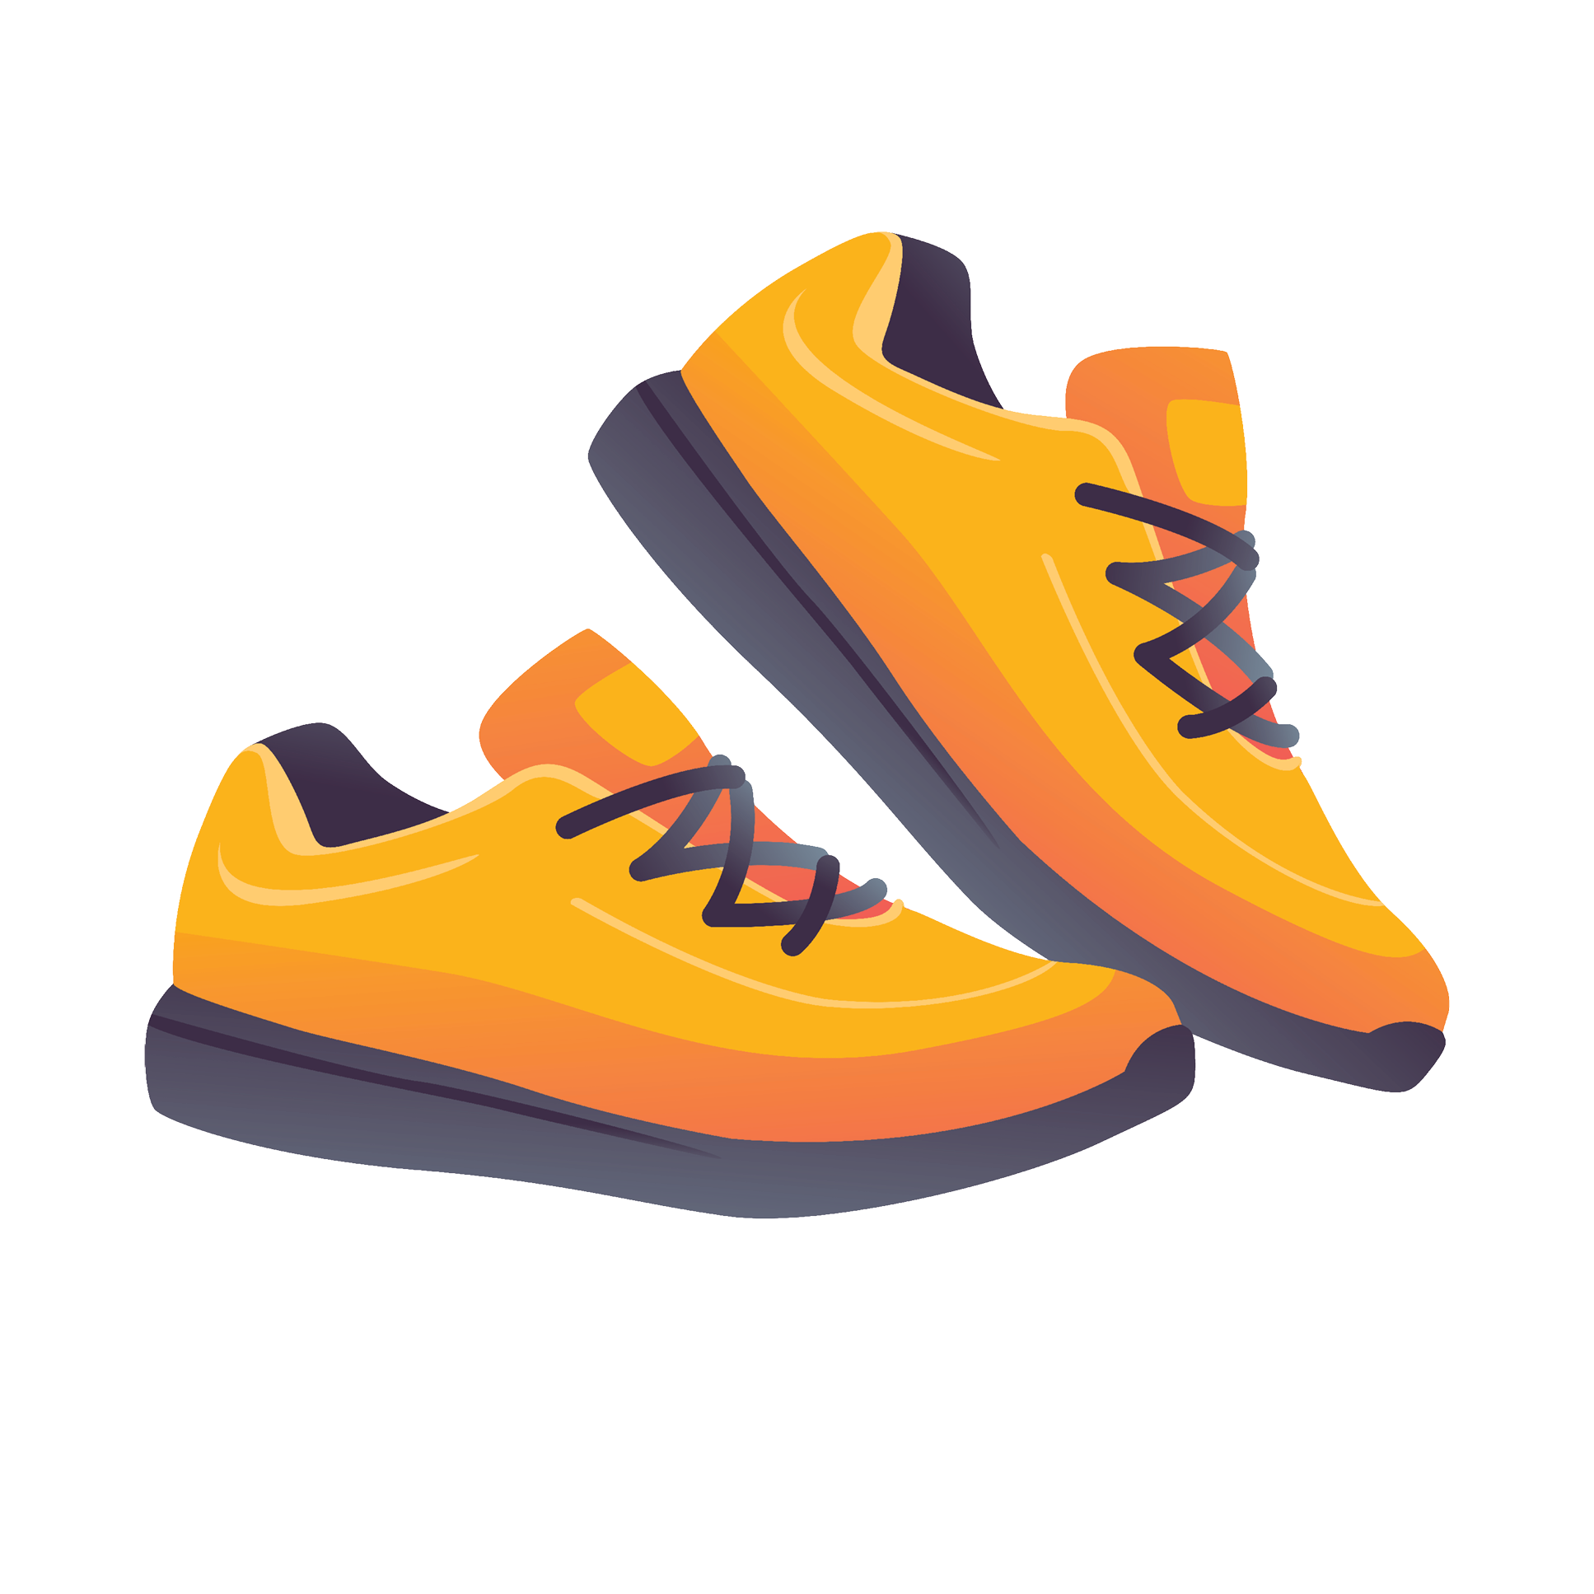
My protections
New Shoes
Eleven-year-old Anas has holes in the soles of his running shoes and asks his parents to buy him a new pair. His parents suggest he use his older brother’s shoes from when he was younger. The shoes are in good shape, and the parents think it’s a reasonable idea. Anas disagrees and tells them his clothing needs are not being met.
Is he right?
Notes:
NOTES FOR THE TEACHER
As a class, read scenario 12. It’s a little more detailed on the activity sheet in the appendix in the Teacher’s Guide. (You can choose to quickly go over several scenarios, then give students time to complete them).
Ask the students to write their hypothesis individually on the additional sheet printed from the Teacher’s Guide.
Discuss some of the answers as a class.

Slide 44
What the law says
New Shoes
Parents are required to feed and provide for their children.
But that doesn’t mean they have to provide new clothes every year!
Notes:
NOTES FOR THE TEACHER
Correct this exercise as a class.
Have the students write the main elements under the question “What the law says” on the activity sheet.
SOURCES
Code civil du Québec, RLRQ c CCQ-1991, art 599.

